Slide 1
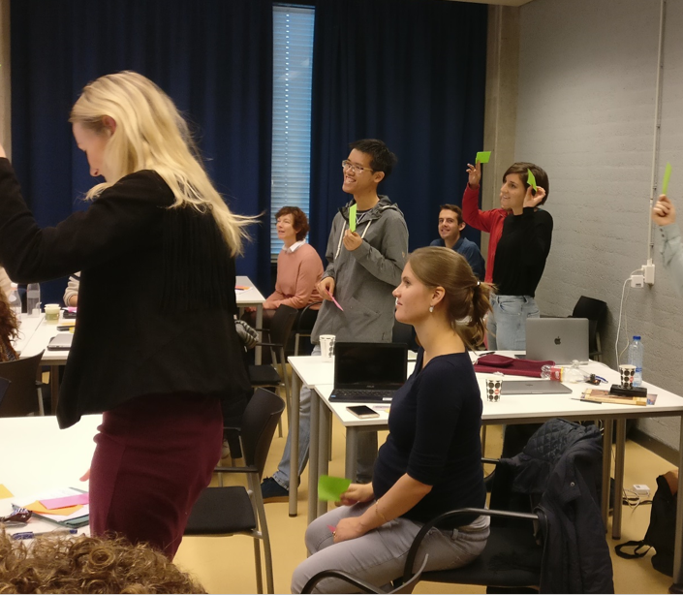
University Library
The Unix Shell + Intro to Git
26 February 2025
09:30 – 14:30
Meron en Stephanie
VU University Library

Slide 2
Setup
If you haven’t done so yet, please follow the setup instructions for this lesson and download the data at:
https://edu.nl/xwhyq
Download the data to your Downloads folder and unzip them (give it the suggested name shell-lesson-data)

Slide 3

Outline for today
09:30-12:20 The Unix Shell
12:20-13:00 Lunch break
13:00-14:30 Intro to Git
No worries: breaks in between!

Slide 4
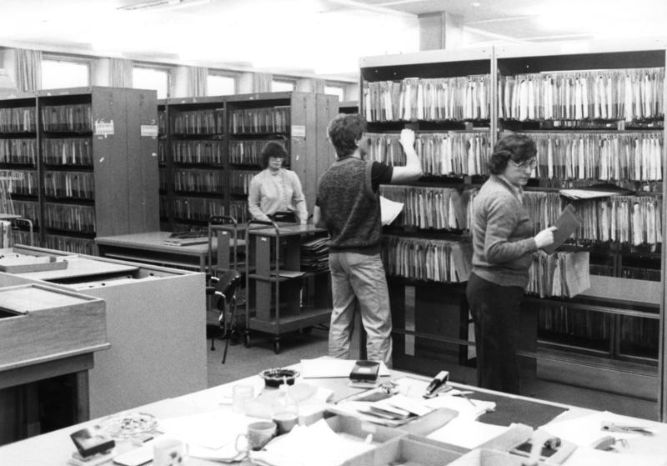
About folders/directories and files
Some analogies:
Cabinet → ‘drive’/root
Folder → folder
Paper file → digital file
This tells us something about how the file system on our computer is organised
Bundesarchiv, B 145 Bild-P109966 / CC-BY-SA 3.0

Slide 5
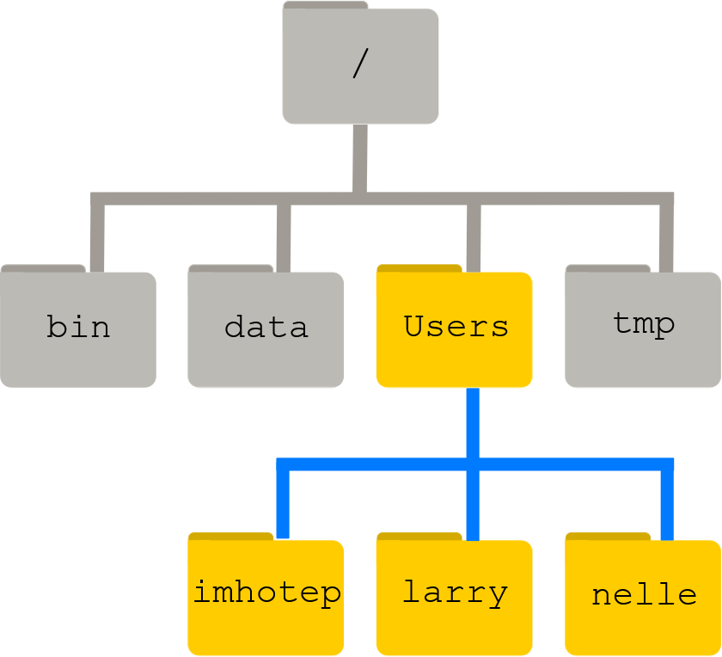
Directories
Paths: /Users/imhotep
/Users/larry
/Users/nelle

Slide 6
Exercise: Absolute vs. Relative Paths
Starting from /Users/amanda/data, which of the following commands could Amanda use to navigate to her home directory, which is /Users/amanda?
cd .
cd /
cd /home/amanda
cd ../..
cd ~
cd home
cd ~/data/..
cd
cd ..

Slide 7
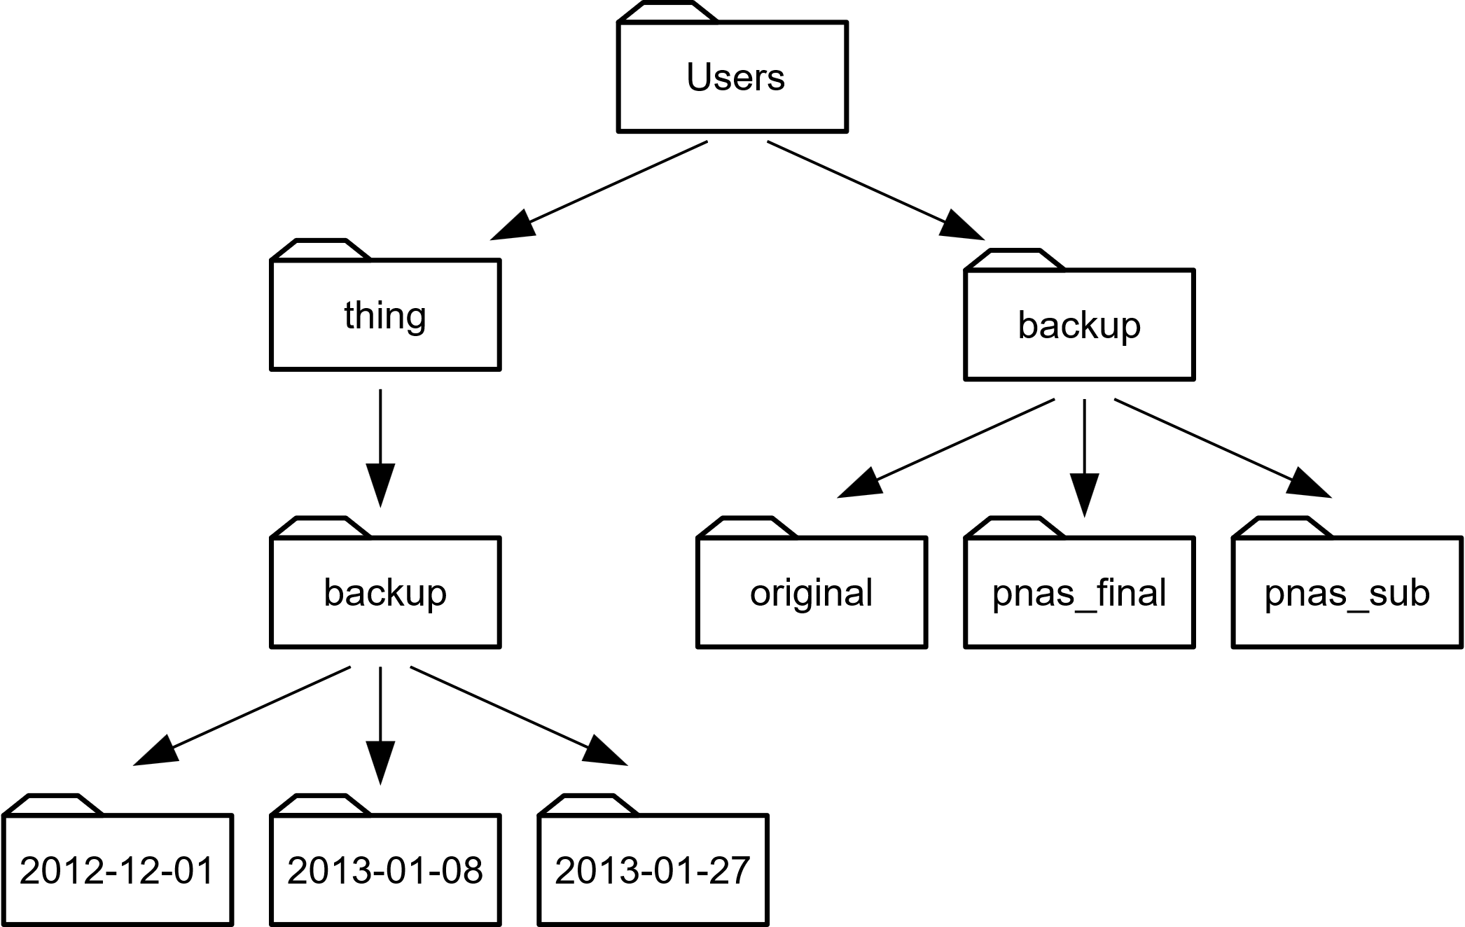
Exercise: Reading Comprehension
Using the filesystem diagram below, if pwd displays /Users/backup, and -r tells ls to display things in reverse order, what command(s) will result in the following output:
pnas_sub/ pnas_final/ original/
ls pwd
ls -r –F
ls -r -F /Users/backup

Slide 8
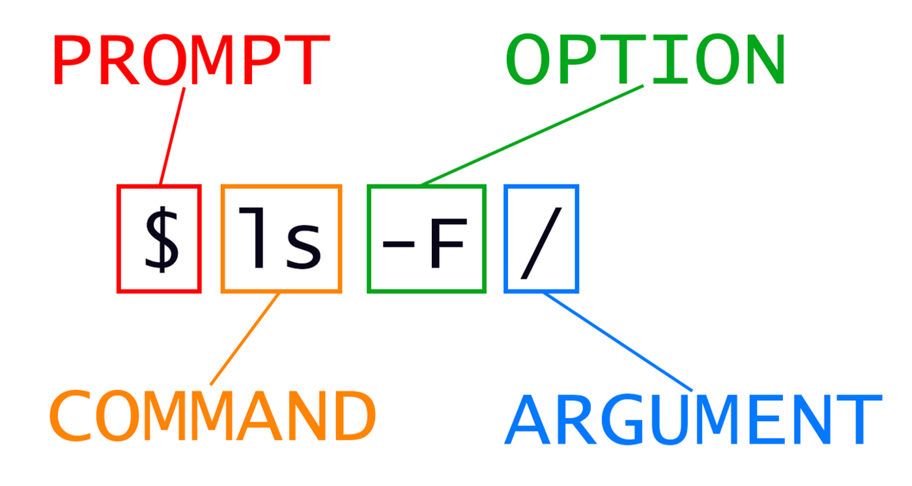
General Syntax of a Shell command

Slide 9
Exercise: Renaming files
Suppose that you created a plain-text file in your current directory to contain a list of the statistical tests you will need to do to analyze your data, and named it: statstics.txt
After creating and saving this file you realize you misspelled the filename! You want to correct the mistake, which of the following commands could you use to do so?
cp statstics.txt statistics.txt
mv statstics.txt statistics.txt
mv statstics.txt .
cp statstics.txt .

Slide 10
Exercise: Moving and Copying
What is the output of the closing ls command in the sequence shown below?
$ pwd
/Users/jamie/data
$ ls
proteins.dat
$ mkdir recombined
$ mv proteins.dat recombined/
$ cp recombined/proteins.dat ../proteins-saved.dat
$ ls
Answers:
proteins-saved.dat recombined
recombined
proteins.dat recombined
proteins-saved.dat

Slide 11
Exercise: wildcards
When run in the alkanes directory, which ls command(s) will produce this output?
ethane.pdb methane.pdb
ls *t*ane.pdb
ls *t?ne.*
ls *t??ne.pdb
ls ethane.*

Slide 12
Exercise: Organising directories and files
Jamie is working on a project, and she sees that her files aren’t very well organised:
$ ls -F
analysed/ fructose.dat raw/ sucrose.dat
The fructose.dat and sucrose.dat files contain output from her data analysis. What command(s) covered in this lesson does she need to run so that the commands below will produce the output shown?
$ ls -F
analysed/ raw/
$ ls analysed
fructose.dat sucrose.dat

Slide 13
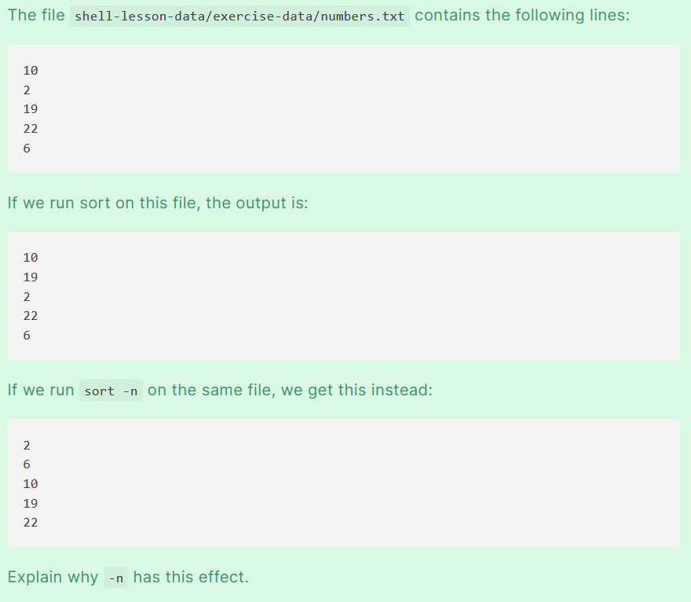
The sort command
The file shell-lesson-data/exercise-data/numbers.txt contains the following lines:
10
2
19
22
6
If we run sort on this file, the output is:
10
19
2
22
6
If we run sort -n on the same file, we get this instead:
2
6
10
19
22
Why?

Slide 14
What does >> mean?
We have seen the use of >, but there is a similar operator >> which works slightly differently. We’ll learn about the differences between these two operators by printing some strings. We can use the echo command to print strings e.g.
$ echo The echo command prints text
The echo command prints text
Now test the commands below to reveal the difference between the two operators:
$ echo hello > testfile01.txt
and:
$ echo hello >> testfile02.txt
Hint: Try executing each command twice in a row and then examining the output files.

Slide 15
Appending data
We have already met the head command, which prints lines from the start of a file. tail is similar, but prints lines from the end of a file instead.
Consider the file shell-lesson-data/exercise-data/animal-counts/animals.csv. After these commands, select the answer that corresponds to the file animals-subset.csv:
$ head -n 3 animals.csv > animals-subset.csv
$ tail -n 2 animals.csv >> animals-subset.csv
The first three lines of animals.csv
The last two lines of animals.csv
The first three lines and the last two lines of animals.csv
The second and third lines of animals.csv

Slide 16
Exercise: Piping commands together
In our current directory, we want to find the 3 files which have the least number of lines. Which command listed below would work?
wc -l * > sort -n > head -n 3
wc -l * | sort -n | head -n 1-3
wc -l * | head -n 3 | sort –n
wc -l * | sort -n | head -n 3
Try this in the shell-lesson-data/exercise-data/alkanes directory and try to understand why things work the way they do

Slide 17
Exercise: Pipe Reading Comprehension
A file called animals.csv (shell-lesson-data/exercise-data/animal-counts) contains the following data:
2012-11-05,deer,5
2012-11-05,rabbit,22
2012-11-05,raccoon,7
2012-11-06,rabbit,19
2012-11-06,deer,2
2012-11-06,fox,4
2012-11-07,rabbit,16
2012-11-07,bear,1
What text passes through each of the pipes and the final redirect in the pipeline below? Note, the sort -r command sorts in reverse order.
$ cat animals.csv | head -n 5 | tail -n 3 | sort -r > final.txt
Hint: build the pipeline up one command at a time to test your understanding

Slide 18
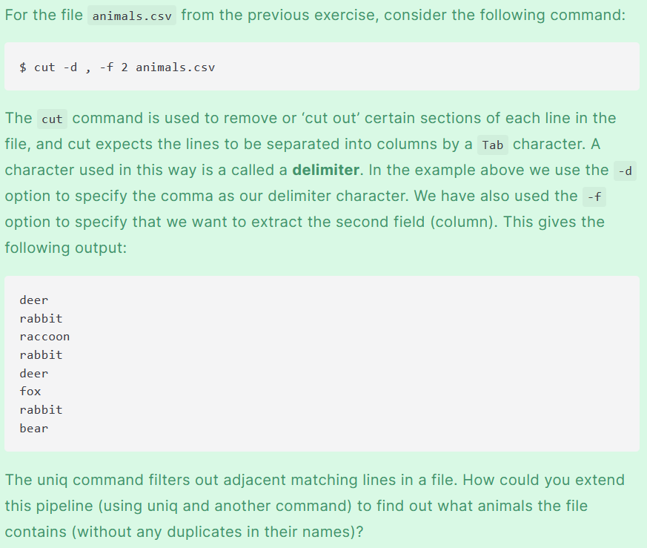
Optional Exercise: Pipe Construction
For the file animals.csv from the previous exercise, consider the following command:
$ cut -d , -f 2 animals.csv
The cut command is used to remove or ‘cut out’ certain sections of each line in the file, and cut expects the lines to be separated into columns by a Tab character. A character used in this way is a called a delimiter. In the example above we use the -d option to specify the comma as our delimiter character. We have also used the -f option to specify that we want to extract the second field (column). This gives the following output:
deer
rabbit
raccoon
rabbit
deer
fox
rabbit
bear
The uniq command filters out adjacent matching lines in a file. How could you extend this pipeline (using uniq
and another command) to find out what animals the file contains (without any duplicates in their names)?
$ cut -d , -f 2 animals.csv | sort | uniq

Slide 19
Optional Exercise: Which pipe?
The file animals.csv contains 8 lines of data formatted as follows:
2012-11-05,deer,5
2012-11-05,rabbit,22
2012-11-05,raccoon,7
2012-11-06,rabbit,19
...
The uniq command has a -c option which gives a count of the number of times a line occurs in its input. Assuming your current directory is shell-lesson-data/exercise-data/animal-counts, what command would you use to produce a table that shows the total count of each type of animal in the file?
sort animals.csv | uniq –c
sort -t, -k2,2 animals.csv | uniq –c
cut -d, -f 2 animals.csv | uniq –c
cut -d, -f 2 animals.csv | sort | uniq –c
cut -d, -f 2 animals.csv | sort | uniq -c | wc -l

