Slide 1
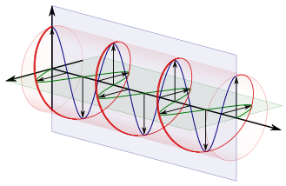
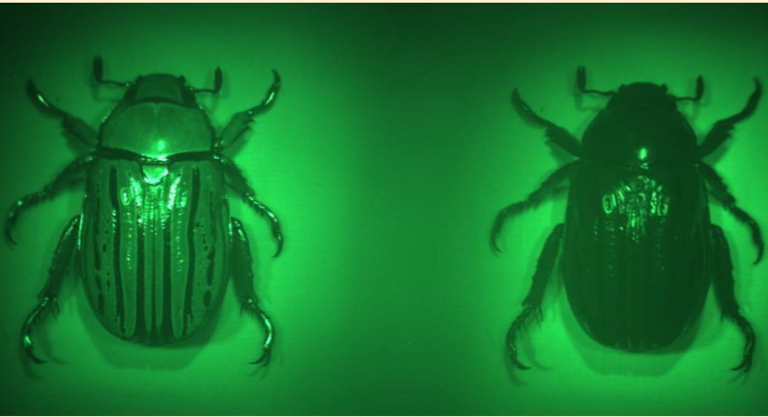
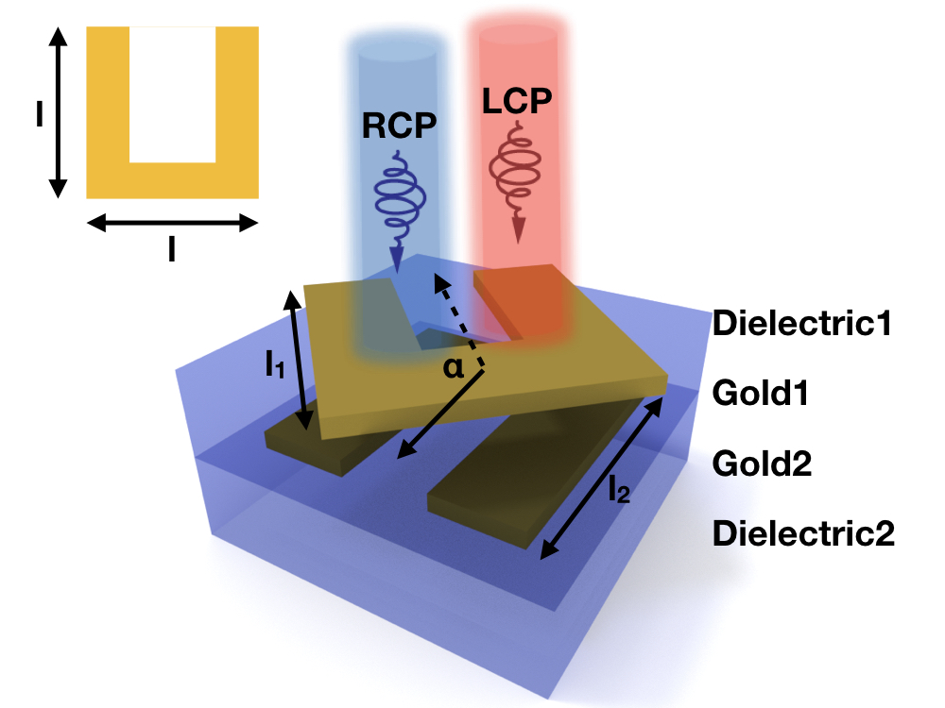
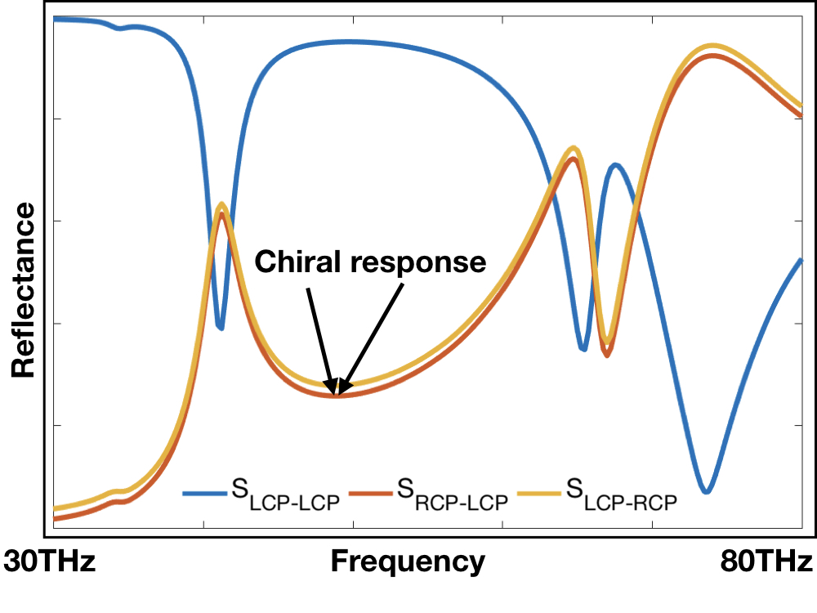
Background
Circularly polarized light
Chiral in nature
The design
Sharma, Vivek, et al. science 325.5939 (2009): 449-451.
Khorasaninejad, M., et al. Nano letters 16.7 (2016): 4595-4600.
Liu, Na, et al. Nature Photonics 3.3 (2009): 157-162.

Slide 2
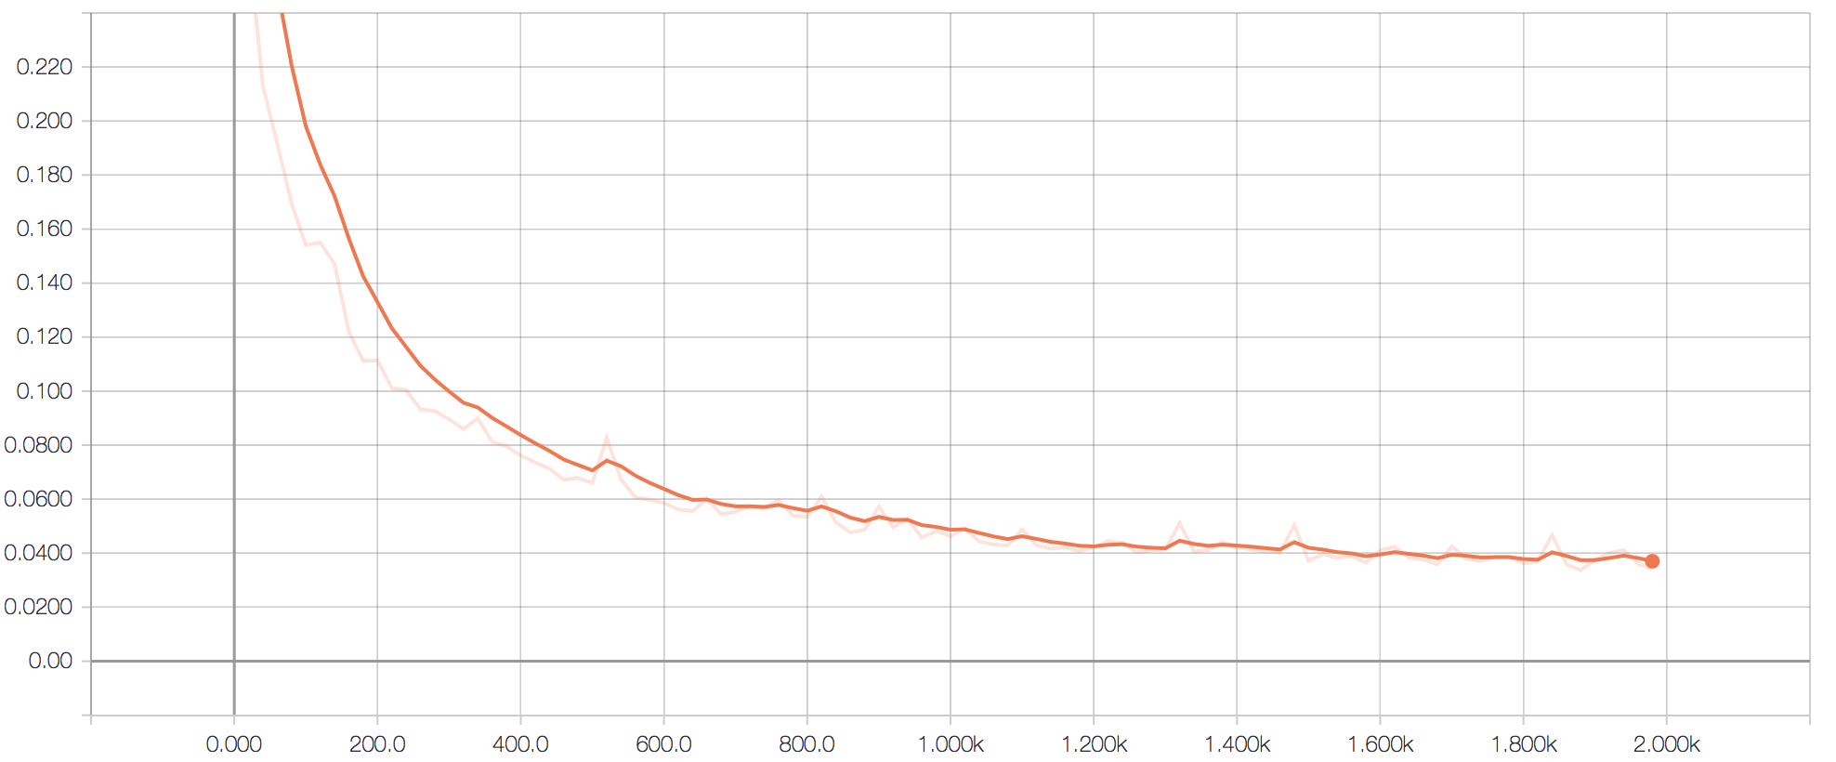
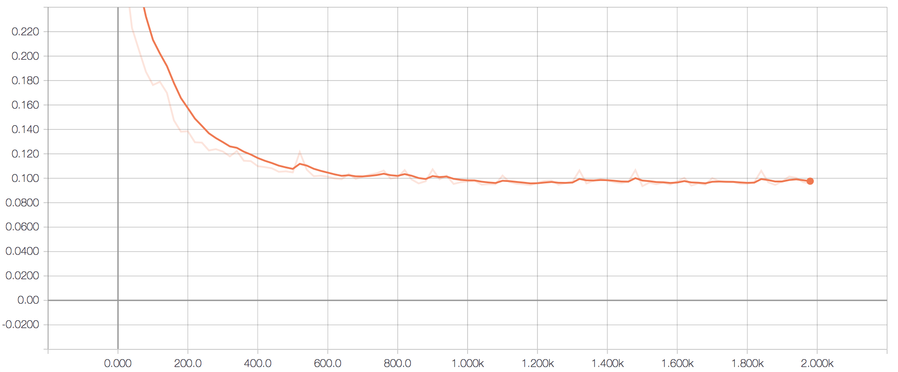
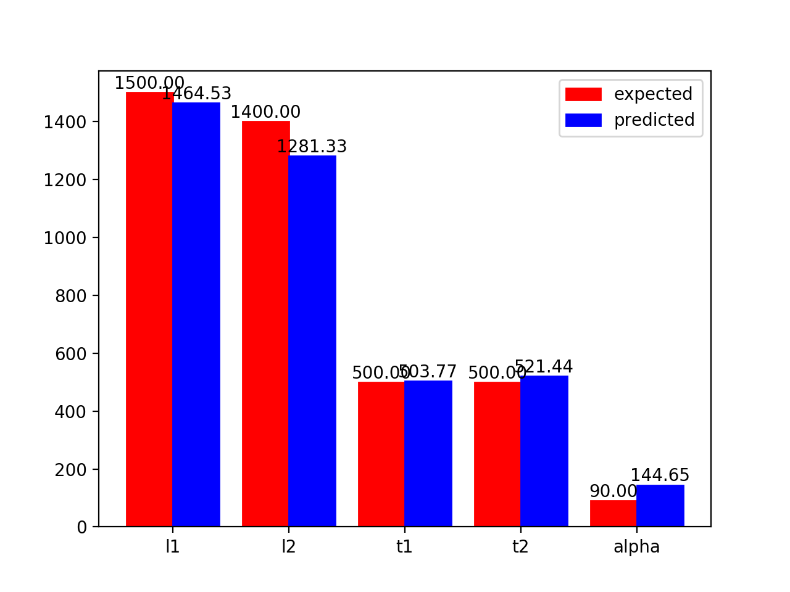
Results
One TestSet: input spectrum
TrainLoss
TestLoss
0.04
0.1
Reflectance
epoch: 2000
epoch: 2000
freq
More test sets:
Feature | Truth/Prediction | Top Length | Bottom Length | Top Spacer | Bottom Spacer | Angle | normalized error
Set 1 | Truth | 1,400.00 | 1,200.00 | 600.00 | 200.00 | 30.00 | 0.43%
 | Prediction | 1,355.92 | 1,171.69 | 597.96 | 209.58 | 4.31
Set 2 | Truth | 1,300.00 | 1,000.00 | 300.00 | 400.00 | 30.00 | 2.44%
 | Prediction | 1,347.19 | 1,076.66 | 408.98 | 232.18 | 14.48
Set 3 | Truth | 1,500.00 | 1,400.00 | 500.00 | 500.00 | 90.00 | 1.99%
 | Prediction | 1,464.53 | 1,281.33 | 503.77 | 521.44 | 144.65
Set 4 | Truth | 1,500.00 | 1,100.00 | 300.00 | 300.00 | 120.00 | 2.06%
 | Prediction | 1,475.32 | 1,102.13 | 312.44 | 341.79 | 63.81
Set 5 | Truth | 1,100.00 | 1,600.00 | 500.00 | 500.00 | 180.00 | 2.34%
 | Prediction | 1,042.84 | 1,531.27 | 479.99 | 467.48 | 120.37
Output designed parameters
Test set | Truth | 1,500 | 1,400 | 500.00 | 500.00 | 90
 | Prediction | 1,464.53 | 1,281.33 | 503.77 | 521.44 | 144.65

Slide 3
Conclusion
We have built up and train a neural network model with the database of chiral meta-materials
We utilize tensor flow to construct the neural network, which is constructed with a 2D convolutional layer, a pooling layer, a fully-connected layer and a output layer
The neural network takes input with the target spectrum with chiral response; and output the designed parameters
The neural network show good performance on parameters l1, l2, t1 and t2, but less good results for rotation angle alpha
It took least than 30mins to train the model with 2000 epochs; this dramatically reduce the time for meta material design, compared with traditional method of parameter sweeping with numerical simulations

