Slide 1
Chiral Metamaterial Design Based on Neural Networks
Prof. Jennifer Dy
Feng Cheng, Wudi Zheng
12/13/2017

Slide 2
Outline
Background
Introduction to TensorFlow
Neural network
Result and Conclution

Slide 3
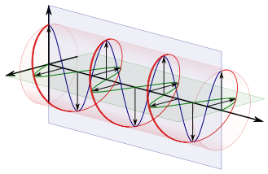
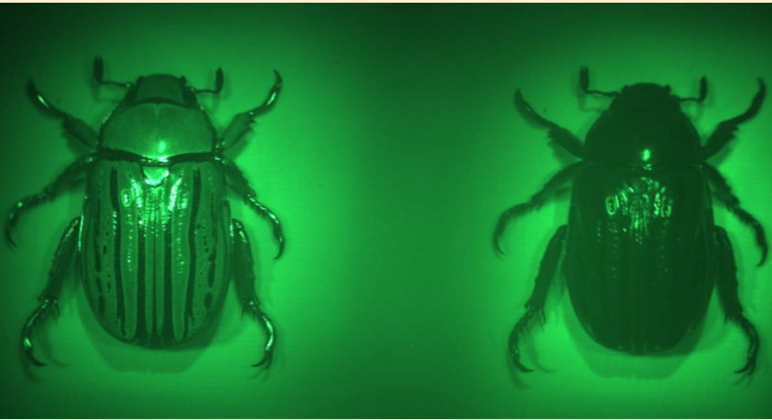
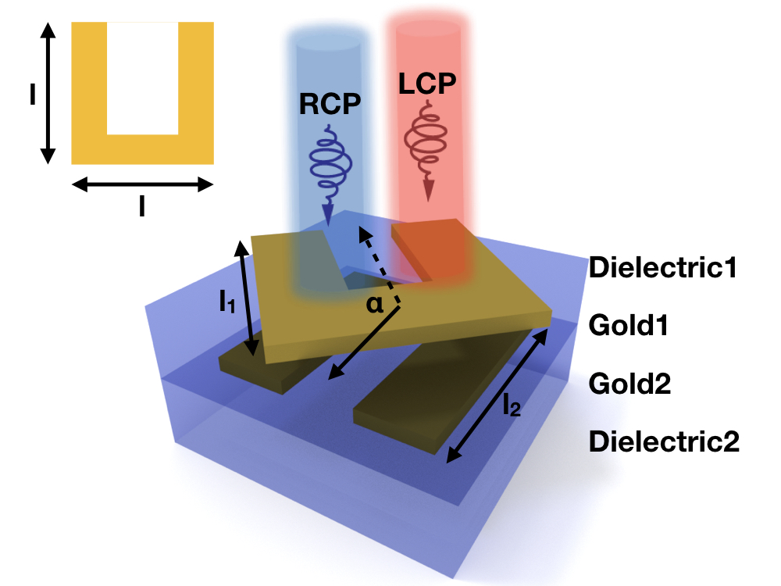
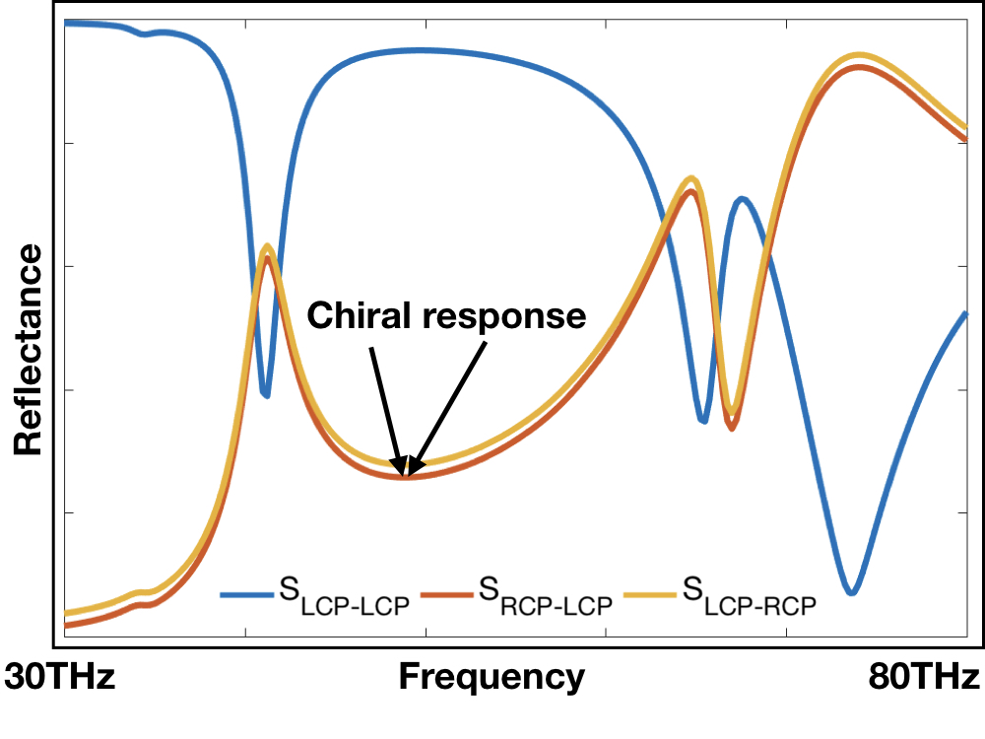
Background
Circularly polarized light
Chiral in nature
The design
Sharma, Vivek, et al. science 325.5939 (2009): 449-451.
Khorasaninejad, M., et al. Nano letters 16.7 (2016): 4595-4600.
Liu, Na, et al. Nature Photonics 3.3 (2009): 157-162.

Slide 4
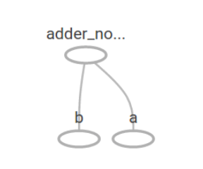
Introduction to TensorFlow
What is TensorFlow?
An open source library.
Often used in machine learning.
2 steps:
Build a computational graph.
Run it.
A simple graph
https://www.tensorflow.org/get_started/get_started
https://www.quora.com/What-is-max-pooling-in-convolutional-neural-networks
Notes:
TensorFlow is an open-source library for dataflow programming.
A computational graph is a series of TensorFlow operations arranged into a graph of nodes. Each node takes zero or more tensors as inputs and produces a tensor as an output.

Slide 5
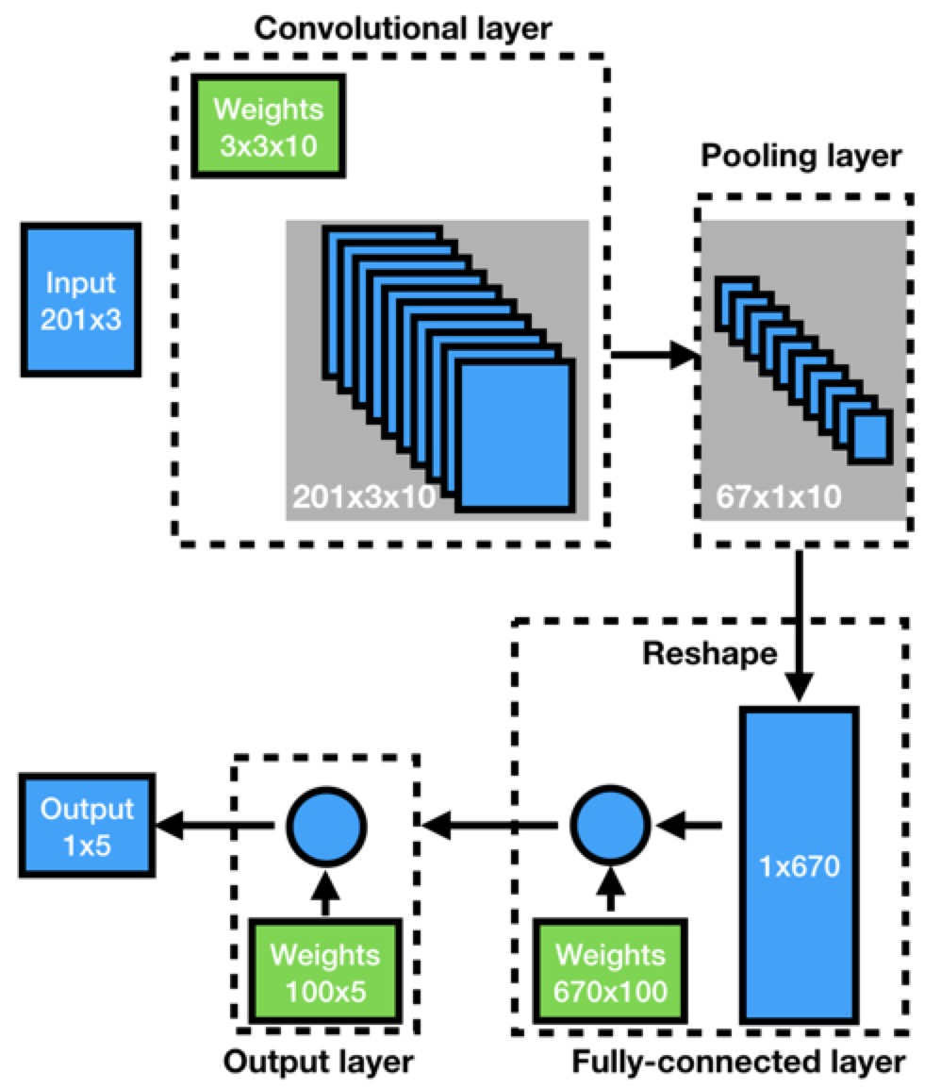
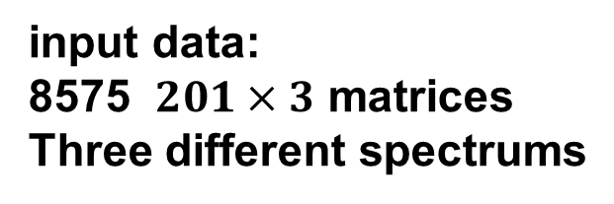
Neural Network
Schematic view
input data:
8575 $201×3$ matrices
Three different spectrums
Output:
5 parameters of structure
L1, L2, T1, T2, alpha
Train set: 7000
Test set: 1575
Typical layers
Convolutional layer:
extract features
Pooling layer:
reduce the No. of parameters, invariance
Y. Shen et al., “Deep learning with coherent nanophotonic circuits,” Nat. Photonics, vol. 11, no. 7, p. nphoton.2017.93, Jun. 2017
Notes:
Here is our network. It has six layers. One convolutional, one pooling and two fully connected.
And our input is the spectrum of different structures, some 201 by 3 matrices. We divide our dataset into two parts, 7 thousand for train and the others for test.
No validation.
Why is 8575:
L1: 1000:100:1600
L2: 1000:100:1600
T1: 200:100:600
T2: 200:100:600
Alpha: 0:30:180
Cnn: different size can find different features.
Convolution is able to extract features from our data. And different size of unit can detect different kind of features. What we need to do is to implement different size of convolution unit and run the graph. The algorithm can adjust the weight for each feature and the ones unrelated to our purpose will die.
Max pooling is to move a window across a 2D input space, and find the maximum in that window.
Two main things:
Reduces the number of parameters within the model - this is called down-sampling or sub-sampling
It generalises the results from a convolutional filter - making the detection of features invariant to scale or orientation changes.

Slide 6
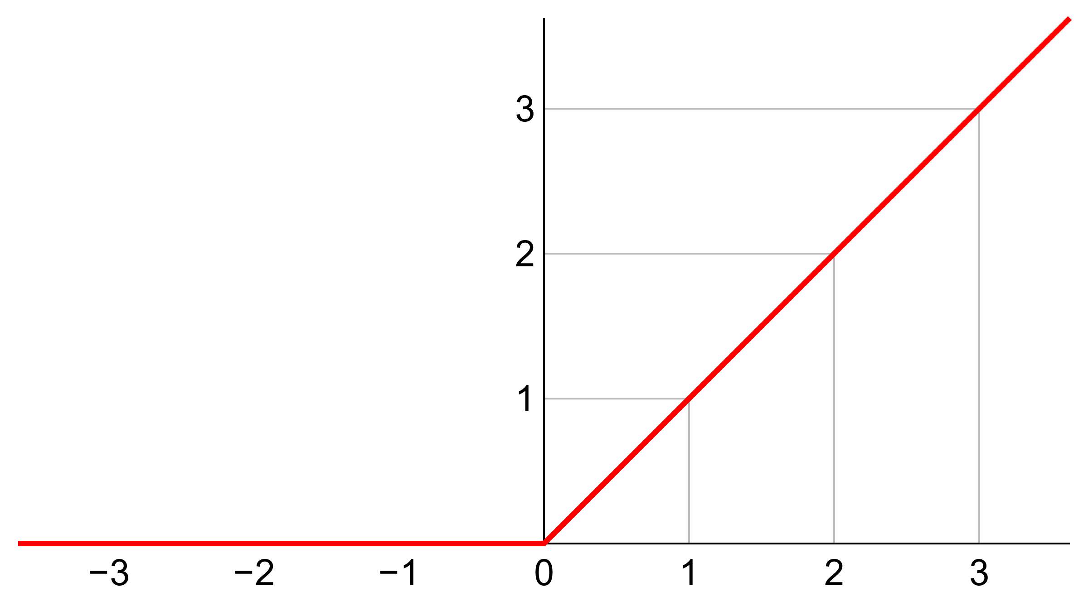
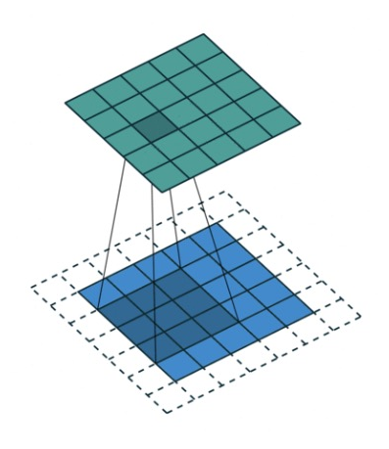
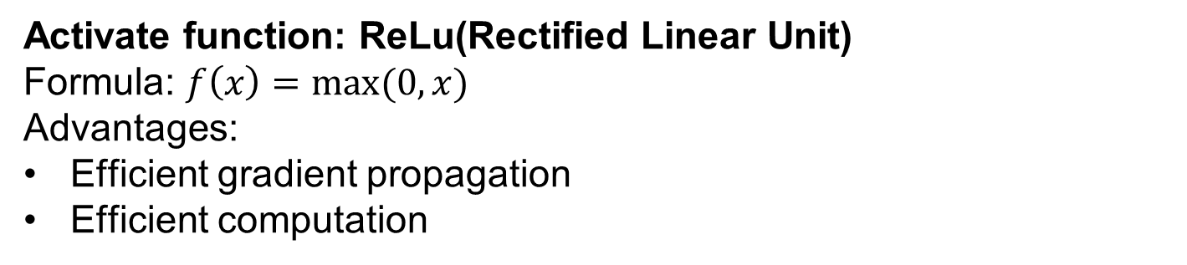
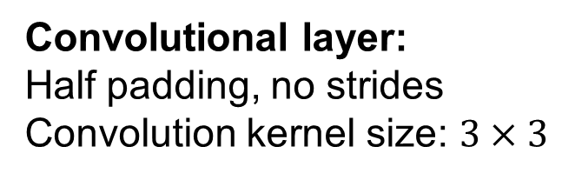
Neural Network
Activate function: ReLu(Rectified Linear Unit)
Formula: $f\left(x\right)=max⁡(0,x)$
Advantages:
Efficient gradient propagation
Efficient computation
Convolutional layer:
Half padding, no strides
Convolution kernel size: $3×3$
http://cs231n.github.io/convolutional-networks/#fc
https://en.wikipedia.org/wiki/Rectifier_(neural_networks)
Notes:
Initialize the parameters
Efficient gradient propagation: No vanishing or exploding gradient problems
Efficient computation: Only comparison, addition and multiplication.
If we use the sigmoid, the gradient may be close to zero when input is large enough. And relu’s gradients is much simpler than sigmoid or tanh.
And here’s our convolutional layer. We extend one line of zeros around it and use a 3 by 3 kernel to do convolution.

Slide 7
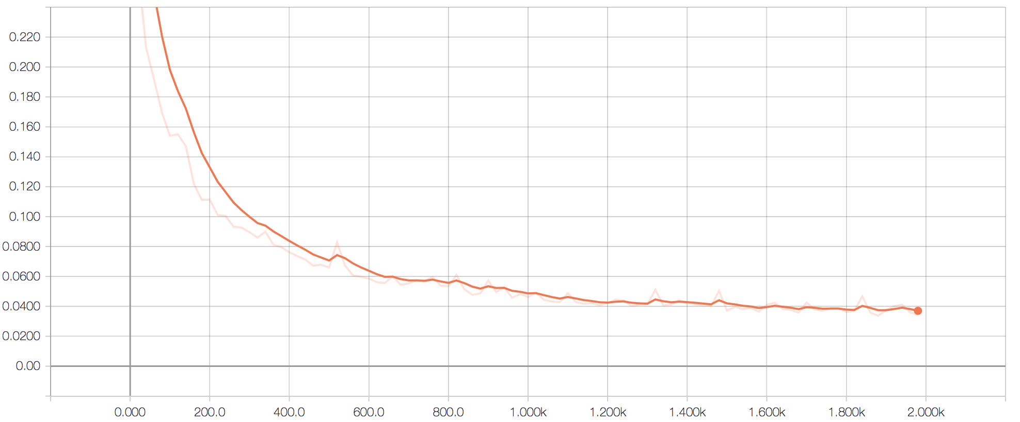
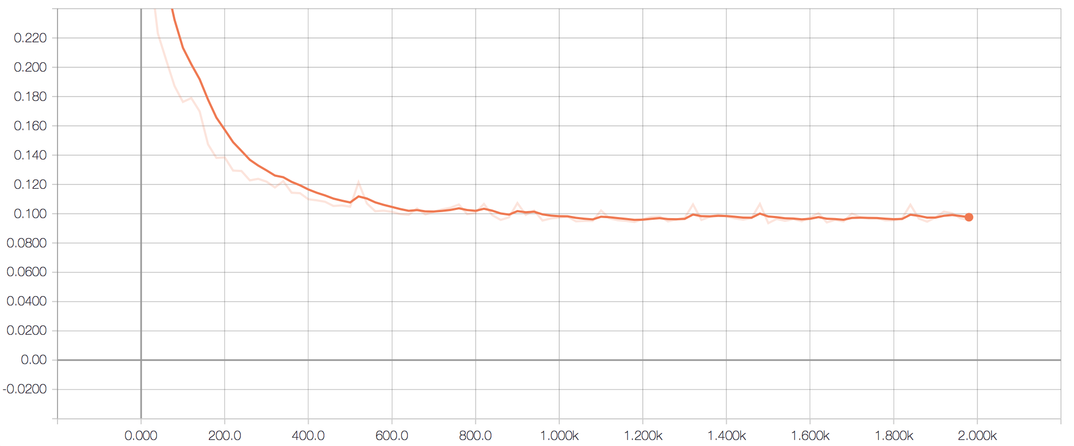
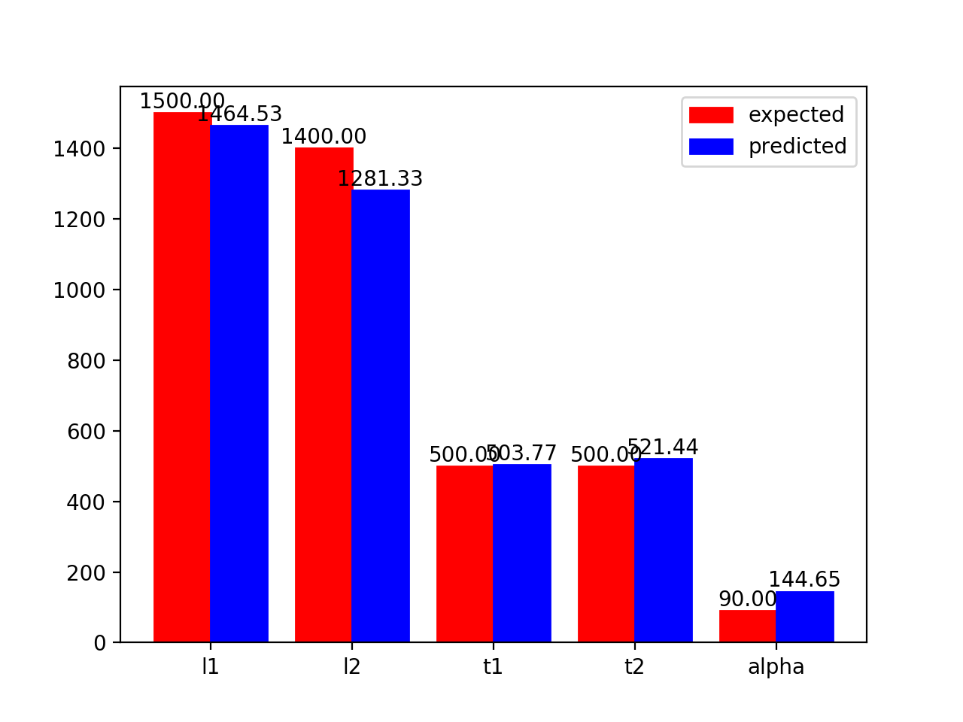
Results
One TestSet: input spectrum
TrainLoss
TestLoss
0.04
0.1
Reflectance
epoch: 2000
epoch: 2000
freq
More test sets:
Output designed parameters
Feature | Truth/Prediction | Top Length | Bottom Length | Top Spacer | Bottom Spacer | Angle | normalized error
Set 1 | Truth | 1,400.00 | 1,200.00 | 600.00 | 200.00 | 30.00 | 0.43%
 | Prediction | 1,355.92 | 1,171.69 | 597.96 | 209.58 | 4.31
Set 2 | Truth | 1,300.00 | 1,000.00 | 300.00 | 400.00 | 30.00 | 2.44%
 | Prediction | 1,347.19 | 1,076.66 | 408.98 | 232.18 | 14.48
Set 3 | Truth | 1,500.00 | 1,400.00 | 500.00 | 500.00 | 90.00 | 1.99%
 | Prediction | 1,464.53 | 1,281.33 | 503.77 | 521.44 | 144.65
Set 4 | Truth | 1,500.00 | 1,100.00 | 300.00 | 300.00 | 120.00 | 2.06%
 | Prediction | 1,475.32 | 1,102.13 | 312.44 | 341.79 | 63.81
Set 5 | Truth | 1,100.00 | 1,600.00 | 500.00 | 500.00 | 180.00 | 2.34%
 | Prediction | 1,042.84 | 1,531.27 | 479.99 | 467.48 | 120.37
Test set | Truth | 1,500 | 1,400 | 500.00 | 500.00 | 90
 | Prediction | 1,464.53 | 1,281.33 | 503.77 | 521.44 | 144.65

Slide 8
Conclusion
We have built up and train a neural network model with the database of chiral meta-materials
We utilize tensor flow to construct the neural network, which is constructed with a 2D convolutional layer, a pooling layer, a fully-connected layer and a output layer
The neural network takes input with the target spectrum with chiral response; and output the designed parameters
The neural network show good performance on parameters l1, l2, t1 and t2, but less good results for rotation angle alpha
It took least than 30mins to train the model with 2000 epochs; this dramatically reduce the time for meta material design, compared with traditional method of parameter sweeping with numerical simulations

Slide 9
Thank you
task distribution:
Feng Cheng: generate data, data cleaning, build up nn
Wudi Zheng: data process, train the network, evaluate data
Both: presentation and report, debugging

