Slide 1
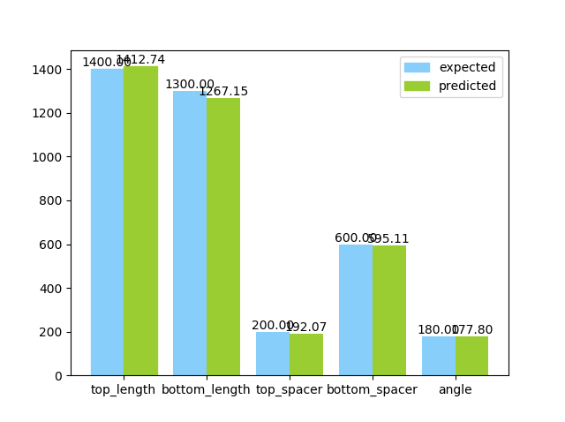
Results
Feature | Truth/Prediction | Top Length | Bottom Length | Top Spacer | Bottom Spacer | Angle | normalized error
Set 1 | Truth | 1,400.00 | 1,200.00 | 600.00 | 200.00 | 30.00 | 0.43%
 | Prediction | 1,355.92 | 1,171.69 | 597.96 | 209.58 | 4.31
Set 2 | Truth | 1,300.00 | 1,000.00 | 300.00 | 400.00 | 30.00 | 2.44%
 | Prediction | 1,347.19 | 1,076.66 | 408.98 | 232.18 | 14.48
Set 3 | Truth | 1,500.00 | 1,400.00 | 500.00 | 500.00 | 90.00 | 1.99%
 | Prediction | 1,464.53 | 1,281.33 | 503.77 | 521.44 | 144.65
Set 4 | Truth | 1,500.00 | 1,100.00 | 300.00 | 300.00 | 120.00 | 2.06%
 | Prediction | 1,475.32 | 1,102.13 | 312.44 | 341.79 | 63.81
Set 5 | Truth | 1,100.00 | 1,600.00 | 500.00 | 500.00 | 180.00 | 2.34%
 | Prediction | 1,042.84 | 1,531.27 | 479.99 | 467.48 | 120.37
typical input
typical output
spectrum
1*5 vector

