Slide 1




piLINCS – interface to Panorama
Szymon Chojnacki¹, Jarek Meller¹, Vagisha Sharma², Jake Jaffe³, Dusica Vidovic⁴, Wen Niu¹, Mario Medvedovic¹
(1) University of Cincinnati, (2) University of Washington, (3) Broad Institute, (4) University of Miami

Slide 2
Goals
Provide interface and seamless access to LINCS proteomics datasets (P100, GCP, etc.) available in Panorama
Build intermediate API layer to enable direct and simple querying and access to proteomics datasets by tools developed within BD2K community
Facilitating data integration by creating a global view of L1000 and proteomic data through iLINCS and related portals

Slide 3
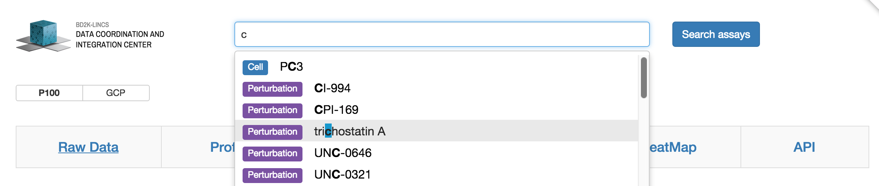
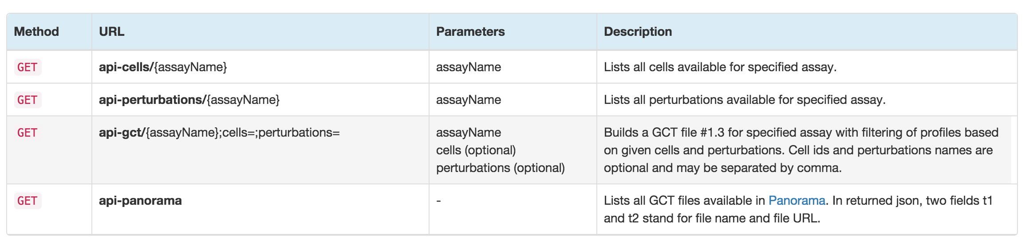
User interface and API

Slide 4
Views
Raw data
Individual measurements with links to corresponding chromatograms in Panorama
Profiles
One profile for each technical replicate
Merged profiles
Concatenated P100 and GCP average profiles for each cell – perturbation pair
Explore tab
Each profile represented by a dot, OLAP cube-like navigation

Slide 5
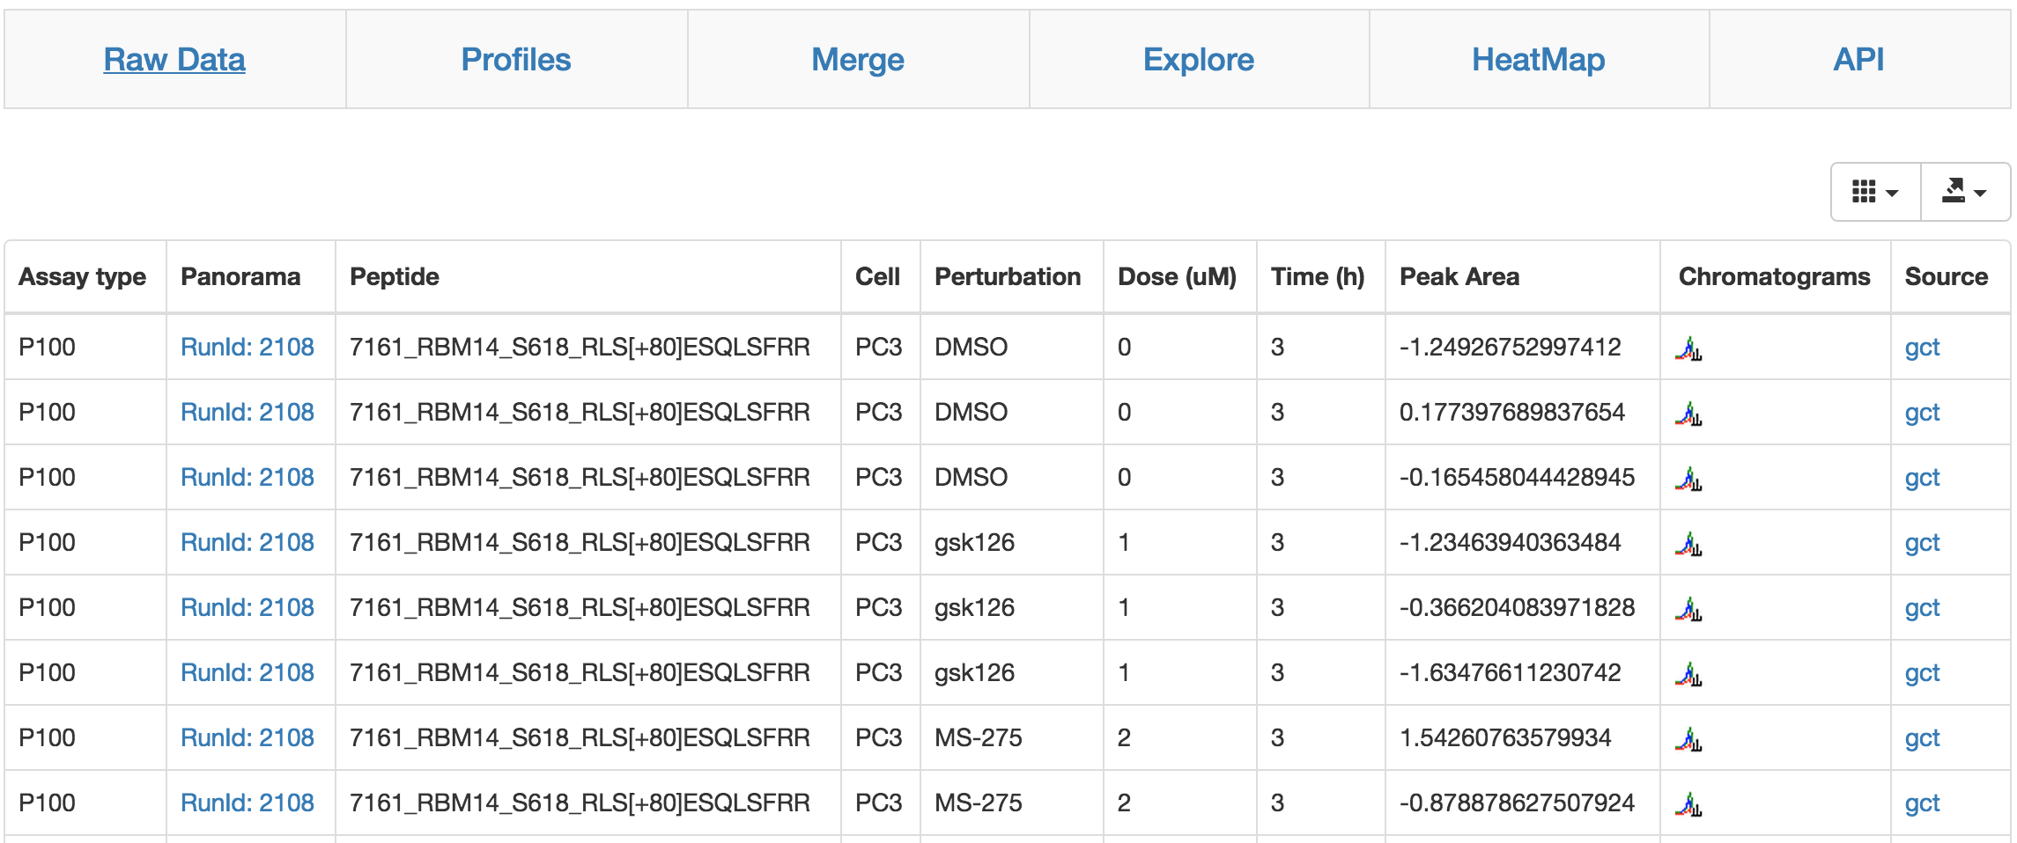
Raw Data (view 1 of 4)

Slide 6
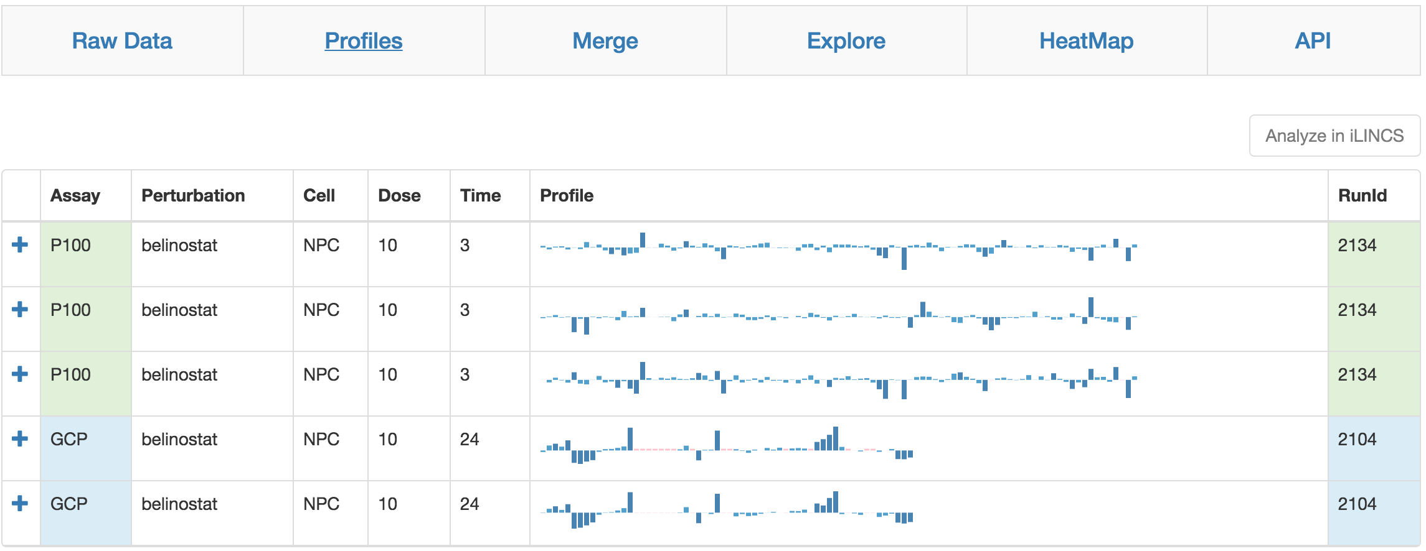
Profiles (view 2 of 4)

Slide 7
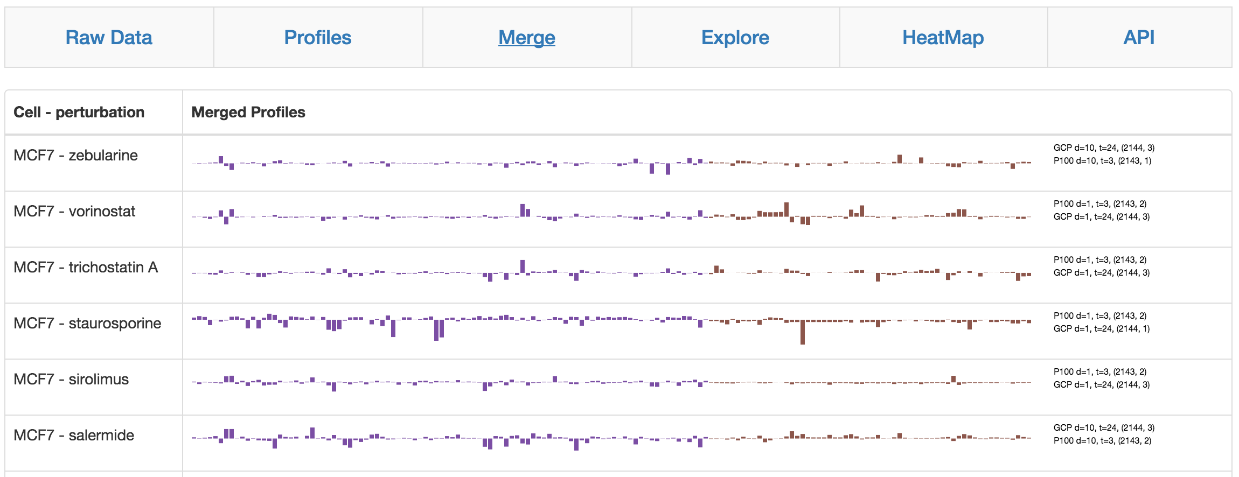
Merged profiles (view 3 of 4)

Slide 8
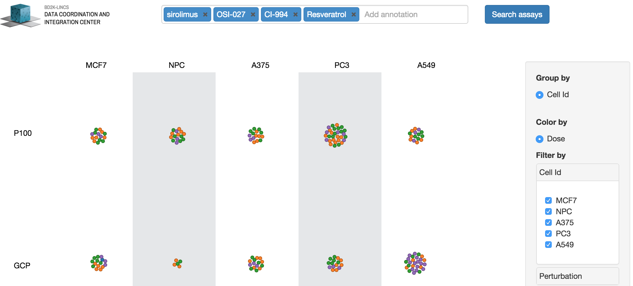
Explore (view 4 of 4)

Slide 9
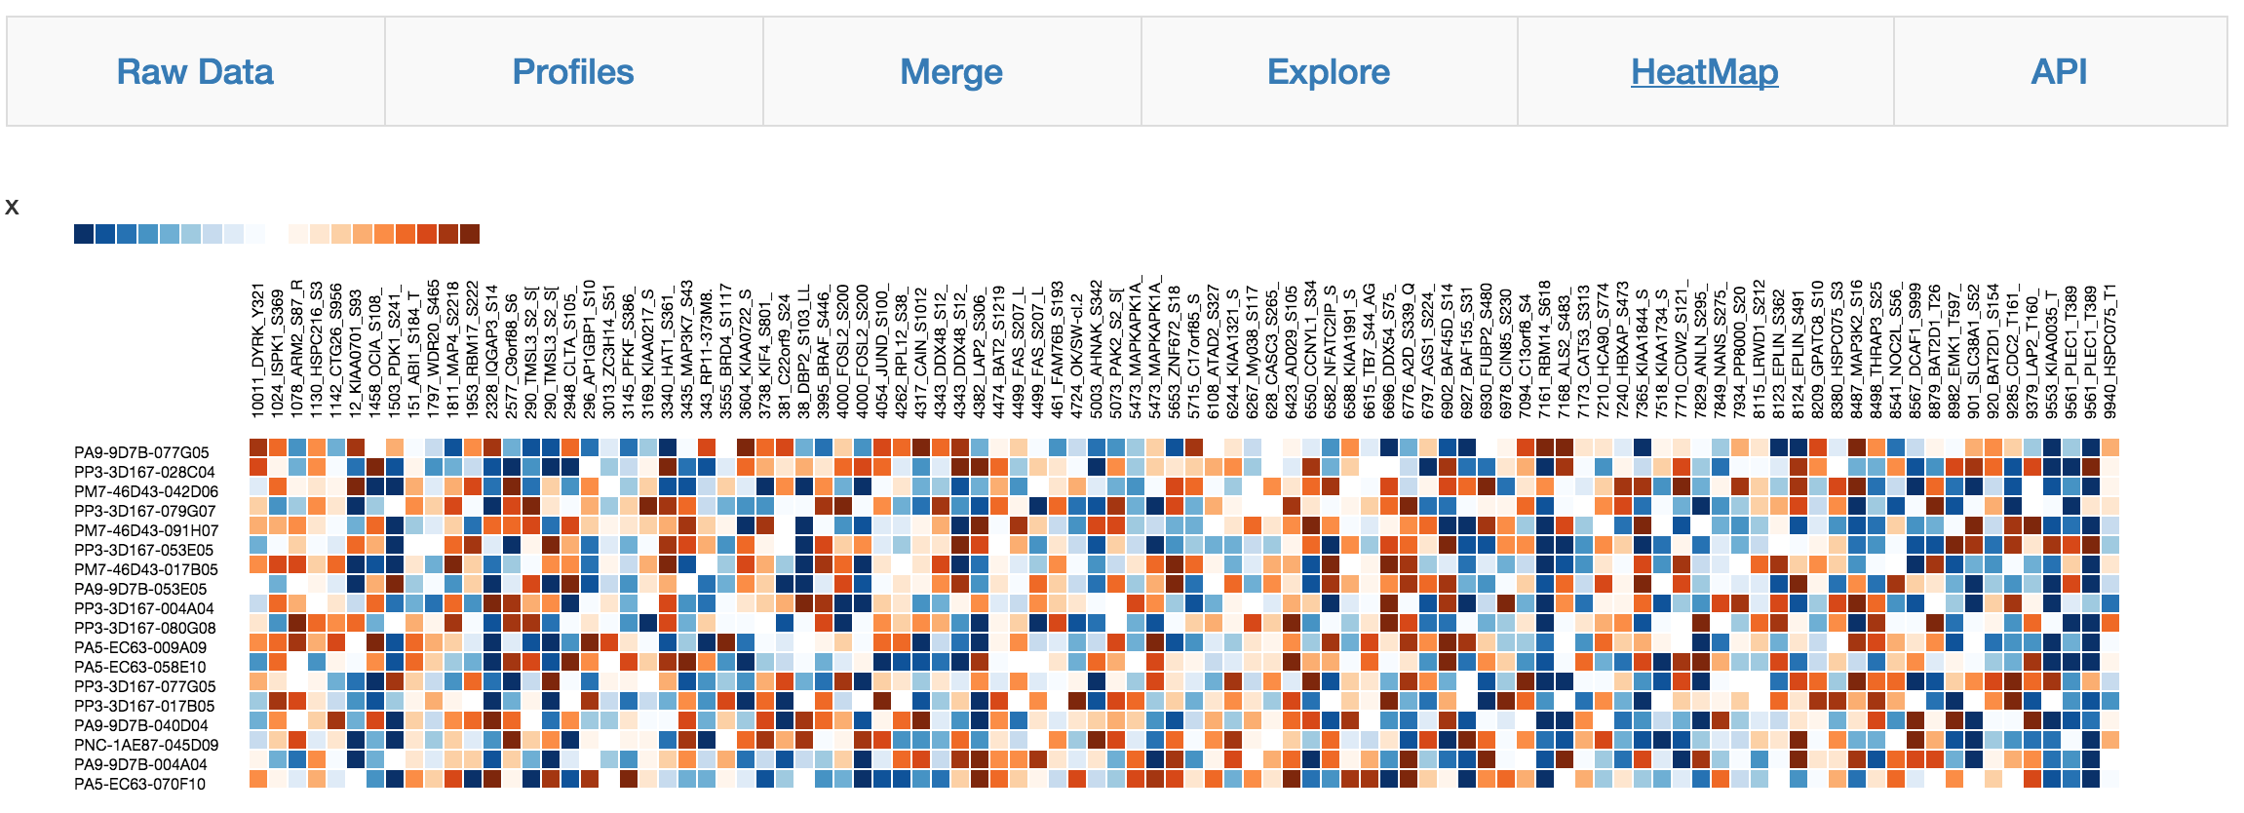
Heat Map (bonus view)

Slide 10
Progress to date
piLINCS interface available at http://www.eh3.uc.edu/pilincs/
All P100, GCP, etc. datasets processed automatically (including meta-data consistency check and imputing of missing values), currently over 80 thousand measurements
Features: quick search, recommender system, quick profile similarity prompt, export as JSON etc.
Quick API to download available datasets: http://www.eh3.uc.edu/pilincs/api-panorama
Open-source code in GitHub: https://github.com/sajmmon/Pilincs

