Slide 1

Dynamic Inventory Management System
Laxmi Kanth Oruganti
University of the Cumberlands
MSCS 532 : Algorithms and Data Structures
Prof. Brandon Bass
11/30/2025

Slide 2
Project Objectives
Resolve Computational Conflict: Build a solution that bridges the gap between instantaneous O(1) transactional speed and flexible O(n) search requirements.
Hybrid Architecture Validation: Design and implement a composite system leveraging Hash Tables, Category Indexes, and Tries within a single memory space.
Performance Optimization: Achieve sub-millisecond query latency for interactive autocomplete or search functionality on large-scale datasets.

Slide 3


The Challenge
Point of Sale Demands
Critical Bottlenecks
Modern retail environments face a computational conflict between transactional speed and predictive discovery.
Transactional Speed: Checkout counters require instantaneous (O(1)) product lookups by SKU.
Predictive Discovery: Staff and customers expect real-time search and autocomplete functionality.
Scale: Traditional single-data structures cannot perform efficiently at scale.

Slide 4






System Architecture: A Hybrid Approach
Hash Table
Category Index
Prefix Trie
Role: Primary Data Store
Role: Browsing Engine
Role: Predictive Search
Provides O(1) constant time access for direct SKU lookups, ensuring zero latency at the checkout counter.
Maps category names to sets of SKUs. Enables O(1) set retrieval for efficient catalog filtering.
Optimized for autocomplete. Retrieval time is proportional to key length O(m), independent of dataset size.

Slide 5
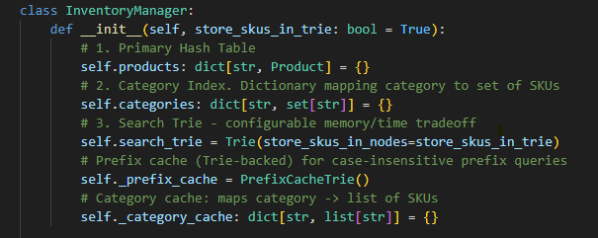
Implementation: The Facade Pattern
Key Responsibilities
To manage the complexity of three synchronized data structures, the system employs the Facade Pattern via the InventoryManager class.
Atomic Updates: Ensures a single "Add Product" call updates the Hash Table, Index, and Trie simultaneously.
Consistency: Prevents "phantom reads" where items exist in inventory but are missing from search.
Abstraction: Clients interact with a simple API, hiding the underlying architectural complexity.

Slide 6
Core operations
add_product(): Updates hash table, category index, search trie.
update_quantity(): O(1) stock modifications via SKU lookup
get_products_by_category(): O(1) + O(k) where k = products in category
get_products_by_name_prefix(): O(m) where m = prefix length

Slide 7

Optimization: The Memory-Latency Trade-off
Mode A: Node-Stored
Mode B: Subtree Collection
Strategy: Every node in the Trie path stores the matching SKUs.
Strategy: Only leaf nodes (end-of-word) store SKUs.
Pros: Instant retrieval. Zero traversal required after prefix match.
Pros: Minimal memory footprint. Efficient storage.
Cons: Higher memory consumption due to data redundancy.
Cons: Latency is high.
Result: ~88ms Latency.
Result: ~0.2ms Latency.

Slide 8
Intelligent Caching
Prefix Cache Trie: Maintains warm queries, sub-microsecond hot lookups
Targeted Invalidation: O(m) instead of O(cache size) on product updates
Category Cache: Eliminates redundant filtering across requests

Slide 9
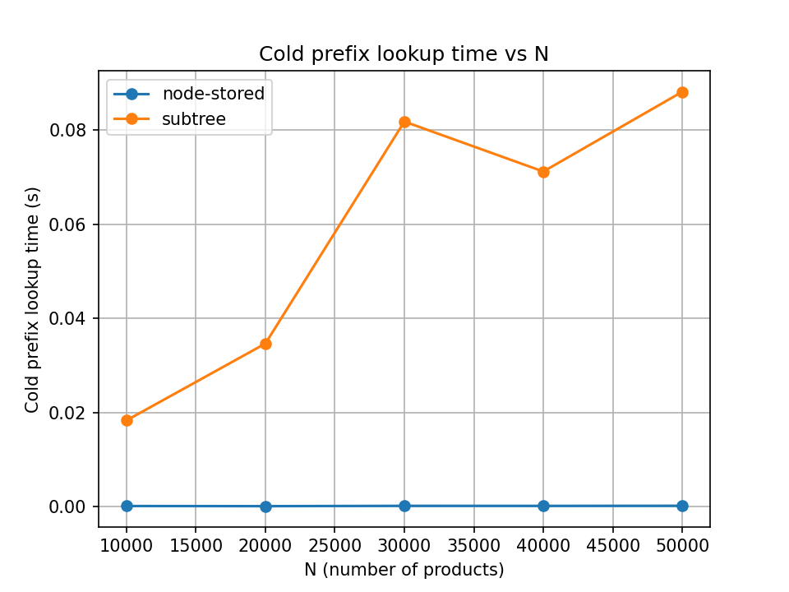
Performance: Cold Query Latency (N=50k)
Note: The Node-Stored optimization delivers a 400x improvement in query speed, making it the only viable option for high-frequency interactive search when memory is not a concern.

Slide 10
System Performance Overview
0.2ms
50k+
100%
AVG QUERY LATENCY
ITEMS SUPPORTED
DATA CONSISTENCY

Slide 11


Advanced Optimization
Trie-Backed Cache
Standard caching is inefficient because updates often require clearing the entire cache. Our solution uses a Trie-Backed Cache.
Context Aware: The cache understands the relationship between keys (e.g., "A" -> "Ap" -> "App").
Surgical Precision: Updating "Apple" only invalidates the specific prefix path.
Impact: Reduces invalidation complexity from O(Cache_Size) to O(m) where m is prefix length.

Slide 12
Future Research & Development
Roadmap for Production
To transition from prototype to enterprise-grade solution, three key areas have been identified:
Bounded Caching: Implementing LRU (Least Recently Used) eviction policies to ensure memory safety in long-running processes.
Persistence: Integration with SQLite/PostgreSQL for durable storage while maintaining in-memory indexes.
Concurrency: Adding thread-safe locking mechanisms for multi-terminal support.

Slide 13
The optimized system achieves query latencies of approximately 0.2 milliseconds, validating its suitability for high-frequency, interactive applications."

Slide 14
Thank you

