Slide 1

Shiny
as Explained to a 5-Year-Old

Slide 2
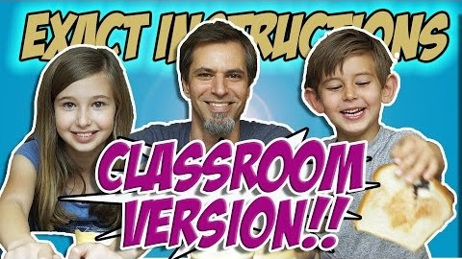

Slide 3
Shiny Examples
https://shiny.rstudio.com/gallery/

Slide 4
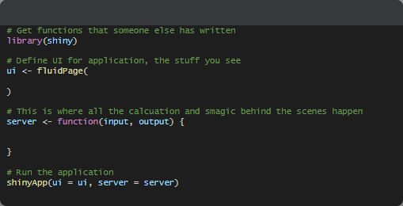
Basic Form of App

Slide 5
Building a UI
https://shiny.rstudio.com/tutorial/written-tutorial/lesson2/

Slide 6
.Rprofile
options(shiny.autoreload = TRUE)

Slide 7
Questions?
Callin Osborn
callin620@gmail.com
Twitter: @callin_osborn

