Slide 1

《一怒之下》
Out of sheer rage
Speaker’s name: Bei Jia Yi Division of labor:
Jiang Ya Xin
Lin Jia Hui
Xie Zi Jing
Date:

Slide 2
目录
CONTENTS
01
Introduction
05
Theme
02
Author
06
Figure
03
Background
07
Style
04
Generalize
08
Conclusion

Slide 3

引言

Slide 4
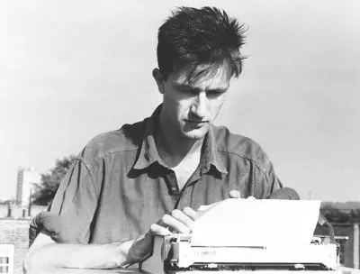
作者简介

Slide 5



小说背景

Slide 6

故事概括
添加小标题
添加小标题
单击此处输入你的正文，请尽量言简意赅的阐述观点，根据需要可酌情增减文字
添加小标题
添加小标题

Slide 7

故事梗概
单击此处添加文本说明
小标题
小标题
小标题
小标题
小标题

Slide 8

主题分析

Slide 9
人物形象
添加标题
添加标题
添加标题
添加标题
添加标题

Slide 10


语言风格
Stylistically, the author's way of observing Lawrence also seems "deviant," and before writing, perhaps because he is afraid of destroying the initial impressions and feelings that lie beneath the ashes of past reading memories, he carefully enters Lawrence from the edges of those seemingly minuscule parts.
As I said before, he is more interested in the fragments of existence that are scattered around the writer.

Slide 11

结论
"A glorious book of life" is "the highest form of human emotion that can be attained at present." Part of his excitement in reading Lawrence comes from "how we feel the potential of this literary form being expanded", and Under the Wrath is another way in which he reviews Lawrence, full of literary form expansion. It is the creative process of a critic, mixed with the urgent desire to be a creator, or to cure art with the elixir of art.

Slide 12
Thanks

