Slide 1



Security metrics for the Android ecosystem
Daniel Alastair Andrew
Thomas Beresford Rice
Firstname.Surname@cl.cam.ac.uk
http://androidvulnerabilities.org
Daniel gpg:
Alastair gpg:
Andrew gpg:
5017 A1EC 0B29 08E3 CF64 7CCD 5514 35D5 D749 33D9
9217 482D D647 8641 44BA 10D8 83F4 9FBF 1144 D9B3
43BF 45D1 1B36 F45C 3F07 DA49 BDB8 8932 5CAC F039

Slide 2
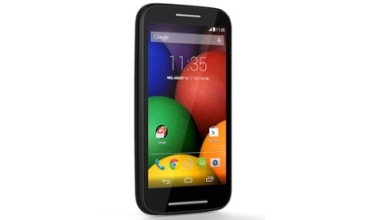
Smartphones contain many apps written by a spectrum of developers
How “secure” is a smartphone?
Notes:
We don't trust developers
We have introduced a sandbox
Is the sandbox working?

Slide 3
Root/kernel exploits are harmful
Root exploits break permission model
Cannot recover to a safe state
37% Android malware uses root exploits (2012)
We're interested in critical vulnerabilities, exploitable by code running on the device
Notes:
Is malware trying to break out of the sandbox?

Slide 4
Hypothesis: devices vulnerable because they are not updated
Anecdotal evidence is that updates rarely happen
Android phones, sold on 1-2 year contracts
Notes:
While there is anecdotal evidence, there is a lack of concrete data about what is really happening.
Quantification.
Windows XP, updates from 2001 until 2014

Slide 5
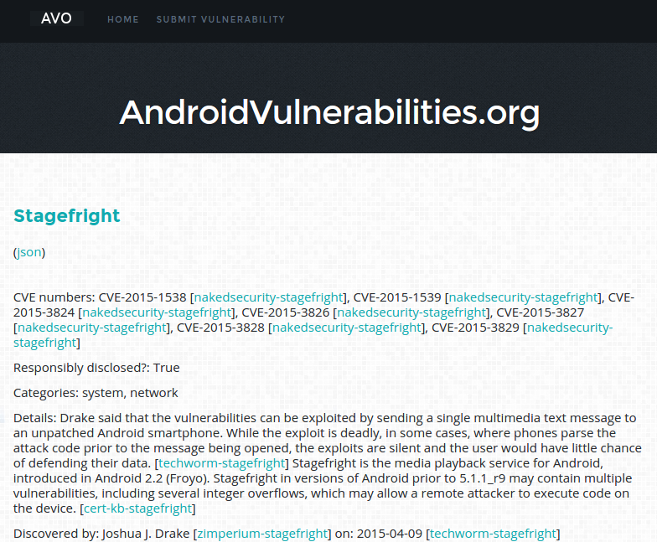
No central database of Android vulnerabilities: so we built one
Notes:
Collected a whole bunch of vulnerabilities, including a number of critical vulnerabilities that lack CVE numbers.
Standard trawling of forums, blog posts etc. as well as the CVE databases.

Slide 6
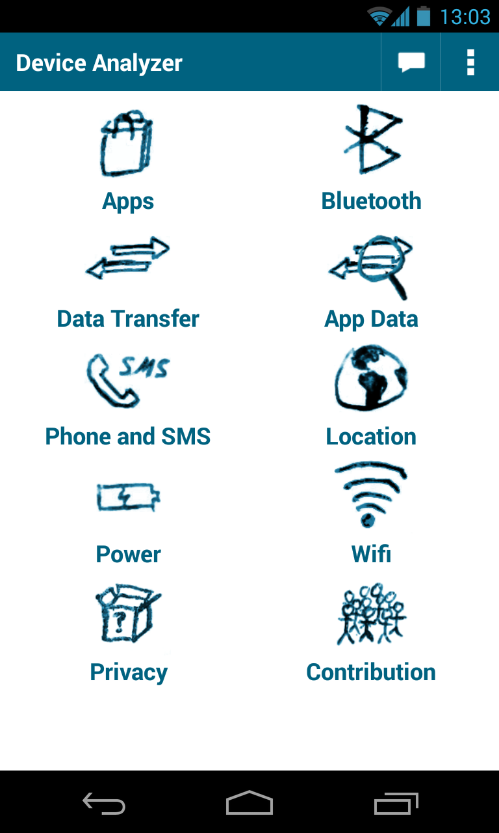
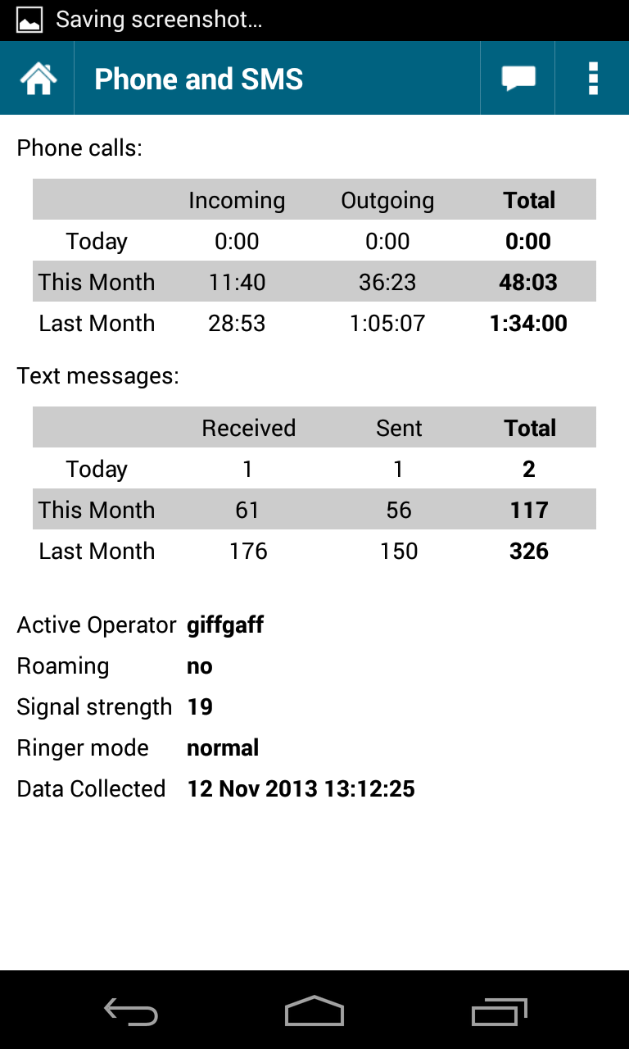
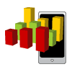
Device Analyzer gathers statistics on mobile phone usage
Deployed May '11
30,000 contributors
4,000 phone years
180 billion records
10TB of data
1089 7-day active contributors
https://deviceanalyzer.cl.cam.ac.uk
Notes:
Device Analyzer has been running since 2011.
You can use the data for your own research and you can install the app to contribute to research.

Slide 7
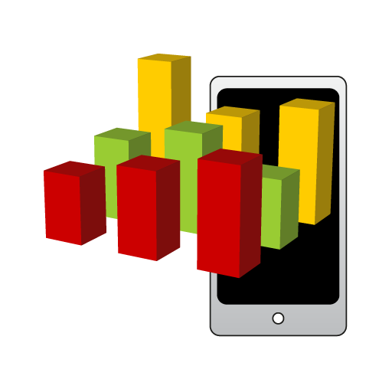
Device Analyzer gathers wide variety of data
Including: system stats
  OS version and build number
  Manufacturer and device model
  Network operators
Notes:
We use the OS version and build number information along with the manufacturer and device model information.
This can be combined with data on vulnerabilities to work out which devices were exposed to which vulnerabilities over time and apportion that to manufacturers, network operators and device models.

Slide 8
Is the ecosystem getting updated?
Notes:
One thing we can look at is whether the ecosystem is being updated.

Slide 9
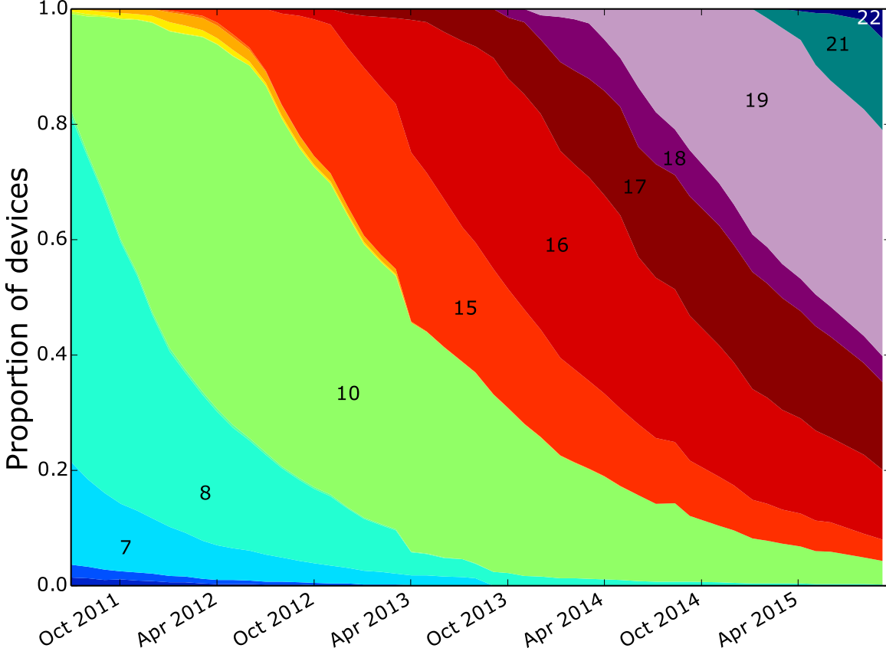
Google data: device API levels
Notes:
I collected Google Play's monthly data on API versions installed on devices contacting Google Play.
This shows that it takes a long time for updates to be deployed.

Slide 10
Are devices getting updated?
Notes:
However the change in the ecosystem could be due to old devices getting binned and new ones being bought.
To work out if devices are being updated we need longitudinal data on individual devices. This is provided by Device Analyzer

Slide 11
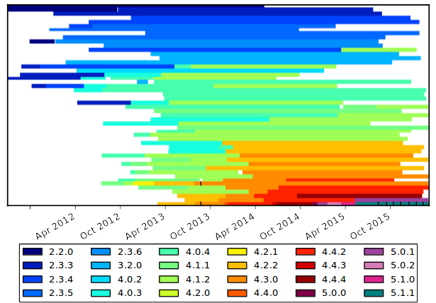
Samsung devices by OS version
Notes:
Top 50 LG devices, many have received updates.

Slide 12
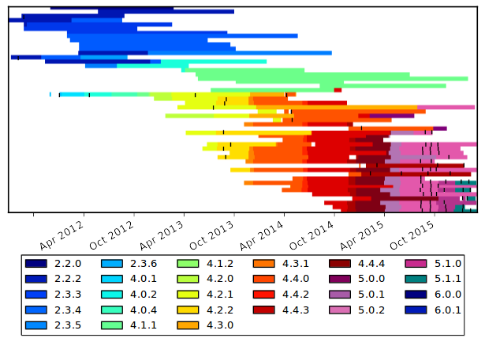
LG devices by OS version
Notes:
Top 50 LG devices, many have received updates.

Slide 13
Connecting the two data sets: assume OS version → vulnerability
We have an OS version from Device Analyzer
We have vulnerability data with OS versions
Match on OS and Build Number and assign:
  Vulnerable
  Maybe invulnerable
  Invulnerable (not known vulnerable)
Notes:
A device is insecure if it is exposed to known vulnerabilities because it's OS was built before the vulnerability was fixed and so must contain the vulnerability.
It is maybe secure if its build number was only observed after the vulnerability was fixed but the OS version number is known to be insecure.
It is secure if it is running a known good version of Android for that date.

Slide 14
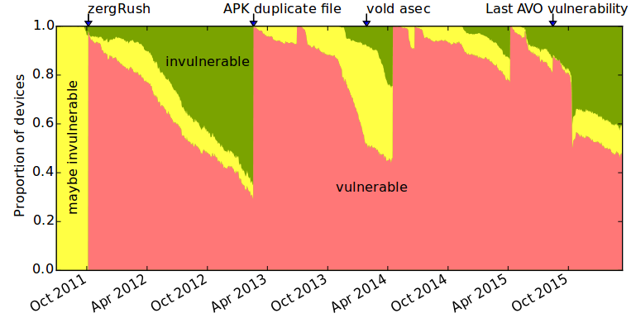
On average, 85% are vulnerable
15%
14%
71%
Notes:
To start off with everything is maybe secure as we don't have data before a vulnerability was discovered to know if the build number was made after it, however once zergRush was discovered we knew how bad things were.
14 vulnerabilities contribute to this graph.
Red vertical lines are caused by the discovery of vulnerabilities.
4% Maybe secure
10.9%

Slide 15
The FUM metric measures the security of Android devices
free from (known) vulnerabilities
updated to the latest version
mean unfixed vulnerabilities
Notes:
To provide a score out of 10 to compare manufacturers we combine three metrics that are variations on ones that have been used in the past.
Free = Proportion of devices free from vulnerabilities
Update = Proportion of devices running the latest version of Android used by that device manufacturer.
Mean = Mean number of vulnerabilities affecting not fixed on any device by the device manufacturer. This has to be scaled to between 0 and 1, hence the more complicated expression.
4+3+3=10
The sensitivity of this metric to changes is discussed in the paper.

Slide 16
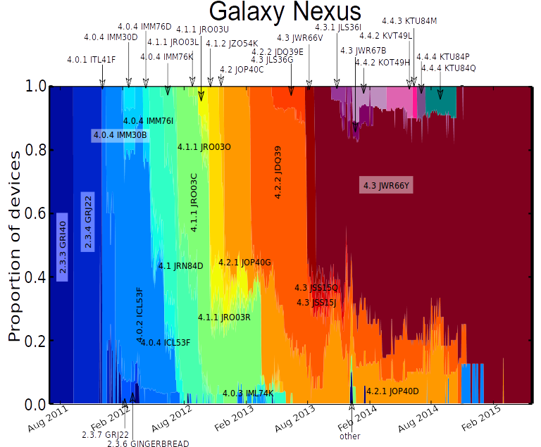
Notes:
Is the score reasonable?
This is the highest scoring device model, it gets lots of updates.

Slide 17
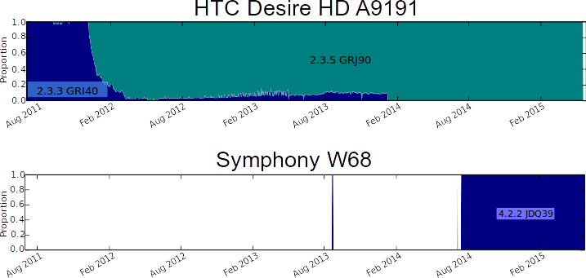
Notes:
These are two of the lowest scoring device models, one of them got one update.

Slide 19
Why is fixing vulnerabilities hard: software ecosystem is complex
Division of labour
  Open source software
  Core OS production
  Driver writer
  Device manufacturer
  Retailer
  Customer
Apple and Google have different models
  Hypothesis: Apple's model is more secure
Notes:
Apple has a vertically integrated solution

Slide 20
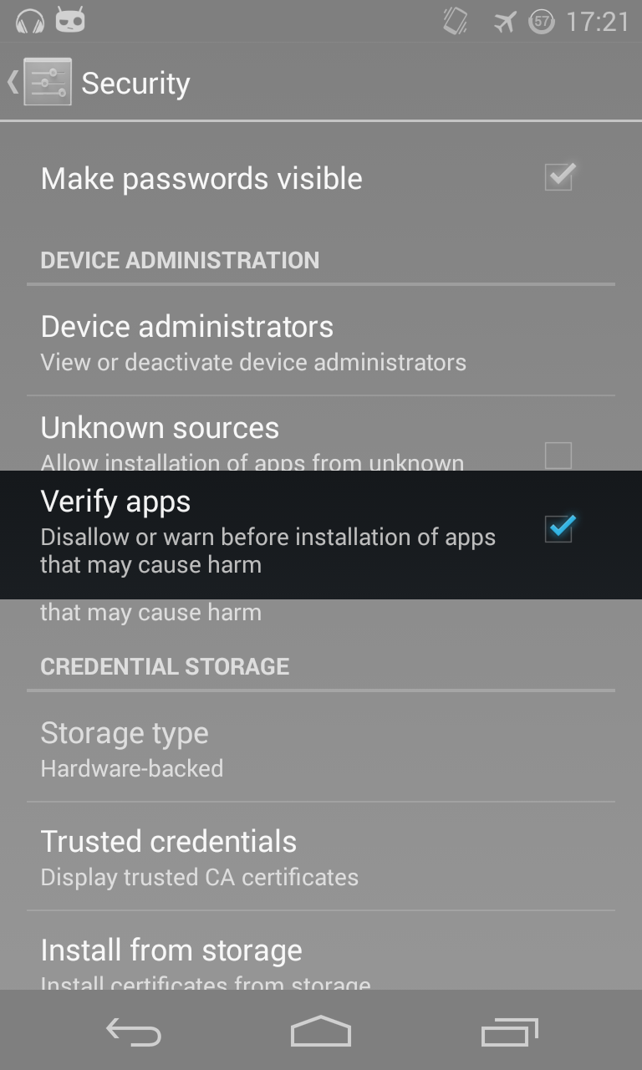
Google to the rescue: Play Store and Verify apps provide security

Slide 21
Conclusions
71% of Android devices are vulnerable
Ecosystem complex; lack of transparency
FUM metric is a robust measure of security
  A step towards an economic incentive

Slide 22

Security metrics for the Android ecosystem
Daniel Alastair Andrew
Thomas Beresford Rice
Daniel gpg:
Alastair gpg:
Andrew gpg:
5017 A1EC 0B29 08E3 CF64 7CCD 5514 35D5 D749 33D9
9217 482D D647 8641 44BA 10D8 83F4 9FBF 1144 D9B3
43BF 45D1 1B36 F45C 3F07 DA49 BDB8 8932 5CAC F039
Notes:
Presenting metrics that produce comparative scores for the security provided by different entities such as manufacturers.

Slide 23
Example: Android APK duplicate file
OS does not check for duplicate files in APK
Not a traditional kernel vulnerability
Affected all manufacturers and versions > 1.5
Timeline:
  February 2013: discovered
  February 2013: fixed
  July 2013: Public announcement
Is the responsible disclosure period sufficient to protect users?

Slide 24
Device Analyzer is a good example of Privacy by Design principles
Transparency, consent, notice and disclosure
Purpose
Security
Access to data and withdrawal
Proactive privacy design
Privacy by default

Slide 25
Device Analyzer is representative
Compared with Google Play API data: Device Analyzer is slightly better
Compared with User-Agent headers from Rwanda: Device Analyzer is better
Compared with MDM data from a FTSE 100 company: Device Analyzer is slightly worse

Slide 26
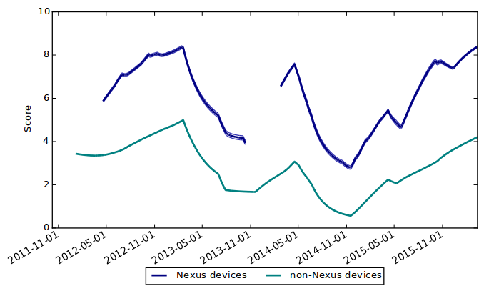
Nexus and non-Nexus devices

