Slide 1



Smartphone vulnerabilities
Daniel Alastair Andrew
Thomas Beresford Rice
University of Cambridge

Slide 2
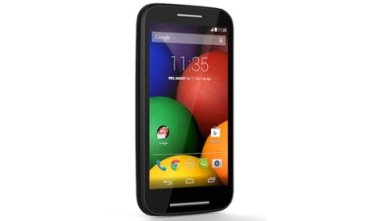
Smartphones contain many apps written by a spectrum of developers
How “secure” is a smartphone?

Slide 3
Root exploits are harmful
Root exploits break permission model entirely
Cannot easily recover to a safe state
37% Android malware uses root exploits [1]
We're interested in “root-equivalent” vulnerabilities, exploitable by the app developer
[1] Yajin Zhou and Xuxian Jiang. Dissecting Android Malware: Characterization and Evolution, Proceedings of the 33rd IEEE Symposium on Security and Privacy, 2012

Slide 4
Hypothesis: phones vulnerable because they are not updated
Windows XP, updates from 2001 until 2014
Android phones, sold on 1-2 year contracts
  Anecdotal evidence is that updates rarely happen

Slide 5
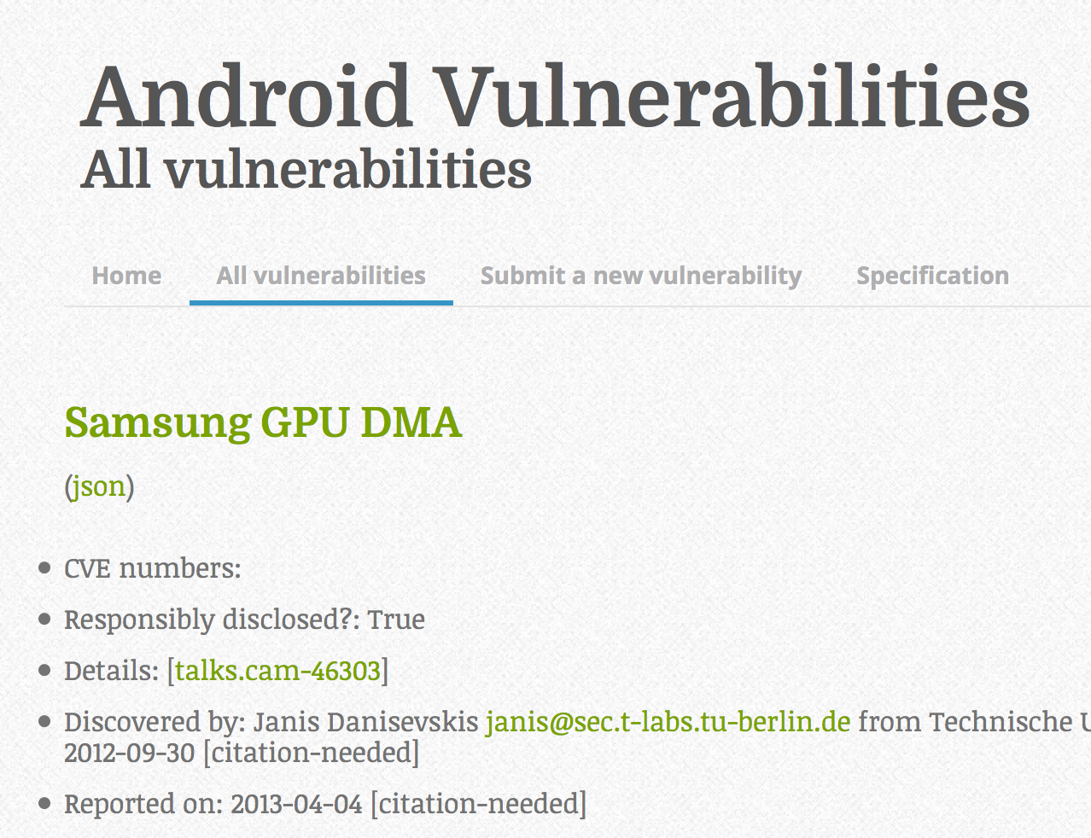
No central database of Android vulnerabilities: so we're building one
http://androidvulnerabilities.org

Slide 6
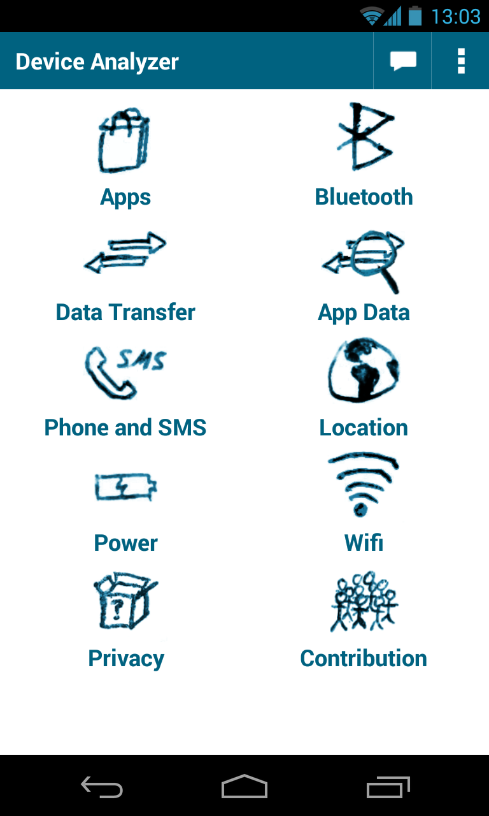
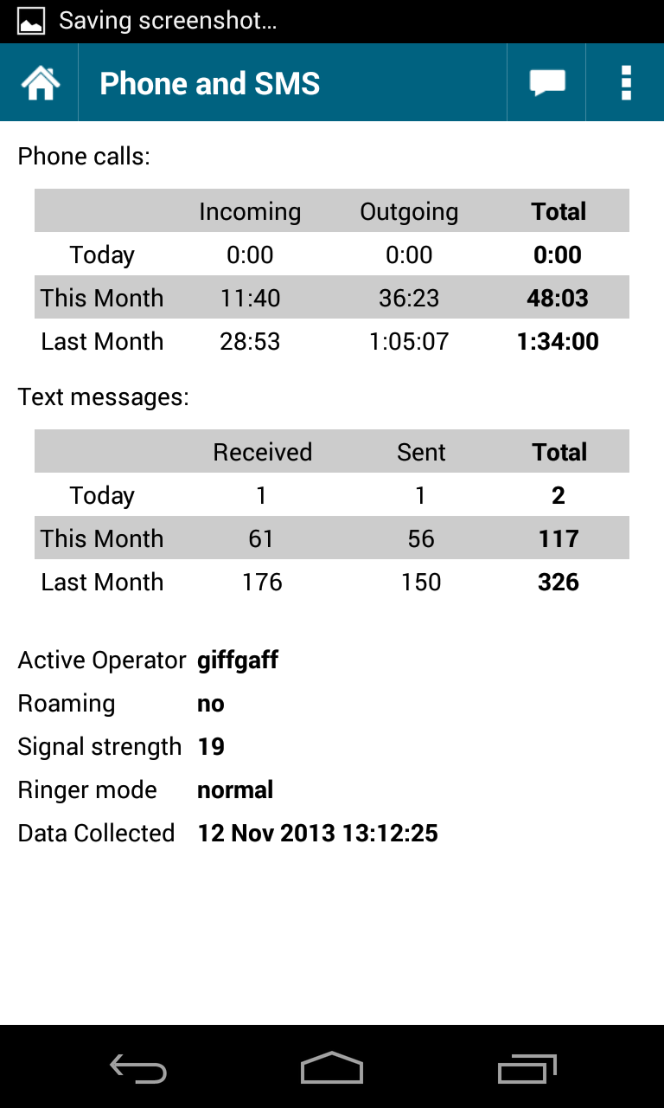
Device Analyzer gathers statistics on mobile phone usage
Deployed May '11
23,300 contributors
2,000 phone years
100 billion records
10TB of data
600 7-day active contributors
https://deviceanalyzer.cl.cam.ac.uk

Slide 7
Device Analyzer gathers wide variety of data
Phone calls and text messages
App installs and resource usage
Location data
Power usage
Wifi, Bluetooth and 3G availability and usage
System stats
  OS version and build number
  Manufacturer and device model
  ...

Slide 8
Is the ecosystem getting updated?

Slide 9
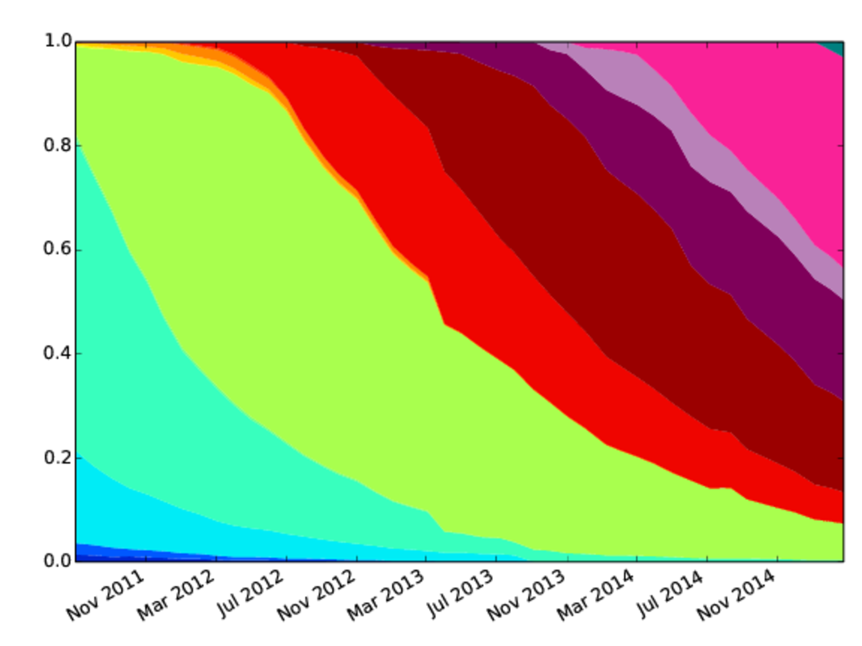
Google data: device API levels
19
18
17
16
15
10
9
7

Slide 10
Are handsets getting updated?

Slide 11
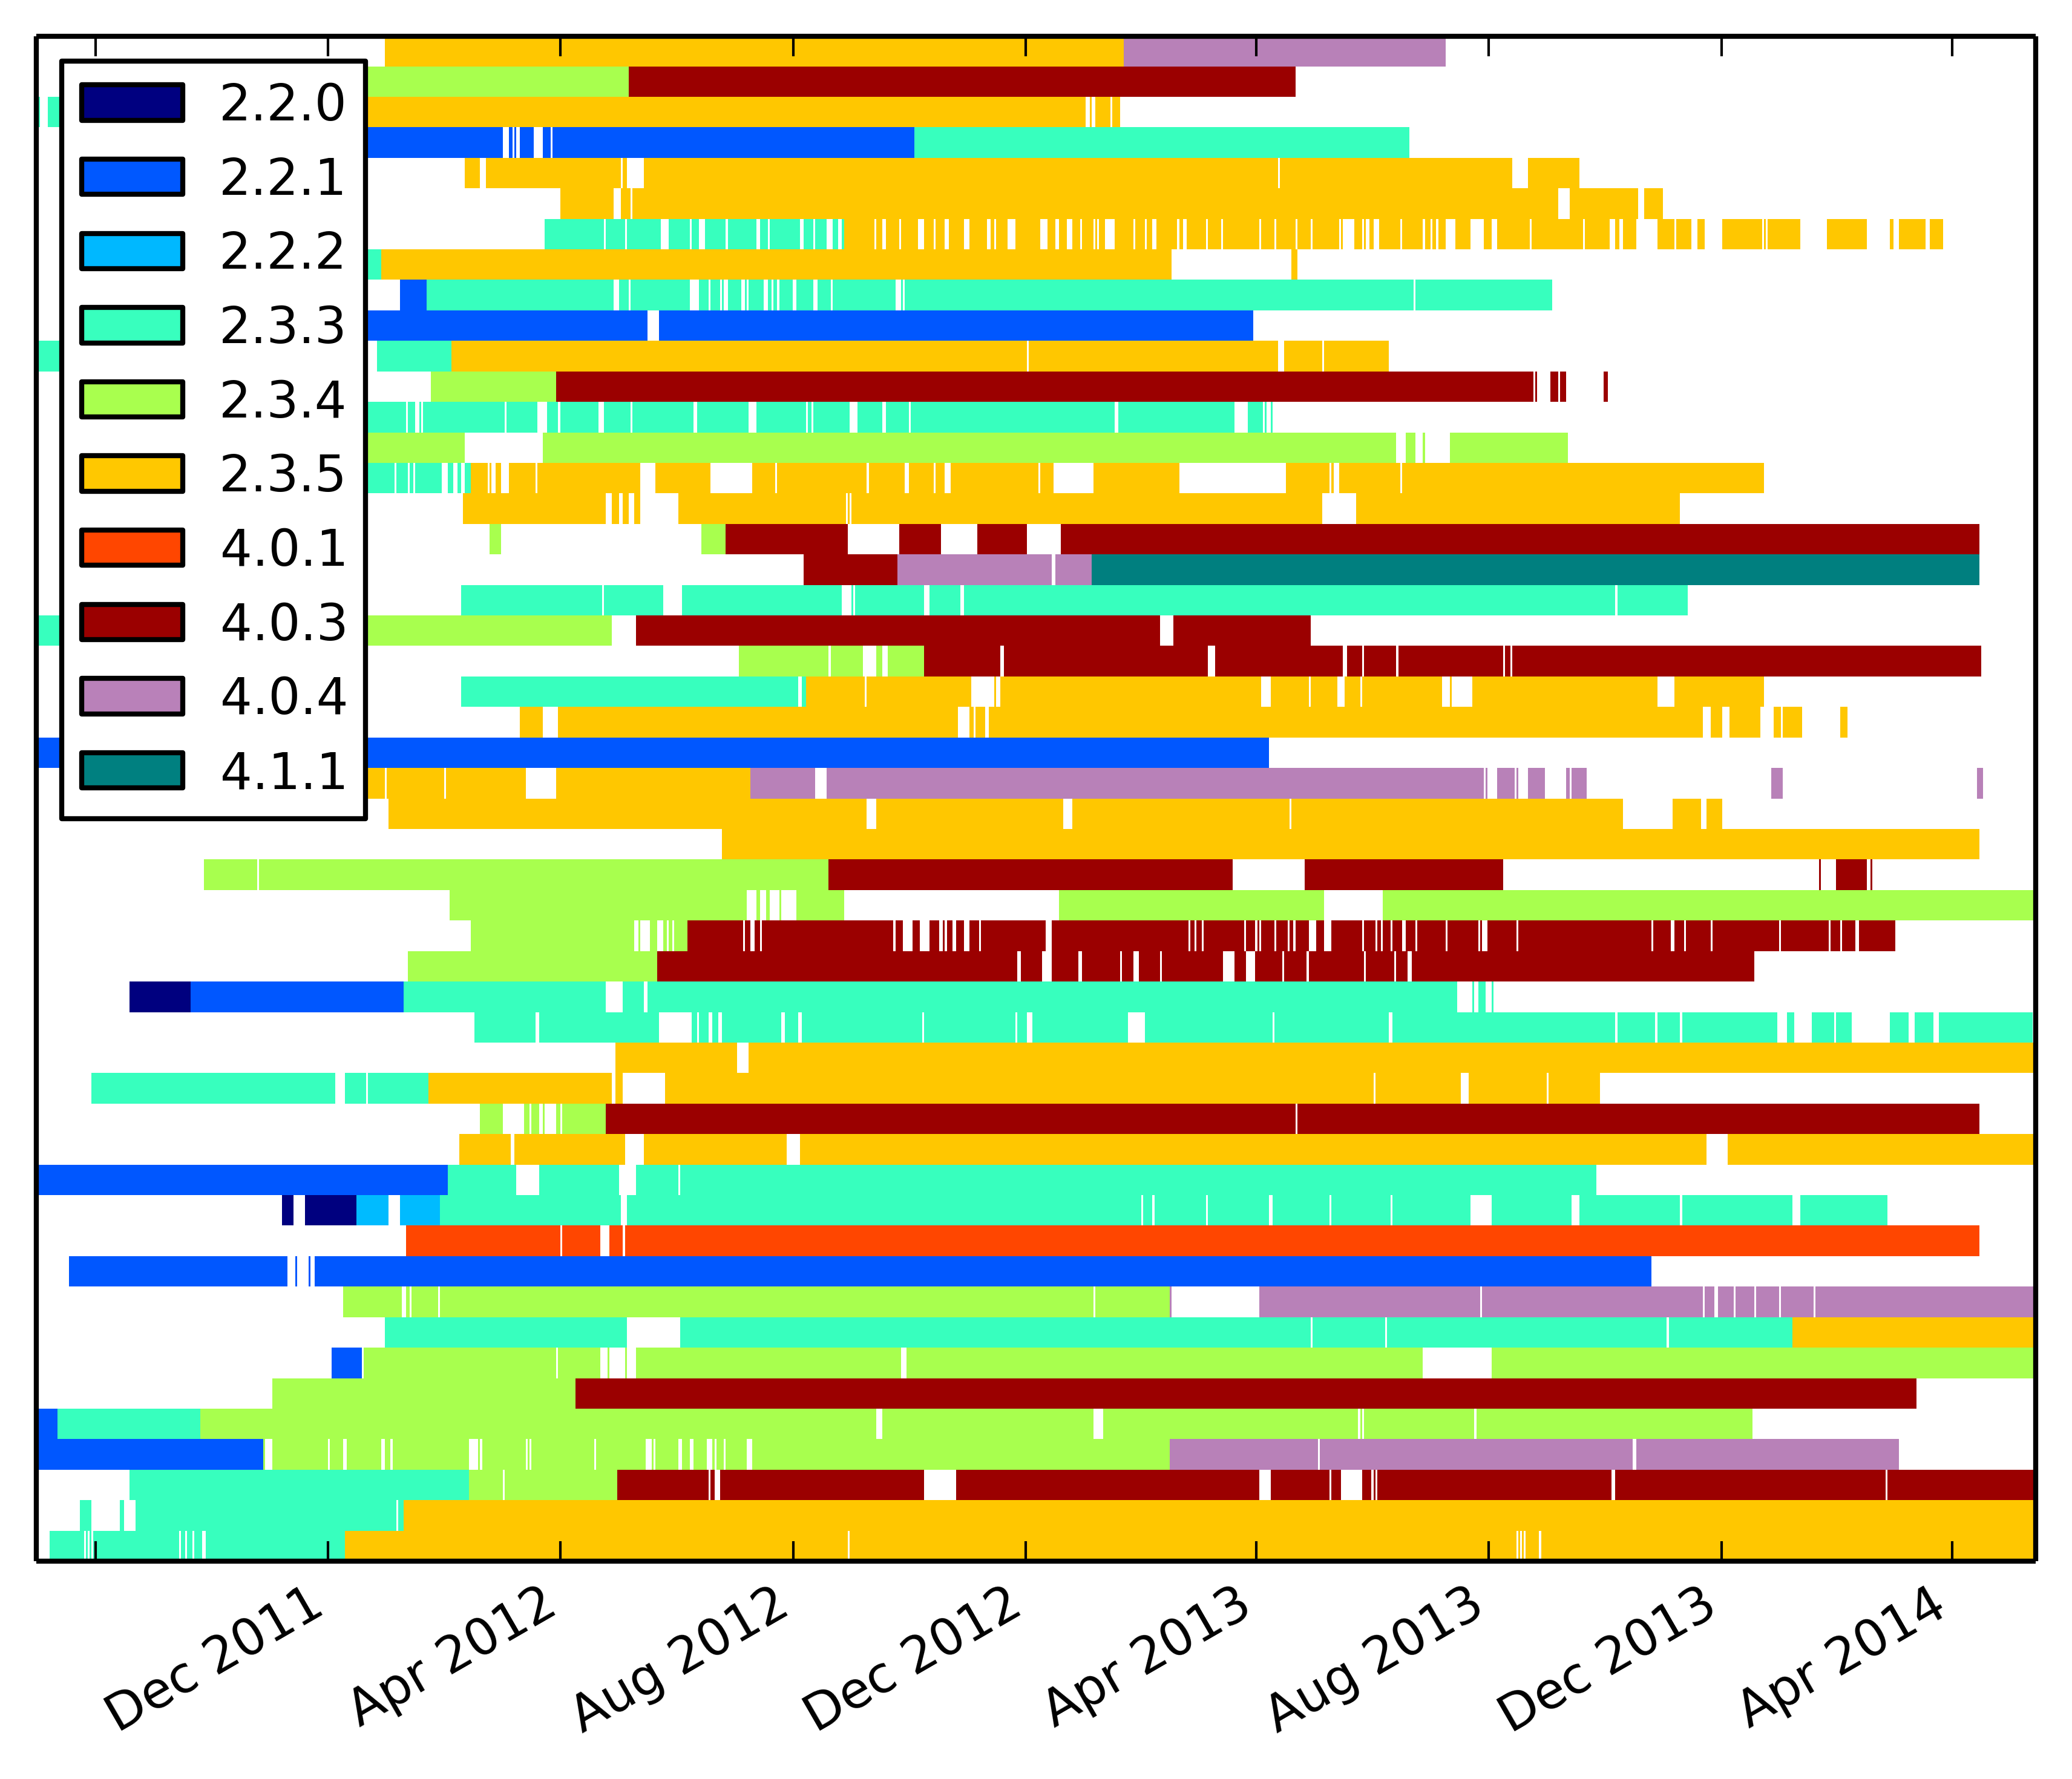
HTC updates by OS version

Slide 12
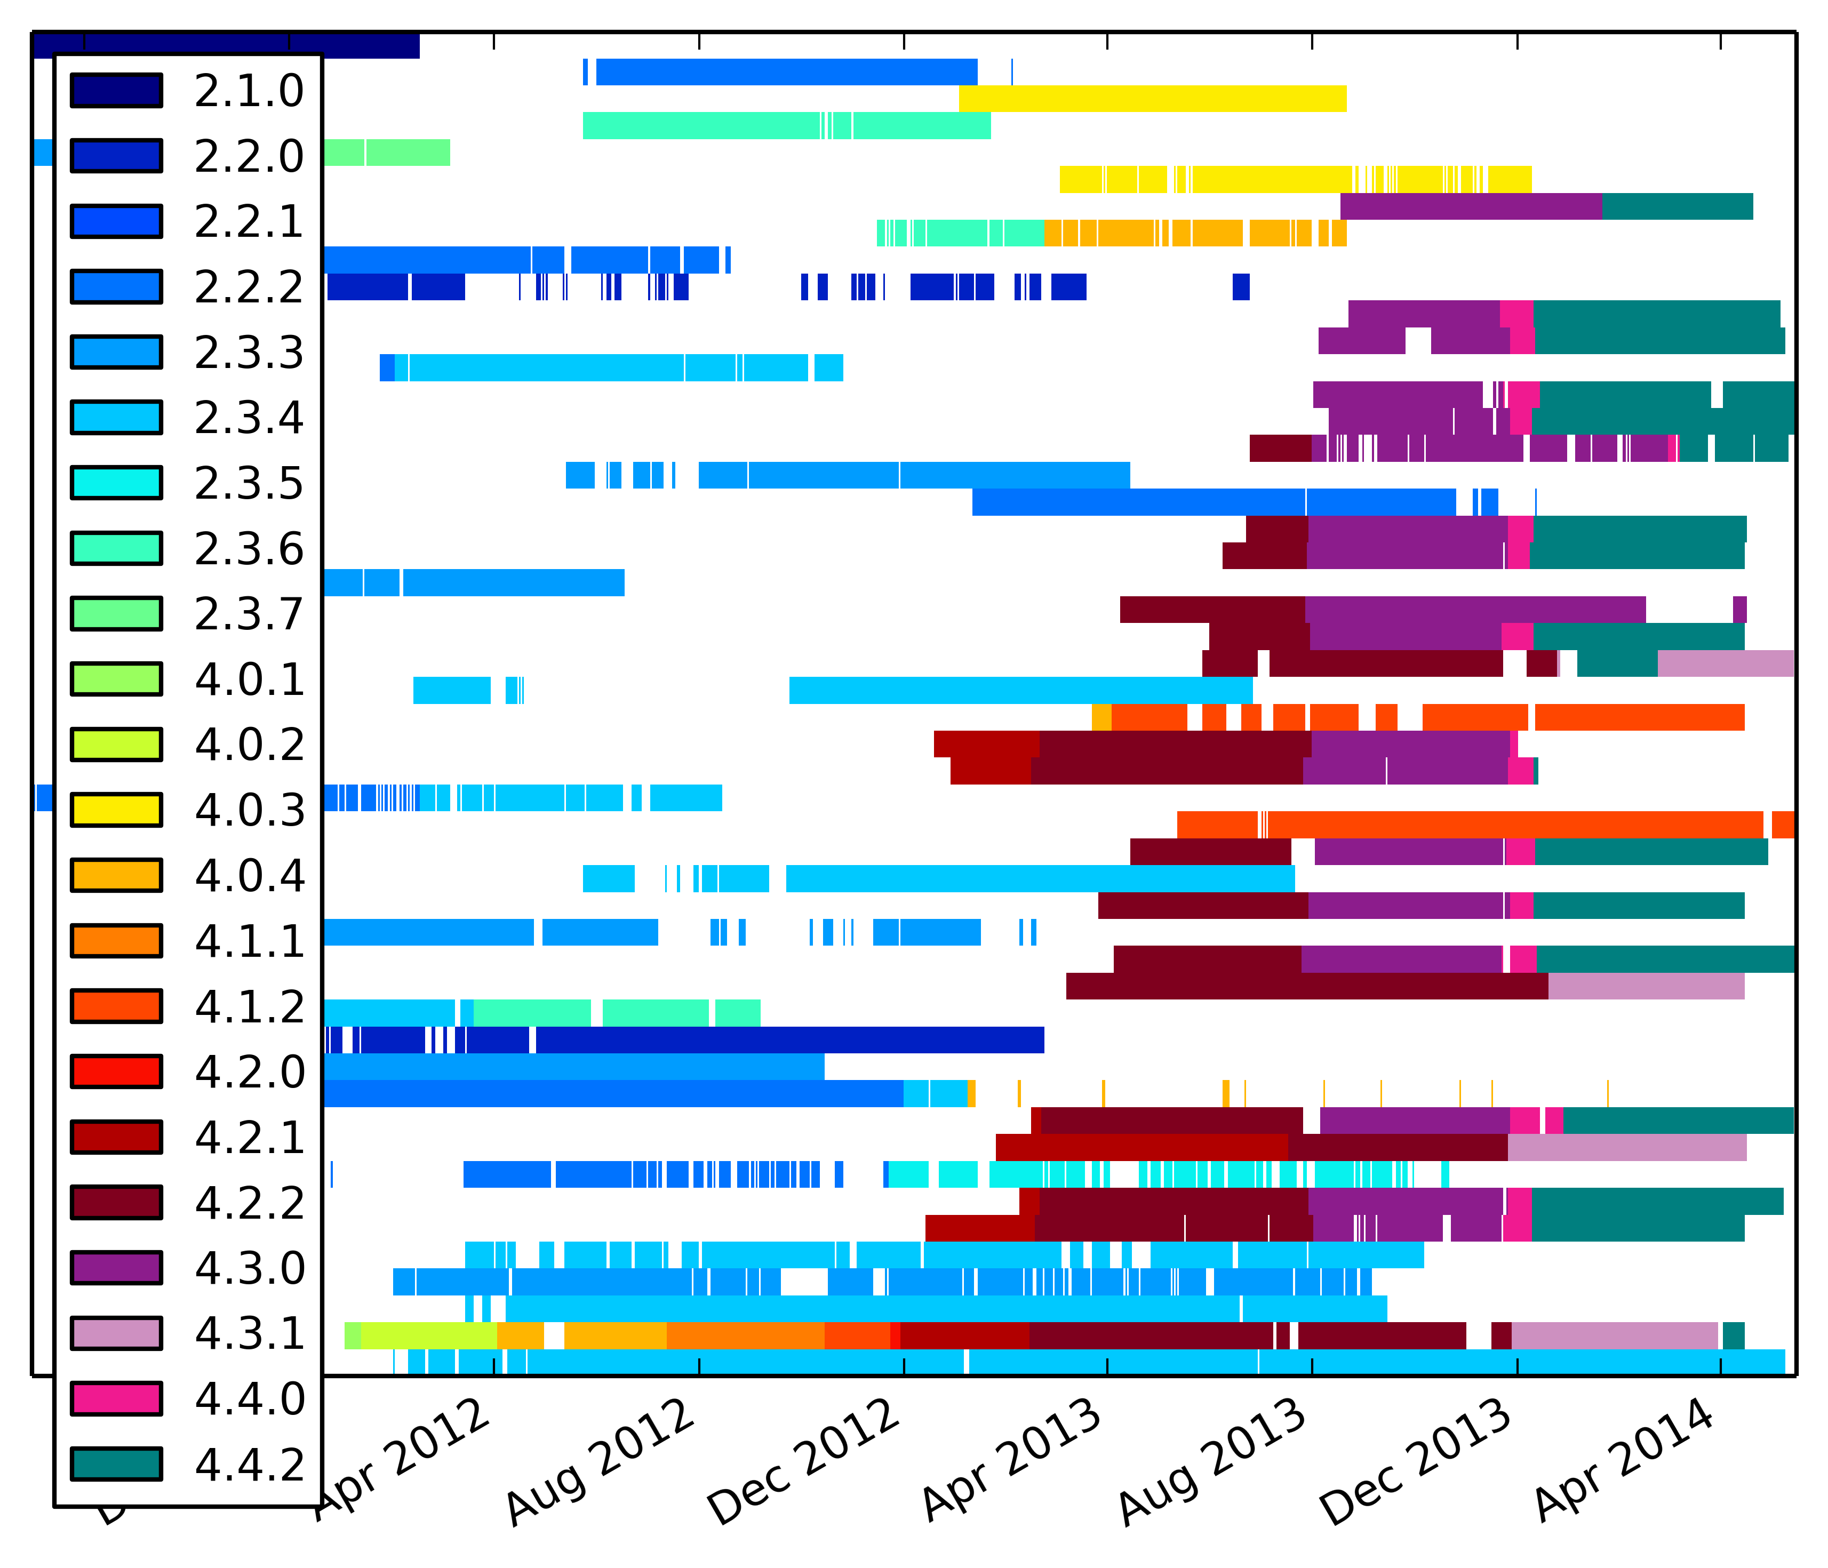
LG updates by OS version

Slide 13
Connecting the two data sets: assume OS version → vulnerability
We have an OS version from Device Analyzer
We have vulnerability data with OS versions
Match on OS and Build Number
  Phone in set of {vulnerable, maybe okay, patched}

Slide 14
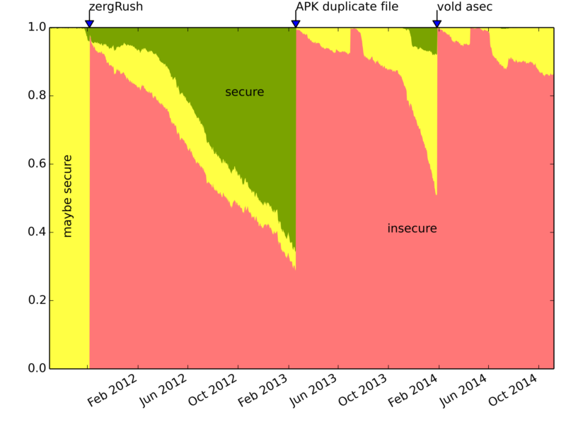
On average, 88% are vulnerable

Slide 15
The FUM metric measure the security of Android devices
Free = The proportion of running devices free from critical vulnerabilities over time
Update = The proportion of devices that run the latest ver- sion of Android shipped to any device produced by that device manufacturer.
Mean = The mean number of outstanding vulnerabilities affecting devices not fixed on any device shipped by the device manufacturer.

Slide 16
FUM Score = ...

Slide 17
[Figure 4 top]

Slide 18
[Figure 4, bottom two]

Slide 19
[Manufacturers table and Nexus number (and non Nexus?)]

Slide 20
Why is fixing vulnerabilities hard: software ecosystem is complex
Division of labour
  Open source software
  Core OS production
  Driver writer
  Device manufacturer
  Retailer
  Customer
Apple and Google have different models
  Hypothesis: Apple's model is more secure

Slide 21
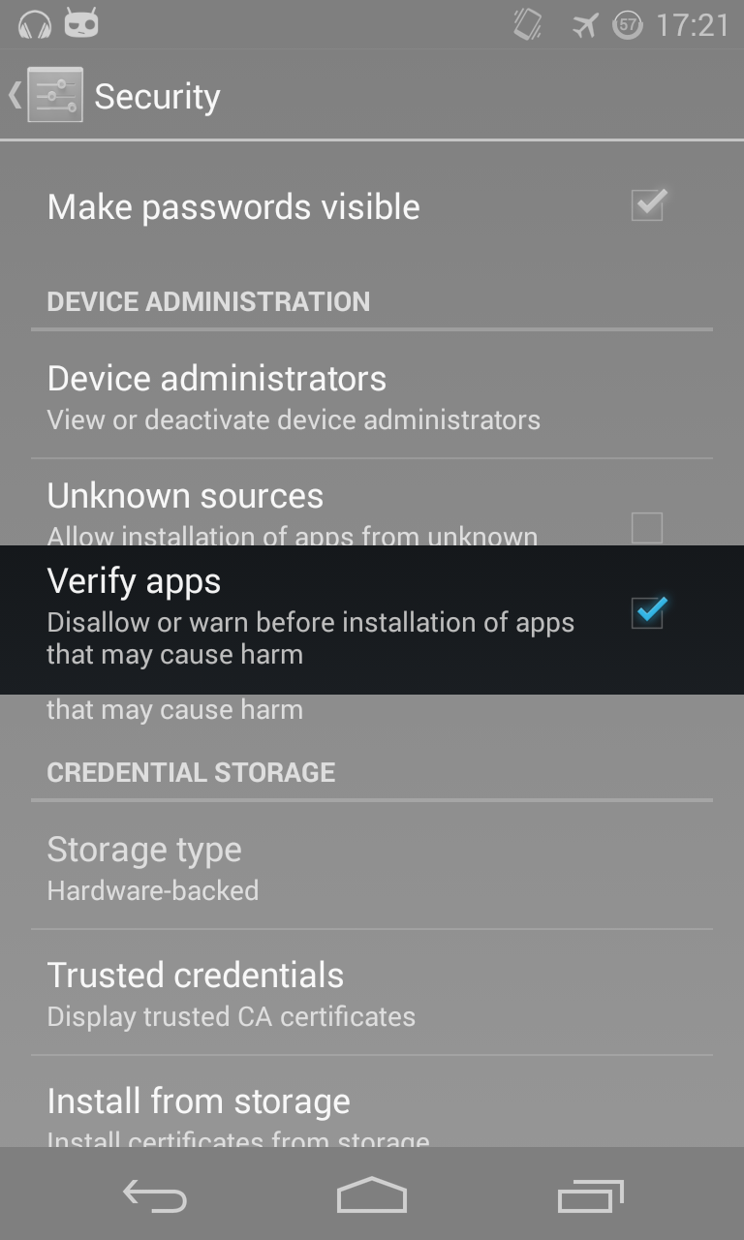
Google to the rescue: Play Store and Verify apps provide security

Slide 22
Conclusions
8x% of Android devices are vulnerable
Ecosystem complex; lack of transparency
FUM metric is a robust measure of security
  A step towards an economic incentive

Slide 23
Smartphone vulnerabilities
Daniel Alastair
Thomas Beresford
University of Cambridge
Firstname.Surname@cl.cam.ac.uk
https://deviceanalyzer.cl.cam.ac.uk
http://androidvulnerabilities.org

Slide 24
Example: Android APK duplicate file
OS does not check for duplicate files in APK
Non-traditional “root-equivalent” exploit
Affected all manufacturers and versions > 1.5
Timeline:
  February 2013: discovered
  February 2013: fixed
  July 2013: Public announcement
Is the responsible disclosure period sufficient to protect users?

Slide 25
Device Analyzer is a good example of Privacy by Design principles
Transparency, consent, notice and disclosure
Purpose
Security
Access to data and withdrawal
Proactive privacy design
Privacy by default

Slide 26
[Is DA representative?]
[Three or four bullet points which summarize Section 6]

Slide 27
[Nexus and non-Nexus devices over time]

