Slide 1


A Selective Preprocessing Offloading Framework for Reducing Data Traffic in DL Training
Meng Wang, Gus Waldspurger,
Swaminathan Sundararaman

Slide 2

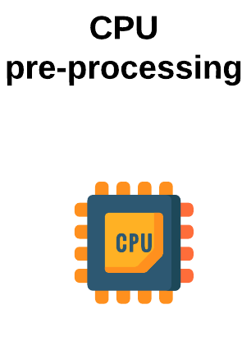
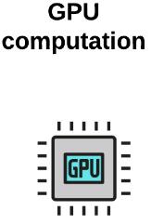
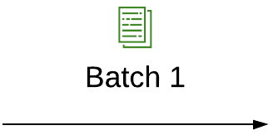
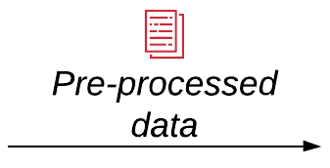

Introduction
Deep Learning (DL) is widely used
Training is important for good accuracy
DL training has intense requirements for storage, CPUs, and GPUs.
(Remote)Storage

Slide 3



Problem Statement
GPUs are becoming increasingly fast!
Training data too large to fit in local storage
For example, OpenImages totals 18TB.
Need to be fetched from remote storage
What if remote data fetch rate < GPU compute rate?
GPU underutilized!
Longer training time!

Slide 4
Existing Solutions
We want to reduce data traffic from remote storage to compute node
Local cache
Selectively cache data in local storage or memory
Can be limited by local storage/memory capacity
Datasets are still increasing in size
Store preprocessed data
Store preprocessed data in remote storage for repeated use
Risks compromising training accuracy
Online preprocessing is important for training accuracy
Data size might even increase after preprocessing

Slide 5
Opportunities in Data Preprocessing
Many samples’ sizes decrease in the middle of preprocessing
Case study: ImageNet classification
1886KB
Smallest!
602KB
602KB
462KB
151KB
151KB
Raw JPEG
Decode
Random
Crop
+ Resize
Random
Flip
ToTensor
Normalize
224x224
1 Byte R/G/B
Int pixel
4 Byte Float pixel

Slide 6
Solution: Preprocessing Offloading
Solution: Selectively offload preprocessing steps to storage side
Offload to near storage
Keep on compute node
1886KB
602KB
602KB
462KB
151KB
151KB
Raw JPEG
Decode
Random
Crop
+ Resize
Random
Flip
ToTensor
Normalize

Slide 7
Challenges in Preprocessing Offloading
Finding 1: NOT all samples can benefit from preprocessing offloading
No offloading
Keep ALL preprocessing on compute node
1769KB
Smallest!
602KB
602KB
151KB
151KB
105KB
Raw JPEG
Decode
Random
Crop
+ Resize
Random
Flip
ToTensor
Normalize

Slide 8
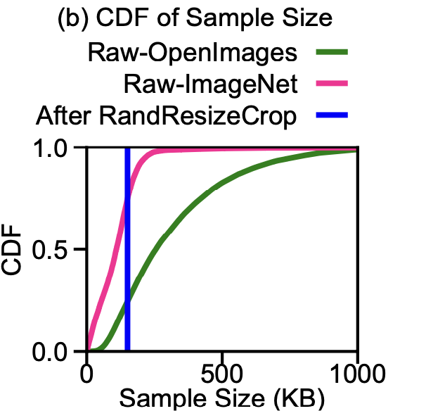
Challenges in Preprocessing Offloading
Finding 2: Different datasets/samples benefit differently from offloading
Case studies:
ImageNet
26% samples can benefit
OpenImages
76% samples can benefit
Larger raw images benefit more
CDF of Sample size

Slide 9
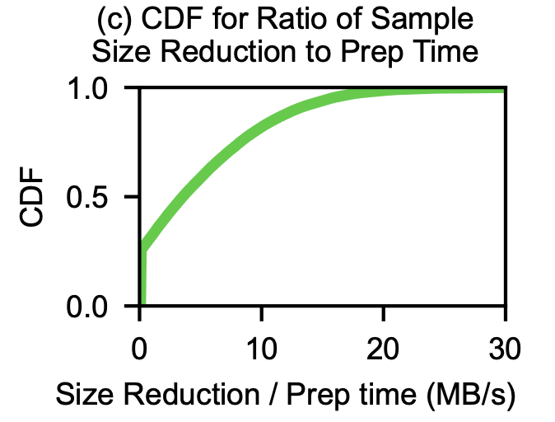
Challenges in Preprocessing Offloading
Finding 3: Offloading introduces CPU overhead to storage node
Storage cluster usually has limited CPU capabilities
Tradeoff between traffic reduction vs. CPU overhead
Offloading efficiency:
Ratio of size reduction to offloaded preprocessing time
Different samples have different offloading efficiency

Slide 10
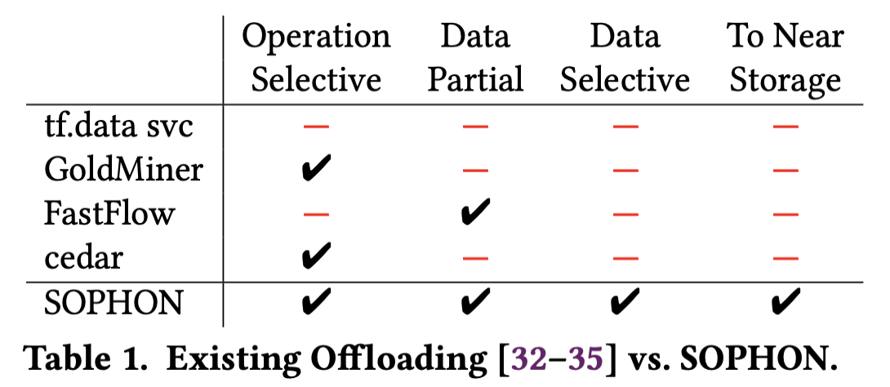
Limitations of Prior Offloading Works
We need a fine-grained, data-selective offloading approach
Data selective: carefully select which samples to offload based on dataset’s characteristics.
Existing preprocessing offloading works
Focuses on CPU bottlenecks
Offload preprocessing to remote CPU workers
Not designed to reduce remote data traffic
NOT data selective
Coarse-grained
Fail to exploit heterogeneous size behavior of samples

Slide 11
Our Solution: SOPHON
SOPHON: Selectively Offloading Preprocessing with Hybrid Operations Near-storage
Per-sample per-operation granularity
First data-selective offloading for DL training
Minimizes remote data traffic
Balances offloaded CPU overhead and traffic reduction

Slide 12
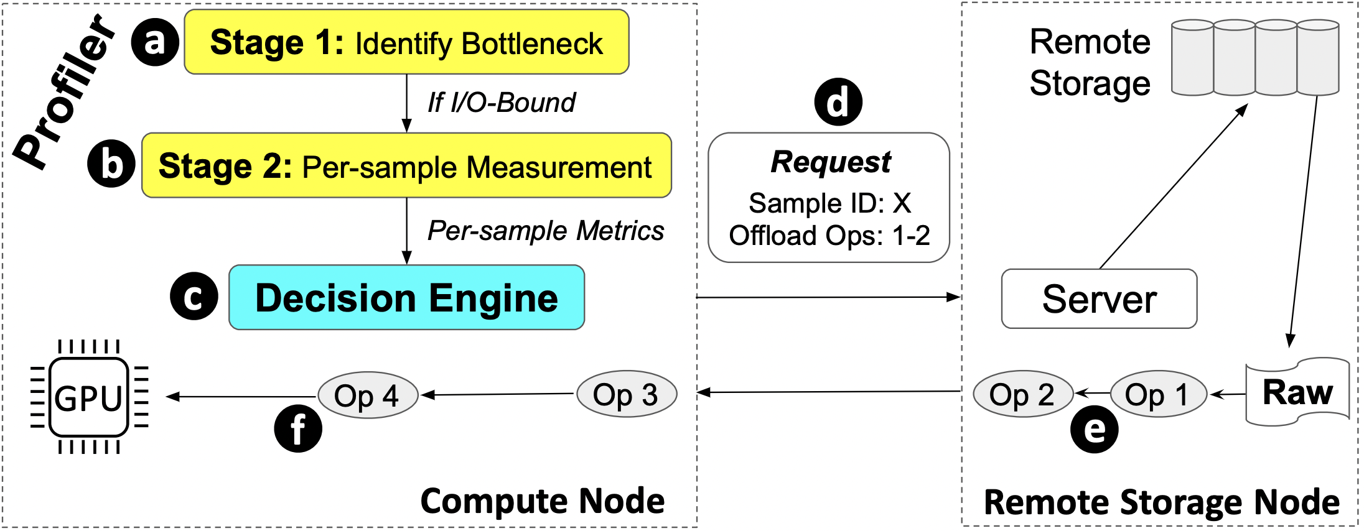
SOPHON Design
Lightweight two-stage profiler
Per-sample offloading decision engine

Slide 13
SOPHON: Two-Stage Profiler
Stage 1: Identify bottlenecks (Inspired by DataStall@VLDB ’21)
Throughput measurement
GPU throughput
I/O throughput
CPU throughput
Proceed only if I/O-bound
Stage 2: Per-sample profiling
Measure time and size per sample per preprocessing step
Online measurement during first epoch without offloading
Assumes homogeneous CPUs

Slide 14
SOPHON: Offloading Policy
Compute offloading efficiency for each sample
Ratio of size reduction to offloaded CPU preprocessing time
Sort samples by offloading efficiency
Prioritize samples with higher offloading efficiency
Pick samples for offloading and update throughput until:
I/O is no longer bottleneck, or
All samples with positive efficiency have been picked
Balances traffic reduction and offloaded CPU overhead

Slide 15
Implementation & Experiment Setup
Implemented on top of PyTorch
Small-scale experiments to mimic real-world scenarios
Two nodes
A GPU (RTX6000) node
A storage node
Benchmarks:
OpenImages (12GB subset)
ImageNet (11GB subset)
Limited bandwidth
Downscaled to 500Mbps
Five offloading policies
No-Off: offload nothing
All-Off: offload everything
FastFlow: designed for CPU bottlenecks
Resize-Off: offload until RandomCropResize
SOPHON

Slide 16
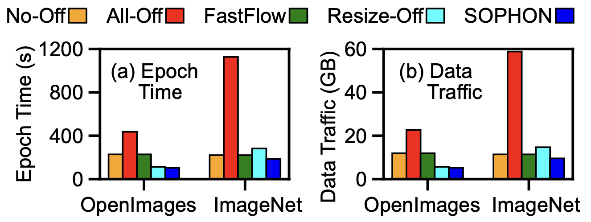
Evaluation: Ample CPUs on Storage
No-Off: Baseline
All-Off: Longest training time
Many samples become larger after all prep
FastFlow: choose to offload nothing
Coarse-grained and detect All-Off is bad
Resize-Off:
2x reduction for OpenImages
1.3x increase for ImageNet
SOPHON:
2.2x reduction for OpenImages
1.2x reduction for ImageNet

Slide 17
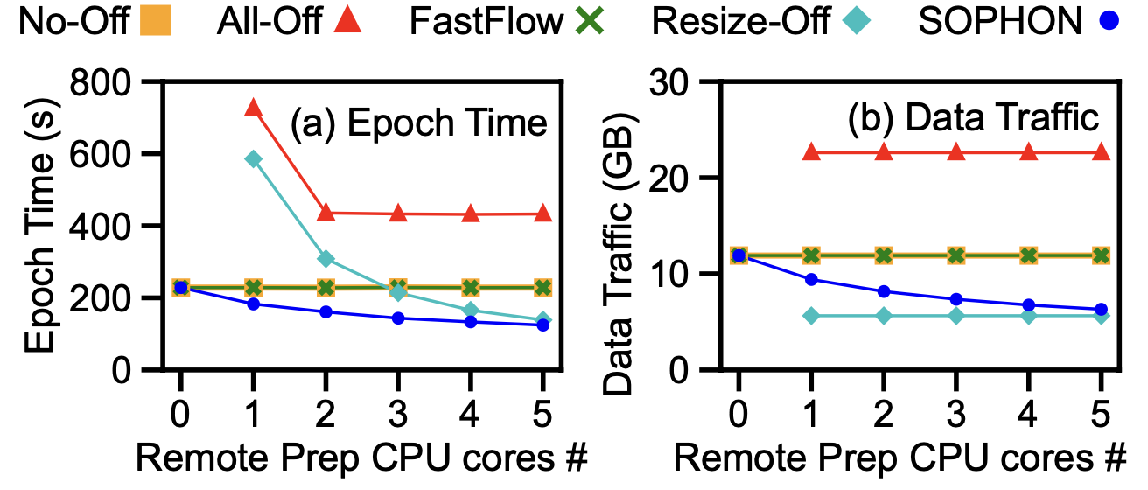
Evaluation: Limited CPUs on Storage
OpenImages
No-Off: Baseline
All-Off: Longest training time
Even longer time when <2 cores due to CPU bottleneck
FastFlow: choose to offload nothing
Resize-Off:
Least traffic BUT longer training time
Can cause CPU bottleneck on storage node
SOPHON:
Least training time

Slide 18
Conclusion & Future Work
SOPHON: Selectively Offloading Preprocessing with Hybrid Operations Near-storage for DL training
Two-stage profiler to collect essential metrics
Per-sample offloading decision engine to balance traffic reduction and CPU overhead
Future work:
Selectively compress preprocessed data
Extend support to heterogeneous CPUs
Study more DL workloads
Conduct more realistic evalutions

Slide 19
Thanks! Q&A

