Slide 1







Heimdall: Optimizing Storage I/O Admission with Extensive Machine Learning Pipeline
Daniar H. Kurniawan, Rani Ayu Putri, Peiran Qin,
Kahfi S. Zulkifli, Ray A. O. Sinurat, Janki Bhimani,
Sandeep Madireddy, Achmad Imam Kistijantoro,
Haryadi S. Gunawi

Slide 2















So why, sometimes it’s fast, sometimes it’s slow?

Slide 3


SSD is Unpredictable
GC
Garbage Collection (GC)
Buffer flush
Write amplification
Invisible to Host!

Slide 4

SSD is Unpredictable
100us
☺
I/O
GC
10ms
slower due to GC
Garbage Collection (GC)
SSDs Read Latency
Buffer flush
p80
p60
p40
p20
Write amplification
Long tails
CDF
better
worse
Invisible to Host!
0 5 10 15 20 25
Latency (ms)

Slide 5
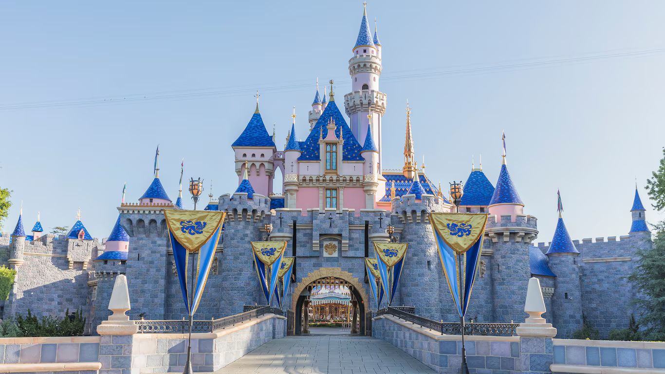
Heimdall: ML-for-I/O admission controller

Slide 6

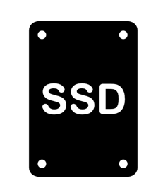


Heimdall: ML-for-I/O admission controller
Which one will make me happier?
App
1
I/O attempt
...
Predict
I/O latency
Predict
waiting time
Slow I/O? Revoke!
2
3
4
I/O re-route

Slide 7
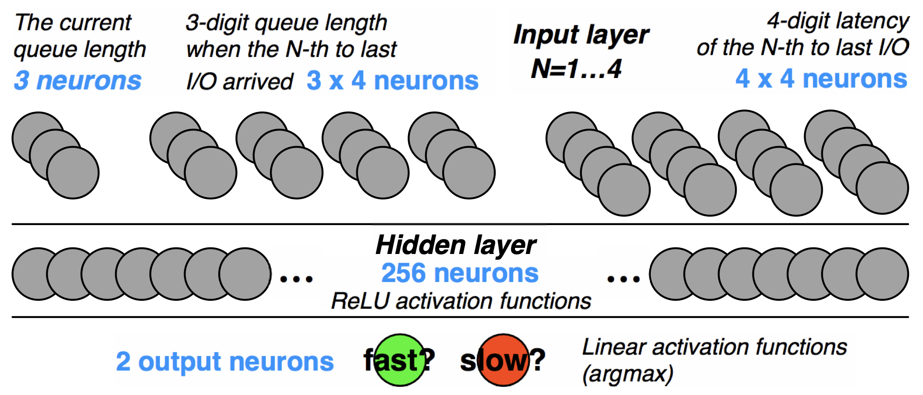
Prior Works
What’s wrong?
Random
Cloning
Hedging (speculative)
Kwiken [SIGCOMM’13]
Replica scoring and rate-limiting
Heron [SRDS’18]
AMS [TCC’23]
OnOff [J. Parallel Distrib. Comput.’23]
L2 [IS’19]
C3 [NSDI’15]
PriorityMeister [SoCC’14]
Aequitas [SIGCOMM’22]
Forecasting and rate controlling
PSLO [EuroSys’19]
TAP [CCPE’19]
ML-based
LinnOS [OSDI’20], LAKE [ASPLOS’23]
Alibaba, MSR, Tencent

Slide 8
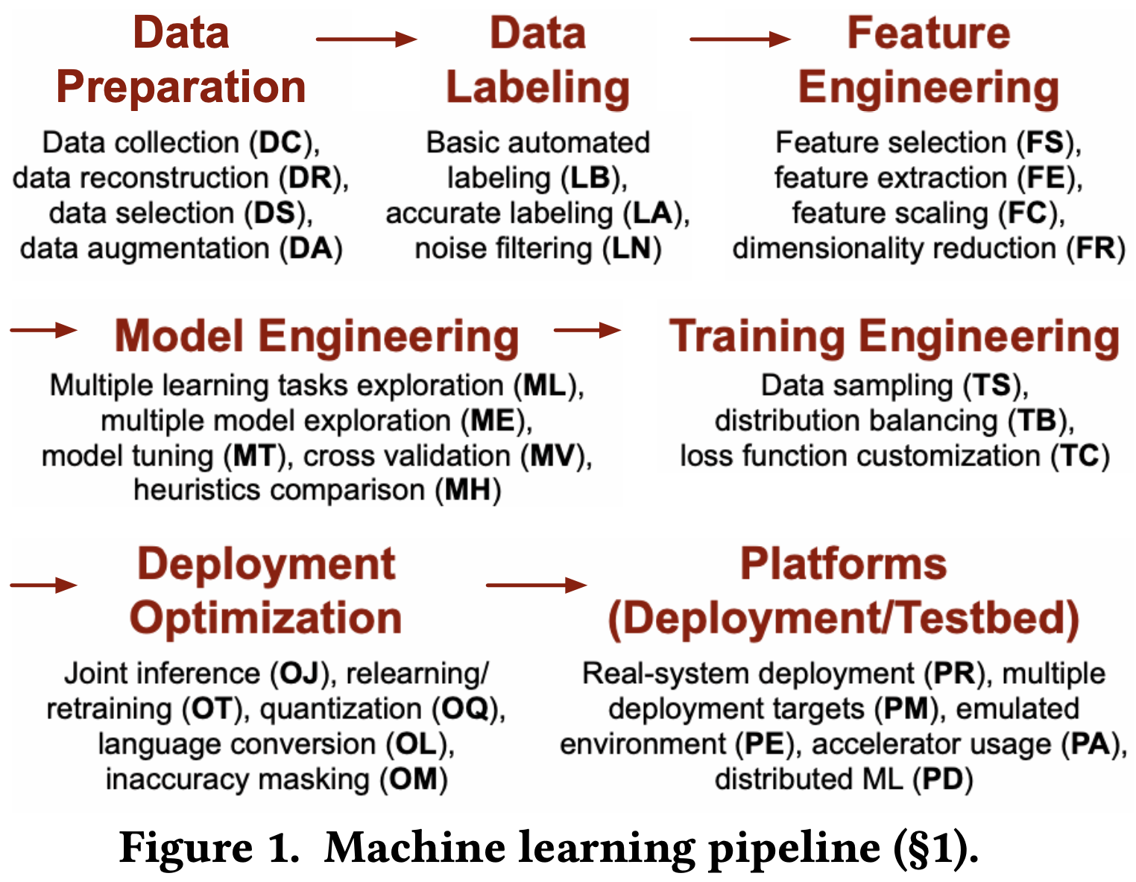
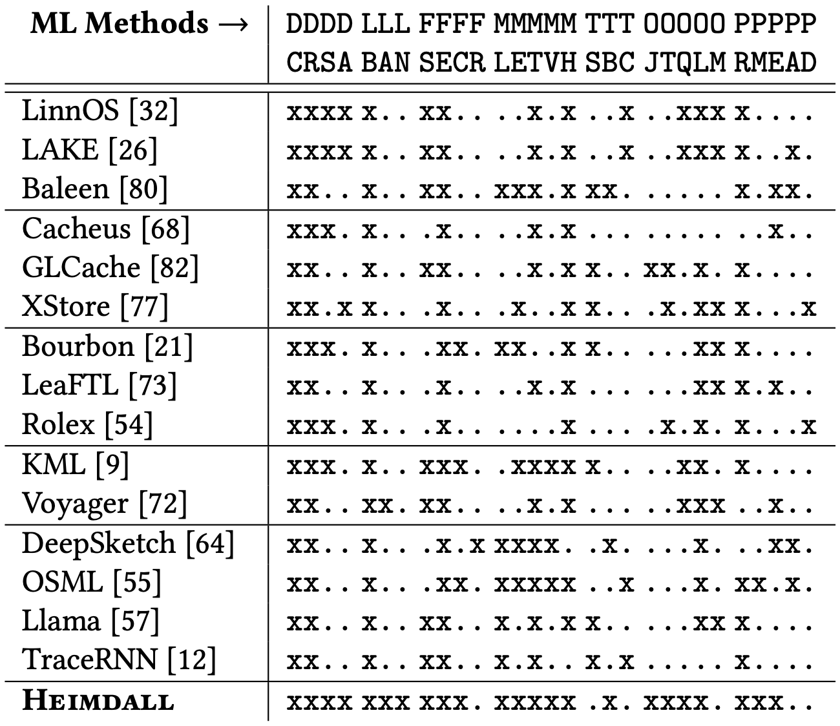
What’s Wrong?
The pipeline is LONG!
Mostly focus on feature & model engineering!
Can exploring other stages help?

Slide 9
Heimdall: The Quest for Tail-free SSDs!
NoGC(perfect)
Room for improvement
Design Principles
Accurate prediction
Light and efficient (deployable!)
GC

Slide 10
Heimdall: The Quest for Tail-free SSDs!
7mIOPS
I/O admission per second
10x
More efficient than GPU batching
15-35%
Lower average I/O latency
4x
Faster inference throughput
How Heimdall achieve this?

Slide 11
Heimdall: Accurate Labeling
Prior works use cutoff-based method on uniform-sized I/Os.
Seer [ASPLOS ‘19], LinnOS [OSDI ’20], Sage [ASPLOS ‘21],
Prophet [ASPLOS ‘17], Laedge [NSDI ‘21]
I/O
Uniform Page Size
…
I/O
I/O
I/O
I/O
I/O
Too many inference (overhead)

Slide 12
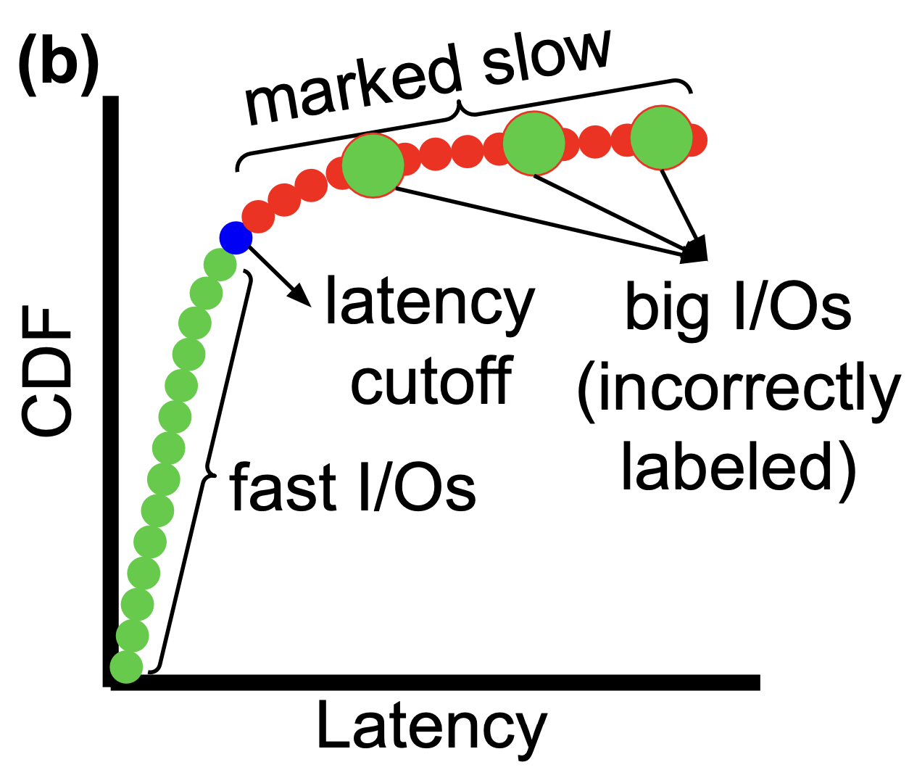
Heimdall: Accurate Labeling
Prior works use cutoff-based method on uniform-sized I/Os.
Seer [ASPLOS ‘19], LinnOS [OSDI ’20], Sage [ASPLOS ‘21],
Prophet [ASPLOS ‘17], Laedge [NSDI ‘21]
Big I/Os will always be slow anyway!
Inaccurate due to I/O size variations

Slide 13
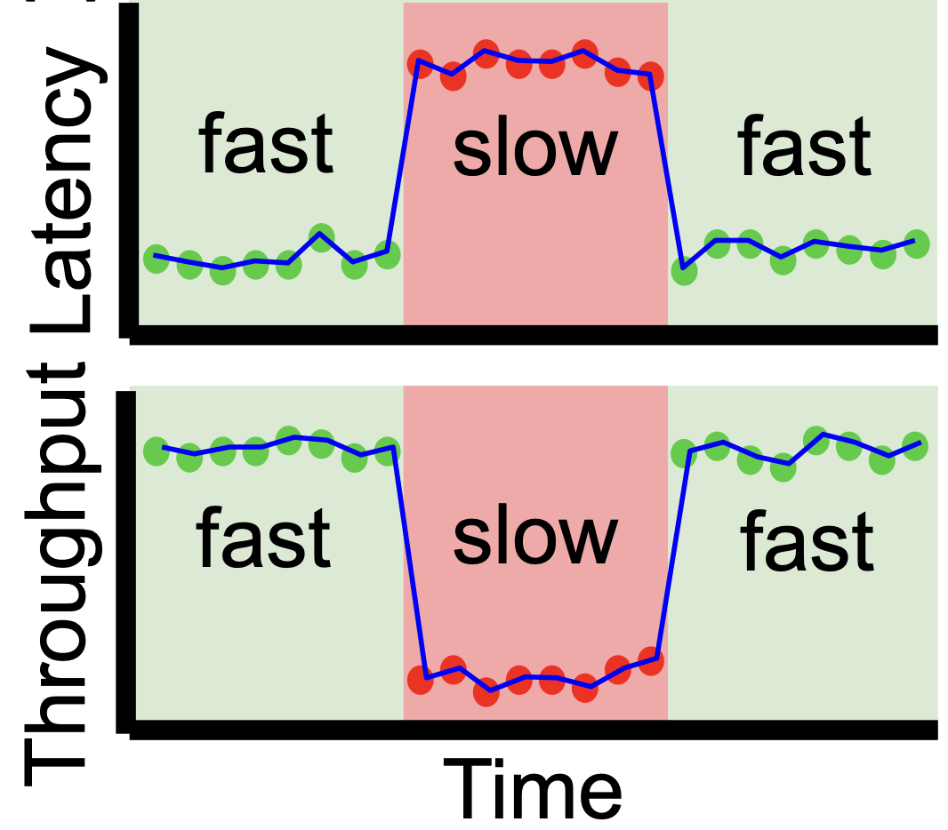
Heimdall: Accurate Labeling
Prior works use cutoff-based method on uniform-sized I/Os.
Heimdall uses period-based labeling
Seer [ASPLOS ‘19], LinnOS [OSDI ’20], Sage [ASPLOS ‘21],
Prophet [ASPLOS ‘17], Laedge [NSDI ‘21]
Latency spike
=
Slow period
Big I/Os will always be slow anyway!
☺
More accurate and dynamic!
Inaccurate due to I/O size variations

Slide 14
Heimdall: Accurate Labeling
Expectation…
Stable

Slide 15
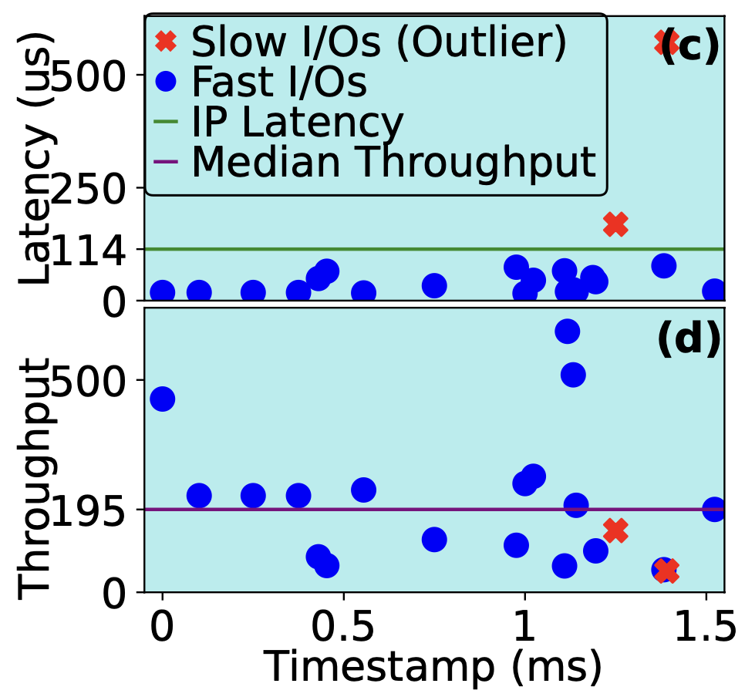
Heimdall: Accurate Labeling
Expectation…
In reality…
Stable
Outliers!
Outliers within the slow period
Outliers within the fast period
Short noises
Period-based method
+ Noise filtering

Slide 16
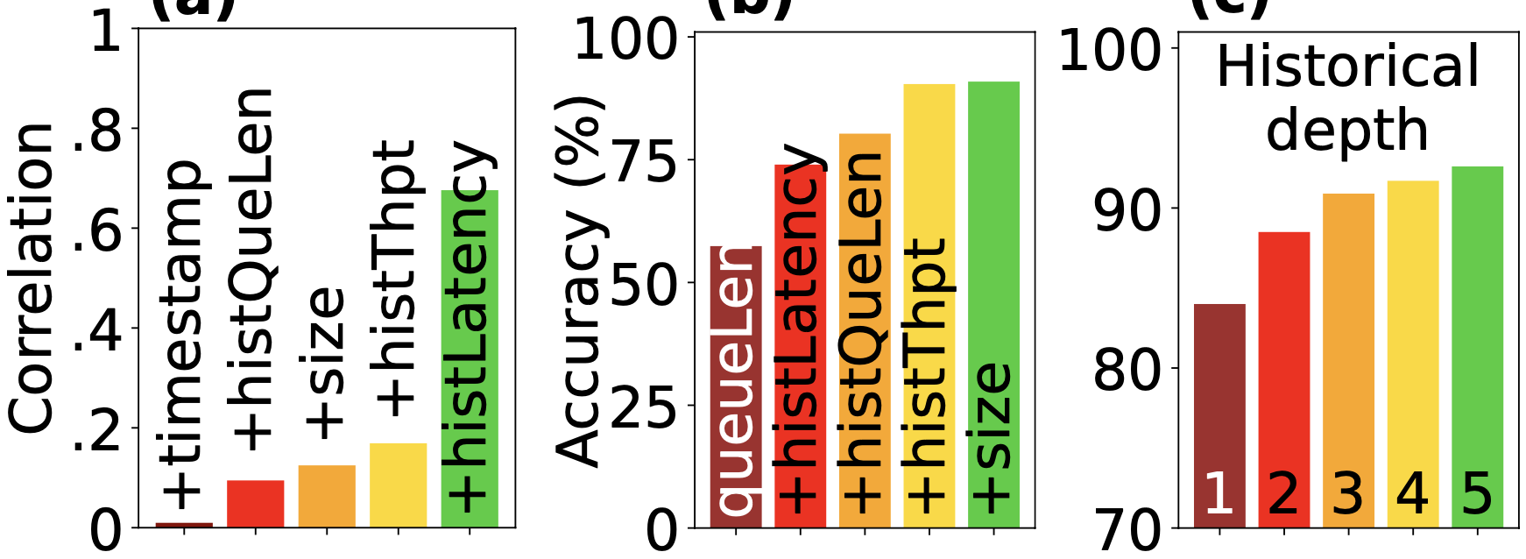
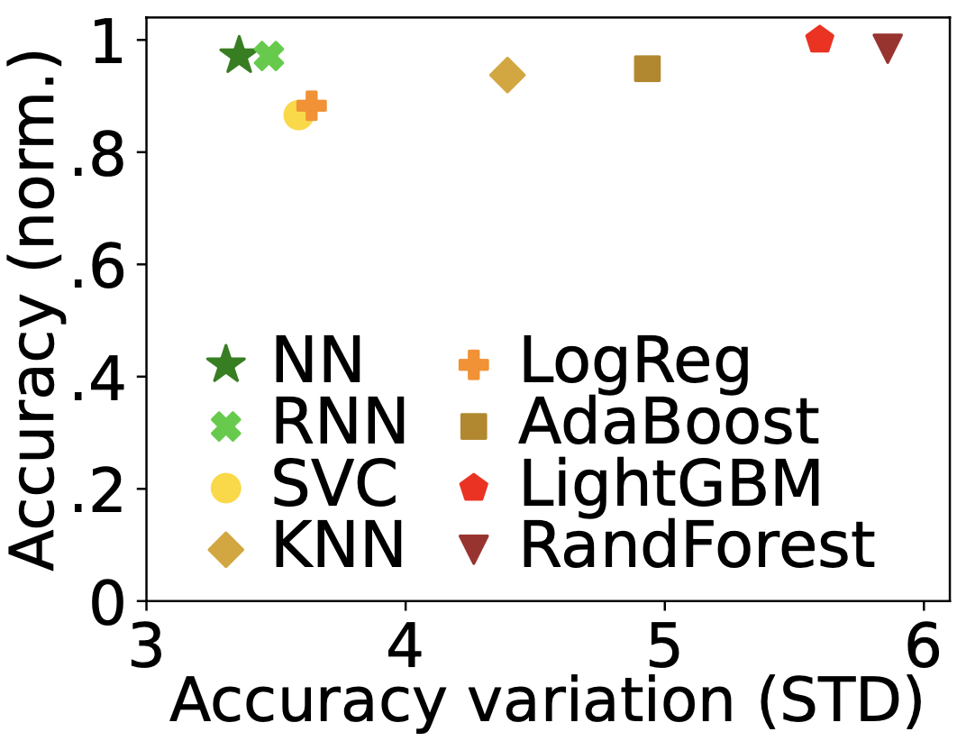
Heimdall: Holistic Pipeline Exploration
Three is good
Neural Network (NN) is better
Four main features :
Historical data is needed
● Queue length ● I/O size
● Latency ● Throughput

Slide 17
Heimdall: Holistic Pipeline Exploration
Three is good
Neural Network (NN) is better
Four main features :
Historical data is needed
● Queue length ● I/O size
● Latency ● Throughput
There are 11 final features:
Current I/O Size
Current Queue Length
1 Previous Queue Length
1 Previous Latency
1 Previous Throughput
2 Previous Queue Length
2 Previous Latency
2 Previous Throughput
3 Previous Queue Length
3 Previous Latency
3 Previous Throughput

Slide 18
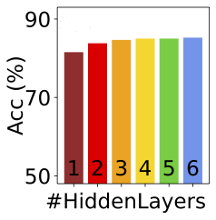
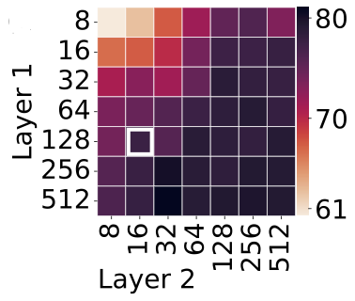
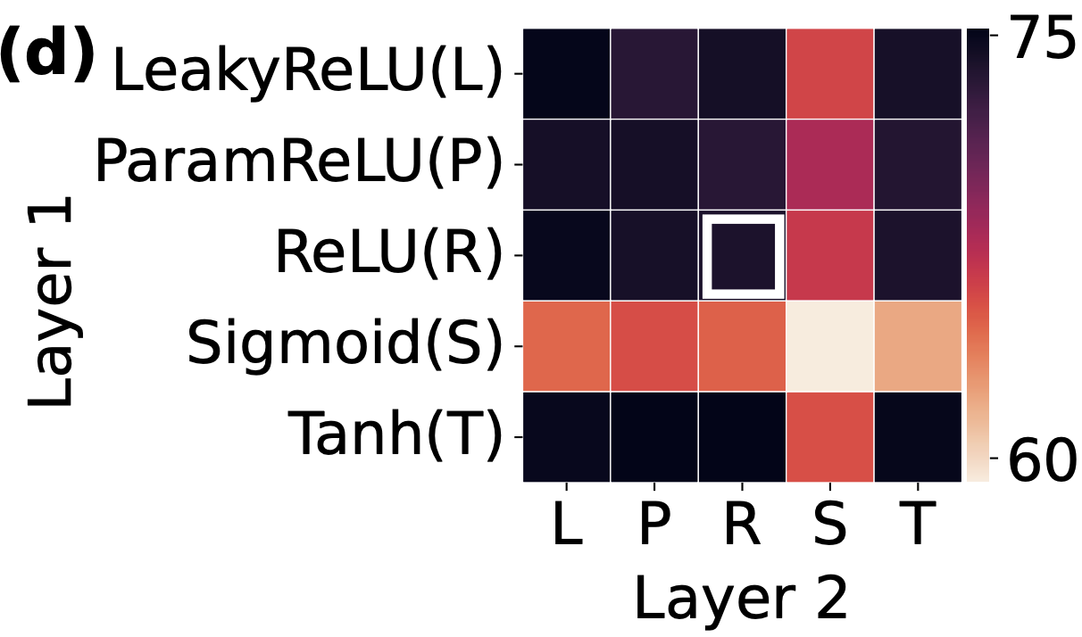
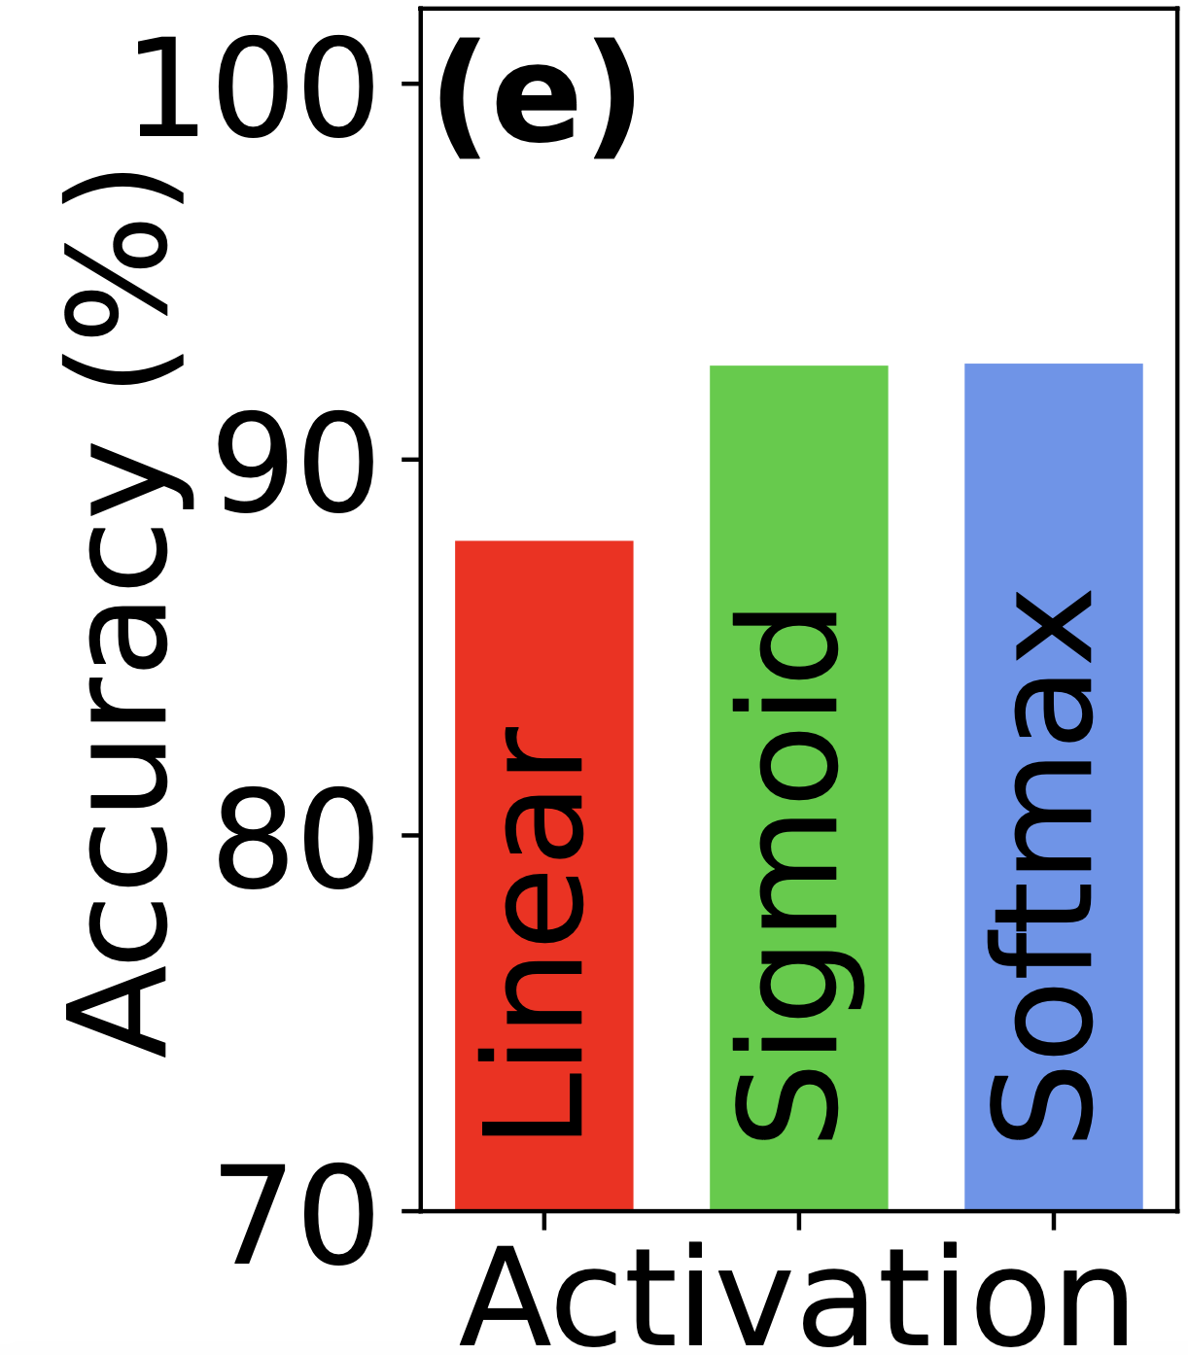
Heimdall: Holistic Pipeline Exploration
Two hidden layers :
128 and 16 neurons with
ReLU activation functions.
Output: Sigmoid neuron

Slide 19
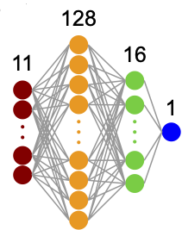
Heimdall: Holistic Pipeline Exploration
Two hidden layers :
128 and 16 neurons with
ReLU activation functions.
Output: Sigmoid neuron
Input
Features
0 = Accept
1 = Reject (re-route)
I/O

Slide 20
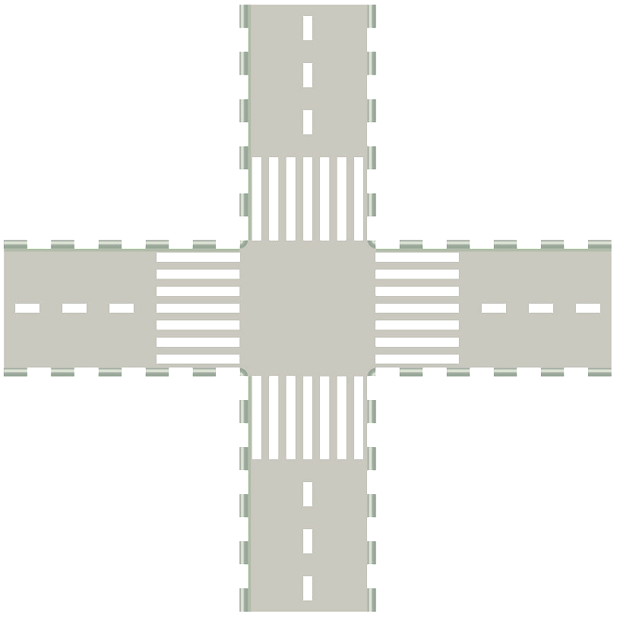


Heimdall: Joint Inference
Go at green light
“Traffic-light” admission

Slide 21
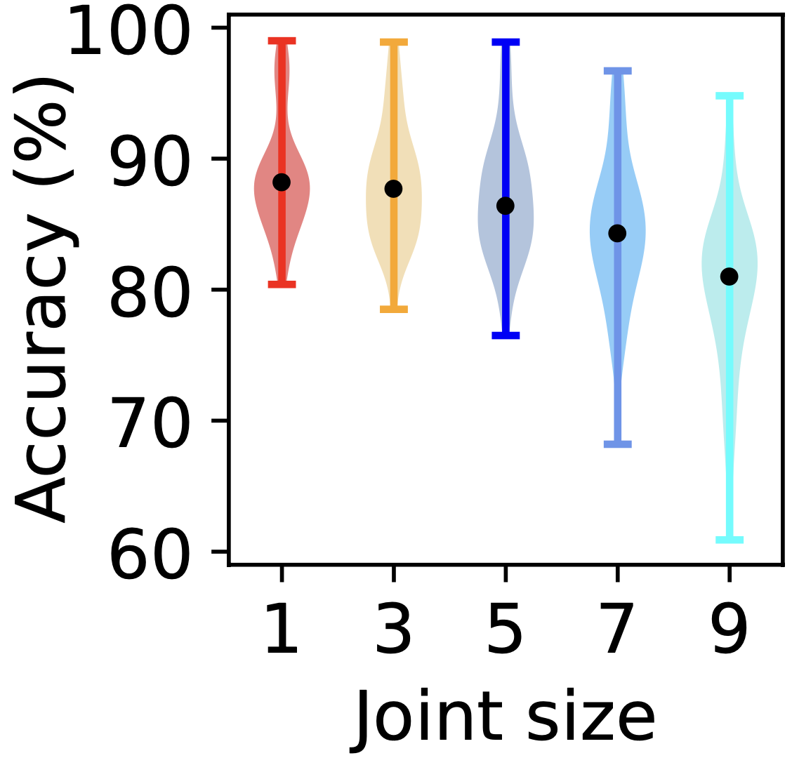
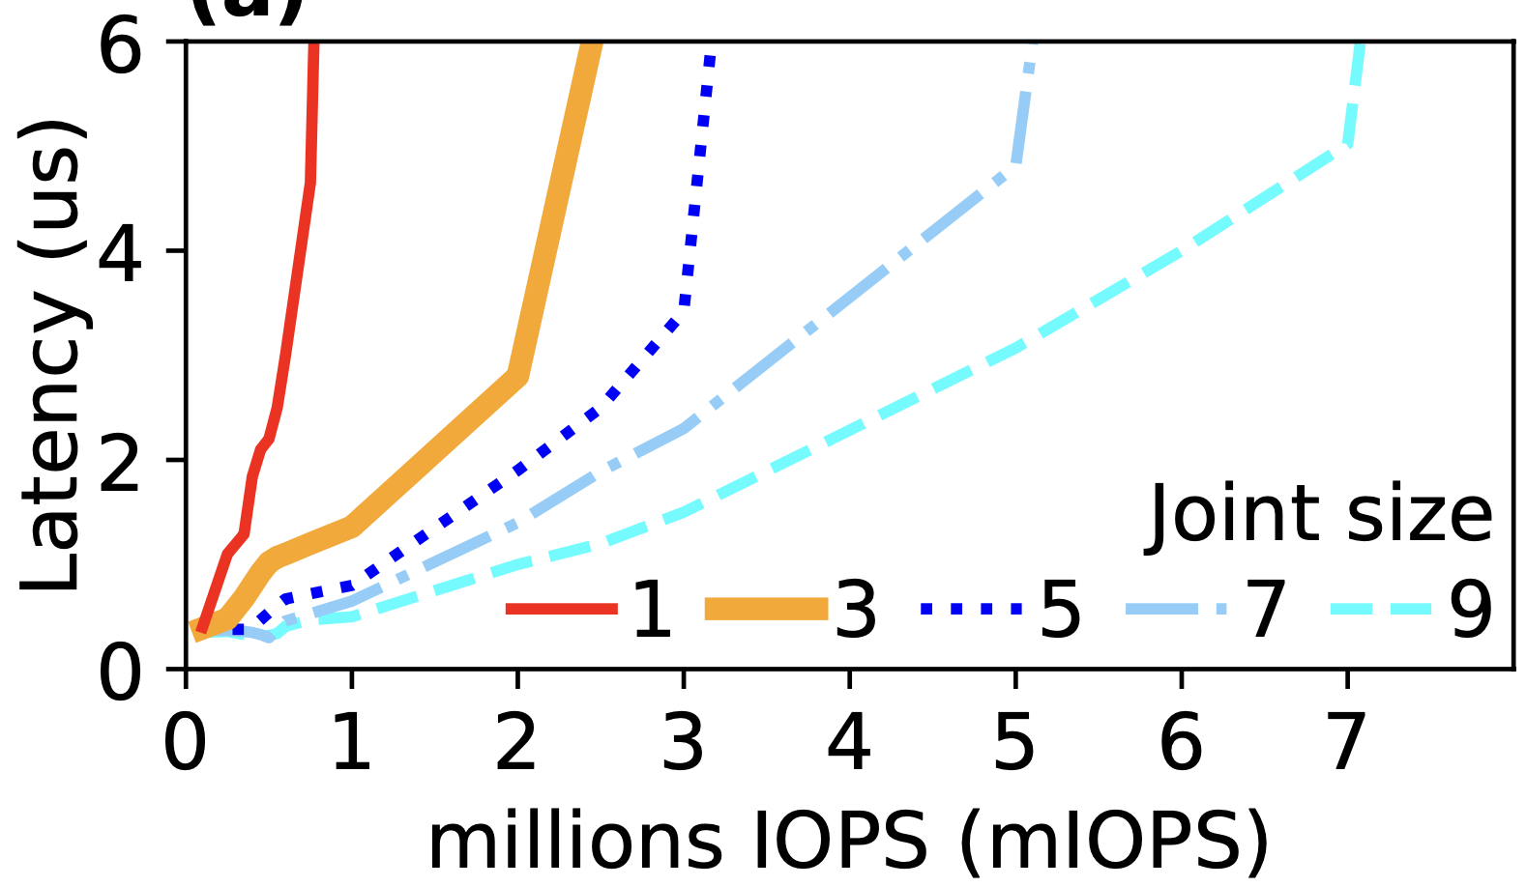
Heimdall: Joint Inference
=
read I/O
Go at green light
Make one inference on behalf of multiple I/Os
Throughput up to 7M I/O admissions per second on single-core CPU
“Traffic-light” admission

Slide 22
Heimdall: Evaluation Setup
Alibaba, MSR, Tencent Block I/O traces
Production traces
Trace file
C++ Clients
Trace file
I/Os
I/Os
Major metric:
Latencies of read I/Os
C++ Clients
Ceph
Linux Kernel
#1
#2
#3
Methods compared:
1. Baseline
2. Random
3. C3 [NSDI ‘15]
Heron [SRDS’18]
AMS [TC’23]
4. LinnOS [OSDI ‘20]
5. LinnOS + Hedging p98
I/Os
I/Os
I/Os
I/Os
I/Os
I/Os
Can reroute
Can reroute
Can reroute

Slide 23
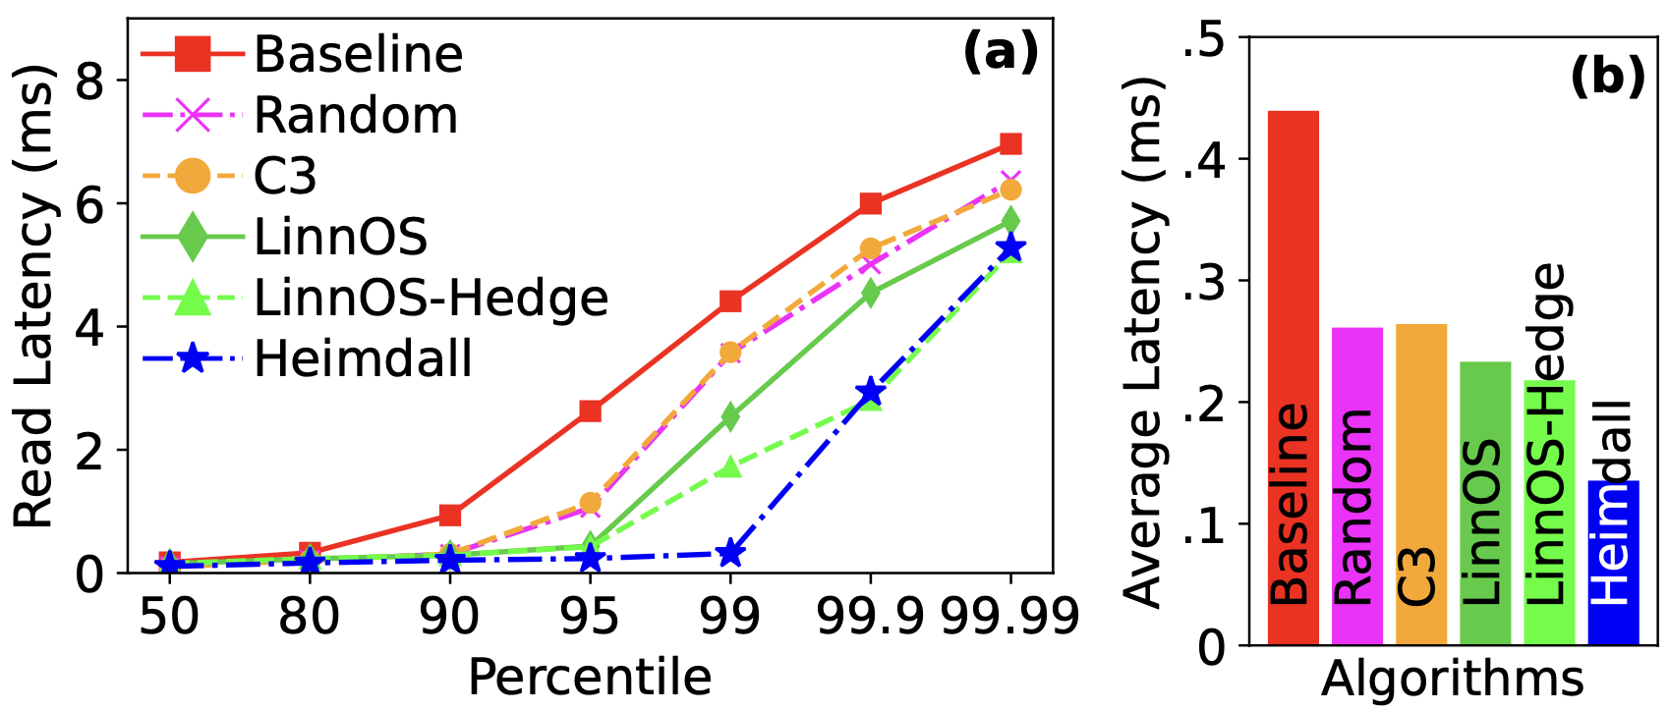
Heimdall: #3. Kernel Eval
Deployment: On Linux Block I/O layer.
Heimdall cuts tail the most!
☺
Heimdall gives the best average latency!

Slide 24
Heimdall Summary
Robust I/O Admission and Redirection for achieving predictability on “unpredictable” SSDs
Accurate labeling algorithm
Holistic data science exploration
Joint-inference for deployment optimization
Accept
or
Reject
??
7mIOPS
I/O admission per second
10x
More efficient than GPU batching
15-35%
Lower average I/O latency
4x
Faster inference throughput

Slide 25
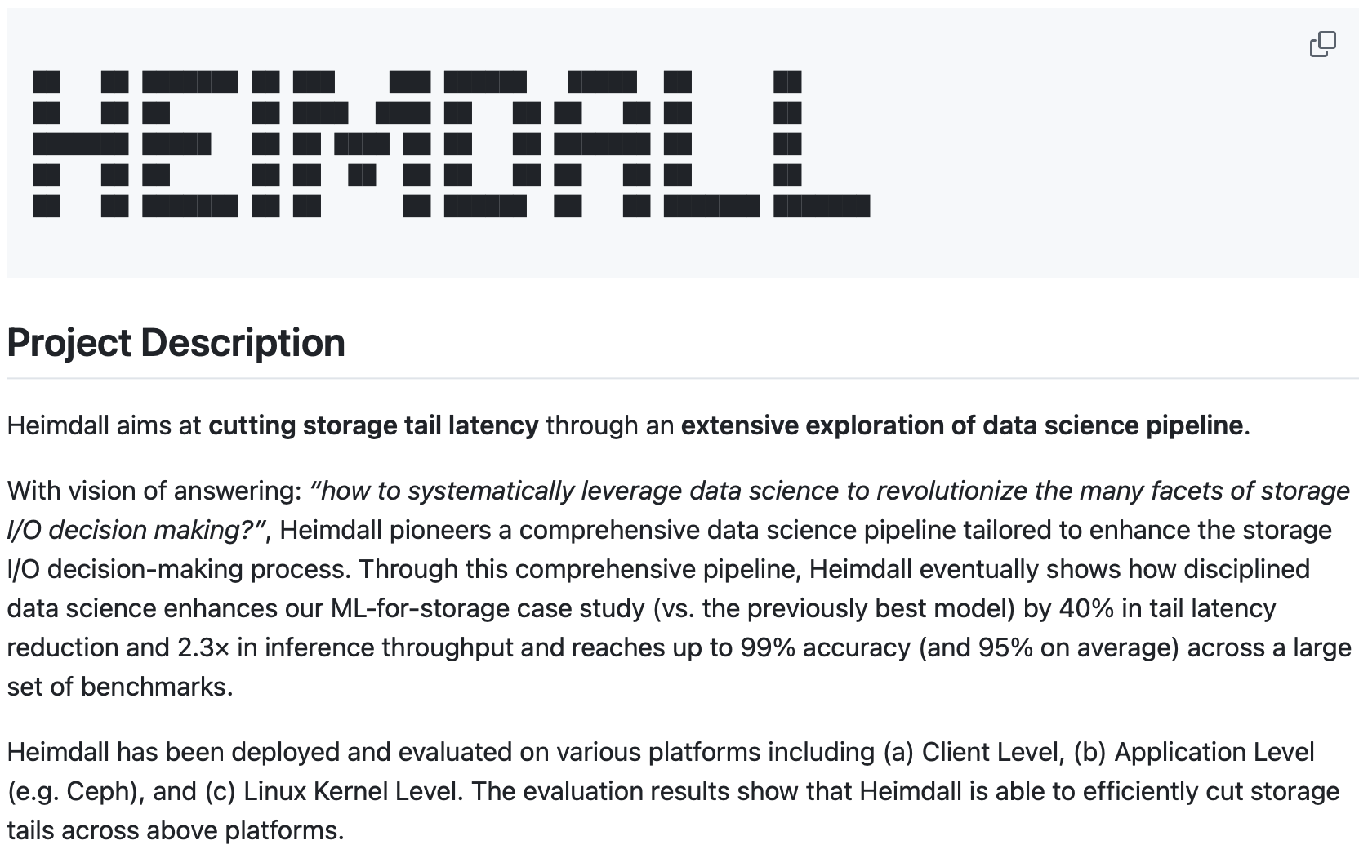
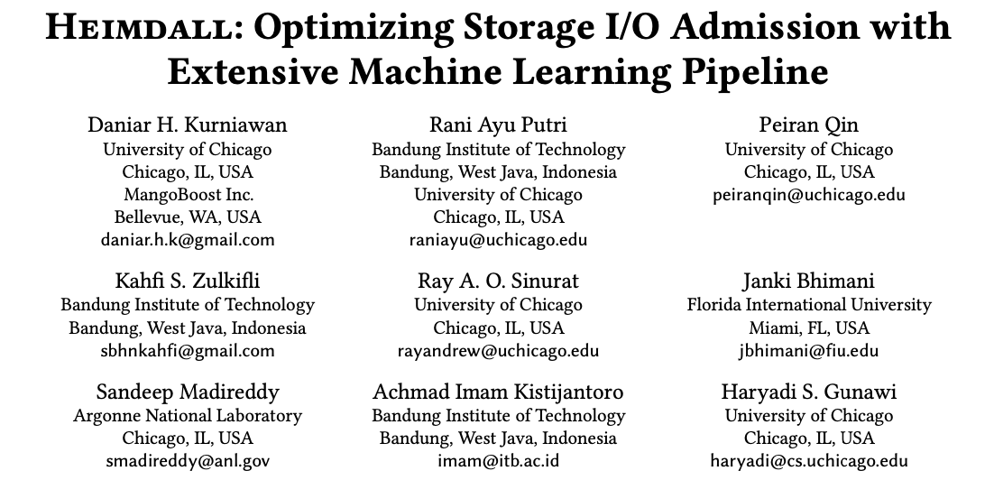
More in the Paper!
https://github.com/ucare-uchicago/Heimdall

Slide 26

Heimdall: Optimizing Storage I/O Admission with Extensive Machine Learning Pipeline
Thank You!

