Slide 1




CNT: Semi-Automatic Translation from CWL to Nextflow for Genomics Workflows
Martin L. Putra*, In Kee Kim†,
Haryadi S. Gunawi*, Robert L. Grossman*
†
*
Notes:
[30 secs] [0-30]
Hello everyone. I am Martin Putra. In this talk I will present CNT, a tool to semi-automatically translate CWL, a popular workflow language used in many production systems, to Nextflow, a continuously growing one with attractive support for parallelization. This is a joint work with In Kee Kim from the University of Georgia, Haryadi Gunawi, and Robert Grossman from the University of Chicago.

Slide 2
Two popular workflow languages
CWL
Used in many production-grade genomics workflows.
Has been around longer, wider user base
Decoupled from any workflow engine.
Nextflow
Rising in popularity
Coupled with its own workflow engine.
Native supports for parallel workflow execution.
Notes:
[45 secs] [30-1:15]
<CLICK>
Many production-grade genomics workflows have been developed using the CWL. For example, the National Cancer Institute’s Genomics Data Commons harmonized a tremendous amount of genomics data using workflows written in CWL.
<CLICK>
Yet the CWL as a language is decoupled from its workflow execution engine, which might or might not support parallel workflow execution.
<CLICK>
<CLICK>
On the other hand, Nextflow is a language which is rising in popularity,
<CLICK>
has its own execution engine,
<CLICK>
and it natively supports parallel execution. This, and several other reasons, makes Nextflow an attractive option for production-grade systems.
And by parallel workflow execution, we mean the following:
<CLICK>

Slide 3
Parallel Workflow Execution
2
1
3
5
₄
Can be executed concurrently.
Sequential Workflow Execution
1
3
2
4
₅
Order of {2, 3, 4} might vary
depending on workflow engine.
Notes:
[30 secs] [1:15-1:45]
Here we show two Directed Acyclic Graphs, or in short, DAG. We say a workflow engine is capable of parallel execution if, for the DAG at the top,
<CLICK>
it can executes steps 2, 3, and 4 simultaneously given enough resources. In contrast, a sequential workflow engine can only execute them one by one, where the order is decided by the workflow engine.

Slide 4






Let’s use Nextflow
Production system using CWL
Uhh .. Sure
Manual Translation
Dataflow programming model
Nextflow syntax & operators
Javascript ←→ Groovy
Automate?
Notes:
Then, what if an institution that uses a lot of CWL workflows in its production system wants to migrate to Nextflow?
<CLICK>
Manually translating CWL to Nextflow requires tremendous effort for at least three reasons.
<CLICK>
First, it requires the developers to be familiar with the dataflow programming model used by Nextflow.
<CLICK>
Second, developers need to learn Nextflow’s syntax and operators in order to utilize the dataflow programming model efficiently.
<CLICK>
Finally, while both CWL and Nextflow supports scripting language, CWL uses Javascript, while Nextflow uses Groovy. This means another learning curve for developers.
<CLICK>
A natural question which might arises is: can we automate this process?

Slide 5
The Need for Automatic Translator
Manual translation is time-consuming and requires domain-specific expertise.
No existing tools for automatic translation.
We propose CNT, the first semi-automatic translator from CWL to Nextflow.
Notes:
To the best of our knowledge, there is no existing tools for automatic translation, while manual translation, as have been mentioned, is time consuming and requires domain-specific expertise.
To solve this problem, we built CNT.

Slide 6


Let’s use Nextflow
Production system using CWL
Oh, sure!
Our solution: CNT
Cwl-to-Nextflow Translator
Tool & workflow-level translation
Partially handle JavaScript
Automate?
Notes:
[20 secs]
<CLICK>
<CLICK>
<CLICK>
CNT is a python-based semi-automatic translator for genomics workflows.
<CLICK>
CNT can perform the heavy-lifting of both tool & workflow-level translation.
<CLICK>
<CLICK>
Furthermore, it can also partially handle JavaScript expressions.

Slide 7
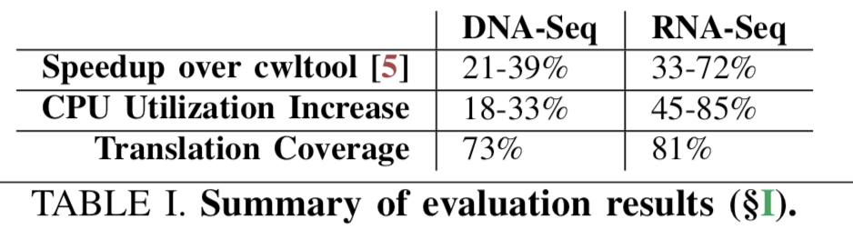
CNT
High similarity
High coverage
High performance gain*
*Evaluated against a sequential workflow engine.
Notes:
[35 secs]
<CLICK>
Workflows translated by CNT has a high similarity with the original one.
<CLICK>
CNT also has a high translation coverage, which in our experience, directly results in reduction of development time.
<CLICK>
<CLICK>
And finally, adopting CNT to migrate a system which initially uses a sequential workflow engine, such as cwltool, can results in tremendous speedup and increase of CPU utilization. We believe this is especially useful for organizations which regularly process huge amount of data.

Slide 8
Outline
Challenges
Fully Automatic Translation
Semi-automatic Translation
Evaluation
Conclusion
Notes:
This will be the outline for the rest of my talk.
<CLICK>
First, I will describe the challenges that need to be addressed by a translation tool such as CNT.
<CLICK>
Then, I will describe how CNT performs automated translation.
<CLICK>
Following that, I will discuss the semi-automatic part required by CNT.
<CLICK>
Last, I will present the evaluation results for CNT.
<CLICK>
And finally I will conclude.

Slide 9
Outline
Challenges
Fully Automatic Translation
Semi-automatic Translation
Evaluation
Conclusion
Notes:
Now we discuss the challenges.

Slide 10
Workflow as DAG
2
1
3
5
₄
Analysis Step
Flow of data
Notes:
We start with the notion of workflow. As everyone already knows, a workflow can be represented as a DAG,
<CLICK>
where a vertex represents a step
<CLICK>
and an edge represents flow of data.
This workflow can be written in both CWL and Nextflow. However, there are several properties that lead to challenges.

Slide 11
Challenge #1: Exploration & ordering of subworkflows.
A step can be a (sub)workflow
2
1
3
5
₄
= Step is a single tool.
= Step is a subworkflow.
Notes:
First, is the exploration and ordering of subworkflows.
<CLICK>
A single step in workflow can be another workflow. To distinguish the two, let us call the latter a subworkflow.
<CLICK>
The DAG shown here is the exact same workflow as shown in previous slide, but has been color-coded, where the green circle means the step is a single tool, while the blue one means the step is a subworkflow.

Slide 12
Challenge #1: Exploration & ordering of subworkflows.
2
1
3
5
₄
= Step is a single tool.
= Step is a subworkflow.
Notes:
This means that, if we take one of the blue circle,
<CLICK>
say step number 2,
<CLICK>

Slide 13
Challenge #1: Exploration & ordering of subworkflows.
Another subworkflow to explore!
2
1
3
5
₄
_{2c}
_{2a}
_{2b}
_{2d}
… up to arbitrary depth.
= Step is a single tool.
= Step is a subworkflow.
Notes:
It might be a subworkflow which contains another subworkflows,
<CLICK>
in this case step 2c.
<CLICK>
This can continue up to arbitrary depth. A translation tool has to take into account this property during translation.

Slide 14
Challenge #2: Ordering of input & output variables.
Difference in invocations:
CWL: named arguments.
Nextflow: positional arguments.
2
1
3
5
₄
Notes:
Second, is related to ordering of input and output variables during step and subworkflow invocations.
<CLICK>
CWL uses named arguments, while Nextflow uses positional arguments. For example,
<CLICK>
let us take a look at flow of data
<CLICK>
from step 1 to step 2.

Slide 15
Challenge #2: Ordering of input & output variables.
Difference in invocations:
CWL: named arguments.
Nextflow: positional arguments.
Order affects invocation!
CWL
Nextflow
2
Step1:
-out:
1a: X
1b: Y
1c: Z
Step2:
-inp:
2b: 1b
2a: 1a
2c: 1c
Process Step2 {
file 2b
file 2c
var 2a
…
}
Step2(1b,
1c, 1a)
1
3
5
₄
Notes:
Here,
<CLICK>
<CLICK>
step 1 has 3 outputs,
<CLICK>
1a, 1b, and 1c. All these outputs become inputs for step2,
<CLICK>
where within the context of step2, each of them is assigned a new name: 2a, 2b, and 2c. The order of declaration does not matter here.
<CLICK>
However, such order matters in Nextflow.
<CLICK>
If we declare 2b first, then 2c, 2a,
<CLICK>
then during invocation of Step2, we need to pass the inputs in the correct order. A wrong order might cause execution to fail. While this is a simple example, we can imagine how this will be problematic once we have dozens of steps and hundreds of variables to manage.

Slide 16
Challenge #3: Scripting Languages.
Javascript usage is complex and pervasive.
Translation to groovy or nextflow operators.
arguments:
- valueFrom: |
${
function to_rg() {
var readgroup_str = "@RG";
var keys = Object.keys(inputs.readgroup_meta).sort();
for (var i = 0; i < keys.length; i++) {
var key = keys[i];
var value = inputs.readgroup_meta[key];
if (key.length == 2 && value != null) {
readgroup_str = readgroup_str + "\\t" + key + ":" + value;
}
}
return readgroup_str
}
Example of JavaScript in CWL
Notes:
And finally,
<CLICK>
the use of scripting language in CWL is pervasive, and the logic they express can be complex.
<CLICK>
Each block of code has to be translated to Groovy or suitable nextflow operators.
<CLICK>
This is a snippet of JavaScript code in one of the popular open-source genomics workflow. As we can see, it is not trivial to understand the code without reading the surrounding lines, which we omit due to space contraints.

Slide 17
Summary of Challenges
C1. Exploration & ordering of subworkflows.
C2. Ordering of input & output variables.
C3. Scripting language.
Notes:
To recap, a translation tool has to solve at least three challenges.
First, the challenge of exploration and ordering of subworkflows.
Second, the ordering of input & output variables.
And finally, it needs to be able to handle the use of scripting languages.

Slide 18
CNT: Summary of Design
 | Challenges | Automatic/Manual
#1 | Exploration & Ordering of Subworkflows | Automatic
#2 | Ordering of Input/Output Variables | Automatic
#3 | Scripting Language | Automatic, Manual
Notes:
We will show how CNT solves the three challenges through a mix of automatic and manual approach. Specifically, CNT solves the first two in a fully automatic manner. Only the scripting language requires manual translation.

Slide 19
Outline
Challenges
Fully Automatic Translation
Semi-automatic Translation
Evaluation
Conclusion
Notes:
We now discuss the fully automatic part of CNT.

Slide 20
Fully Automatic Translation
1
2
3
Tool-level Translation
Graph-dependency Analysis
Correctness Check
Notes:
CNT’s performs automatic translation in three stages. First, it conducts a tool-level translation. Following that, it does a graph-dependency analysis. And finally, it performs a correctness check.

Slide 21
Fully Automatic Translation
1
2
3
Tool-level Translation
Graph-dependency Analysis
Correctness Check
Notes:
Let us start with the first stage.

Slide 22
Tool-Level Translation
Gather all CWL files by doing recursive exploration.
Classify CommandLineTool vs Workflow files.
For each CommandLineTool, call tool-level-translation module.
If Workflow, repeat recursive exploration.
CommandLineTool == single tool
Workflow == subworkflow
Tool-level Translation
Graph-dependency Analysis
Correctness Check
Fully Automatic Translation: Ch#1, Ch#2
Notes:
At a high-level,
<CLICK>
the tool-level translation stage gather all CWL files by doing recursive exploration of the filesystem.
<CLICK>
<CLICK>
For each CWL file, CNT will group the file based on its class: the CommandLineTool class or Workflow class.
<CLICK>
If it is a CommandLineTool, CNT calls the tool-level translation module.
<CLICK>
However, if it is a Workflow class, then it has other steps to explore, so CNT once again performs recursive exploration. CNT repeat this procedure until all files have been processed.

Slide 23
Tool-Level Translation
2
1
3
5
₄
Step | Type | Path
1 | Tool | <…>
2 | Workflow | <…>
= Step is a single tool.
= Step is a subworkflow.
Tool-level Translation
Graph-dependency Analysis
Correctness Check
Fully Automatic Translation
Notes:
Let us see an example. For this DAG, CNT will first inspect Step 1,
<CLICK>
and it sees that it is a single tool.
<CLICK>
It will record its path, and perform tool-level translation, which we will describe later.

Slide 24
Tool-Level Translation
2
1
3
5
₄
Step | Type | Path
1 | Tool | <…>
2 | Workflow | <…>
= Step is a single tool.
= Step is a subworkflow.
Tool-level Translation
Graph-dependency Analysis
Correctness Check
Fully Automatic Translation
Notes:
Following that,
<CLICK>
<CLICK>
it will inspect Step 2, and sees that it is a subworkflow

Slide 25
Tool-Level Translation
2
_{2c}
1
3
5
_{2a}
_{2b}
₄
_{2d}
Step | Type | Path
1 | Tool | <…>
2 | Workflow | <…>
2a | Tool | <…>
2b | Tool | <…>
2c | Workflow | <…>
2d | Tool | <…>
Tool-level Translation
Graph-dependency Analysis
Correctness Check
Fully Automatic Translation
Notes:
CNT then list down all of its steps,
<CLICK>
and repeat this procedure
<CLICK>
Until it has explored all CWL files in the workflow.

Slide 26
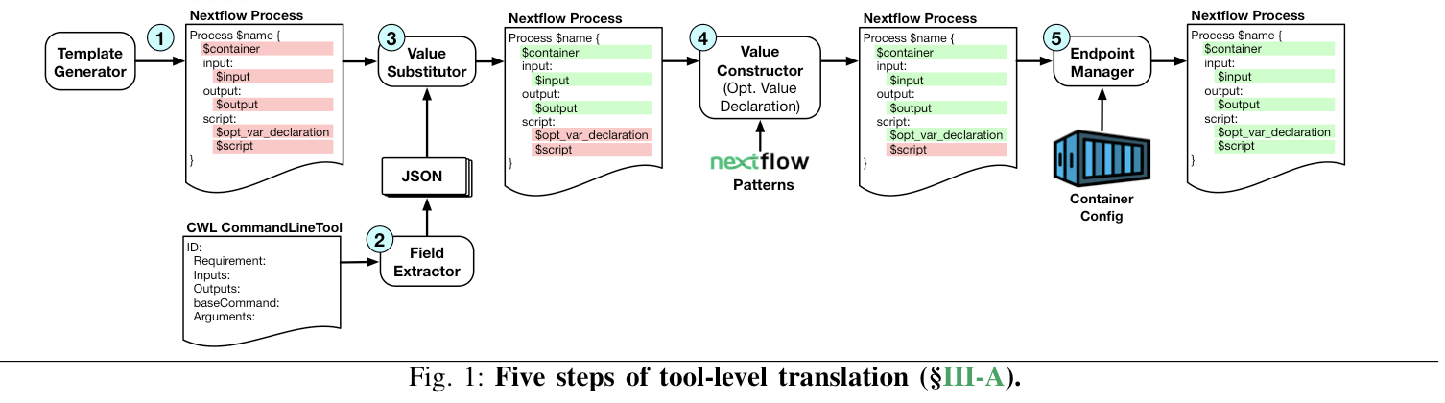
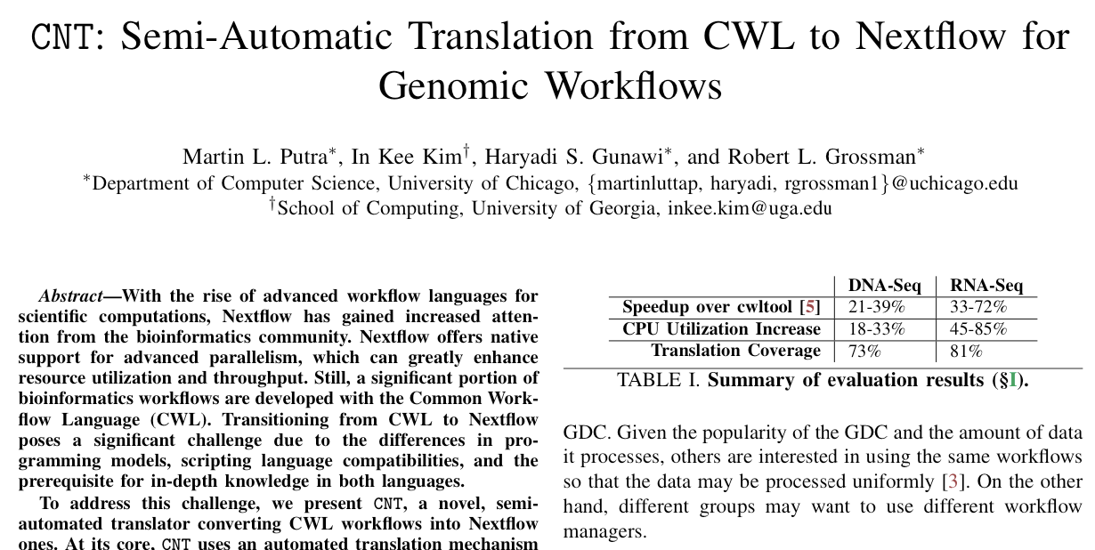
Tool-Level Translation
[Tool-level Translation Module]
More details on our paper!
Tool-level Translation
Graph-dependency Analysis
Correctness Check
Fully Automatic Translation
Notes:
Due to interest of time, we are not able to describe the translation module in detail. Readers who are interested are encouraged to check out our paper!

Slide 27
Fully Automatic Translation
1
2
3
Tool-level Translation
Graph-dependency Analysis
Correctness Check
Notes:
Next, we move on to the second stage.

Slide 28
Graph-dependency analysis
CWL’s named-arguments invocation abstract away positional information.
Insight: possible to reconstruct given suitable data structure.
2
1
3
5
₄
Tool-level Translation
Graph-dependency Analysis
Correctness Check
Fully Automatic Translation
Notes:
<CLICK>
As we mentioned before, one of the challenge CNT has to face is the different way of invocations. CWL’s way of invocations abstracts away positional information, which is necessary for Nextflow’s invocations.
<CLICK>
<CLICK>
However, it is possible to reconstruct this information given suitable data structure.

Slide 29
Graph-dependency analysis
Create DAG data structure.
Input & output variable names as vertex attribute.
Store both caller’s and callee’s perspective.
Reconstruct type signature by traversing edges and reconciling caller’s/callee’s perspective.
Tool-level Translation
Graph-dependency Analysis
Correctness Check
Fully Automatic Translation
Notes:
<CLICK>
What we need to do is create a DAG data structure which stores the variable names from caller’s and callee’s perspective.
<CLICK>
This way, for each invocation, we can reconstruct its type signature by traversing DAG edges and reconcile variable names based on the two perspectives.

Slide 30
Fully Automatic Translation
1
2
3
Tool-level Translation
Graph-dependency Analysis
Correctness Check
Notes:
The third one is correctness check.

Slide 31
Correctness Check
Variable type is important for intermediate data staging.
Tracks files, ensuring proper variable type (i.e. ‘File’ or ‘Path’).
More details on our paper!
Tool-level Translation
Graph-dependency Analysis
Correctness Check
Fully Automatic Translation
Notes:
<CLICK>
We observe that it is important to consider Nextflow’s runtime data staging. Files will only be staged if their corresponding variables are declared with the proper variable type,
<CLICK>
which is either ‘File’ or ‘Path’. To tackle this issue, we devised a method called Typecasting.
<CLICK>
However, due to interest of time, interested readers are once again encouraged to check the details in our paper.

Slide 32
Outline
Challenges
Automatic Translation
Semi-automatic Translation
Evaluation
Conclusion
Notes:
The final component of CNT is the semi-automatic part.

Slide 33
Semi-Automatic Translation
Focus: JavaScript expressions
Regex-based automatic classifier:
Pattern #1: Object attribute access.
Pattern #2: Object method call.
Pattern #3: ‘Actual’ code block.
1
Attribute Access
<Auto Translated>
…
JS Code
…
Semi-automated handling
2
Automatic
Classifier
Method Call
3
Manual with guideline
‘Actual’ code block
Final Result
Notes:
The focus here is JavaScript Expressions.
<CLICK>
While it is difficult to fully automate their translation, we performed code-level analysis on our target workflows and found that the JavaScript expressions can be categorized into three common patterns.
<CLICK>
<CLICK>
The first is object attribute access,
<CLICK>
the second one is object method call,
<CLICK>
and the last one is ‘actual’ code block which express complex logic.
<CLICK>
Based on this insight, we built a module which uses carefully crafted regular expressions to automatically classify JavaScript expressions into one of these patterns.

Slide 34
Semi-Automatic Translation
Focus: JavaScript expressions
Regex-based automatic classifier:
Pattern #1: Object attribute access.
Pattern #2: Object method call.
Pattern #3: ‘Actual’ code block.
Uses non-exhaustive mapping table
1
Attribute Access
<Auto Translated>
…
JS Code
…
Semi-automated handling
2
Automatic
Classifier
Method Call
3
Manual with guideline
‘Actual’ code block
Final Result
Notes:
Following that, <CLICK><CLICK>
For the first and second pattern, CNT replaces them with suitable Groovy functions based on a mapping table. The mapping table does not cover all possible conversions, so developers might still need to fix the translation.
<CLICK>
<CLICK>
For the third category, CNT guides developers by leaving a placeholder, and developers are required to manually translate this part of the code.
<CLICK>

Slide 35
Outline
Challenges
Automatic Translation
Manual Translation
Evaluation
Conclusion
Notes:
Now let us move on to evaluation.

Slide 36
Evaluation
MD5 Similarity
Translation Coverage
Performance gain
Notes:
We evaluate CNT against three metrics.
<CLICK>
First, the MD5 similarity, which is the percentage of exact MD5 match for intermediate & final workflow outputs.
<CLICK>
Second is coverage of both automatic & manual translation.
<CLICK>
And finally, we assess the potential speedup & CPU utilization increase of migrating from a sequential workflow engine to Nextflow using CNT.

Slide 37
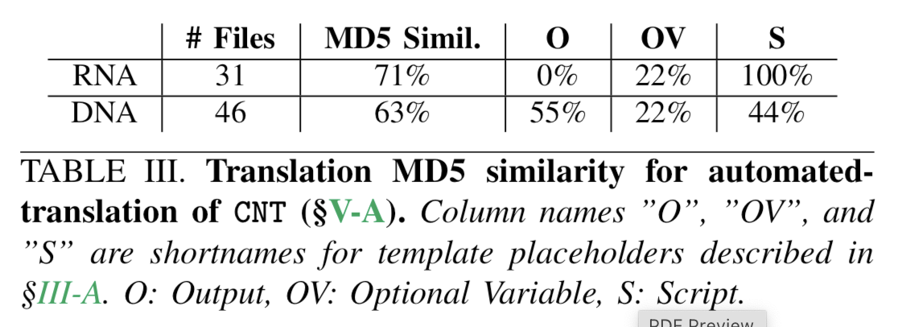
MD5 Similarity
Two production workflows:
GDC DNA-Seq & RNA-Seq alignment.
High MD5 similarity for both.
Notes:
<CLICK>
We evaluate CNT using two production-grade genomics workflows, namely the GDC DNA-Seq alignment & RNA-Seq alignment.
<CLICK>
<CLICK>
CNT is able to achieve high MD5 similarity for both workflows, where our analysis also shows peculiar JavaScript usage of each workflows.

Slide 38
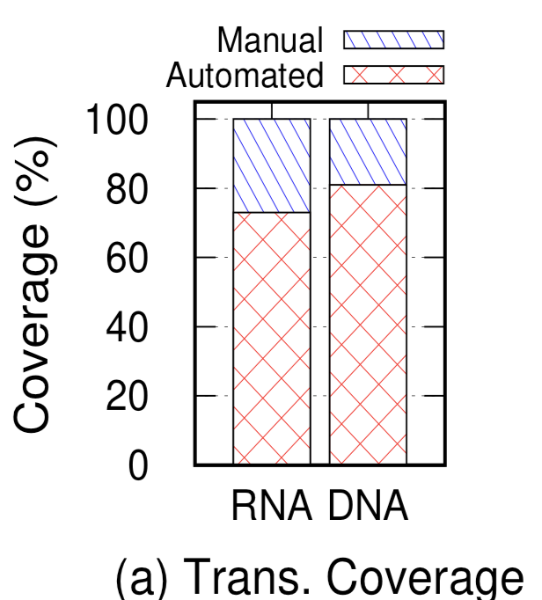
Translation Coverage
73%-81% fully automated.
Expected to reduce ~75% development time.
Notes:
CNT
<CLICK>
<CLICK>
is able to achieve high translation coverage, ranging from 73% up to 81% of fully automated translation.
<CLICK>
We believe this translates directly to reduction of development time.

Slide 39
Performance Gain*
*Compared against cwltool, a sequential CWL workflow engine.
Speedup:
Avg. of 52.5% for RNA-Seq
Avg. of 30% for DNA-Seq
CPU Utilization:
Avg. of 65% for RNA-Seq
Avg. of 25.5% for DNA-Seq.
Notes:
And finally, we evaluate the speedup and CPU utilization increase of translated workflows compared to cwltool, a popular sequential CWL workflow engine.
<CLICK>
We found compelling benefits of using CNT. In particular, we observe up to 52% average speedup, and up to 65% average cpu utilization increase.

Slide 40
Outline
Challenges
Automatic Translation
Manual Translation
Evaluation
Conclusion
Notes:
To conclude,

Slide 41
Conclusion
The first semi-automatic translator from CWL → Nextflow.
High translation accuracy and coverage.
Potential to reduce development time and increase job processing throughput.
Notes:
<CLICK>
CNT is the first semi-automatic translator from CWL to Nextflow.
<CLICK>
CNT provides high translation accuracy and coverage.
<CLICK>
And it shows potential to reduce development time and increase job processing throughput of existing genomics data processing system.

Slide 42
Thank you!
Questions?
Notes:
Thank you.

Slide 43
Backup Slides
Notes:
(XX MINUTE)
Good afternoon, I am Martin Putra. In this talk I will show the progress our team has made regarding automatic translation of CWL, a popular workflow language used in many production systems, to Nextflow, a continuously growing one with attractive support for parallelization. This is a joint work with In Kee Kim from the University of Georgia, Haryadi Gunawi, and Robert Grossman from the University of Chicago.

Slide 44
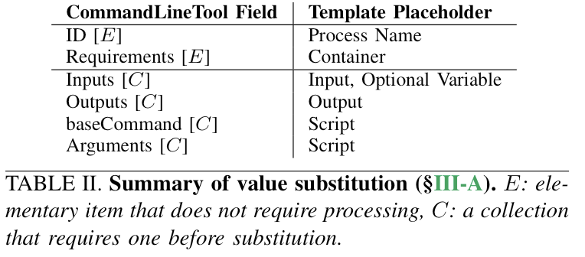

Slide 45
