Slide 1

FREP: Fleet Performance Evaluation Pipeline for Identifying Server Degradation in Large-Scale Datacenters
Ruidan Li
Advisor: Haryadi S. Gunawi
Notes:
Hi everyone, my name is Ruidan Li, advised by Professor Haryadi Gunawi. Today, I am gonna talk about Frep, which is a fleet performance evaluation pipeline used for identifying server degradation in large-scale data centers.
Alright, let’s get started.

Slide 2
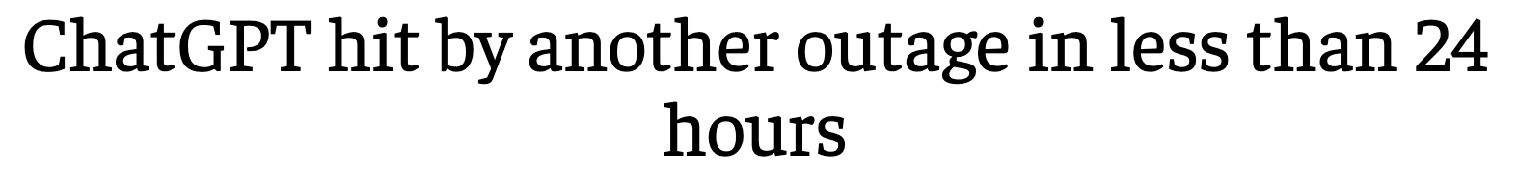

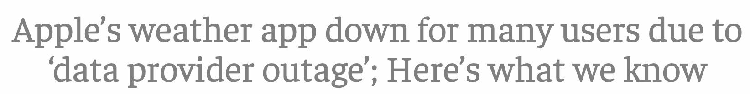





Introduction
Fleet reliability is important but can be hard to achieve.
Fleet reliability is important
Why?
Notes:
Nowadays, so many services that people use on a daily basis rely on data centers at hyberscale, and thus a good management of the fleet, which is a group of servers under unified control, has becoming more and more important.
Well, outage is certainly one thing that we all want to avoid, right
[click]
but before things get that bad, having unstable performance could also be very detrimental. Think about you are watching a short video of your friends on social media and suddenly it keeps loading. What’s the chance that you are gonna wait? Or maybe you just go directly to the next app, right?
Therefore, having stable, and predictable performance is critical for service reliability and can never be over-emphasized.
[click]
However, this is not easy to achieve. [wait] Why?

Slide 3



Fleet Performance is Dynamic
Configuration update
How to catch them?
Performance
Notes:
Many things could happen when you are managing a bunch of servers. For example, [click] there could be random server failures, or, [click] the newly introduced configuration is bad or causing some kind of unexpected issues, or, [click] the hardware could just gradually be less performant. And things can be tricker at scale. Well, now you may want to ask, [wait] how do we catch those cases then?

Slide 4



Measure Fleet Performance
2023-08-13:19:14:13,996 INFO [serviceA.py:19] Things are doing fine
2023-08-13:19:14:17,374 INFO [serviceA.py:21] Still fine
2023-08-13:19:14:17,658 ERROR [serviceA.py:31] Well, maybe not
2023-08-13:19:14:20,412 CRITICAL [serviceB.py:418] What is happening?
High volume
ERROR: Service halted
Too late
Is there any straightforward, applicable, and accurate method?
App level
Notes:
There are many ways to see if the server is behaving normally, or if your application is running well.
[click] A typical one is using traces and logs. [wait] but the volume could be a bit hard to manage.
[click] Or you can rely on error messages from various layers, [wait] but sometimes it could be too late and even worse, sometimes we have silent failures.
[click] There are also many monitoring frameworks, [wait] but unfortunately they are usually application specific.
[wait]
Given all that, is there any straightforward, widely applicable, and relatively accurate method to measure the performance then?

Slide 5

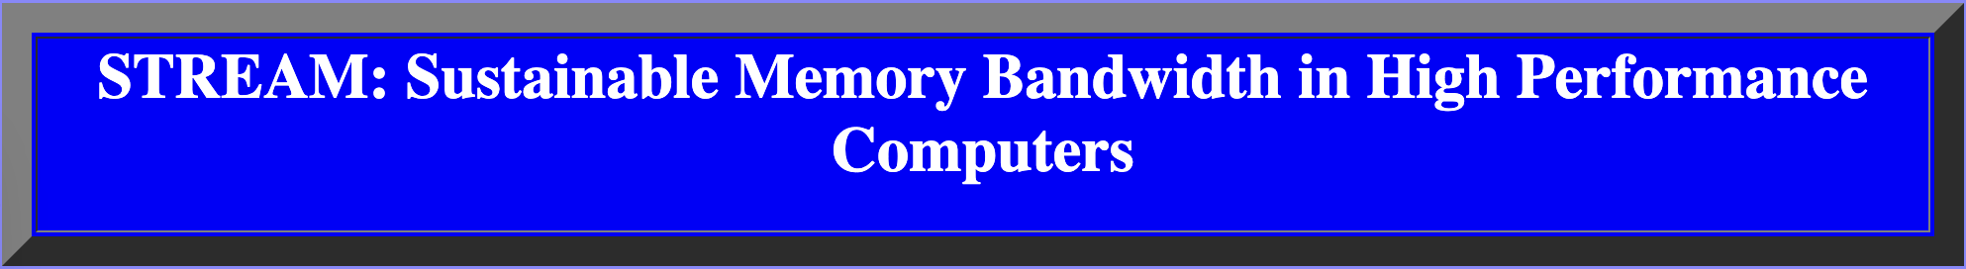

Measure Fleet Performance
Memory: STREAM
CPU: Coremark Pro
Benchmark
Straightforward
General
Accurate
Popularity
All good? No.
Notes:
The answer is using benchmarks. We can leverage benchmarks to get straightforward results. At this stage, we are limiting the scope to a single host as the measured entity.
[click]
Stream measures the memory bandwidth while coremark pro provides a score based on various workloads. Therefore, the outputs from both are quite easy to draw comparisons on.
[click]
Another advantage of these two benchmarks is their popularity in the community, making the result widely understood and thus easy for open discussions in the future.
Great, now we have the tool to use. [click] But there’s no perfect solution in this world, and here is why.

Slide 6

Existing Issues
Large scale → heterogeneity
Cost of running → sparsity
Current heuristic:
Single distribution
Relaxed rules
Over-generalization
Limited exploration
High false negative
Notes:
There are multiple existing issues with this solution.
First, the heterogeneity in a hyperscale fleet must be addressed. Yes, I just mentioned that the outputs are easy to digest, but that’s the case for a single host. When the score goes up, that’s great, when it drops a lot, then we need to take a look. But what about comparing scores from different servers?
It would not be fair to compare a highly performant new model with an old, entry-level server, right?
[click]
Besides that, running benchmarks is also quite expensive. Because we need to drain the server first for a more accurate result, otherwise the score would be affected by the other active workloads.
Since limiting production downtime is crucial, we have to be prepared for the sparsity of the benchmark results. We want to make sure that whatever measurement we use could provide the highest possible signal in the least amount of time.
[click]
Current heuristic uses the benchmark result, but only calculate the distribution of the entire population’s benchmark results and use very relaxed rule to alert for low positive rate, and thus [click] it suffers from over-generalization and [wait] missed many potential candidates. [wait] Even worse, it lacks the capability to explore other available patterns in the dataset.

Slide 7
Problem Statement
Identify anomalous pattern given data heterogeneity and sparsity.
How to break data into smaller sets?
How to leverage asset similarity?
Notes:
For addressing these two major challenges in the benchmark dataset, and do better than the current heuristic, we now propose our methodology for detecting anomalous pattern given the heterogeneity and data sparsity in a fleet.
[click]
That is, how do we break data into smaller sets for better and more meaningful comparison, and how should we leverage potential asset similarity to tackle the sparsity?

Slide 8
Contribution
Benchmark results collected from over 2 million assets.
FREP - customized and composed a variety of statistical techniques for identifying anomalous patterns.
Real world case study.
Notes:
The contribution comes threefold.
First, we present the largest dataset on CPU and memory benchmarks. The results are collected from over 2 million assets.
[click]
Then, we show why the off-the-shelf stats tools cannot be used directly and must be customized for yielding high accuracy, which leads to our framework, FREP.
[click]
Lastly, we will talk about how the cases captured by FREP helped our industry collaborator understand fleet behaviors. The cases are discussed at the end of each module.

Slide 9
Roadmap
Dataset Overview
Feature Selection
Divergence
Outlier
Large Variance
Key Observations
Notes:
Alright. So the talk today is structured as follows.
We will start with a brief overview of the benchmark dataset. After that, we will show how we select the features to be used later on. Then we will then talk about how we use them to find different types of cases using the three independent modules shown here. And we will wrap up the talk with some key observations.

Slide 10
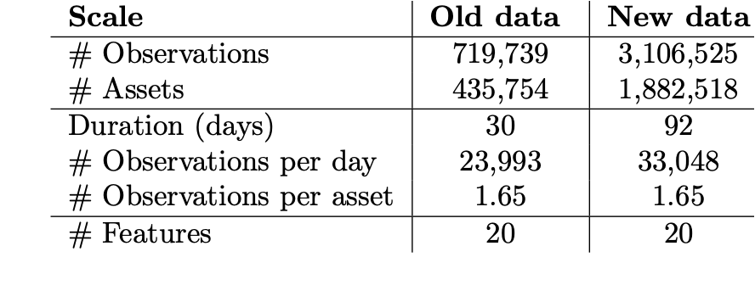
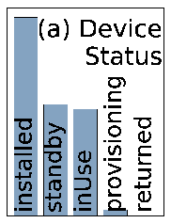
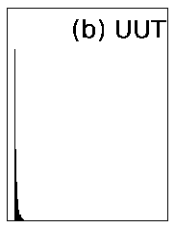
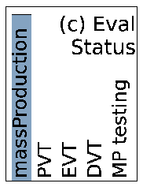
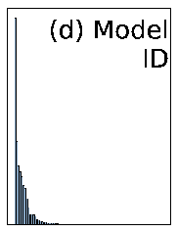
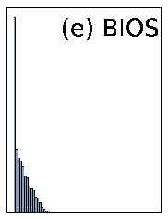
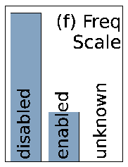
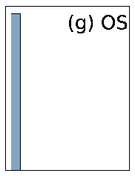
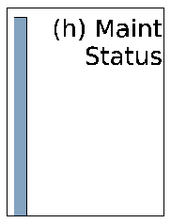
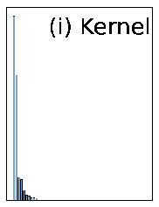
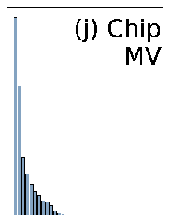
Dataset Overview
CPU + Memory
Name, type, duration, run uuid
Test | Asset
CPU/Memory | Deployment status
Asset ID, model ID, kernel, OS
CM version, frequency scaling status
Device status, evaluation status
Notes:
First thing first, let’s take a look at the collected dataset. [click] For each machine, the pair of benchmark results from CPU and memory is called one observation.
There are two datasets used. The difference lies in how some of the fields are anonymized.
[click]
Overall we have nearly 4 million observations drawn from over 2 million machines.
[click]
There are 20 features available as we can see in this table, and we split them into four major categories:
[click] Test-related, such as test name, test duration, and run uuid.
[click] Asset-specific like asset id, model id, and kernel or os versions.
[click] And there is CPU/memory-related ones including chip management version and frequency scaling status.
[click] Lastly we have deployment status features like device status and asset evaluation status.
[click]Note the distribution of the features could vary a lot as we can see here. [click] Some only have few unique values while some contains thousands of distinct ones. [click]The difference in skewness of the features is also quite obvious. Such differences across the features will later on be leveraged in the feature selection stage of the pipeline, which we will describe next.

Slide 11
Roadmap
Dataset Overview
Feature Selection
Divergence
Outlier
Large Variance
Key Observations
Notes:
Now let’s move to the feature selection.

Slide 12
Feature selection
Entropy
Uncertainty
Surprise
Information Gain
Build on entropy
Predictiveness
Feature Target
Lower
Higher
Notes:
Alright, before diving into the detail of feature selection, let’s look at the building blocks of this stage - entropy and information gain
So what is entropy? Entropy measures the uncertainty, or say, surprise contained in the data.
[click]
In the toy example here, the blue dot in the bottom set gives us more surprise than the set above. When we apply this concept in our dataset, for example, if for one feature, there is only one value across all the observations, then it means no surprise at all and thus the entropy will be zero, and obviously, we probably won’t use this feature as it won’t be useful in telling us anything.
[click]
And information gain is built upon entropy. It measures the “predictiveness” of a feature against our target feature, which is the benchmark score.
[click]
That is, if we split the target based on one feature’s value, and then compute the entropy of each group, if we see a big drop in the entropy because of this split, then we say the information gain from this feature is high, and it indicates strong predictiveness against our target.
Based on these two metrics, we can split the features into four categories.

Slide 13

Feature selection
Characteristic
Feature Type | Example
Determining | Model ID
Significant | BIOS
In-between | FreqScaling
Trivial | OS
Usage
Dominate others
Top level grouping
High in both metrics
Next level grouping
(subgroup)
Low in metrics
Discard
Groups
Heterogeneity
Sparsity
Subgroups
Subgroups
Notes:
[click] The first category is the determining feature, which is basically the most important set. Here, model ID consistently dominates in entropy and info gain,
so we have it in this category. And indeed, domain experts confirm that model id is the most informative feature as it defines the model architecture.
[click] Then it comes to the other significant features which contains features such as BIOS version and chip management version. Even though they are not dominating as the previous one, the entropy and info gain are still quite high as compared to the rest.
[click] Then we have the features that could simply be discarded as they don’t tell much about the performance. For example, since almost all the observations share the same OS value, its entropy is zero.
[click] And there is one category for everything in between.
[click] We use the top two to tackle the data heterogeneity and sparsity issues mentioned before.
By forming groups using features such as model ID, because we can assume that observations that fall into the same group should display some level of similarity, we can draw more meaningful intra-group comparisons instead of comparing an apple to an orange.
[click]
And when keep dividing the groups into subgroups using the significant features, because of the increased level of similarity, the entire subgroup can be viewed as one relaxed entity and hence the data sparsity issue is mitigated.

Slide 14
Roadmap
Dataset Overview
Feature Selection
Divergence
Outlier
Large Variance
Key Observations
Subgroup Level
Asset
Level
Group Level
Notes:
Alright, so now we know what features to use, and how we partition the data using those features. Let’s dive right into the first module.

Slide 15
Divergence
Defined by Determining feature
Group 1
All observations
Group n
Subgroup
A_1
B_1
A_n
E_n
Defined by Significant feature
C_1
D_1
H_n
J_n
How to measure?
Configuration change
Performance change
What’s that?
Divergence
Notes:
As discussed in the previous slide, we use the determining feature for the initial grouping, [click] here we break it down to n group.
[click]
And the significant features to define subgroups
Note there’s no cross-group comparison because of the data heterogeneity. For example, we are not going to compare subgroup A one with subgroup A n.
[click]
Then given the benchmark results from a subgroup pair, for example, defined by two different BIOS versions, say A and B, we are interested in if the performance between A and B are different. But because the data points within each subgroup could be collected from multiple assets, the results may fluctuate even within one subgroup.
[click]
To tolerate this, we estimate the result distribution of both A and B, and use divergence to tell how far away A is from B.
[click]
Wait, what is divergence?

Slide 16
Divergence
What is divergence?
Statistical distance.
Why should we choose divergence?
Diff in relaxed entities.
Which divergence measurement to use?
Kullback-Leibler (KLD)
Jensen-Shannon (JSD)
Wasserstein (WSD)
Notes:
[click] Divergence is just distance in stats world. The most basic one is squared euclidean distance.
[click] Why do we use divergence to measure the change? Because we are trying to find the difference between two relaxed entities, So getting the statistical difference helps deal with natural fluctuation.
[click] And there are three different divergence measurement methods used here: Kullback-Leibler divergence, Jensen-Shannon divergence, and wasserstein distance.

Slide 17
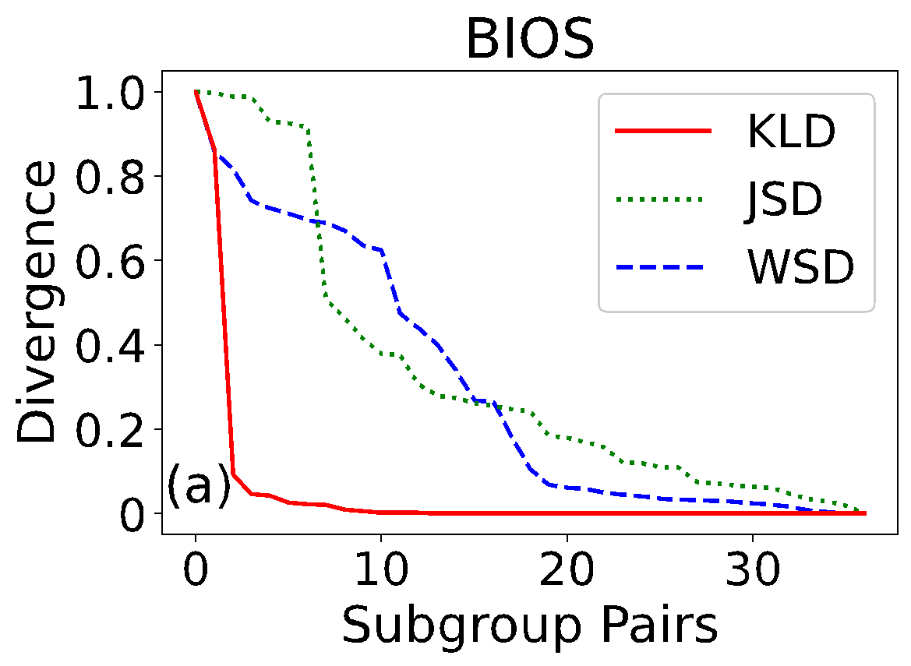
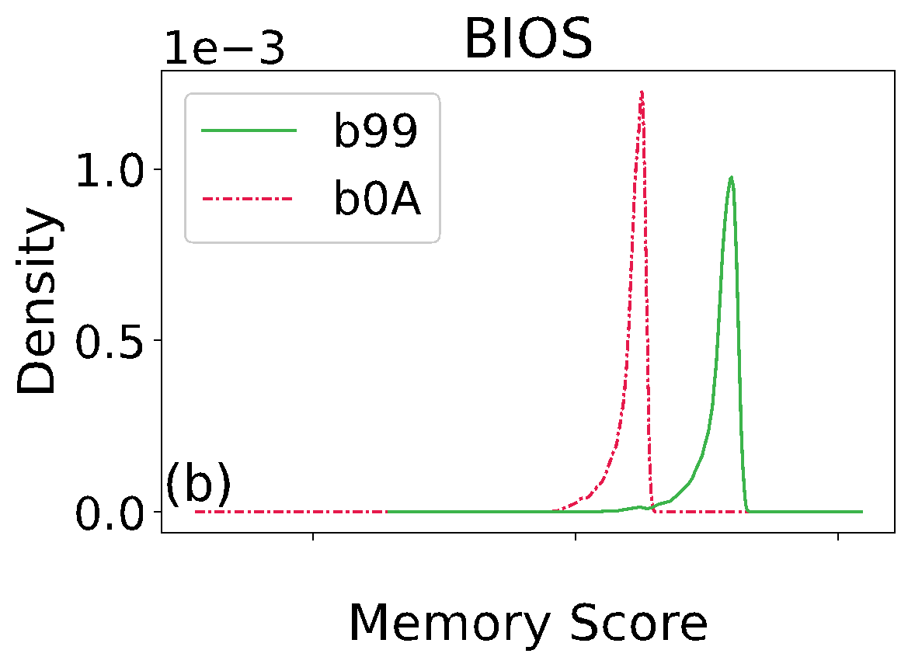
Divergence
Kullback-Leibler (KLD)
Separation
Kullback-Leibler (KLD)
Separation
Unstable
Asymmetric
Notes:
Each method has its own pro and con.
KLD surpassed the other two in separating highly divergent pairs. As we can see here in plot (a), x is pair index and y is the normalized divergence score, [click] the score shows a clear turning point when using KLD but is not as obvious in the other two methods. [click] The distribution of the highly divergent pair highlighted by KLD is shown in figure (b) and we can see indeed, they look quite different.
However, [click] it suffers from being unstable as well. And its asymmetric nature makes the order between the pair matters.

Slide 18
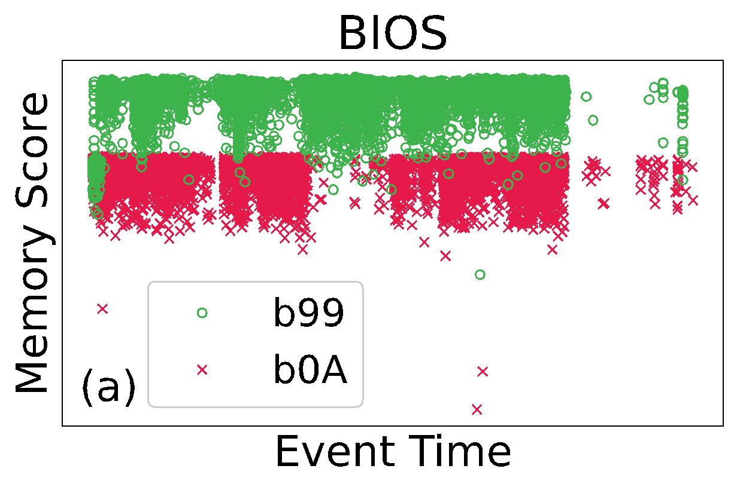
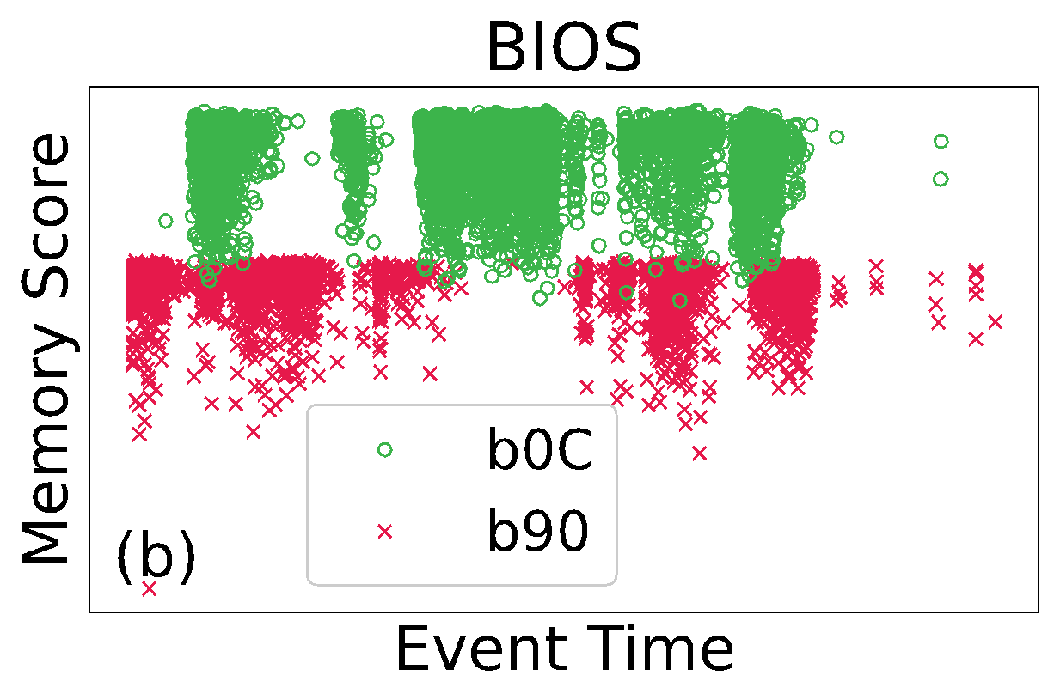
Divergence
Kullback-Leibler (KLD)
Separation
Unstable
Asymmetric
KLD: 3.1
JSD: 3.16
Jensen-Shannon (JSD)
Stable
Symmetric
Separation
KLD: 156.9
JSD: 3.13
Wasserstein (WSD)
Earth-moving
Symmetric
Separation
Notes:
Then is comes to JSD, [click] which is more stable because it is considered the symmetric, and some may say enhanced, version of KLD, and thus it yields more consistent results as shown here in the plots, x is timestamp and y is the normalized benchmark score, both pair display similar degree of divergence, but only JSD gives us relatively similar divergence value.
[click]
WSD, which is usually called the earth-moving distance, complements the previous two as it captures other corner cases.
Great, now we have multiple tools to use, can we just simply use them directly? The answer is no. And here’s why.

Slide 19
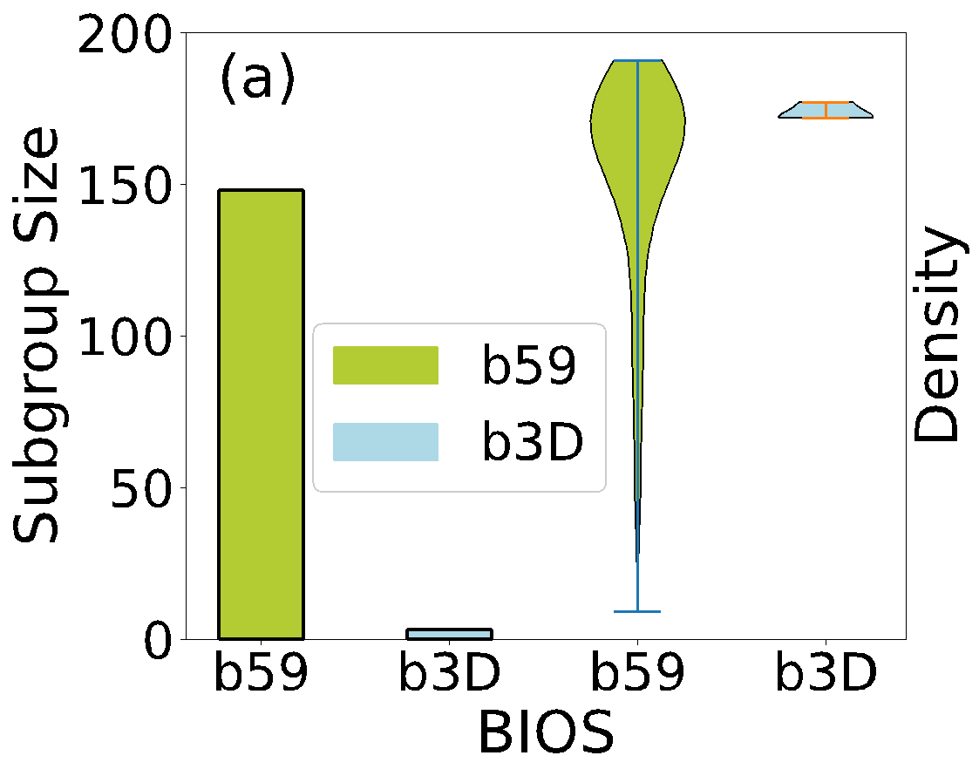

Divergence Denoise
Big size difference
Distributions differ as well
Multiplier 1: penalize large size difference
Notes:
Remember the first issue that we have is data sparsity. And some assets can be benchmarked way more frequently than the others due to, for example, client requirements.
The number of observations in a subgroup can have a big effect on the accuracy of the distribution estimation.
[click] For example, here the two bars on the left show the size of two subgroups. And we can see that one subgroup has nearly 150 observations whereas the other one has less than 5. [click] It wouldn’t make sense to alert the domain experts about this pair even though their distributions indeed look quite different as we can see from the two violin plot on the right.
[click]
Therefore, we use the size of the pair to construct a multiplier that discourages the pairs with imbalance sizes.

Slide 20
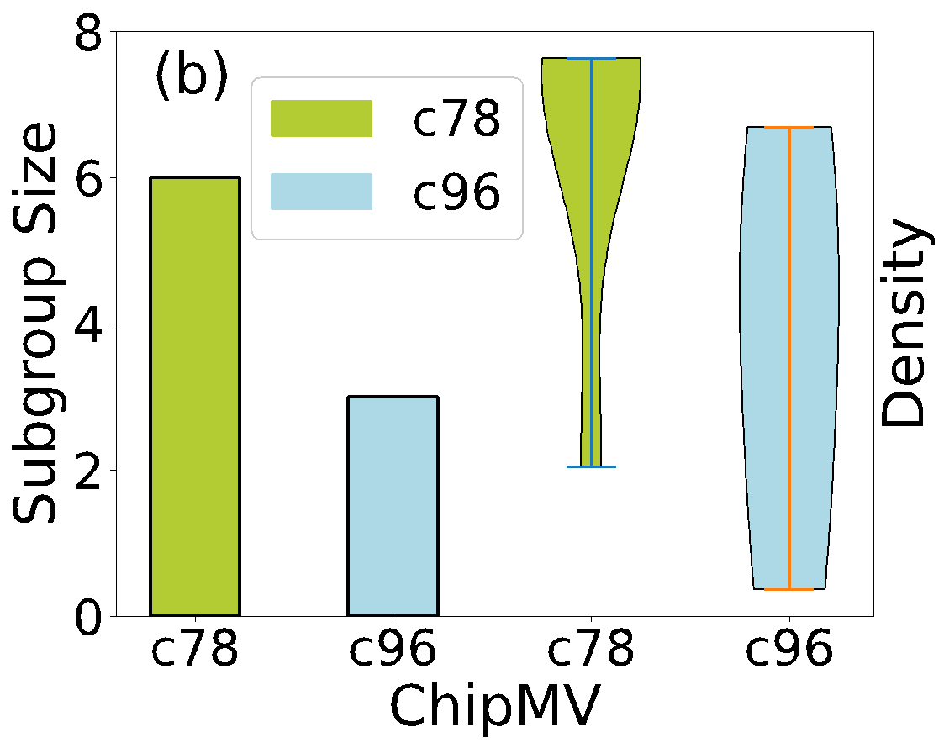
Divergence Denoise
Similar sizes, but…
Distributions still differ
Multiplier 2: penalize small subgroups
Notes:
The previous multiplier surely mitigates the big size difference issue, [click] but when the size of both subgroups is equally small, should we alert the domain experts then? Well, the answer is probably not, since there is a high chance that both subgroups suffer from under sampling, and we certainly don’t want to send out false positives.
[click]
Therefore, to discourage this case, we have another multiplier to prioritize the large pairs and discourage the small ones.

Slide 21
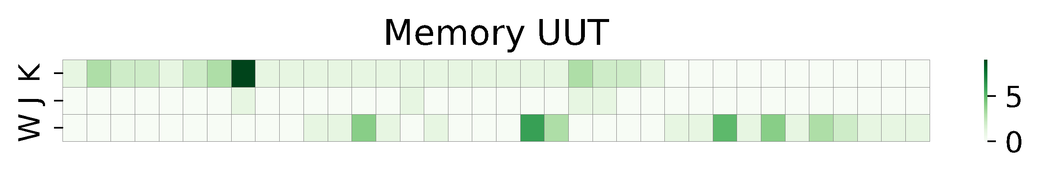
Effectiveness
Group Level
Impact from configuration change
Heterogeneity
Impact from configuration change
Potentially problematic configuration
Subgroup Level
Sparsity
Asset Level
Notes:
So, this divergence module enables us to detect the impact of a configuration change, which is missing in the current heuristic. It also highlights potentially problematic configs.
Here is one example we shown earlier, which is captured by the pipeline due to the abnormally high distribution divergence. And it is confirmed later on by our industry collaborator that the performance change is caused by an intentional downgrade.
[click]
Another example here is shown using the heatmap, showing a potentially problematic configuration. It shows how frequently one particular configuration appears in the highly divergent pairs. Darker color indicates higher frequency. [wait] Here we have a particular unit under test model stands out. And indeed this signal is strengthened by the alert from the existing heuristics, showing that the two methods do align.
[click] So in this way, we not only addressed the heterogeneity by data grouping but at the same time mitigated data sparsity via the similarity within subgroups.

Slide 22
Roadmap
Dataset Overview
Feature Selection
Divergence
Outlier
Large Variance
Key Observations
Subgroup Level
Asset
Level
Group Level
Notes:
So we just showed how we leverage the similarity among subsets of data to conquer the observation sparsity issue while factoring in the heterogeneity of the data.
Now let’s move onto the next module, where we try to find performance outliers at asset level.

Slide 23
Performance Outlier
Current heuristics:
Over-generalization
Lemon!
High false negative
Can we do better?
Notes:
The current heuristic aims to catch the underperforming servers by comparing a newly available observation against the population wide distribution. [click] Therefore, it suffers from over generalization, as it does not consider the heterogeneity within the dataset. The abnormally low score from one machine could be higher than the best result from another. And because of that, even though the false positive is low, [click] the false negative could be surprisingly high. [click] So, can we do better?

Slide 24
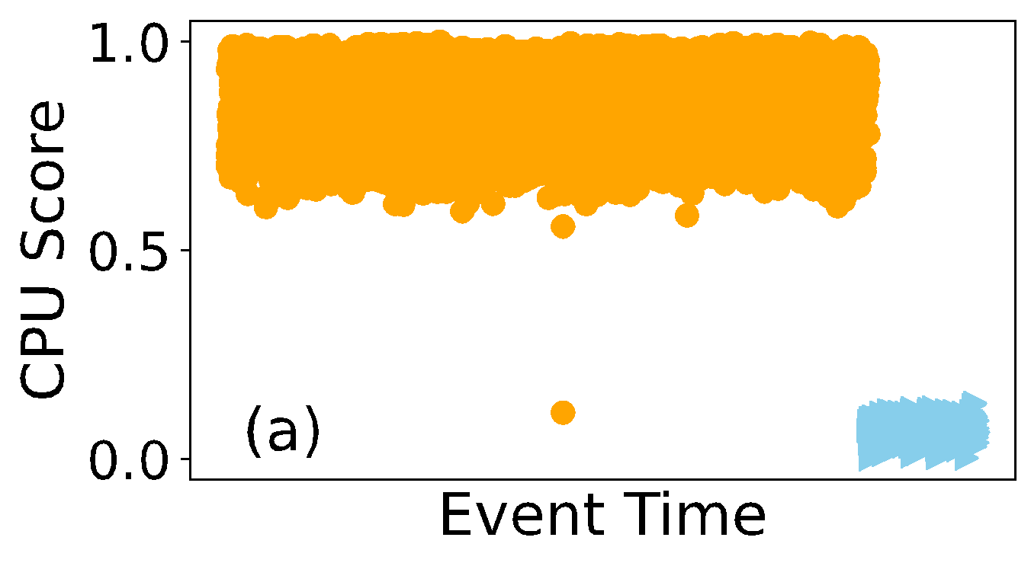
Performance Outlier
How to catch this?
Clustering
OC-SVM
Local outlier factor
Isolation Forest
Which one to use?
DBSCAN
K-Means
Notes:
The answer is yes, we can apply clustering methods when an asset is sufficiently sampled. Here in this example, x is timestamp and y is the benchmark result, and we would like to catch performance drop patterns like this so that the operators can start the investigation.
There are many existing clustering methods that can be used for anomalous data identification. [click] We evaluated quite a few computationally lightweight methods including one class svm, isolation forest, DBSCAN, kmeans, and local outlier factor. However, none of them can achieve a satisfying result by itself. [click] So which one to use then?

Slide 25
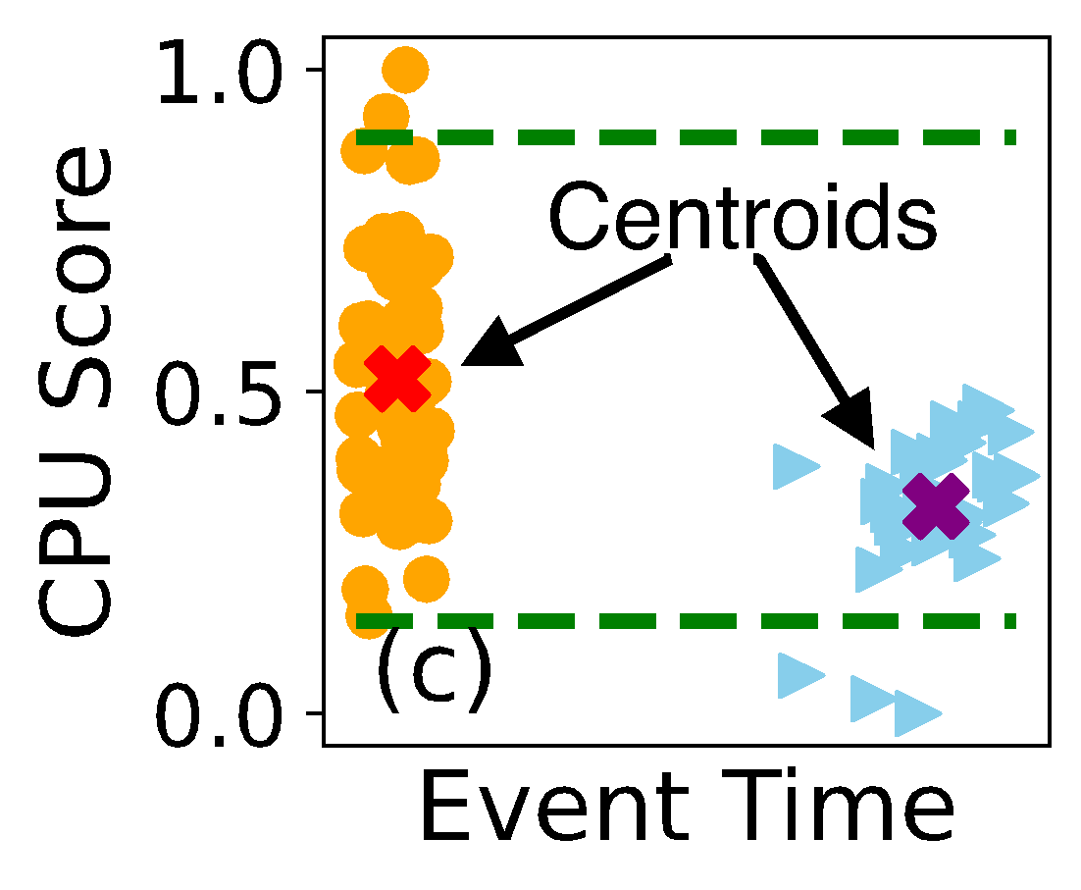
Performance Outlier
Denoise I
Discard small performance change
Notes:
Well we ended up with DBSCAN, which works more stable in our case than the others ones.
Here we see the clustering result from it and there are two clusters, each marked differently.
But is that it? See here the two clusters certainly don’t show any obvious performance degradation, as the clustering result is mainly driven by the temporal gap, not performance gap. How do we fix that?
We fix it by the centroid check step. [click] If the second centroid falls in the acceptable range of the first one, it will be classified as a normal case. [click] And this step helps reducing the false positives significantly.
So far so good, right?

Slide 26
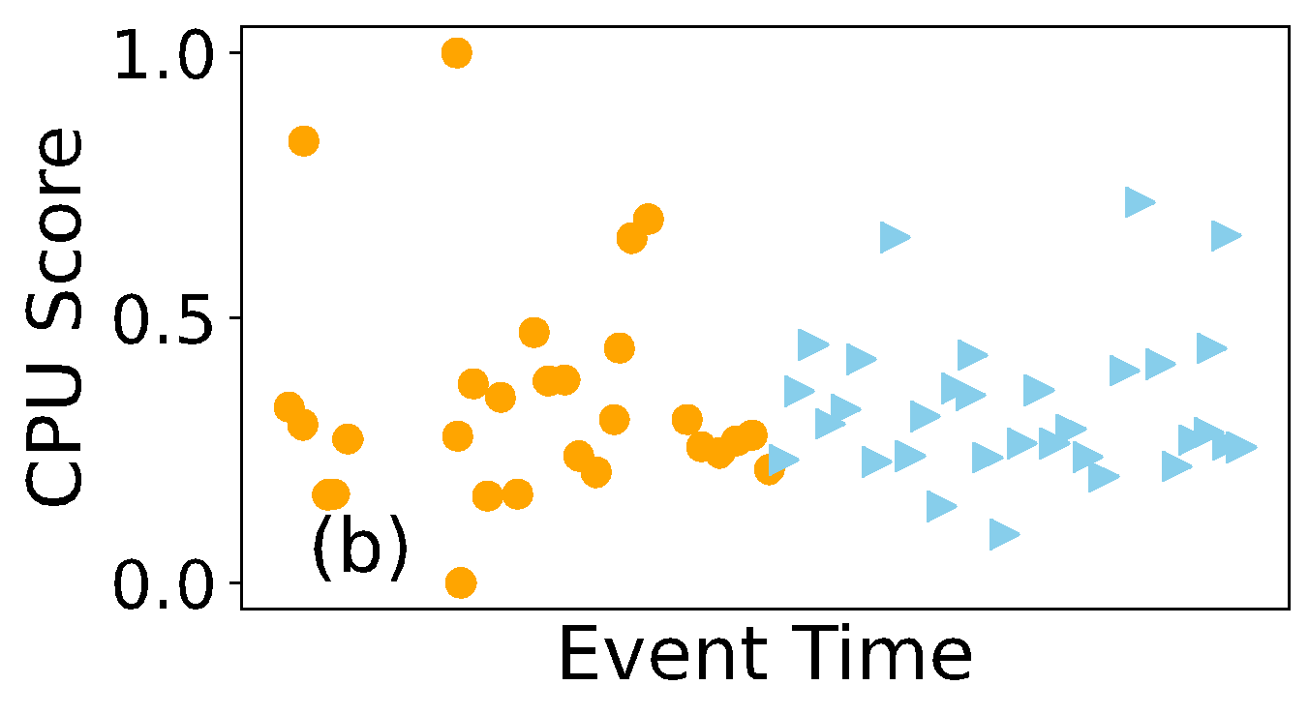
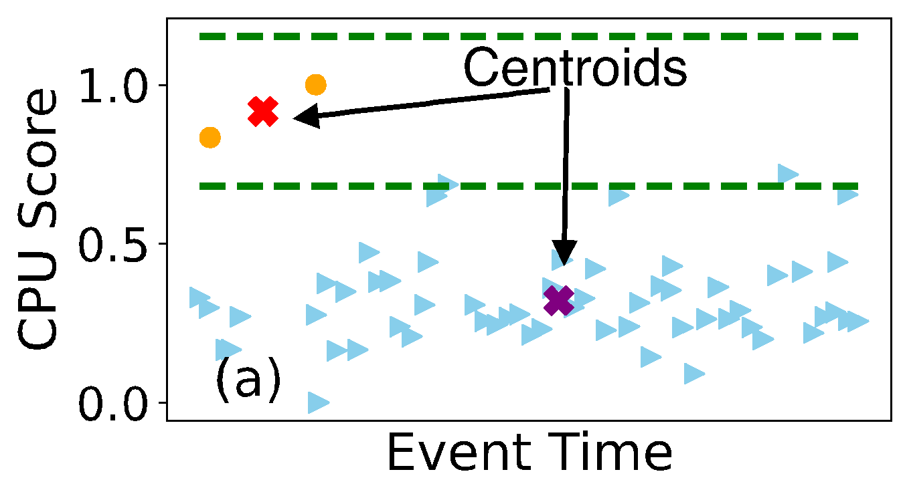
Performance Outlier
Pass the centroid check, but…
Jaccard Similarity
K-means
DBSCAN
Denoise II
Discard clustering result with vague boundary
Notes:
But what if we run into this case.
The performance between the two clusters are indeed quite different, but really it does not seem like a degradation case since the majority of the results fall in a similar range.
[click]
Therefore, to further denoise, we also apply kmeans on the same set of observations, and [click] use Jaccard similarity to compare the difference between the clustering results from both approaches. Why? Because if there indeed is a very clear cut between the two clusters, the classification of each data point should be fairly stable regardless of the clustering methods used.
[click] So, only when the similarity is sufficiently high, we claim the asset has an abnormal performance trend, and punt it over for further investigation.

Slide 27
Enhancement
Compared to ALL
Transiently low →Lemon!
Group Level
Before
Now
Assets are self-compared
Assets are self-compared
Tolerate transient issue
Assets are self-compared
Tolerate transient issue
Resistant to temporal gap
Subgroup Level
Asset Level
Notes:
As mentioned early on, this module aims to enhance a functionality that the current heuristic provides, but may be too relaxed and labels server based on single low score, even when it is transient.
But now, the assets are compared against itself instead of the mass, making the comparison more meaningful. [click] And it tolerates transient issues as well as we can see in this example, where it detects the sudden degradation in CPU performance effectively, but the early on low score will not trigger anything.
[click]Lastly, it handles the temporal gap properly, which is crucial since the gap could be common and unpredictable due to the benchmark running cost.

Slide 28
Roadmap
Dataset Overview
Feature Selection
Divergence
Outlier
Large Variance
Key Observations
Subgroup Level
Asset
Level
Group Level
Notes:
Now let’s move to the last module, where we explore at the group level.

Slide 29
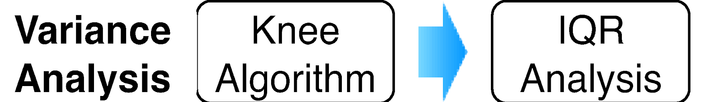
Larger Variance
Unreliability
Group Level
Subgroup Level
Automatically define high variance (unreliability) threshold
Asset Level
Lower the priority of cases with potential high variance explanation
Notes:
This module aims to check the model-wide unreliability. Due to time constraint, we will go over it at a very high level. [click]We first calculate the group-based variance and use an existing algorithm to detect the knee, the sharpest turning point of a monotonic sequence, and use that as the threshold. [click]And we perform another analysis to de-prioritize the candidates with potential explanation for the high variance.

Slide 30
Roadmap
Dataset Overview
Feature Selection
Divergence
Outlier
Large Variance
Key Observations
Notes:
Great, now let’s wrap this up with some key observations gained from this project.

Slide 31
Key observations
Performance benchmarking at scale is a hard problem.
Understanding large-scale datasets requires efforts in state space reduction, correlation techniques along with manual fine-tuning.
Periodic performance benchmarking tracks fleet regressions and can enhance fleet stability.
Notes:
First of all, performance benchmarking at scaling making the problem surprisingly hard. Not only that we need to consider the cost of fleet monitoring, but we also need to consider what features to collect, since the impact of such choice at scale could be huge. We may waste storage space if collecting non-informative features, and the root cause analysis may be blocked if the crucial features are not recorded.
[click]
The second takeaway is that in a large-scale fleet where configuration changes is continuously rolled out, the capability of tracking the impact of such change, especially capturing potential regression can enhance the overall fleet stability.
[click]
Lastly, manual fine-tuning is helpful even when the state space reduction and other correlation techniques are present. Not all the features are equally important, hence using tools to rank, to zoom into the key ones is critical in yielding the result efficiently. During this process the input from domain experts is particularly valuable because the techniques are not able to understand the general contexts such as the nuanced state transitions of an asset, and thus the manual fine-tuning is crucial in guiding the pipeline in the right direction.

Slide 32
Conclusion
Stable and predictable performance of fleet servers is critical for providing reliable services.
Off-the-shelf statistical techniques must be composed and customized FREP
FREP provides various types of important recommendations to operators and helped improve the understanding of the fleet behaviors.
Notes:
To wrap up, because stable and predictable performance of the fleet is so critical for reliable services, we developed FREP, a recommendation pipeline that compose and customized the off-the-shelf stats techniques to provide high signals to the operators with the hope that it can help them understand the fleet behaviors better.

Slide 33
Q&A
Group Level
Unreliability
Subgroup Level
Divergence
Asset Level
Outlier

Slide 34
Related works
Large-scale studies
Performance, failure and crash recovery, hardware errors
Dataset scale
Incident records, tickets, log and error messages
Analysis techniques
Information theory, transfer learning, clustering, and neural network
Notes:
There are many existing studies trying to understand the machine behaviors at large scale, from the general performance studies to failure and crash recovery, as well as hardware errors. Most of them are based on traces and logs.
The scale of the dataset being studied is getting larger as well. There have been empirical studies on incident report and tickets from platforms based on 100k nodes. And we start to see more and more analysis on log and error message collected from millions of servers.
Various types of analysis techniques are used in this area as well including information theory, transfer learning, and different types of clustering methods.

Slide 35
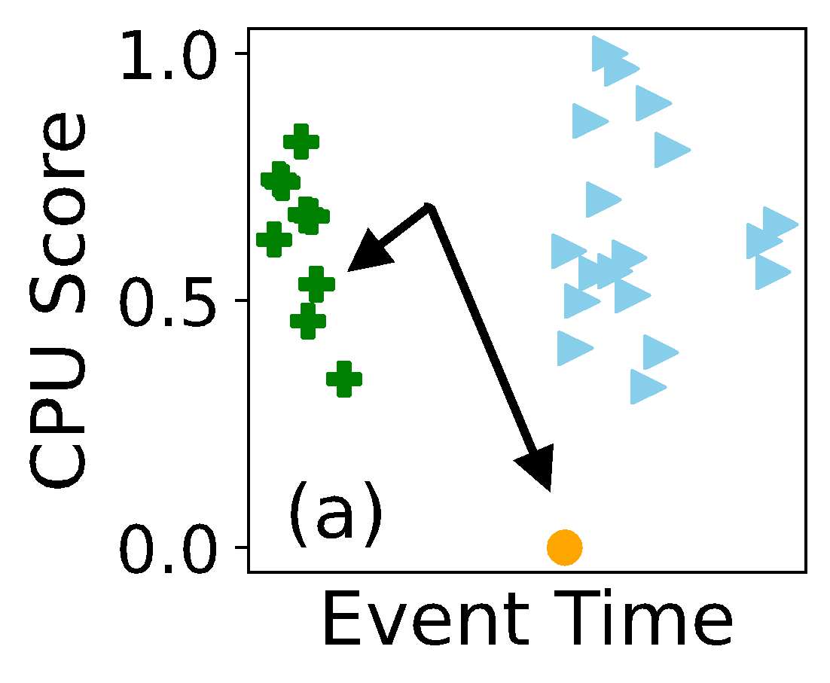
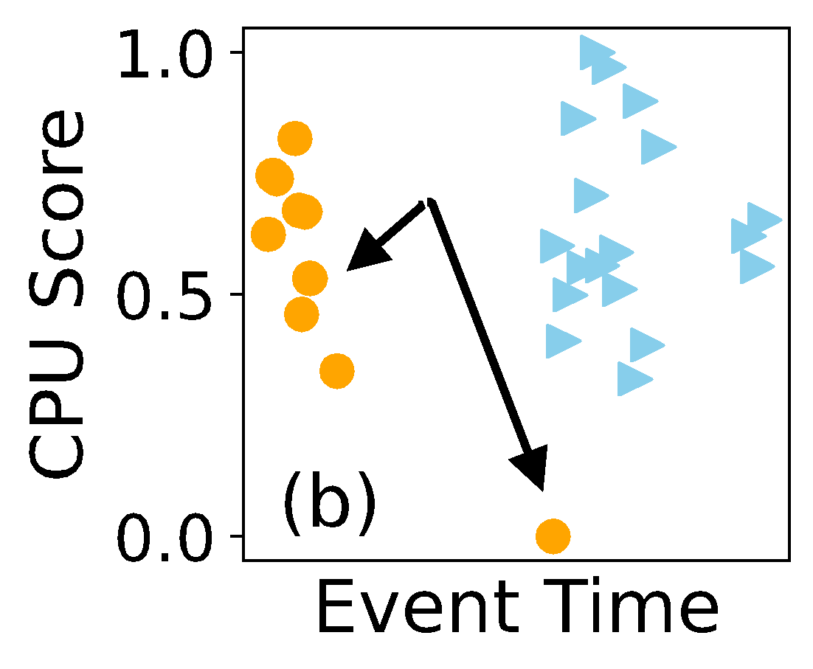
Performance Outlier
No degradation…
Binary conversion
Result from DBSCAN
# Cluster = 3
Result after conversion
# Cluster = 2
Notes:
So now let’s take a deep dive into the design.
Here we see the result from DBSCAN, there are three clusters, each represented by different mark.
[click]
Then we convert the clustering result into binary based on the temporal information, now there are two clusters, great.
But is that it? [click] See here the two clusters certainly don’t show any performance degradation, as the clustering result is mainly driven by the temporal gap. How do we fix that?

Slide 36
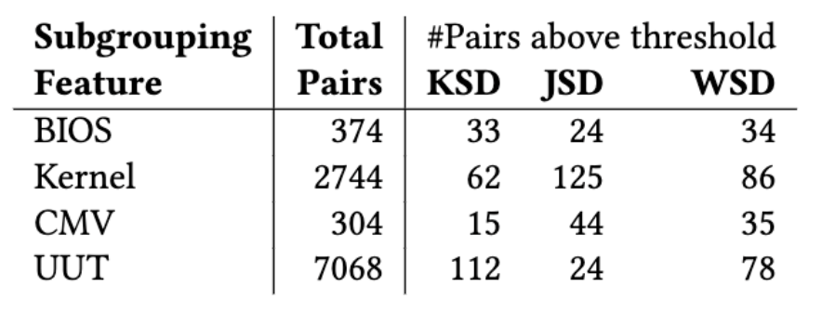
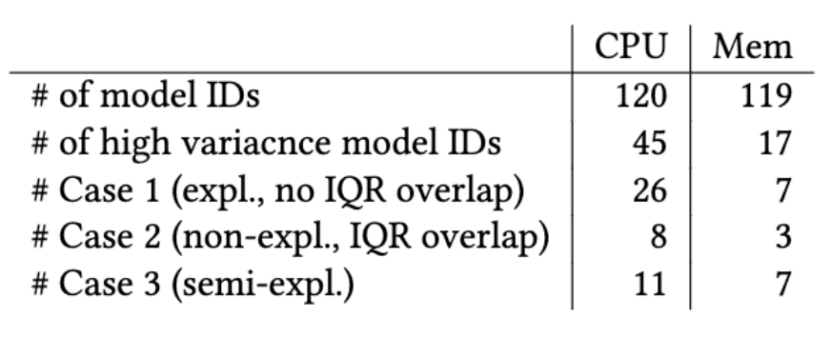
Result & Case Studies
Larger-scope Unreliability
Configuration Impact
Detected performance change caused by intentional downgrade for undisclosable reason.

