Slide 1





啦Wz
霹
雳
吧
bilibili
：

Slide 2

深度学习-图像处理篇
啦Wz
霹
雳
吧
bilibili
：
作者：神秘的wz

Slide 3
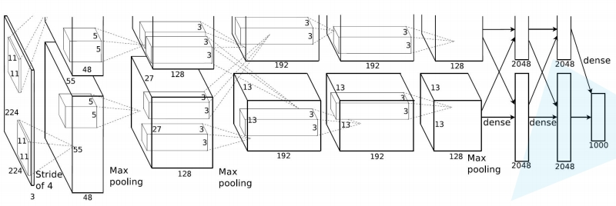
AlexNet详解
AlexNet是2012年ISLVRC 2012（ImageNet Large Scale Visual Recognition Challenge）竞赛的冠军网络，分类准确率由传统的 70%+提升到 80%+。 它是由Hinton和他的学生Alex Krizhevsky设计的。也是在那年之后，深
度学习开始迅速发展。
ISLVRC 2012
训练集：1,281,167张已标注图片 验证集：50,000张已标注图片 测试集：100,000张未标注图片
：

Slide 4
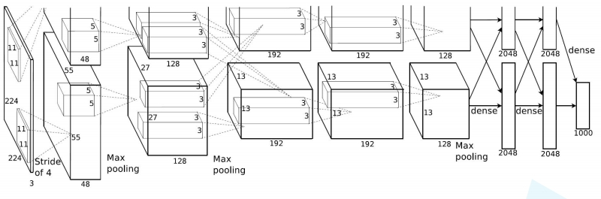
AlexNet详解
该网络的亮点在于：
（2）使用了 ReLU 激活函数，而不是传统的 Sigmoid 激活函数以及 Tanh 激活函数。 （3）使用了 LRN 局部响应归一化。
（4）在全连接层的前两层中使用了 Dropout 随机失活神经元操作，以减少过拟合。

Slide 5
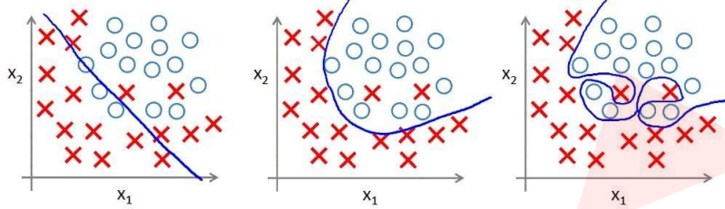
AlexNet详解
过拟合：根本原因是特征维度过多，模型假设过于复杂，参数 过多，训练数据过少，噪声过多，导致拟合的函数完美的预测 训练集，但对新数据的测试集预测结果差。 过度的拟合了训练 数据，而没有考虑到泛化能力。
：

Slide 6
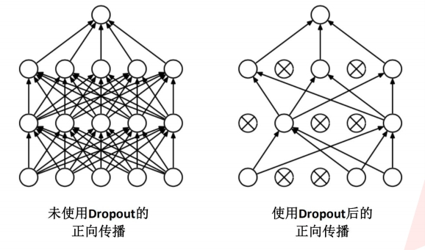
AlexNet详解
使用 Dropout 的方式在网络正向传播过程中随机失活一部分神经元

Slide 7
AlexNet详解
经卷积后的矩阵尺寸大小计算公式为： N = (W − F + 2P ) / S + 1
① 输入图片大小 W×W
啦Wz
② Filter大小 F×F
吧
霹
雳
：
③ 步长 S

Slide 8
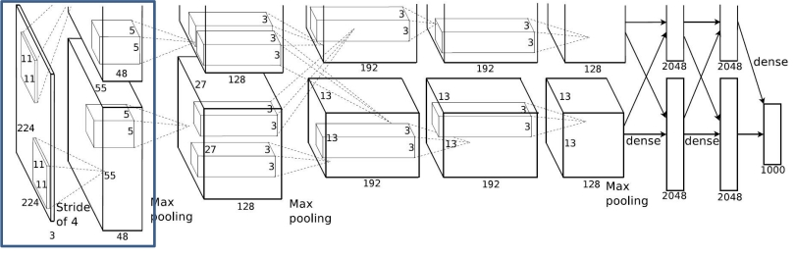
AlexNet详解
Conv1:kernels:48*2=96kernel_size:11：霹input_size:output_size:雳吧[55,[224,啦55,224,W96]3]z padding:[1, 2]
Conv1
bilibili
N = (W − F + 2P ) / S + 1 =[224-11+(1+2)]/4+1
stride:4

Slide 9
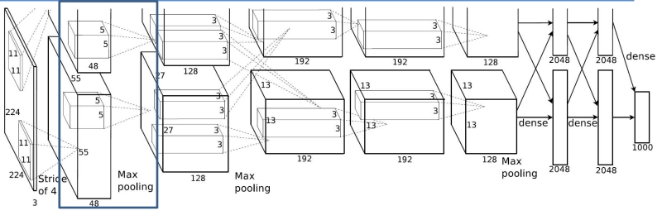
AlexNet详解
Maxpool1
吧input_size:啦W[55,z55, 96]
kernel_size:11padding:bili[1,b2]ili pading: 0
霹雳
Conv1:
Maxpool1:
：
kernels:48*2=96
kernel_size:3
output_size: [27, 27, 96]
stride:4 stride:2
N = (W − F + 2P ) / S + 1 =(55-3)/2+1
output_size:
[55, 55, 96]

Slide 10
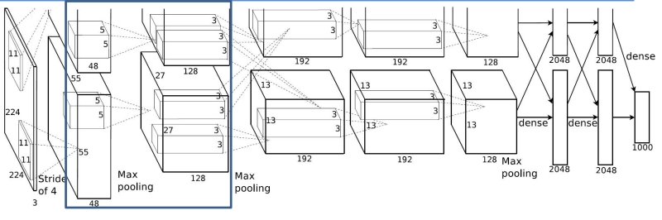
AlexNet详解
Conv2
kernels:48*2=96kernel_size:11padding: [1, 2] ：kernel_size:3pading:stride:2霹0 雳kernels:128*2=256kernel_size:5padding:吧啦[2, 2]Wz
Conv2:
bilibili
Conv1:
Maxpool1:
input_size: [27, 27, 96]
output_size: [27, 27, 256]
stride:1
N = (W − F + 2P ) / S + 1 =(27-5+4)/1+1
stride:4
output_size: output_size:
[55, 55, 96] [27, 27, 96]

Slide 11
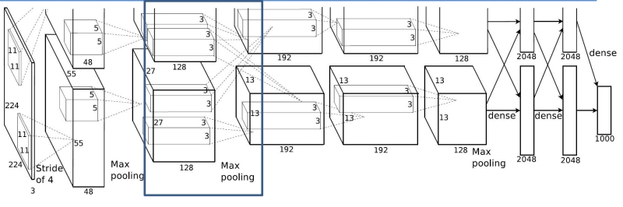
AlexNet详解
Maxpool2
kernels:48*2=96kernel_size:11 ：kernel_size:3pading:霹0 雳kernels:128*2=256kernel_size:5吧啦Wpading:z 0
Maxpool2:
input_size: [27, 27, 256]
bilibili
Conv1:
Maxpool1:
Conv2:
kernel_size:3
output_size: [13, 13, 256]
padding: [1, 2] stride:2 padding: [2, 2] stride:2 stride:4 stride:1
N = (W − F + 2P ) / S + 1 =(27-3)/2+1
output_size: output_size: output_size:
[55, 55, 96] [27, 27, 96] [27, 27, 256]

Slide 12
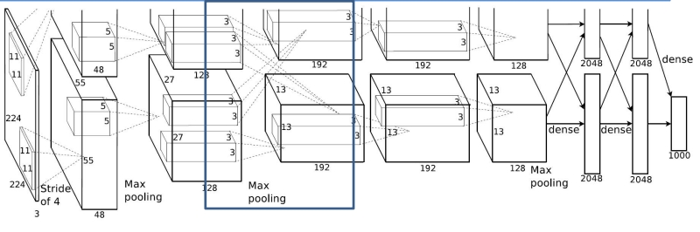
AlexNet详解
N = (W − F + 2P ) / S + 1 =(13-3+2)/1+1
Conv3
kernels:48*2=96kernel_size:11 ：kernel_size:3pading:霹0 雳kernels:128*2=256kernel_size:5吧啦Wkernel_size:3pading: 0
Conv3:
bilibili
Conv1:
Maxpool1:
Conv2:
Maxpool2:
kernels:192*2=384
kernel_size:3
padding: [1, 1]
padding: [1, 2] stride:2 padding: [2, 2] stride:2 stride:4 stride:1
stride:1
input_size: [13, 13, 256]
output_size: output_size: output_size: output_size: [55, 55, 96] [27, 27, 96] [27, 27, 256] [13, 13, 256]
output_size: [13, 13, 384]

Slide 13
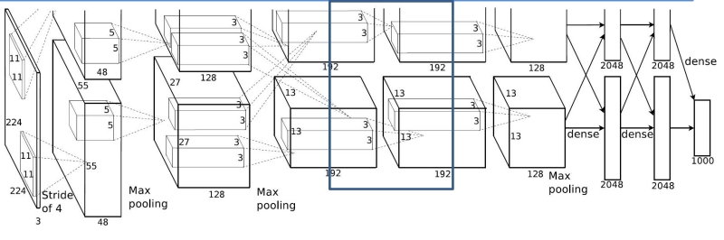
AlexNet详解
Conv4
N = (W − F + 2P ) / S + 1 =(13-3+2)/1+1
kernels:48*2=96kernel_size:11 kernel_size:3pading:：0 霹kernels:128*2=256kernel_size:5雳吧kernel_size:3pading:啦0Wkernels:192*2=384kernel_size:3
bilibili
Conv4:
Conv1:
Maxpool1:
Conv2:
Maxpool2:
Conv3:
kernels:192*2=384
padding: [1, 2] stride:2 padding: [2, 2] stride:2 padding: [1, 1] stride:4 stride:1 stride:1
kernel_size:3
padding: [1, 1]
output_size: output_size: output_size: output_size: output_size:
stride:1 input_size: [13, 13, 384]
[55, 55, 96] [27, 27, 96] [27, 27, 256] [13, 13, 256] [13, 13, 384]
output_size: [13, 13, 384]

Slide 14
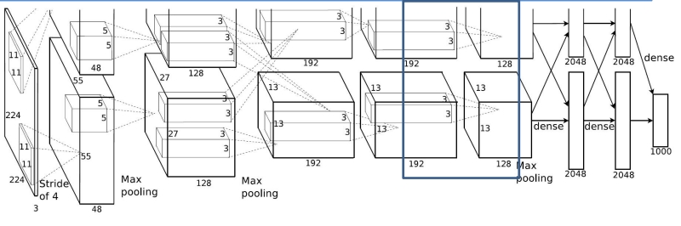
AlexNet详解
Conv5
N = (W − F + 2P ) / S + 1 =(13-3+2)/1+1
kernels:48*2=96kernel_size:11 kernel_size:3pading:：0 霹kernels:128*2=256kernel_size:5雳吧kernel_size:3pading:啦0Wkernels:192*2=384kernel_size:3
Conv5:
bilibili
kernels:128*2=256
Conv1:
Maxpool1:
Conv2:
Maxpool2:
Conv3:
Conv4:
kernels:192*2=384
kernel_size:3
kernel_size:3
padding: [1, 1]
padding: [1, 2] stride:2 padding: [2, 2] stride:2 padding: [1, 1] stride:4 stride:1 stride:1
padding: [1, 1]
stride:1
stride:1
output_size:
output_size:
output_size:
output_size:
output_size:
output_size:
input_size: [13, 13, 384]
[55, 55, 96]
[27, 27, 96]
[27, 27, 256]
[13, 13, 256]
[13, 13, 384]
[13, 13, 256]
output_size: [13, 13, 256]

Slide 15
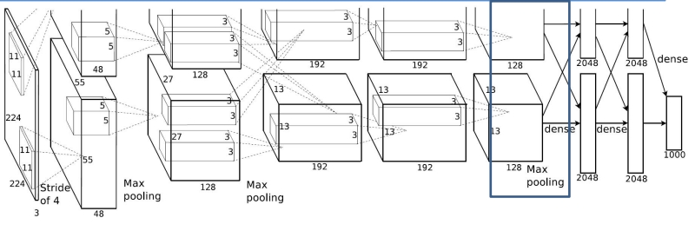
AlexNet详解
Maxpool3
N = (W − F + 2P ) / S + 1 =(13-3)/2+1
kernels:96kernel_size:11 kernel_size:3pading: ：0 kernels:256kernel_size:5霹雳kernel_size:3pading:吧0 啦kernels:=384kernel_size:3Wz
bilibili
Maxpool3:
Conv1:
Maxpool1:
Conv2:
Maxpool2:
Conv3:
Conv4:
Conv5:
kernels:384
kernels:128*2=256
kernel_size:3
kernel_size:3
kernel_size:3
padding: 0
padding: [1, 2] stride:2 padding: [2, 2] stride:2 padding: [1, 1] stride:4 stride:1 stride:1
padding: [1, 1]
padding: [1, 1]
stride:1
stride:1
stride:2
output_size:
output_size:
output_size:
output_size:
output_size:
output_size:
output_size:
input_size: [13, 13, 256]
[55, 55, 96]
[27, 27, 96]
[27, 27, 256]
[13, 13, 256]
[13, 13, 384]
[13, 13, 384]
[13, 13, 256]
output_size: [6, 6, 256]

Slide 16
layer_name | kernel_size | kernel_num | padding | stride
Conv1 | 11 | 96 | [1, 2] | 4
Maxpool1 | 3 | None | 0 | 2
Conv2 | 5 | 256 | [2, 2] | 1
Maxpool2 | 3 | None | 0 | 2
Conv3 | 3 | 384 | [1, 1] | 1
Conv4 | 3 | 384 | [1, 1] | 1
 |  |  | [1, 1] | 1
 | 3 | None | 0 | 2
FC1 | 2048 | None | None | None
FC2 | 2048 | None | None | None
FC3 | 1000 | None | None | None

Slide 17



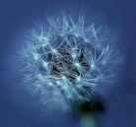

AlexNet详解
下载花分类数据集
daisy
dandelion
sunflower
tulips
蒲公英
玫瑰
向日葵
郁金香

Slide 18
沟通方式
1.github
https://github.com/WZMIAOMIAO/deep-learning-for-image-processing
2.CSDN
https://blog.csdn.net/qq_37541097/article/details/1034820033.bilibili：霹雳吧啦Wz
bilibili
https://www.bilibili.com/video/av79436317
尽可能每周更新

Slide 19



