Slide 1


A COMPARATIVE ANALYSIS OF WEBSOCKETS
websockets vs autobahn-ws
Ufuk Civan Atbaş

Slide 2
Outline
Introduction: Purpose and Objectives
Choosing websockets and autobahn-ws
Metrics and Evaluation Criteria
Analysis and Findings

Slide 3
Introduction: Purpose and Objectives
Evaluation of two widely used WebSocket libraries.
Conducted on MacBook Pro M1 Max with 32GB RAM.
Utilized Docker with resource constraints: 1 CPU, 1GB RAM.

Slide 4
Choosing websockets and autobahn-ws
websockets:
Strong community (5k stars)
Correctness and simplicity
Supports various WebSocket protocol versions and offers robust error handling.
Built on top of asyncio
autobahn-ws:
Strong community (2.5k stars)
Performance optimization
Suitable for applications requiring low latency and high throughput.
Built on top of asyncio (it also has twisted version)

Slide 5
Metrics and Evaluation Criteria
Latency Metrics Comparison
Average Latency: average time taken for messages to travel
Minimum Latency: lowest recorded
Maximum Latency: highest recorded
Throughput Metrics Comparison
Overall Throughput: successfully transmitted messages over the ws connection.
Throughput per Client

Slide 6
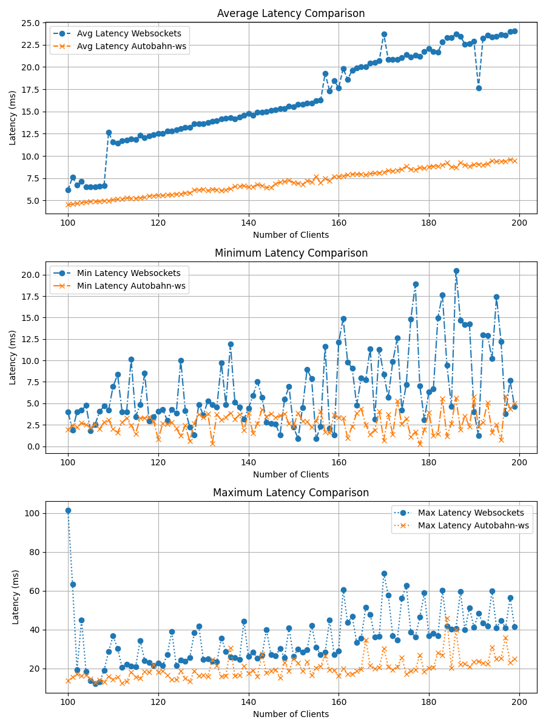
Analysis and Findings: Latency
Average Latency: autobahn is performing more stable and better in average.
Minimum Latency: the value and volatility of websockets is worse than autobahn
Maximum Latency: autobahn is performing better in maximum values.
Conclusion: websockets has higher latency compared to autobahn

Slide 7
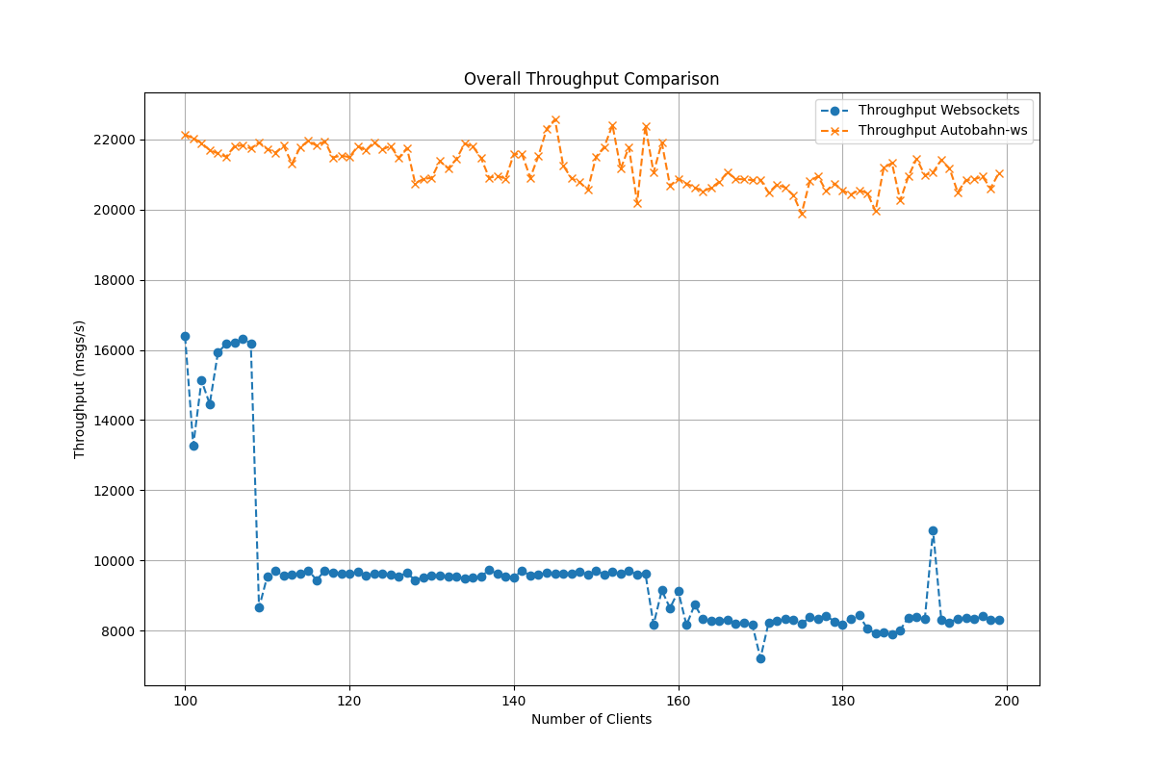
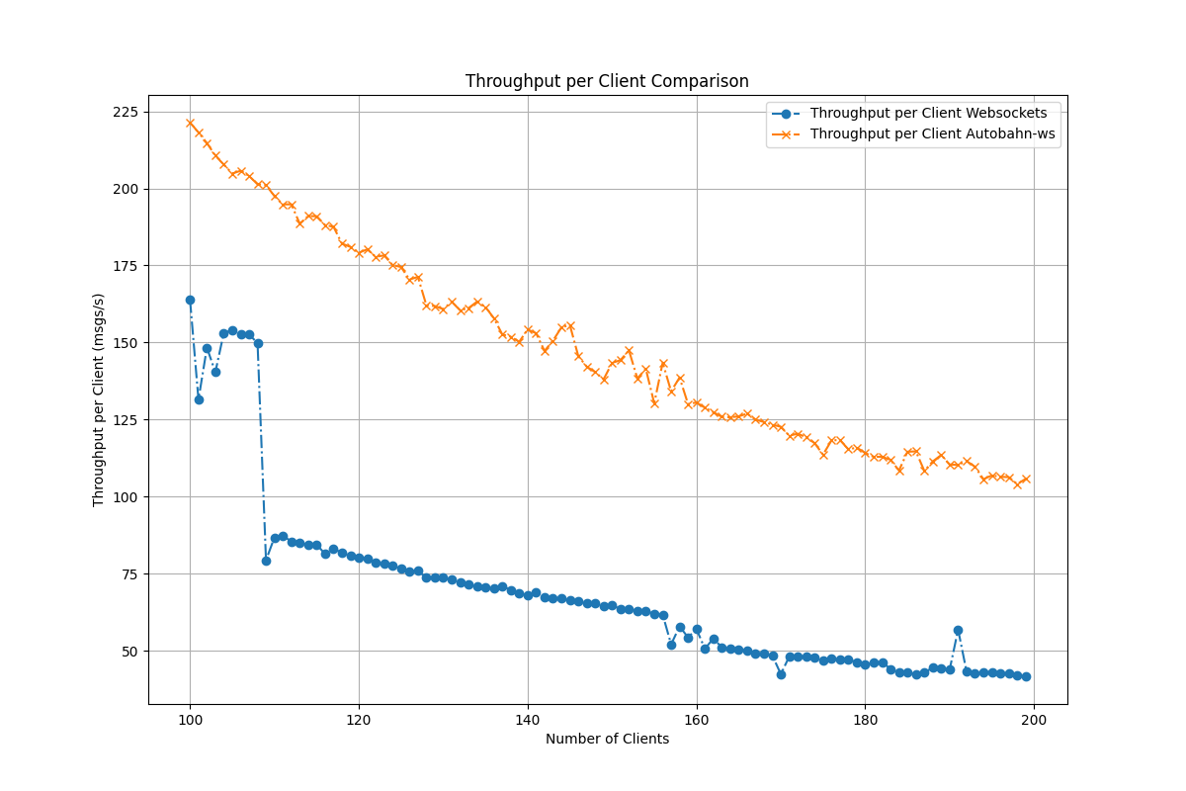
Analysis and Findings: Throughput
Overall Throughput: autobahn performs higher overall throughput.
Throughput per Client: autobahn delivers higher throughput per client
Conclusion: autobahn has higher throughput performance

Slide 8
Final
For applications prioritizing low latency and high throughput, Autobahn-ws is recommended over Websockets.

Slide 9
Thank you!

