Slide 1
Lecture 4
Two-View Geometry

Slide 2
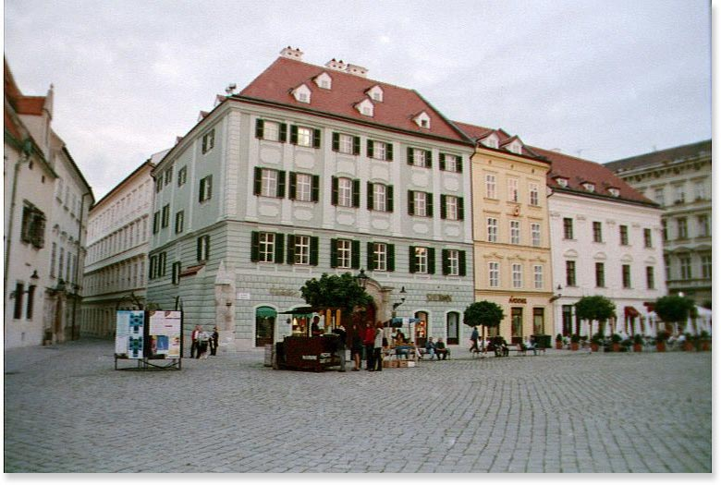
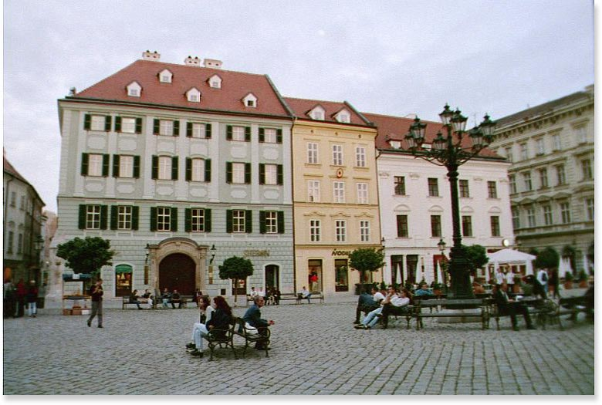





General Formulation
Given two views of the scene
recover the unknown camera
displacement and 3D scene
structure
MASKS © 2004
Invitation to 3D vision

Slide 3
Pinhole Camera Model
3D points
Image points
Perspective Projection
Rigid Body Motion
Rigid Body Motion + Projective projection
MASKS © 2004
Invitation to 3D vision

Slide 4
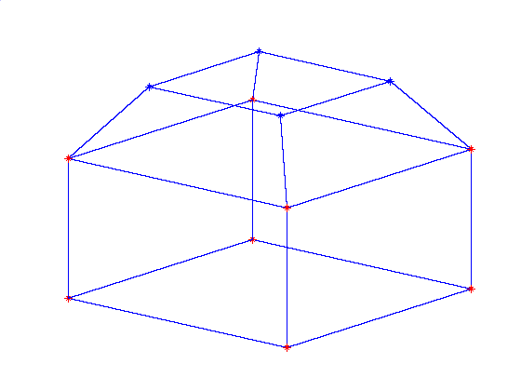

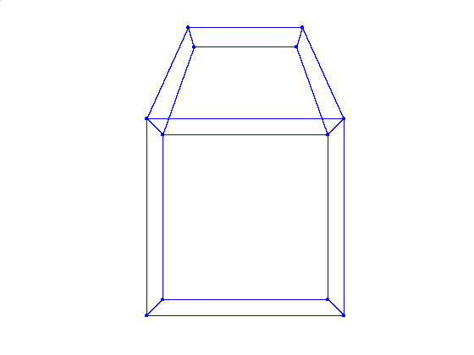
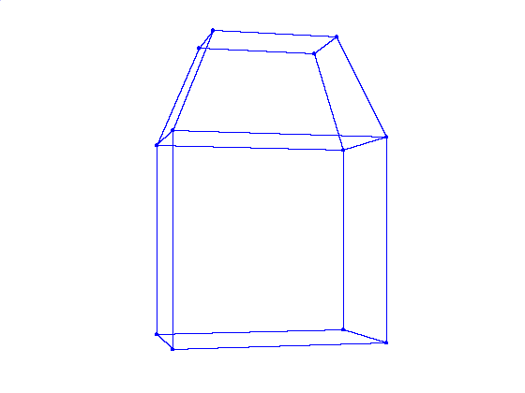


Rigid Body Motion – Two views
MASKS © 2004
Invitation to 3D vision

Slide 5
3D Structure and Motion Recovery
Euclidean transformation
measurements
unknowns
Find such Rotation and Translation and Depth that the reprojection error is minimized
Two views ~ 200 points
6 unknowns – Motion 3 Rotation, 3 Translation
- Structure 200x3 coordinates
- (-) universal scale
Difficult optimization problem
MASKS © 2004
Invitation to 3D vision

Slide 6
Epipolar Geometry
Image
correspondences
Algebraic Elimination of Depth
[Longuet-Higgins ’81]:
Essential matrix
MASKS © 2004
Invitation to 3D vision

Slide 7






Epipolar Geometry
Epipolar lines
Epipoles
Image
correspondences
MASKS © 2004
Invitation to 3D vision

Slide 8

Characterization of the Essential Matrix
Essential matrix
Special 3x3 matrix
Theorem 1a (Essential Matrix Characterization)
A non-zero matrix is an essential matrix iff its SVD:
satisfies: with and
and
MASKS © 2004
Invitation to 3D vision

Slide 9

Estimating the Essential Matrix
Estimate Essential matrix
Decompose Essential matrix into
Given n pairs of image correspondences:
Find such Rotation and Translation that the epipolar error is minimized
Space of all Essential Matrices is 5 dimensional
3 Degrees of Freedom – Rotation
2 Degrees of Freedom – Translation (up to scale !)
MASKS © 2004
Invitation to 3D vision

Slide 10
Pose Recovery from the Essential Matrix
Essential matrix
Theorem 1a (Pose Recovery)
There are two relative poses with and
corresponding to a non-zero matrix essential matrix.
Twisted pair ambiguity
MASKS © 2004
Invitation to 3D vision

Slide 11
Estimating Essential Matrix
Denote
Rewrite
Collect constraints from all points
MASKS © 2004
Invitation to 3D vision

Slide 12

Estimating Essential Matrix
Solution
Eigenvector associated with the smallest eigenvalue of
if degenerate configuration
Projection on to Essential Space
Theorem 2a (Project to Essential Manifold)
If the SVD of a matrix is given by
then the essential matrix which minimizes the
Frobenius distance is given by
with
MASKS © 2004
Invitation to 3D vision

Slide 13
Two view linear algorithm
Solve the LLSE problem:
followed by projection
Project onto the essential manifold:
SVD:
E is 5 diml. sub. mnfld. in
8-point linear algorithm
Recover the unknown pose:
MASKS © 2004
Invitation to 3D vision

Slide 14

Pose Recovery
There are exactly two pairs corresponding to each
essential matrix .
There are also two pairs corresponding to each
essential matrix .
Positive depth constraint - used to disambiguate the physically impossible solutions
Translation has to be non-zero
Points have to be in general position
- degenerate configurations – planar points
- quadratic surface
Linear 8-point algorithm
Nonlinear 5-point algorithms yield up to 10 solutions
MASKS © 2004
Invitation to 3D vision

Slide 15
3D structure recovery
Eliminate one of the scale’s
Solve LLSE problem
If the configuration is non-critical, the Euclidean structure of then points and motion of the camera can be reconstructed up to a universal scale.
MASKS © 2004
Invitation to 3D vision

Slide 16
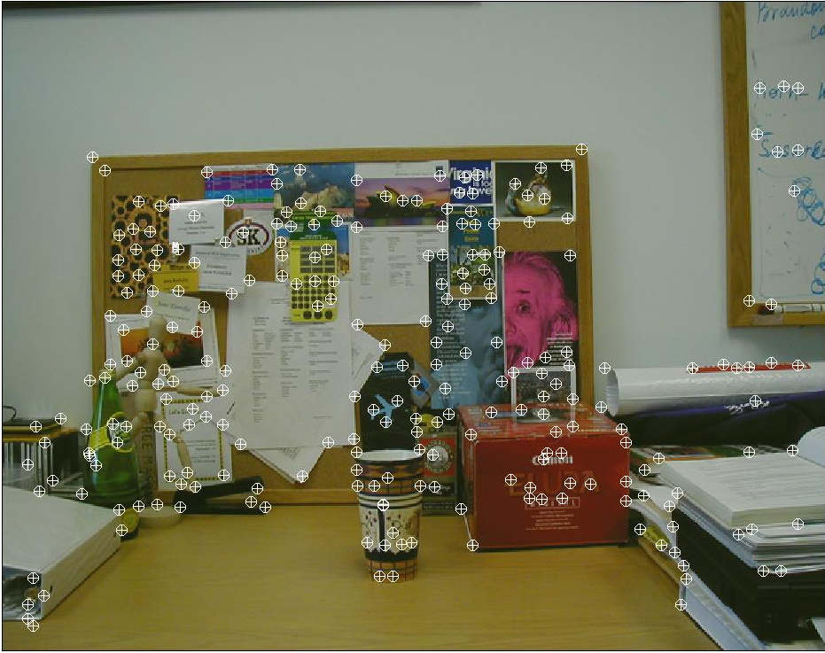
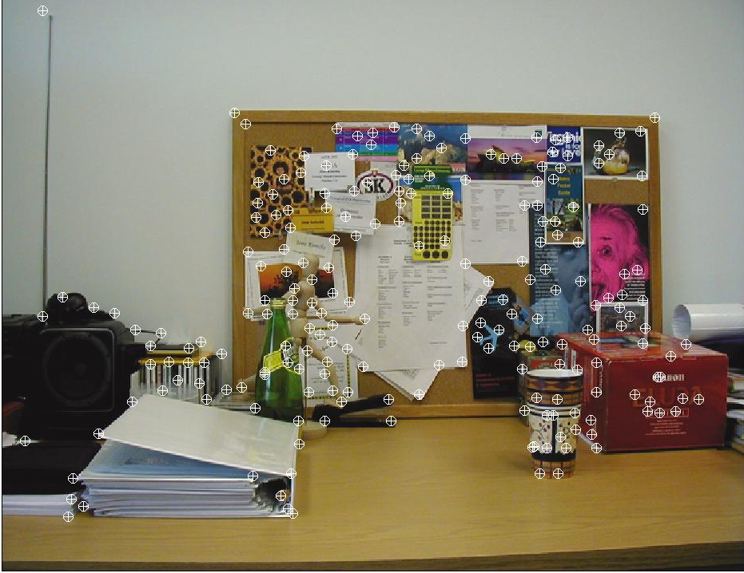
Example- Two views
Point Feature Matching
MASKS © 2004
Invitation to 3D vision

Slide 17
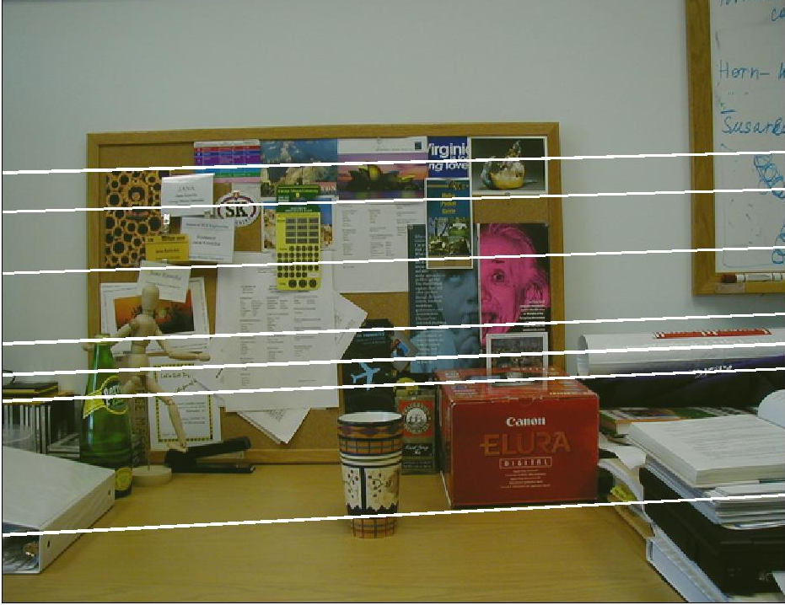
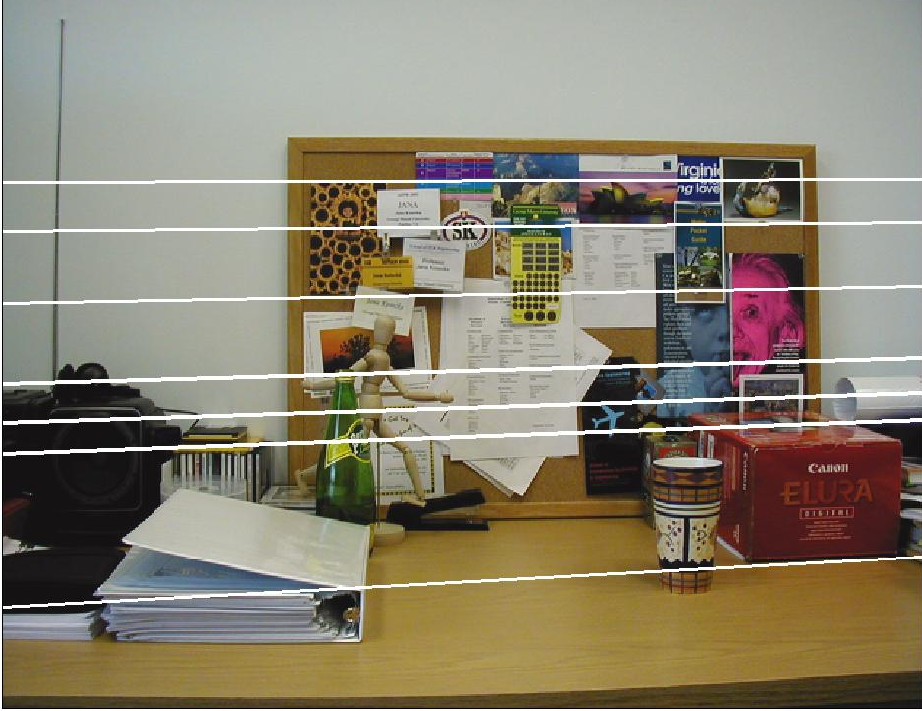
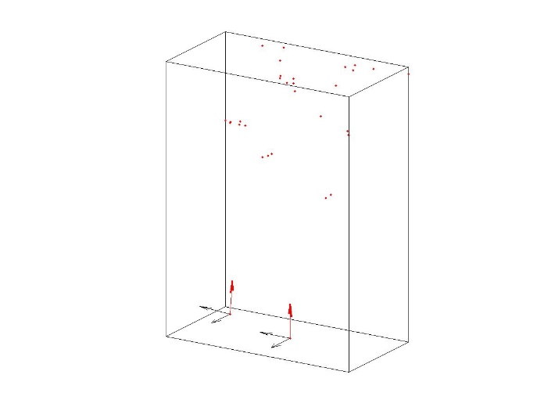
Example – Epipolar Geometry
Camera Pose
and
Sparse Structure Recovery
MASKS © 2004
Invitation to 3D vision

Slide 18

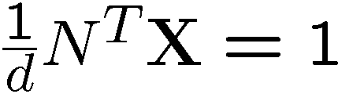
Epipolar Geometry – Planar Case
Plane in first camera coordinate frame
Image
correspondences
Planar homography
Linear mapping relating two
corresponding planar points
in two views
MASKS © 2004
Invitation to 3D vision

Slide 19

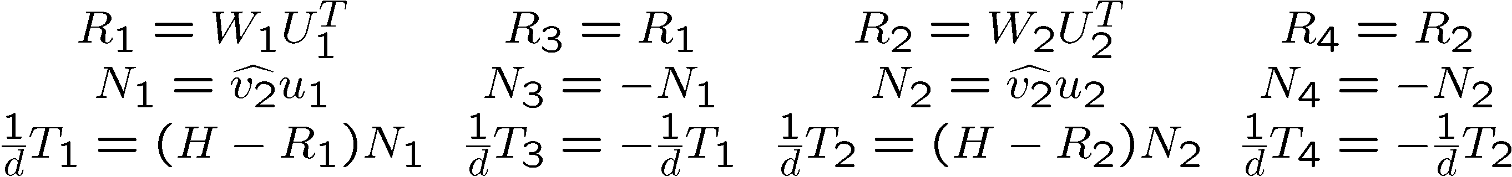
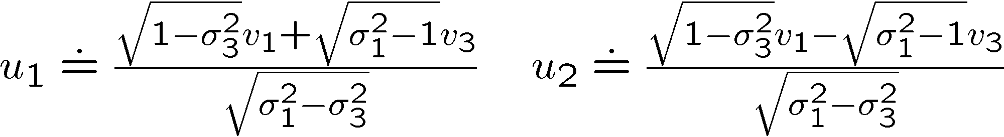
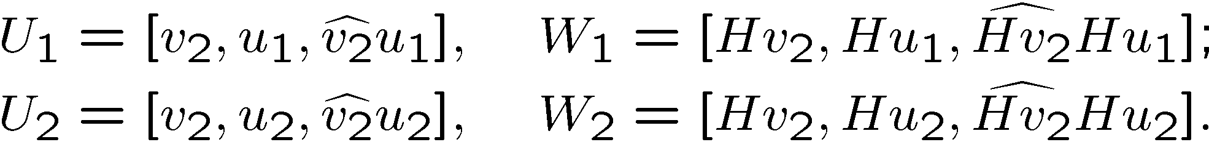
Decomposition of H
Algebraic elimination of depth
can be estimated linearly
Normalization of
Decomposition of H into 4 solutions
MASKS © 2004
Invitation to 3D vision

Slide 20
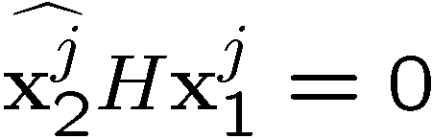


Motion and pose recovery for planar scene
Given at least 4 point correspondences
Compute an approximation of the homography matrix
As nullspace of
Normalize the homography matrix
Decompose the homography matrix
Select two physically possible solutions imposing
positive depth constraint
the rows of are
MASKS © 2004
Invitation to 3D vision

Slide 21
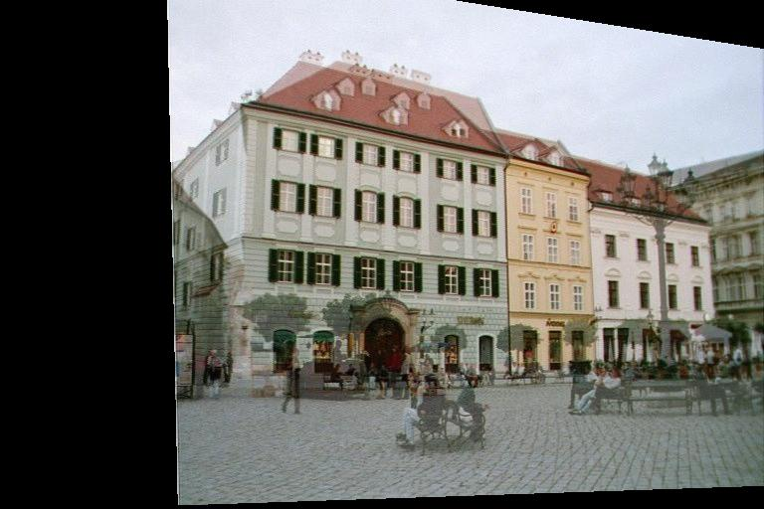
Example
MASKS © 2004
Invitation to 3D vision

Slide 22
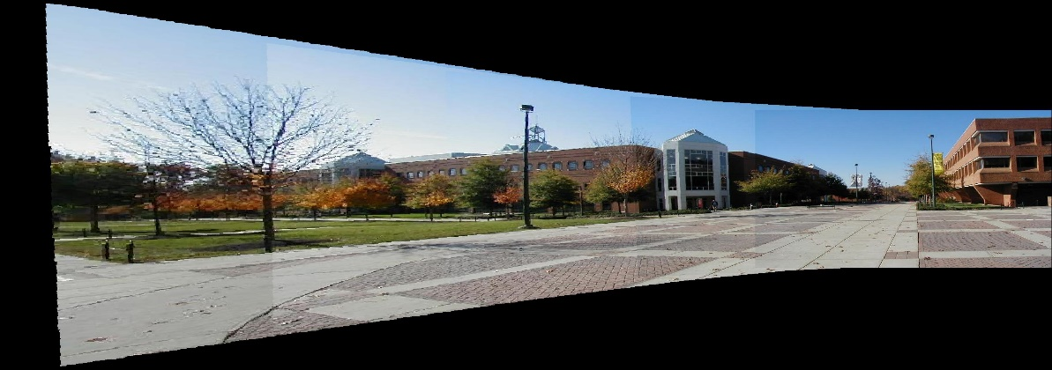
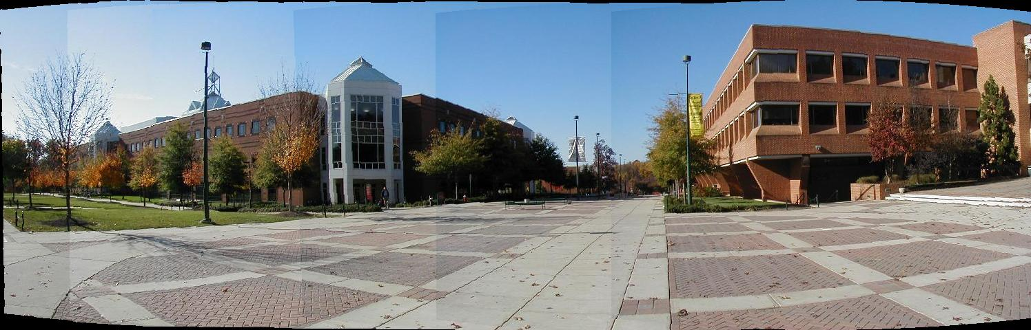
Special Rotation Case
Two view related by rotation only
Mapping to a reference view
Mapping to a cylindrical surface
MASKS © 2004
Invitation to 3D vision

Slide 23
Motion and Structure Recovery – Two Views
Two views – general motion, general structure
1. Estimate essential matrix
2. Decompose the essential matrix
3. Impose positive depth constraint
4. Recover 3D structure
Two views – general motion, planar structure
1. Estimate planar homography
2. Normalize and decompose H
3. Recover 3D structure and camera pose
MASKS © 2004
Invitation to 3D vision

