Slide 1
Lecture 2
Rigid-Body Motion
and
Imaging Geometry
MASKS © 2004
Invitation to 3D vision

Slide 2
OUTLINE
3-D EUCLIDEAN SPACE & RIGID-BODY MOTION
  Coordinates and coordinate frames
  Rigid-body motion and homogeneous
  coordinates
GEOMETRIC MODELS OF IMAGE FORMATION
  Pinhole camera model
CAMERA INTRINSIC PARAMETERS
  From metric to pixel coordinates
SUMMARY OF NOTATION
MASKS © 2004
Invitation to 3D vision

Slide 3


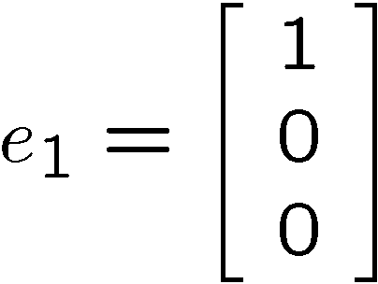
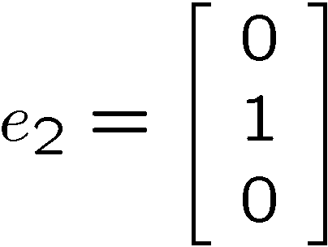
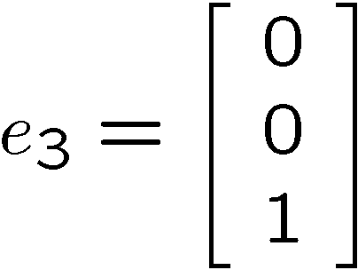







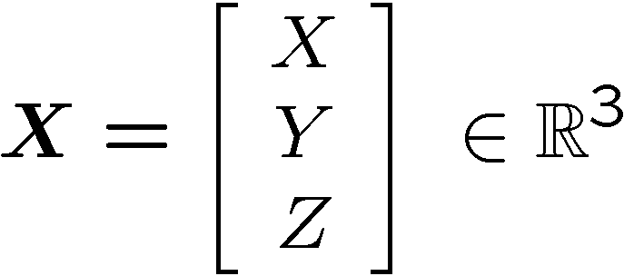
3-D EUCLIDEAN SPACE - Cartesian Coordinate Frame
Standard base vectors:
Coordinates of a point in space:
MASKS © 2004
Invitation to 3D vision

Slide 4

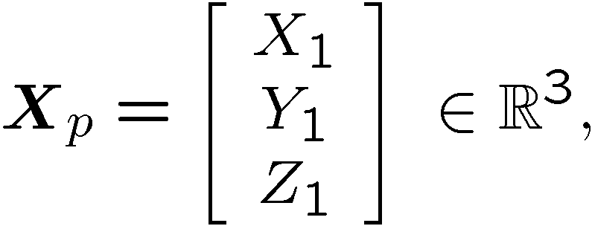
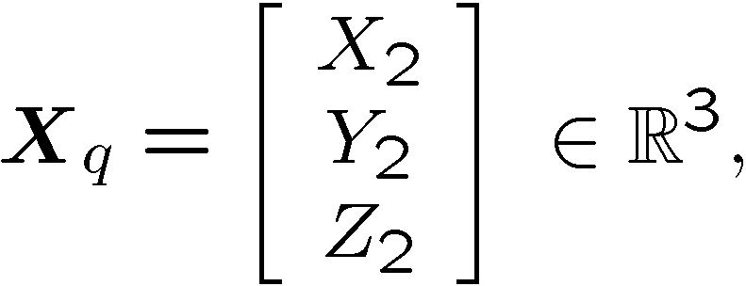



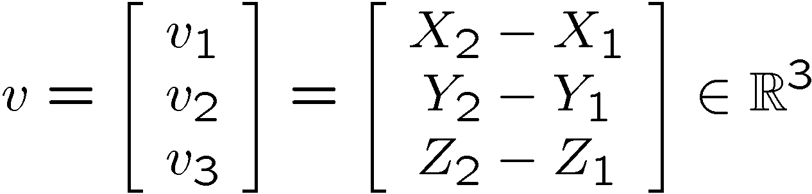

3-D EUCLIDEAN SPACE - Vectors
A “free” vector is defined by a pair
of points :
Coordinates of the vector :
MASKS © 2004
Invitation to 3D vision

Slide 5
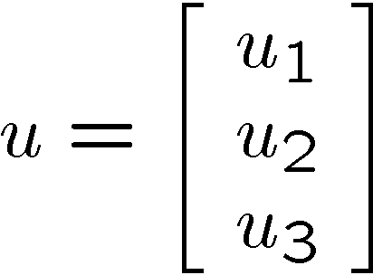
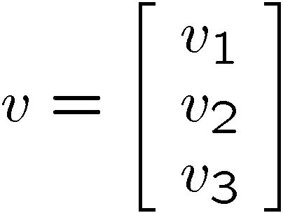


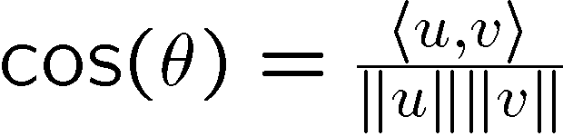
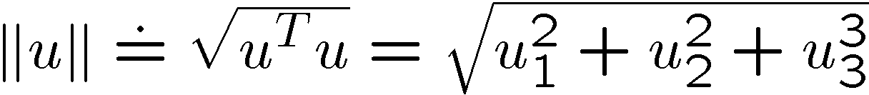


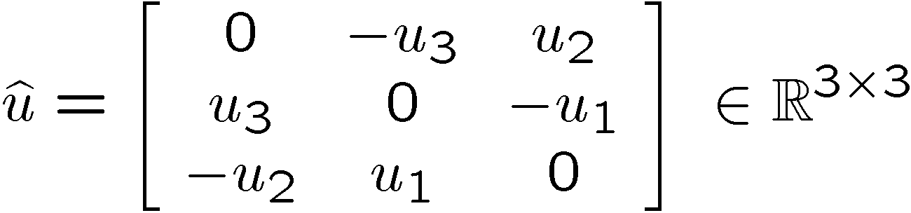
3-D EUCLIDEAN SPACE – Inner Product and Cross Product
Inner product between two vectors:
Cross product between two vectors:
MASKS © 2004
Invitation to 3D vision
Notes:
We will always use column vectors, except for one case which I will mention later on. Given a three dimensional vector u, we use u-hat to represent a 3x3 skew symmetric matrix associated to it. In the literature, people also use u-product for the same thing. Using this notation, u-hat multiplying a vector v is then equal to their cross product. In particular, u crosses with u itself gets zero.

Slide 6








RIGID-BODY MOTION – Rotation
Rotation matrix:
Coordinates are related by:
MASKS © 2004
Invitation to 3D vision

Slide 7








RIGID-BODY MOTION – Rotation and Translation
Coordinates are related by:
Velocities are related by:
MASKS © 2004
Invitation to 3D vision
Notes:
We will always use column vectors, except for one case which I will mention later on. Given a three dimensional vector u, we use u-hat to represent a 3x3 skew symmetric matrix associated to it. In the literature, people also use u-product for the same thing. Using this notation, u-hat multiplying a vector v is then equal to their cross product. In particular, u crosses with u itself gets zero.

Slide 8
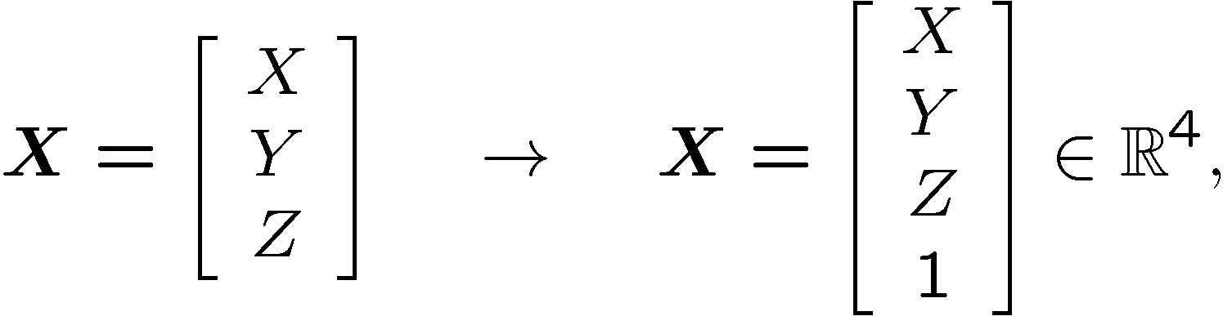
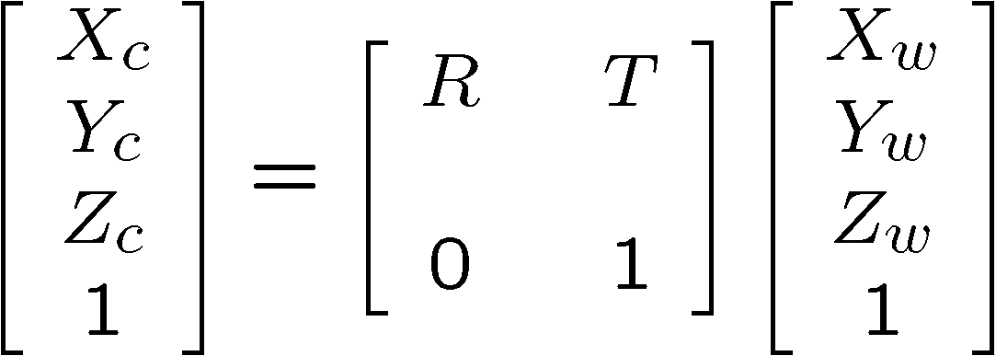
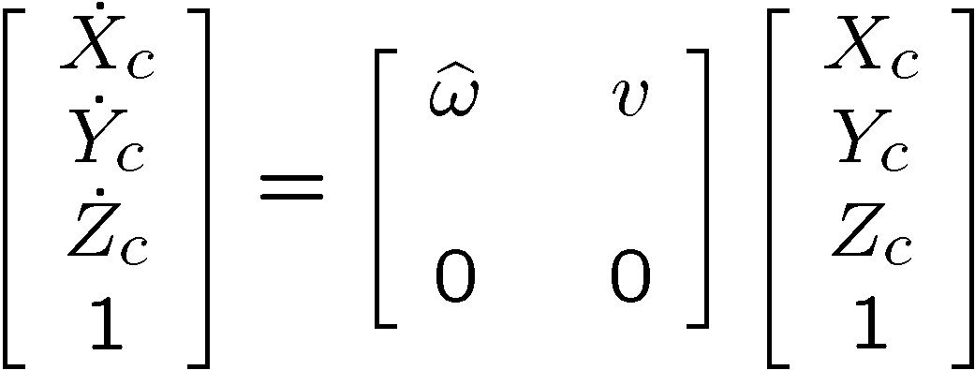
RIGID-BODY MOTION – Homogeneous Coordinates
3-D coordinates are related by:
Homogeneous coordinates:
Homogeneous coordinates/velocities are related by:
MASKS © 2004
Invitation to 3D vision
Notes:
We will always use column vectors, except for one case which I will mention later on. Given a three dimensional vector u, we use u-hat to represent a 3x3 skew symmetric matrix associated to it. In the literature, people also use u-product for the same thing. Using this notation, u-hat multiplying a vector v is then equal to their cross product. In particular, u crosses with u itself gets zero.

Slide 9
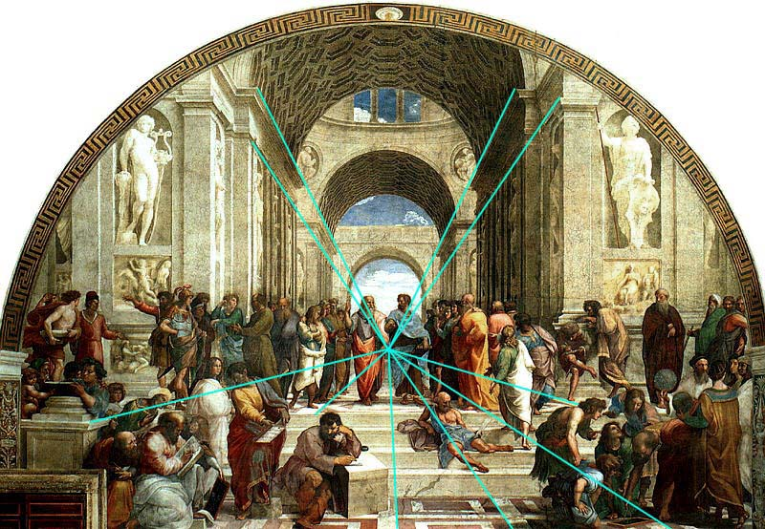
IMAGE FORMATION – Perspective Imaging
“The Scholar of Athens,” Raphael, 1518
MASKS © 2004
Invitation to 3D vision
Image courtesy of C. Taylor
Notes:
By the end of Renaissance, artists have perfected the techniques on how to paint with correct perspective projection. This is shown vividly and overwhelmingly in paintings from this era.

Slide 10


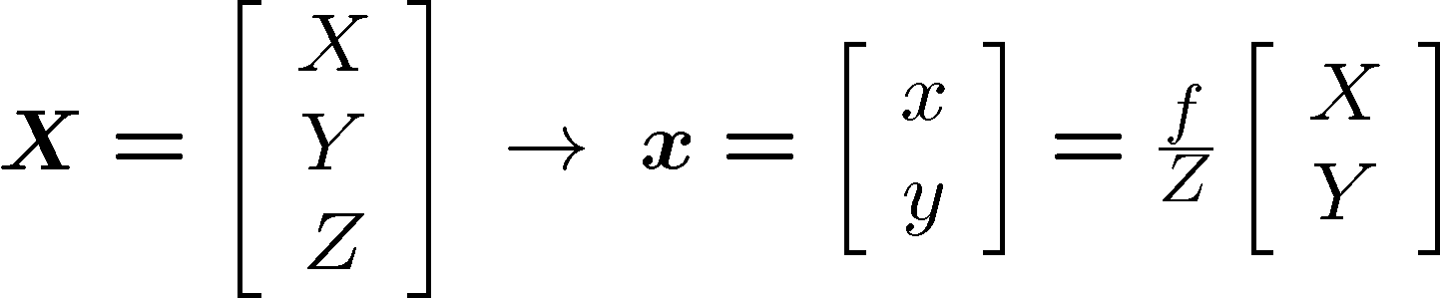
IMAGE FORMATION – Pinhole Camera Model
Pinhole
Frontal
pinhole
MASKS © 2004
Invitation to 3D vision
Notes:
We will always use column vectors, except for one case which I will mention later on. Given a three dimensional vector u, we use u-hat to represent a 3x3 skew symmetric matrix associated to it. In the literature, people also use u-product for the same thing. Using this notation, u-hat multiplying a vector v is then equal to their cross product. In particular, u crosses with u itself gets zero.

Slide 11
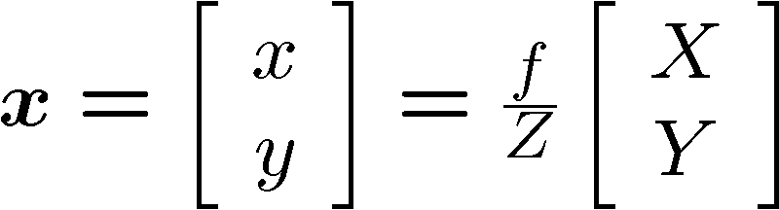
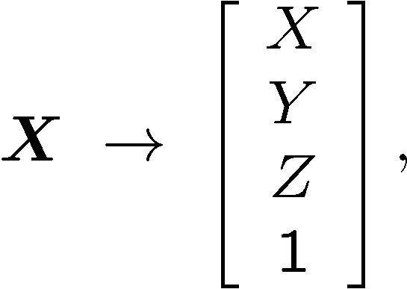
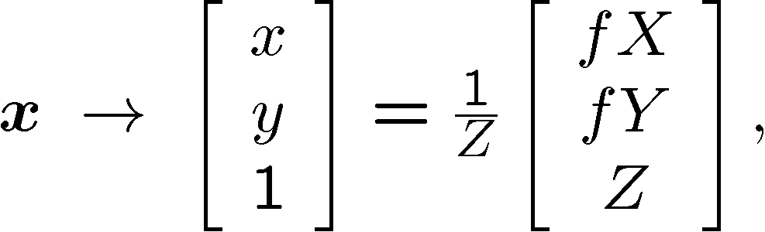
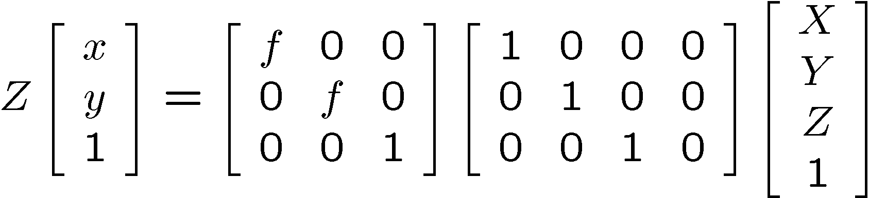


IMAGE FORMATION – Pinhole Camera Model
2-D coordinates
Homogeneous coordinates
MASKS © 2004
Invitation to 3D vision
Notes:
We will always use column vectors, except for one case which I will mention later on. Given a three dimensional vector u, we use u-hat to represent a 3x3 skew symmetric matrix associated to it. In the literature, people also use u-product for the same thing. Using this notation, u-hat multiplying a vector v is then equal to their cross product. In particular, u crosses with u itself gets zero.

Slide 12
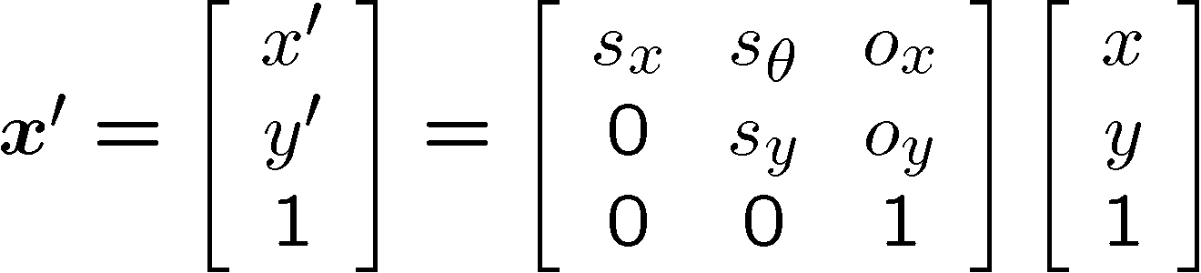








CAMERA PARAMETERS – Pixel Coordinates
metric
coordinates
Linear transformation
pixel
coordinates
MASKS © 2004
Invitation to 3D vision
Notes:
We will always use column vectors, except for one case which I will mention later on. Given a three dimensional vector u, we use u-hat to represent a 3x3 skew symmetric matrix associated to it. In the literature, people also use u-product for the same thing. Using this notation, u-hat multiplying a vector v is then equal to their cross product. In particular, u crosses with u itself gets zero.

Slide 13


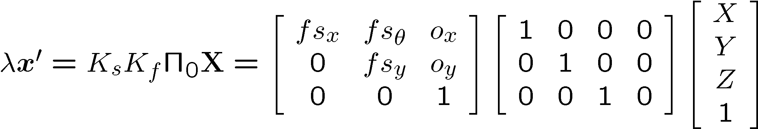



CAMERA PARAMETERS – Calibration Matrix and Camera Model
Pinhole camera
Pixel coordinates
Calibration matrix
(intrinsic parameters)
Projection matrix
Camera model
MASKS © 2004
Invitation to 3D vision
Notes:
We will always use column vectors, except for one case which I will mention later on. Given a three dimensional vector u, we use u-hat to represent a 3x3 skew symmetric matrix associated to it. In the literature, people also use u-product for the same thing. Using this notation, u-hat multiplying a vector v is then equal to their cross product. In particular, u crosses with u itself gets zero.

Slide 14
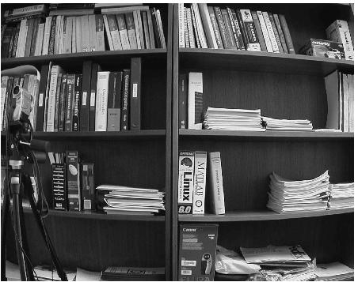
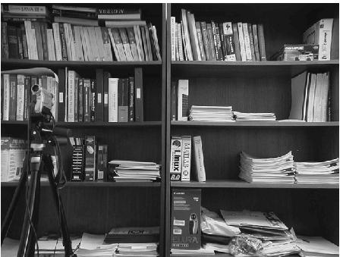






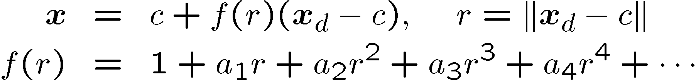
CAMERA PARAMETERS – Radial Distortion
Nonlinear transformation along the radial direction
Distortion correction: make lines straight
MASKS © 2004
Invitation to 3D vision
Notes:
We will always use column vectors, except for one case which I will mention later on. Given a three dimensional vector u, we use u-hat to represent a 3x3 skew symmetric matrix associated to it. In the literature, people also use u-product for the same thing. Using this notation, u-hat multiplying a vector v is then equal to their cross product. In particular, u crosses with u itself gets zero.

Slide 15




IMAGE FORMATION – Image of a Point
Homogeneous coordinates of a 3-D point
Homogeneous coordinates of its 2-D image
Projection of a 3-D point to an image plane
MASKS © 2004
Invitation to 3D vision
Notes:
Now let me quickly go through the basic mathematical model for a camera system. Here is the notation. We will use a four dimensional vector X for the homogeneous coordinates of a 3-D point p, its image on a pre-specified plane will be described also in homogeneous coordinate as a three dimensional vector x. If everything is normalized, then W and z can be chosen to be 1. We use a 3x4 matrix Pi to denote the transformation from the world frame to the camera frame. R may stand for rotation, T for translation. Then the image x and the world coordinate X of a point is related through the equation, where lambda is a scale associated to the depth of the 3D point relative to the camera center o. But in general the matrix Pi can be any 3x4 matrix, because the camera may add some unknown linear transformation on the image plane. Usually it is denoted by a 3x 3 matrix A(t).

Slide 16

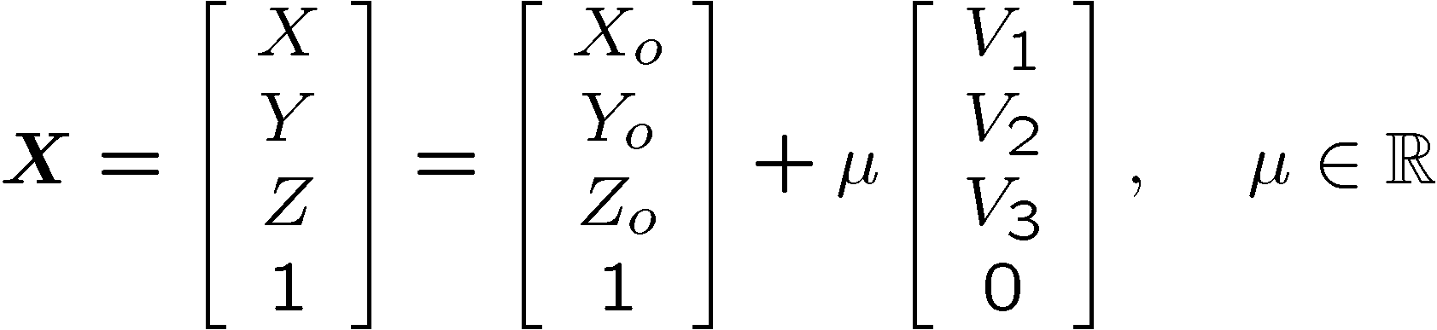


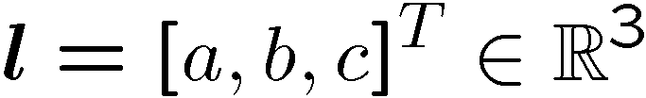


IMAGE FORMATION – Image of a Line
Homogeneous representation of a 3-D line
Homogeneous representation of its 2-D image
Projection of a 3-D line to an image plane
MASKS © 2004
Invitation to 3D vision
Notes:
To describe a line in 3-D, we need to specify a base point on the line and a vector indicating the direction of the line. On the image plane we can use a three dimensional vector l to describe the image of a line L. More specifically, if x is the image of a point on this line, its inner product with l is 0.

Slide 17













SUMMARY OF NOTATION – Multiple Images
.
.
.
Images are all “incident” at the corresponding features in space;
Features in space have many types of incidence relationships;
Features in space have many types of metric relationships.
MASKS © 2004
Invitation to 3D vision
Notes:
Now consider multiple images of a simplest object, say a cube. All the constraints are incidence relations, are all of the same nature. Is there any way that we can express all the constraints in a unified way? Yes, there is.

