Slide 1
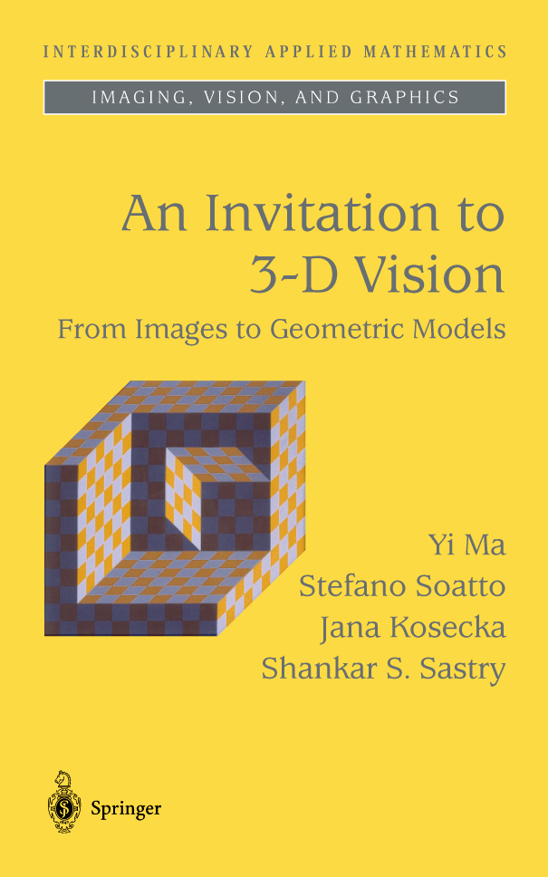
MASKS © 2004
Invitation to 3D vision
Notes:
A primary reference for this course is a book soon to be published by Springer Verlag, authored by me, Stefano, Jana, and Shankar Sastry. There is a bound version displayed at Springer-Verlag’s booth.

Slide 2
Lecture 1
Overview and Introduction
MASKS © 2004
Invitation to 3D vision
Notes:
Let me first give a brief introduction to multiple-view geometry. Before we address how to reconstruct 3-D geometry from 2-D images, we first need to understand how 2-D images are generated.

Slide 3
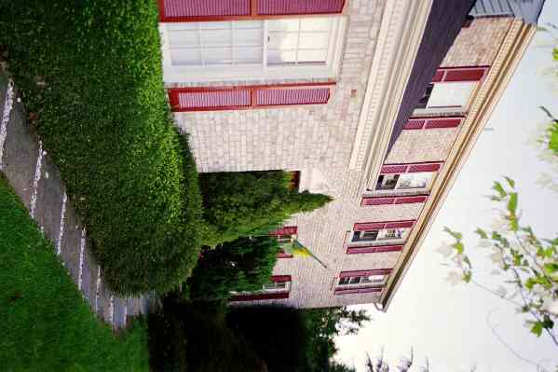
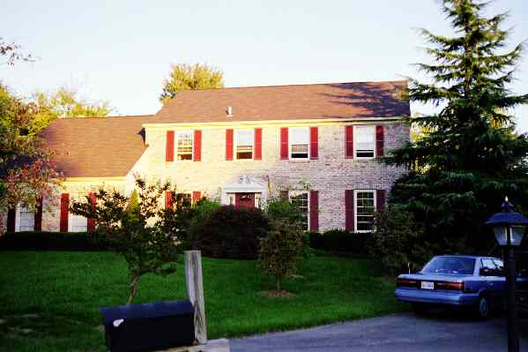
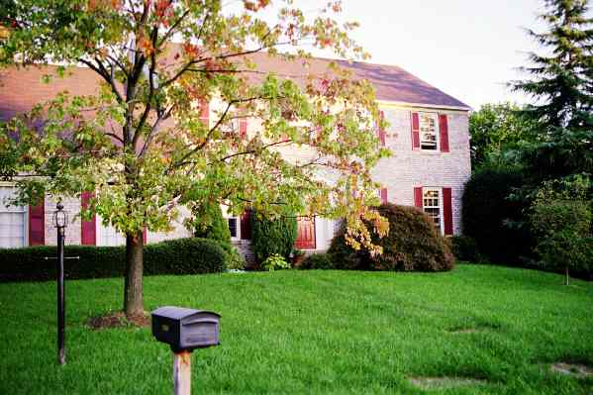
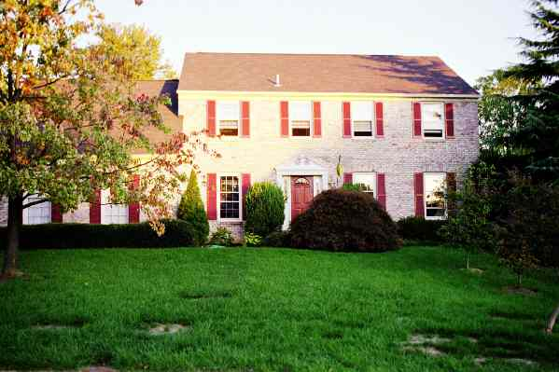
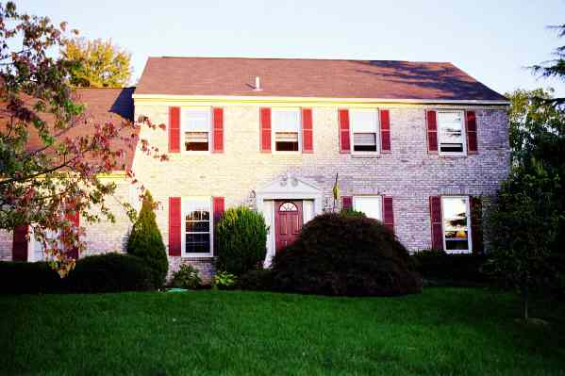
Reconstruction from images – The Fundamental Problem
Input: Corresponding “features” in multiple perspective images.
Output: Camera pose, calibration, scene structure representation.
MASKS © 2004
Invitation to 3D vision
Notes:
The problem in which we are interested, however, is almost opposite or inverse to the problem of painting. That is, given set of 2-D images or paintings how to recover the 3-D geometry of the scene. What makes this problem difficult is that we typically do NOT know the viewpoints from which the images were taken. Furthermore, some of the camera parameters such as the focal length is also unknown. In spite of these difficulties, this course will show that, under some reasonable modeling assumptions, how we can recover the camera pose, calibration, scene structure, and even some surface photometry from the given images.

Slide 4
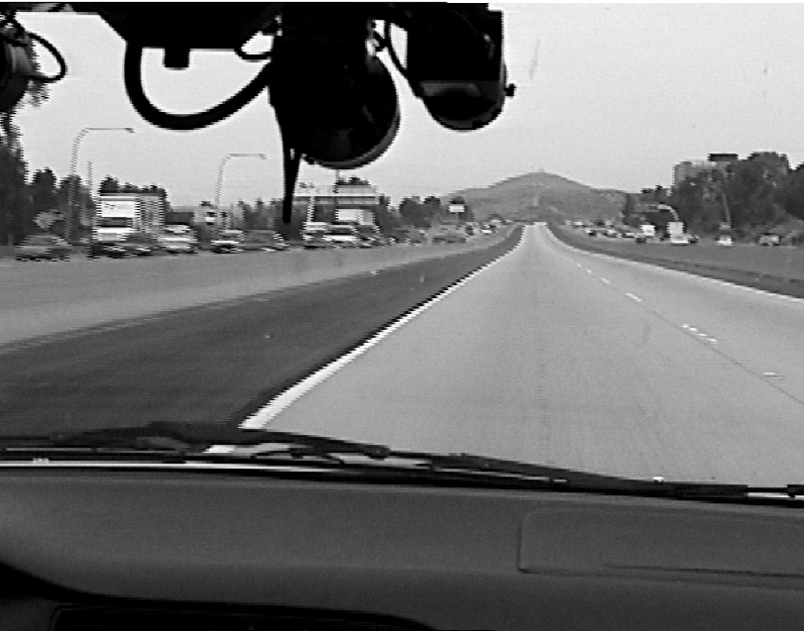
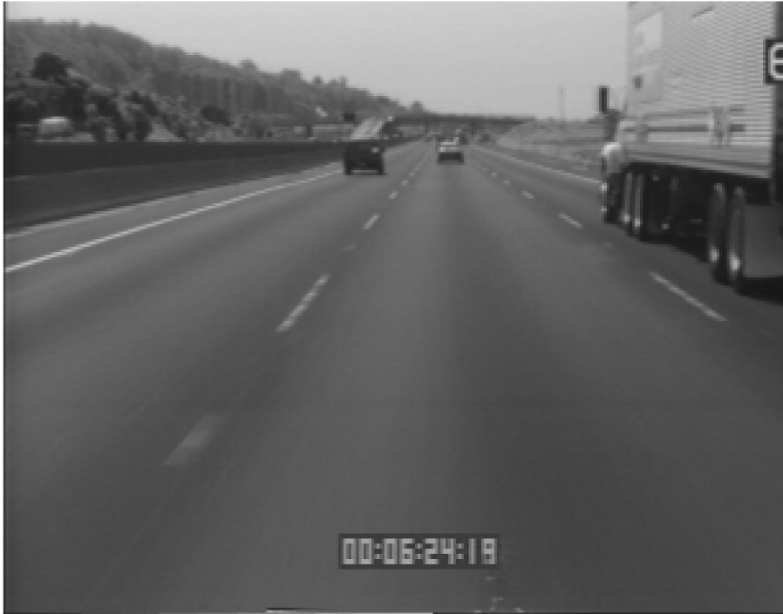
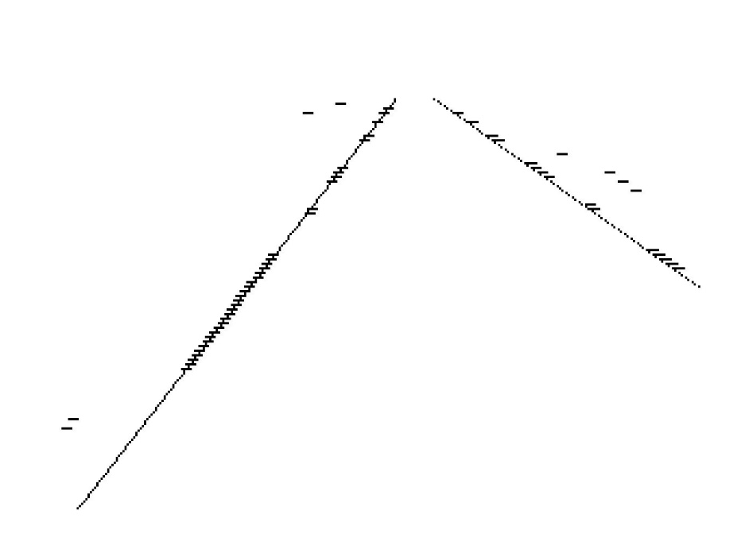
APPLICATIONS – Autonomous Highway Vehicles
Image courtesy of California PATH
MASKS © 2004
Invitation to 3D vision

Slide 5
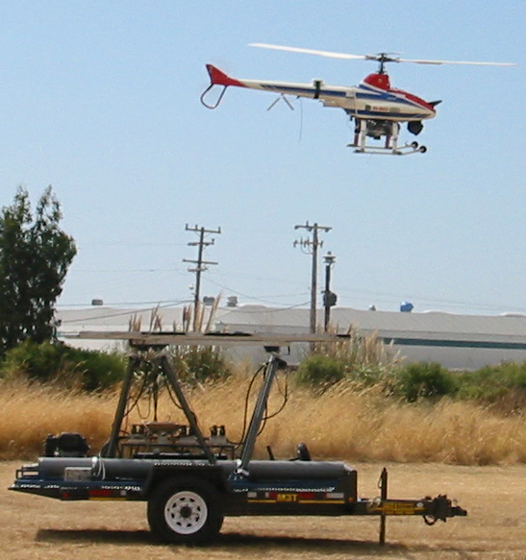
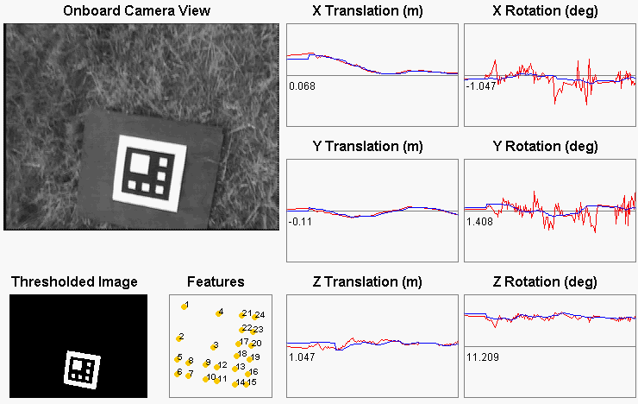
APPLICATIONS – Unmanned Aerial Vehicles (UAVs)
Rate: 10Hz; Accuracy: 5cm, 4º
MASKS © 2004
Invitation to 3D vision
Courtesy of Berkeley Robotics Lab

Slide 6
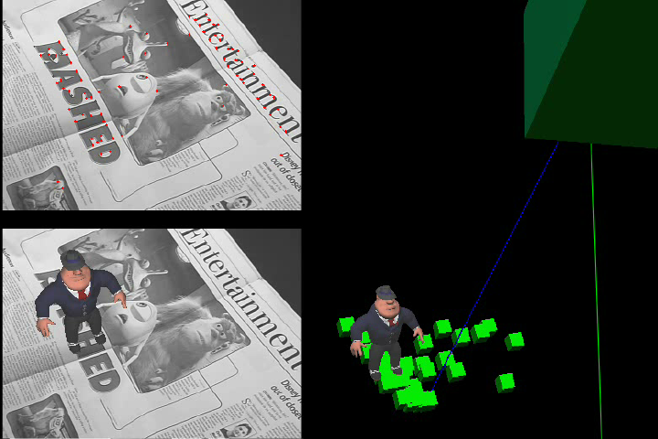
APPLICATIONS – Real-Time Virtual Object Insertion
MASKS © 2004
Invitation to 3D vision
UCLA Vision Lab

Slide 7
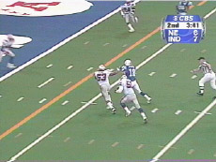
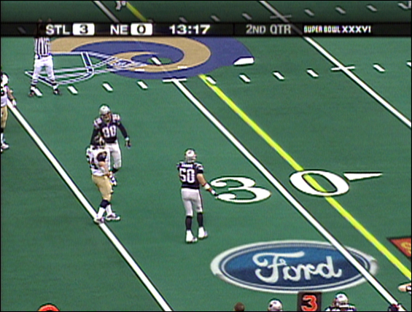
APPLICATIONS – Real-Time Sports Coverage
First-down line and virtual advertising
MASKS © 2004
Invitation to 3D vision
Princeton Video Image, Inc.

Slide 8
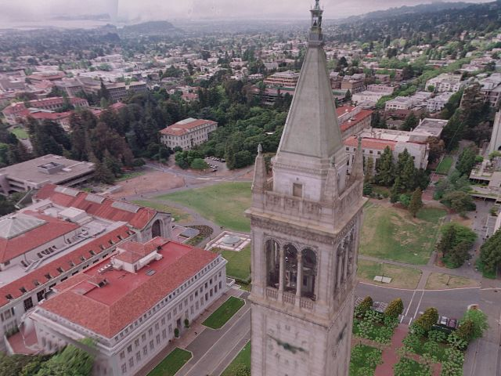
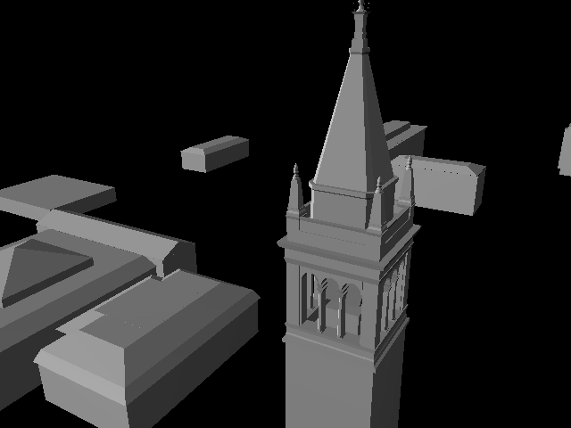
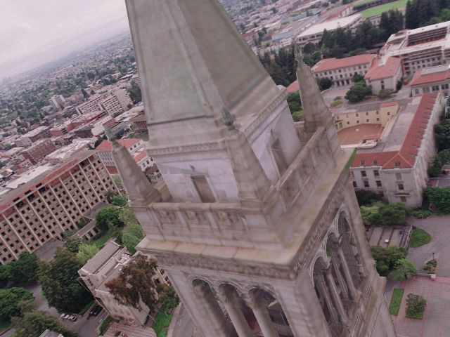
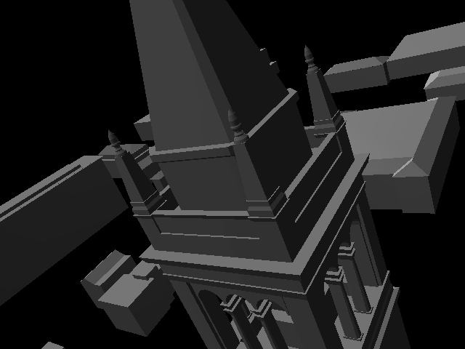
APPLICATIONS – Image Based Modeling and Rendering
MASKS © 2004
Invitation to 3D vision
Image courtesy of Paul Debevec
Notes:
If we can further impose some knowledge about the scene such that the objects are made of regular geometric primitives, we may obtain much more accurate and impressive 3-D models.

Slide 9
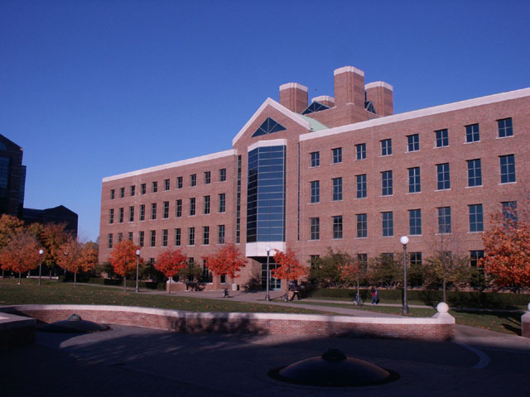
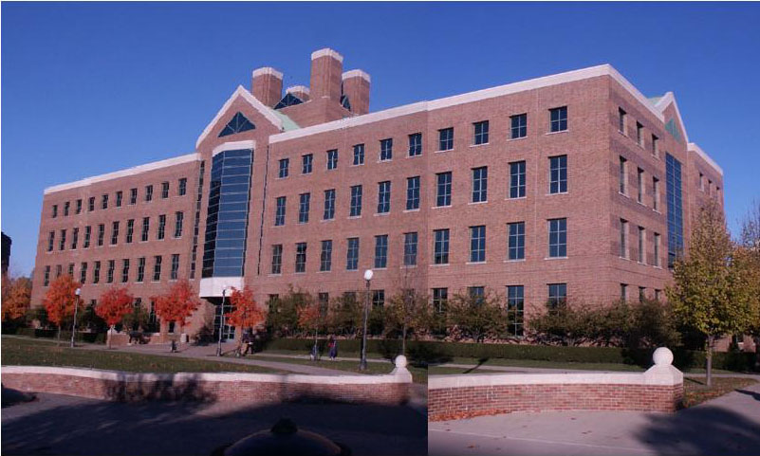
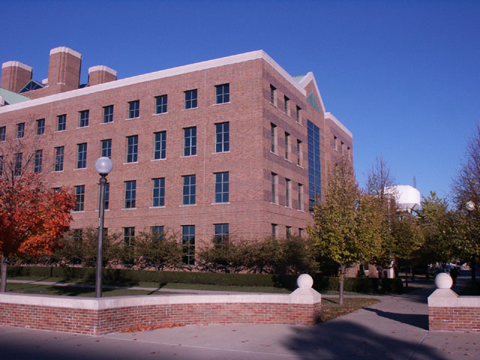
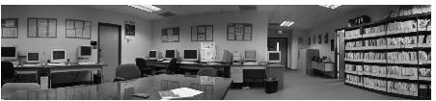
APPLICATIONS – Image Alignment, Mosaicing, and Morphing
MASKS © 2004
Invitation to 3D vision
Notes:
Even if our final goal is not for a 3-D model, understanding the 3-D geometry encoded in the images facilitates many image processing tasks.

Slide 10
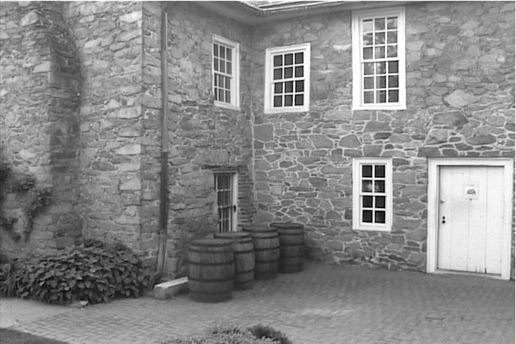
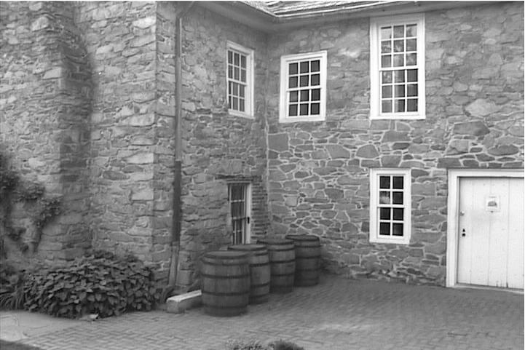
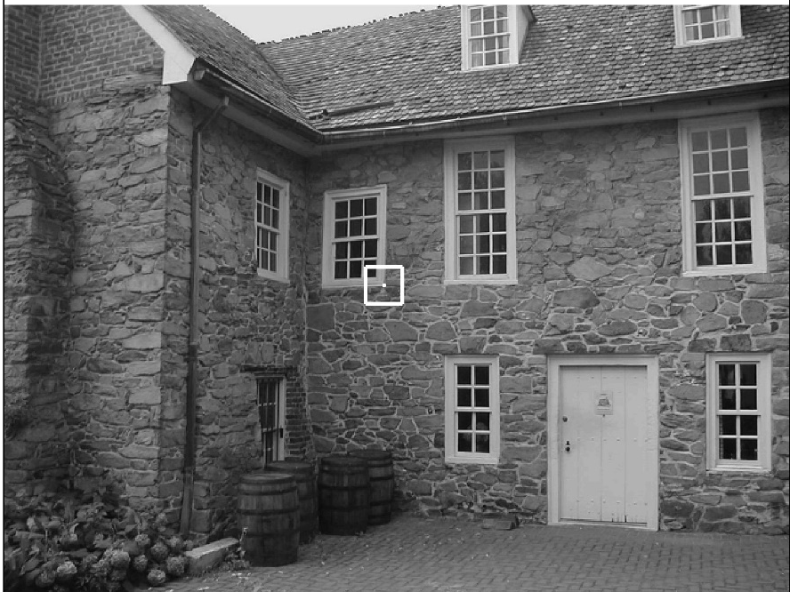
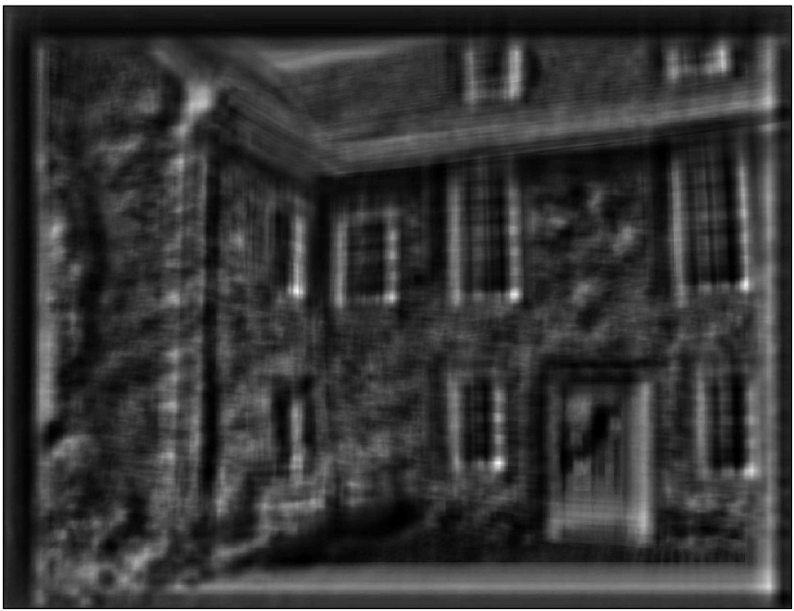
GENERAL STEPS – Feature Selection and Correspondence
Small baselines versus large baselines
Point features versus line features
MASKS © 2004
Invitation to 3D vision

Slide 11
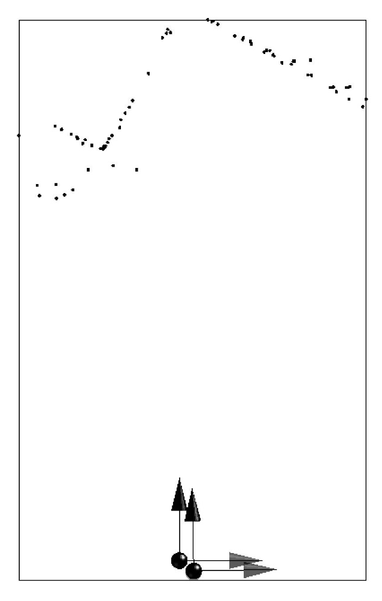
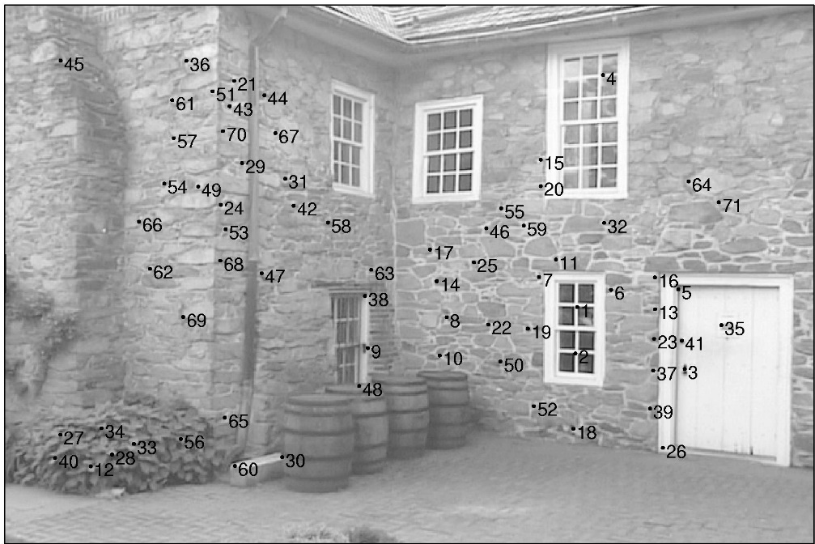
GENERAL STEPS – Structure and Motion Recovery
Two views versus multiple views
Discrete versus continuous motion
General versus planar scene
Calibrated versus uncalibrated camera
One motion versus multiple motions
MASKS © 2004
Invitation to 3D vision
Notes:
.

Slide 12
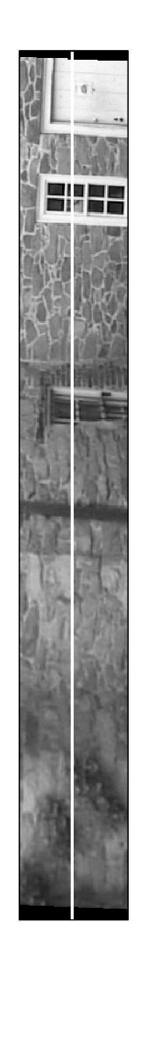
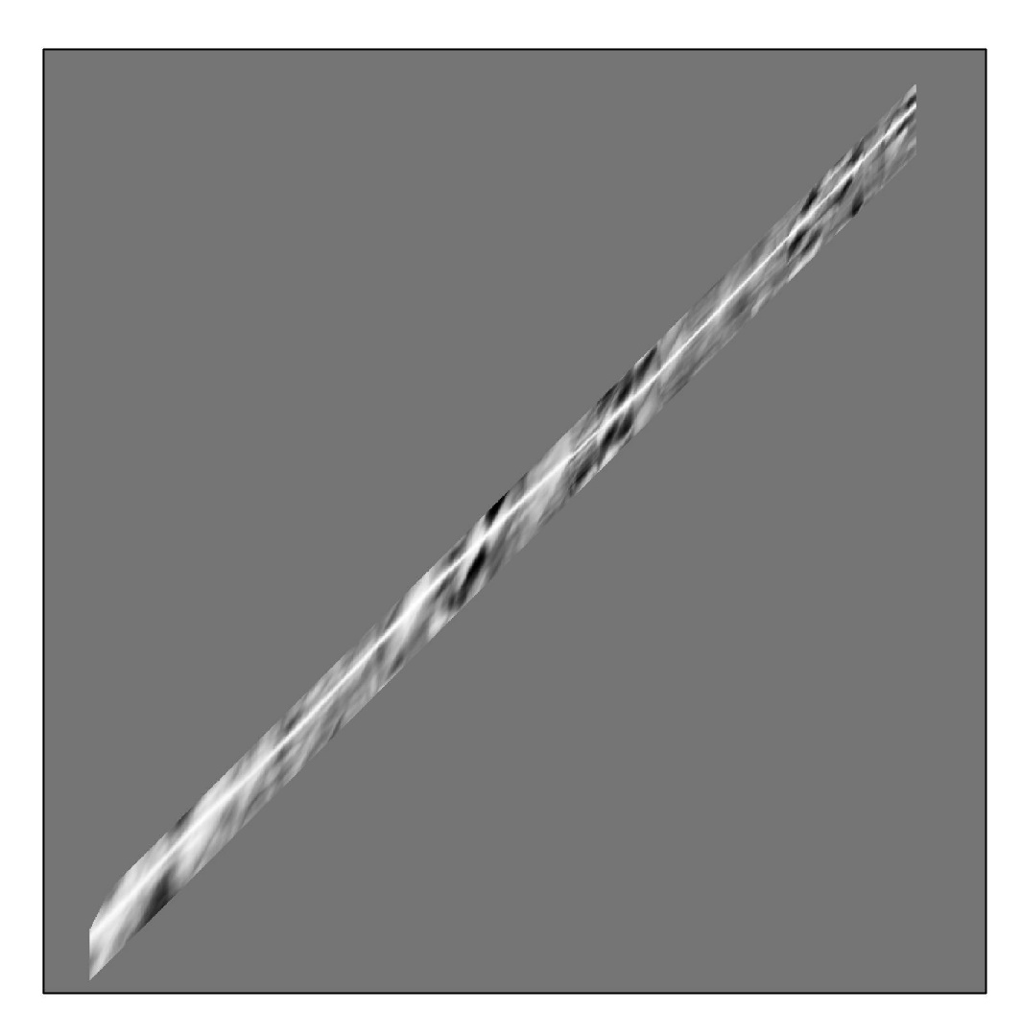
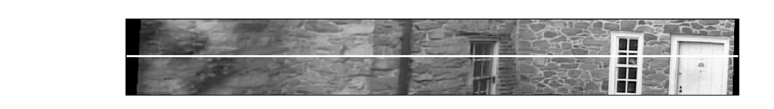
GENERAL STEPS – Image Stratification and Dense Matching
Left
Right
MASKS © 2004
Invitation to 3D vision
Notes:
.

Slide 13
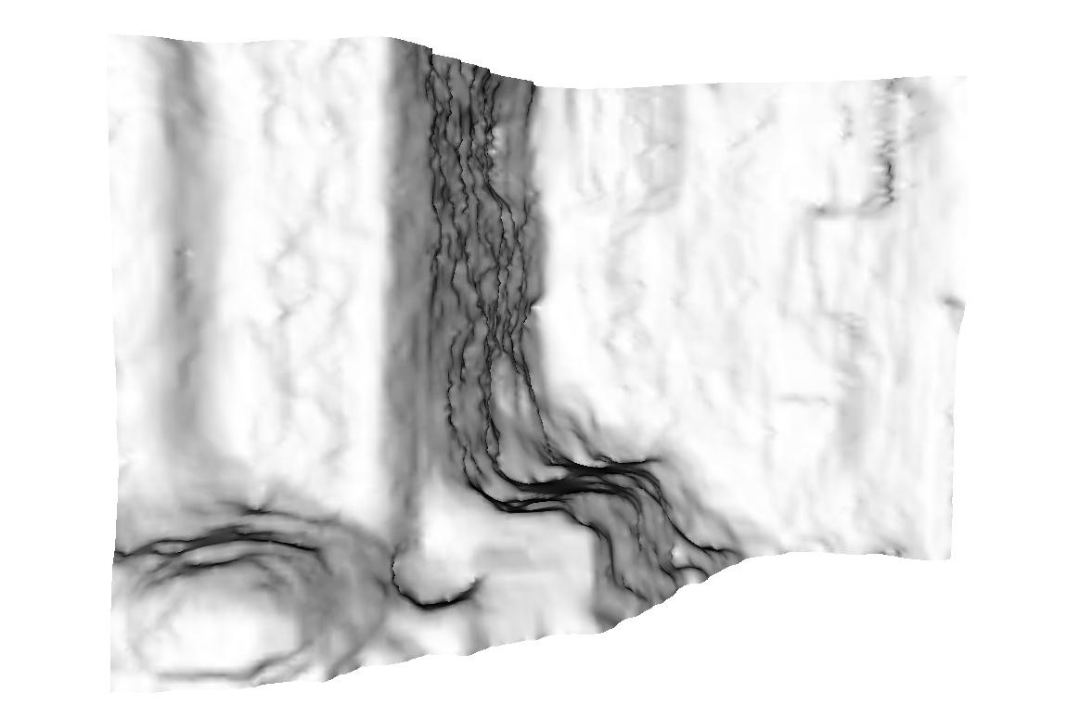
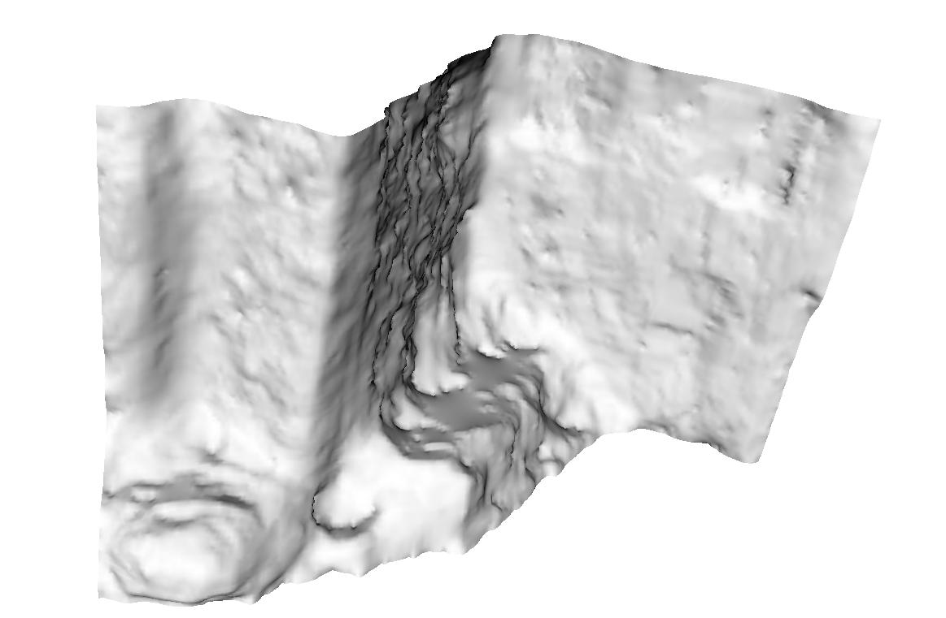
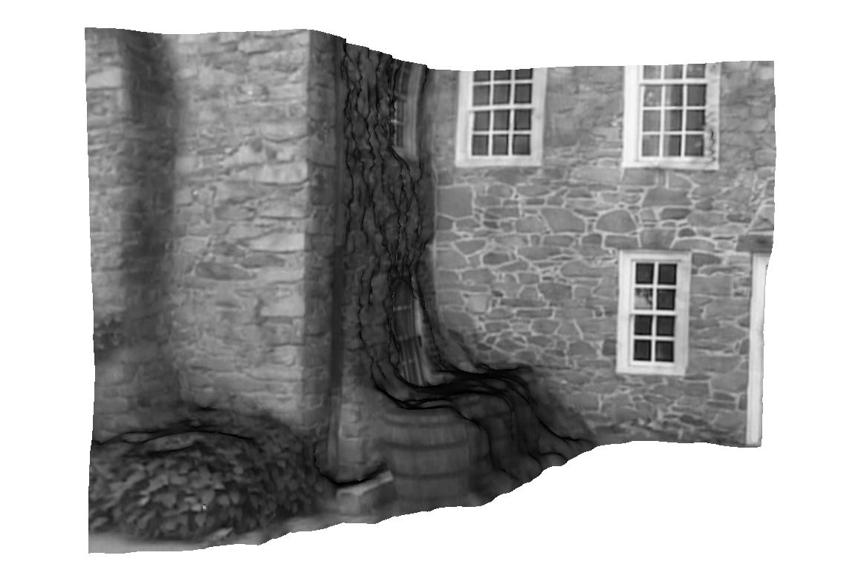
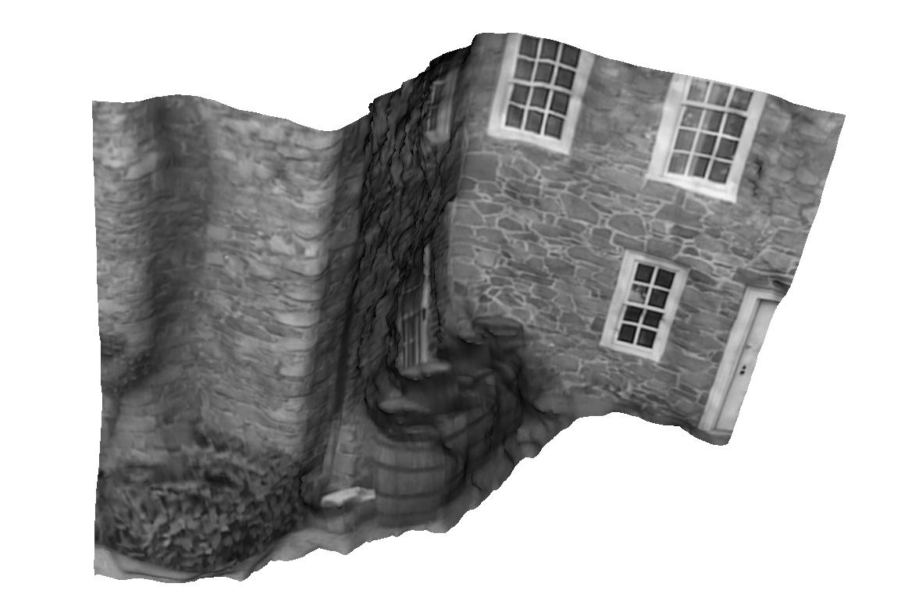
GENERAL STEPS – 3-D Surface Model and Rendering
Point clouds versus surfaces (level sets)
Random shapes versus regular structures
MASKS © 2004
Invitation to 3D vision

