Slide 1
12/19/17 BOM Builder is a bill-of-materials “match-maker” program. We use it as the central conductor of our BOM-centric flow with the Altium 18 board tools.
BOM Builder
Altium 18 tools
PartSync

Slide 2
12/19/17 Specifically, we keep all info about parts in a database, rather than dragging it along with schematic symbols in an Altium schematic sheet.
BOM Builder
…reads a netlist or partlist generated from an Altium (footprint-less) schematic
…generates a list of un-matched line items
…allows the designer to “match” each line item (an abstract part) to a real physical manufacturer’s part info saved in BWRC.mdb
Altium 18 tools
PartSync
…makes schematics for a board
…makes a board layout
…makes a multi-board schematic
… makes a multi-board assembly
…makes a .BomDoc (that we won’t use)
…reads/manipulates BWRC.mdb, PartSync.mdb and Sample.mdb
…keeps info/URLs about individual parts and part lists
… makes kits
…makes Purchasing BOM reports
…makes Assembly BOM reports
…saves a designer’s sanity(!)

Slide 3
12/19/17
BOM Builder
Altium 18 tools
PartSync
First, create entries in the BWRC.mdb database for each of your parts. Add info about manufacturer, manufacturer part number, vendor, vendor part number, vendor prices and vendor price breaks. Add URLs to: vendor web page, manufacturer datasheet and manufacturer recommended footprint layout. Also, add package info and footprint name.

Slide 4
12/19/17
BOM Builder
Altium 18 tools
PartSync
Second, update BWRC.SchLib with schematic library part info (just a refdes placeholder and graphic, no footprint info), Update BWRC.PcbLib with footprint library part info.
Create a project file for you design and a top-level schematic sheet. Place (footprint-less) schematic library parts onto your schematic sheet. Write out a netlist/partlist.

Slide 5
12/19/17
12/19/17
BOM Builder
Third, set BB’s System Options and BMB Options to point to the correct places. Read in the Altium netlist. BB creates a “line-item list” where each line item is red. Your goal is to make each line item turn white.
By hand, match each BB line item to a real part in Part Sync.
Save this .bmb file in the PartSyncBB_Jobs directory. Write the footprint data back into your Altium schematic sheet.
Altium 18 tools
PartSync

Slide 6
12/19/17
BOM Builder
Altium 18 tools
PartSync
Fourth, now that your schematic sheet has each part you put on it updated with a footprint name, compile your Altium project. Add a .PcbDoc sheet to your Altium project and from that .PcbDoc editor window, do an “Update from Schematic” and start doing layout. Do a DRC and then write out gerbers and the NC drill file. Write out an XYRS file (x, y and rotation and side info of each placed component).

Slide 7
12/19/17
BOM Builder
Fifth, read in gerbers for just the Top and Bottom layers (just copper, silkscreen and pastemask gerbers for each of the top and bottom sides). Read in the XYRS file. Look in BB’s Assembly View window. Click on each line item list and a package will be placed on each footprint, zooming to each. Make sure that all packages fit perfectly onto all footprints. Save this updated .bmb.
Altium 18 tools
PartSync

Slide 8
12/19/17
BOM Builder
Altium 18 tools
PartSync
Sixth, from PartSync, read the .bmb into PartSync as a “part list” entry. This part list item will contain all the parts needed to assemble one copy of your board design.
Go to PS’s “Eng & CAD” tab and create a Kit … i.e. a “build” of a certain number of copies of this board that you want stuffed. You can run a cost estimate. You can also then do a Release … and then write out a Purchasing BOM report and an Assembly BOM report.

Slide 9
12/19/17 Now you can commit all these files to Git and add a tag since this is a “Release”.
Then you can send the various files off to the vendors: Streamline, Beam On, Quik-Pak and Digicom to get your boards fabbed, pastemask stencils cut, dies wirebonded, parts purchased, boards stuffed, etc.
BOM Builder
Altium 18 tools
PartSync

Slide 10
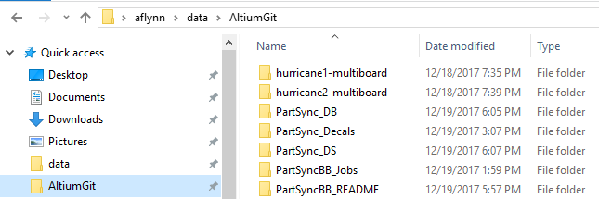
12/19/17 Of course, all of this moving of data between tool programs requires having the correct paths set up in the various tools. Since we’re storing these various libraries, databases and board files on Git, we need a convention for setting up path names in each tool so the tool can find the needed file on your local Windows machine (yes, all tools for boards are Windows programs).
The repo name is “AltiumGit”. If you have a directory where you want to checkout this repo to, such as:
C:\User\username\data
… then you’ll have something similar to mine:
C:\Users\aflynn\data\AltiumGit

Slide 11
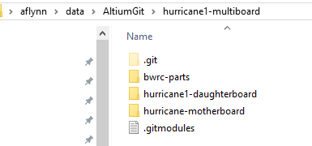
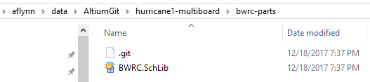
12/19/17 The AltiumGit/hurricane1-multiboard directory contains a bwrc-parts sub-directory and also a hurricane-motherboard sub-directory:
That AltiumGit/hurricane1-multiboard/bwrc-parts directory is stored in GitHub as a sub-module.
In the same way, hurricane-motherboard is also stored as a Git sub-module.

Slide 12
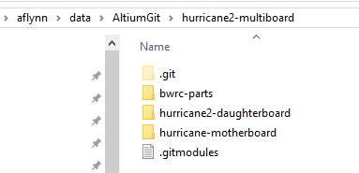
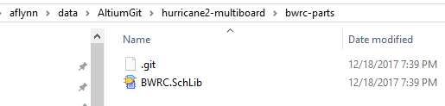
12/19/17 The AltiumGit/hurricane2-multiboard directory contains the same bwrc-parts and hurricane-motherboard sub-directories:
That AltiumGit/hurricane1-multiboard/bwrc-parts directory looks the same, because it is:

Slide 13

12/19/17 The AltiumGit/PartSync_DB directory contains our database: BWRC.mdb

Slide 14
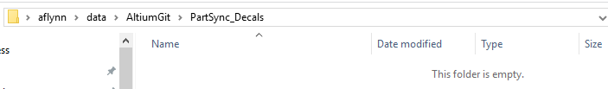
12/19/17 The AltiumGit/PartSync_Decals directory contains is presently empty. It will be a scratch directory where you can write out decals (i.e. footprints) from PartSync’s Package tab.

Slide 15

12/19/17 The AltiumGit/PartSync_DS directory contains is also presently empty. It is a directory where you can store datasheets if you want and PartSync will know to look there for any datasheets you ask it for.

Slide 16
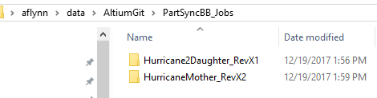
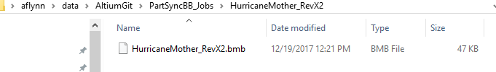
12/19/17 The AltiumGit/PartSyncBB_Jobs directory is a parallel tree named similarly to the different board designs. This is an important directory, because PartSync needs a place to find .bmb files it will read in and a place to write out reports. For every board where you’re going to store a part list for it in PartSync, you’ll need to create a sub-directory here. Importantly, each sub-directory here will contain solely one .bmb file, as shown for the example of HurricaneMother_RevX2:
Minor aside: we use the convention of RevX1 or RevX2 to mean “experimental”. Rev1 or Rev2 is nomenclature used by, say, a real company that is selling new products with increased functionality, where Rev1 is a product release and Rev2 is a subsequent advanced-functionality product release. In contrast RevX1 is engineer’s first attempt at spinning the board and getting things to work, and RevX2 is the second spin, etc. BWRC is always X1, X2, etc.
You must name this directory and the .bmb file in it, identically.

Slide 17
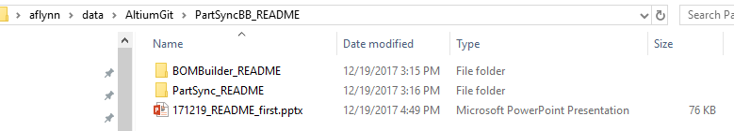


12/19/17 The AltiumGit/PartSyncBB_README directory contains this documentation (i.e. this file you’re presently reading) on how to convert the info you checkout from the GitLab AltiumGit repo to make all these pathnames in the local tools point to the right place (see the next few slides).
Note: These other 2 sub-directories, BOMBuilder_README and PartSync_README each contain a file that BB or PS can have customized by each designer. Explained later in these slides, but basically, you’d modify the file and then rename it by taking off the “savedDec2017” suffix and copy it over the same file in the installation directory. Then BB and/or PS will pick up your customizations.
Note 7/26/21: As of today, there are new versions of BB and PS that deal with the problem that we had that our user versions of these files would get overwritten when installing the latest versions of BB and PS. The fix is that instead of putting these user versions of these files over top the versions that come with each upgrade, instead stick these user versions directly into C:\ProgramData\IndexDesigns.
Their names should simply be CompType.txt and Part_Type_List.txt.

Slide 18
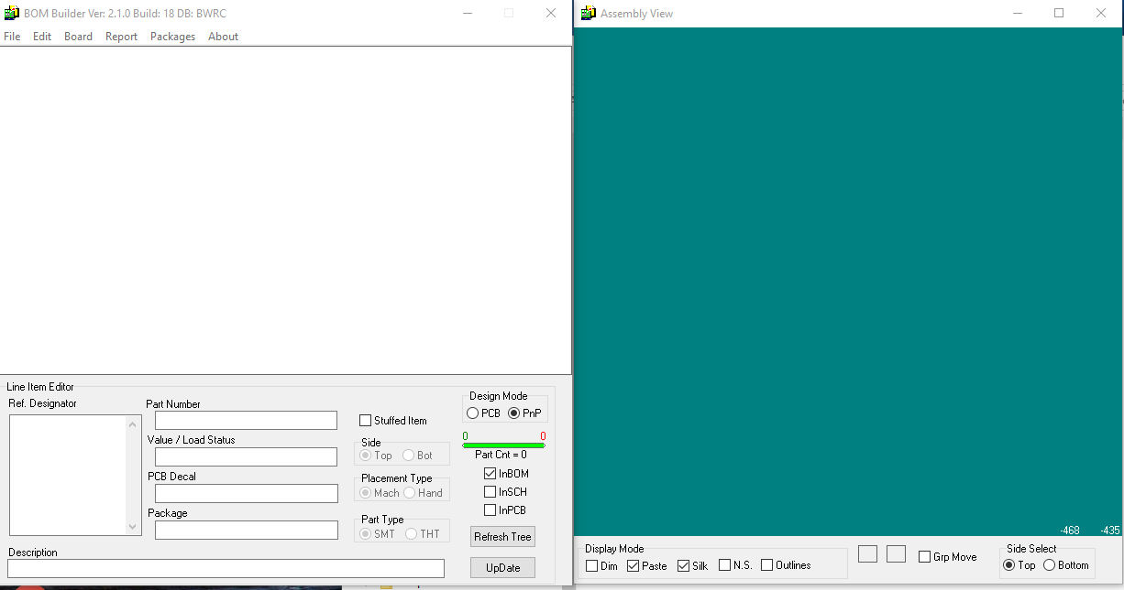
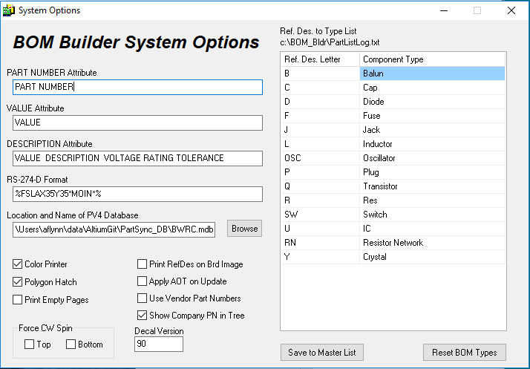
12/19/17 When you open BOM Builder you get the pic at left below. BOM Builder’s menu item Edit -> System Options shows this dialog at right. The field “Location and Name of PV4 Database” should really say “Location and Name of PartSync database”. BOM Builder accesses the same database as PartSync, an .mdb file (a Microsoft Access database). Our database is BWRC.mdb and so in this field (red arrow) I’ve typed in:
C:\Users\data\aflynn\AltiumGit\PartSync_DB\BWRC.mdb.
Here, when BB opened, it knew to use the database named BWRC.mdb, as set in the System Options.

Slide 19
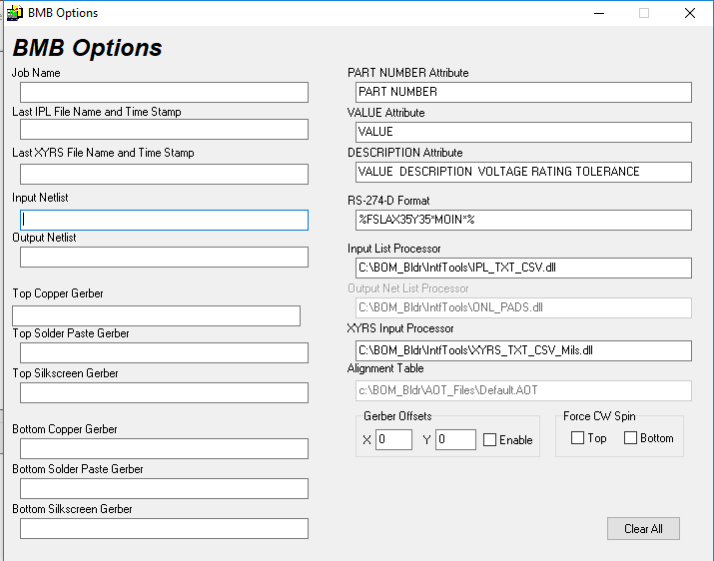
12/19/17 Next, look at BB’s Edit -> BMB Options menu. This window opens. You need to set the correct .dll files so that BB can read the netlist or partlist or XYRS files that Altium can write out. Basically, when you installed BB, it installed into:
C:\BOM_Bldr
…in there is a sub-directory of a number of interface .dlls. These are stored in the C:\BOM_Bldr\IntfTools sub-directory. Pick the correct .dlls for what you’ll be wanting to do. We’ll be making Altium write out .csv files for netlist/partlist and XYRS data, so fill in the fields of Input List Processor and XYRS Input Processor as shown here:

Slide 20
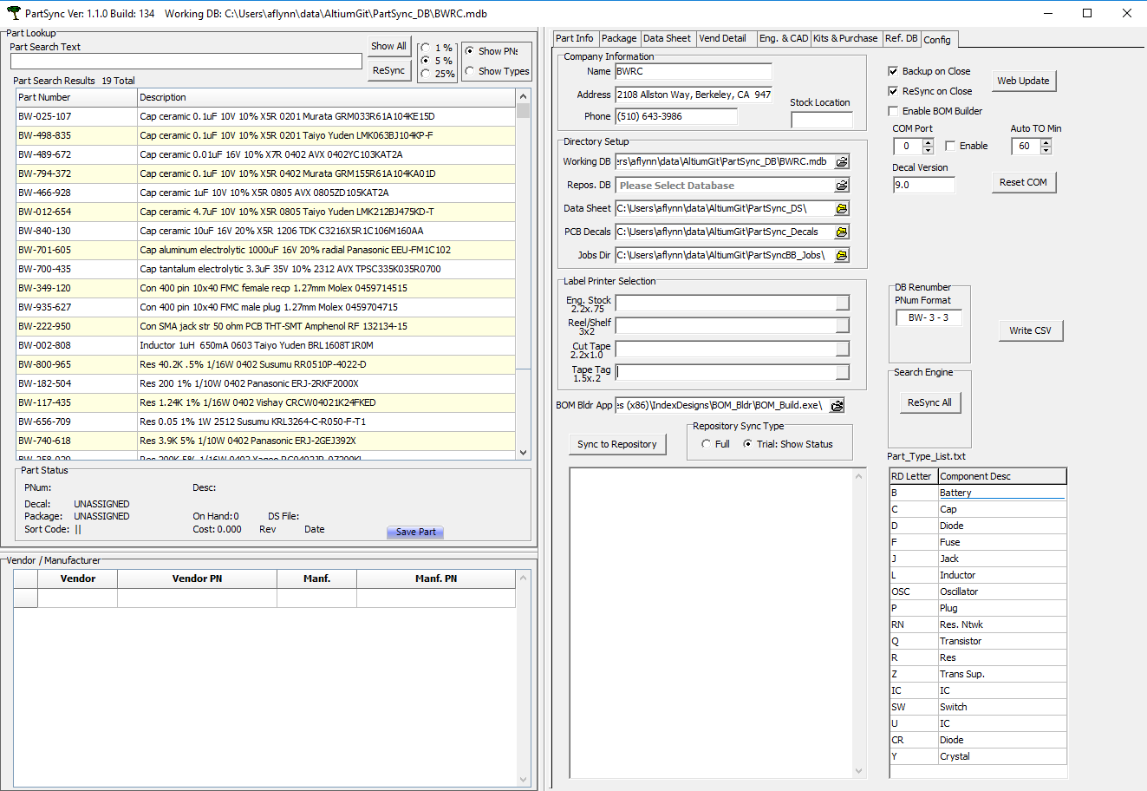
12/19/17 When you open PartSync, at the top right, select the Config and set the various pathnames for your local files in your AltiumGit checked-out directory, in the Directory Setup area (red arrows). Also, make sure the field for the BOM Bldr App is pointed at its installation directory (blue arrow), which should be:
C:\Program Files (x86)\IndexDesigns\BOM_Bldr\BOM_Build.exe\

Slide 21
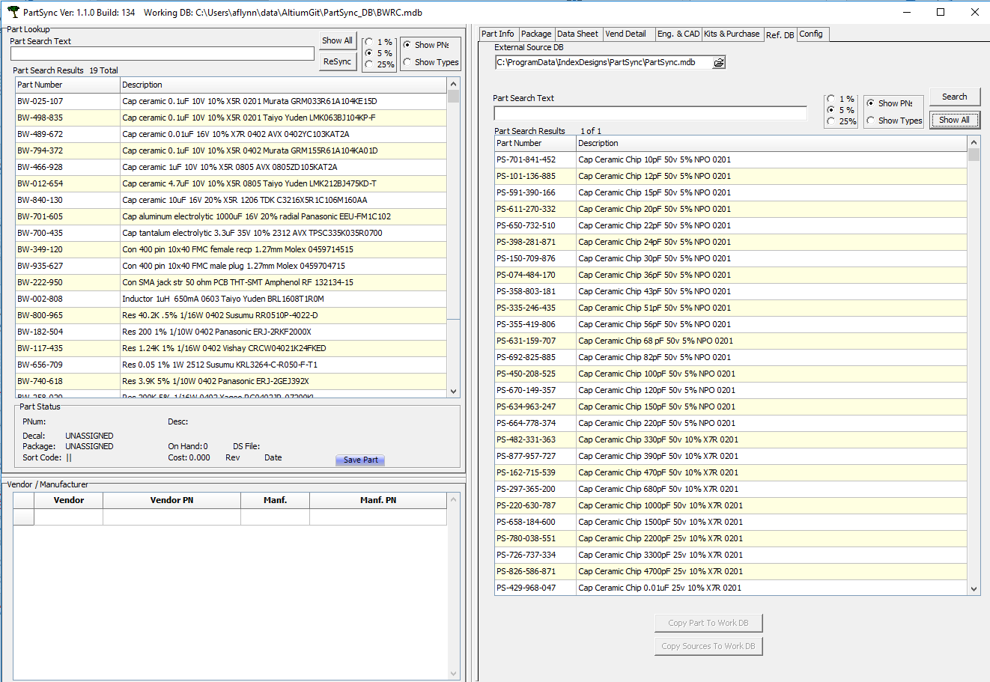
12/19/17 Close out both BOM Builder and PartSync and re-open them. Double-check all those fields for correct pathnames. In PartSync, on the grid on the left, you should see all your working database parts from BWRC.mdb (green) or hit Show All. Go to the Ref DB tab (red). The field for the external source database should be pointing to a reference database which came with the installation. This PartSync.mdb contains not only a sampling of parts, but also an entire package database, which can be seen on the Package tab. If you want to see those packages on the Package tab, this Ref DB tab must point to the PartSync.mdb database which comes with the installation. You can use a reference database to copy parts into your working database.

Slide 22
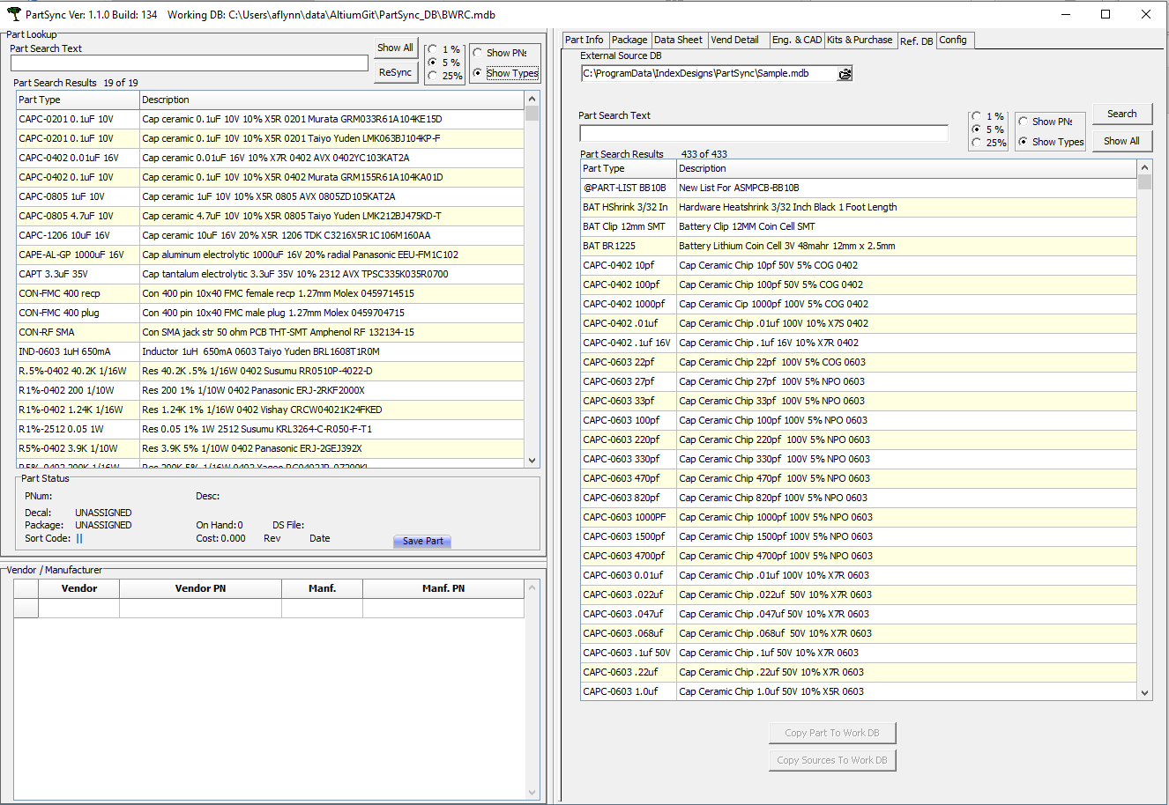
12/19/17 Another database, Sample.mdb, also comes with the PartSync installation. It has a sampling of other parts, but does not hold the packages.
Also, if you click on the button for Show Types, the parts grids will sort by type instead of by the randomly-assigned part number unique identifier.

Slide 23
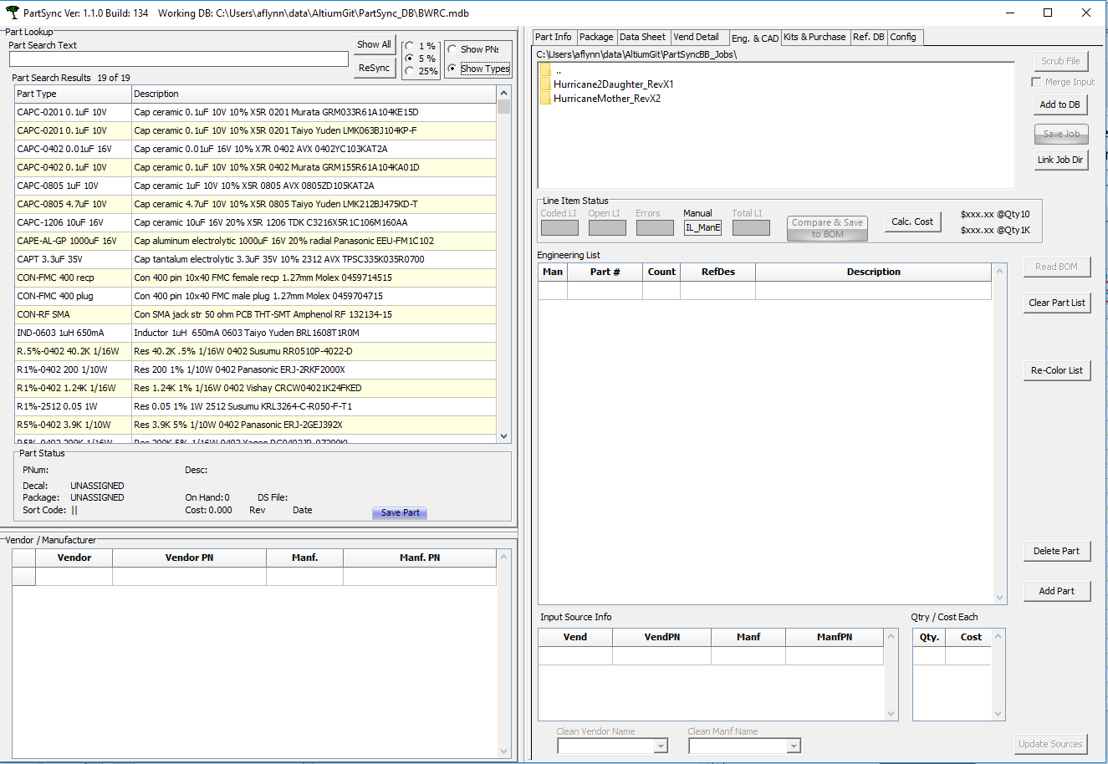
12/19/17 Also check that the Jobs directory has been set correctly. Go the Eng & CAD tab. It should be pointing to:
C:\Users\username\whatever\AltiumGit\PartSyncBB_Jobs

Slide 24
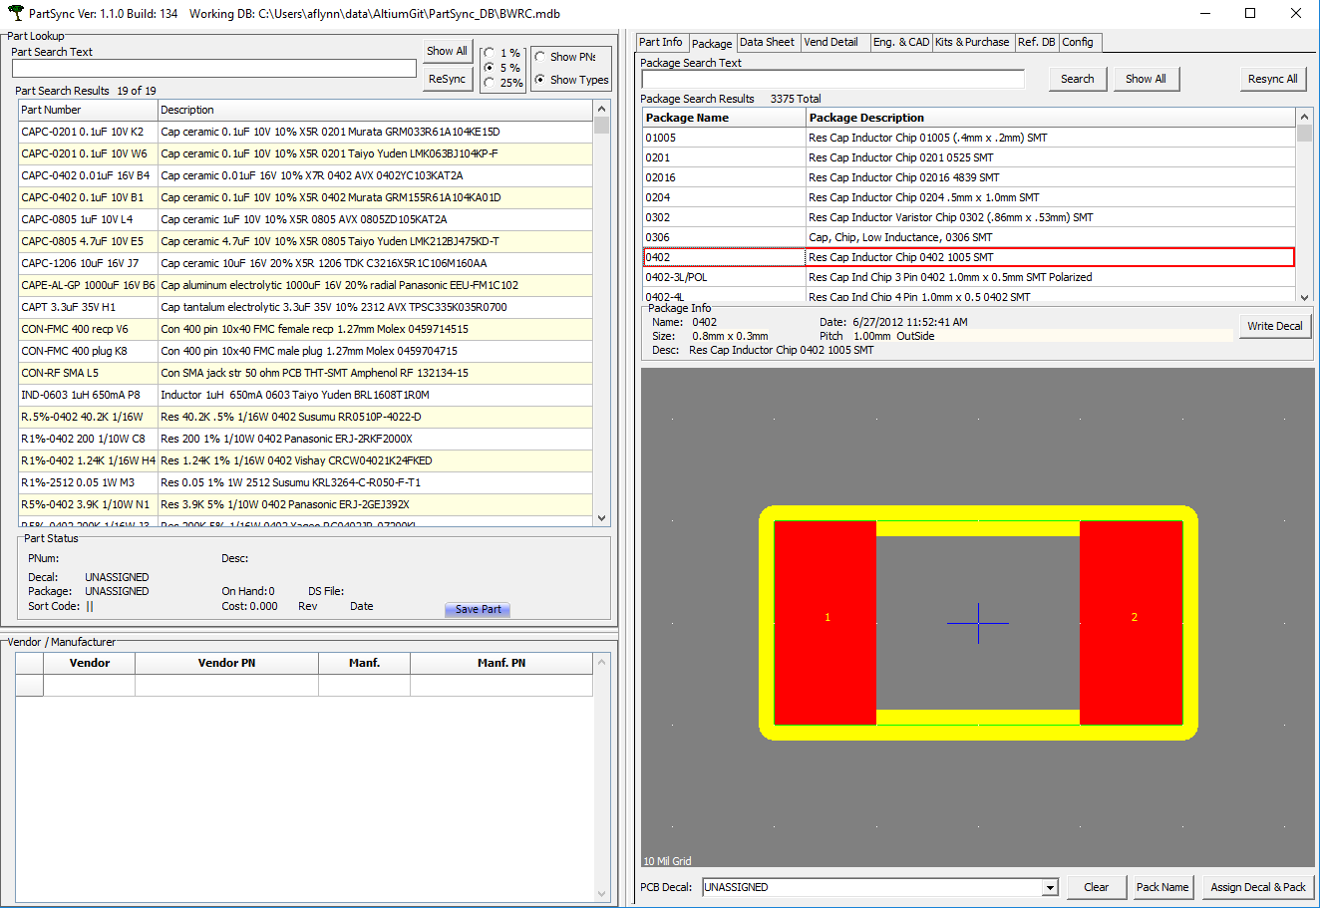
12/19/17 Ensure the Packages tab is working. Set the Ref DB tab back to pointing to PartSync.mdb. Then on the Package tab, hit Show All. You can look at all the packages that come with PartSync. Packages represent where the feet of a component will touch down on a board.

Slide 25
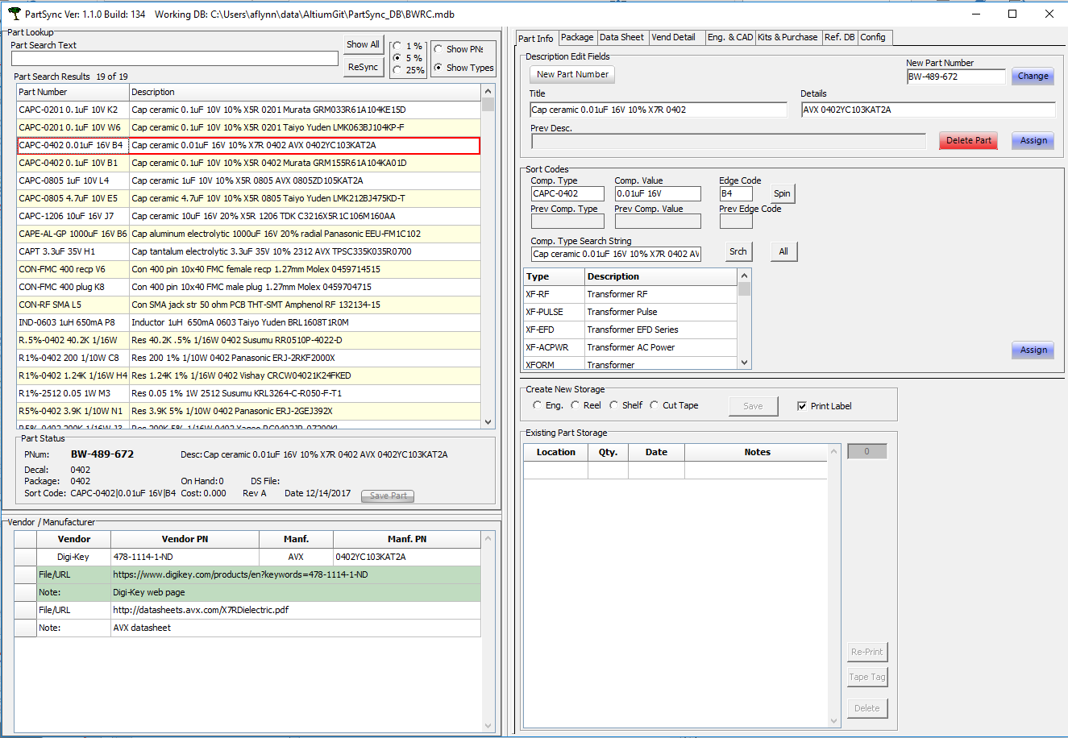
12/19/17 The Part Info tab is where you enter new parts or view parts currently in your working database, BWRC.mdb. You create a new part by selecting some part on the left grid and then hitting the New Part Number button on the right.

Slide 26
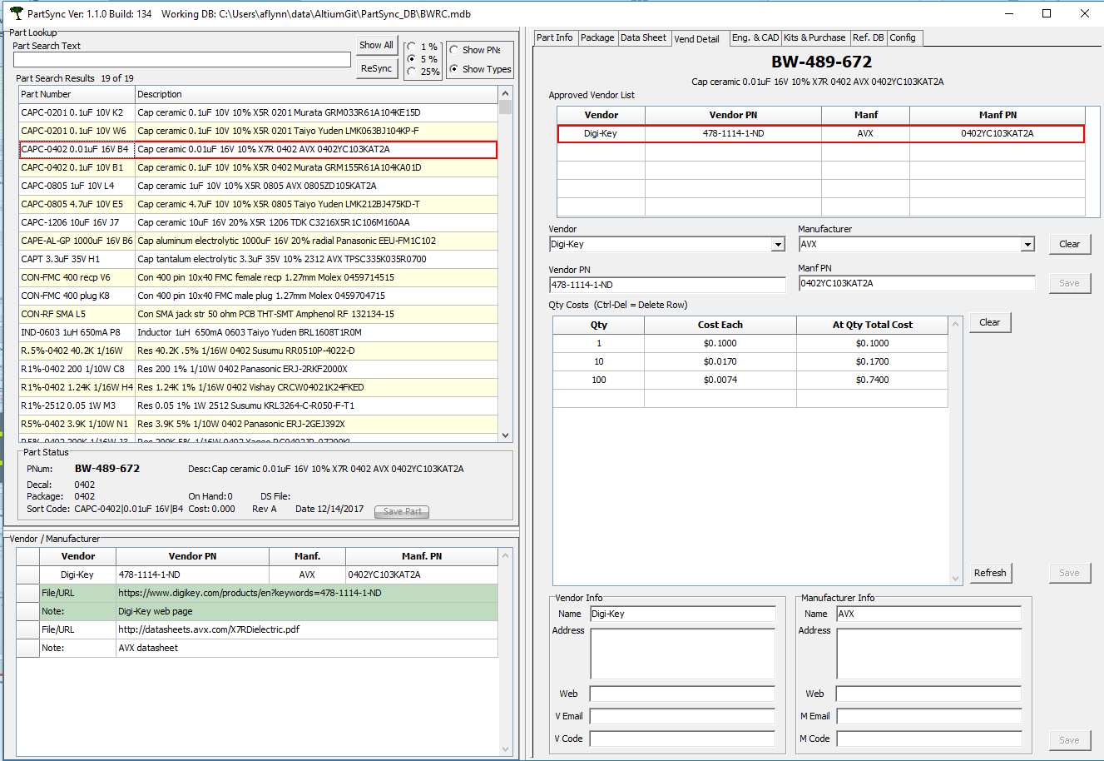
12/19/17 Alternatively, you can go look on the Vendor tab for vendor and manufacturer info and links:
Type Alt-I in this area to insert a new 2-row blank field for URL links. Alt-D to delete.

