Slide 1
How to Git
By Mona Gupta

Slide 2
What is Git?

Slide 3
What git is
Versioning system
Allows teams to work on shared code individually and easily “push” code so that their teammates can see

Slide 4
What git is
There are lots of different services that use git and come with a nice web interface to view commits and changes
Github
Probably better for public projects that you want an audience for
Bitbucket
Unlimited free private repos, same functionality

Slide 5
Why this is really cool
It lets you share code, track changes, and collaborate!
Using git is the industry standard -- if you don’t learn it now, you will at your first internship!

Slide 6
Git Workflow

Slide 7
Overview
Need to tell git which files you care about
No reason to store .class files on git!
After implementing some feature or bug fix, need to “save” your work
Once you’re ready for your teammates to see, push the code

Slide 8
git add
Tells git which files to track
In general, you should add all of your .java files
You should NOT add .class files (unless you do not have the corresponding .java file)

Slide 9
.gitignore
A file you put inside of your repo telling git which files you will never want to add

Slide 10
.gitignore
A file you put inside of your repo telling git which files you will never want to add
Short demo

Slide 11
git add
Short demo--commands run:
touch kittens
git status
git add kittens
git status

Slide 12
git commit
Commit when you feel like you’ve reached a good point in your code
Fixed a bug
Implemented a new feature
etc.

Slide 13
git commit
Short demo-- commands run:
git status
git commit -m ‘adding kittens’
git status
If you want to add and commit all tracked files, you can do
git commit -am ‘adding kittens’

Slide 14
git push
Time to show your changes to the rest of your team!
You can have multiple commits inside of one push.

Slide 15
git push
Short demo--commands run:
git status
git push <or git push origin master>
git status

Slide 16
git pull
This will change your files to reflect your teammate’s changes too!
You must always commit before pulling
Technically not true, but that’s more advanced stuff...
You must always pull before pushing

Slide 17

Git, The Merge Command
git merge <branch>

Slide 18
What is the merge command for?
Merging is used to stitch two forked commit histories back into a single branch.
Useful when developing a new feature on a different branch than master
User decides new feature is ready to become a part of main program and then merges branch new feature is on with master

Slide 19
Merging
git will automatically merge your partner’s changes into your files
Sometimes when you pull, you’ll get a merge conflict
This means your changes and your teammate’s changes affect similar lines and git doesn’t know which to choose.

Slide 20
The commands
git merge <branch name goes here>
Merges specified branch into current branch. Git determines merging algorithm automatically
git merge --no--ff <branch>
Merges specified branch into current branch and always creates a merge commit (even in the case of a fast-forward merge). Usefule for documentation of merges in repo.
Source: https://www.atlassian.com/git/tutorials/using-branches/git-merge

Slide 21
Merge Conflicts
Here we see a merge conflict where two users made changes to the same line of code.
<<<<<<<<<yours:sample.txt
if (n == 0) {
=======
if (n == 1) {
>>>>>>>>>theirs:sample.txt

Slide 22
Resolving Merge Conflicts
Resolve conflicts by choosing either your changes, your teammates changes or some combination of the two!
After fixing conflicts, you must add and commit your work.

Slide 23
Private vs. Public
Repos

Slide 24
Private vs. Public Repos
Do not put class code in a public repo!

Slide 25
Getting Started

Slide 26
Getting git on your computer
Linux
yum install git-core
sudo apt-get install git
Mac
https://code.google.com/p/git-osx-installer/downloads/list
Windows
http://msysgit.github.io/

Slide 27
Setting up a repo from scratch
Go to bitbucket/github and make a new repo
Make it private if it’s for class projects!
mkdir /path/to/your/project cd /path/to/your/project git init git remote add origin <URL>
Example URL: https://monagupta@bitbucket.org/monagupta/project-2.git

Slide 28
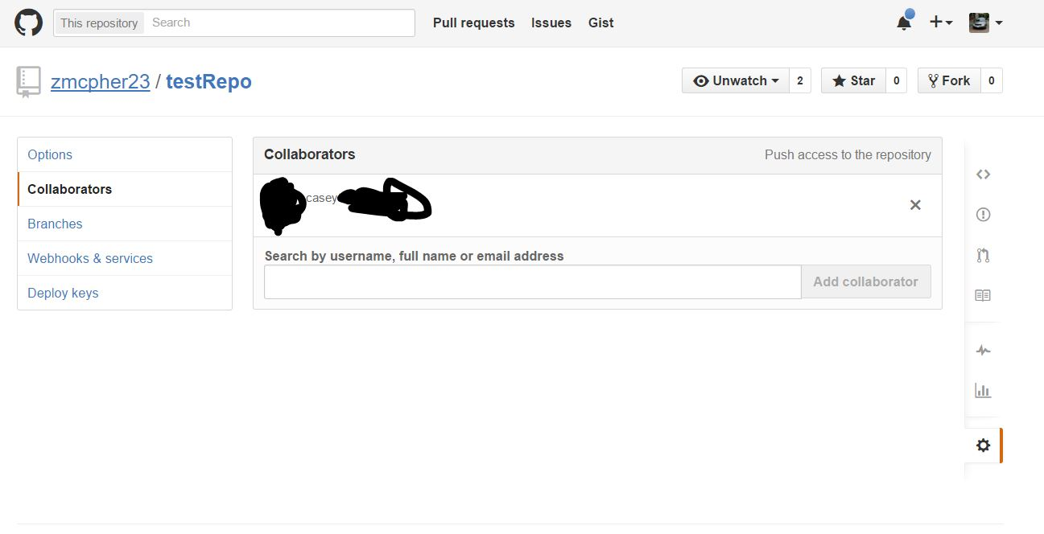
Sharing a repo with others

Slide 29
Cloning an existing repo
If your friend shares code with you, you’ll need a way to get that code onto your computer!
git clone <URL>

Slide 30
More Features

Slide 31
More Features
Git is very powerful -- what we’ve seen so far is just a small subset of what you can do!
You can check online for lots of online resources
Official documentation: http://git-scm.com/doc

