Slide 1
Recursive Art
Snap! Below the Line DeCal.
Week 5 Assignment

Slide 2
Instructions
Use JavaScript block in Snap to draw your own recursive art.
Take a screenshot and send it to tony.lee@berkeley.edu
I made my personal art and attached the screenshot.

Slide 3
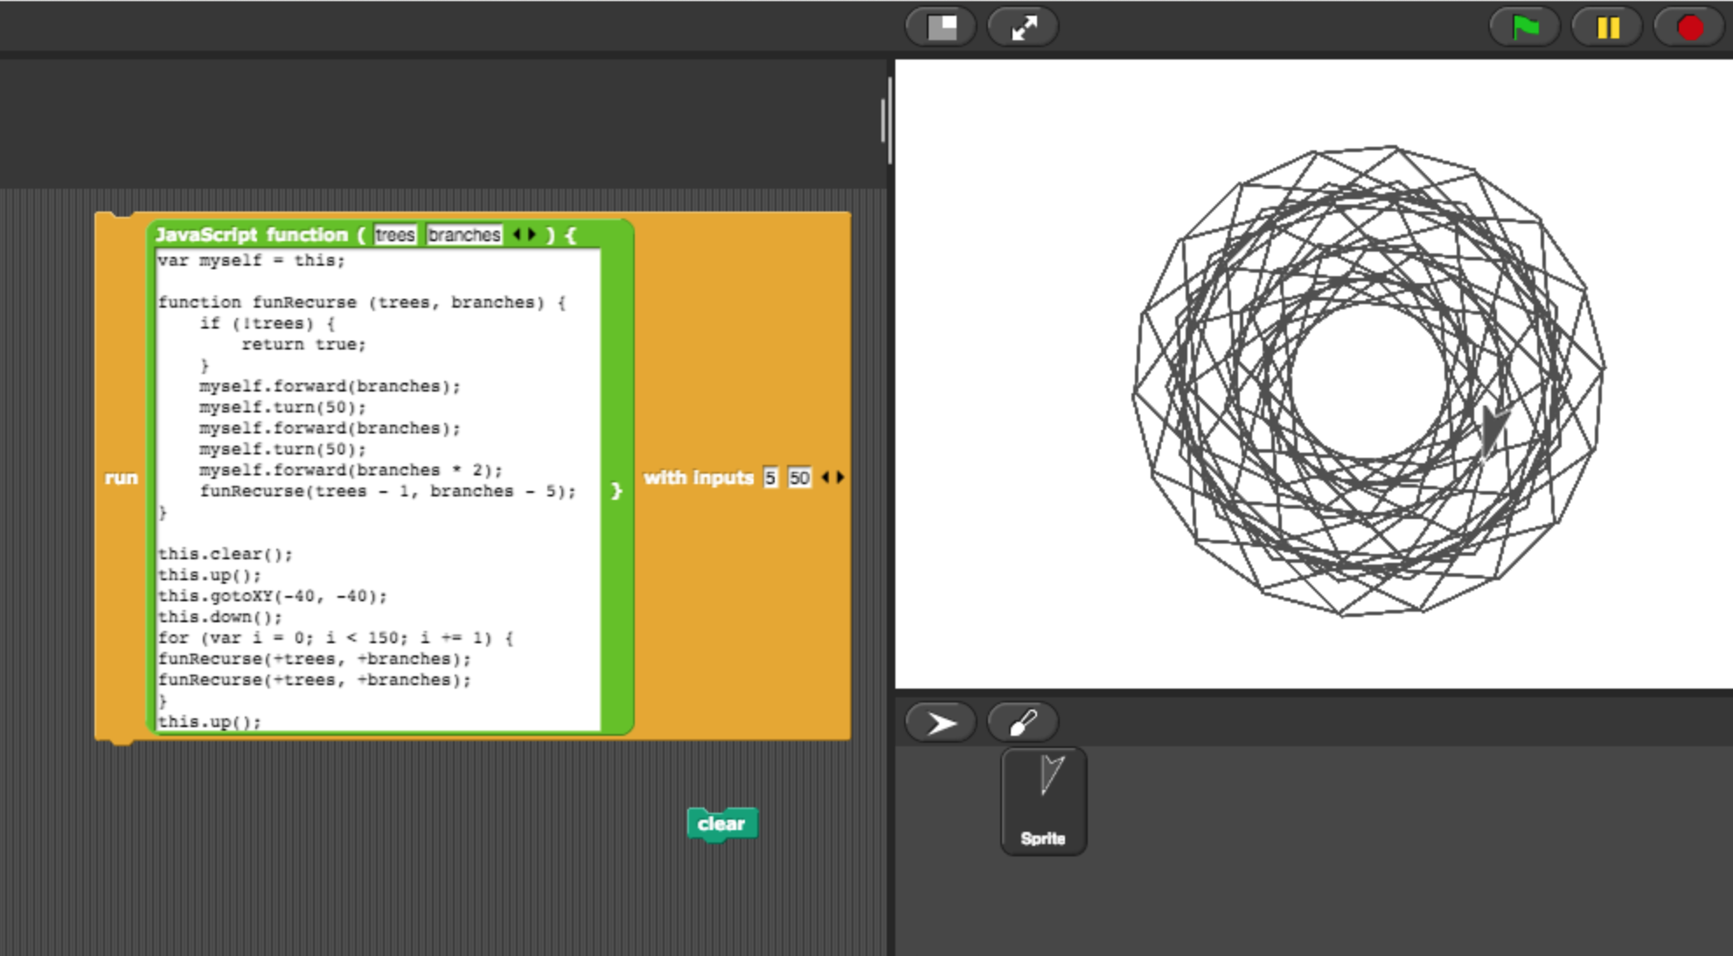
Example Recursive Art

Slide 4
Optional Morphic Art Contest
Go to http://snap.berkeley.edu/snapsource/morphic.html
Play around with Morphic objects and make a self portrait
Send it to tony.lee@berkeley.edu with title [Contest Entry]
The winner will be honored and awarded

Slide 5
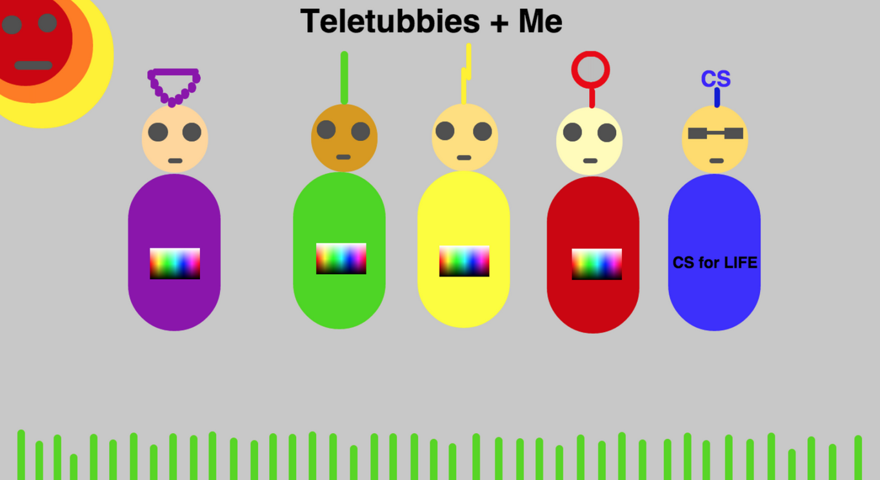
Examples from last semester 1

Slide 6
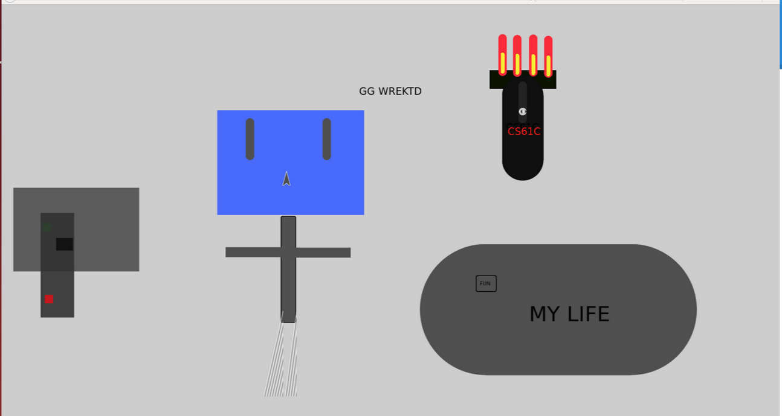
Examples from last semester 2

Slide 7
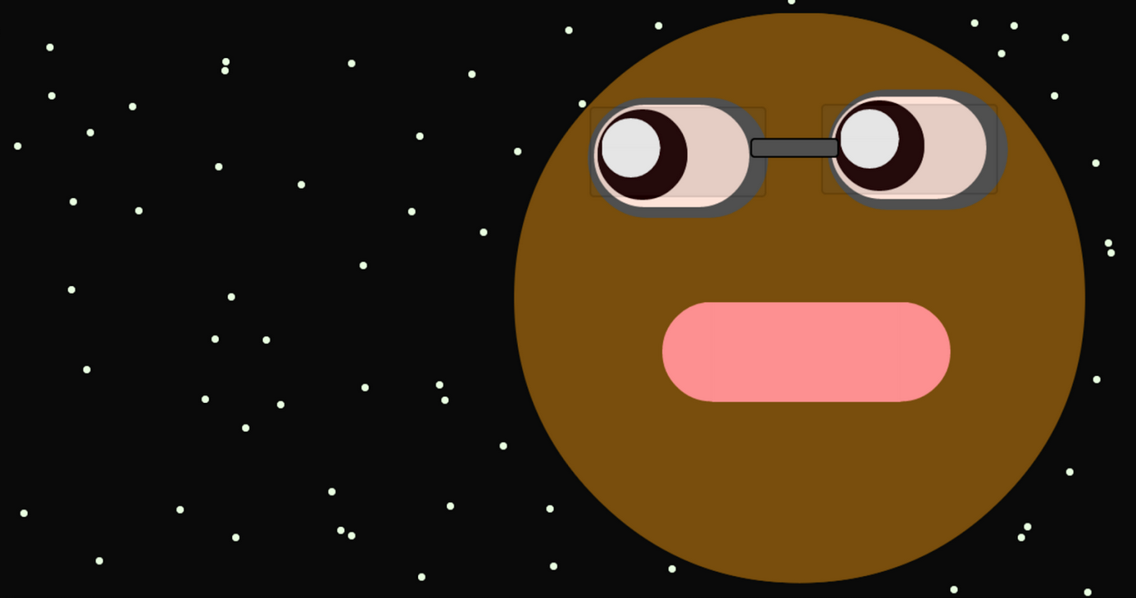
Examples from last semester 3

