Slide 1


Welcome to
Snap!
Below the Line
Week 6

Slide 2
Agenda
Dev Mode
Console, debugging, IDEs(JavaScript IDE)
Morphic
Java Script Blocks
Self-portrait contest

Slide 3
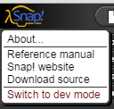
Dev Mode
Shift+click

Slide 4
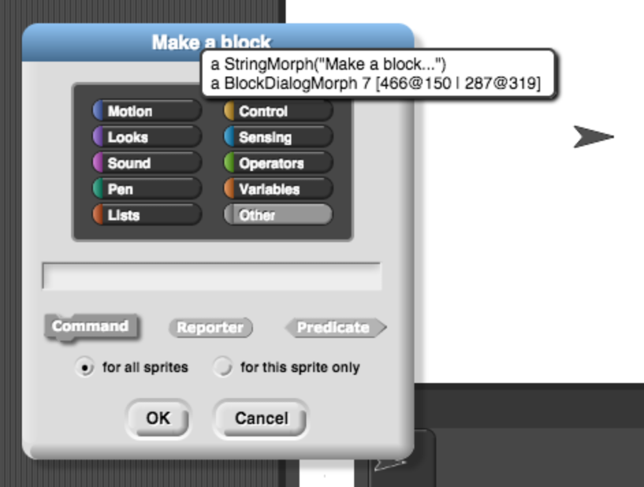
Dev Mode
Notes:
byob 1183, 1260

Slide 5
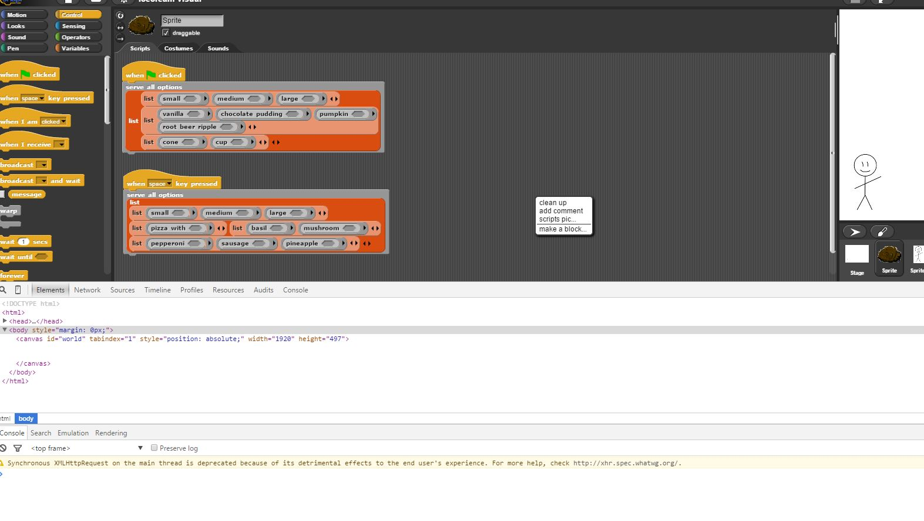
Console
Use console in Snap! for debugging
Notes:
threads 458

Slide 6
IDE(Integrated Development Environment)
What I used for the decal:
https://www.jetbrains.com/webstorm/
Very useful for debugging, figuring out how Snap operators.
Can obtain a student license for free via Berkeley.edu email

Slide 7
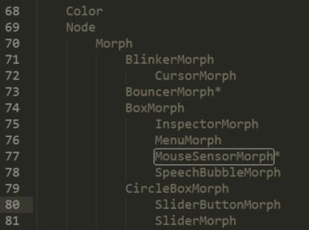
Morphic!
Object Hierarchy is as follows (not the whole picture, limited to fit on slide. Morphic is ~10,000 lines) :
Notes:
Morphic is a big file, however understanding morphic is crucial as it is the backbone of Snap.

Slide 8
Important Resources
Morphic Documentation:
http://snap.berkeley.edu/snapsource/morphic.txt
Object Hierarchy:
https://goo.gl/U1rnXA
File Structure:
https://goo.gl/pc0S3u

Slide 9
Breaking Down Morphic
Working in groups of two, choose a Morph object from the following google doc.
https://goo.gl/4IJBXK
Once you’ve chosen an object list your names.
Read through the Morphic file and develop a general overview/description of the object you have chosen.
Perhaps also list some important prototypes and briefly describe their purpose.

Slide 10
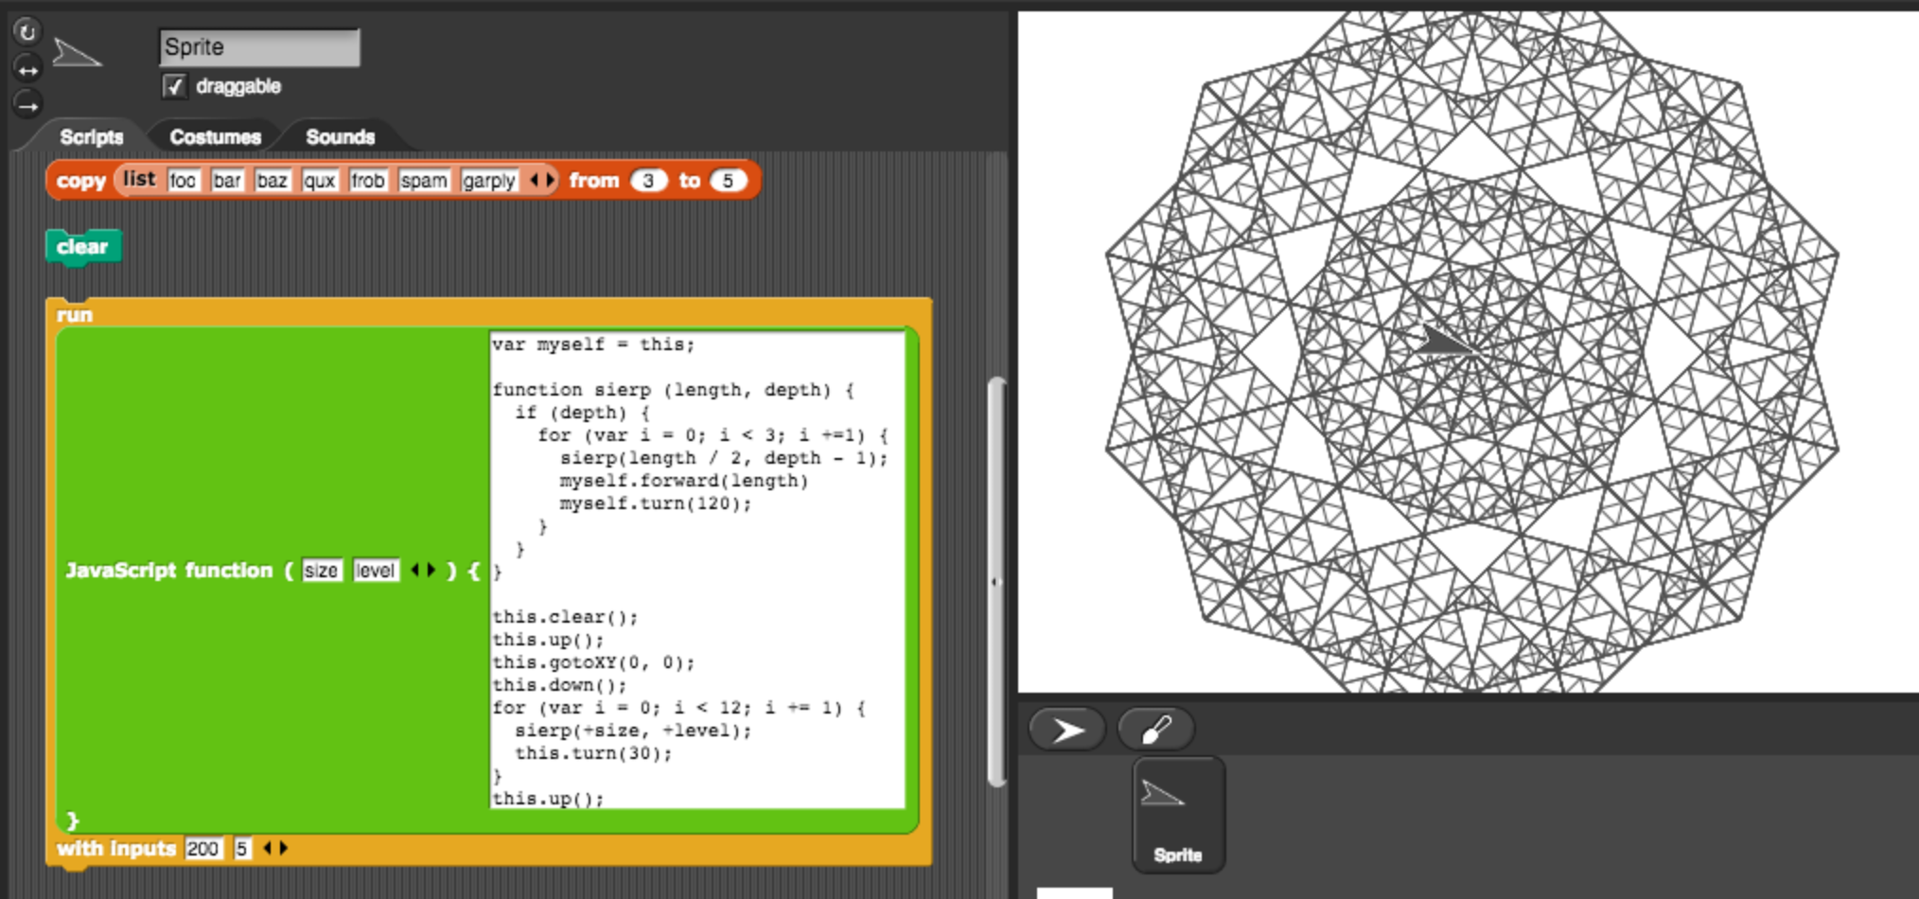
JS Function Examples
Notes:
General description of how to use JS Function Blocks. Show examples given from Snap and how they work.

Slide 11
Morphic Self Portrait Contest
Go here: http://snap.berkeley.edu/snapsource/morphic.html
Create a self portrait, here are some cool examples from the previous semester ^-^

Slide 12
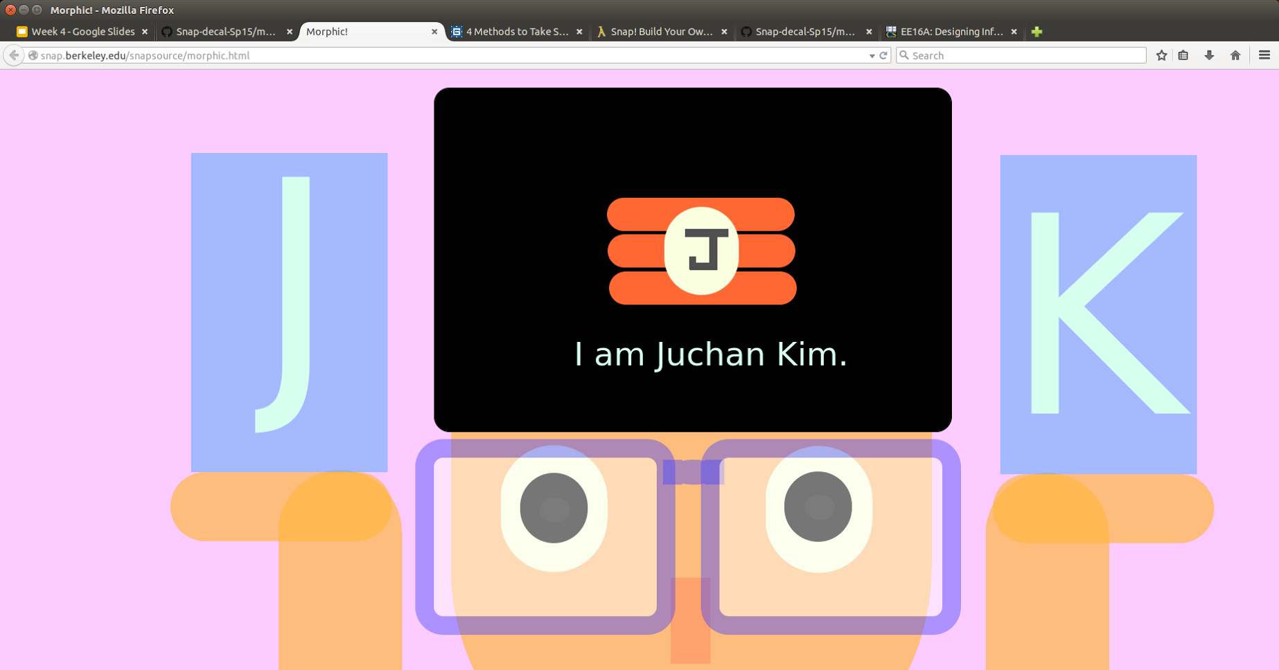
Anonymous

Slide 13

http://makeagif.com/i/Fy5fWL

Slide 14
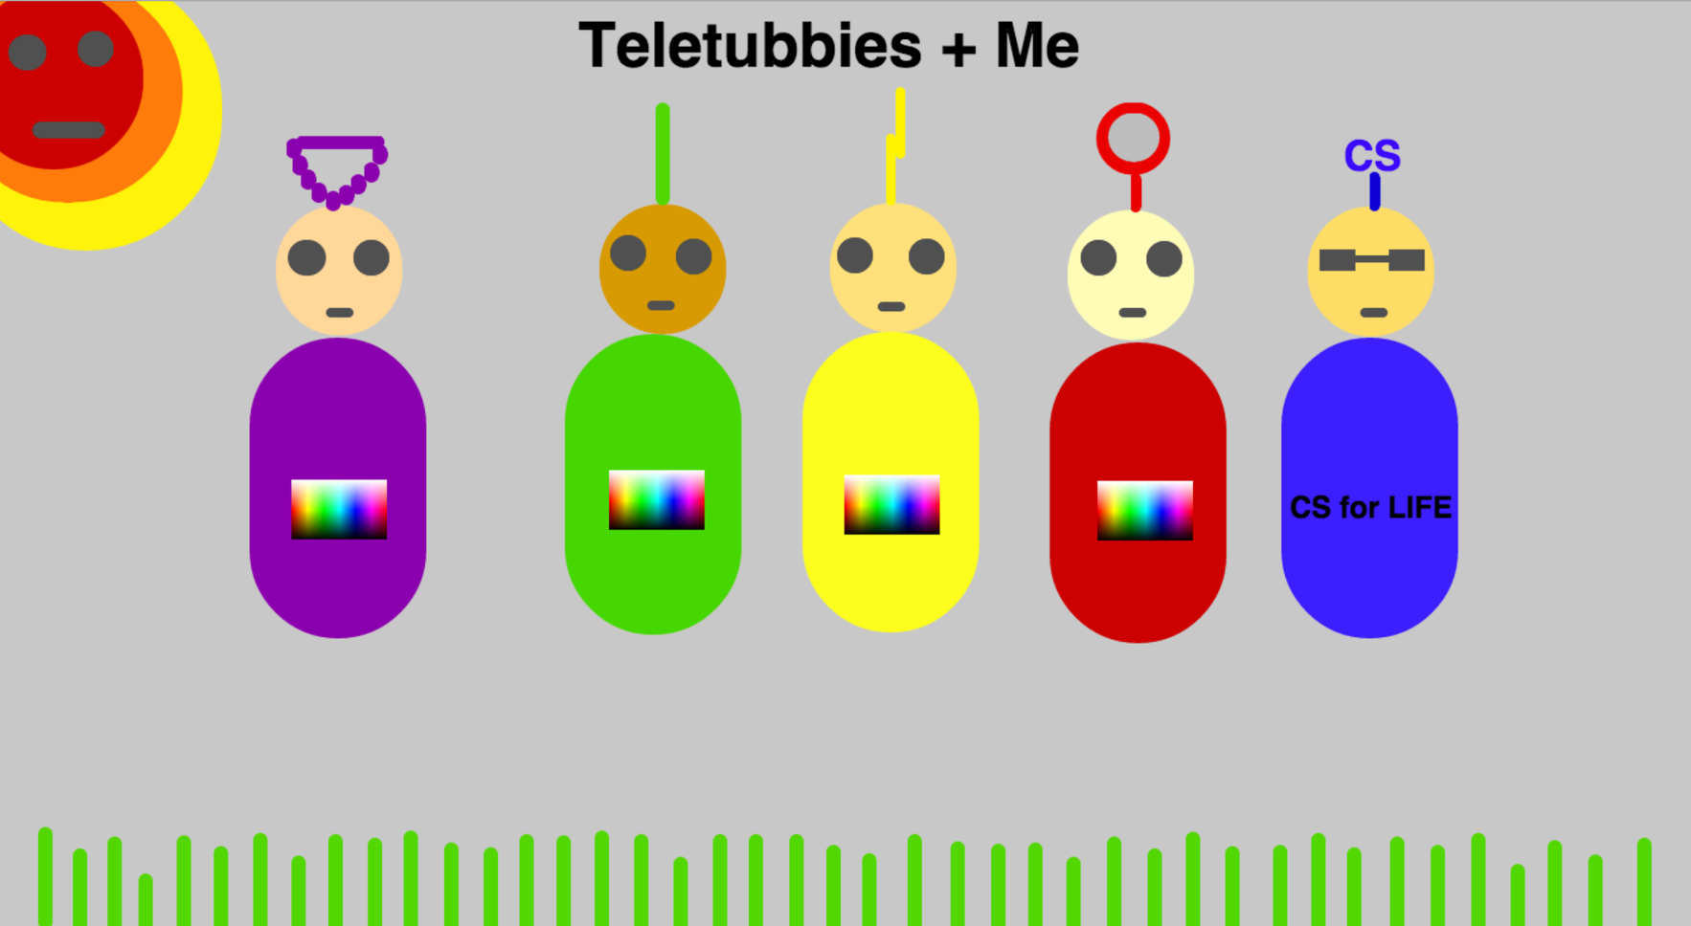

Slide 15


Slide 16
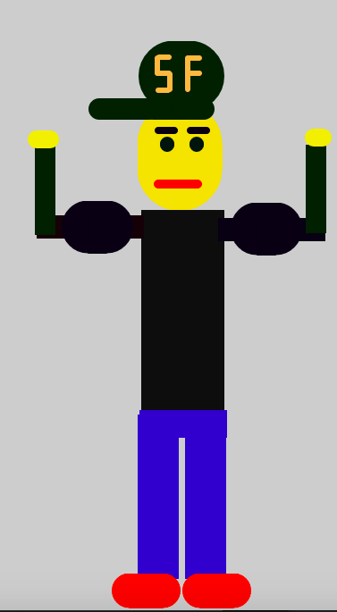

Slide 17
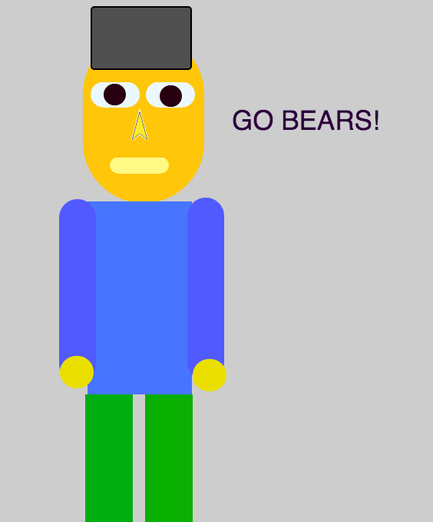

Slide 18
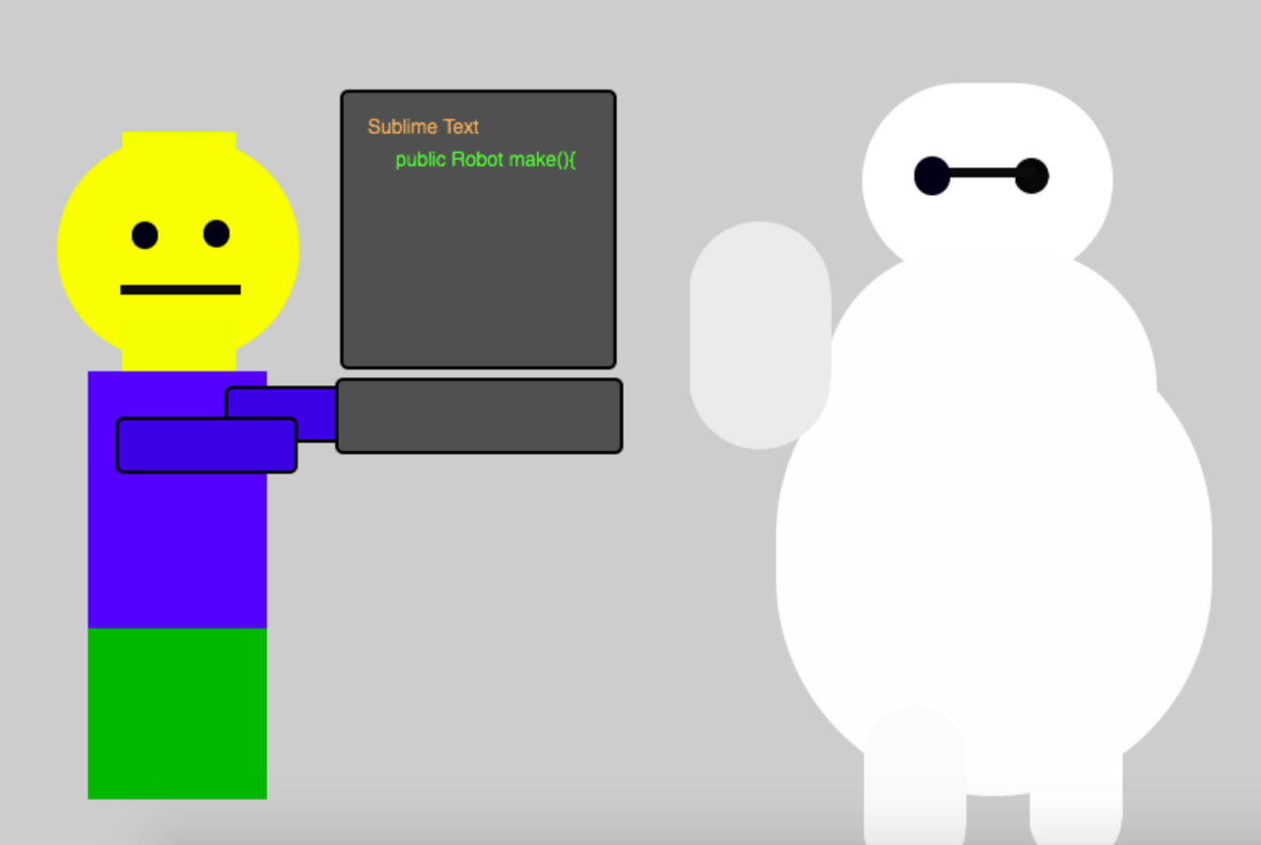

Slide 19
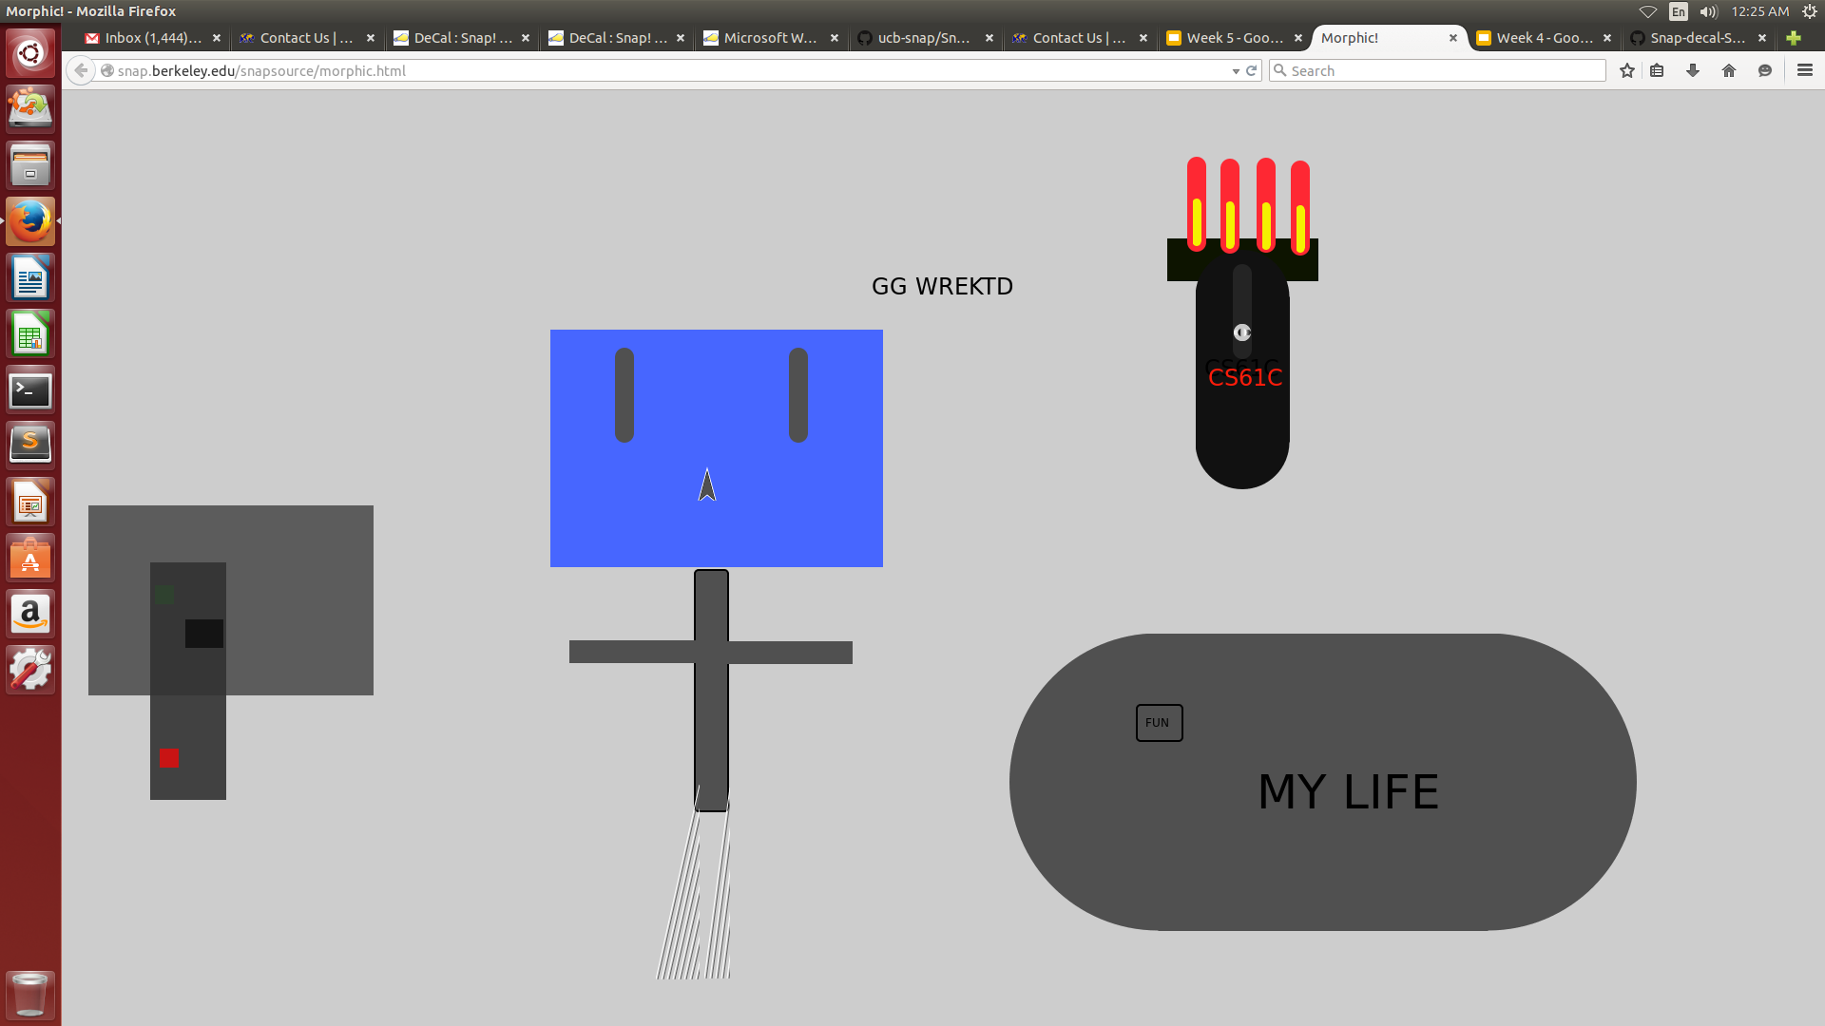

Slide 20
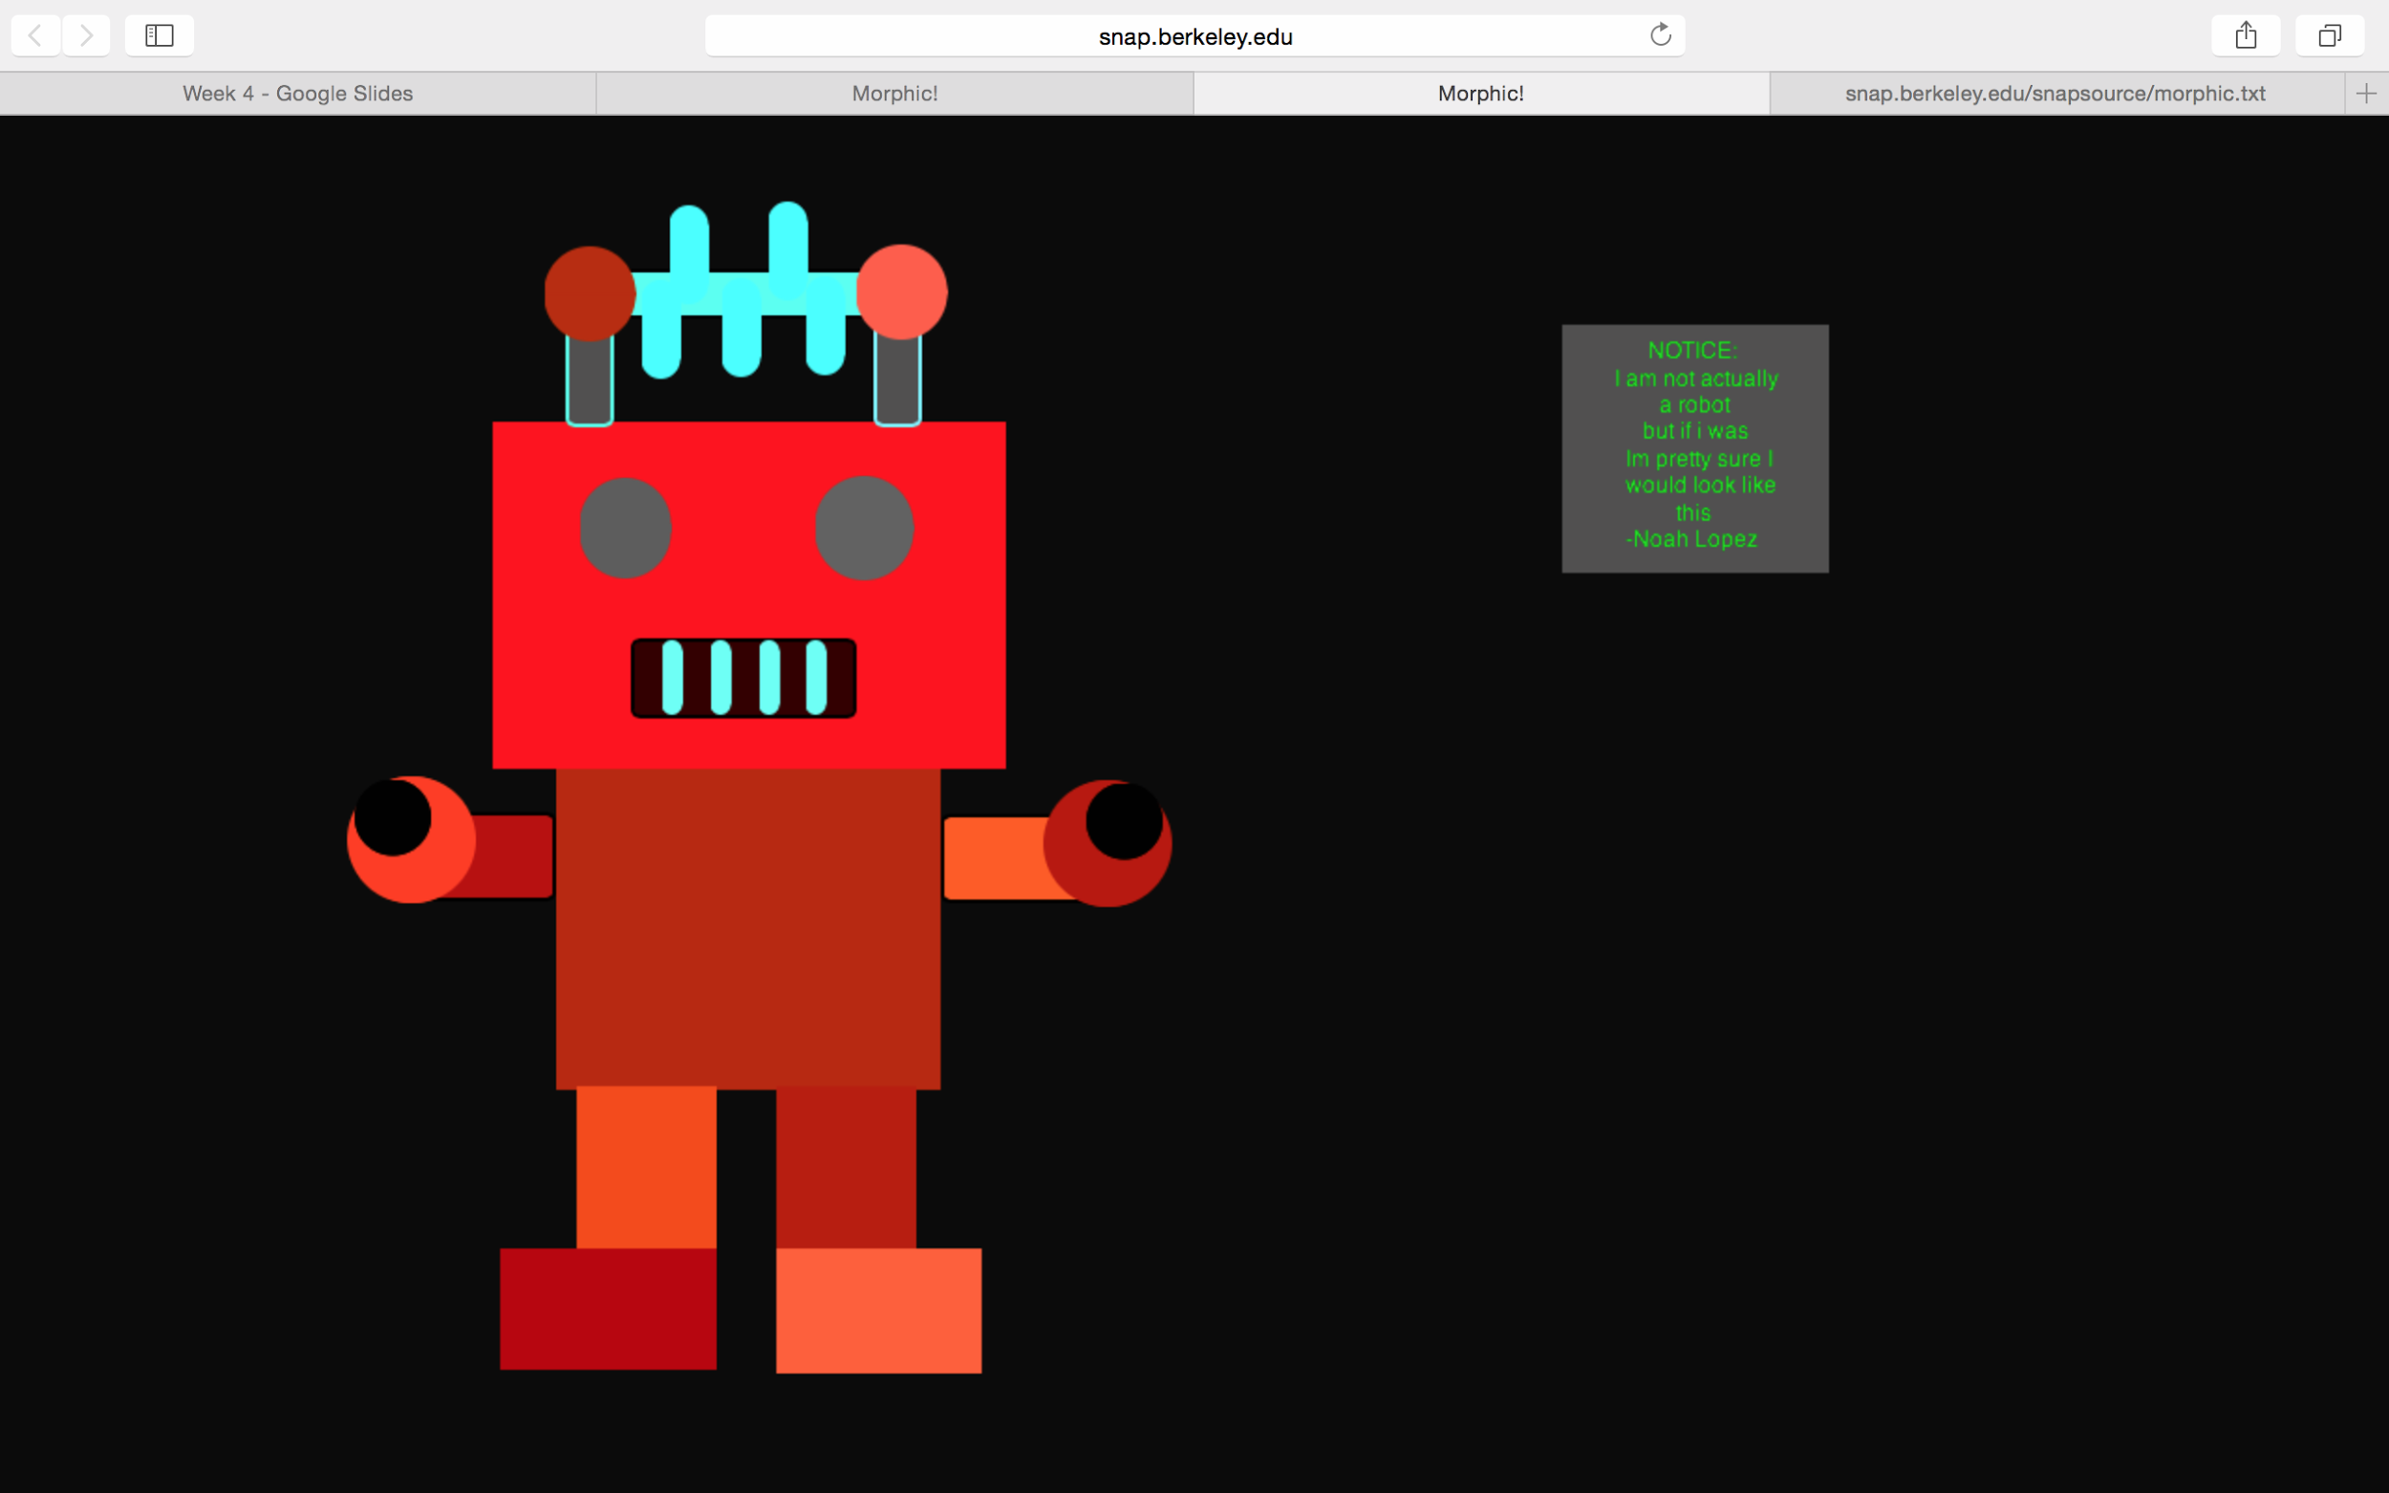

Slide 21
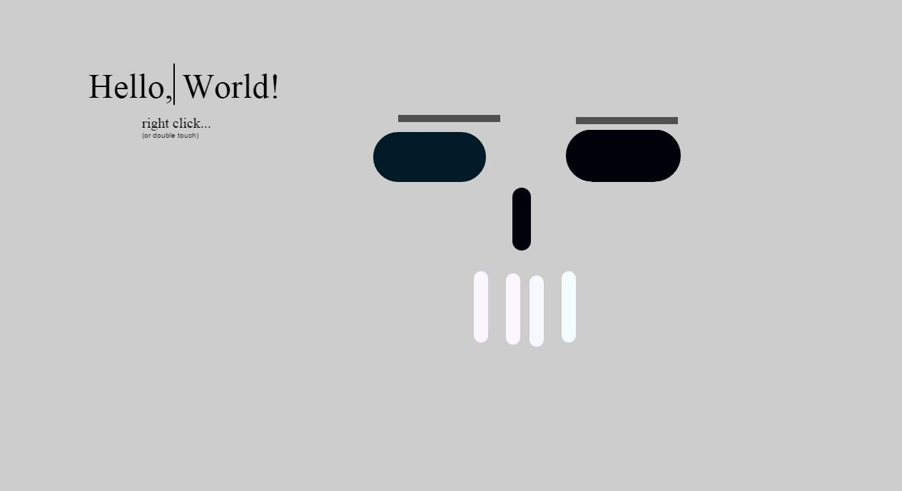

Slide 22
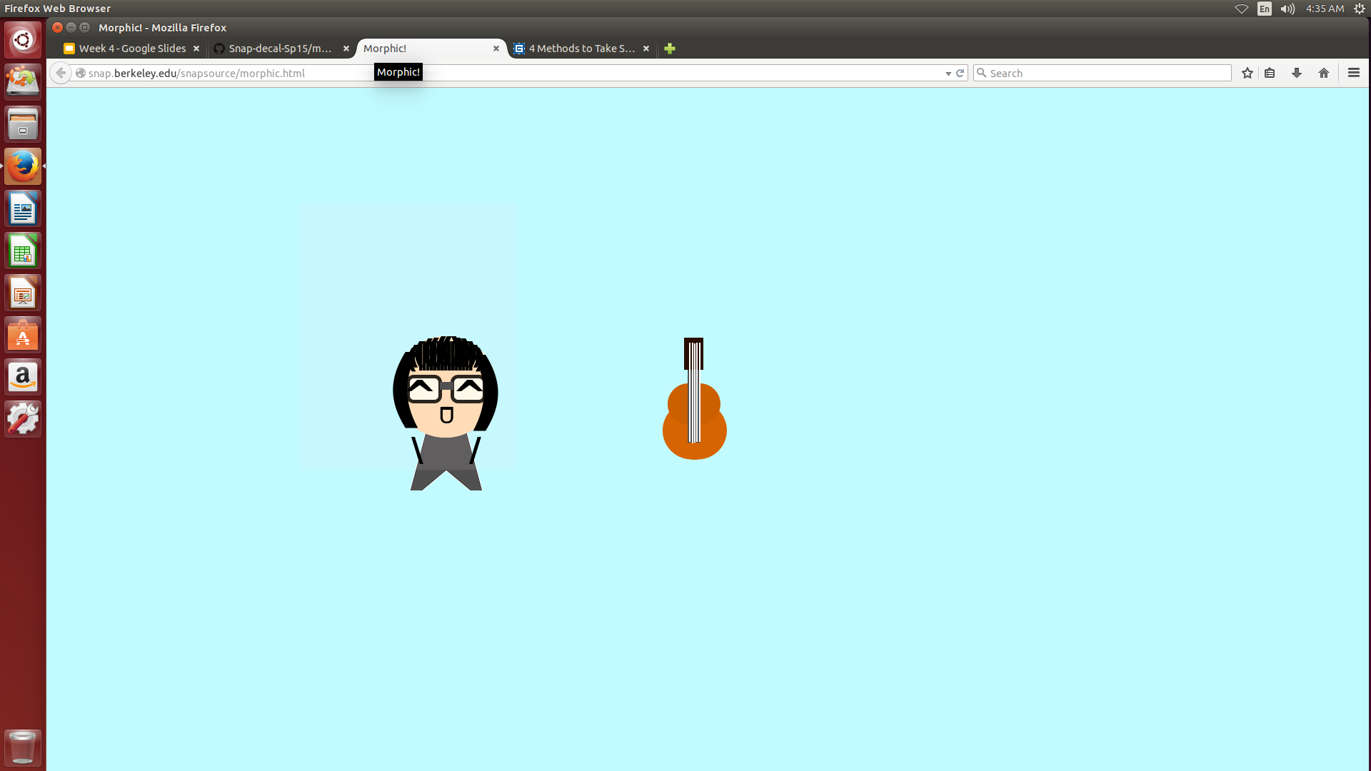

Slide 23
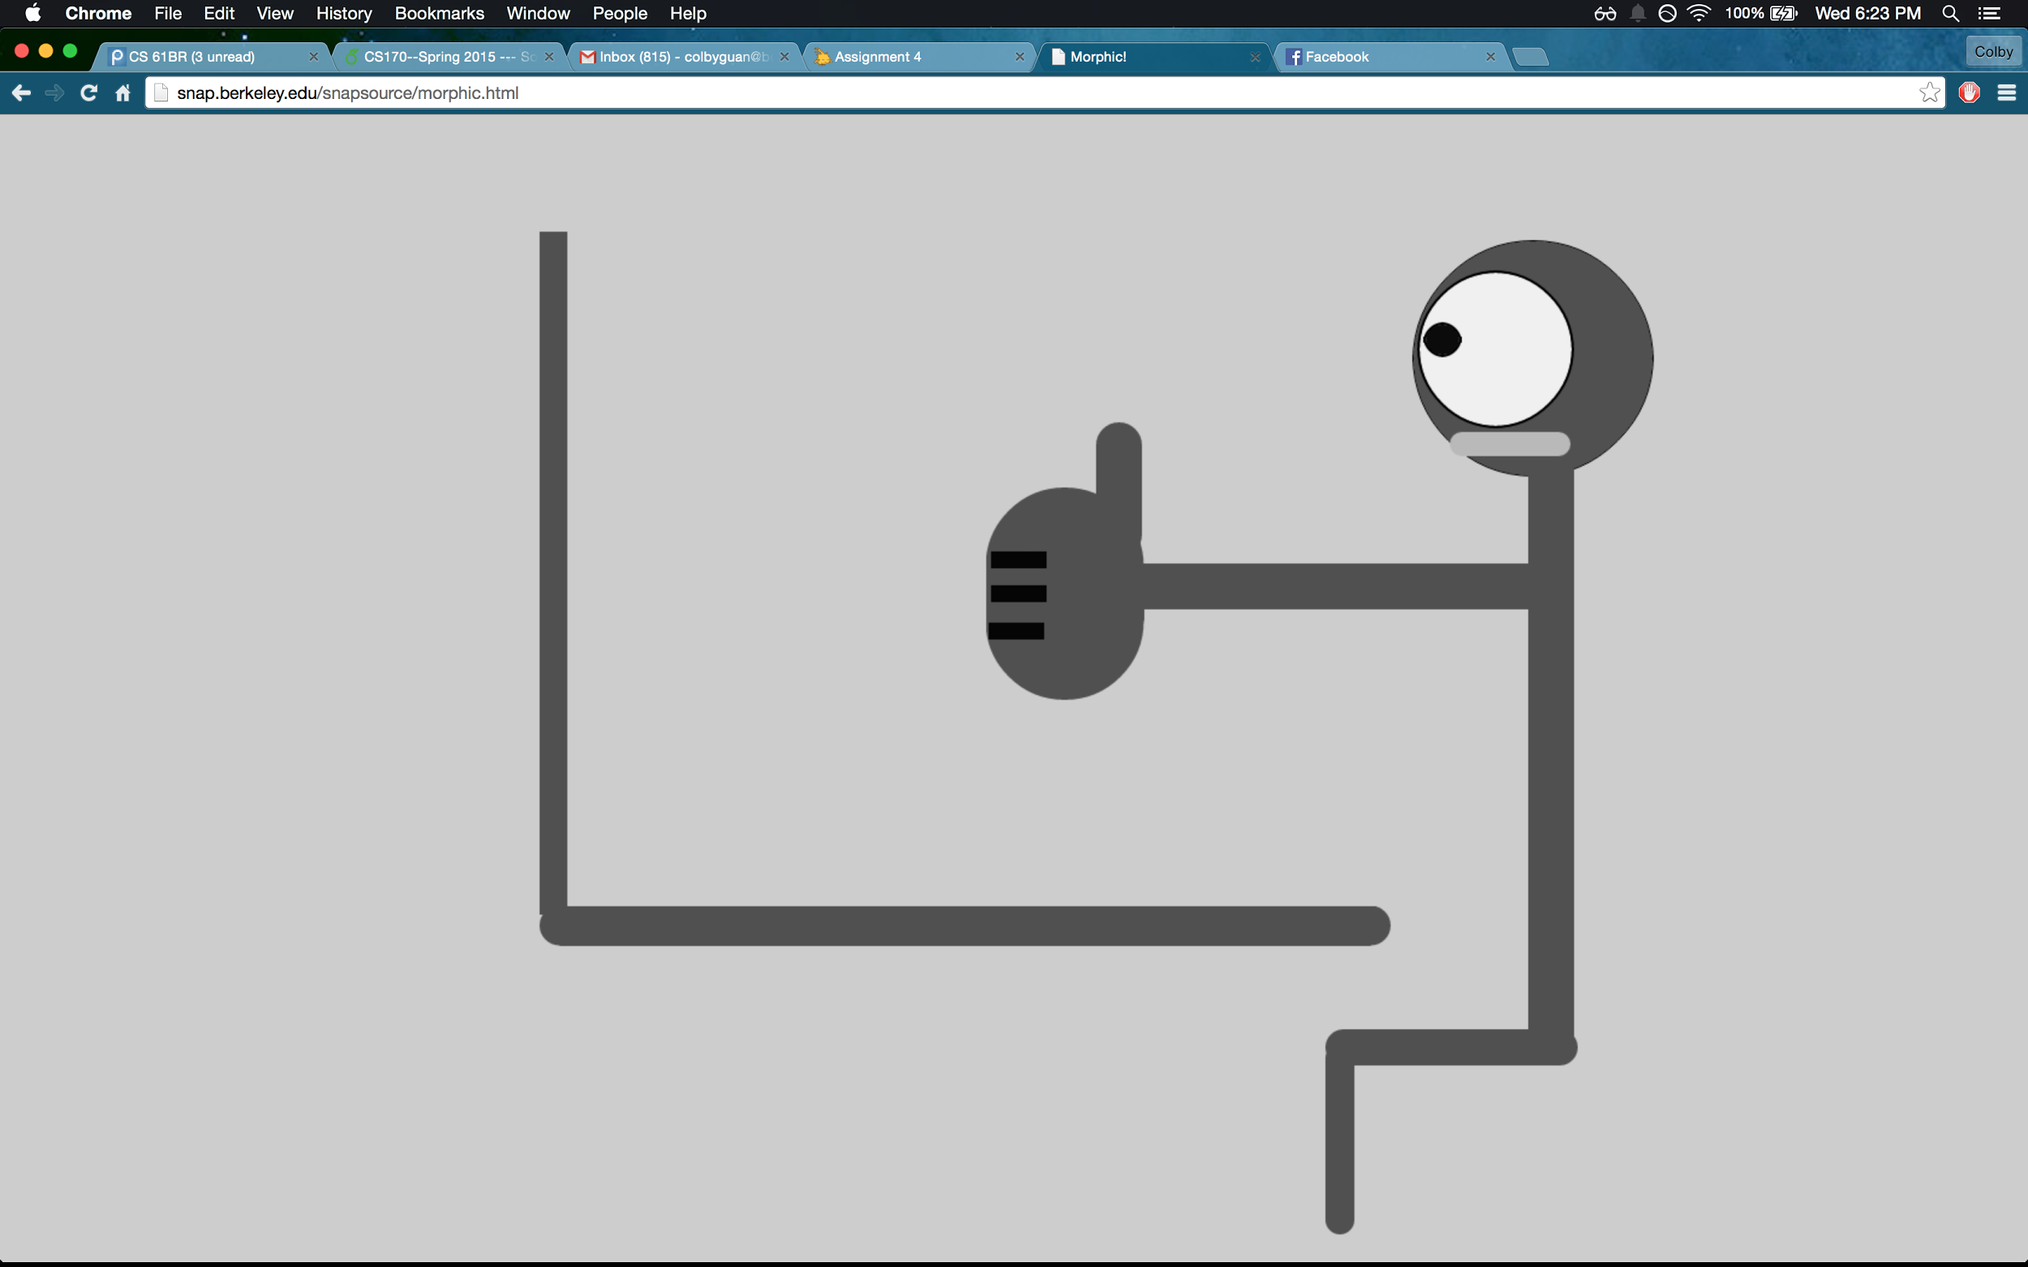

Slide 25
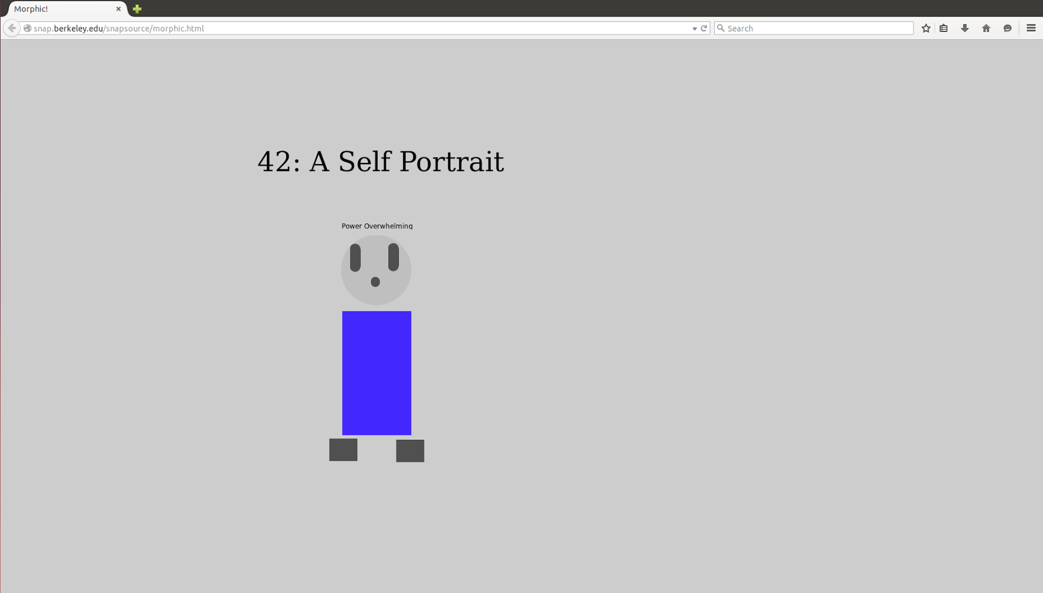

Slide 26
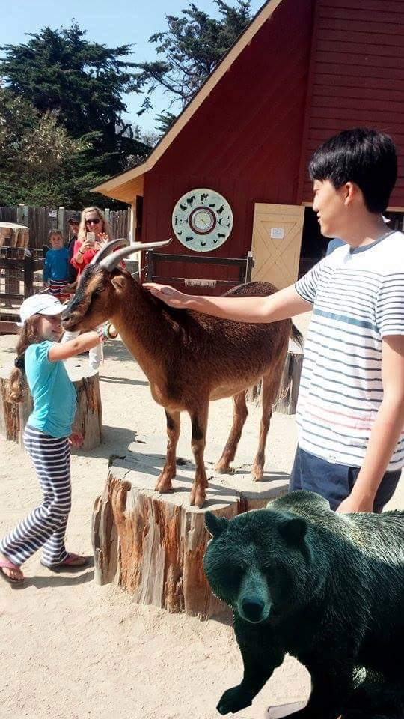
HW Assignment
Tony will now present the homework assignment for this week.
Here is a picture of Tony at the Zoo

