Slide 1
Welcome to Snap! Below the Line Decal
Facilitated By: Zachary, Susanna, Tony, and Jae

Slide 2
What is this decal about anyways?
Learning to work on and manage a large code base
Cultivating interest in Snap Dev team

Slide 3
What will you learn/accomplish?
How to approach a large code base and break it down into manageable abstractions
Using git to make contributions/enhancements to an existing project
Understanding work flow of a development team
Some experience in Java Script
Experience with Git version control system

Slide 4
Assignments
Weekly reading assignments
3 or 4 in class mini-projects
1 final project

Slide 5
Final Project
This is your chance to make a significant contribution and/or enhancement to the Snap! Program
You will work in teams of two mostly, three if necessary
Final projects will be presented at the end of the semester
Successful completion of final project is mandatory

Slide 6
Grading
You will be graded on the following criteria
You may have up to two unexcused absences
Reasonable effort and completion of all assignments
Effort and completion of final project

Slide 7
Survey
Please take a minute to fill out the following survey
http://goo.gl/forms/RFYYKTSGkr
CCN’s for enrollment will be sent out via email to everyone who fills out the survey.
In order to enroll and get units for the decal you must fill out the survey or you will not get a CCN.

Slide 8
Setup: The first steps to success
Text Editor
Recommended: Sublime
Get git setup on you personal machine
Download Git: The Version Control Manager
http://git-scm.com/downloads
Create a github account if you don’t have one already!
Some Advice on choosing a username:
Choose a username wisely as this is something you might want to show to employers and co workers later down the road
Keep it short and professional

Slide 9
Git and GitHub!
Download & setup time! We will be walking around the room to help you get git setup on your personal computer. If you finish early and find others around you still working see if they need any help!
Make sure you “git config”
https://help.github.com/articles/set-up-git/#setting-up-git

Slide 10
Github Continued
Now that you have an account with github and have your personal computer setup lets make a new repository titled “website”
Here is a guide on creating a new repository
https://help.github.com/articles/create-a-repo/

Slide 11
What is a repository?
A folder which acts like a “camera”
It tracks all the files and sub folders contained in the repository but only if you tell git to track these things!
Let’s “clone” the repository on Github to a folder on your personal computer
Git clone <link to your newly created repo here>
Now we’re ready to start on our first assignment

Slide 12
Front-end
Snap! Below the Line DeCal 2015 Fall

Slide 13
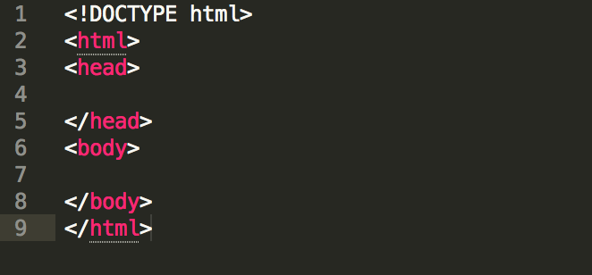
Intro
HyperText Markup Language = HTML
Most commonly used for front-end
Code looks like below

Slide 14
Anatomy of HTML file
<!DOCTYPE html> -> helps browser to display a web page correctly
Multiple tags such as <html>, <head> and <body>
<head> provides information about the document
<body> has visual page contents

Slide 15
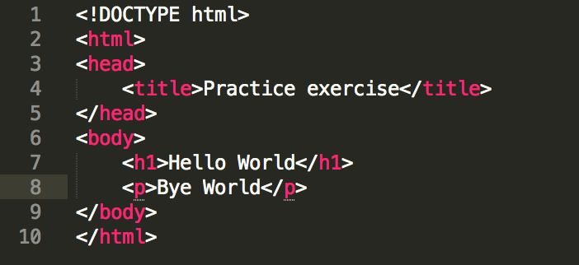
Anatomy of HTML file cont.
<title> provides title for the document
<h1> is a header styled font (<h1> … <h6>)
<p> is a paragraph tag
There are a lot of tags
How does it look like?

Slide 16
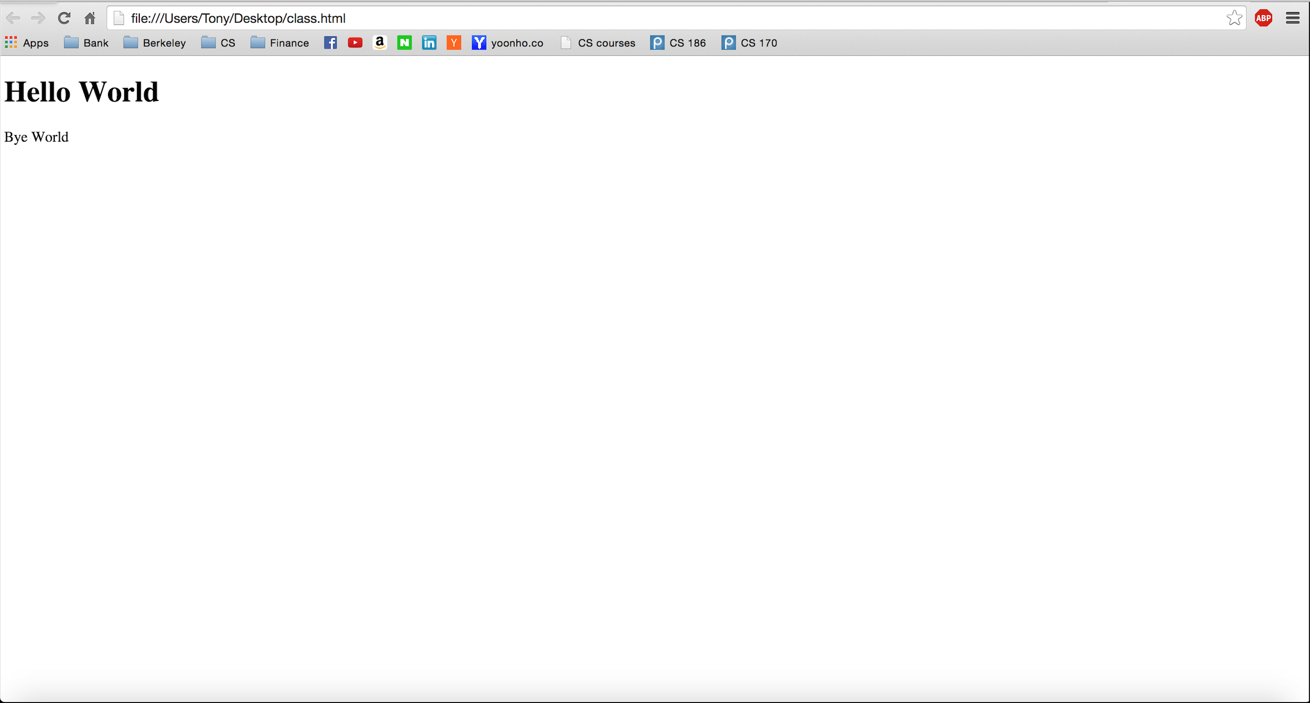

Slide 17
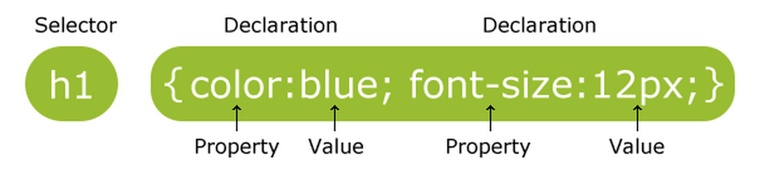
CSS
Cascading Style Sheets = CSS
CSS defines how html elements are displayed

Slide 18
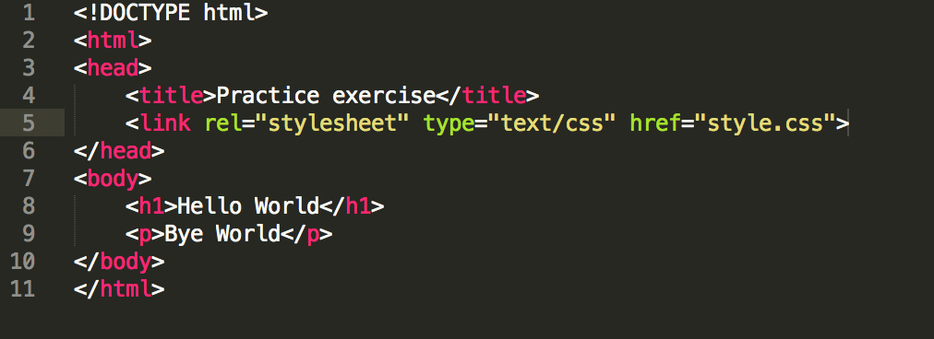
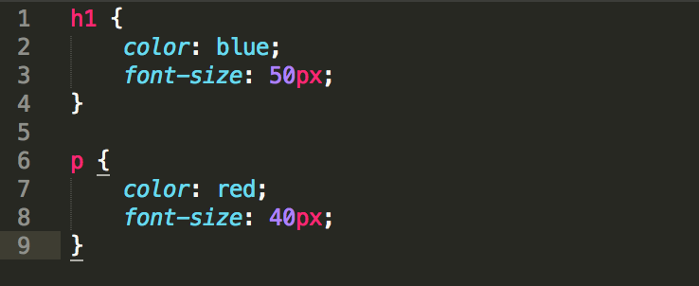
CSS cont.

Slide 19
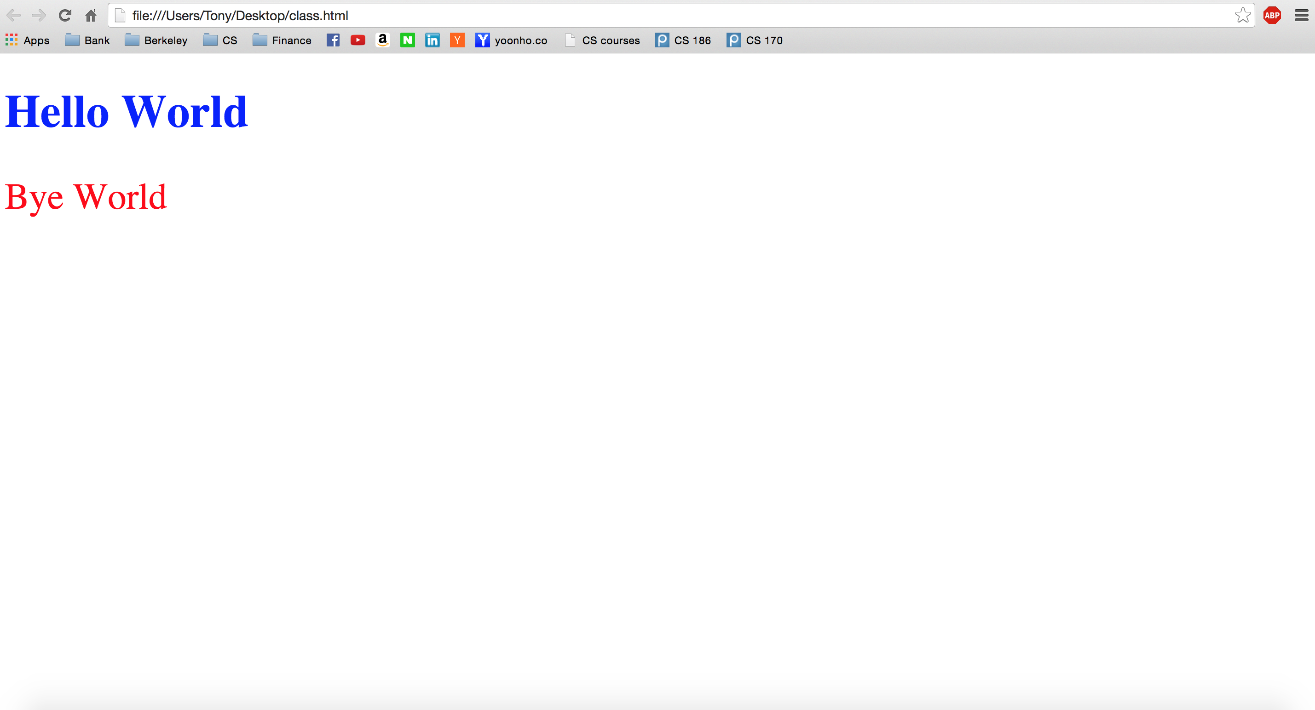
CSS cont.

Slide 20
Javascript
Programming language of HTML and the web.
Why learn Javascript?
Snap! is built using Javascript
Exercise:
http://www.w3schools.com/js/tryit.asp?filename=tryjs_myfirst

Slide 21
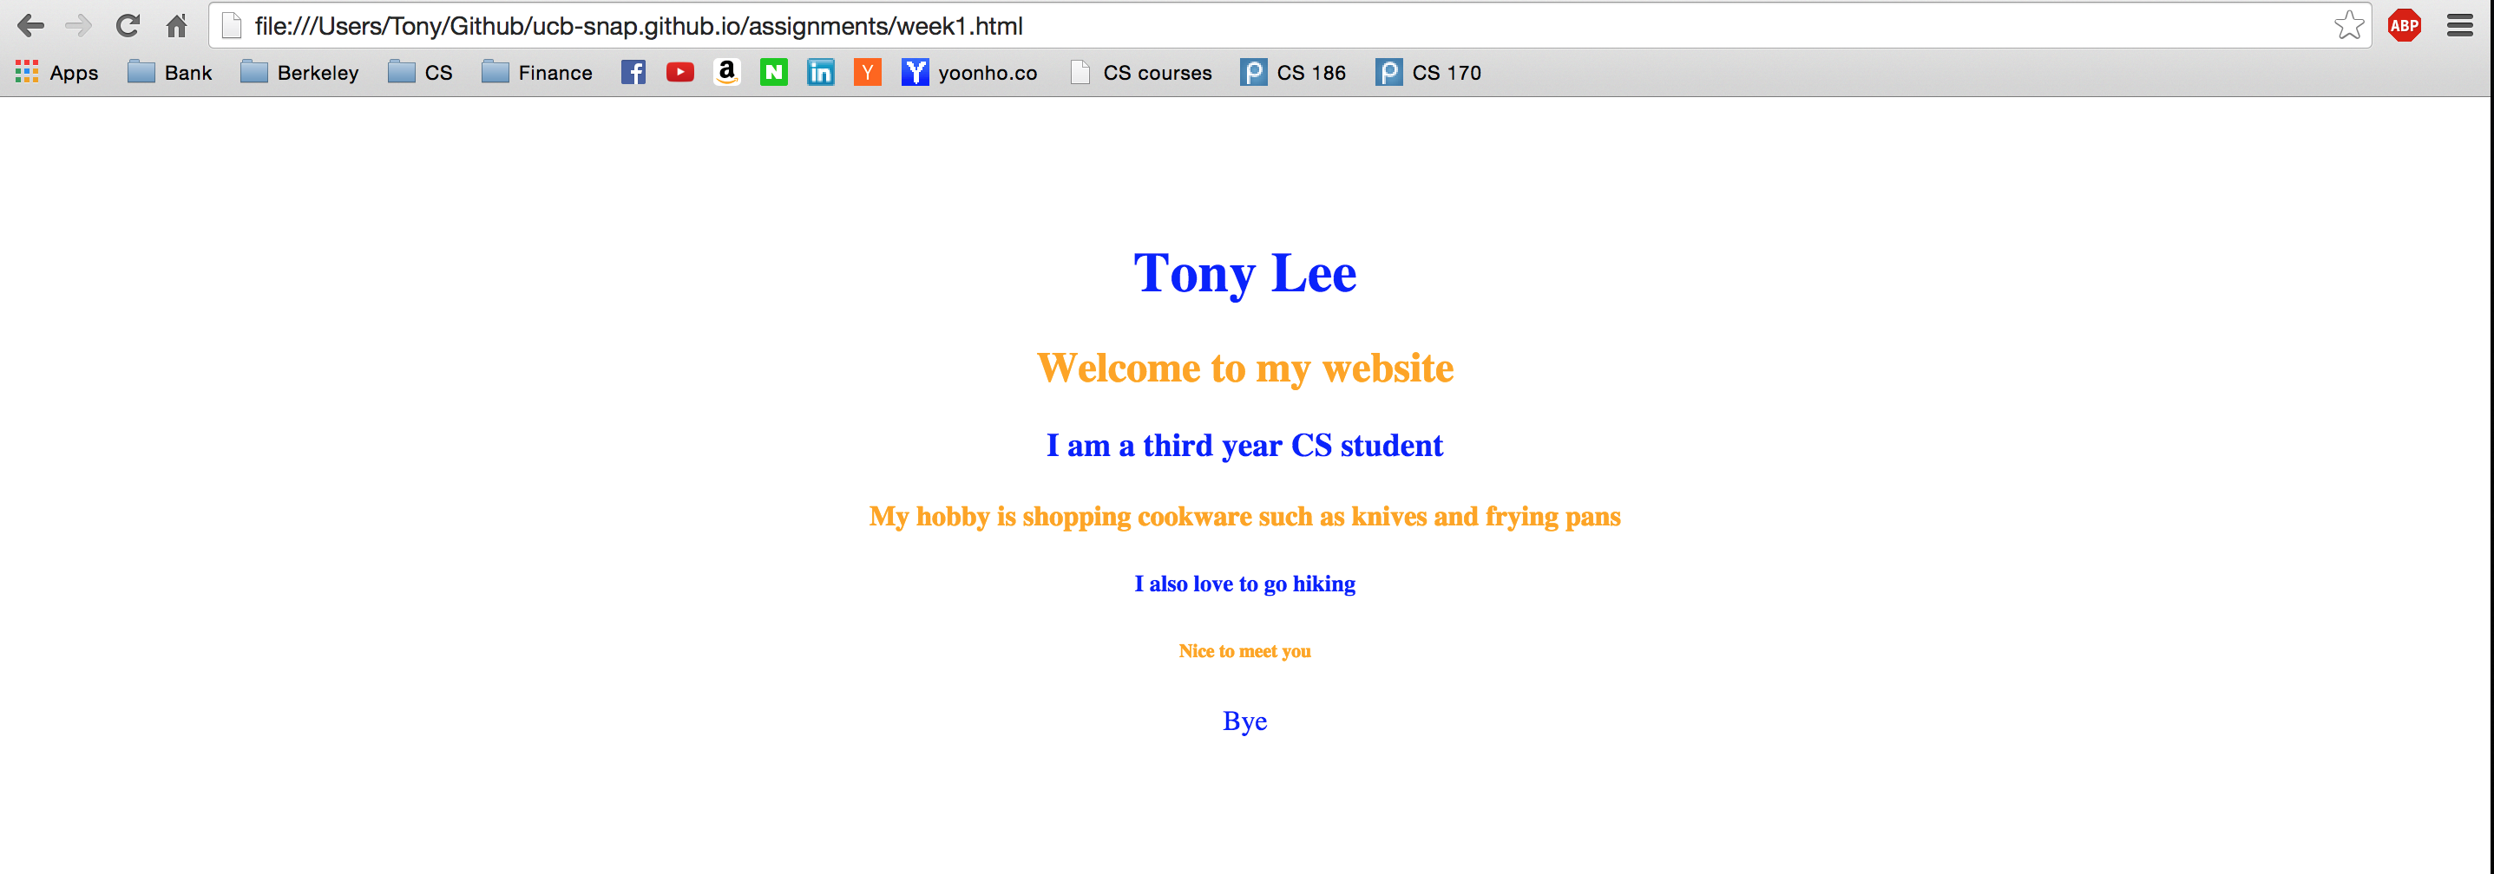
Week1 Assignment
Introduce yourself in your own HTML file using various tags
Make it pretty!

Slide 22
Summary
HTML defines the content of web pages
CSS to specify the layout of web pages
JavaScript to program the behavior of web pages
Majority of Snap! is JavaScript

Slide 23
Q & A

Slide 24
Tracking Your Work with Github
You will need to run the command
Git add <file name here>
This will tell git to track your file
Then when you want to save the changes you have made run
Git commit –m “<Relevant message about changes goes here>”
Finally to push the changes up to github we run
Git push origin master
Now your file has been saved!

Slide 25
Don’t Call it Homework
Reading:
http://git-scm.com/book/en/v1/Git-Basics
https://docs.google.com/document/d/15debDrZIIUHng5GhcE3_4CRPFKIXXjKYYn3wJEV68Mc/edit
*See the website for all homework assignments, reading links, course updates, and resources(the dates/assignments on the syllabus are subject to change)

