Slide 1
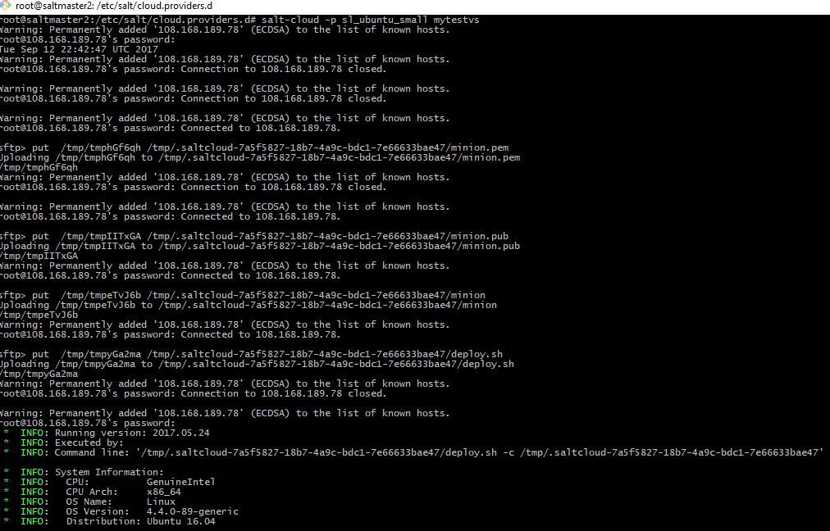
Salt using John Tabbone’s suggestion

Slide 2
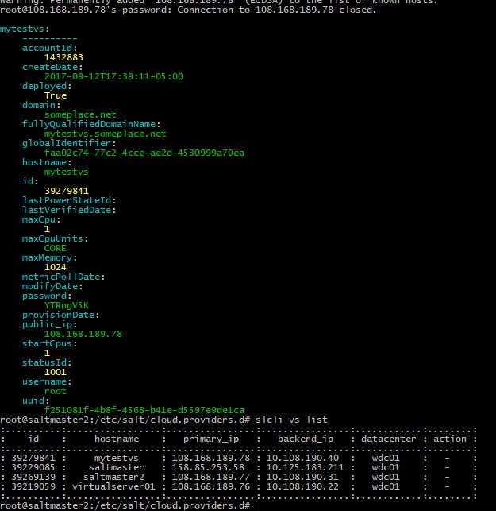

Slide 3
Salt, with error, using the instructions from the HW

