Slide 1
yes/no classification: logistic regression
MCB288 Spring 2022
Lecture 4
31 January 2022

Slide 2
Classification problems
Given a data point (as last time, perhaps specified by many measurements), assign it to a discrete class (with a measure of confidence?)
Study habits => grade
Protein-sequence => domain
DNA sequence => exon/intron/….
Genotype => ancestry
Clinical data => benign/malignant
Image of a hand-drawn digit => 0, 1, 2, 3, … or 9
Logistic regression is the simplest kind of “supervised” learning

Slide 3
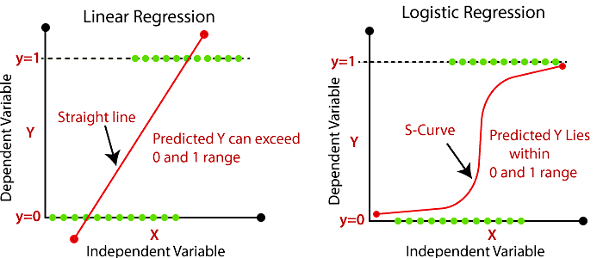
Linear regression is clearly not applicable…
https://www.analyticsvidhya.com/blog/2020/10/demystification-of-logistic-regression/

Slide 4
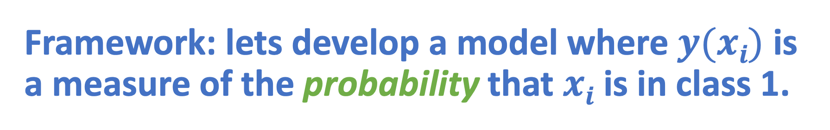
Framework: lets develop a model where $y(xi)$ is a measure of the probability that $xi$ is in class 1.
https://www.analyticsvidhya.com/blog/2020/10/demystification-of-logistic-regression/

Slide 5

If ranges of known ”yes” and “no” are distinct, then this is a relatively easy problem.
YES!
Clearly YES to right of dashed line
Clearly NO to left of dashed line
NO
$$x$$

Slide 6
If ranges of known ”yes” and “no” overlap, we can only give a probabilistic answer anyway
YES!
NO
$$x$$

Slide 7
Estimate the probability from data by sliding bin (need lots of data)
0%
50%
100%
YES!
NO
$$x$$

Slide 8
Or, fit a sigmoidal curve through data
YES!
NO
$$x$$

Slide 9
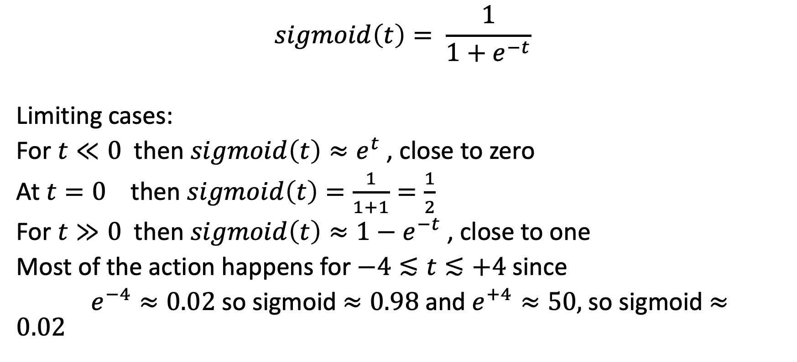
A useful sigmoid (s-shaped) function
$$sigmoid\left(t\right)= \frac{1}{1+e^{−t}}$$
Limiting cases:
For $t≪0$ then $sigmoid\left(t\right)≈e^{t}$, close to zero
At $t=0$ then $sigmoid\left(t\right)=\frac{1}{1+1}=\frac{1}{2}$
For $t≫0$ then $sigmoid\left(t\right)≈{1−e}^{−t}$, close to one
Most of the action happens for $−4≲t≲+4$ since
$e^{−4}≈0.02$so sigmoid $≈0.98$and $e^{+4}≈50,$so sigmoid $≈0.02$

Slide 10
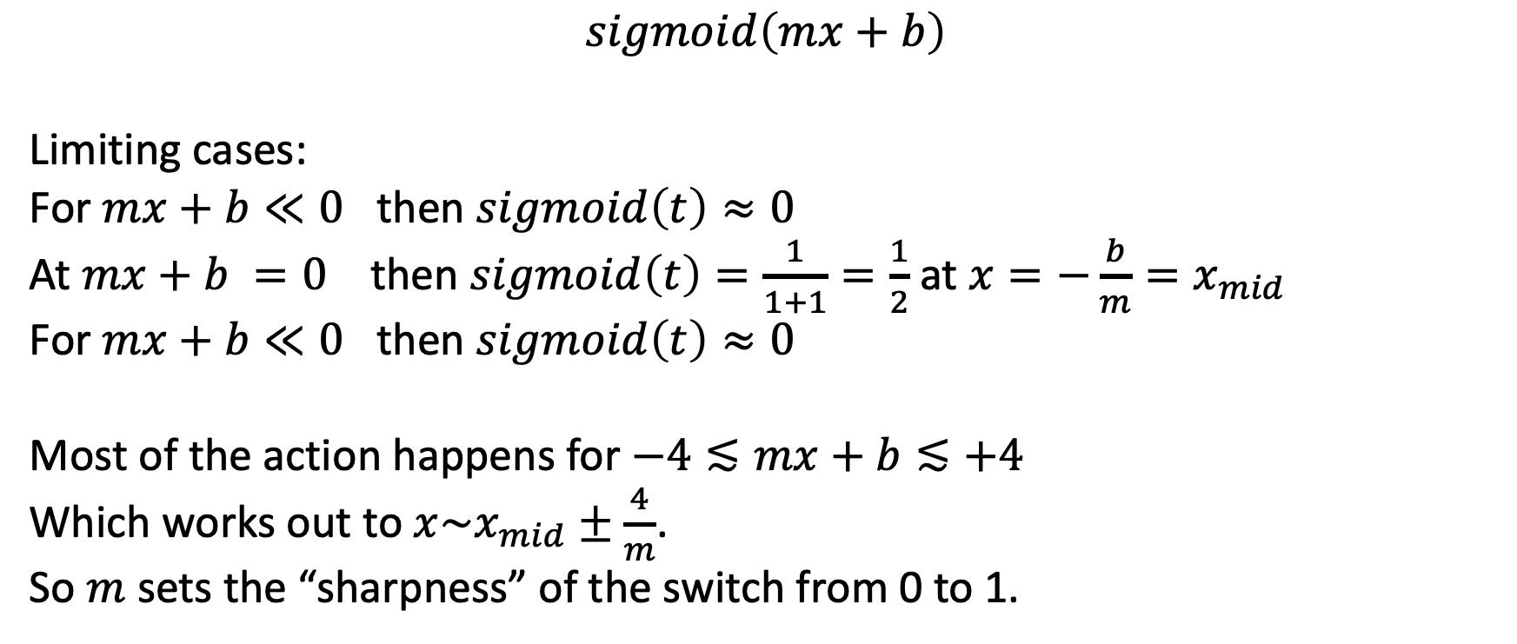
Using the sigmoid – we want a function that has that shape, but whose midpoint and active range depends on data.
$$sigmoid\left(mx+b\right)$$
Limiting cases:
For $mx+b≪0$ then $sigmoid\left(t\right)≈0$
At $mx+b =0$ then $sigmoid\left(t\right)=\frac{1}{1+1}=\frac{1}{2}$ at $x=−\frac{b}{m}=x_{mid}$
For $mx+b≪0$ then $sigmoid\left(t\right)≈0$
Most of the action happens for $−4≲mx+b≲+4$
Which works out to $x\sim x_{mid}±\frac{4}{m}$.
So $m$ sets the “sharpness” of the switch from 0 to 1.

Slide 11
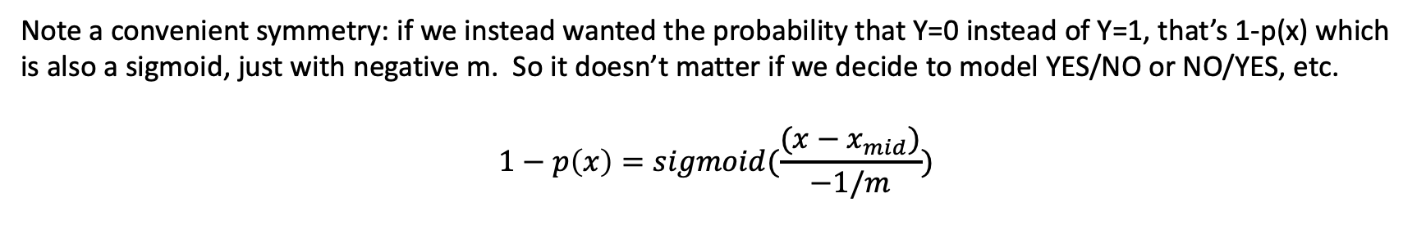

A convenient symmetry
$$p\left(x\right)=sigmoid(\frac{x−x_{mid}}{1/m})$$
Kind of like a z-score: measure distance of x from midpoint, and divide by active range.
Note a convenient symmetry: if we instead wanted the probability that Y=0 instead of Y=1, that’s 1-p(x) which is also a sigmoid, just with negative m. So it doesn’t matter if we decide to model YES/NO or NO/YES, etc.
$$1−p\left(x\right)=sigmoid(\frac{(x−x_{mid})}{−1/m})$$

Slide 12

Bayesian thinking (countbayesie.com)
Prior probability of hypothesis without new data (i.e., bias)
Likelihood of data given the hypothesis
$$P\left(H | D\right)=\frac{P(D|H)×P(H)}{P(D)}$$
“posterior probability”
(prob of hypothesis after new data D has been considered)

Slide 13
We do this all the time …
Consider a disease with prevalence 1/1000
This is the “prior” P(sick) that a randomly sampled person has the disease = 0.1%
Now we perform a diagnostic test that has a 90% rate of correctly diagnosing a sick person (true positive), and a 1% false positive rate (diagnose sick when person is well).
These are the likelihoods of sickness, given data = P(sick|pos test), P(sick|neg test)
Out of 10,000 people, 10 will be sick.
Diagnostic test will find 90% = 9 of them, missing 1.
Out of 10,000 people, 9,990 will be healthy.
Diagnostic test incorrectly call 1% of them = 100 as sick even though they are not.
So after the test, our “posterior probabilities” P(sick | diagnosis) change:
Of those 109 who are diagnosed, 9 will actually be sick = 8.3% => 91.7% false positive!
Of those 9,991 who are cleared by the test, one will be sick = 0.01% (false negative)

Slide 14
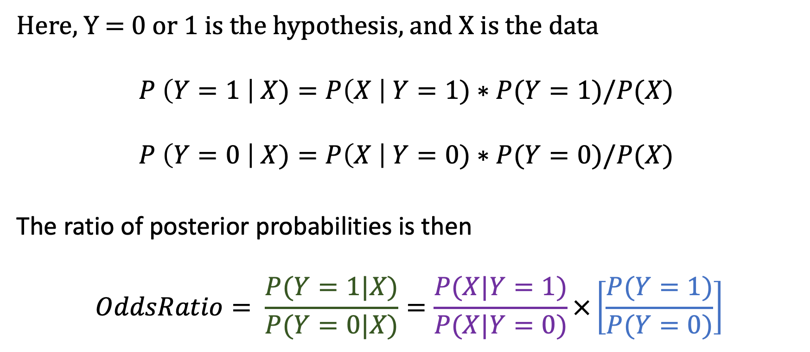
Odds ratio
Here, Y = 0 or 1 is the hypothesis, and X is the data
$$P \left(Y=1 \right| X)=P\left(X \right| Y=1)∗P(Y=1)/P(X)$$
$$P \left(Y=0 \right| X)=P\left(X \right| Y=0)∗P(Y=0)/P(X)$$
The ratio of posterior probabilities is then
$$OddsRatio= \frac{P(Y=1|X)}{P(Y=0|X)}=\frac{P(X|Y=1)}{P(X|Y=0)}×\left[\frac{P(Y=1)}{P(Y=0)}\right]$$
Posterior odd ratio
Likelihood ratio
Prior odds ratio

Slide 15
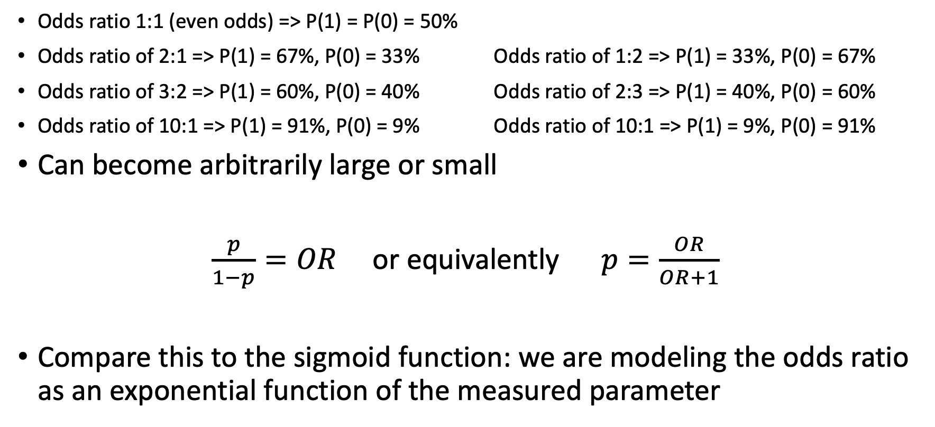
Odds ratio
Odds ratio 1:1 (even odds) => P(1) = P(0) = 50%
Odds ratio of 2:1 => P(1) = 67%, P(0) = 33% Odds ratio of 1:2 => P(1) = 33%, P(0) = 67%
Odds ratio of 3:2 => P(1) = 60%, P(0) = 40% Odds ratio of 2:3 => P(1) = 40%, P(0) = 60%
Odds ratio of 10:1 => P(1) = 91%, P(0) = 9% Odds ratio of 10:1 => P(1) = 9%, P(0) = 91%
Can become arbitrarily large or small
$\frac{p}{1−p}=OR$ or equivalently $p=\frac{OR}{OR+1}$
Compare this to the sigmoid function: we are modeling the odds ratio as an exponential function of the measured parameter

Slide 16
Fit a sigmoidal curve through data
YES!
Odds ratio approaches infinity
Odds ratio near 0
NO
$$x$$

Slide 17
Odds ratio goes from 0 to infinity (“even odds” means OR = 1)
So it is natural to use a log transform to make things symmetric
Log(number near zero) = - (large number)
Log(1) = 0
Log(very large number) = +(large number)

Slide 18
Fit a sigmoidal linear curve through data log(OddsRatio)
Log of odds ratio (LOD)
YES!
Odds ratio approaches infinity
Odds ratio near 0
NO
$$x$$

Slide 19
A little bit of algebra shows that this is the same as our sigmoidal fit = “Logistic regression”
Linear regression minimized ”sum of squares”

Slide 20
How do we operationally do this?
Linear regression => find the line y=mx+b that minimizes sum of squares of errors
Logistic regression => find the m and b that maximizes the probability of the entire dataset (where p(x) = sigmoid(mx+b) )
Cost function = -log(likelihood of dataset given model parameters m and b)

Slide 21

Generalize to multiple descriptive variables (e.g., pixels, principal components, etc.)
Log(odds ratio)
$\log\left(\frac{p}{1−p}\right)= β_{0}+$ $β_{1}$ $x_{1}+$ $β_{2}$ $x_{2}+$ $β_{3}$ $x_{3}…$
$$p=\frac{1}{1+e^{−(β_{0}+ β_{1} x_{1}+ β_{2} x_{2}+ β_{3} x_{3}… )}}$$
Latent hidden variable
Same as “m”
“binary logistic regression”

