Slide 1
The Case for Learned Index Structures
John Yang | CS 294 | Feb 11, 2019

Slide 2
Outline
Background
Problem
Success Metrics
B-Trees
RM-Index
Hashmaps
Bloom Filters
Conclusions
3
5
7
8
13
21
25
28

Slide 3

Background
The State of System Design Today
Data Structures and Algorithms are
General Purpose, “One Size Fits All”
Assume nothing about data distribution
Oblivious towards the nature of data
Notes:
Authors give an example of building a system, for querying + storing a range of records over a set of continuous integer keys (1 to 100M)
To us, it’s obvious to use the integers as an offset. Lookup time would be O(1)
However, for B-Trees, no matter the data, the lookup is O(log n)
Joins, Sorts, Trees, Scheduling Cache, Bloom Filter

Slide 4






Background
Data Structure and Algorithm Domains
Join
Sort
Tree
Scheduling
Cache
Bloom Filter
Notes:
Commonality: Looks at the general format of the data, but not the content or nature of the data itself.

Slide 5
Problem
“One Size Does Not Fit All”
Traditional Data Structures do not account for the nature of data
Scales poorly with more data
Do not take advantage of common patterns in real world data
Suboptimal edge cases can fail with increases in computation time by orders of magnitude.
Learn the Data Distribution for Time, Space, Performance Improvements
Scale with complexity, not size
Machine Learning, Reinforcement Learning, and Neural Nets can replace, complement, improve existing heuristics and system operations.
Notes:
1.
A. Linear Trend , O(n)
B. Example from before
C. Join Query Optimization

Slide 6
Problem
Idea: Use Machine Learning Models to Learn Different Data Distributions and Create Adaptive Structures and Algorithms
In some sense, indexes are already models, so it’s worth exploring transitioning from rigid index structures to learned, more flexible models.

Slide 7
Success Metrics
Traditional Systems Metrics
I/O Count
Space + Memory Requirements
Query + Lookup Time
Model Metrics
Size of the Model
Amount of Overhead
Number of Training Iterations
Amount of Training Data
Notes:
Less space, shorter amounts of time is better.
Constant theme: model size, invocation + execution time is longer than traditional index

Slide 8
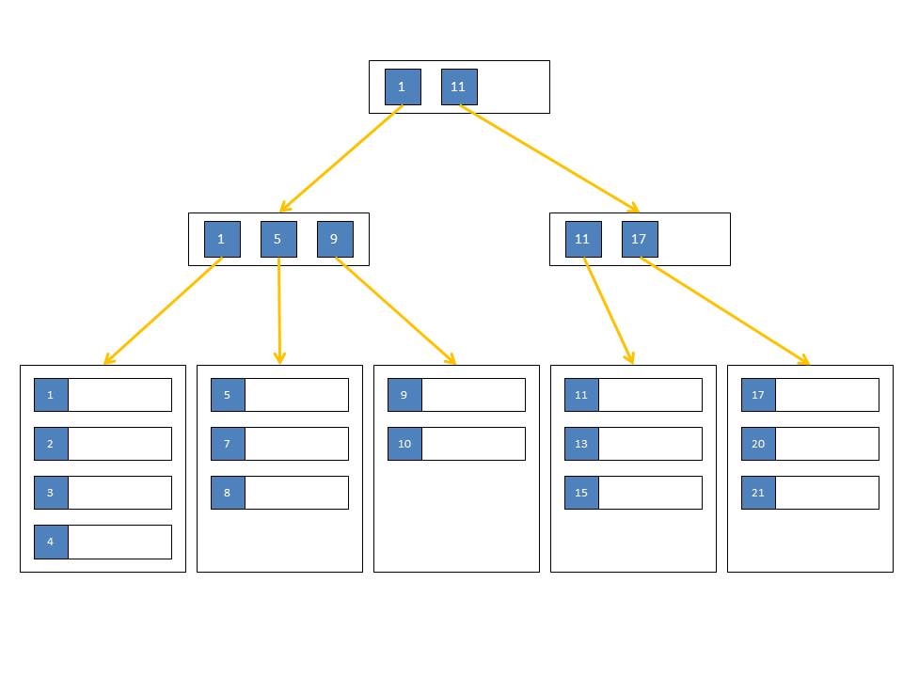
B-Trees | Range Index
CPU Cache
Main Memory
Disk / Main Memory
Notes:
3 Case Studies
B-Trees
Hashmaps
Bloom Filters
Models are largely supervised, prediction problems

Slide 9
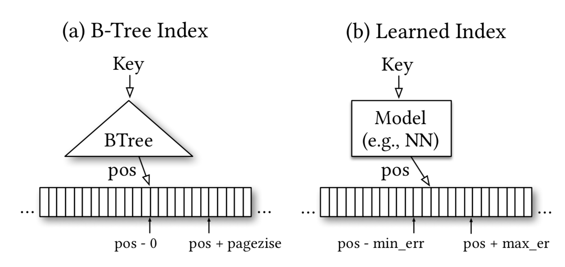
Key Innovations
B-Trees as a Modeling Problem
Smaller Index
Faster Lookup
More Parallelism
Cheaper Insertion
Hardware Acceleration
Notes:
B-Tree: Map Key to Page, then Search within Page
Already a model: function(key) => Position, “predict” the location of a value within a key sorted set
Clustered / Unclustered Indexes for efficient range requests
Builds Cumulative Distribution Function

Slide 10
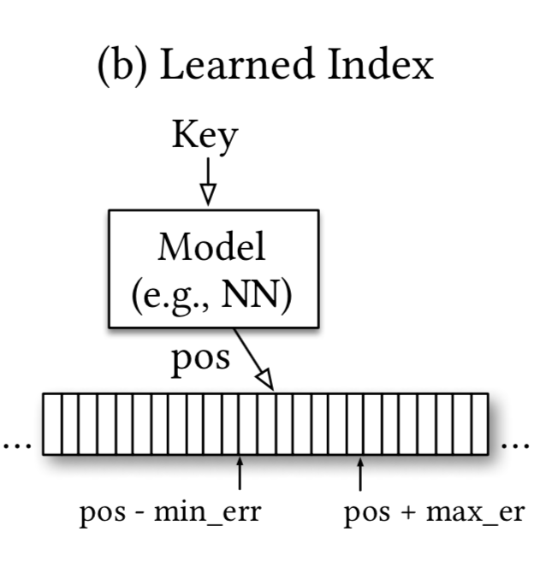
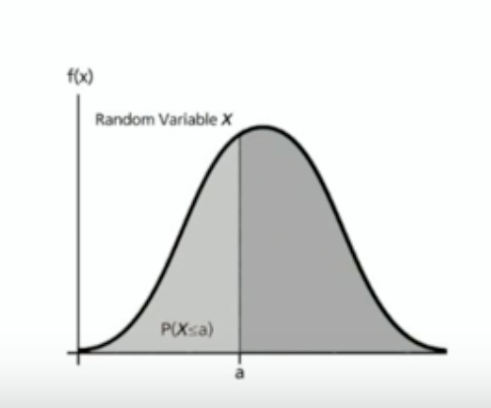
Key Innovations
B-Trees as a Cumulative Distribution Function
Predicted Position = P(x < key) * # of Keys
What is the distribution of data?
Where is it coming from?
How does it look?
Notes:
B-Tree: Map Key to Page, then Search within Page
Already a model: function(key) => Position, “predict” the location of a value within a key sorted set
Clustered / Unclustered Indexes for efficient range requests
Builds Cumulative Distribution Function (Random Variable, gives area under probability density function from - infinity to x)
CDF (cumulative distribution function) Formula:
P is estimated cumulative distribution for data to estimate likelihood

Slide 11
Key Innovations
Tensorflow Implementation of B-Tree Lookup
200M Web Server Log Records sorted by Timestamp
2 Layer Neural Network, 32-width fully connected, ReLU Activation Function
Given the timestamp, predict the position!
Results:
Tensorflow: 1250 Predictions / Sec ~ 80000 ns Lookup
B-Trees: 300 ns Lookup, 900 ns Binary Search across entire data set
Notes:
Tensorflow may have been overkill for this purpose and context

Slide 12
Key Results & Takeaways
Tensorflow is designed for running larger models. Python paired with significant invocation overhead equals slower execution.
When is a model driven approach more appropriate than traditional indexes?
B Trees better at overfitting, more accurate at individual data instance level.
How does a model solve the “last mile” problem - Narrow down a data set
from large range to specific instance? (Overfitting?)
B Trees are cache efficient, keep relevant nodes and operations close by. On the other hand, neural nets require
Notes:
Overfitting is usually a bad word in machine learning - more specific = more and more irregularities. May not be so bad for databases.
Overfit = Customized index for a particular database
What is best search style given approximate answer. Models good at approximating to a range, but last mile is up to debate

Slide 13
Learning Index Framework (LIF)
Problem: How to better investigate different models for index replacement or optimization.
Solution: Learning Index Framework
Index Synthesis System
Given an Index => Generate, optimize, and test different index configurations
For simple models (e.g. linear regression), learns values on the fly
For complex models, extract model weights and generate C++ index structure
Notes:
LIF: Learning Index Framework
RIM: Recursive Model Index
Never use Tensorflow at inference to remove invocation overhead
Experimental Framework (Does not use SIMD)
Best index configuration found with autotuning (more research can be done here, just uses simple grid search for now)

Slide 14
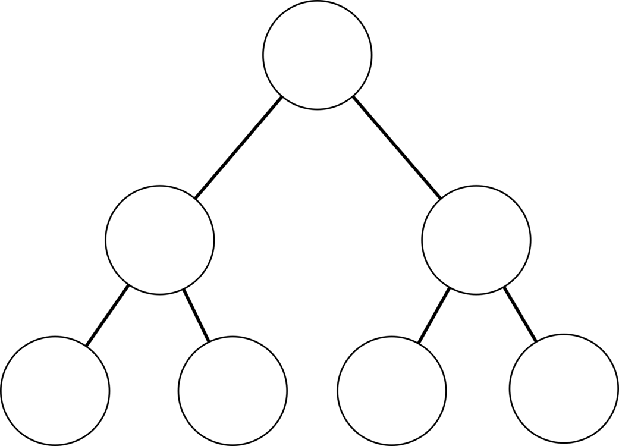
Recursive Model Index (RMI)
Problem: Accuracy of Last Mile Search
Solution: Recursive Regression Model
Idea: Reduce error across a hierarchy of models focusing on subsets of data
1.5 Million Records, ~60 Cycles
24K Records,
120 Cycles
Loss Function
Loss Function Initialization
Notes:
LIF: Learning Index Framework
RIM: Recursive Model Index
B-Trees and overfitting: better at determining values at specific index level
More difficult to reduce prediction error within one model
One way to think about it: one model makes prediction about key, the output prediction is used to find the next model (responsible for smaller area of key space to make better prediction), pick an expert with better knowledge about certain keys
Each model approximates less data over time
Trained stage wise (top layer then onwards)
Benefits:
Separate model size + complexity from execution cost (modularize the two in two separate steps)
Easier to learn overall data distribution shape
Divide space into smaller sub-ranges to solve last mile problem
No Search Process required between stages (output directly used to pick next one, no need to look for model) => Reduce instructions

Slide 15
Hybrid Recursive Model Index
Problem: Specific Data at the bottom of RMI may be harder to learn
Solution: Combine different models at different layers of RMI
Neural Nets at the top
Simple Linear Regression on the bottom
Fall back on B-Trees if data is particularly difficult to learn
Notes:
LIF: Learning Index Framework
RIM: Recursive Model Index
Small ReLU neural net on top -> learn wide range of data distributions
Linear Regression inexpensive in space and execution time
Allow us to bound worst case performance of learned indexes (for very difficult data distributions to comprehend, replace all models with B-Trees), dynamic model

Slide 16
Search Strategies
Binary Search
Biased Quaternary Search
Exponential Search
Notes:
Search strategies for solving last mile problem
Search strategies that take advantage of a model guessing the position, not just region of the key
Quaternary: takes three, not just one data point

Slide 17
Experiments with LIF, RIM
Four Different Datasets
Timestamps from weblogs (200 M)
Longitudes from Maps (200 M)
Data sample from log-normal distribution (190 M)
String Document IDs (10 M, non linear!)
Notes:
LIF: Learning Index Framework
RIM: Recursive Model Index
Experiment: Index real valued keys (Integers and Strings)
Strings: Turn strings into features of model (efficient yet expressive model)
Training times were all very fast

Slide 18
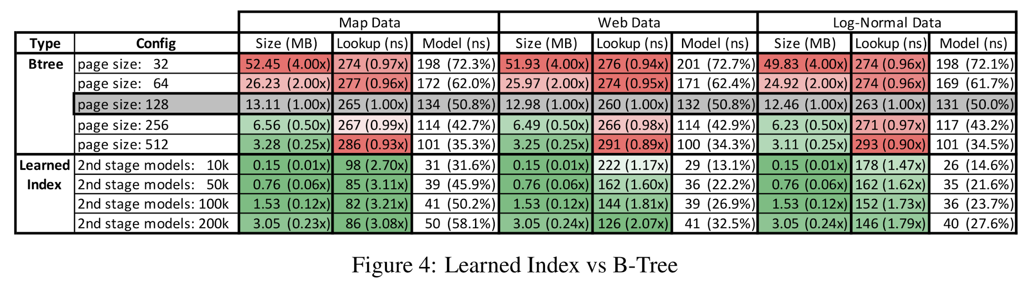
Experiment Results
Integer Datasets
Notes:
Integer Data Sets
LIF: Learning Index Framework
RIM: Recursive Model Index
128 is highlighted as reference point because it provides best lookup performance
Learned Indexes 1.5 - 3x faster while being 2x smaller

Slide 19
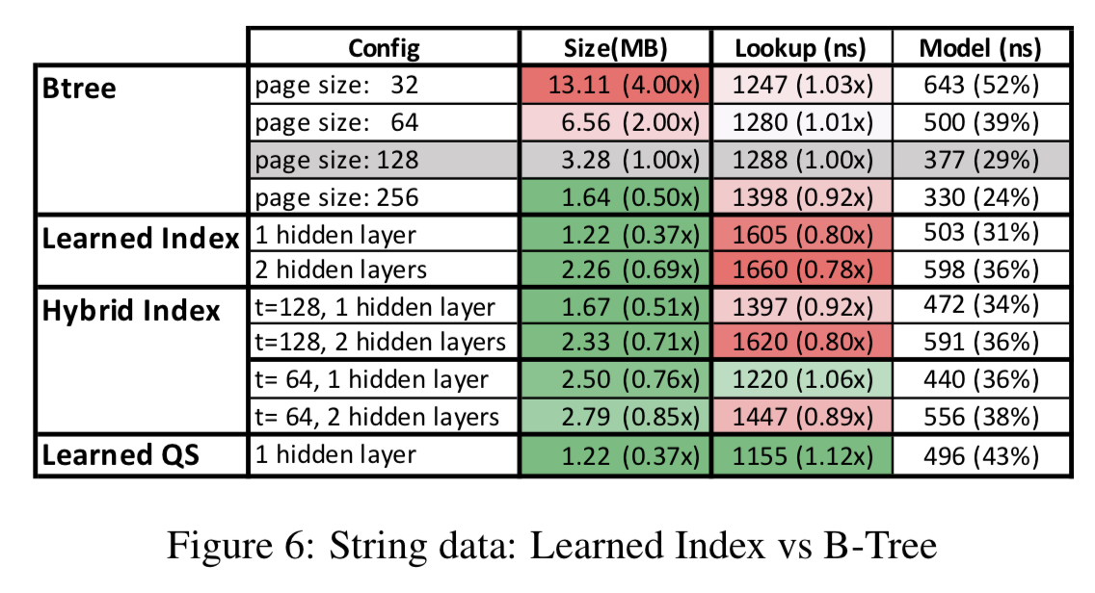
Experiment Results
String Datasets
Notes:
String Datasets
Speedups for Learned Indexes over B-Trees for strings not as prominent (3x, just 1.12x here)
High cost of model execution - potentially removed by GPUs/TPUs
Searching over strings more expensive => higher precision pays off
LIF: Learning Index Framework
RIM: Recursive Model Index

Slide 20
Experiment Results
Dataset | Memory Savings | Speedup
Server Logs (Timestamps) | 88% | 1.88x
Longitudes | 99% | 2.7x
Synthetic Log Normal Data | 88% | 1.8x
Strings (Document IDs) | 63% | 1.1x
Notes:
Did not report on search processes other than binary search OR hybrid models, did not provide significant benefits

Slide 21
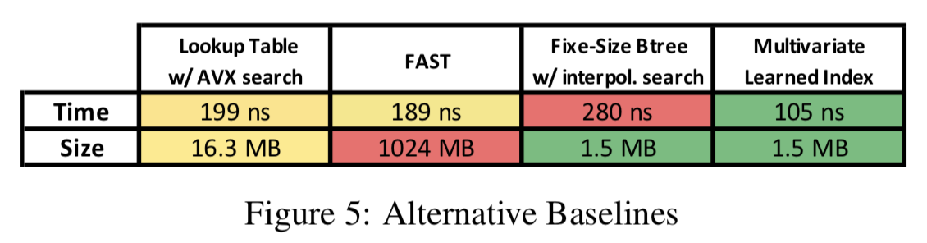
Experiment Results | Alternative Baselines
Notes:
Compare alternative baselines against learned indexes:
Hierarchical Lookup Tables: Fixed size + structure, highly optimized w/ AVX instructions
FAST: SIMD optimized data structure, size super big b/c alignment requirement
Fixed Size B-Tree
Comparison: Lognormal data w/ eight byte pointer payload

Slide 22
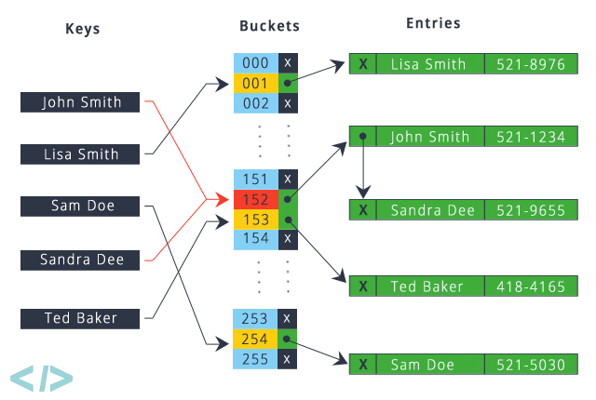
Hashmaps | Point Index

Slide 23
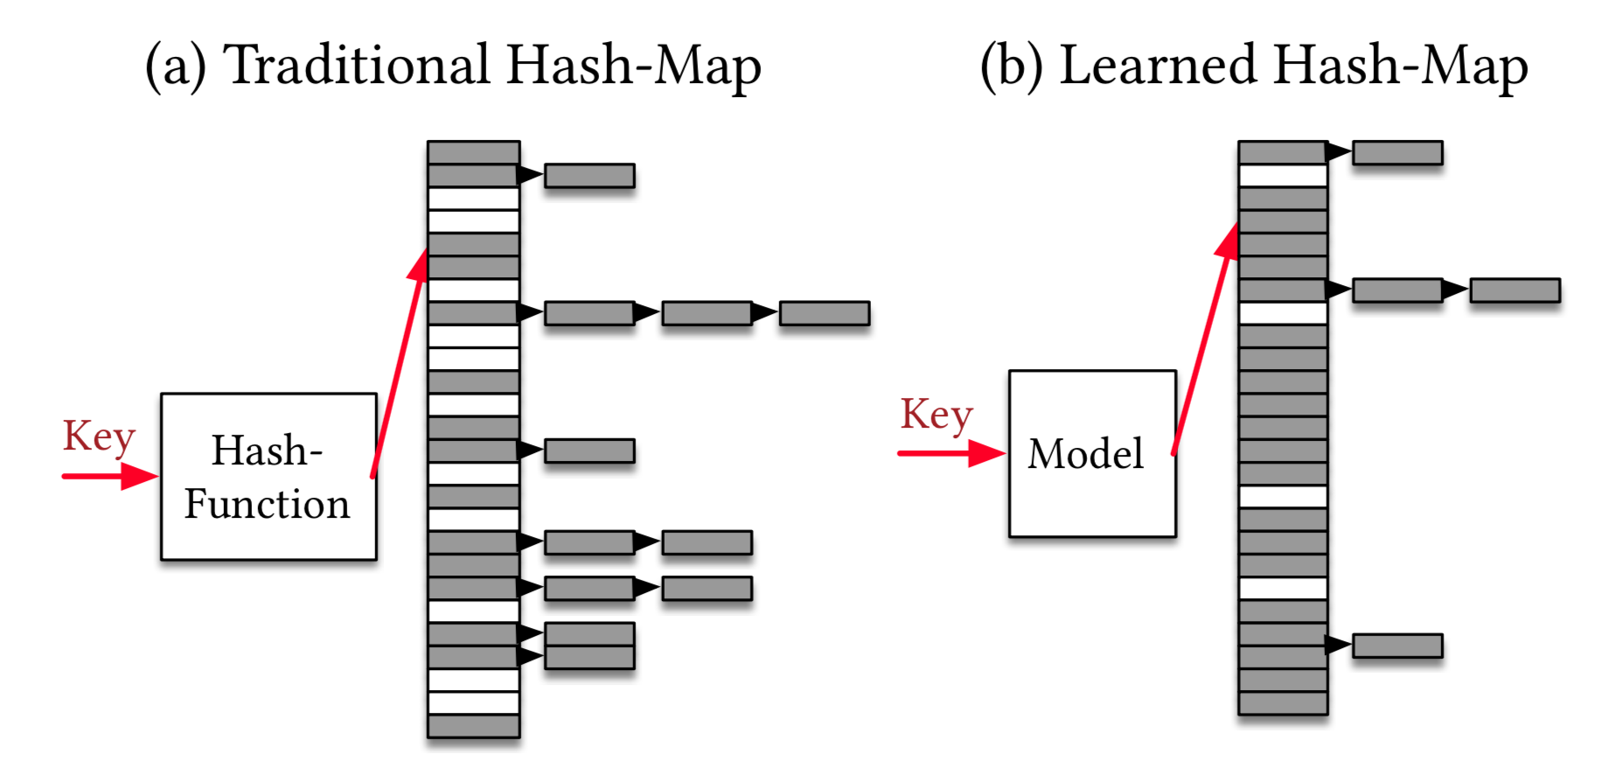
Key Innovations
Hashmaps as a Model
Idea: Use Learned CDF as the Hash Function
Perfect CDF model should have zero collisions
Independent of type of hashmap
Notes:
Collisions are extremely expensive (essentially the job of the hashmap)
Think about hashmap as learned model, same ideas as in B Trees also apply
Model learns CDF, use function as hash (very cheap model, just learning CDF)
Idea of perfection: we know about every key that we care about (as long as reads, updates needed w/ more insertions)

Slide 24
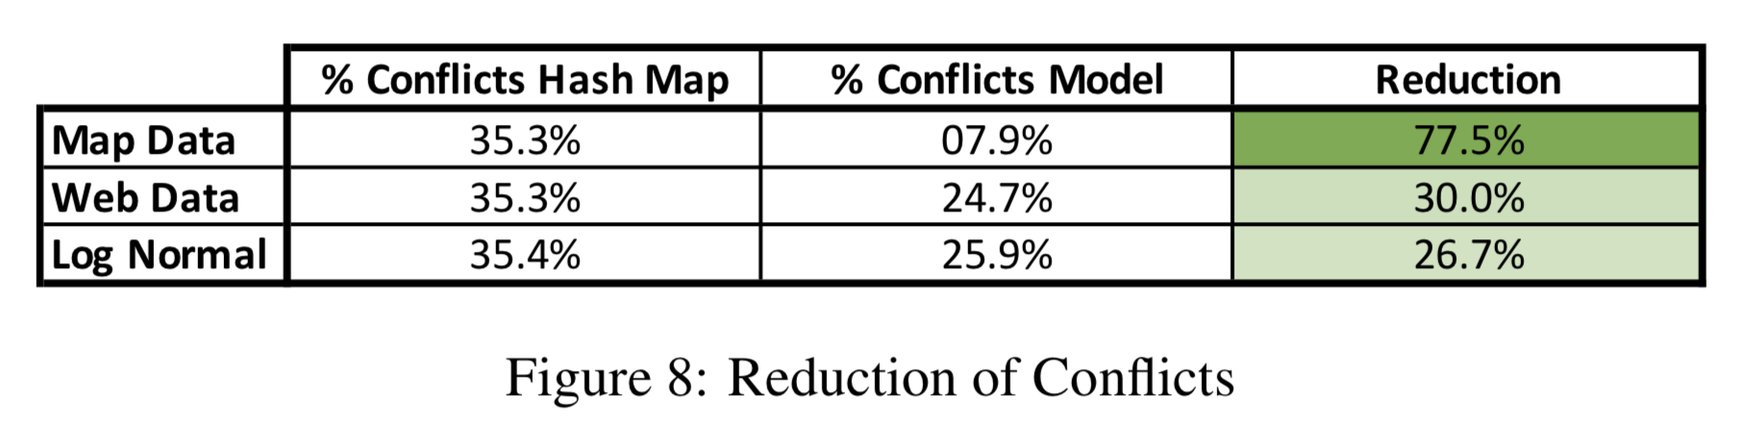
Key Results & Takeaways
Control / Base: MurmurHash3-like Hash Function
Model: 2-Stage RMI Models, 100k models on 2nd stage, no hidden layers
Notes:
A bit of controversy: Authors did not use the state of the art hash function
Random hash function versus learned model
Roughly 35% range vs. learned model has drastic reduction

Slide 25
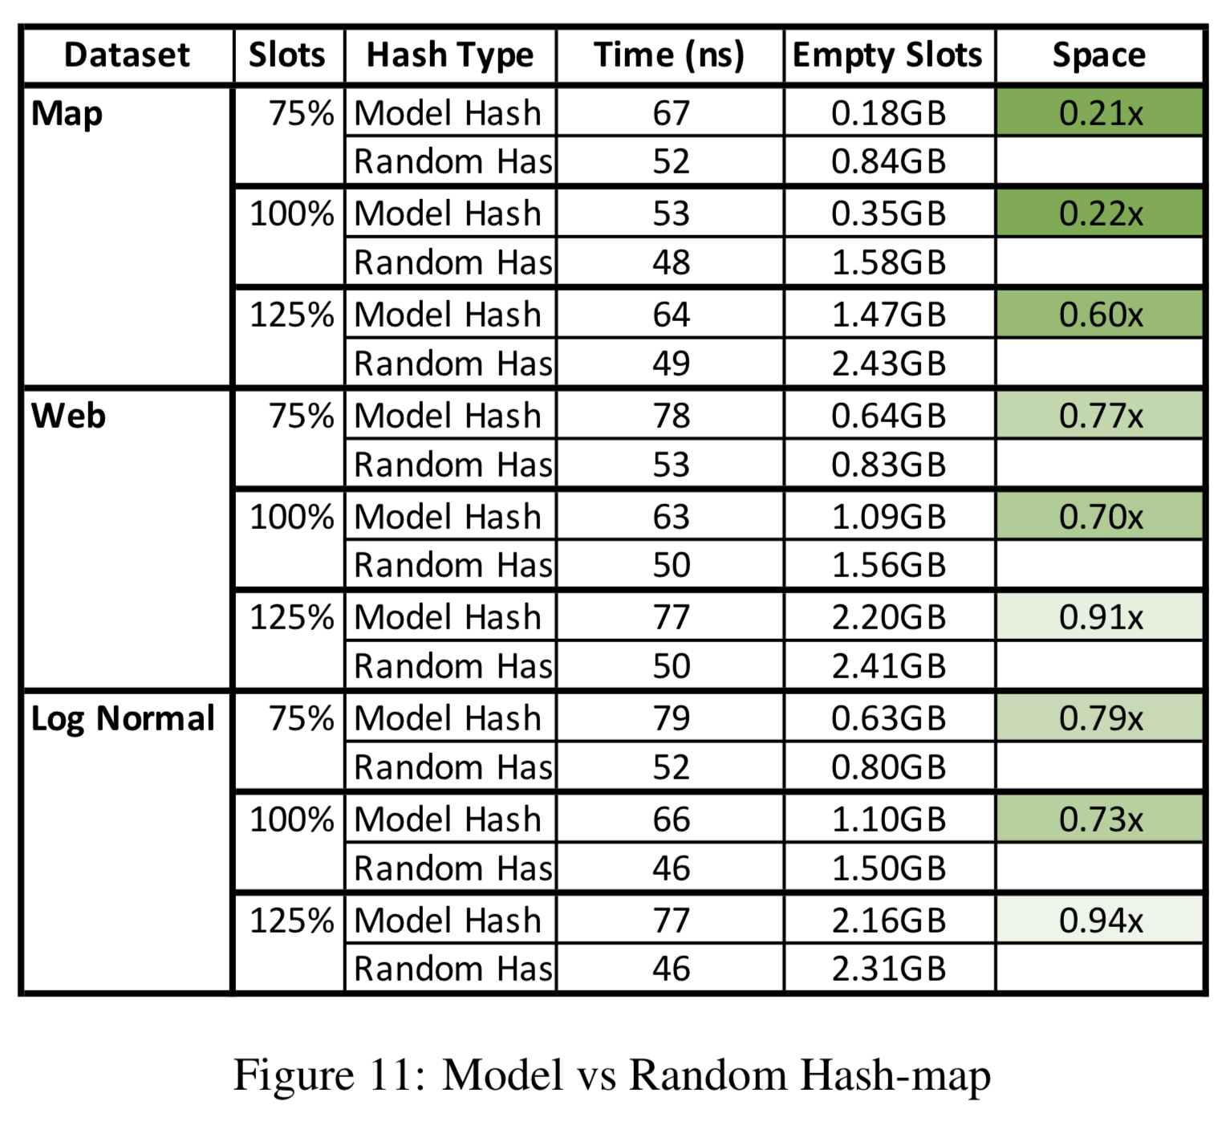
Key Results & Takeaways
Conclusion: Actual benefits from reducing conflicts depends on a variety of factors (e.g. architecture, payload), complexity not guaranteed to pay off
Small Payloads - Traditional Cuckoo hashing works best
Larger Payloads + Distributed Settings - Increased latency okay when considering cache miss, conflict costs
Notes:
Left hand graph demonstrates longer lookup time in exchange for space reduction (proves that fewer collisions occurs), higher amount of utilization
Ultimately, benefits of learned model in hash map is highly consequential and dependent upon the usage and architecture of the hashmap itself.

Slide 26
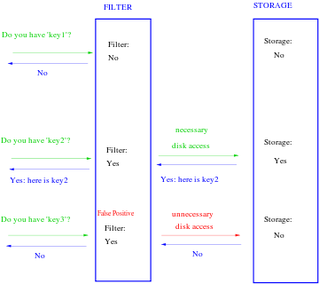
Bloom Filter | Existence Index
Notes:
Traditional Logic:
Probabilistic Data structure
Test whether element is a member of a set
Take a key, pass into multiple hash functions
Bit array serves as a lookup (if any position is a 0, then return false / not in storage)
Machine Learning wise - Binary Classification (1/0 Membership)

Slide 27
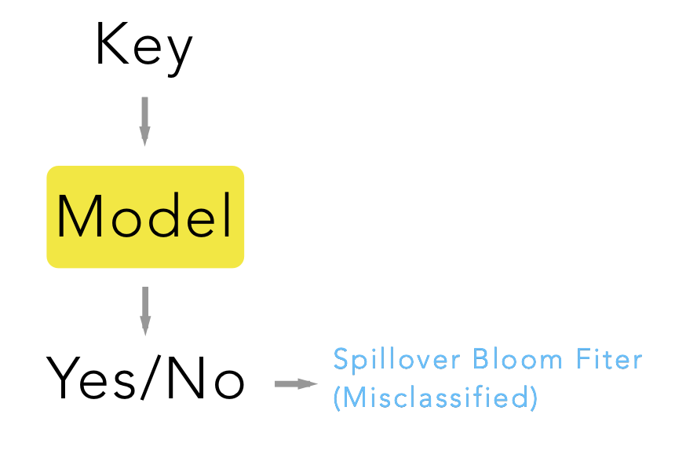
Key Innovations
Bloom Filters as Binary Classification
Idea: Binary Classification
Problem: False Negatives
Solution: Hybrid Model / Bloom Filter

Slide 28
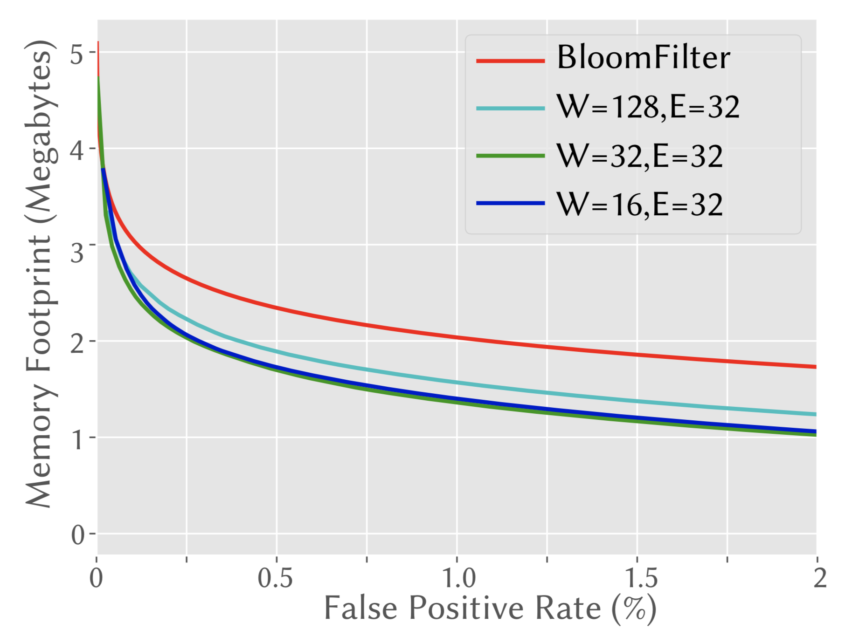
Key Results & Takeaways
Task: Determine if URLs are “good”. If bad, warn about phishing / hacked
Built with RNN, W is number of neurons, E is embedding size
36% Reduction in Memory
Notes:
Random hash function versus learned model
Roughly 35% range vs. learned model has drastic reduction

Slide 29
Future Implications & Research Potentials
Trees: Insertion, B-Tree Variants, when should a model be retrained?
Joins: Estimating Cardinality (Next Paper!)
Sorting: CDF provides approximate sort order, use sandwiched / hybrid approach alongside traditional sorting algorithms
Modeling Data Structures or Datasets with Non-Linear Behavior
Neural Networks for Multidimensional Indexed Structures: Creating mapping function to capture more complicated, multidimensional keys (3+ Dimensions)
TPUs/GPUs: Run learning indices on vector processors, replace if-then statements with multiplexers.
Notes:
Section 6 a laundry list of research directions
B-Tree Variants: B+ Tree, red black tree, T-Trees, balanced trees

Slide 30
Future Implications & Research Areas
Conclusions
Benefits of learned indexes are dependent upon the usage and architecture of the data structure or algorithm in question
Don’t necessarily replace, use traditional indexes alongside learned models
Questions
What factors can help guide the transition from a data structure or an algorithm to an appropriate model?
How can we effectively scale accuracy with size?
What are some principles for designing hybrid models?

