Slide 1
CS 262a: Advanced Topics in Computer Systems
Spring 2018 (MW 9:00-10:30, 320 Soda Hall)
Ali Ghodsi and Ion Stoica
(https://ucbrise.github.io/cs262a-spring2018/)

Slide 2
What is System Research about?
Manage resources:
Memory, CPU, storage
Data (database systems)
Provide abstractions to applications:
File systems
Processes, threads
VM, containers
Naming system
…

Slide 3
This Class
Learn about systems research by
Reading several seminal papers
Doing it: work on an exciting project
Hopefully start next generation of impactful systems

Slide 4
Appreciate what is Good Research
Problem selection
Solution & research methodology
Presentation

Slide 5
What do you need to do?
Research oriented class project
Groups of 2-3
Paper reading
Submit answers to four questions for each paper before lecture
Discuss paper during class

Slide 6
Research Project
Investigate new ideas and solutions in a class research project
Define the problem
Execute the research
Write up and present your research
Ideally, best projects will become conference papers (e.g., OSDI/SOSP, NSDI, EuroSys)

Slide 7
Research Project: Steps
We’ll distribute a list of projects
You can either choose one or come up with your own
Pick your partner(s) and submit a one page proposal describing:
The problem you are solving
Your plan of attack with milestones and dates
Any special resources you may need
Poster session
Submit project report

Slide 8
Paper Reading: Key Questions
What is the problem?
What is the solution’s main idea?
Why did it succeed or failed?
Does the paper (or do you) identify any fundamental/hard trade-offs?
Submissions: Will send out a google form for every paper that you need to fill in (will close it 10min before the class)

Slide 9
Distributed Shared Memory
Countless papers in 1990s:
Very compelling abstraction
Many hard challenges, so many researchers worked on it
Today
Few systems using distributed shared memory, if any
Note: Comeback in the context of disaggregated memory?
Message passing (e.g., MPI) or bulk synchronous processing (e.g., Spark) prevalent

Slide 10
Why did it fail?

Slide 11
Virtual Machine
Many papers in 1990s:
Very compelling abstraction
Many hard challenges, so many researchers worked on it
Today
VMs everywhere
Containers (e.g., docker) take this concept to the next level

Slide 12
Why did it succeed?

Slide 13
What are Hard/Fundamental Tradeoffs?
Brewer’s CAP conjecture: “Consistency, Availability, Partition-tolerance”, you can have only 2/3 in a distributed system
Tradeoff between latency and throughput for arbitrary updates in distributed systems
Batch request to increase throughput, but hurts latency

Slide 14
Grading
Project: 60%
Paper blogs: 20%
Class participation: 20%

Slide 15
Exciting times in systems research
Moore’s law ending → many challenges
Many-cores machines
Amazon’s X1 instances: 120 vcores and 2TB RAM
Large scale distributed systems maturing, but many challenges remain
Specialized hardware: FPGAs, GPUs, ASICs
New memory technologies: 3D XPoint

Slide 16
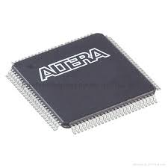
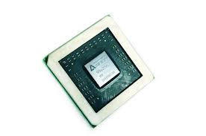
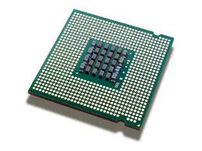
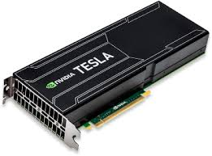
Increased complexity – Computation
Software
Software
CPU
CPU
+
SGX
GPU
FPGA
ASIC

Slide 17
Increased complexity – Memory
2015
2020
L1/L2 cache
~1 ns
L1/L2 cache
~1 ns
L3 cache
~10 ns
L3 cache
~10 ns
HBM
~10 ns / ~1TB/s / ~10GB
Main memory
~100 ns / ~80 GB/s / ~100GB
Main memory
~100 ns / ~80 GB/s / ~100GB
NVM (3D Xpoint)
~1 usec / ~10GB/s / ~1TB
NAND SSD
~100 usec / ~10 GB/s / ~1 TB
NAND SSD
~100 usec / ~10 GB/s / ~10 TB
Fast HHD
~10 msec / ~100 MB/s / ~10 TB
Fast HHD
~10 msec / ~100 MB/s / ~100 TB

Slide 18
Increased complexity – more and more choices
Basic tier: A0, A1, A2, A3, A4
Optimized Compute : D1, D2, D3, D4, D11, D12, D13
D1v2, D2v2, D3v2, D11v2,…
Latest CPUs: G1, G2, G3, …
Network Optimized: A8, A9
Compute Intensive: A10, A11,…
t2.nano, t2.micro, t2.small
m4.large, m4.xlarge, m4.2xlarge, m4.4xlarge, m3.medium, c4.large, c4.xlarge, c4.2xlarge,
c3.large, c3.xlarge, c3.4xlarge,
r3.large, r3.xlarge, r3.4xlarge,
i2.2xlarge, i2.4xlarge, d2.xlarge d2.2xlarge, d2.4xlarge,…
n1-standard-1, ns1-standard-2, ns1-standard-4, ns1-standard-8, ns1-standard-16, ns1highmem-2, ns1-highmem-4, ns1-highmem-8, n1-highcpu-2, n1-highcpu-4, n1-highcpu-8, n1-highcpu-16, n1-highcpu-32, f1-micro, g1-small…
Microsoft AZURE
Amazon EC2
Google Cloud Engine

Slide 19
Increase complexity – more and more requirements
Scale
Latency
Accuracy
Cost
Security

Slide 20
The Unix Time-sharing System
Third major time-sharing operating system
CTSS (Compatible Time-Sharing System):
MIT, 1961
Multics (MULTiplexed Information and Computing System)
MIT, 1969
Unix stands for UNiplexed Information and Computing Systems (initially, spelled Unics)
AT&T, 1971

Slide 21
Context
Multics: 2nd system syndrome (coined by Fred Brooks)
Following a successful system, designers become over-ambitious → complex system
“If your project is the second system for most of your designers, then it will probably fail outright. If it doesn't fail, it will be bloated, inefficient, and icky”
Unix a reaction to Multics
Uniplexed vs. Multiplexed ;-)
Simple, small system

Slide 22
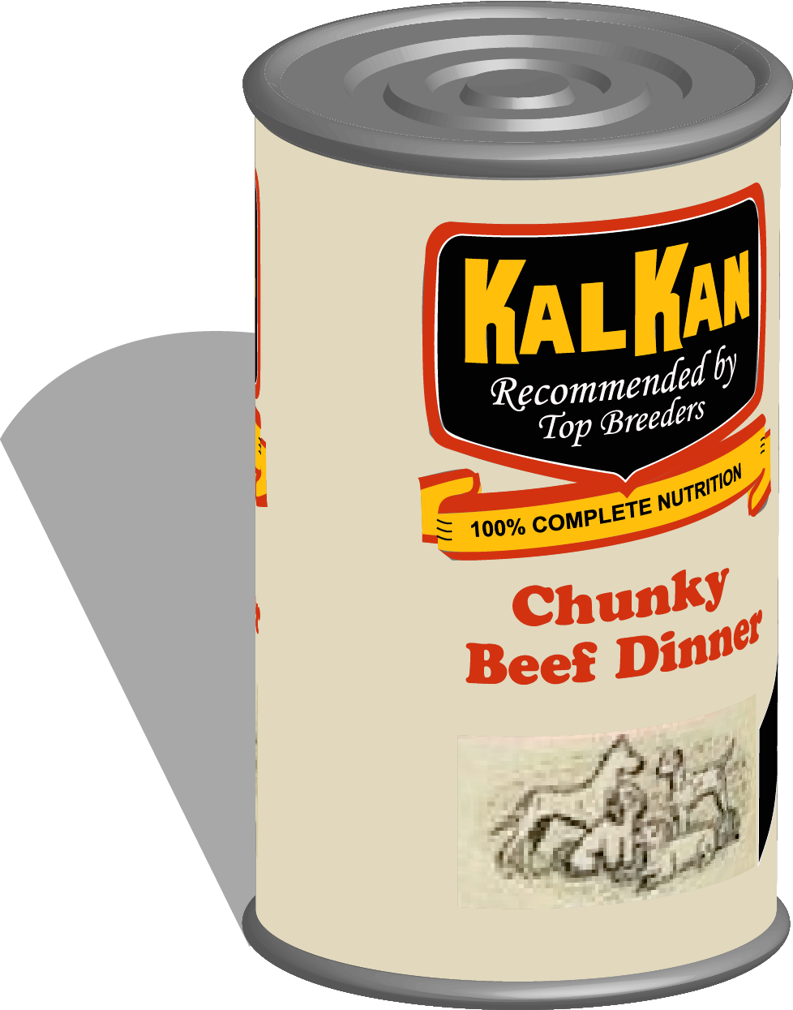
“Self-Supporting System”
Use your own system, i.e., “eating your own dog food” – a lesson more valuable than ever today
Users are best developers of a system as they are in the best position to know requirements
Dogfooding origin (unverified, but nice story!):
President of Kal Kan Pet Food would eat a can of his dog food at shareholders' meetings

Slide 23
Written in C
At that time all Operating Systems were written in Assembly language, so why C?
Much easier to understand
Faster to develop
More portable (at that time there were many architectures)
33% increased in size deemed acceptable
Unix played a big role in the rapid raise of C
Designed by Dennis Ritchie

Slide 24
Minimalist design
No user-visible locks. Why?
No restrictions on number of users who can open a file, even though… “contents of a file [can] become scrambled when two users write on it simultaneously”
Deemed neither necessary nor sufficient
Doesn’t enforce consistency on buffer cache. Why?
Doesn’t charge users for storage allocated to their files. Why?

Slide 25
Simple abstractions
Files store bytes, there is no concept of records. Why?
No distinction between “random” and sequential I/O. Why?
Files use fixed block allocation (i.e., 512B). Why?
Simple way to implement multi-processing
Fork, wait, exit: trivial to share data and wait for a process (i.e., child) to terminate

Slide 26
Unifying abstractions
I/O devices treated like files:
File and device names have same syntax and meaning
A program can pass either a device or file
Use same protection mechanisms like regular files
Directories special files, except
System control the content of directory

Slide 27
Unifying abstractions (cont’d)
Pipes: unified with files
Can easily compose simple commands to provide complex functionality
E.g., “grep ERROR log.txt | sort | less”
Shell: just a program
Reads user commands, interpret, and execute them
Supports multitasking (backgrounding)
Support filters, pipes

Slide 28
Small code base
< 50kB kernel
A few thousands LoC
High level language helped a lot
Only 2 man-years to write
Most successful projects start small!
Linux 1st version: 12 LoC
Also, our own experience:
Mesos: 10K LoC
Spark: 3K LoC
Tachyon: 10K LoC

Slide 29
In the author’s own words
About UNIX’s qualities “most important characteristics of the system are its simplicity, elegance, and ease of use.”
About being small: “UNIX can run on hardware costing as little as $40,000” ;-)
About functionality: “The most important job of UNIX is to provide a file system.”

Slide 30
In the author’s own words
About applications: “Most [users] are engaged in applications such as the preparation and formatting of patent applications and other textual material, the collection and processing of trouble data from various switching machines within the Bell System, and recording and checking telephone service order.”

Slide 31
Grading the paper
What is the problem?
Simple, powerful system that users themselves can easily evolve
What is the solution’s main idea?
Minimalist design, unified abstractions (avoid 2nd system syndrome)

Slide 32
Grading the paper
Why did it succeed (or failed)?
Powerful, time-sharing system
Addictive to use: interactive shell
Open-source
High level language made it easy to port to other architectures
Does the paper (or do you) identify any fundamental/hard trade-offs?
Fixed block size not optimal for all apps but minimizes system overhead

