Slide 1
E2E Arguments & Project Suggestions (Lecture 4, cs262a)
Ali Ghodsi and Ion Stoica,
UC Berkeley
Jan 29, 2018
Notes:
3-D graph
Checklist
What we want to enable
What we have today
How we’ll get there

Slide 2
Software Modularity
Break system into modules
Well defined interface, implementation behind interface
Separation of concerns, encapsulation, information hiding, …
Main advantages?
Hides complexity from user, division of labor, scaling teams
Implementation can change, interface stays the same, apps don’t need to change
SQL! Functional programming, ADT, functions, modules, OS, …
Main way humans build complex systems (e.g. computer, car, buildings)
Can be more efficient. Why?

Slide 3
Software Modularity
Disadvantages?
Can hurt performance
DLL-hell, can it apply to networking?
Can it increase complexity?

Slide 4
Network Modularity
Like software modularity, but with a twist:
Implementation distributed across routers and hosts
Must decide:
How to break system into modules
Where modules are implemented

Slide 5
Layering
Layering is a particular form of modularization
System is broken into a vertical hierarchy of logically distinct entities (layers)
Service provided by one layer is based solely on the service provided by the layer(s) below
Rigid structure: easy reuse, performance can suffer

Slide 6
The Problem
Application
p2p
FTP
NFS
HTTP
Transmission
Media
Coaxial
cable
Fiber
optic
Packet
radio
Re-implement every application for every technology?
No! But how does the Internet architecture avoid this?
How do you solve problems in CS?

Slide 7
Solution: Intermediate Layer
Introduce an intermediate layer that provides a single abstraction for various network technologies
A new app/media implemented only once
Application
p2p
SSH
NFS
HTTP
Intermediate
layer
Transmission
Media
Coaxial
cable
Fiber
optic
Packet
radio

Slide 8
Placing Functionality
Most influential paper about placing functionality is “End-to-End Arguments in System Design” by Saltzer, Reed, and Clark
“Sacred Text” of the Internet
Endless disputes about what it means
Everyone cites it as supporting their position
http://www.martingeddes.com/think-tank/the-future-of-the-internet-the-end-to-end-argument/

Slide 9
Basic Observation
Some applications have end-to-end performance requirements
Reliability, security, etc
Implementing these in the network is very hard:
Every step along the way must be fail-proof
Hosts:
Can satisfy the requirement without the network
Can’t depend on the network

Slide 10
Example: Reliable File Transfer
Host A
Host B
Appl.
Appl.
OS
OS
OK + HASH
Solution 1: make each step reliable, and then concatenate them
Solution 2: end-to-end check and retry

Slide 11
Discussion
Problems with Solution 1?
What happens if any network element misbehaves?
Receiver has to do the check anyway!
Doesn’t reduce host implementation complexity
Does increase network complexity
Probably imposes delay and overhead on all applications, even if they don’t need functionality

Slide 12
Discussion
Advantages of Solution 2?
Full functionality can be entirely implemented at application layer with no need for reliability from lower layers
Simpler solution
Fewer dependencies, fewer parts
Changes in software easier than changes in hardware
When would you still want reliability on a link-level?
Really lossy link → big performance improvement

Slide 13
Conservative Interpretation
“Don’t implement a function at the lower levels of the system unless it can be completely implemented at this level”
Unless you can relieve the burden from hosts, then don’t bother
Lossy-link vs conservative interpretation?

Slide 14
Radical Interpretation
Don’t implement anything in the network that can be implemented correctly by the hosts
E.g., multicast
Make network layer absolutely minimal
Ignore performance issues

Slide 15
Moderate Interpretation
Think twice before implementing functionality in the network
If hosts can implement functionality correctly, implement it a lower layer only as a performance enhancement
But do so only if it does not impose burden on applications that do not require that functionality

Slide 16
Discuss examples
How is it E2E?
Network Address Translation (NATs)
Middleboxes
Congestion control

Slide 17
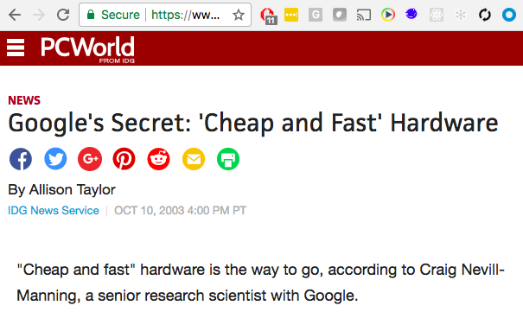
Discuss: Google
By using commodity PC hardware, which is similar to that of home PCs, Google buys cheap and builds high levels of redundancy into its system in an effort to compensate for the fact that one full day of Google use on a server is the equivalent of 40 machine years, Nevill-Manning said.
"Each server has many twins," he said. "Replication is needed for scalability.”

Slide 18
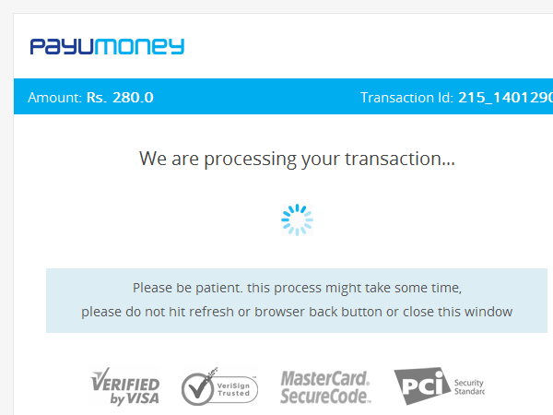
Discuss: WWW
Why include this example?
State management in App Server / Web App?
Can refresh/back-button issues be avoided? How?
State closer to app (host)

Slide 19
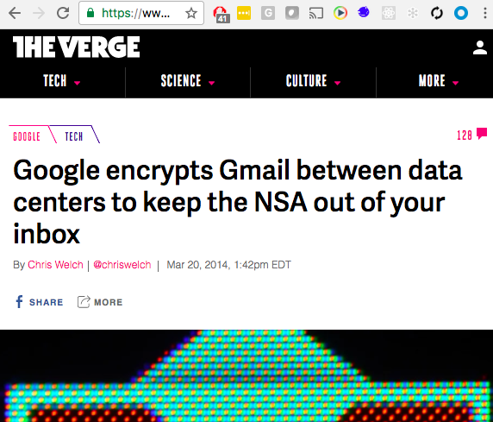
Discuss: e-mail
Are we safe now?
Could still force companies to reveal keys, or they leak keys
What’s the bullet proof solution
Put keys on host

Slide 20
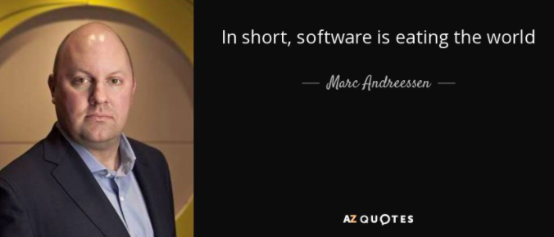
Discuss
Examples
Software Defined Networking
Software Defined Storage
VMs and containers

Slide 21
Summary
Layering is a good way to organize systems (e.g., networks)
Implement functionality at highest level possible, optimize if needed in layers below
E2E argument encourages us to keep lower layers (e.g., IP) simple

Slide 22
Projects Suggestions (see https://tinyurl.com/y8rfenr5)

Slide 23
Project Dates
Wednesday, 1/31: add more projects to google sheet
Add your own project if you are looking for a partner
Wednesday, 2/7: pick a partner and send your project proposal
We will send out a google form to fill in for your project proposals
Monday, 3/12: project progress review
More details to follow

