Slide 1
HP AutoRAID (Lecture 5, cs262a)
Ali Ghodsi and Ion Stoica,
UC Berkeley
January 31, 2018
(based on slide from John Kubiatowicz, UC Berkeley)
Notes:
3-D graph
Checklist
What we want to enable
What we have today
How we’ll get there

Slide 2
Array Reliability
Reliability of N disks = Reliability of 1 Disk ÷ N
50,000 Hours ÷ 70 disks = 700 hours
Disk system MTTF: Drops from 6 years to 1 month!
Arrays (without redundancy) too unreliable to be useful!
Hot spares support reconstruction in parallel with access: very high media availability can be achieved

Slide 3



RAID
Redundant Array of Inexpensive Disks (RAID)
Invented at Berkeley 1988:
Dave Patterson
Garth Gibson (now at CMU, CEO of the Vector Institute, Toronto)
Randy Katz
Patterson, David; Gibson, Garth A.; Katz, Randy (1988). A Case for Redundant Arrays of Inexpensive Disks (RAID), SIGMOD ‘88

Slide 4
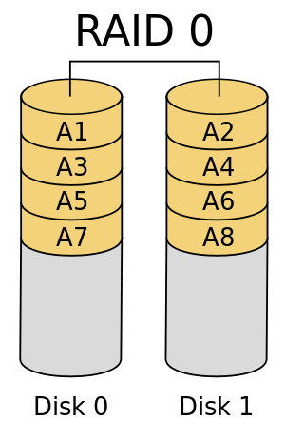
RAID Basics: Levels* of RAID
RAID 0: striping with no parity
High read/write throughput; theoretically Nx where N is number of disks
No data redundancy
https://en.wikipedia.org/wiki/Standard_RAID_levels
Levels in RED are used in practice

Slide 5
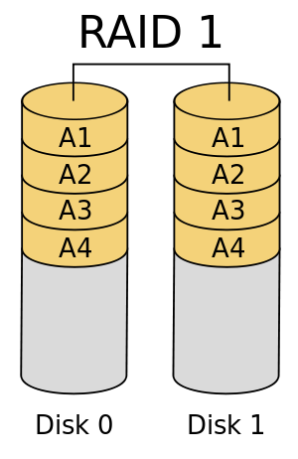
RAID Basics: Levels* of RAID
RAID 0: striping with no parity
RAID 1: Mirroring, simple, fast, but 2x storage
Each disk is fully duplicated onto its "shadow” → high availability
Read throughput (2x) assuming N disks
Writes (1x): two physical writes
https://en.wikipedia.org/wiki/Standard_RAID_levels
Levels in RED are used in practice

Slide 6
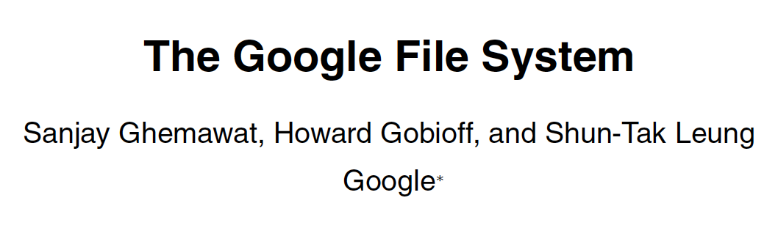

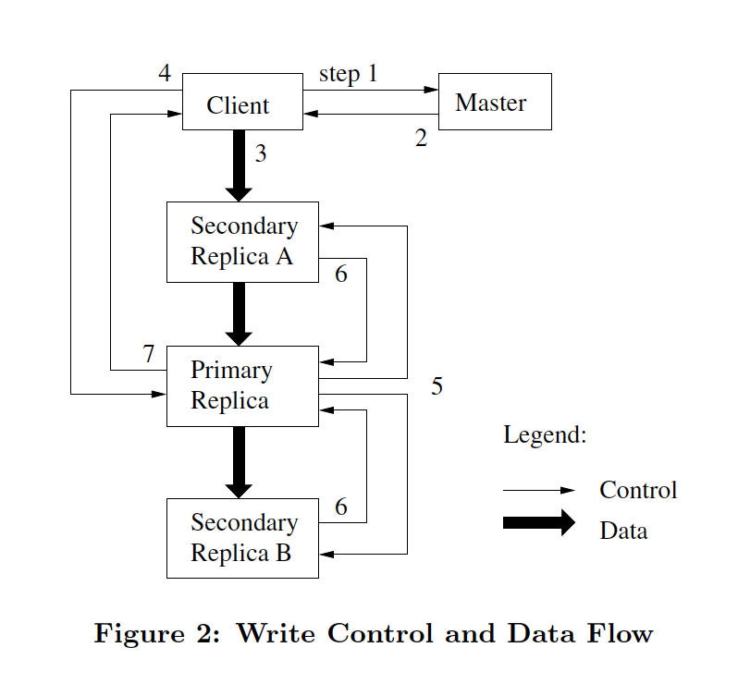
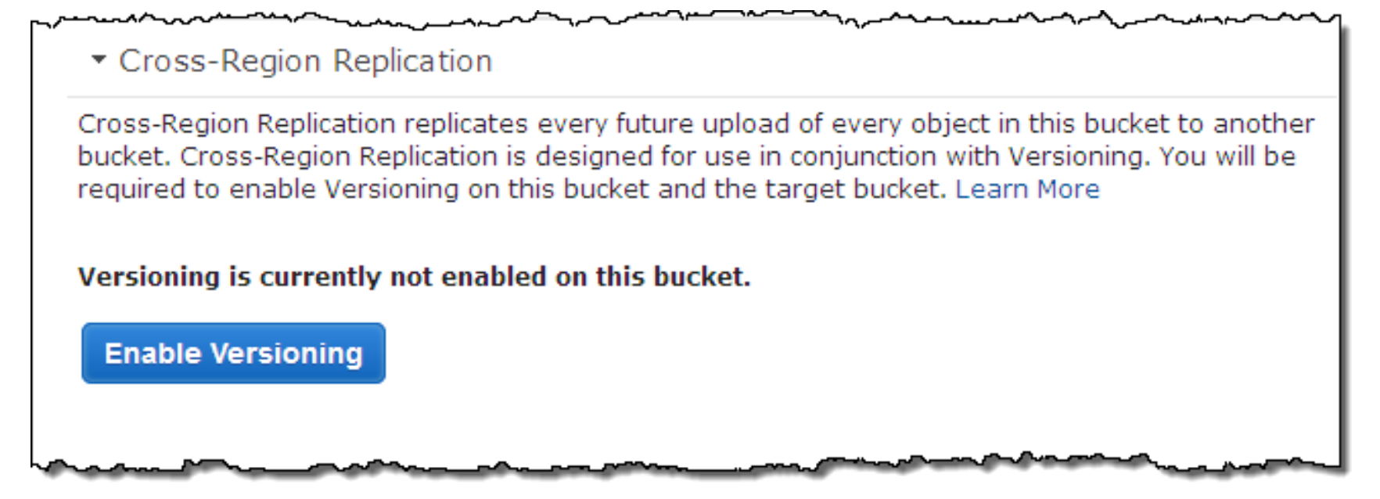

Slide 7
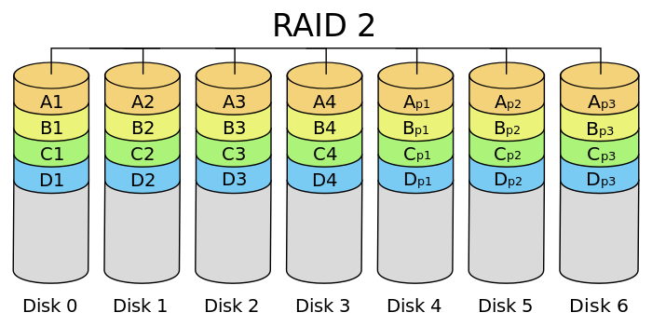
RAID Basics: Levels* of RAID
RAID 2: bit-level interleaving with Hamming error-correcting codes
d bit Hamming code can detect d-1 errors and correct (d-1)/2
Need synchronized disks, i.e., spin at same angular rotation
Hamming code
https://en.wikipedia.org/wiki/Standard_RAID_levels
Levels in RED are used in practice

Slide 8
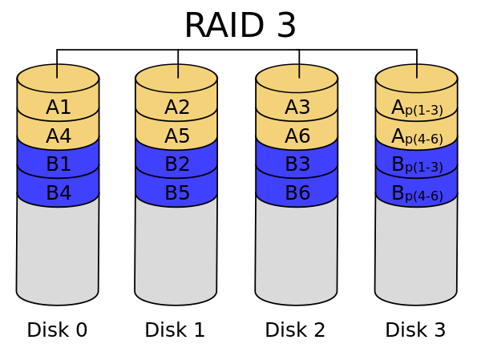
RAID Basics: Levels* of RAID
RAID 3: byte-level striping with dedicated parity disk
Dedicated parity disk is write bottleneck: every write writes parity
parity disk
https://en.wikipedia.org/wiki/Standard_RAID_levels
Levels in RED are used in practice

Slide 9
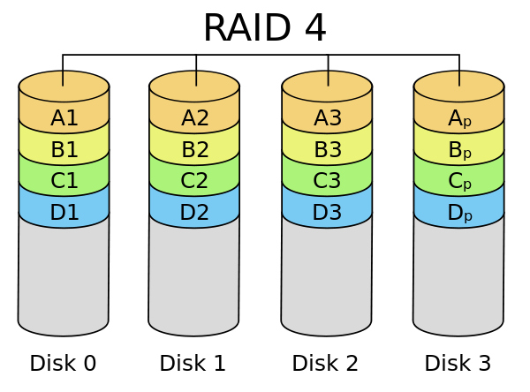
RAID Basics: Levels* of RAID
RAID 4: block-level striping with dedicated parity disk
Same bottleneck problems as RAID 3
parity disk
https://en.wikipedia.org/wiki/Standard_RAID_levels
Levels in RED are used in practice

Slide 10
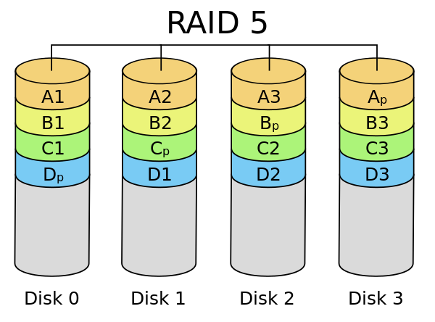
RAID Basics: Levels* of RAID
RAID 5: block-level striping with rotating parity disk
Most popular; spreads out parity load; space 1-1/N, read/write (N-1)x
parity block
https://en.wikipedia.org/wiki/Standard_RAID_levels
Levels in RED are used in practice

Slide 11
RAID Basics: Levels* of RAID
RAID 5: block-level striping with rotating parity disk
Most popular; spreads out parity load; space 1-1/N, read/write (N-1)x
RAID 6: RAID 5 with two parity blocks (tolerates two drive failures)
Use with today’s drive sizes! Why?
Correlated drive failures (2x expected in 10hr recovery) [Schroeder and Gibson, FAST07]
Failures during multi-hour/day rebuild in high-stress environments
Levels in RED are used in practice

Slide 12
Redundant Arrays of Disks RAID 5+: High I/O Rate Parity
D0
D1
D2
D3
P
Increasing
Logical
Disk
Addresses
Independent writes possible because of interleaved parity
Reed-Solomon Codes ("Q") for protection during reconstruction
A logical write becomes four physical I/Os
D4
D5
D6
P
D7
D8
D9
P
D10
D11
D12
P
D13
D14
D15
Stripe
P
D16
D17
D18
D19
Stripe
Unit
D20
D21
D22
D23
P
Targeted for mixed
applications
…
…
…
…
…
Disk Columns

Slide 13
Problems of Disk Arrays: Small Writes
RAID-5: Small Write Algorithm
1 Logical Write = 2 Physical Reads + 2 Physical Writes
D0'
D0
D1
D2
D3
P
old
data
new
data
(1. Read)
old
parity
(2. Read)
+
XOR
+
XOR
(3. Write)
(4. Write)
D0'
D1
D2
D3
P'

Slide 14
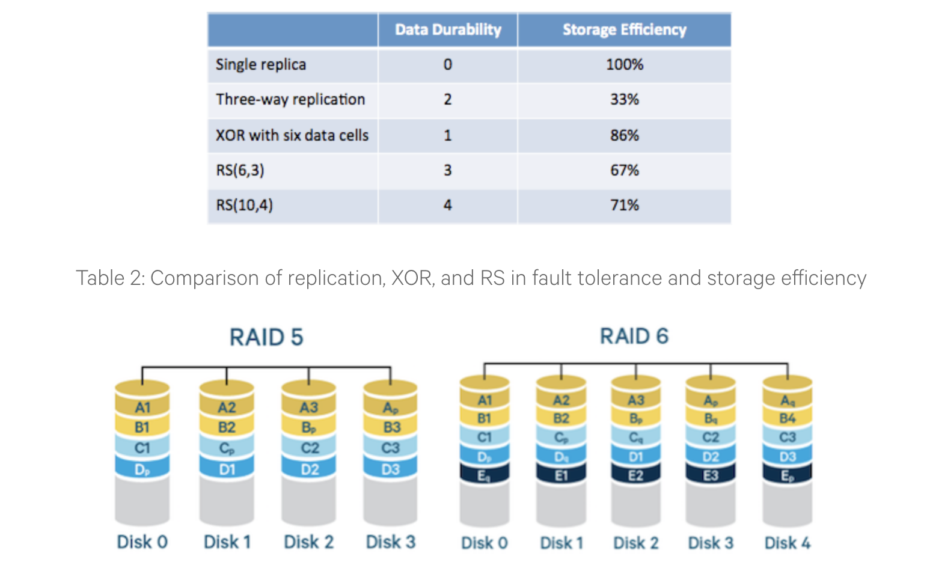
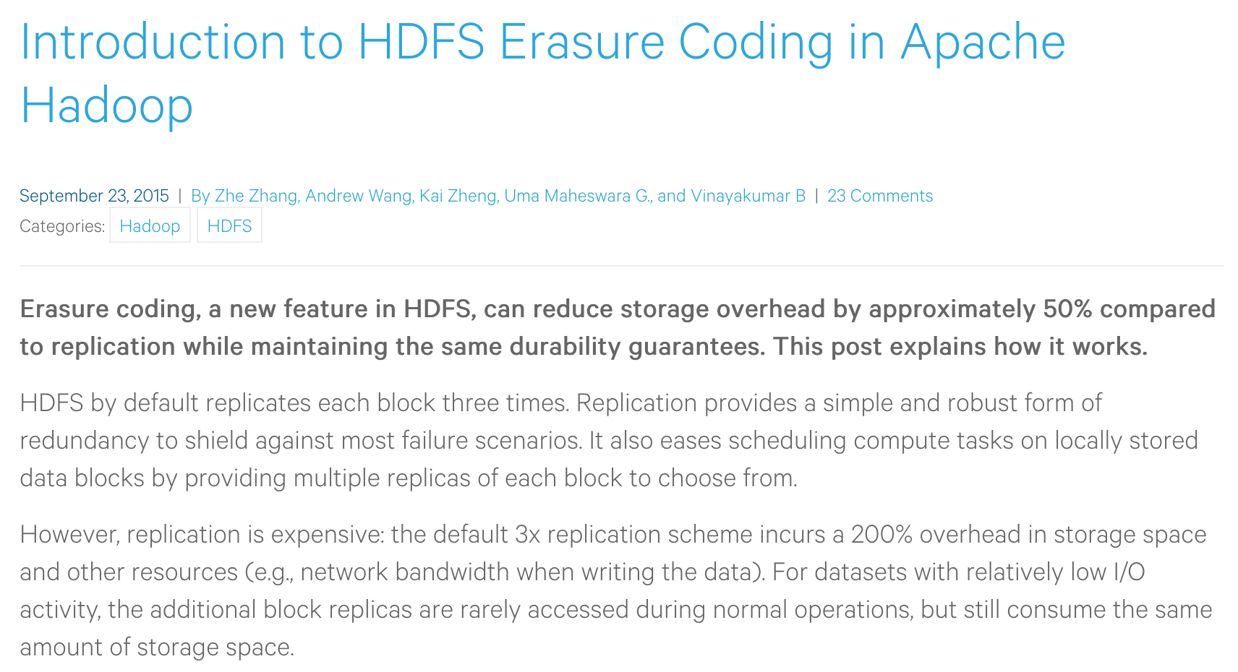

Slide 16
System Availability: Orthogonal RAIDs
Array
Controller
String
Controller
. . .
String
Controller
. . .
String
Controller
. . .
String
Controller
. . .
String
Controller
. . .
String
Controller
. . .
Data Recovery Group: unit of data redundancy
Redundant Support Components: fans, power supplies, controller, cables
End to End Data Integrity: internal parity protected data paths

Slide 17
System-Level Availability
host
host
I/O Controller
Fully dual redundant
I/O Controller
Array Controller
Array Controller
. . .
. . .
. . .
Goal: No Single
Points of
Failure
. . .
. . .
Recovery
Group
.
.
.
with duplicated paths, higher performance can be
obtained when there are no failures

Slide 18
HP AutoRAID – Motivation
Goals: automate the efficient replication of data in a RAID
RAIDs are hard to setup and optimize
Different RAID Levels provide different tradeoffs
Automate the migration between levels
RAID 1 and 5: what are the tradeoffs?
RAID 1: excellent read performance, good write performance, performs well under failures, expensive
RAID 5: cost effective, good read performance, bad write performance, expensive recovery

Slide 19
HP AutoRAID – Motivation
Each kind of replication has a narrow range of workloads for which it is best...
Mistake ⇒ 1) poor performance, 2) changing layout is expensive and error prone
Difficult to add storage: new disk ⇒ change layout and rearrange data...
Difficult to add disks of different sizes

Slide 20
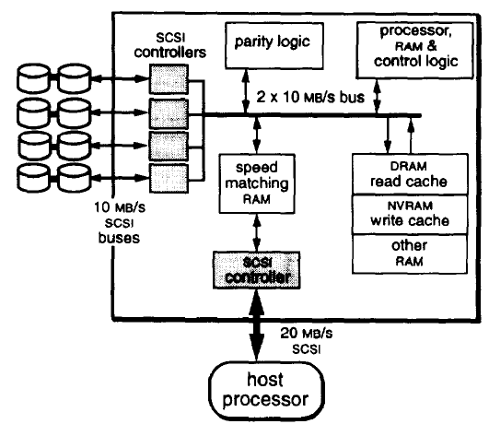
HP AutoRAID – Key Ideas
Key idea: mirror active data (hot), RAID 5 for cold data
Assumes only part of data in active use at one time
Working set changes slowly (to allow migration)

Slide 21
HP AutoRAID – Key Ideas
How to implement this idea?
Sys-admin
make a human move around the files.... BAD. painful and error prone
File system
Hard to implement/ deploy; can’t work with existing systems
Smart array controller: (magic disk) block-level device interface
Easy to deploy because there is a well-defined abstraction
Enables easy use of NVRAM (why?)

Slide 22
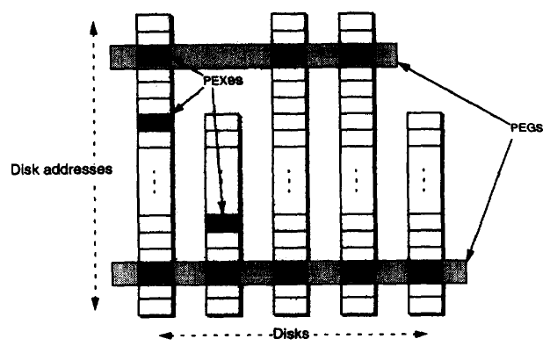
AutoRAID Details
PEX (Physical Extent): 1MB chunk of disk space
PEG (Physical Extent Group): Size depends on # Disks
A group of PEXes assigned to one storage class
Stripe: Size depends # Disks
One row of parity and data segments in a RAID 5 storage class
Segment: 128 KB
Strip unit (RAID 5) or half of a mirroring unit
Relocation Block (RB): 64KB
Client visible space unit

Slide 23
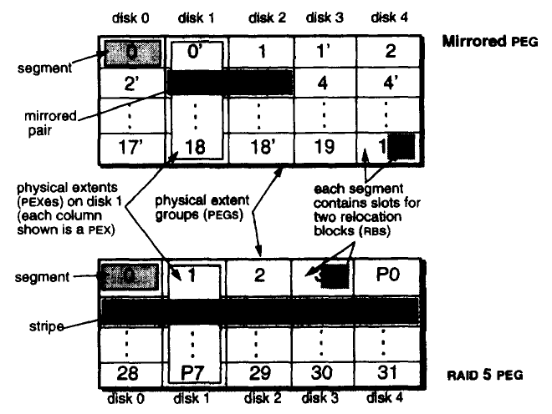
Closer Look

Slide 24
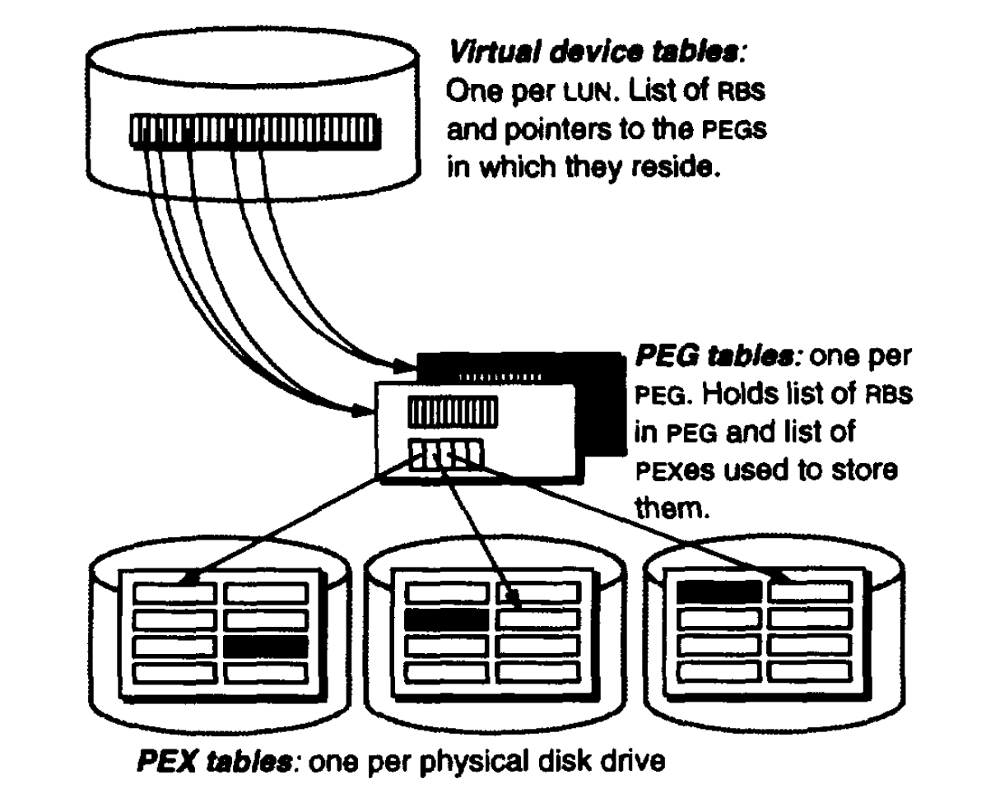
Putting Everything Together
Virtual Device Tables
Map RBs to PEGs
RB allocated to a PEG only when written
PEG Tables
Map PEGs to physical disk addresses
Unused slots in PEG are marked free until and RB is allocated to them

Slide 25
HP AutoRaid – Features
Promote/demote in 64KB chunks (8-16 blocks)
Hot swap disks, etc. (A hot swap is just a controlled failure)
Add storage easily (goes into the mirror pool)
Useful to allow different size disks (why?)
No need for an active hot spare (per se);
Just keep enough working space around
Log-structured RAID 5 writes
Nice big streams, no need to read old parity for partial writes

Slide 26
Questions
When to demote? When there is too much mirrored storage (>10%)
Demotion leaves a hole (64KB). What happens to it? Moved to free list and reuse
Demoted RBs are written to the RAID5 log, one write for data, a second for parity
Why log RAID 5 better than update in place?
Update of data requires reading all the old data to recalculate parity
Log ignores old data (which becomes garbage) and writes only new data/parity stripes
How to promote? When a RAID5 block is written...
Just write it to mirrored and the old version becomes garbage.

Slide 27
Questions
How big should an RB be?
Bigger ⇒ Less mapping information, fewer seeks
Smaller ⇒ fine grained mapping information
How do you find where an RB is?
Convert addresses to (LUN, offset) and then lookup RB in a table from this pair
Map size = Number of RBs and must be proportional to size of total storage
How to handle thrashing (too much active write data)?
Automatically revert to directly writing RBs to RAID 5!

Slide 28
Issues
Disks writes go to two disks (since newly written data is “hot”)
Must wait for both to complete - why?
Does the host have to wait for both? No, just for NVRAM
Controller uses cache for reads
Controller uses NVRAM for fast commit, then moves data to disks
What if NVRAM is full? Block until NVRAM flushed to disk, then write to NVRAM

Slide 29
Issues
What happens in the background?
1) compaction, 2) migration, 3) balancing
Compaction: clean RAID 5 and plug holes in the mirrored disks
Do mirrored disks get cleaned? Yes, when a PEG is needed for RAID5; i.e., pick a disks with lots of holes and move its used RBs to other disks Resulting empty PEG is now usable by RAID5
What if there aren’t enough holes? Write the excess RBs to RAID5, then reclaim the PEG
Migration: which RBs to demote? Least-recently-written (not LRU)
Balancing: make sure data evenly spread across the disks. (Most important when you add a new disk)

