Slide 1
Aries (Lecture 6, cs262a)
Ali Ghodsi and Ion Stoica,
UC Berkeley
February 5, 2018
(based on slide from Joe Hellerstein and Alan Fekete)

Slide 2
Today’s Paper
ARIES: A Transaction Recovery Method Supporting Fine-Granularity Locking and Partial Rollbacks Using Write-ahead Logging, C. Mohan, Don Haderle, Bruce Lindsay, Hamid Pirahesh and Peter Schwarz. Appears in Transactions on Database Systems, Vol 17, No. 1, March 1992, Pages 94-162
Thoughts?

Slide 3
Review: The ACID properties
Atomicity: All actions in the Transaction happen, or none happen
Consistency: If each Transaction is consistent, and the DB starts consistent, it ends up consistent
Isolation: Execution of one Transaction is isolated from that of other Transactions
Durability: If a Transaction commits, its effects persist
The Recovery Manager guarantees Atomicity & Durability

Slide 4
Motivation
Atomicity:
Transactions may abort (“Rollback”)
Durability:
What if DBMS stops running? (Causes?)
Desired Behavior after system restarts:
T1, T2 & T3 should be durable
T4 & T5 should be aborted (effects not seen)
crash!
T1
T2
T3
T4
T5

Slide 5
Intended Functionality
At any time, each (visible) data item contains the value produced by the most recent update done by a transaction that committed

Slide 6
Goals
Simplicity
Operation logging (example?)
Flexible storage management
Partial rollbacks
Flexible buffer management
Recovery independence
Logical undo
Parallelism and fast recovery
Minimal overhead
Notes:
2: operation login → commutative operations
3. Ability to do compaction moving data without locking
4. Set savepoints, e.g., rollback only to save points
5. Least restrictive assumption about buffer management, but take advantage of the policy
6. Fine granularity recover; not at the level of the entire db!
7. Affect a page that is different from the one modified initially by the transaction
9. Minimize number of pages written to disk; CPU usage

Slide 7
Assumptions
Essential concurrency control is in effect
For read/write items: Write locks taken and held till commit
E.g., Strict 2PL, but read locks not important for recovery
For more general types: operations of concurrent transactions commute
Updates are happening “in place”
i.e. data is overwritten on (or deleted from) its location
Unlike multiversion (e.g., shadow pages) approaches
Buffer in volatile memory
Data persists on disk

Slide 8
Challenge: REDO
Action | Buffer | Disk
Initially |  | 0
T1 writes 1 | 1 | 0
T1 commits | 1 | 0
CRASH |  | 0
Need to restore value 1 to item
Last value written by a committed transaction

Slide 9
Challenge: UNDO
Action | Buffer | Disk
Initially |  | 0
T1 writes 1 | 1 | 0
Page flushed |  | 1
CRASH |  | 1
Need to restore value 0 to item
Last value from a committed transaction

Slide 10
Handling the Buffer Pool
What is a simple scheme to guarantee Atomicity & Durability?
Force write to disk at commit?
Poor response time
But provides durability
No Steal of buffer-pool frames from uncommited Transactions (“pin”)?
Poor throughput
But easily ensure atomicity
No Steal
Steal
Force
Trivial
No Force
Desired

Slide 11
More on Steal and Force
STEAL (why enforcing Atomicity is hard)
To steal frame F: Current page in F (say P) is written to disk; some Transaction holds lock on P
What if the Transaction with the lock on P aborts?
Must remember old value of P at steal time (to support UNDOing the write to page P)
NO FORCE (why enforcing Durability is hard)
What if system crashes before a modified page is written to disk?
Write as little as possible, in a convenient place, at commit time, to support REDOing modifications

Slide 12



Basic Idea: Logging
Record REDO and UNDO information, for every update, in a log
Sequential writes to log (put it on a separate disk)
Minimal info (diff) written to log, so multiple updates fit in a single log page
Log: An ordered list of REDO/UNDO actions
Log record contains:
<XID, pageID, offset, length, old data, new data>
and additional control info (which we’ll see soon)
For abstract types, have operation(args) instead of old value new value

Slide 13
Write-Ahead Logging (WAL)
The Write-Ahead Logging Protocol:
Must force the log record for an update before the corresponding data page gets to disk
Must write all log records for a Transaction before commit
#1 (undo rule) allows system to have Atomicity
#2 (redo rule) allows system to have Durability

Slide 14
ARIES
Exactly how is logging (and recovery!) done?
Many approaches (traditional ones used in relational systems of 1980s)
ARIES algorithms developed by IBM used many of the same ideas, and some novelties that were quite radical at the time
Research report in 1989; conference paper on an extension in 1989; comprehensive journal publication in 1992
10 Year VLDB Award 1999

Slide 15
Key ideas of ARIES
Log every change (even UNDOs during Transaction abort)
In restart, first repeat history without backtracking
Even REDO the actions of loser transactions
Then UNDO actions of losers
LSNs in pages used to coordinate state between log, buffer, disk
Novel features of ARIES in italics

Slide 16

WAL & the Log
DB
RAM
LSNs
pageLSNs
flushedLSN
Each log record has a unique Log Sequence Number (LSN)
LSNs always increasing
Each data page contains a pageLSN
The LSN of the most recent log record for an update to that page
System keeps track of flushedLSN
The max LSN flushed so far
Log records
flushed to disk
pageLSN
“Log tail”
in RAM

Slide 17
WAL constraints
Before a page is written,
pageLSN ≤ flushedLSN
Commit record included in log; all related update log records precede it in log

Slide 18
Log Records
Possible log record types:
Update
Commit
Abort
End (signifies end of commit or abort)
Compensation Log Records (CLRs)
for UNDO actions
(and some other tricks!)
LogRecord fields:
prevLSN
XID
type
pageID
update
records
only
length
offset
before-image
after-image

Slide 19
Other Log-Related State
Transaction Table:
One entry per active Transaction
Contains XID, status (running/commited/aborted), and lastLSN
Dirty Page Table:
One entry per dirty page in buffer pool
Contains recLSN – the LSN of the log record which first caused the page to be dirty

Slide 20
Normal Execution of a Transaction
Series of reads & writes, followed by commit or abort
We will assume that page write is atomic on disk
In practice, additional details to deal with non-atomic writes
Strict 2PL (at least for writes)
STEAL, NO-FORCE buffer management, with Write-Ahead Logging

Slide 21
Checkpointing
Periodically, the DBMS creates a checkpoint, in order to minimize the time taken to recover in the event of a system crash. Write to log:
begin_checkpoint record: Indicates when chkpt began.
end_checkpoint record: Contains current Transaction table and dirty page table. This is a `fuzzy checkpoint’:
Other Transactions continue to run; so these tables only known to reflect some mix of state after the time of the begin_checkpoint record.
No attempt to force dirty pages to disk; effectiveness of checkpoint limited by oldest unwritten change to a dirty page. (So it’s a good idea to periodically flush dirty pages to disk!)
Store LSN of chkpt record in a safe place (master record)

Slide 22
The Big Picture: What’s Stored Where
LOG
RAM
DB
LogRecords
Transaction Table
lastLSN
status
Dirty Page Table
recLSN
flushedLSN
prevLSN
Data pages
each
with a
pageLSN
XID
type
pageID
length
offset
before-image
master record
after-image
Notes:
Master record: contains the pointer to the beginning of the chkpt record of the last complete checkpoint taken before site failure or shutdown.

Slide 23
Simple Transaction Abort
For now, consider an explicit abort of a Transaction
No crash involved
We want to “play back” the log in reverse order, UNDOing updates.
Get lastLSN of Transaction from Transaction table
Can follow chain of log records backward via the prevLSN field
Note: before starting UNDO, could write an Abort log record
Why bother?

Slide 24


Abort, cont
To perform UNDO, must have a lock on data!
No problem!
Before restoring old value of a page, write a compensation log record (CLR):
You continue logging while you UNDO!!
CLR has one extra field: undonextLSN
Points to next LSN to undo (i.e. prevLSN of the record we’re currently undoing)
CLR contains REDO info
CLRs never Undone
Undo needn’t be idempotent (>1 UNDO won’t happen)
But they might be Redone when repeating history (=1 UNDO guaranteed)
At end of all UNDOs, write an “end” log record

Slide 25
Transaction Commit
Write commit record to log
All log records up to Transaction’s lastLSN are flushed
Guarantees that flushedLSN ≥ lastLSN
Note that log flushes are sequential, synchronous writes to disk
Many log records per log page
Make transaction visible
Commit() returns, locks dropped, etc.
Write end record to log

Slide 26
Crash Recovery: Big Picture
Oldest log rec. of Xact active at crash
Start from a checkpoint (found via master record)
Three phases. Need to:
Figure out which Xacts committed since checkpoint, which failed (Analysis)
REDO all actions
(repeat history)
UNDO effects of failed Xacts.
Smallest recLSN in dirty page table after Analysis
Last chkpt
CRASH
A
R
U

Slide 27
Recovery: The Analysis Phase
Reconstruct state at checkpoint
via end_checkpoint record
Scan log forward from begin_checkpoint
End record: Remove Xact from Xact table
Other records: Add Xact to Xact table, set lastLSN=LSN, change Xact status on commit
Update record: If P not in Dirty Page Table (DPT)
Add P to DPT., set its recLSN=LSN
This phase could be skipped;
information can be regained in subsequent REDO pass

Slide 28
Recovery: The REDO Phase
We repeat History to reconstruct state at crash:
Reapply all updates (even of aborted Xacts!), redo CLRs
Scan forward from log rec containing smallest recLSN in DPT. For each CLR or update log rec LSN, REDO the action unless page is already more up-to-date than this record:
REDO when Affected page is in D.P.T., and has pageLSN (in DB) < LSN. (if page has recLSN > LSN no need to read page in from disk to check pageLSN)
To REDO an action:
Reapply logged action
Set pageLSN to LSN. No additional logging!

Slide 29
Invariant
State of page P is the outcome of all changes of relevant log records whose LSN is <= P.pageLSN
During redo phase, every page P has P.pageLSN >= currently-redoing-LSN
Thus at end of redo pass, the database has a state that reflects exactly everything on the (stable) log

Slide 30
Recovery: The UNDO Phase
Key idea: Similar to simple transaction abort, for each loser transaction (that was in flight or aborted at time of crash)
Process each loser transaction’s log records backwards; undoing each record in turn and generating CLRs
But: loser may include partial (or complete) rollback actions
Avoid undo-ing what was already undone
undoNextLSN field in each CLR equals prevLSN field from the original action

Slide 31
Example of Recovery
LSN LOG
RAM
00
05
10
20
30
40
45
50
60
begin_checkpoint
end_checkpoint
update: T1 writes P5
update T2 writes P3
T1 abort
CLR: Undo T1 LSN 10
T1 End
update: T3 writes P1
update: T2 writes P5
CRASH, RESTART
Xact Table
lastLSN
status
Dirty Page Table
recLSN
flushedLSN
prevLSNs
ToUndo

Slide 32
Example: Crash During Restart!
LSN LOG
00,05
10
20
30
40,45
50
60
70
80,85
90
begin_checkpoint, end_checkpoint
update: T1 writes P5
update T2 writes P3
T1 abort
CLR: Undo T1 LSN 10, T1 End
update: T3 writes P1
update: T2 writes P5
CRASH, RESTART
CLR: Undo T2 LSN 60
CLR: Undo T3 LSN 50, T3 end
CRASH, RESTART
CLR: Undo T2 LSN 20, T2 end
RAM
undonextLSN
Xact Table
lastLSN
status
Dirty Page Table
recLSN
flushedLSN
ToUndo

Slide 33
Additional Crash Issues
What happens if system crashes during Analysis? During REDO?
How do you limit the amount of work in REDO?
Flush asynchronously in the background.
Watch “hot spots”!
How do you limit the amount of work in UNDO?
Avoid long-running Xacts.

Slide 34
Parallelism during restart
Remember the invariants!
Activities on a given page must be processed in sequence
Activities on different pages can be done in parallel

Slide 35
Log record contents
What is actually stored in a log record, to allow REDO and UNDO to occur?
Many choices, 3 main types
PHYSICAL
LOGICAL
PHYSIOLOGICAL

Slide 36
Physical logging
Describe the bits (optimization: only those that change)
Example
OLD STATE: 0x47A90E….
NEW STATE: 0x632F00…
So REDO: set to NEW; UNDO: set to OLD
Or just delta (OLD XOR NEW)
DELTA: 0x24860E…
So REDO=UNDO=xor with delta
Question: XOR is not idempotent, but redo and undo must be; why is this OK?

Slide 37
Logical Logging
Describe the operation and arguments
E.g., Update field 3 of record whose key is 37, by adding 32
We need a programmer supplied inverse operation to undo this

Slide 38
Physiological Logging
Describe changes to a specified page, logically within that page
Goes with common page layout, with records indexed from a page header
Allows movement within the page (important for records whose length varies over time)
E.g., on page 298, replace record at index 17 from old state to new state
E.g., on page 35, insert new record at index 20

Slide 39
ARIES logging
ARIES allows different log approaches; common choice is:
Physiological REDO logging
Independence of REDO (e.g. indexes & tables)
Can have concurrent commutative logical operations like increment/decrement (“escrow transactions”)
Logical UNDO
To allow for simple management of physical structures that are invisible to users
CLR may act on different page than original action
To allow for escrow

Slide 40
Interactions
Recovery is traditionally designed with deep awareness of access methods (eg B-trees) and concurrency control
And vice versa
Need to handle failure during page split, reobtaining locks for prepared transactions during recovery, etc

Slide 41
Summary of Logging/Recovery
Recovery Manager guarantees Atomicity & Durability.
Use WAL to allow STEAL/NO-FORCE w/o sacrificing correctness.
LSNs identify log records; linked into backwards chains per transaction (via prevLSN).
pageLSN allows comparison of data page and log records.

Slide 42
Summary, Cont.
Checkpointing: A quick way to limit the amount of log to scan on recovery.
Recovery works in 3 phases:
Analysis: Forward from checkpoint.
Redo: Forward from oldest recLSN.
Undo: Backward from end to first LSN of oldest Xact alive at crash.
Upon Undo, write CLRs.
Redo “repeats history”: Simplifies the logic!

Slide 43
Further Readings
Repeating History Beyond ARIES,
C. Mohan, Proc VLDB’99
Reflections on the work 10 years later
Model and Verification of a Data Manager Based on ARIES
D. Kuo, ACM TODS 21(4):427-479
Proof of a substantial subset
A Survey of B-Tree Logging and Recovery Techniques
G. Graefe, ACM TODS 37(1), article 1

Slide 44
Is this a good paper?
What were the authors’ goals?
What about the performance metrics?
Did they convince you that this was a good system?
Were there any red-flags?
What mistakes did they make?
Does the system meet the “Test of Time” challenge?
How would you review this paper today?

Slide 45
Backup

Slide 46
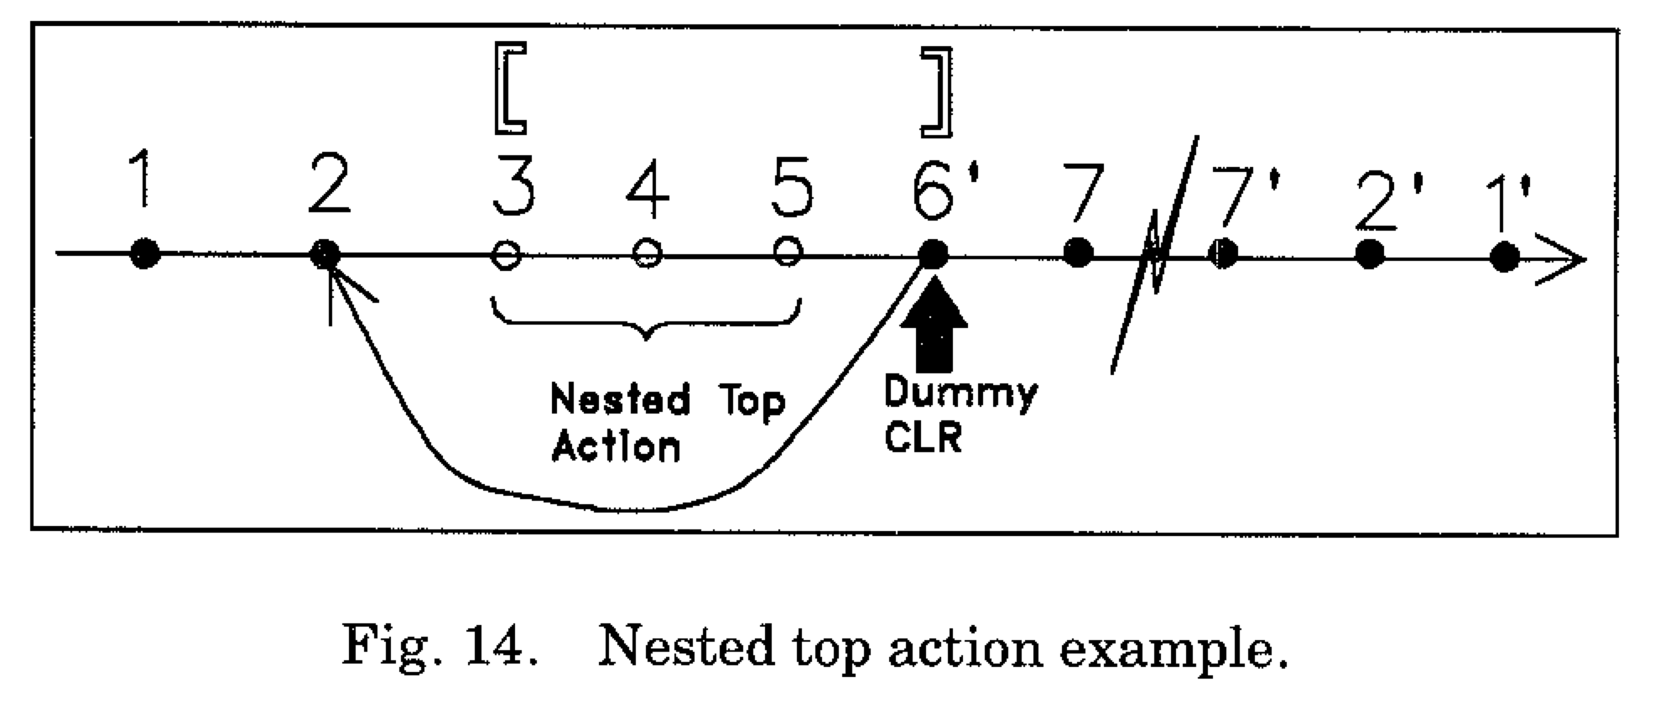
Nested Top Actions
Trick to support physical operations you do not want to ever be undone
Example?
Basic idea
At end of the nested actions, write a dummy CLR
Nothing to REDO in this CLR
Its UndoNextLSN points to the step before the nested action

Slide 47
Recovery: The UNDO Phase
ToUndo={ l | l a lastLSN of a “loser” Xact}
Repeat:
Choose largest LSN among ToUndo.
If this LSN is a CLR and undonextLSN==NULL
Write an End record for this Transaction
If this LSN is a CLR, and undonextLSN != NULL
Add undonextLSN to ToUndo
(Q: what happens to other CLRs?)
Else this LSN is an update. Undo the update, write a CLR, add prevLSN to ToUndo
Until ToUndo is empty

Slide 48
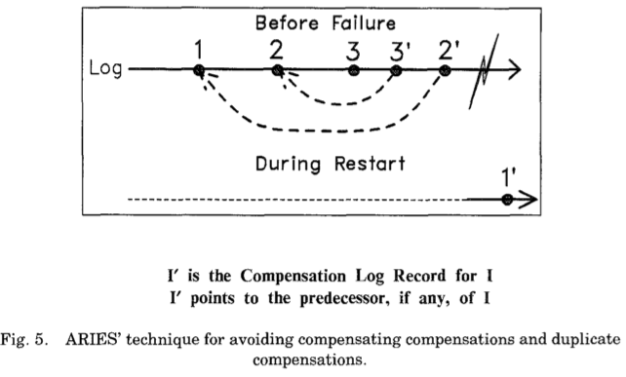
UndoNextLSN

Slide 49
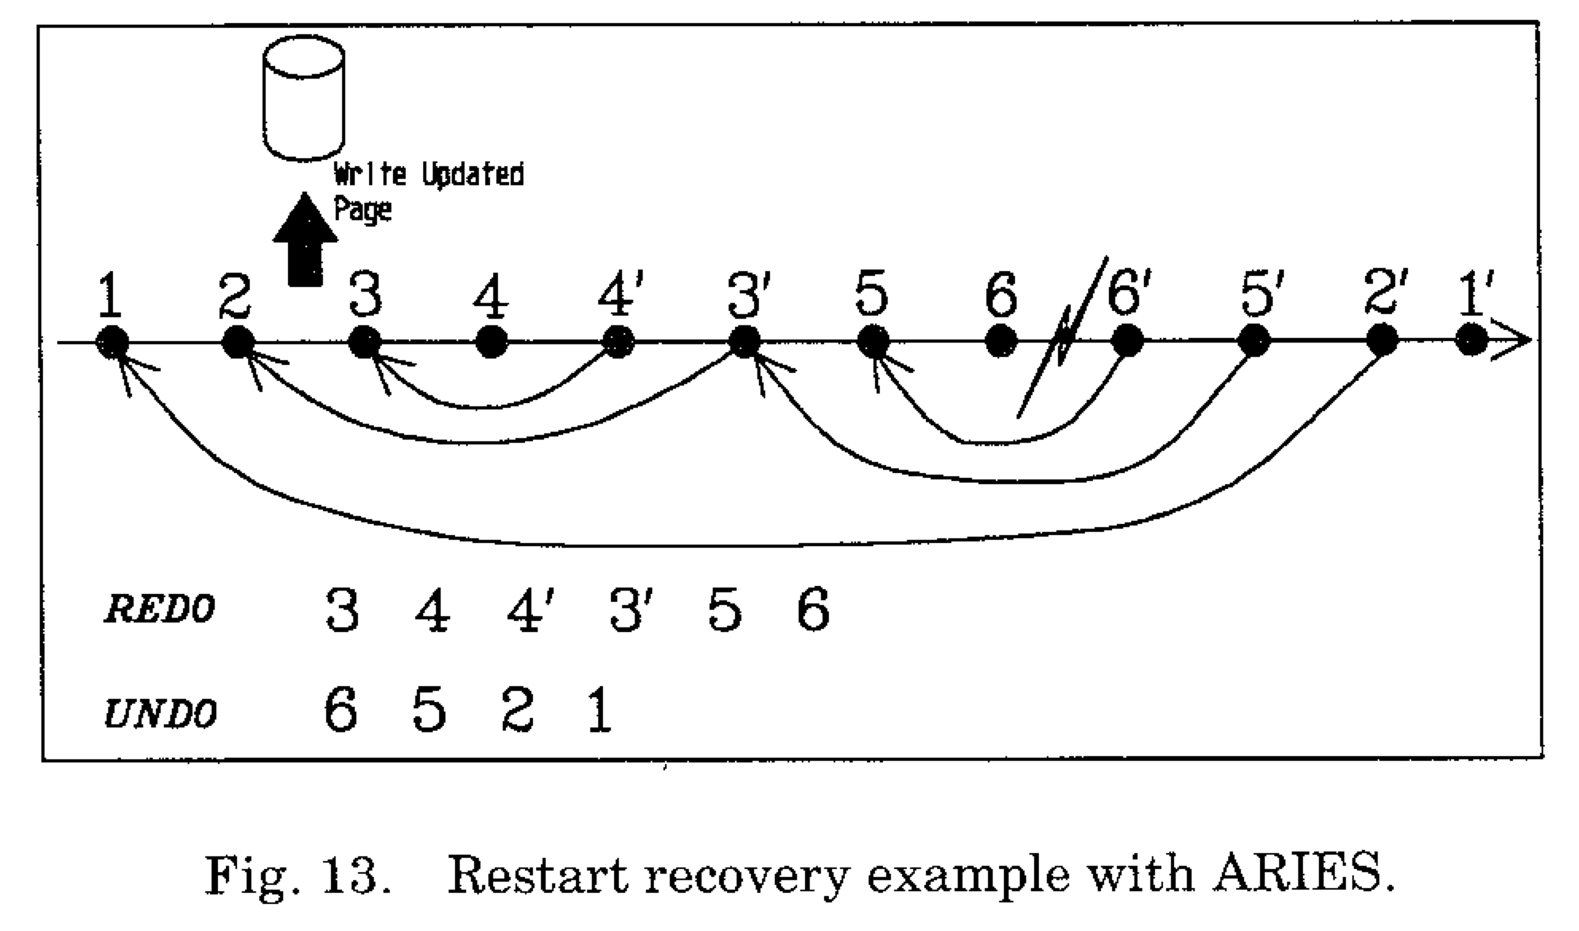
Restart Recovery Example
From Mohan et al, TODS 17(1):94-162

