Slide 1
CRDTs and Coordination Avoidance (Lecture 8, cs262a)
Ion Stoica & Ali Ghodsi
UC Berkeley
February 12, 2018
Notes:
3-D
What we want to enable
What we have today
How we’ll get there

Slide 2
Today’s Papers
CRDTs: Consistency without concurrency control, Marc Shapiro, Nuno Preguica, Carlos Baquero, Marek Zawirski Research Report, RR-6956, INRIA, 2009
(https://hal.inria.fr/inria-00609399v1/document)
Coordination Avoidance in Database Systems, Peter Bailis, Alan Fekete, Michael J. Franklin, Ali Ghodsi, Joseph M. Hellerstein, Ion Stoica, Proceedings of VLDB’14
(http://www.vldb.org/pvldb/vol8/p185-bailis.pdf)

Slide 3
Replicated Data
Replicate data at many nodes
Performance: local reads
Fault-tolerance: no data loss unless all replicas fail or become unreachable
Availability: data still available unless all replicas fail or become unreachable
Scalability: load balance across nodes for reads
Updates
Push to all replicas
Consistency: expensive!

Slide 4
Conflicts
Updating replicas may lead to different results → inconsistent data
s₁
5
3
7
s₂
5
3
7
s₃
5
7
3

Slide 5
Strong Consistency
All replicas execute updates in same total order
Deterministic updates: same update on same objects → same result
s₁
5
3
3
7
s₂
5
3
7
s₃
5
7
3
7
coordinate

Slide 6
Strong Consistency
All replicas execute updates in same total order
Deterministic updates: same update on same objects → same result
Requires coordination and consensus to decide on total order of operations
N-way agreement, basically serialize updates → very expensive!

Slide 7
CAP theorem
Can only have two of the three properties in a distributed system
Consistency. Always return a consistent results (linearizable). As if there was only a single copy of the data.
Availability. Always return an answer to requests (faster than really long lived partitions).
Partition-tolerance. Continue operating correctly even if the network partitions.

Slide 8
CAP theorem v2
When the networked is partitioned, you must chose one of these
Consistency. Always return a consistent results (linearizable). As if there was only a single copy of the data.
Availability. Always return an answer to requests (faster than really long lived partitions).
How can we get around CAP?

Slide 9
Eventual Consistency to the rescue
If no new updates are made to an object all replicas will eventually converge to the same value
Update local and propagate
No consensus in the background → scale well for both reads and writes
Expose intermediate state
Assume, eventual, reliable delivery
On conflict, applications
Arbitrate & Rollback

Slide 10
Eventual Consistency
If no new updates are made to an object all replicas will eventually converge to the same value
However
High complexity
Unclear semantics if application reads data and then we have a rollback!

Slide 11
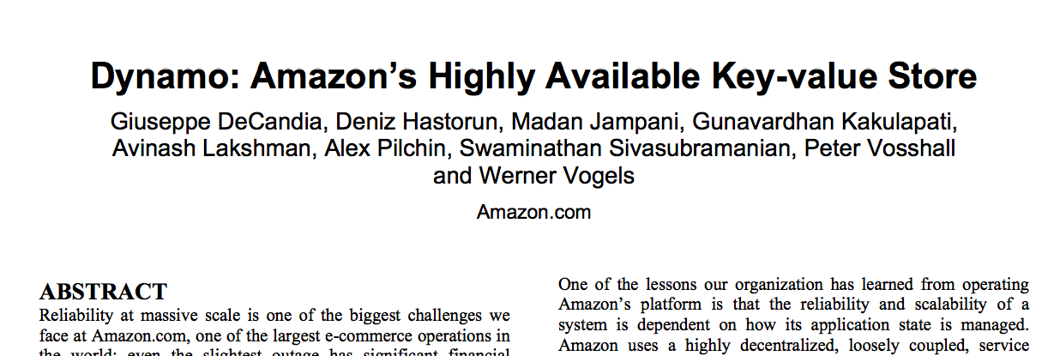

Slide 12
Must be available when partitions happen
“For example, customers should be able to view and add items to their shopping cart even if disks are failing, network routes are flapping, or data centers are being destroyed by tornados. Therefore, the service responsible for managing shopping carts requires that it can always write to and read from its data store, and that its data needs to be available across multiple data centers.”
Handles 3 million checkouts a day (2009). Availability!

Slide 13
Must be available when partitions happen
“Many traditional […]. In such systems, writes may be rejected if the data store cannot reach all (or a majority of) the replicas at a given time. On the other hand, Dynamo targets the design space of an “always writeable” data store (i.e., a data store that is highly available for writes). […] For instance, the shopping cart service must allow customers to add and remove items from their shopping cart even amidst network and server failures. This requirement forces us to push the complexity of conflict resolution to the reads in order to ensure that writes are never rejected”

Slide 14
Must be available when partitions happen
“There is a category of applications in Amazon’s platform that can tolerate such inconsistencies and can be constructed to operate under these conditions. For example, the shopping cart application requires that an “Add to Cart” operation can never be forgotten or rejected. If the most recent state of the cart is unavailable, and a user makes changes to an older version of the cart, that change is still meaningful and should be preserved. Note that both “add to cart” and “delete item from cart” operations are translated into put requests to Dynamo. When a customer wants to add an item to (or remove from) a shopping cart and the latest version is not available, the item is added to (or removed from) the older version and the divergent versions are reconciled later. .”

Slide 15
Main idea of CRDTs
How does CRDTs get around these consistency problems of eventual consistency?
Create many specialized APIs with custom semantics
Shopping cart might need a SET instead of PUT/GET
A search engine might need a distributed DAG
CS Research Trick: assume more semantics. More limited applicability, but can do things that were impossible before!

Slide 16
Strong Eventual Consistency
Strong Eventual Consistency (SEC) is Eventual Consistency with the guarantee that correct replicas that have received the same updates (maybe in different order) have an equivalent correct state!
Like eventual consistency but with deterministic outcomes of concurrent updates
No need for background consensus
No need to rollback
Available, fault-tolerant, scalable

Slide 17
Partial Order (poset)
Set of objects S and an order relationship ≤ between them, such that for all a, b, c in S
Reflexive: a ≤ a
Antisymmetric: ( a ≤ b ∧ b ≤ a ) ⇒ ( a = b )
Transitive: ( a ≤ b ∧ b ≤ c ) ⇒ ( a ≤ c )

Slide 18
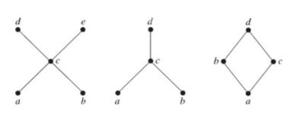
Hesse diagram
Simple way of describing posets, with a graph
Read bottom to top (smaller to greater), no arrows, just links
Remove self links
Remove transitive links

Slide 19
Semi-lattice
Partial order ≤ set S with a least upper bound (LUB), denoted ⊔
m = x ⊔ y is a LUB of {x, y} under ≤ iff ∀ m′ ( x ≤ m′ ∧ y ≤ m′) ⇒ ( x ≤ m ∧ y ≤ m ∧ m ≤ m′ )
The nice thing about semi-lattices is that it follows that ⊔ is:
commutative: x ⊔ y = y ⊔ x
idempotent: x ⊔ x = x
associative: ( x ⊔ y) ⊔ z = x ⊔ ( y ⊔ z)

Slide 20
Example
Partial order ≤ on set of integers
⊔: max( )
Then, we have:
commutative: max(x, y) = max(y, x)
idempotent: max(x, x) = x
associative: max(max(x, y), z) = max(x, max(y, z))

Slide 21
Example
Partial order ⊆ on sets
⊔: U (set union)
Then, we have:
commutative: A U B = B U A
idempotent: A U A = A
associative: (A U B) U C = A U (B U C)

Slide 22
Aha!
How can this help us in building replicated distributed systems?
Just use the LUB ⊔ to merge state between replicas
For instance, could build a CRDT using
Supports add(integer)
Supports get → returns the maximum integer
How?
Always correct: available and strongly eventually consistent
Can we support remove(integer)?

Slide 23
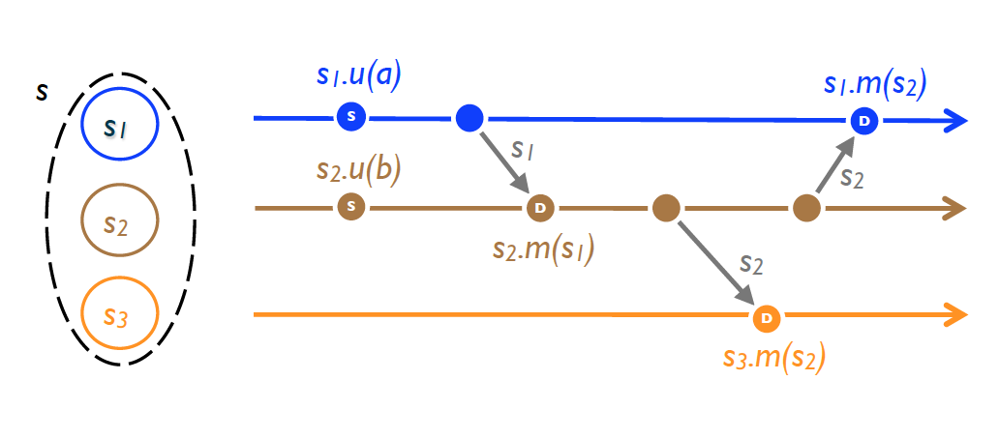
State-based Replication
Replicated object: a tuple (S, s₀, q, u, m).
Replica at process p_{i} has state s_{i} ∈ S
s₀: initial state
Each replica can execute one of following commands
q: query object’s state
u: update object’s state
m: merge state from a remote replica

Slide 24
State-based Replication
Algorithm
Periodically, replica at p_{i} sends its current state to p_{j}
Replica p_{j} merges received state into its local state by executing m
After receiving all updates (irrespective of order), each replica will have same state

Slide 25
Monotonic Semi-lattice Object
A state-based object with partial order ≤, noted (S,≤, s₀, q, u, m), that has following properties, is called a monotonic semi-lattice:
Set S of values forms a semi-lattice ordered by ≤
Merging state s with remote state s′ computes the LUB of the two states, i.e., s •m (s′ ) = s⊔s′
State is monotonically non-decreasing across updates, i.e., s ≤ s • u

Slide 26
Convergent Replicated Data Type (CvRDT)
Theorem: Assuming eventual delivery and termination, any state-based object that satisfies the monotonic semi-lattice property is
SEC

Slide 27
Why does it work?
Don’t care about order:
Merge is both commutative and associative
Don’t care about delivering more than once
Merge is idempotent

Slide 28
Numerical Example: Union Set
u: add new element to local replica
q: return entire set
merge: union between remote set and local replica
{5}
{5} U {3} = {3, 5}
{3, 5} U {5, 7} = {3, 5, 7}
{5}
{5}
{5} U {3, 5} = {3, 5}
{5}
{5}
{3, 5} U {5, 7} = {3, 5, 7}
{5}
{5} U {7} = {5, 7}
{5, 7} U {3, 5} = {3, 5, 7}

Slide 29
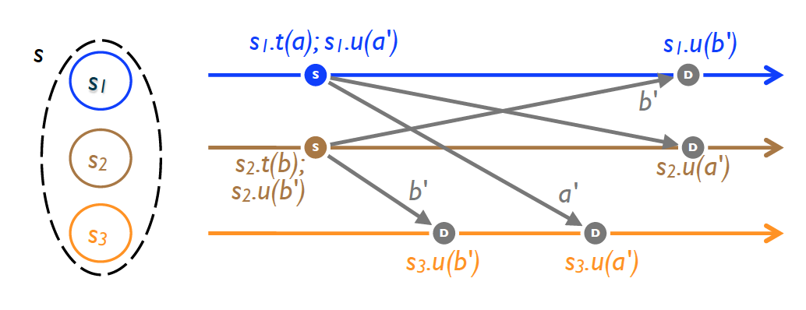
Operation-based Replication
An op-based object is a tuple (S, s₀, q, t, u, P ), where S, s₀ and q have same meaning: state domain, initial state and query method
No merge method; instead an update is split into a pair (t, u ), where
t: side-effect-free prepare-update method (at local copy)
u: effect-free update method (at all copies)
P: delivery precondition (see next)

Slide 30
Operation-based Replication
Algorithm
Updates are delivered to all replicas
Use causally-ordered broadcast communication protocol, i.e., deliver every message to every node exactly once, consistent with happen-before order
Happen-before: updates from same replica are delivered in the order they happened to all recipients (effectively delivery precondition, P)
Note: concurrent updates can be delivered in any order

Slide 31
Commutativity Property
Updates (t, u) and (t′, u′) commute, iff for any reachable
replica state s where both u and u′ are enabled
u (resp. u′ ) remains enabled in state s • u′ (resp. s • u )
s • u • u′ ≡ s • u′ • u
Commutativity holds for concurrent updates

Slide 32
Commutative Replicated Data Type (CmRDT)
Assuming causal delivery of updates and method termination, any op-based object that satisfies the commutativity property for all concurrent updates is SEC

Slide 33
Numerical Example: Union Set
t: add a set to local replica
u: add delta to every remote replica
{5}
{5} U {3} = {3, 5}
{3, 5} U {5,7} = {3, 5, 7}
{5}
{5}
{5} U {3} = {3, 5}
{5}
{5}
{3, 5} U {5,7} = {3, 5, 7}
{5}
{5} U {5, 7} = {5, 7}
{5, 7} U {3} = {3, 5, 7}

Slide 34
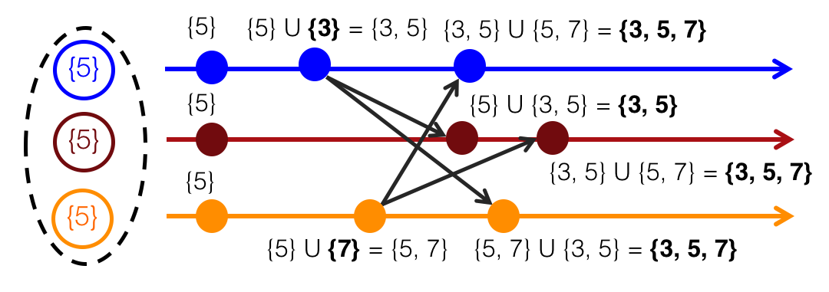
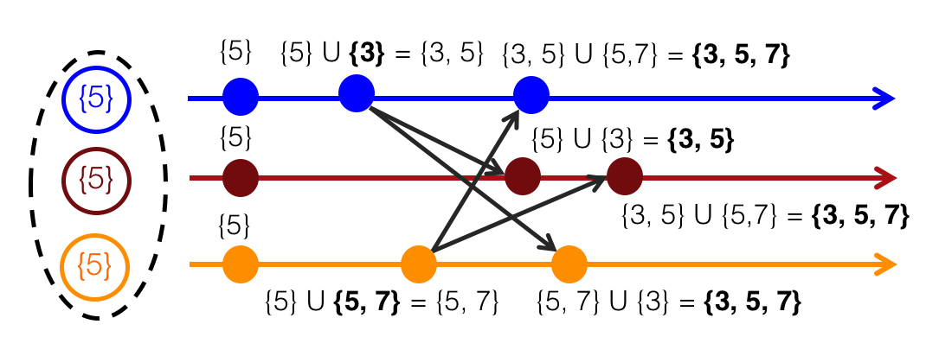
State-based vs Op-based
State Based CRDT (CvRDT)
Op Based CRDT (CmRDT)
What is the differences and why might it matter?

Slide 35
State-based vs Operation-based Replication
Both are equivalent!
You can use one to emulate the other
Operation-based
More efficient since you can ship only small updates, but requires causally-ordered broadcast
State-based
Just requires reliable broadcast; causally-ordered broadcast much more complex! But requires sending all state

Slide 36
CRDT Examples (cont’d)
Integer vector (virtual clock):
u: increment value at corresponding index by one, inc(i)
m: maximum across all values, e.g., m([1, 2, 4], [3, 1, 2]) = [3, 2, 4]
Counter: use an integer vector, with query operation
q: returns sum of all vector values (1-norm), e.g., q([1, 2, 4]) = 7
Counter that decrements as well:
Use two integer vectors:
I updated when incrementing
D updated when decrementing
q: returns difference between 1-norms of I and D

Slide 37
CRDT Examples (cont’d)
Add only set object
u: add new element to set
m: union between two sets
q: return local set
Add and remove set object
Two add only sets
A: when adding an element, add it to A
R: when removing an element, add it to R
q: returns A\R (only supports adding an element at most once)

Slide 38
CAP Theorem
You cannot achieve simultaneously
Strong consistency
Availability
Partition tolerance
Why?

Slide 39
SEC a Solution for CAP?
Availability: a replica is always available for both reads and writes
Partition tolerance: any communicating subset of replicas of
eventually converges, even if partitioned from the rest of the network.
Fault tolerance: n-1 nodes can fail!
Almost a solution: SEC weaker than Strong Consistency, though good enough for many practical situations

Slide 40
Summary
Serialization, strong consistency
Easy to use by applications, but don’t scale well due to conflicts
Two solutions to dramatically improve performance:
CRDTs: eliminate coordination by restricting types of supported objects for concurrent updates
Coordination avoidance: rely on application hints to avoid coordination for transactions

Slide 41
Discussion
What’s the main contribution of this paper?
What do these models mean for applications?
What’s the relationship between transactions and CRDTs?

