Slide 1
Paxos and Raft (Lecture 9 cont’d, cs262a)
Ali Ghodsi and Ion Stoica,
UC Berkeley
February 21, 2018
Notes:
3-D graph
Checklist
What we want to enable
What we have today
How we’ll get there

Slide 2
About mixing isolation models (Lecture 7…)

Slide 3
Direct Serialization Graph (DSG)
Conflict Name | Description | DSG
Directly write-depends | T1 writes value, then T2 overwrites it | T1 T2
Directly read-depends | T1 writes value, then T2 reads it | T1 T2
Directly anti-depends | T1 reads value, then T2 writes it | T1 T2
ww
wr
rw
Example:
T1:W(A), W(B), W(C)
T2: R(B), W(C)
T3: W(B) R(C), W(B)
wr
rw
T1
T2
wr
T3
ww
ww

Slide 4
Phenomena
G0 – DSG contains a directed cycle with ww edges
G1 – contains a directed cycle with ww and dependency cycles
G2 – contains a directed cycle with one or more anti-dependency edges
G2-item: DSG contains a directed cycle having one or more item-anti dependency edges

Slide 5
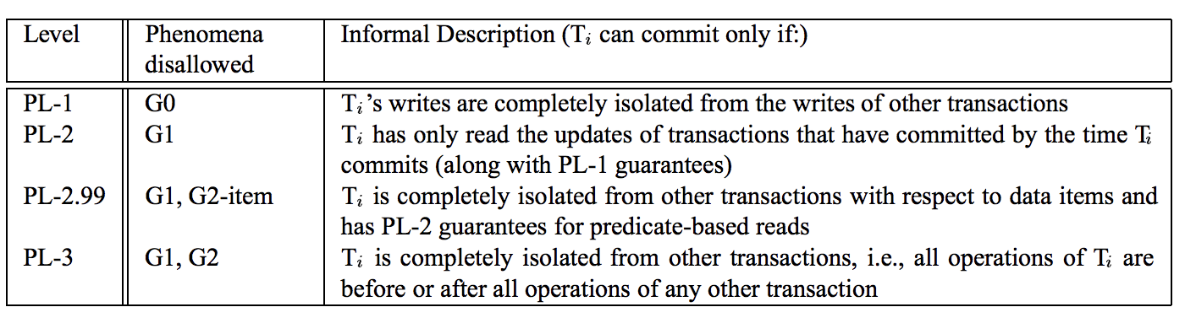
Summary of portable ANSI isolation levels

Slide 6
Mixing of Isolation Levels
Different transactions have different isolation levels
MSG (Mixed Serialization Graph): contains only dependencies relevant to a transaction’s level + obligatory conflict edges
Transaction Ti has an obligatory conflict with transaction Tk if
Tk is running at a higher level than Ti
Ti conflicts with Tk
conflict is relevant at Tk ’s level
E.g., An anti-dependency edge from a PL-3 transaction to a PL-1 transaction is an obligatory edge since overwriting of reads matters at level PL-3

Slide 7
Today’s Papers
Paxos Made Simple,
Leslie Lamport
(research.microsoft.com/en-us/um/people/lamport/pubs/paxos-simple.pdf)
In Search of an Understandable Consensus Algorithm,
Diego Ongaro and John Ousterhout, USENIX ATC’14
(https://ramcloud.stanford.edu/raft.pdf)
The Chubby lock service for loosely-coupled distributed systems,
Mike Burrows, OSDI’06
(https://www.usenix.org/event/osdi06/tech/full_papers/burrows/burrows.pdf )

Slide 8
Paxos
Based on many slides from Indranil Gupta’s presentation:
(https://courses.engr.illinois.edu/cs525/sp2013/L9_paxos.sp13.ppt),
and Gene Pang’s presentation (www.cs.berkeley.edu/~istoica/classes/cs294/11/notes/07-gene-paxos.pptx)

Slide 9
Distributed consensus problem
Group of processes must agree on a single value
Value must be proposed
After value is agreed upon, it can be learned

Slide 10
Two types of failures
Non-Byzantine
Failed nodes stop communicating with other nodes
"Clean" failure
Fail-stop behavior
Byzantine
Failed nodes will keep sending messages
Incorrect and potentially misleading
Failed node becomes a traitor
Assumption: asynchronous, non-byzantine model

Slide 11
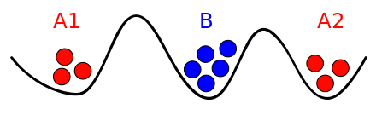
Consensus Impossibility Result
Byzantine Generals’ Problem
Why cannot reach consensus?

Slide 12
Paxos
L. Lamport, The Part-Time Parliament, September 1989
Aegean island of Paxos
A part-time parliament
Goal: determine the sequence of decrees passed (consensus!)

Slide 13
Political Analogy
Paxos has rounds: each round has a unique ballot ID
Rounds are asynchronous
Time synchronization not required
If you are in round j and hear a message from round j+1, abort everything and go to round j+1
Each round
Phase 1: A leader is elected (election)
Phase 2: Leader proposes a value (bill), processes acks
Phase 3: Leaders multicast final value (law)

Slide 14
Does Paxos Solve Consensus?
Provides safety and liveness
Safety:
Only a value which has been proposed can be chosen
Only a single value can be chosen
A process never learns a value unless it was actually chosen
Eventual liveness: If things go “well” at some point in the future (e.g., no longer losses or failures), consensus is eventually reached. However, this is not guaranteed.

Slide 15
So Simple, So Obvious
“In fact, it is among the simplest and most obvious of distributed algorithms.”
- Leslie Lamport

Slide 16
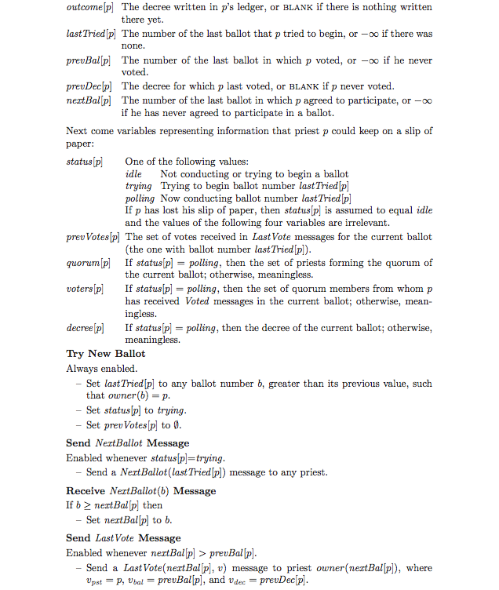
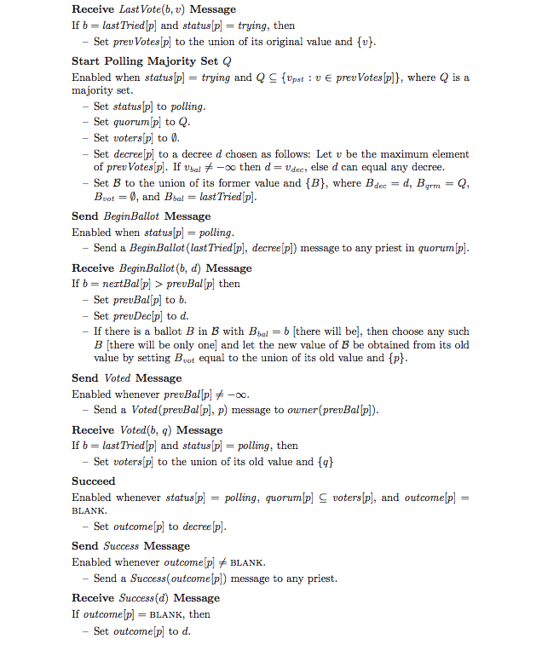
Simple Pseudocode

Slide 17
3 Types of Agents
Proposers
Acceptors
Learners

Slide 18
Simple Implementation
Typically, every process is acceptor, proposer, and learner
A leader is elected to be the distinguished proposer and learner
Distinguishes proposes to guarantee progress
Avoid dueling proposers
Distinguishes learners to reduce too many broadcast messages

Slide 19
Recall…
Rounds are asynchronous
Time synchronization not required
If you are in round j and hear a message from round j+1, abort everything and move to round j+1
Each round consists of three phases
Phase 1: A leader is elected (Election)
Phase 2: Leader proposes a value, processes acks (Bill)
Phase 3: Leader multicasts final value (Law)

Slide 20
Phase 1 – Election
Potential leader chooses a unique ballot ID, higher than anything it has seen so far
Sends ballot ID to all processes
Processes respond to highest ballot ID
If potential leader sees a higher ballot ID, it can’t be a leader
Paxos tolerant to multiple leaders, but we’ll mainly discuss only one leader case
Processes also log received ballot ID on disk (why?)
Please elect me!
OK!

Slide 21
Phase 1 – Election
If majority (i.e., quorum) respond OK then you are the leader
If no one has majority, start new round
A round cannot have two leaders (why?)
Please elect me!
OK!

Slide 22
Phase 2 – Proposal (Bill)
Leader sends proposal value v to all
If some process already decided value v’ in a previous round sends v = v’
Recipient log on disk, and responds OK
Value v ok?
Please elect me!
OK!
OK!

Slide 23
Phase 3 – Decision (Law)
If leader hears OKs from majority, it lets everyone know of the decision
Recipients receive decisions, log it on disk
Value v ok?
v!
Please elect me!
OK!
OK!

Slide 24
When is Consensus Achieved?
Value v ok?
v!
Please elect me!
OK!
OK!

Slide 25
When is Consensus Achieved?
When a majority of processes hear proposed value and accept it:
Value v ok?
v!
Please elect me!
OK!
OK!

Slide 26
When is Consensus Achieved?
When a majority of processes hear proposed value and accept it:
Are about to respond (or have responded) with OK!
At this point decision has been made even though
Processes or even leader may not know!
What if leader fails after that?
Keep having rounds until some round complete
Value v ok?
v!
Please elect me!
OK!
OK!

Slide 27
Safety
Assume a round with a majority hearing proposed value v and accepting it (mid of Phase 2). Then subsequently at each round either:
The round chooses v as decision
The round fails
Value v ok?
v!
Please elect me!
OK!
OK!

Slide 28
Safety
Assume a round with a majority hearing proposed value v and accepting it (mid of Phase 2). Then subsequently at each round either:
The round chooses v as decision
The round fails
“Proof”:
Potential leader waits for majority of OKs in Phase 1
At least one will contain v (because two majority sets intersect)
It will choose to send out v in Phase 2
Success requires a majority, and two majority sets intersects
Value v ok?
v!
Please elect me!
OK!
OK!

Slide 29
More Paxos in more detail…

Slide 30
Basic Paxos Protocol
Phase 1a: “Prepare”
Select proposal number* N and send a prepare(N) request to a quorum of acceptors.
Phase 1b: “Promise”
If N > number of any previous promises or acceptances,
* promise to never accept any future proposal less than N,
- send a promise(N, U) response
(where U is the highest-numbered proposal accepted so far (if any))
Proposer
Phase 2a: “Accept!”
If proposer received promise responses from a quorum,
- send an accept(N, W) request to those acceptors
(where W is the value of the highest-numbered proposal among the promise responses, or any value if no promise contained a proposal)
Acceptor
Phase 2b: “Accepted”
If N >= number of any previous promise,
* accept the proposal
- send an accepted notification to the learner
* = record to stable storage

Slide 31
Trivial Example: P1 wants to propose “A”
P1
A1
prepare(1)
A2
prepare(1)
L1

Slide 32
Trivial Example: P1 wants to propose “A”
promise(1)
promise(1)
P1
A1
prepare(1)
A2
prepare(1)
L1

Slide 33
Trivial Example: P1 wants to propose “A”
promise(1)
promise(1)
P1
A1
prepare(1)
accept(1, A)
A2
prepare(1)
accept(1, A)
L1

Slide 34
Trivial Example: P1 wants to propose “A”
promise(1)
promise(1)
P1
A1
prepare(1)
accept(1, A)
A2
prepare(1)
accept(1, A)
L1
accepted(A)
accepted(A)

Slide 35
Example
P1
A1
prepare(1)
A2
prepare(1)
L1

Slide 36
Prepare Example
P1
A1
Highest Accept: (5, A)
Highest Prepare: 15
Prepare(10)
A2
Highest Accept: (5, A)
Highest Prepare: 8
prepare(10)

Slide 37
Prepare Example
Promise(10, (5, A))
P1
A1
Highest Accept: (5, A)
Highest Prepare: 15
Prepare(10)
A2
Highest Accept: (5, A)
Highest Prepare: 8
prepare(10)
Highest Accept: (5, A)
Highest Prepare: 10

Slide 38
Simple Accept Example
P1
Assume it got promise for 10 from a quorum
A1
Highest Accept: (5, A)
Highest Prepare: 15
accept(10, A)
A2
Highest Accept: (5, A)
Highest Prepare: 10
accept(10, A)
…
L1

Slide 39
Simple Accept Example
P1
Assume it got promise for 10 from a quorum
A1
Highest Accept: (5, A)
Highest Prepare: 15
accept(10, A)
A2
Highest Accept: (5, A)
Highest Prepare: 10
accept(10, A)
…
L1
accepted(A)

Slide 40
Example: Livelock
P1
P2
A1
A1: Highest accept; (5, A)
Highest prepare: 8

Slide 41
Example: Livelock
promise(10, (5, A))
P1
P2
A1
prepare(10)
A1: Highest accept; (5, A)
Highest prepare: 10

Slide 42
Example: Livelock
promise(10, (5, A))
P1
P2
Promise(11,(5, A))
A1
prepare(10)
prepare(11)
A1: Highest accept; (5, A)
Highest prepare: 11

Slide 43
Example: Livelock
promise(10, (5, A))
P1
P2
Promise(11,(5, A))
A1
prepare(10)
prepare(11)
accept(10, A)
A1: Highest accept; (5, A)
Highest prepare: 11

Slide 44
Example: Livelock
promise(10, (5, A))
promise(12, (5, A))
P1
P2
Promise(11,(5, A))
A1
prepare(10)
prepare(11)
accept(10, A)
prepare(12)
A1: Highest accept; (5, A)
Highest prepare: 12

Slide 45
Example: Livelock
promise(10, (5, A))
promise(12, (5, A))
P1
P2
Promise(11,(5, A))
Promise(13,(5, A))
A1
prepare(10)
prepare(11)
accept(10, A)
prepare(12)
prepare(13)
A1: Highest accept; (5, A)
Highest prepare: 13

Slide 46
Example: P1 want to propose value A
P1
P2
A1
prep(5)
A2
prep(5)
A3
prep(5)
L

Slide 47
Example: P1 want to propose value A
prom(5)
prom(5)
P1
P2
A1
prep(5)
A2
prep(5)
A3
prep(5)
L

Slide 48
Example: P1 want to propose value A
prom(5)
prom(5)
P1
P2
A1
prep(5)
accept(5, A)
A2
prep(5)
accept(5, A)
A3
prep(5)
accept(5, A)
L

Slide 49
Example: P1 want to propose value A
prom(5)
prom(5)
accepted(A)
P1
P2
A1
prep(5)
accept(5, A)
A2
prep(5)
accept(5, A)
A3
prep(5)
accept(5, A)
L
accepted(A)

Slide 50
Example
prom(5, (3, C))
prom(5, (2, B))
prom(5, (4, D))
accepted(D)
P1
P2
A1
prep(5)
accept(5,D)
A2
prep(5)
accept(5, D)
A3
prep(5)
accept(5, D)
L
Accepted(D)

Slide 51
Example: P1 wants A, and P2 wants B
prom(5)
prom(5)
P1
prom(8)
prom(8)
P2
A1
prep(5)
prep(8)
A2
prep(5)
prep(8)
A3
prep(8)
prep(5)
L
accepted(A)

Slide 52
Example: P1 wants A, and P2 wants B
prom(5)
prom(5)
P1
prom(8)
prom(8)
P2
A1
prep(5)
prep(8)
accept(5, A)
A2
prep(5)
prep(8)
accept(5, A)
A3
prep(8)
prep(5)
accept(5, A)
L

Slide 53
Example: P1 wants A, and P2 wants B
prom(5)
prom(5)
P1
prom(8)
prom(8)
P2
A1
prep(5)
prep(8)
accept(5, A)
accept(8, B)
A2
prep(5)
accept(5, A)
accept(8, B)
prep(8)
A3
prep(8)
prep(5)
accept(5, A)
Accept(8, B)
L

Slide 54
Example: P1 wants A, and P2 wants B
prom(5)
prom(5)
P1
prom(8)
prom(8)
Accepted(8, B)
P2
A1
prep(5)
prep(8)
accept(5, A)
accept(8, B)
A2
prep(5)
accept(5, A)
accept(8, B)
prep(8)
A3
prep(8)
prep(5)
accept(5, A)
accept(8, B)
L
Accepted(8, B)

Slide 55
Others
In practice send NACKs if not accepting a promise
Promise IDs should increase slowly
Otherwise too much too converge
Solution: different ID spaces for proposers

Slide 56
Raft
Many slides from Diego Ongaro & John Ousterhout presentation:
(http://www2.cs.uh.edu/~paris/6360/PowerPoint/Raft.ppt)

Slide 57
Paxos Limitations
“The dirty little secret of the NSDI community is that at most five people really, truly understand every part of Paxos ;-).” – NSDI reviewer
“There are significant gaps between the description of the Paxos algorithm and the needs of a real-world system…the final system will be based on an unproven protocol.” – Chubby authors

Slide 58

Replicated State Machines
Clients
z←6
Consensus Module
Consensus Module
Consensus Module
State Machine
State Machine
State Machine
x | 1
y | 2
z | 6
x | 1
y | 2
z | 6
x | 1
y | 2
z | 6
Servers
Log
Log
Log
x←3
y←2
x←1
z←6
x←3
y←2
x←1
z←6
x←3
y←2
x←1
z←6
Replicated log ⇒ replicated state machine
All servers execute same commands in same order
Consensus module ensures proper log replication
System makes progress as long as any majority of servers are up
Failure model: fail-stop (not Byzantine), delayed/lost messages

Slide 59
Designing for understandability
Main objective of RAFT
Whenever possible, select the alternative that is the easiest to understand
Techniques that were used include
Dividing problems into smaller problems
Reducing the number of system states to consider

Slide 60
Raft Overview
Leader election
Select one of the servers to act as cluster leader
Detect crashes, choose new leader
Log replication (normal operation)
Leader takes commands from clients, appends them to its log
Leader replicates its log to other servers (overwriting inconsistencies)
Safety
Only a server with an up-to-date log can become leader

Slide 61
Raft basics: the servers
A RAFT cluster consists of several servers
Typically five
Each server can be in one of three states
Leader
Follower
Candidate (to be the new leader)
Followers are passive:
Simply reply to requests coming from their leader

Slide 62
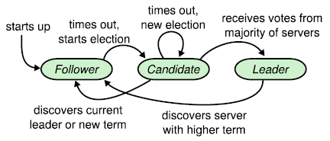
Server states

Slide 63
Raft basics: terms (I)
Epochs of arbitrary length
Start with the election of a leader
End when
Leader becomes unavailable
No leader can be selected (split vote)
Different servers may observe transitions between terms at different times or even miss them

Slide 64
Raft basics: terms (II)

Slide 65
Raft basics: RPC
Servers communicate though idempotent RPCs
RequestVote
Initiated by candidates during elections
AppendEntry: Initiated by leaders to
Replicate log entries
Provide a form of heartbeat
Empty AppendEntry( ) calls

Slide 66
Leader elections
Servers start being followers
Remain followers as long as they receive valid RPCs from a leader or candidate
When a follower receives no communication over a period of time (the election timeout), it starts an election to pick a new leader

Slide 67
S1
1
S5
1
1
S2
1
1
Follower
S4
S3
Candidate
Leader

Slide 68
S1
1
S5
1
1
S2
ReqVote (2)
ReqVote (2)
ReqVote (2)
1
ReqVote (2)
2
Follower
S4
S3
Candidate
Leader
S3 timeouts, switch to candidate state,
increment term, vote itself as a leader and ask everyone else to confirm

Slide 69
S1
2
ReqVote(2)
ReqVote (2)
S5
1
1
S2
ReqVote (2)
ReqVote (2)
1
2
Follower
S4
S3
Candidate
Leader
Concurrently S1 timeouts, switch to candidate state,
increment term, vote itself as a leader and ask everyone else to confirm

Slide 70
S1
2
Granted
S5
2
2
S2
Granted
2
2
Follower
S4
S3
Candidate
Leader
S5 grant vote to S1
S2 grants vote to S3

Slide 71
S1
2
Denied
S5
2
2
S2
Denied
2
Denied
2
Follower
S4
S3
Candidate
Leader

Slide 72
S1
2
Denied
S5
2
2
S2
Denied
Denied
Denied
2
Denied
2
Follower
S4
S3
Candidate
Leader
Neither candidate gets majority.
After a random delay between 150-300ms try again.

Slide 73
S1
3
ReqVote (3)
ReqVote (3)
S5
2
2
S2
ReqVote (3)
ReqVote (3)
2
2
Follower
S4
S3
Candidate
Leader
S1 initiates another election for term 3.

Slide 74
S1
3
Granted
Granted
S5
3
3
S2
Granted
Granted
3
3
Follower
S4
S3
Candidate
Leader
Everyone grants the vote to S1

Slide 75
S1
3
Granted
Granted
S5
3
3
S2
Granted
Granted
3
3
Follower
S4
S3
Candidate
Leader
S1 becomes leader for term 3,
and the others become followers.

Slide 76
Log replication
Leaders
Accept client commands
Append them to their log (new entry)
Issue AppendEntry RPCs in parallel to all followers
Apply the entry to their state machine once it has been safely replicated
Entry is then committed

Slide 77
A client sends a request
Log
State
machine
Client
Log
State
machine
Log
State
machine
Leader stores request on its log and forwards it to its followers

Slide 78
The followers receive the request
Log
State
machine
Client
Log
State
machine
Log
State
machine
Followers store the request on their logs and acknowledge its receipt

Slide 79
The leader tallies followers' ACKs
Log
State
machine
Client
Log
State
machine
Log
State
machine
Once it ascertains the request has been processed by a majority of the servers, it updates its state machine

Slide 80
The leader tallies followers' ACKs
Log
State
machine
Client
Log
State
machine
Log
State
machine
Leader's heartbeats convey the news to its followers: they update their state machines

Slide 81
Log organization
Colors identify
terms

Slide 82
Handling slow followers ,…
Leader reissues the AppendEntry RPC
They are idempotent

Slide 83
Committed entries
Guaranteed to be both
Durable
Eventually executed by all the available state machine
Committing an entry also commits all previous entries
All AppendEntry RPCs—including heartbeats—include the index of its most recently committed entry

Slide 84
Why?
Raft commits entries in strictly sequential order
Requires followers to accept log entry appends in the same sequential order
Cannot "skip" entries
Greatly simplifies the protocol

Slide 85

Raft log matching property
If two entries in different logs have the same index and term
These entries store the same command
All previous entries in the two logs are identical

Slide 86
Safety
Two main questions
What if the log of a new leader did not contain all previously committed entries?
Must impose conditions on new leaders
How to commit entries from a previous term?
Must tune the commit mechanism

Slide 87
Election restriction (I)
The log of any new leader must contain all previously committed entries
Candidates include in their RequestVote RPCs information about the state of their log
Before voting for a candidate, servers check that the log of the candidate is at least as up to date as their own log.
Majority rule does the rest

Slide 88
Election restriction (II)
Servers holding
the last committed
log entry
Servers having
elected the
new leader
Two majorities of the same cluster must intersect

Slide 89
Committing entries from previous term
A leader cannot conclude that an entry from a previous term is committed even if stored on a majority of servers.
Leader should never commits log entries from previous terms by counting replicas
Should only do it for entries from the current term
Once it has been able to do that for one entry, all prior entries are committed indirectly

Slide 90
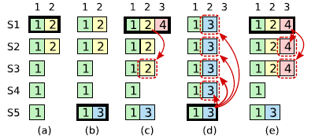
Committing entries from previous term
S1 is leader and partially replicates the log entry at index 2.

Slide 91
Committing entries from previous term
S1 crashes; S5 is elected leader for term 3 with votes from S3, S4, and itself, and accepts a different entry at log index 2.

Slide 92
Committing entries from previous term
S5 crashes; S1 restarts, is elected leader, and continues replication

Slide 93
Committing entries from previous term
S1 crashes, S5 is elected leader (with votes from S2, S3, and S4) and overwrites the entry with its own entry from term 3.

Slide 94
Committing entries from previous term
However, if S1 replicates an entry from its current term on a majority of the servers before crashing, as this entry is committed (S5 cannot win an election).

Slide 95
Summary
Consensus key building block in distributed systems
Raft similar to Paxos
Raft arguably easier to understand than Paxos
It separates stages which reduces the algorithm state space
Provides a more detailed implementation

