Slide 1
The Chubby lock service for loosely-coupled distributed systems (Lecture 10, cs262a)
Ali Ghodsi and Ion Stoica,
UC Berkeley
February 21, 2018
Notes:
3-D graph
Checklist
What we want to enable
What we have today
How we’ll get there

Slide 2
Today’s Paper
The Chubby lock service for loosely-coupled distributed systems,
Mike Burrows, OSDI’06
(https://www.usenix.org/event/osdi06/tech/full_papers/burrows/burrows.pdf )

Slide 3
What is this paper about?
“Building Chubby was an engineering effort … it was not research. We claim no new algorithms or techniques. The purpose of this paper is to describe what we did and why, rather than to advocate it.”

Slide 4
Introduction
What is Chubby?
Lock service in a loosely-coupled distributed system (e.g., 10K 4-processor machines connected by 1Gbps Ethernet)
Client interface similar to whole-file advisory locks with notification of various events (e.g., file modifications)
Primary goals: reliability, availability, easy-to-understand semantics
How is it used?
Used in Google: GFS, Bigtable, etc.
Elect leaders, store small amount of meta-data, as the root of the distributed data structures

Slide 5
Design
Lock service, instead of consensus library
Serve small files
Support large-scale concurrent file viewing
Event notification mechanism
Caching of files (consistent caching)
Security, including access control

Slide 6
Design Decisions
Lock service vs. consensus (Paxos) library
Advantages:
Maintain program structure, communication patterns
Can support notification mechanism
Smaller # of nodes (servers) needed to make progress
Advisory instead of mandatory locks (why?):
Holding a lock called F neither is necessary to access the file F, nor prevents other clients from doing so

Slide 7
Design Decisions
Coarse vs. fine-grained locks
Advantages of coarse-grained locks
Less load on lock server
Less delay when lock server fails
Less lock servers and availability required
Advantages of fine-grained locks
More lock server load
If needed, could be implemented on client side

Slide 8
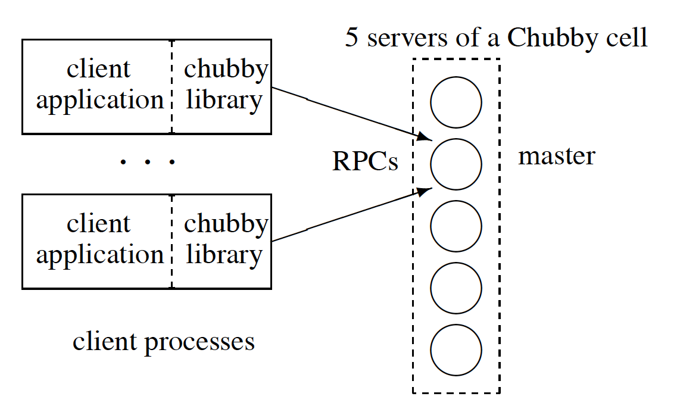
System Structure
Chubby cell: a small number of replicas (e.g., 5)
Master is selected using a consensus protocol (e.g., Paxos)
Master gets a lease of several seconds
If master fails, it’s lease expires and a new one is selected

Slide 9
System Structure
Clients
Send reads/writes only to the master
Communicates with master via a chubby library
Every replica server
Is listed in DNS
Direct clients to master
Maintain copies of a simple database

Slide 10
Read and Writes
Write
Master propagates write to replica Replies after the write reaches a majority (e.g., quorum)
Read
Master replies directly, as it has most up to date state

Slide 11
Simple UNIX-like File System Interface
Bare bone file & directory structure
/ls/foo/wombat/pouch
Name within cell
Cell name
Lock service; common to all names

Slide 12
Simple UNIX-like File System Interface
Bare bone file & directory structure
/ls/foo/wombat/pouch
Does not support, maintain, or reveal
Moving files
Path-dependent permission semantics
Directory modified times, files last-access times

Slide 13
Nodes
Node: a file or directory
Any node can act as an advisory reader/writer lock
A node may be either permanent or ephemeral
Ephemeral used as temporary files, e.g., indicate a client is alive
Metadata
Three names of ACLs (R/W/change ACL name)
Authentication build into ROC
64-bit file content checksum

Slide 14
Locks
Any node can act as lock (shared or exclusive)
Advisory (vs. mandatory)
Protect resources at remote services
No value in extra guards by mandatory locks
Write permission needed to acquire
Prevents unprivileged reader blocking progress

Slide 15
Locks and Sequences
Potential lock problems in distributed systems
A holds a lock L, issues request W, then fails
B acquires L (because A fails), performs actions
W arrives (out-of-order) after B’s actions
Solution 1: backward compatible
Lock server will prevent other clients from getting the lock if a lock become inaccessible or the holder has failed
Lock-delay period can be specified by clients

Slide 16
Locks and Sequences
Potential lock problems in distributed systems
A holds a lock L, issues request W, then fails
B acquires L (because A fails), performs actions
W arrives (out-of-order) after B’s actions
Solution 2: sequencer
A lock holder can obtain a sequencer from Chubby
It attaches the sequencer to any requests that it sends to other servers
The other servers can verify the sequencer information

Slide 17
Design: Events
Client subscribes when creating handle
Delivered async via up-call from client library
Event types
File contents modified
Child node added / removed / modified
Chubby master failed over
Handle / lock have become invalid
Lock acquired / conflicting lock request (rarely used)

Slide 18
Design: API
Open() (only call using named node)
how handle will be used (access checks here)
events to subscribe to
lock-delay
whether new file/dir should be created
Close() vs. Poison()
Other ops:
GetContentsAndStat(), SetContents(), Delete(), Acquire(), TryAcquire(), Release(), GetSequencer(), SetSequencer(), CheckSequencer()

Slide 19
Caching
Client caches file data, node meta-data
Write-through held in memory
Strict consistency: easy to understand
Lease based
Master will invalidate cached copies upon a write request
Handles and locks cached as well
Event informs client of conflicting lock request

Slide 20
Sessions and Keep-Alives
A client sends keep-alive requests to a master
A master responds by a keep-alive response
Immediately after getting the keep-alive response, the client sends another request for extension
The master will block keep-alives until close the expiration of a session
Extension is default to 12s

Slide 21
Sessions and Master Fail-overs
Clients maintain a local timer for estimating the session timeouts (time is not perfectly synchronized)
If local timer runs out, wait for a 45s grace period before ending the session
Happens when a master fails over

Slide 22
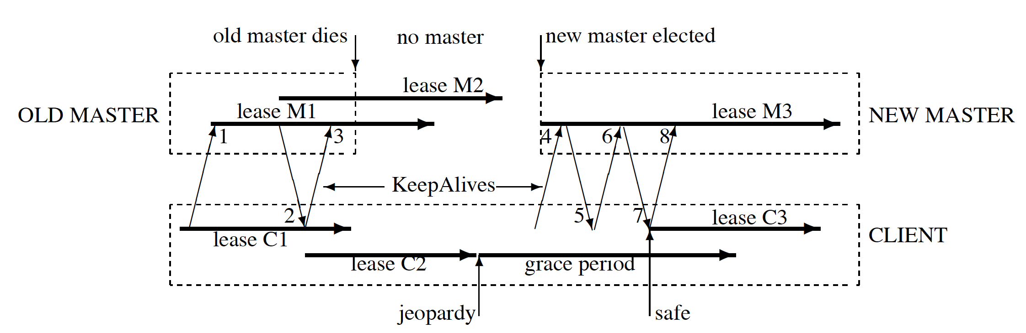
Example

Slide 23
Other Details
Database implementation
A simple database with write ahead logging and snapshotting
Switched from BerkeleyDB to bare-bone internally-developed DB (why?)
Backup:
Write a snapshot to a GFS server in a different building
Mirroring files across multiple cells
Configuration files (e.g., locations of other services, access control lists, etc.)

Slide 24
Why scaling is important?
Clients connect to a single instance of master in a cell
Much more client processes that number of machines
Existing mechanisms:
More Chubby cells
Increase lease time from 12s to 60s to reduce KeepAlive messages (dominant requests in experiments)
Client caches

Slide 25
New Mechanisms
Proxies:
Handle KeepAlive and read requests, pass write requests to the master
Reduce traffic but reduce availability
Partitioning: partition name space
A master handles nodes with hash(name) mod N == id
Limited cross-partition messages

Slide 26
Cell outages Stats
61 outages for all cells in a few weeks
52 outages were under 30s, incur under 30s delay in applications
Remaining 9 outages
Network maintenance (4)
Suspected network connectivity problems (2)
Software errors (2)
Overload (1)

Slide 27
Java Clients
Google systems are mostly written in C++
Chubby client library is complex (7000 lines)
Hard to port to Java and maintain in Java
JNI is inefficient
Java users run a protocol-conversion server with a simple RPC protocol
Don’t know how to avoid running this additional server

Slide 28
As a Name Service
Chubby’s most popular use
For availability, need to set DNS TTL short, but often overwhelms DNS server
Must poll each DNS entry: O(N²)
Chubby is invalidation based
Besides KeepAlives, no need to poll

Slide 29
Abusive Clients
Review before clients can use shared Chubby cells
Problem cases encountered:
Repeated open/close calls for polling a file
Cache file handles aggressively
Lack of quotas
256Kbytes file size limit
Publish/subscribe system on Chubby? inefficient

Slide 30
Lesson Learned
Developers rarely consider availability
Should plan for short Chubby outages
Crashed applications on failover event
Fine grained locking not essential
API mostly good, but one bad chose stands out
Handles acquiring locks cannot be shared
RPC affects transport protocols
Forced to send KeepAlives by UDP (why?)

Slide 31
Summary
Distributed Lock Service
Coarse-grained synchronization for Google’s distributed systems
Primarily used as internal name service
Repository for files requiring high availability
Well-known techniques
Distributed consensus, caching, notifications
UNIX-like file system interface

