Slide 1
Mesos and Borg and Kubernetes Lecture 13, cs262a
Ion Stoica & Ali Ghodsi
UC Berkeley
March 5, 2018
Notes:
3-D graph
Checklist
What we want to enable
What we have today
How we’ll get there

Slide 2
Today’s Papers
Mesos: A Platform for Fine-Grained Resource Sharing in the Data Center,
Benjamin Hindman, Andy Konwinski, Matei Zaharia,
Ali Ghodsi, Anthony D. Joseph, Randy Katz, Scott Shenker, Ion Stoica, NSDI’11
https://people.eecs.berkeley.edu/~alig/papers/mesos.pdf
Large-scale cluster management at Google with Borg,
Abhishek Verma, Luis Pedrosa, Madhukar R. Korupolu, David Oppenheimer, Eric Tune, John Wilkes, EuroSys’15
http://static.googleusercontent.com/media/research.google.com/en//pubs/archive/43438.pdf

Slide 3
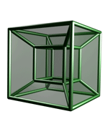









Motivation
Rapid innovation in cloud computing
Today
No single framework optimal for all applications
Each framework runs on its dedicated cluster or cluster partition
Dryad
Hypertable
Cassandra
Pregel
Notes:
Today we are witnessing rapid innovation in cloud computing.
Over the past decade a large number of cloud computing frameworks have been developed, starting with MapReduce. Other examples, are Hadoop, HDFS, ….,
Framework: software system that manages and runs one or multiple jobs simultaneously on a cluster computer
It is clear that at least today there is no genera framework, and different applications will need to use different frameworks. Unfortunately, existing frameworks assumes they own the cluster. Running each framework on a dedicate cluster or a set of virtual machines is expensive as it does not allow fine grained sharing of resources. Furthermore, more than one frameworks may require to access the same data and this data would be hard, if not infeasible. To replicate.
The challenge we want to address is to run multiple frameworks on some cluster.

Slide 4

Computation Model: Frameworks
A framework (e.g., Hadoop, MPI) manages one or more jobs in a computer cluster
A job consists of one or more tasks
A task (e.g., map, reduce) is implemented by one or more processes running on a single machine
cluster
Executor
(e.g., Task
Tracker)
Executor
(e.g., Task
Traker)
Job 1: tasks 1, 2, 3, 4
Job 2: tasks 5, 6, 7
task 1
task 2
task 5
task 6
Framework
Scheduler (e.g., Job Tracker)
Executor
(e.g., Task
Tracker)
Executor
(e.g., Task
Tracker)
task 3
task 7
task 4

Slide 5
One Framework Per Cluster Challenges
Inefficient resource usage
E.g., Hadoop cannot use available resources from Pregel’s cluster
No opportunity for stat. multiplexing
Hard to share data
Copy or access remotely, expensive
Hard to cooperate
E.g., Not easy for Pregel to use graphs generated by Hadoop
Hadoop
Pregel
Hadoop
Pregel
Need to run multiple frameworks on same cluster
2011 slide

Slide 6
What do we want?
Common resource sharing layer
Abstracts (“virtualizes”) resources to frameworks
Enable diverse frameworks to share cluster
Make it easier to develop and deploy new frameworks (e.g., Spark)
Hadoop
MPI
Hadoop
MPI
Resource Management System
Uniprograming
Multiprograming
Notes:
Our solution is Mesos, a resource sharing layer that abstracts resources to framework, and this way allows over which diverse frameworks cab run, by abstracting resources to framework
By doing so we go from uniprograming or one framework per cluster to multiprogramming where we share entire cluster among diverse frameworks.

Slide 7
Fine Grained Resource Sharing
Task granularity both in time & space
Multiplex node/time between tasks belonging to different jobs/frameworks
Tasks typically short; median ~= 10 sec, minutes
Why fine grained?
Improve data locality
Easier to handle node failures
Notes:
Mesos provide fine grained resource sharing. In particular, with Mesos resources are shared at the task granukarity both in time & space. What I mean by this is that Mesos multiplex a node and the tome between tasks belonging to different jobs and frameworks.
In addition, tasks are typically small with median between 10s of seconds and minutes.
Fine grain sharing has two immediate advantages. First, it improves data locality. If the multiple jobs and frameworks have input data stored or cached at a few nodes, fine grained sharing minimizes the time a job needs to wait before running on a node that has its data, Second, it makes it easier to tolerate node failures, as a node failure will result in the loss of relatively little work.

Slide 8
Goals
Efficient utilization of resources
Support diverse frameworks (existing & future)
Scalability to 10,000’s of nodes
Reliability in face of node failures
Notes:
Assumptions
Shared storage
Not all tasks require full node
Not all nodes identical
We have achieved these goals and it’s been deployed

Slide 9
Approach: Global Scheduler
Organization policies
Global
Scheduler
Resource availability
Job requirements
Response time
Throughput
Availability
…
Notes:
…
Complexity. There are two kinds of complexity. The first is the computation complexity. Computing an on-line a schedule for a cluster with 10Ks machines and millions of tasks can be a challenge. This has a negative impact on scale and resilience, and the scheduler needs to recover a non-trivial amount of state upon failure. However, arguable the biggest complexity challenge is that such scheduler needs to provide a rich API or or generic language to allow frameworks and job wide types of requirements, Furthermore such language should cover not only existing frameworks but also of the future requirements. Point in case. Condor’s ClassAds provides a very popular specification language in grid computing. While ClassAds is good, very good. However, despite the fact that its specification is tens of pages, it cannot capture some of the
However despite the fact hat ClassAds’ specification is tens of pages it does not cover all requirements of today;s frameworks, such as delay scheduling, which we are going to discuss later.
Finally, one of our primary goals is to port the existing frameworks which have their won sophisticated scheduling algorithms. This approach oould require to factor these frameowkrs and push their scheduling into the global scheduler. This can be intrusive and time consuming proposition.

Slide 10
Approach: Global Scheduler
Organization policies
Global
Scheduler
Resource availability
Job requirements
Job execution plan
Task DAG
Inputs/outputs
Notes:
…
Complexity. There are two kinds of complexity. The first is the computation complexity. Computing an on-line a schedule for a cluster with 10Ks machines and millions of tasks can be a challenge. This has a negative impact on scale and resilience, and the scheduler needs to recover a non-trivial amount of state upon failure. However, arguable the biggest complexity challenge is that such scheduler needs to provide a rich API or or generic language to allow frameworks and job wide types of requirements, Furthermore such language should cover not only existing frameworks but also of the future requirements. Point in case. Condor’s ClassAds provides a very popular specification language in grid computing. While ClassAds is good, very good. However, despite the fact that its specification is tens of pages, it cannot capture some of the
However despite the fact hat ClassAds’ specification is tens of pages it does not cover all requirements of today;s frameworks, such as delay scheduling, which we are going to discuss later.
Finally, one of our primary goals is to port the existing frameworks which have their won sophisticated scheduling algorithms. This approach oould require to factor these frameowkrs and push their scheduling into the global scheduler. This can be intrusive and time consuming proposition.

Slide 11
Approach: Global Scheduler
Organization policies
Global
Scheduler
Resource availability
Job requirements
Job execution plan
Estimates
Task durations
Input sizes
Transfer sizes
Notes:
…
Complexity. There are two kinds of complexity. The first is the computation complexity. Computing an on-line a schedule for a cluster with 10Ks machines and millions of tasks can be a challenge. This has a negative impact on scale and resilience, and the scheduler needs to recover a non-trivial amount of state upon failure. However, arguable the biggest complexity challenge is that such scheduler needs to provide a rich API or or generic language to allow frameworks and job wide types of requirements, Furthermore such language should cover not only existing frameworks but also of the future requirements. Point in case. Condor’s ClassAds provides a very popular specification language in grid computing. While ClassAds is good, very good. However, despite the fact that its specification is tens of pages, it cannot capture some of the
However despite the fact hat ClassAds’ specification is tens of pages it does not cover all requirements of today;s frameworks, such as delay scheduling, which we are going to discuss later.
Finally, one of our primary goals is to port the existing frameworks which have their won sophisticated scheduling algorithms. This approach oould require to factor these frameowkrs and push their scheduling into the global scheduler. This can be intrusive and time consuming proposition.

Slide 12
Approach: Global Scheduler
Organization policies
Global
Scheduler
Resource availability
Job requirements
Task schedule
Job execution plan
Estimates
Advantages: can achieve optimal schedule
Disadvantages:
Complexity → hard to scale and ensure resilience
Hard to anticipate future frameworks’ requirements
Need to refactor existing frameworks
Notes:
…
Complexity. There are two kinds of complexity. The first is the computation complexity. Computing an on-line a schedule for a cluster with 10Ks machines and millions of tasks can be a challenge. This has a negative impact on scale and resilience, and the scheduler needs to recover a non-trivial amount of state upon failure. However, arguable the biggest complexity challenge is that such scheduler needs to provide a rich API or or generic language to allow frameworks and job wide types of requirements, Furthermore such language should cover not only existing frameworks but also of the future requirements. Point in case. Condor’s ClassAds provides a very popular specification language in grid computing. While ClassAds is good, very good. However, despite the fact that its specification is tens of pages, it cannot capture some of the
However despite the fact hat ClassAds’ specification is tens of pages it does not cover all requirements of today;s frameworks, such as delay scheduling, which we are going to discuss later.
Finally, one of our primary goals is to port the existing frameworks which have their won sophisticated scheduling algorithms. This approach oould require to factor these frameowkrs and push their scheduling into the global scheduler. This can be intrusive and time consuming proposition.

Slide 13
Mesos
Notes:
3-D graph
Checklist
What we want to enable
What we have today
How we’ll get there

Slide 14
Resource Offers
Unit of allocation: resource offer
Vector of available resources on a node
E.g., node1: <1CPU, 1GB>, node2: <4CPU, 16GB>
Master sends resource offers to frameworks
Frameworks select which offers to accept and which tasks to run
Push task scheduling to frameworks
Notes:
The basic abstraction to allocate resources to framework is the resource offer. A resource offer represents the set of available resources on a node.
Push task scheduling to frameworks as they they are in the best position to perform this activity; they have most ssematics about job requirements, constraints, and preferences. This can be viewed as an application of the e2e argument.

Slide 15
Mesos Architecture: Example
Slaves continuously send status updates about resources
Framework executors launch tasks and may persist across tasks
Framework scheduler selects resources and provides tasks
Slave S1
Hadoop Executor
task 1
MPI executor
Hadoop
JobTracker
task 1
8CPU, 8GB
(task1:[S1:<2CPU,4GB>];
task2:[S2:<4CPU,4GB>])
S1:<8CPU,8GB>
Mesos Master
Slave S2
task1:<4CPU,2GB>
S1
S1
S1
<6CPU,4GB>
<8CPU,8GB>
<2CPU,2GB>
Hadoop Executor
task 1:<2CPU,4GB>
task 2
S2
S2
<8CPU,16GB>
<4CPU,12GB>
(S1:<8CPU, 8GB>,
S2:<8CPU, 16GB>)
(S1:<6CPU,4GB>, S3:<16CPU,16GB>)
S3
<16CPU,16GB>
S2:<8CPU,16GB>
task 2:<4CPU,4GB>
8CPU, 16GB
Allocation Module
Slave S3
MPI
JobTracker
S3:<16CPU,16GB>
Pluggable scheduler to
pick framework to
send an offer to
([task1:S1:<4CPU,2GB])
16CPU, 16GB

Slide 16
Why does it Work?
A framework can just wait for an offer that matches its constraints or preferences!
Reject offers it does not like
Example: Hadoop’s job input is blue file
Accept: both S2 and S3 store the blue file
Reject: S1 doesn’t store blue file
S1
Hadoop
(Job tracker)
(task1:[S2:<…>];
task2:[S3:<..>])
S1:<…>
Mesos
master
(S2:<…>,S3:<…>)
S2
task1:<…>
task2:<…>
S3

Slide 17
Two Key Questions
How long does a framework need to wait?
How do you allocate resources of different types?
E.g., if framework A has (1CPU, 3GB) tasks, and framework B has (2CPU, 1GB) tasks, how much we should allocate to A and B?

Slide 18
Two Key Questions
How long does a framework need to wait?
How do you allocate resources of different types?

Slide 19
How Long to Wait?
Depend on
Distribution of task duration
“Pickiness” – set of resources satisfying framework constraints
Hard constraints: cannot run if resources violate constraints
Software and hardware configurations (e.g., OS type and version, CPU type, public IP address)
Special hardware capabilities (e.g., GPU)
Soft constraints: can run, but with degraded performance
Data, computation locality
Notes:
So how long does a framework need to wait to get the resources that satisfy its constraints? This time depends on at least two parameters: distribution of task duration; indeed if we assume no preemption the framework needs to wait for existing tasks to finish and free the resources. And, how many resources satisfy the framework’s constraints.

Slide 20
Model
One job per framework
One task per node
No task preemption
Pickiness, p = k/n
k – number of nodes required by job, e.g., it’s target allocation
n – number of nodes satisfying framework’s constraints in the cluster

Slide 21
Ramp-Up Time
Ramp-Up Time: time job waits to get its target allocation
Example:
Job’s target allocation, k = 3
Number of nodes job can pick from, n = 5
S5
S4
S3
S2
S1
time
job ready
ramp-up time
job ends

Slide 22
Pickiness: Ramp-Up Time
Estimated ramp-up time of a job with pickiness p
is ≅ (100p)-th percentile of task duration distribution
E.g., if p = 0.9, estimated ramp-up time is the 90-th percentile of task duration distribution (T)
Why? Assume: k = 3, n = 5, p = k/n
S5
job needs to wait for first k (= p×n) tasks to finish
Ramp-up time: k-th order statistics of task
duration dist. sample, i.e., (100p)th perc. of dist.
S4
S3
S2
S1
time
job ready
ramp-up time

Slide 23
Alternate Interpretations
If p = 1, estimated time of a job getting fraction q of its allocation is ≅ (100q)-th percentile of T
E.g., estimate time of a job getting 0.9 of its allocation is the 90-th percentile of T
If utilization of resources satisfying job’s constraints is q, estimated time to get its allocation is ≅ (100q)-th perc. of T
E.g., if resource utilization is 0.9, estimated time of a job to get its allocation is the 90-th percentile of T

Slide 24
Ramp-Up Time: Mean
Impact of heterogeneity of task duration distribution
p ≤ 0.86 →
ramp-up ≤ 2T_{mean}
Ramp-up Time (T_{mean}×)
p ≤ 0.5 →
ramp-up ≤ T_{mean}
Pickyness (p)
Pickyness (p)

Slide 25
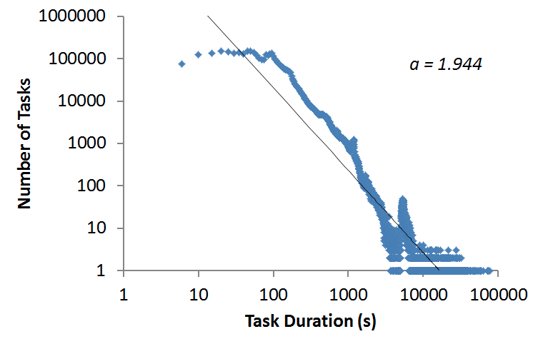
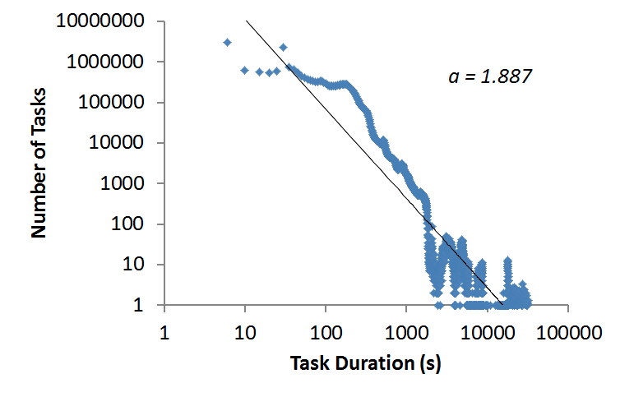
Ramp-up Time: Traces
Facebook (Oct’10)
a = 1.944
T_{mean} = 168s
MS Bing (’10)
a = 1.887
T_{mean} = 189s
shape parameter, a = 1.9
Ramp-up | formula | p =0.1 | p =0.5 | p =0.9 | p =0.98
mean (μ) |  | 0.5 T_{mean} | 0.68 T_{mean} | 1.59 T_{mean} | 3.71T_{mean}
stdev (σ) |  | 0.01 T_{mean} | 0.04 T_{mean} | 0.25 T_{mean} | 1.37T_{mean}

Slide 26
Improving Ramp-Up Time?
Preemption: preempt tasks
Migration: move tasks around to increase choice, e.g.,
Existing frameworks implement
No migration: expensive to migrate short tasks
Preemption with task killing (e.g., Dryad’s Quincy): expensive to checkpoint data-intensive tasks
Job 1 constraint set = {m1, m2, m3, m4}
task
task
wait!
Job 2 constraint set = {m1, m2}
task
task
m1
m2
m3
m4

Slide 27
Macro-benchmark
Simulate an 1000-node cluster
Job and task durations: Facebook traces (Oct 2010)
Constraints: modeled after Google*
Allocation policy: fair sharing
Scheduler comparison
Resource Offers: no preemption, and no migration (e.g., Hadoop’s Fair Scheduler + constraints)
Global-M: global scheduler with migration
Global-MP: global scheduler with migration and preemption
*Sharma et al., “Modeling and Synthesizing Task Placement Constraints in Google Compute Clusters”, ACM SoCC, 2011.

Slide 28
Facebook: Job Completion Times
res. offers

Slide 29
Facebook: Pickiness
Average cluster utilization: 82%
Much higher than at Facebook, which is < 50%
Mean pickiness: 0.11
90th perc. → p = 0.4
50th perc. → p = 0.014

Slide 30
Summary: Resource Offers
Ramp-up time low under most scenarios
Barely any performance differences between global and distributed schedulers in Facebook workload
Optimizations
Master doesn’t send an offer already rejected by a framework (negative caching)
Allow frameworks to specify white and black lists of nodes

Slide 31
Lookback
Why resource offers?
What was the main contribution?
How important was fine grained task scheduling?

Slide 32
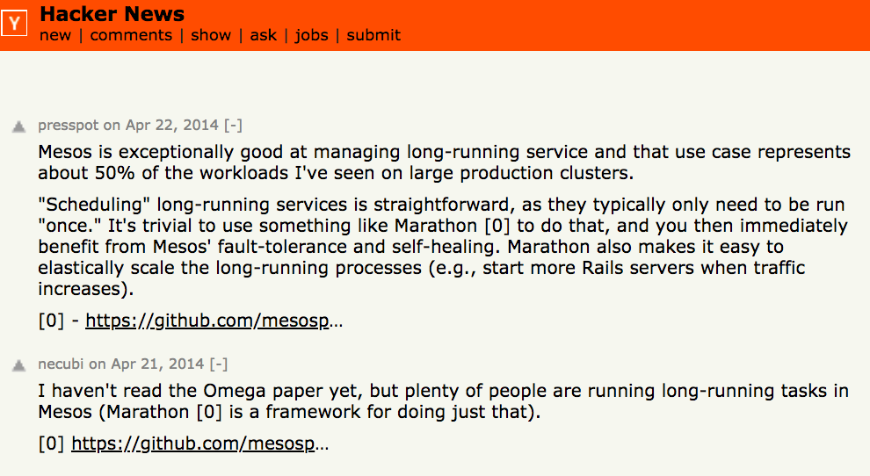

Slide 33
My biased summary
AirBnB built Marathon, a framework for Mesos that takes detailed job descriptions and schedules long running tasks
Ben’s high school friend, was behind Marathon. It was written in Scala and was dubbed “crontab for Mesos”. Both are co-founders of Mesosphere
Ben joined Twitter full time to ensure Mesos adoption
Twitter mainly used Mesos for long-running tasks
Twitter was important when other companies adopted Mesos

Slide 34
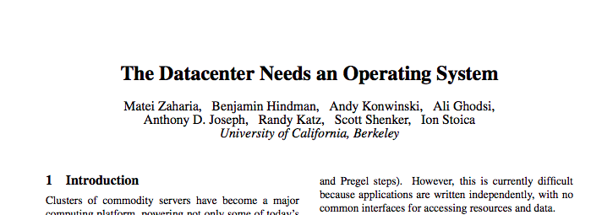
My biased summary
Mesos “heavily” influenced the YARN design

Slide 35
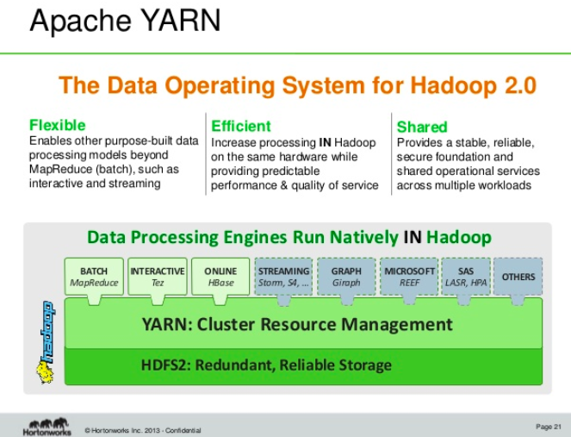
My biased summary

Slide 36
My biased summary
Why was Mesos so successful?
Ben working at Twitter?
The Datacenter OS vision?
The availability of open source software that worked with modern tech (Hadoop etc)?
The academic impact? The Berkeley brand?
The fact that it solved a real and important problem?

Slide 37
Borg
Notes:
3-D graph
Checklist
What we want to enable
What we have today
How we’ll get there

Slide 38
Borg
Cluster management system at Google that achieves high utilization by:
Admission control
Efficient task-packing
Over-commitment
Machine sharing

Slide 39
The User Perspective
Users: Google developers and system administrators mainly
The workload: Production and batch, mainly
Cells, around 10K nodes
Jobs and tasks

Slide 40
The User Perspective
Allocs
Reserved set of resources
Priority, Quota, and Admission Control
Job has a priority (preempting)
Quota is used to decide which jobs to admit for scheduling
Naming and Monitoring
50.jfoo.ubar.cc.borg.google.com
Monitoring health of the task and thousands of performance metrics

Slide 41
Scheduling a Job
job hello_world = {
runtime = { cell = “ic” } //what cell should run it in?
binary = ‘../hello_world_webserver’ //what program to run?
args = { port = ‘%port%’ }
requirements = {
RAM = 100M
disk = 100M
CPU = 0.1
}
replicas = 10000
}

Slide 42
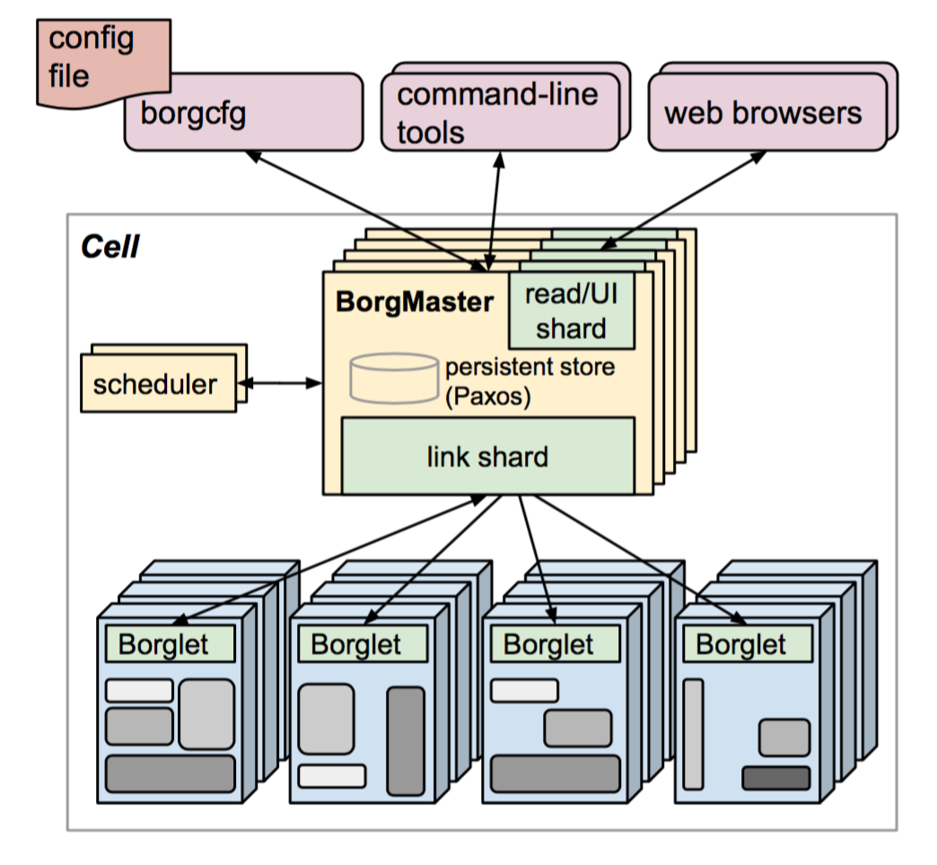
Borg Architecture
Borgmaster
Main Borgmaster process & Scheduler
Five replicas
Borglet
Manage and monitor tasks and resource
Borgmaster polls Borglet every few seconds
Notes:
Take helloworld as example to example how it works.

Slide 43
Borg Architecture
Fauxmaster: high-fidelity Borgmaster simulator
Simulate previous runs from checkpoints
Contains full Borg code
Used for debugging, capacity planning, evaluate new policies and algorithms
Notes:
Take helloworld as example to example how it works.

Slide 44
Scalability
Separate scheduler
Separate threads to poll the Borglets
Partition functions across the five replicas
Score caching
Equivalence classes
Relaxed randomization
Notes:
Score caching: Cache score, ignore small changes
Equivalence classes: scoring for one task per equivalence class
Relaxed randomization: don’t scores all machines, choose random number of machines.

Slide 45
Scheduling
Feasibility checking: find machines for a given job
Scoring: pick one machines
User prefs & built-in criteria
Minimize the number and priority of the preempted tasks
Picking machines that already have a copy of the task’s packages
spreading tasks across power and failure domains
Packing by mixing high and low priority tasks
Notes:
feasibility checking, to find machines on which the task could run
scoring, which picks one of the feasible machines.
The scoring system is a combine of user-specified preferences & build-in criteria: picking machines that already have a copy of the task’s packages.

Slide 46
Scheduling
Feasibility checking: find machines for a given job
Scoring: pick one machines
User prefs & build-in criteria
E-PVM (Enhanced-Parallel Virtual Machine) vs best-fit
Hybrid approach
Notes:
feasibility checking, to find machines on which the task could run
scoring, which picks one of the feasible machines.
The scoring system is a combine of user-specified preferences & build-in criteria: picking machines that already have a copy of the task’s packages.

Slide 47
Borg’s Allocation Algorithms and Policies
Advanced Bin-Packing algorithms:
Avoid stranding of resources
Evaluation metric: Cell-compaction
Find smallest cell that we can pack the workload into…
Remove machines randomly from a cell to maintain cell heterogeneity
Evaluated various policies to understand the cost, in terms of extra machines needed for packing the same workload

Slide 48
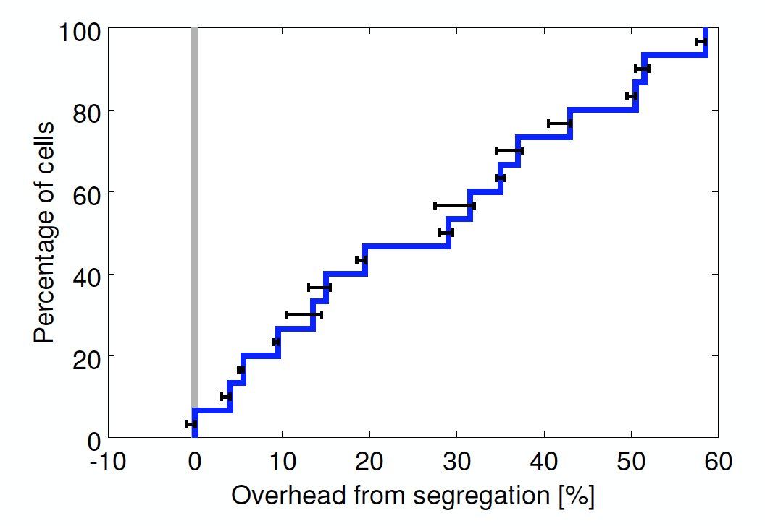
Should we Share Clusters…
… between production and non-production jobs?
Notes:
Y-axis, sort cells according to What percentage of reclaimed resources they use
Median CELL uses 20% of reclaimed resources

Slide 49
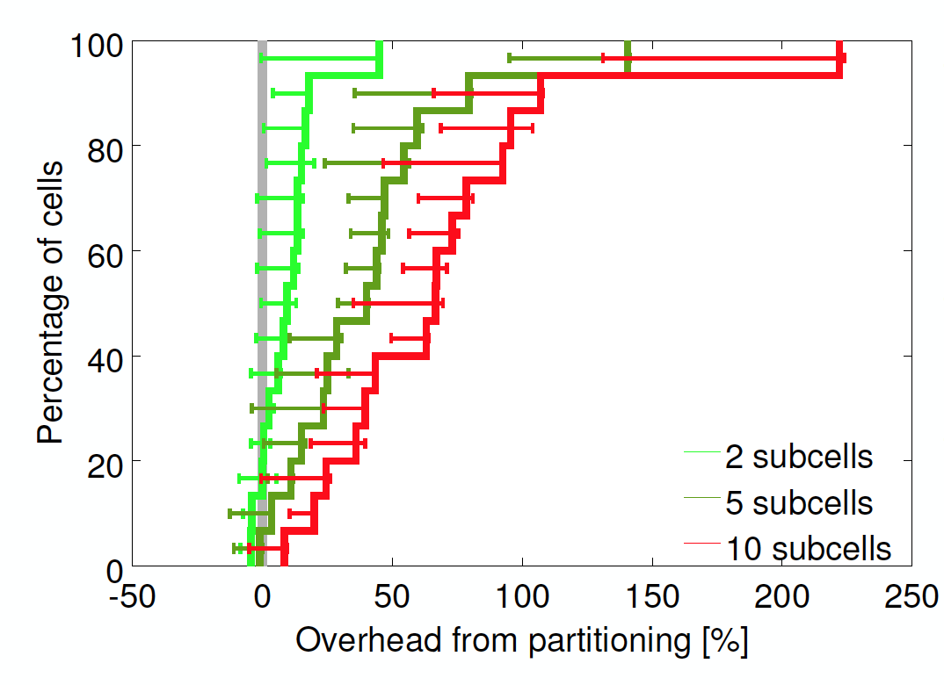
Should we use Smaller Cells?
Notes:
15 cells total. Even halfing cell size would require 50% more overhead. 10 subcells (10 times more cells) would require over 3x the machines.

Slide 50
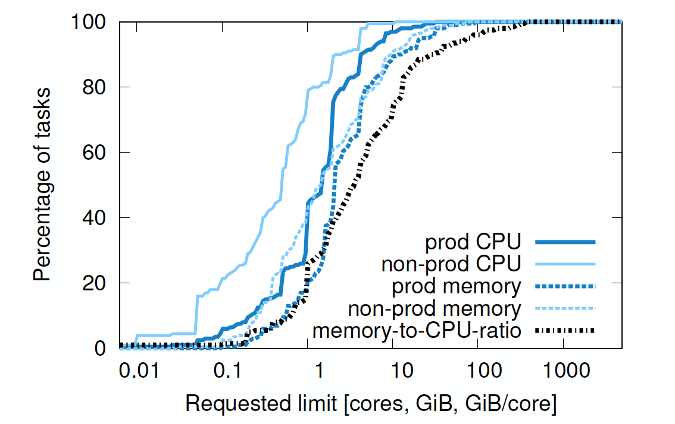
Would fixed resource bucket sizes be better?
Notes:
Tasks do use different amount of resources. X axis is logarithmic.

Slide 51
Kubernetes (K8s)

Slide 52
Vision of Mesos
The datacenter is the new computer!
Modern apps will be distributed on the datacenter
It needs everything an OS had
Processes
Filesystem
IPC
Scheduler
Cache
Software patches (+)
Hardware upgrades (++)
Fault-tolerance

Slide 53
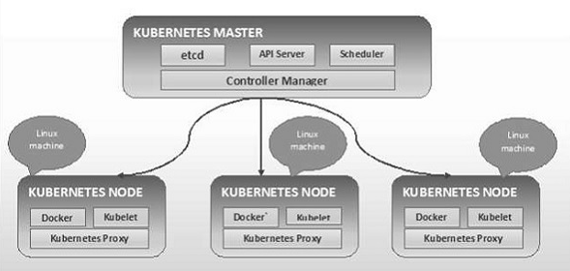
https://www.tutorialspoint.com/kubernetes/kubernetes_architecture.htm

Slide 54
Kubernetes Project
The datacenter is the new computer!
Modern apps will be distributed on the datacenter
It needs everything an OS had
Processes → Docker (threads?) & PODs (processes?)
Filesystem → volumes
IPC → K8s Proxy
Scheduler → K8s Scheduler
Cache → etcd
Software patches (+) → blue/green updates
Hardware upgrades (++) → pod migration and services
Fault-tolerance → replicasets

Slide 55

Summary
Kubernetes implements a full fledged operating system for the datacenter
Write useful software that solves practical problems
OSS enables massive impact
Important to make the system useable
Potential for you to have software impact is greater than ever!

Slide 56
Kubernetes
Google open source project loosely inspired by Borg
Directly derived
Improved
Borglet => Kubelet
alloc => pod
Borg containers => docker
Declarative specifications
Job => labels
managed ports => IP per pod
Monolithic master => micro-services

