Slide 1
Multi-tenancy in Datacenters: to each according to his …
Lecture 15, cs262a
Ion Stoica & Ali Ghodsi
UC Berkeley, March 10, 2018

Slide 2
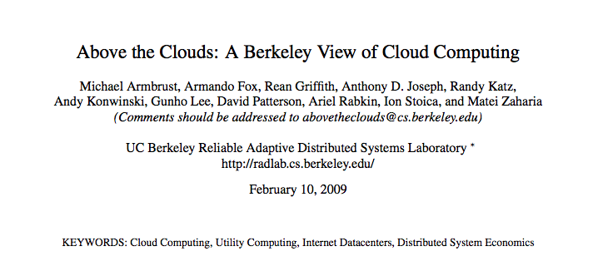
Cloud Computing
IT revolution happening in-front of our eyes

Slide 3
Basic tenet of cloud computing
Consolidate workloads into datacenters
Better resource utilization
Goal: consolidate workloads onto one cluster
Now powering most of Twitter, Netflix, eBay, etc

Slide 4
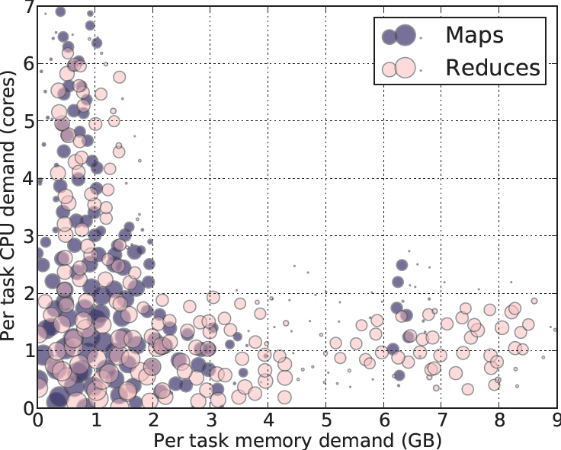
Workload Study
Some tasks are CPU-intensive
Most task need ~
<2 CPU, 2 GB RAM>
Some tasks are memory-intensive
Tasks have heterogeneous resource demands
Notes:
What’s a task?
2000-node Hadoop Cluster at Facebook (Oct 2010)

Slide 5
How to allocate resources to jobs with heterogeneous resource demands?

Slide 6
How to allocate resources to jobs with heterogeneous resource demands?
Terminology
– Synonymous: jobs, users, applications
– A job can consist of many tasks
– A task is a program running on one machine
– Fine-grained scheduling (schedule one task at a time)
Notes:
----- Meeting Notes (12/12/14 16:55) -----
fair share ...add it ... model

Slide 7
Example Problem
Assume two users with equal entitlement
Infinite request of tasks
Single resource example
1 resource: 1,000,000 CPU
User 1 wants <1 CPU> per task
User 2 wants <3 CPU> per task
Multi-resource example
2 resources: CPUs & mem
User 1 wants <1 CPU, 4 GB> per task
User 2 wants <3 CPU, 1 GB> per task
What’s a fair allocation?
100%
50%
50%
50%
0%
CPU
100%
? ?
50%
0%
CPU
mem
Notes:
Identical tasks
Divisible resources
----- Meeting Notes (12/12/14 16:55) -----
CPUs vs CPU, how many?

Slide 8
Why fairness? Equal entitlements?
Fairness policy equivalent to isolation policy
Users cannot affect others beyond their fair share
Weighted fairness implements many policies
Not equal: user 1 weight 9, User 2 weight 1, …
Priority: User 1 weight 10¹⁰, User 2 weight 10, …
Fairness generalized by Max-Min Fairness
Handles if a user uses less than her fair share
e.g. user 1 only uses 20% of it’s 33% entitlement
100%
90%
50%
10%
0%
100%
20%
40%
50%
40%
0%
Notes:
Windows joke
----- Meeting Notes (12/12/14 16:55) -----
avoid starvation
properties

Slide 9
Talk from Bird’s-eye View
 | Allocation Policy
Single-Resource Fairness | Max-Min Fairness
Fair scheduling well studied in many contexts
Surprisingly little work on multi-resource fairness
Multi-Resource Fairness | ?
Multi-resource scenario opens many new fundamental challenges
Notes:
Rawls came out with helping person who is worst off. Max min means help the one who is worst off recursively
FQ generalized this to to the time domain, main technique VIRTUAL TIME
----- Meeting Notes (12/10/14 01:40) -----
10,000 feet summary of talk
----- Meeting Notes (12/12/14 17:17) -----
why box

Slide 10
Talk Outline
Multi-resource fairness – DRF
DRF deployments in organizations
Applying DRF to modern network routers
Follow-up work on DRF
Other research

Slide 11
Talk Outline
Multi-resource fairness – DRF
What properties do we want?
Our proposed solution (DRF)
How would an economist solve this?
How well does this work in practice?

Slide 12
Properties of policies
Share guarantee
Strategy-proofness
Pareto efficiency
Envy-freeness
Single resource fairness
Bottleneck resource fairness
Population monotonicity
Resource monotonicity
Notes:
----- Meeting Notes (12/10/14 01:40) -----
econ

Slide 13
Properties of policies
Share guarantee
Strategy-proofness
Pareto efficiency
Envy-freeness
Single resource fairness
Bottleneck resource fairness
Population monotonicity
Resource monotonicity
Notes:
----- Meeting Notes (12/10/14 01:40) -----
econ

Slide 14
A Natural Policy
Asset Fairness
Equalize each user’s sum of resource shares
Cluster with 70 CPUs, 70 GB RAM
U₁ needs <2 CPU, 2 GB RAM> per task
U₂ needs <1 CPU, 2 GB RAM> per task
Asset fairness yields
U₁: 15 tasks: 30 CPUs, 30 GB (∑=60)
U₂: 20 tasks: 20 CPUs, 40 GB (∑=60)
User 1
User 2
Problem
User 1 has < 50% of both CPUs and RAM
Better off in a separate cluster with 50% of the resources
100%
43%
43%
50%
57%
28%
0%
CPU
RAM
Notes:
The first solution people come up

Slide 15
Share Guarantee
Every user should get 1/n of at least one resource
Intuition:
“You shouldn’t be worse off than if you ran your own cluster with 1/n of the resources”

Slide 16
Cheating the Scheduler
Users willing to game the system to get more resources
Real-life examples
A familiar company provided dedicated machines to users that could ensure certain level of utilization (e.g. 80%)
Users used busy-loops to inflate utllization
A cloud provider had quotas on map and reduce slots
Some users found out that the map-quota was low
Users implemented map-reduce in the reduce phase!

Slide 17
Strategy-proofness
A user should not be able to increase her allocation by lying about her demand
Intuition:
Users are incentivized to make truthful resource requirements
Notes:
----- Meeting Notes (12/12/14 17:17) -----
why...

Slide 18
Pareto efficiency
There should not exist another allocation where at least one user is better off and no user is worse off.
Avoid inefficient solutions
User 1 wants <1 CPU, 4 GB> per task
User 2 wants <3 CPU, 1 GB> per task
100%
25%
50%
50%
50%
33%
0%
CPU
mem

Slide 19
Challenge
Max-min fairness for a single resource trivially satisfies all these properties
Can we find a multi-resource fair sharing policy that provides:
Strategy-proofness
Share guarantee
Pareto efficiency

Slide 20
Talk Outline
Multi-resource fairness – DRF
What properties do we want?
Our proposed solution (DRF)
How would an economist solve this?
How well does this work in practice?

Slide 21
Dominant Resource Fairness
A user’s dominant resource is the resource she has the biggest share of
Example:
Total resources: <10 CPU, 4 GB>
User 1’s allocation: <2 CPU, 1 GB>
Dominant resource is memory as 1/4 > 2/10 (1/5)
A user’s dominant share is the fraction of the dominant resource she is allocated
User 1’s dominant share is 25% (1/4)

Slide 22
Dominant Resource Fairness (2)
Apply max-min fairness to dominant shares
Equalize the dominant share of the users
Example:
Total resources: <9 CPU, 18 GB>
User 1 demand: <1 CPU, 4 GB> dom res: mem
User 2 demand: <3 CPU, 1 GB> dom res: CPU
100%
3 CPUs
12 GB
User 1
User 2
66%
50%
66%
0%
6 CPUs
2 GB
CPU
(9 total)
mem
(18 total)

Slide 23
Online DRF Scheduler
O(log n) time per decision using binary heaps
Whenever there are available resources and tasks to run:
Schedule a task to the user with smallest dominant share

Slide 24
Talk Outline
Multi-resource fairness – DRF
What properties do we want?
Our proposed solution (DRF)
How would an economist solve this?
How well does this work in practice?

Slide 25
How would an economist solve it?
Use pricing
Set prices for each good
Give each user the same budget
Let users buy what they want
Problem
How do we determine the right prices for different goods?

Slide 26
The market approach
Let the market determine the prices
Competitive Equilibrium from Equal Incomes (CEEI)
Give each user 1/n of every resource
Let users trade in a perfectly competitive market
Analytical solution: max of product of dominant shares
Violates strategy-proofness
Notes:
Setup using pricing

Slide 27
DRF vs CEEI
User 1: <1 CPU, 4 GB> User 2: <3 CPU, 1 GB>
DRF more fair, CEEI better utilization
User 1: <1 CPU, 4 GB> User 2: <3 CPU, 2 GB>
User 2 increased her share of both CPU and memory
Dominant Resource Fairness
Competitive Equilibrium from Equal Incomes
Dominant Resource Fairness
Competitive Equilibrium from Equal Incomes
100%
100%
100%
100%
66%
66%
91%
user 1
80%
50%
50%
user 2
50%
50%
66%
66%
55%
60%
0%
0%
0%
0%
CPU mem
CPU mem
CPU mem
CPU mem
Notes:
Nash: .49948 u1:.5161 u2:0.9677 --

Slide 28
Properties of DRF
We proved DRF is strategy-proof
Assuming linear utilities
Others proved it’s the only policy satisfying Strategy-proofness, sharing incentive, Pareto
Results carried over the economics literature

Slide 29
Properties of Policies
Property | Asset | CEEI | DRF
Share guarantee |  | ✔ | ✔
Strategy-proofness | ✔ |  | ✔
Pareto efficiency | ✔ | ✔ | ✔
Envy-freeness | ✔ | ✔ | ✔
Single resource fairness | ✔ | ✔ | ✔
Bottleneck res. fairness |  | ✔ | ✔
Population monotonicity | ✔ |  | ✔
Resource monotonicity

Slide 30
Talk Outline
Multi-resource fairness – DRF
What properties do we want?
Our proposed solution (DRF)
How would an economist solve this?
DRF variants?

Slide 31
Follow-up papers
 | Allocation in Space | Allocation in Time
Single-Resource Fairness | Max-Min Fairness | Fair Queueing
Multi-Resource Fairness | DRF | DRFQ
DRFQ broadly applicable: VMs, OSs
Notes:
Rawls came out with helping person who is worst off. Max min means help the one who is worst off recursively
FQ generalized this to to the time domain, main technique VIRTUAL TIME

Slide 32
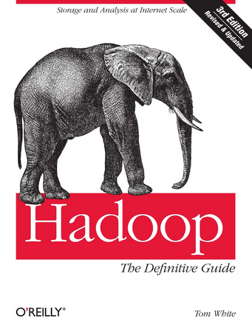
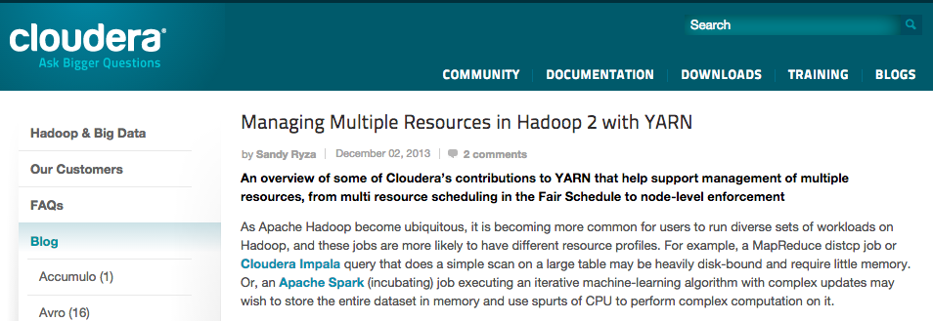
DRF in the wild
DRF de-facto scheduler in Hadoop & Mesos
DRF capacity scheduler (HortonWorks)
DRF fair scheduler (Cloudera)
Mesos cluster of O(10k) nodes at Twitter
Notes:
Well understood
----- Meeting Notes (11/8/13 00:38) -----
Need for multi-resources led to industry

Slide 33
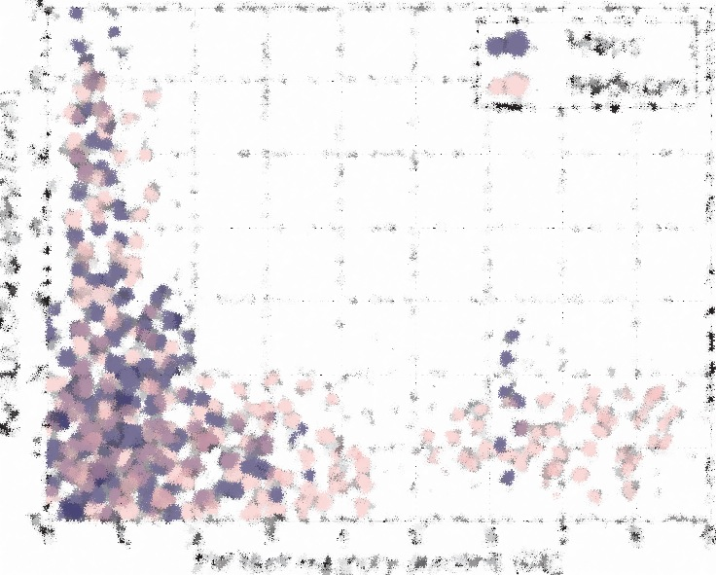
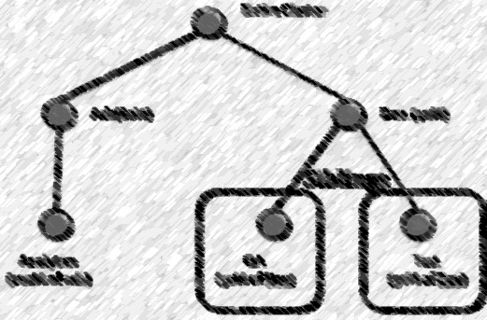
Challenging
Multi-Resource Scheduling
Hierarchical Policies
+
=
Hadoop DRF schedulers can break down
Leave resources unallocated (not Pareto) or
Starve users

Slide 34
Hierarchical Share Guarantee Violated
Share Guarantees:
Final Allocation
100%
Anlt : 66%
Anlt : 66%
Ads
50 %
Dev
50 %
50%
Test : 33%
QA : 33%
Dev : 33%
Anlt
Test
QA
0%
50 %
25 %
25 %
Resource 1
Resource 2

Slide 35
Follow-up papers
Dominant Resource Fairness
H-DRF
+
Share guarantee 1/n share to leafs
Pareto efficiency Work-conservation
Hierarchical share guarantee 1/n to every node
Pareto efficiency Work-conservation
➔

Slide 36
Talk Outline
Multi-resource fairness – DRF
What properties do we want?
Our proposed solution (DRF)
How would an economist solve this?
DRF variants?
DRF evaluation

Slide 37
Previous approach: slot-based scheduling
Hadoop Fair Scheduler
Each machine consists of k slots (e.g. k=14)
Run at most one task per slot
Give jobs ”equal” number of slots,
This is what we compare against

Slide 38
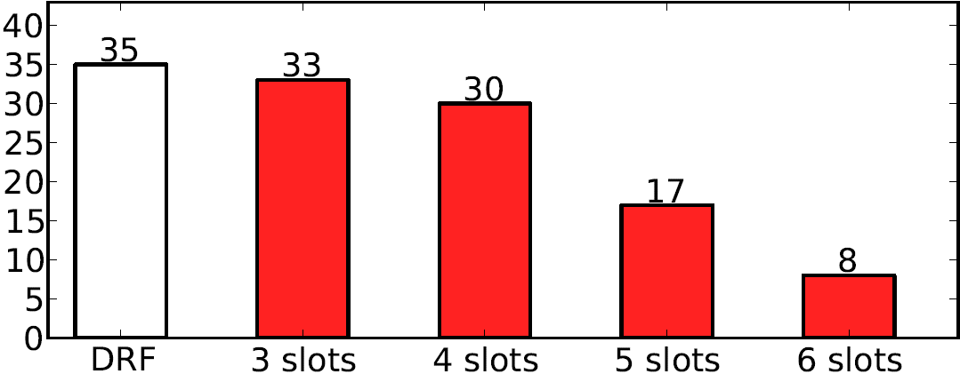
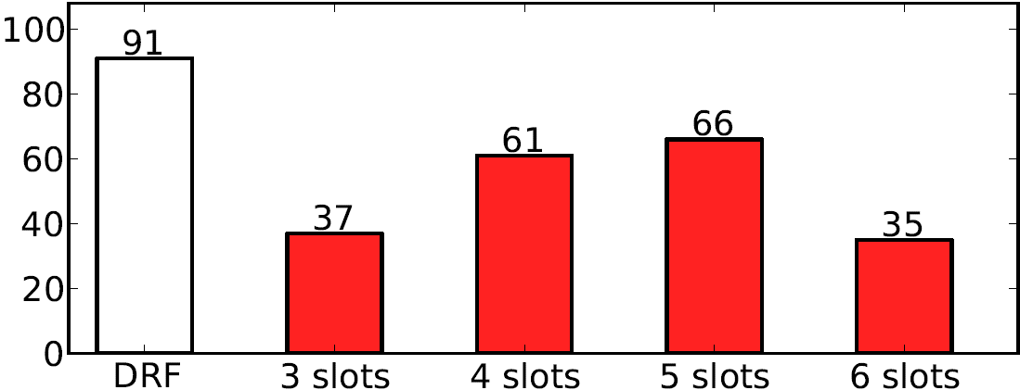
Experiment: DRF vs Slots
Number of Type 1 Jobs Finished
Thrashing
Jobs finished
Number of Type 2 Jobs Finished
Low utilization
Thrashing
Jobs finished
Type 1 jobs <2 CPU, 2 GB> Type 2 jobs <1 CPU, 0.5GB>
Notes:
EC2 8 cpu, 7 gb, 2 types of jobs j1 <1 cpu, 0.5gb> and j2 <2cpu, 2 gb>.

Slide 39
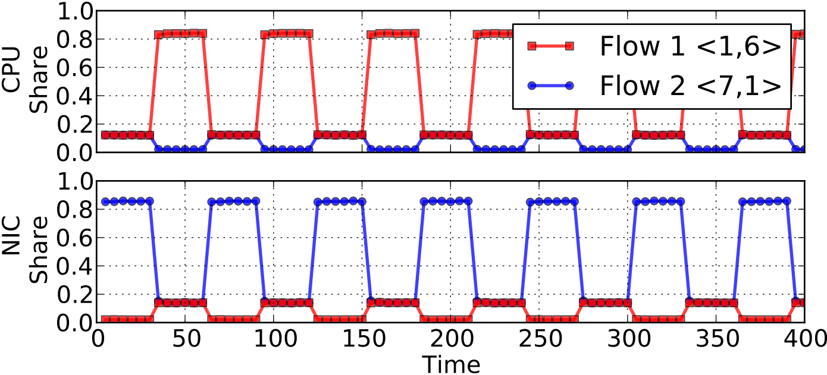
State-of-the-art: bottleneck fairness
2 flows and 2 res. <CPU μs, NIC μs>
Demands <1,6> and <7,1> → bottleneck unclear
Especially bad for TCP and video/audio traffic

Slide 40
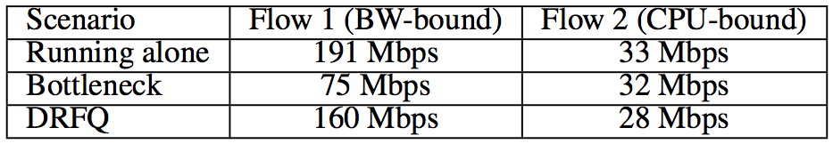
TCP and oscillations
Implemented Bottleneck Fairness in Click
Bottleneck determined every 300 ms
1 BW-bound flow and 1 CPU-bound flow
Oscillations in Bottleneck degrade performance of TCP
Notes:
20 ms artificial link delay added to simulate WAN

Slide 41
Thank you!
Questions?

