Slide 1
Key-Value Tables: Chord and DynamoDB (Lecture 16, cs262a)
Ali Ghodsi and Ion Stoica,
UC Berkeley
March 14, 2018

Slide 2
Today’s Papers
Chord: A Scalable Peer-to-peer Lookup Service for Internet Applications,
Ion Stoica, Robert Morris, David Karger, M. Frans Kaashoek, Hari Balakrishnan, SIGCOMM’02
(https://pdos.csail.mit.edu/papers/chord:sigcomm01/chord_sigcomm.pdf)
Dynamo: Amazon's Highly Available Key-value Store,
Giuseppe DeCandia, Deniz Hastorun, Madan Jampani, Gunavardhan Kakulapati, Avinash Lakshman, Alex Pilchin, Swaminathan, Sivasubramanian, Peter Vosshall, and Werner Vogels, SOSP’07
(www.allthingsdistributed.com/files/amazon-dynamo-sosp2007.pdf)

Slide 3
Key Value Storage
Interface
put(key, value); // insert/write “value” associated with “key”
value = get(key); // get/read data associated with “key”
Abstraction used to implement
File systems: value content → block
Sometimes as a simpler but more scalable “database”
Can handle large volumes of data, e.g., PBs
Need to distribute data over hundreds, even thousands of machines

Slide 4






Key Values: Examples
Amazon:
Key: customerID
Value: customer profile (e.g., buying history, credit card, ..)
Facebook, Twitter:
Key: UserID
Value: user profile (e.g., posting history, photos, friends, …)
iCloud/iTunes:
Key: Movie/song name
Value: Movie, Song
Distributed file systems
Key: Block ID
Value: Block

Slide 5
System Examples
Google File System, Hadoop Dist. File Systems (HDFS)
Amazon
Dynamo: internal key value store used to power Amazon.com (shopping cart)
Simple Storage System (S3)
BigTable/Hbase: distributed, scalable data storage
Cassandra: “distributed data management system” (Facebook)
Memcached: in-memory key-value store for small chunks of arbitrary data (strings, objects)

Slide 6

Key Value Store
Also called a Distributed Hash Table (DHT)
Main idea: partition set of key-values across many machines
key, value
…

Slide 7
Challenges
…
Fault Tolerance: handle machine failures without losing data and without degradation in performance
Scalability:
Need to scale to thousands of machines
Need to allow easy addition of new machines
Consistency: maintain data consistency in face of node failures and message losses
Heterogeneity (if deployed as peer-to-peer systems):
Latency: 1ms to 1000ms
Bandwidth: 32Kb/s to 100Mb/s

Slide 8
Key Questions
put(key, value): where do you store a new (key, value) tuple?
get(key): where is the value associated with a given “key” stored?
And, do the above while providing
Fault Tolerance
Scalability
Consistency

Slide 9
Directory-Based Architecture
Have a node maintain the mapping between keys and the machines (nodes) that store the values associated with the keys
Master/Directory
put(K14, V14)
K5
N2
K14
N3
K105
N50
put(K14, V14)
K5
V5
K14
V14
K105
V105
…
N₁
N₂
N₃
N₅₀

Slide 10
Directory-Based Architecture
Have a node maintain the mapping between keys and the machines (nodes) that store the values associated with the keys
Master/Directory
get(K14)
K5
N2
V14
K14
N3
K105
N50
get(K14)
V14
K5
V5
K14
V14
K105
V105
…
N₁
N₂
N₃
N₅₀

Slide 11
Directory-Based Architecture
Having the master relay the requests → recursive query
Another method: iterative query (this slide)
Return node to requester and let requester contact node
Master/Directory
put(K14, V14)
K5
N2
N3
K14
N3
K105
N50
put(K14, V14)
K5
V5
K14
V14
K105
V105
…
N₁
N₂
N₃
N₅₀

Slide 12
Directory-Based Architecture
Having the master relay the requests → recursive query
Another method: iterative query
Return node to requester and let requester contact node
Master/Directory
get(K14)
N3
K5
N2
K14
N3
V14
K105
N50
get(K14)
K5
V5
K14
V14
K105
V105
…
N₁
N₂
N₃
N₅₀

Slide 13
Discussion: Iterative vs. Recursive Query
Master/Directory
Master/Directory
get(K14)
get(K14)
V14
K14
N3
N3
K14
N3
V14
get(K14)
get(K14)
Recursive
V14
Iterative
K14
V14
K14
V14
…
…
N1
N2
N3
N50
N1
N2
N3
N50
Recursive Query:
Advantages:
Faster, as typically master/directory closer to nodes
Easier to maintain consistency, as master/directory can serialize puts()/gets()
Disadvantages: scalability bottleneck, as all “Values” go through master
Iterative Query
Advantages: more scalable
Disadvantages: slower, harder to enforce data consistency

Slide 14
Fault Tolerance
Replicate value on several nodes
Usually, place replicas on different racks in a datacenter to guard against rack failures
Master/Directory
put(K14, V14)
K5
N2
N1, N3
K14
N1,N3
K105
N50
put(K14, V14)
put(K14, V14), N1
K14
V14
K5
V5
K14
V14
K105
V105
…
N₁
N₂
N₃
N₅₀

Slide 15
Fault Tolerance
Again, we can have
Recursive replication (previous slide)
Iterative replication (this slide)
Master/Directory
put(K14, V14)
K5
N2
N1, N3
K14
N1,N3
K105
N50
put(K14, V14)
put(K14, V14)
K14
V14
K5
V5
K14
V14
K105
V105
…
N₁
N₂
N₃
N₅₀

Slide 16
Scalability
Storage: use more nodes
Request throughput:
Can serve requests from all nodes on which a value is stored in parallel
Master can replicate a popular value on more nodes
Master/directory scalability:
Replicate it
Partition it, so different keys are served by different masters/directories (see Chord)

Slide 17
Scalability: Load Balancing
Directory keeps track of the storage availability at each node
Preferentially insert new values on nodes with more storage available
What happens when a new node is added?
Cannot insert only new values on new node. Why?
Move values from the heavy loaded nodes to the new node
What happens when a node fails?
Need to replicate values from fail node to other nodes

Slide 18
Replication Challenges
Need to make sure that a value is replicated correctly
How do you know a value has been replicated on every node?
Wait for acknowledgements from every node
What happens if a node fails during replication?
Pick another node and try again
What happens if a node is slow?
Slow down the entire put()? Pick another node?
In general, with multiple replicas
Slow puts and fast gets

Slide 19
Consistency
How close does a distributed system emulate a single machine in terms of read and write semantics?
Q: Assume put(K14, V14’) and put(K14, V14’’) are concurrent, what value ends up being stored?
A: assuming put() is atomic, then either V14’ or V14’’, right?
Q: Assume a client calls put(K14, V14) and then get(K14), what is the result returned by get()?
A: It should be V14, right?
Above semantics, not trivial to achieve in distributed systems

Slide 20
Concurrent Writes (Updates)
If concurrent updates (i.e., puts to same key) may need to make sure that updates happen in the same order
Master/Directory
put(K14, V14’) and put(K14, V14’’) reach N1 and N3 in reverse order
What does get(K14) return?
Undefined!
put(K14, V14’)
K5
N2
put(K14, V14’’)
K14
N1,N3
K105
N50
put(K14, V14’’)
put(K14, V14’)
K14
K14
V14
V14’’
K5
V5
K14
K14
V14
V14’
K105
V105
…
N₁
N₂
N₃
N₅₀

Slide 21
Concurrent Writes (Updates)
If concurrent updates (i.e., puts to same key) may need to make sure that updates happen in the same order
Master/Directory
put(K14, V14’) and put(K14, V14’’) reach N1 and N3 in reverse order
What does get(K14) return?
Undefined!
put(K14, V14’)
K5
N2
put(K14, V14’’)
K14
N1,N3
K105
N50
put(K14, V14’’)
put(K14, V14’)
put(K14, V14’’)
put(K14, V14’)
K14
K14
V14’’
K14
V14
V14’
K5
V5
K14
V14
K105
V105
…
N₁
N₂
N₃
N₅₀

Slide 22
Read after Write
Read not guaranteed to return value of latest write
Can happen if Master processes requests in different threads
Master/Directory
get(K14) happens right after put(K14, V14’)
get(K14) reaches N3 before put(K14, V14’)!
put(K14, V14’)
get(K14)
K5
N2
K14
N1,N3
V14
K105
N50
put(K14, V14’)
V14
put(K14, V14’)
get(K14, V14’)
K14
K14
V14
V14’
K5
V5
K14
K14
V14
K105
V105
V14’
…
N₁
N₂
N₃
N₅₀

Slide 23
Consistency (cont’d)
Large variety of consistency models (we’ve already seen):
Atomic consistency (linearizability): reads/writes (gets/puts) to replicas appear as if there was a single underlying replica (single system image)
Think “one updated at a time”
Transactions
Eventual consistency: given enough time all updates will propagate through the system
One of the weakest form of consistency; used by many systems in practice
And many others: causal consistency, sequential consistency, strong consistency, …

Slide 24
Strong Consistency
Assume Master serializes all operations
Challenge: master becomes a bottleneck
Not addressed here
Still want to improve performance of reads/writes → quorum consensus

Slide 25
Quorum Consensus
Improve put() and get() operation performance
Define a replica set of size N
put() waits for acks from at least W replicas
get() waits for responses from at least R replicas W+R > N
Why does it work?
There is at least one node that contains the update
Why you may use W+R > N+1?

Slide 26
Quorum Consensus Example
N=3, W=2, R=2
Replica set for K14: {N1, N2, N4}
Assume put() on N3 fails
put(K14, V14)
ACK
put(K14, V14)
put(K14, V14)
ACK
K14
V14
K14
V14
N₁
N₂
N₃
N₄

Slide 27
Quorum Consensus Example
Now, for get() need to wait for any two nodes out of three to return the answer
V14
get(K14)
get(K14)
get(K14)
V14
nill
K14
V14
K14
V14
N₁
N₂
N₃
N₄

Slide 28
Chord

Slide 29
Scaling Up Directory
Challenge:
Directory contains a number of entries equal to number of (key, value) tuples in the system
Can be tens or hundreds of billions of entries in the system!
Solution: consistent hashing
Associate to each node a unique id in an uni-dimensional space 0..2^{m}-1
Partition this space across M machines
Assume keys are in same uni-dimensional space
Each (Key, Value) is stored at the node with the smallest ID larger than Key

Slide 30
Recap: Key to Node Mapping Example
m = 6 → ID space: 0..63
Node 8 maps keys [5,8]
Node 15 maps keys [9,15]
Node 20 maps keys [16, 20]
…
Node 4 maps keys [59, 4]
63
0
4
58
8
14
V14
15
44
20
35
32

Slide 31
Scaling Up Directory
With consistent hashing, directory contains only a number of entries equal to number of nodes
Much smaller than number of tuples
Next challenge: every query still needs to contact the directory

Slide 32
Scaling Up Directory
Given a key, find the node storing that key
Key idea: route request from node to node until reaching the node storing the request’s key
Key advantage: totally distributed
No point of failure; no hot spot

Slide 33
Chord: Distributed Lookup (Directory) Service
Key design decision
Decouple correctness from efficiency
Properties
Each node needs to know about O(log(M)), where M is the total number of nodes
Guarantees that a tuple is found in O(log(M)) steps
Many other lookup services: CAN, Tapestry, Pastry, Kademlia, …

Slide 34
Lookup
lookup(37)
Each node maintains pointer to its successor
Route packet (Key, Value) to the node responsible for ID using successor pointers
E.g., node=4 lookups for node responsible for Key=37
4
58
8
node=44 is responsible for Key=37
15
44
20
35
32

Slide 35
Stabilization Procedure
Periodic operation performed by each node n to maintain its successor when new nodes join the system
n.stabilize()
x = succ.pred;
if (x (n, succ))
succ = x; // if x better successor, update
succ.notify(n); // n tells successor about itself
n.notify(n’)
if (pred = nil or n’ (pred, n))
pred = n’; // if n’ is better predecessor, update

Slide 36
Joining Operation
Node with id=50 joins the ring
Node 50 needs to know at least one node already in the system
Assume known node is 15
succ=4
pred=44
4
58
8
succ=nil
pred=nil
50
15
44
succ=58
20
pred=35
35
32

Slide 37
Joining Operation
n=50 sends join(50) to node 15
n=44 returns node 58
n=50 updates its successor to 58
succ=4
pred=44
4
58
8
join(50)
succ=nil
succ=58
pred=nil
50
58
15
44
succ=58
20
pred=35
35
32

Slide 38
Joining Operation
succ=4
n=50 executes stabilize()
n’s successor (58) returns x = 44
pred=44
4
x=44
58
8
succ=58
pred=nil
15
50
44
succ=58
20
pred=35
n.stabilize()
x = succ.pred;
if (x (n, succ))
succ = x;
succ.notify(n);
35
32

Slide 39
Joining Operation
succ=4
n=50 executes stabilize()
x = 44
succ = 58
pred=44
4
58
8
succ=58
pred=nil
15
50
44
succ=58
20
pred=35
n.stabilize()
x = succ.pred;
if (x (n, succ))
succ = x;
succ.notify(n);
35
32

Slide 40
Joining Operation
n=50 executes stabilize()
x = 44
succ = 58
n=50 sends to it’s successor (58) notify(50)
succ=4
pred=44
4
58
notify(50)
8
succ=58
pred=nil
15
50
44
succ=58
20
pred=35
n.stabilize()
x = succ.pred;
if (x (n, succ))
succ = x;
succ.notify(n);
35
32

Slide 41
Joining Operation
n=58 processes notify(50)
pred = 44
n’ = 50
succ=4
pred=44
4
58
notify(50)
8
succ=58
pred=nil
15
50
44
succ=58
20
pred=35
n.notify(n’)
if (pred = nil or n’ (pred, n))
pred = n’
35
32

Slide 42
Joining Operation
n=58 processes notify(50)
pred = 44
n’ = 50
set pred = 50
succ=4
pred=44
pred=50
4
58
notify(50)
8
succ=58
pred=nil
15
50
44
succ=58
20
pred=35
n.notify(n’)
if (pred = nil or n’ (pred, n))
pred = n’
35
32

Slide 43
Joining Operation
succ=4
n=44 runs stabilize()
n’s successor (58) returns x = 50
pred=50
4
58
8
x=50
succ=58
pred=nil
15
50
44
succ=58
20
pred=35
n.stabilize()
x = succ.pred;
if (x (n, succ))
succ = x;
succ.notify(n);
35
32

Slide 44
Joining Operation
succ=4
n=44 runs stabilize()
x = 50
succ = 58
pred=50
4
58
8
succ=58
pred=nil
15
50
44
succ=58
20
pred=35
n.stabilize()
x = succ.pred;
if (x (n, succ))
succ = x;
succ.notify(n);
35
32

Slide 45
Joining Operation
succ=4
n=44 runs stabilize()
x = 50
succ = 58
n=44 sets succ=50
pred=50
4
58
8
succ=58
pred=nil
15
50
44
succ=58
20
succ=50
pred=35
n.stabilize()
x = succ.pred;
if (x (n, succ))
succ = x;
succ.notify(n);
35
32

Slide 46
Joining Operation
succ=4
n=44 runs stabilize()
n=44 sends notify(44) to its successor
pred=50
4
58
8
succ=58
pred=nil
15
50
notify(44)
44
succ=50
20
pred=35
n.stabilize()
x = succ.pred;
if (x (n, succ))
succ = x;
succ.notify(n);
35
32

Slide 47
Joining Operation
n=50 processes notify(44)
pred = nil
succ=4
pred=50
4
58
8
succ=58
pred=nil
15
50
notify(44)
44
succ=50
20
pred=35
n.notify(n’)
if (pred = nil or n’ (pred, n))
pred = n’
35
32

Slide 48
Joining Operation
n=50 processes notify(44)
pred = nil
n=50 sets pred=44
succ=4
pred=50
4
58
8
succ=58
pred=nil
pred=44
15
50
notify(44)
44
succ=50
20
pred=35
n.notify(n’)
if (pred = nil or n’ (pred, n))
pred = n’
35
32

Slide 49
Joining Operation (cont’d)
This completes the joining operation!
pred=50
4
58
8
succ=58
50
pred=44
15
44
20
succ=50
35
32

Slide 50
Achieving Efficiency: finger tables
Say m=7
Finger Table at 80
0
i ft[i]
0 96
1 96
2 96
3 96
4 96
5 112
6 20
(80 + 2⁶) mod 2⁷ = 16
80 + 2⁵
112
20
96
80 + 2⁴
32
80 + 2³
80 + 2²
80 + 2¹
45
80 + 2⁰
80
ith entry at peer with id n is first peer with id >=

Slide 51
Achieving Fault Tolerance for Lookup Service
To improve robustness each node maintains the k (> 1) immediate successors instead of only one successor
In the pred() reply message, node A can send its k-1 successors to its predecessor B
Upon receiving pred() message, B can update its successor list by concatenating the successor list received from A with its own list
If k = log(M), lookup operation works with high probability even if half of nodes fail, where M is number of nodes in the system

Slide 52
Storage Fault Tolerance
Replicate tuples on successor nodes
Example: replicate (K14, V14) on nodes 20 and 32
63
0
4
58
8
14
V14
15
14
V14
44
20
14
V14
35
32

Slide 53
Storage Fault Tolerance
If node 15 fails, no reconfiguration needed
Still have two replicas
All lookups will be correctly routed
Will need to add a new replica on node 35
63
0
4
58
8
14
V14
15
14
V14
44
20
14
V14
35
32

Slide 54
Iterative vs. Recursive Lookup
58
4
Iteratively:
Example: node 44 issue query(31)
Recursively
Example: node 44 issue query(31)
8
50
15
25
44
32
4
35
25
58
32
8
50
15
44
32
35
25
32

Slide 55
Dynamo

Slide 56
Motivation
Build a distributed storage system:
Scale
Symmetry: every node should have same functionality
Simple: key-value
Highly available
Heterogeneity: allow adding nodes with different capacities
Guarantee Service Level Agreements (SLA)

Slide 57
System Assumptions and Requirements
ACID Properties: Atomicity, Consistency, Isolation, Durability
Weaker Consistency, i.e., eventual consistency
High Availability
No Isolation guarantees
Only single key updates.
SLA (Service Level Agreement): 99.9% performance guarantees
E.g., 500ms latency for 99.9% of its requests for a peak client load of 500 requests per second
average, median, variance not representative for user’s experience
Other Assumptions: internal service, no security related requirements

Slide 58
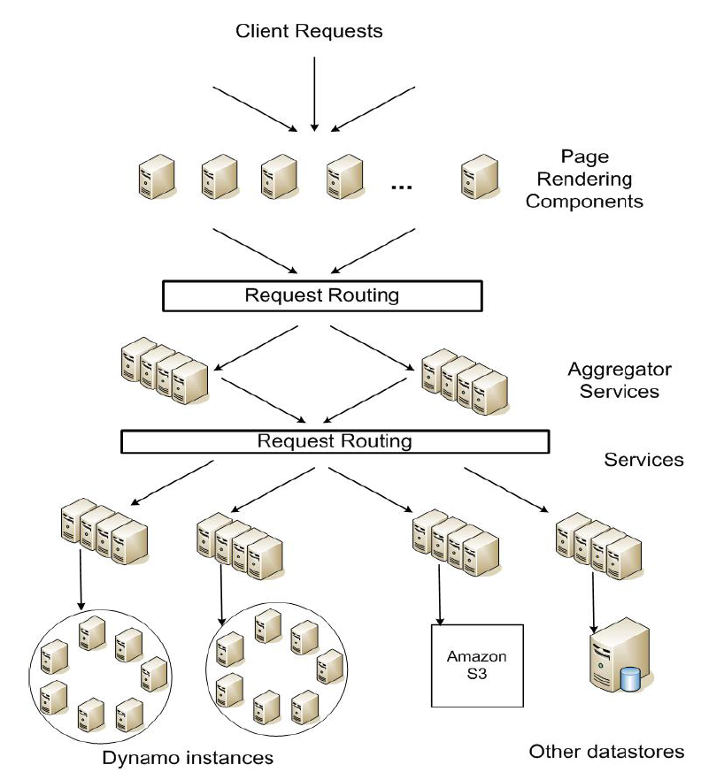
Architecture
Service oriented architecture: modular, composable
Challenge: end-to-end SLAs
Each service should provide even tighter latency bounds

Slide 59
Design Consideration
Sacrifice strong consistency for availability
Conflict resolution is executed during read instead of write, i.e. “always writeable”.
Other principles:
Incremental scalability
Symmetry
Decentralization
Heterogeneity

Slide 60
Summary of techniques used in Dynamo and their advantages
Problem | Technique | Advantage
Partitioning | Consistent Hashing | Incremental Scalability
High Availability for writes | Vector clocks with reconciliation during reads | Version size is decoupled from update rates.
Handling temporary failures | Sloppy Quorum and hinted handoff | Provides high availability and durability guarantee when some of the replicas are not available.
Recovering from permanent failures | Anti-entropy using Merkle trees | Synchronizes divergent replicas in the background.
Membership and failure detection | Gossip-based membership protocol and failure detection. | Preserves symmetry and avoids having a centralized registry for storing membership and node liveness information.

Slide 61
Data Versioning
A put() call may return to its caller before the update has been applied at all the replicas
A get() call may return many versions of the same object.
Challenge: an object having distinct version sub-histories, which the system will need to reconcile in the future.
Solution: uses vector clocks in order to capture causality between different versions of the same object.

Slide 62
Vector clock
Vector clock: a list of (node, counter) pairs
Every object version is associated with one vector clock
v2 > v1, if the counter of every node in v2 is greater or equal to the counter of every node in v1

Slide 63
Vector clock example

Slide 64
Sloppy Quorum
Read and write operations are performed on the first N healthy nodes from the preference list
May not always be the first N nodes encountered while walking the consistent hashing ring.
Recall: latency of a get (or put) operation is dictated by the slowest of the R (or W) replicas

Slide 65
Other techniques
Replica synchronization:
Merkle hash tree
Hash tree where leaves are hashes of individual key values
Parent nodes hashes of their respective children
Each branch of the tree can be checked independently without requiring nodes to download the entire data set
Membership and Failure Detection:
Gossip

Slide 66
Implementation
Java
Local persistence:
BerkeleyDB
MySQL
BDB Java Edition, etc.

Slide 67
Evaluation

Slide 68
Conclusions: Key Value Stores
Very large scale storage systems
Two operations
put(key, value)
value = get(key)
Challenges
Fault Tolerance → replication
Scalability → serve get()’s in parallel; replicate/cache hot tuples
Consistency → quorum consensus to improve put() performance

