Slide 1
GFS and BigTable Lecture 17, cs262a
Ion Stoica & Ali Ghodsi,
UC Berkeley
March 19, 2018
Notes:
3-D graph
Checklist
What we want to enable
What we have today
How we’ll get there

Slide 2
Today’s Papers
The Google File System,
Sanjay Ghemawat, Howard Gobioff, and Shun-Tak Leung, SOSP’03
http://static.googleusercontent.com/media/research.google.com/en//archive/gfs-sosp2003.pdf
BigTable: A Distributed Storage System for Structured Data.
Fay Chang, Jeffrey Dean, Sanjay Ghemawat, Wilson C. Hsieh, Deborah A. Wallach, Mike Burrows, Tushar Chandra, Andrew Fikes, Robert E. Gruber,
OSDI’06
http://static.googleusercontent.com/media/research.google.com/en//archive/bigtable-osdi06.pdf

Slide 3
Google File System

Slide 4
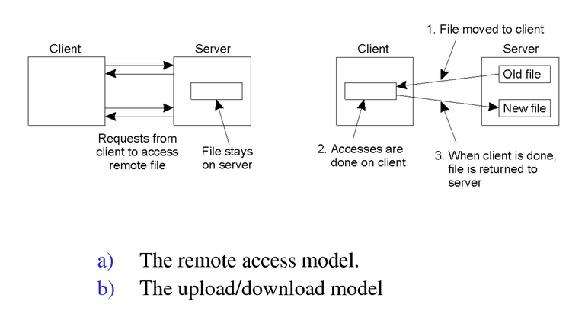
Distributed File Systems before GFS
Pros/Cons?

Slide 5
What is Different?
Component failures are norm rather than exception, why?
File system consists of 100s/1,000s commodity storage servers
Comparable number of clients
Much bigger files, how big?
GBs file sizes common
TBs data sizes: hard to manipulate billions of KB size blocks

Slide 6
What is Different?
Files are mutated by appending new data, and not overwriting
Random writes practically non-existent
Once written, files are only read sequentially
Own both applications and file system → can effectively co-designing applications and file system APIs
Relaxed consistency model
Atomic append operation: allow multiple clients to append data to a file with no extra synchronization between them

Slide 7
Assumptions and Design Requirements (1/2)
Should monitor, detect, tolerate, and recover from failures
Store a modest number of large files (millions of 100s MB files)
Small files supported, but no need to be efficient
Workload
Large sequential reads
Small reads supported, but ok to batch them
Large, sequential writes that append data to files
Small random writes supported but no need to be efficient

Slide 8
Assumptions and Design Requirements
Implement well-defined semantics for concurrent appends
Producer-consumer model
Support hundreds of producers concurrently appending to a file
Provide atomicity with minimal synchronization overhead
Support consumers reading the file as it is written
High sustained bandwidth more important than low latency

Slide 9
API
Not POSIX, but..
Support usual ops: create, delete, open, close, read, and write
Support snapshot and record append operations

Slide 10
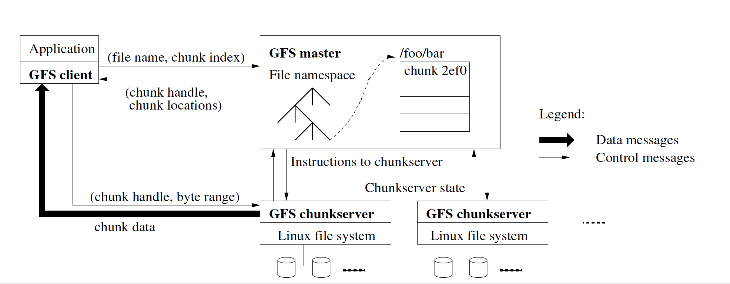
Architecture
Single Master (why?)
Notes:
READ. Filename + Offset → Chunk Index, ask server for chunk handle and location
How can the MASTER SCALE? Caching, only metadata,

Slide 11
Architecture
64MB chunks identified by unique 64 bit identifier

Slide 12
Discussion
64MB chunks: pros and cons?
How do they deal with hotspots?
How do they achieve master fault tolerance?
How does master achieve high throughput, perform load balancing, etc?
Notes:
• 64MB: less master util, less traffic to master, metadata in memory
• Hotspots, replication factor app startup time
• Shadow masters, do everything but write, quick startup seconds
• Data vs Control plane, spreads chunks

Slide 13
Consistency Model
Mutation: write/append operation to a chunk
Use lease mechanism to ensure consistency:
Master grants a chunk lease to one of replicas (primary)
Primary picks a serial order for all mutations to the chunk
All replicas follow this order when applying mutations
Global mutation order defined first by
lease grant order chosen by the master
serial numbers assigned by the primary within lease
If master doesn’t hear from primary, it grant lease to another replica after lease expires
Notes:
• Advantages? Offload master.
• Separate data control

Slide 14
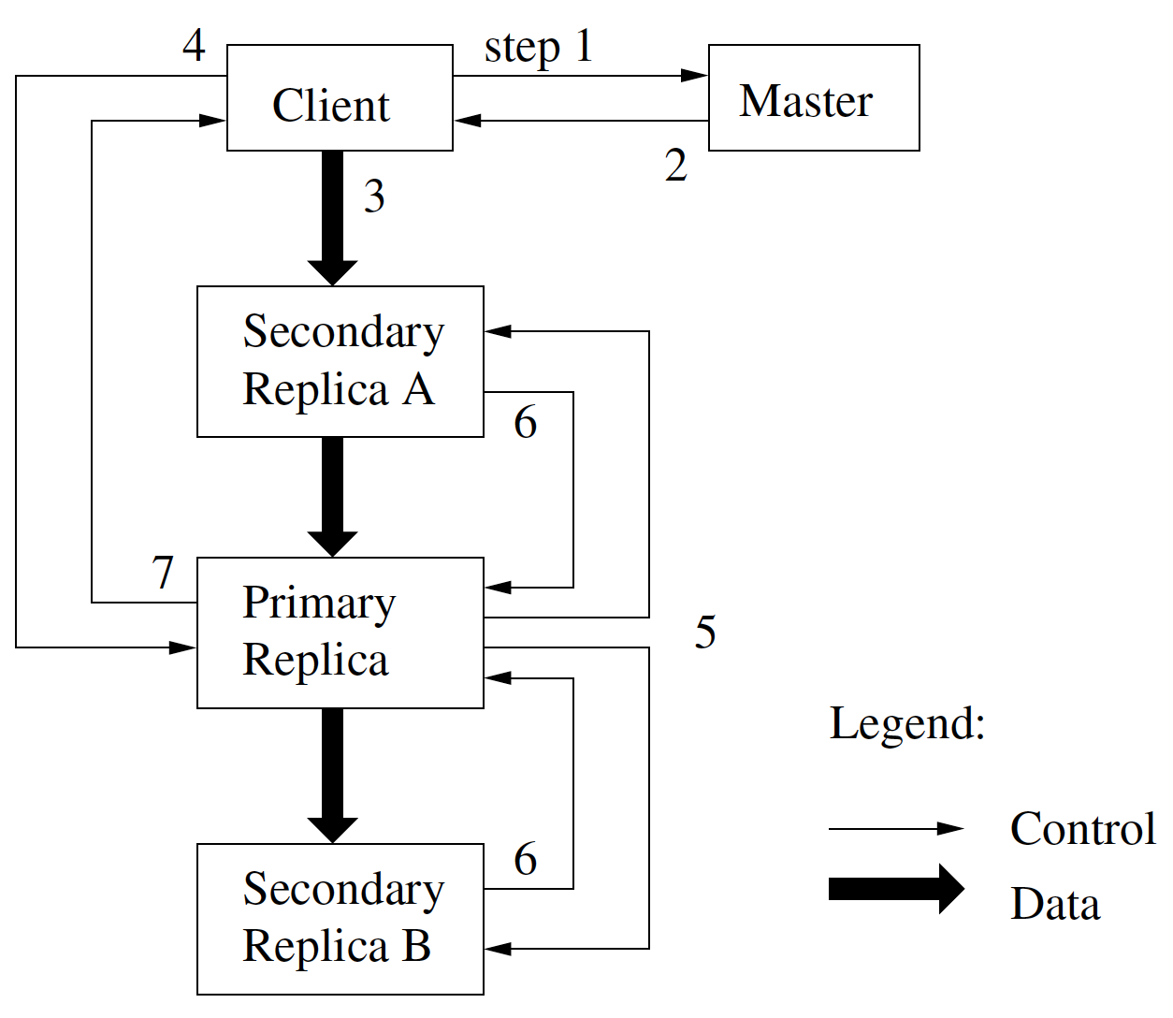
Write Control and data Flow

Slide 15
Atomic Writes Appends
Client specifies only the data
GFS picks offset to append data and returns it to client
Primary checks if appending record will exceed chunk max size
If yes
Pad chunk to maximum size
Tell client to try on a new chunk
Notes:
• Advantage? Multiple writes without sync or locks

Slide 16
Master Operation
Namespace locking management
Each master operation acquires a set of locks
Locks are acquired in a consistent total order to prevent deadlock
Replica Placement
Spread chunk replicas across racks to maximize availability, reliability, and network bandwidth
Notes:
• Why namespace locking? Locking scheme allows concurrent mutations in same directory
• Replas across racks? Limited bandwidth across them.

Slide 17
Others
Chunk creation
Equalize disk utilization
Limit the number of creations on same chunk server
Spread replicas across racks
Rebalancing
Move replica for better disk space and load balancing.
Remove replicas on chunk servers with below average free space
Notes:
• How to ensure not lots of padded empty files? ¼
• Creations means lots of writes, so spread those

Slide 18
Summary
GFS meets Google storage requirements
Optimized for given workload
Simple architecture: highly scalable, fault tolerant
Why is this paper so highly cited?
Changed all DFS assumptions on its head
Thanks for new application assumptions at Google

Slide 19
BigTable

Slide 20
Motivation
Highly available distributed storage for structured data, e.g.,
URLs: content, metadata, links, anchors, page rank
User data: preferences, account info, recent queries
Geography: roads, satellite images, points of interest, annotations
Large scale
Petabytes of data across thousands of servers
Billions of URLs with many versions per page
Hundreds of millions of users
Thousands of queries per second
100TB+ satellite image data

Slide 21
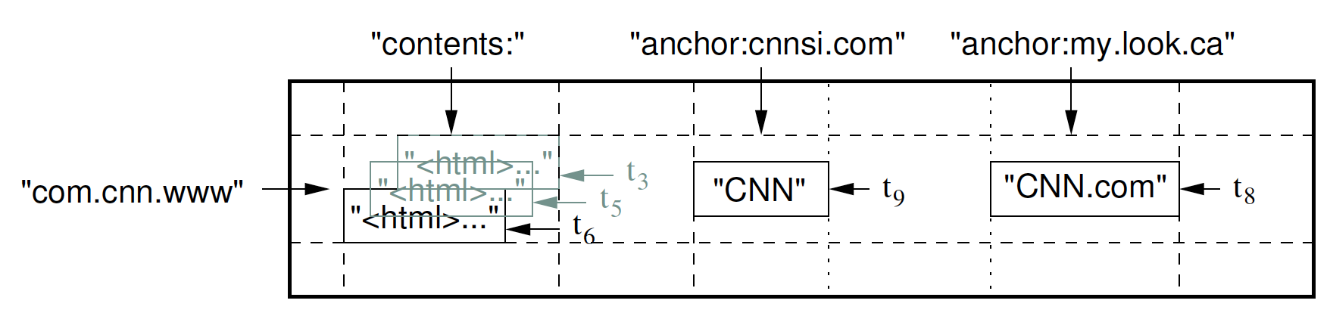
(Big) Tables
“A BigTable is a sparse, distributed, persistent multidimensional sorted map”
(row:string, column:string, time:int64) → cell content

Slide 22
Column Families
Column Family
Group of column keys
Basic unit of data access
Data in a column family is typically of the same type
Data within the same column family is compressed
Identified by family:qualifier, e.g.,
“language”:language_id
“anchor”:referring_site
Example: <a href="http://www.w3.org/">CERN</a> appearing in www.berkeley.edu
Cell content
Referring site

Slide 23
Timestamps
Each cell in a Bigtable can contain multiple versions of same data
Version indexed by a 64-bit timestamp: real time or assigned by client
Per-column-family settings for garbage collection
Keep only latest n versions
Or keep only versions written since time t
Retrieve most recent version if no version specified
If specified, return version where timestamp ≤ requested time

Slide 24
Tablets
Table partitioned dynamically by rows into tablets
Tablet = range of contiguous rows
Unit of distribution and load balancing
Nearby rows will usually be served by same server
All rows are sorted
Accessing nearby rows requires communication with small # of servers
Usually, 100-200 MB per tablet
Users can control related rows to be in same tablet by row keys
E.g., store maps.google.com/index.html under key com.google.maps/index.html

Slide 25
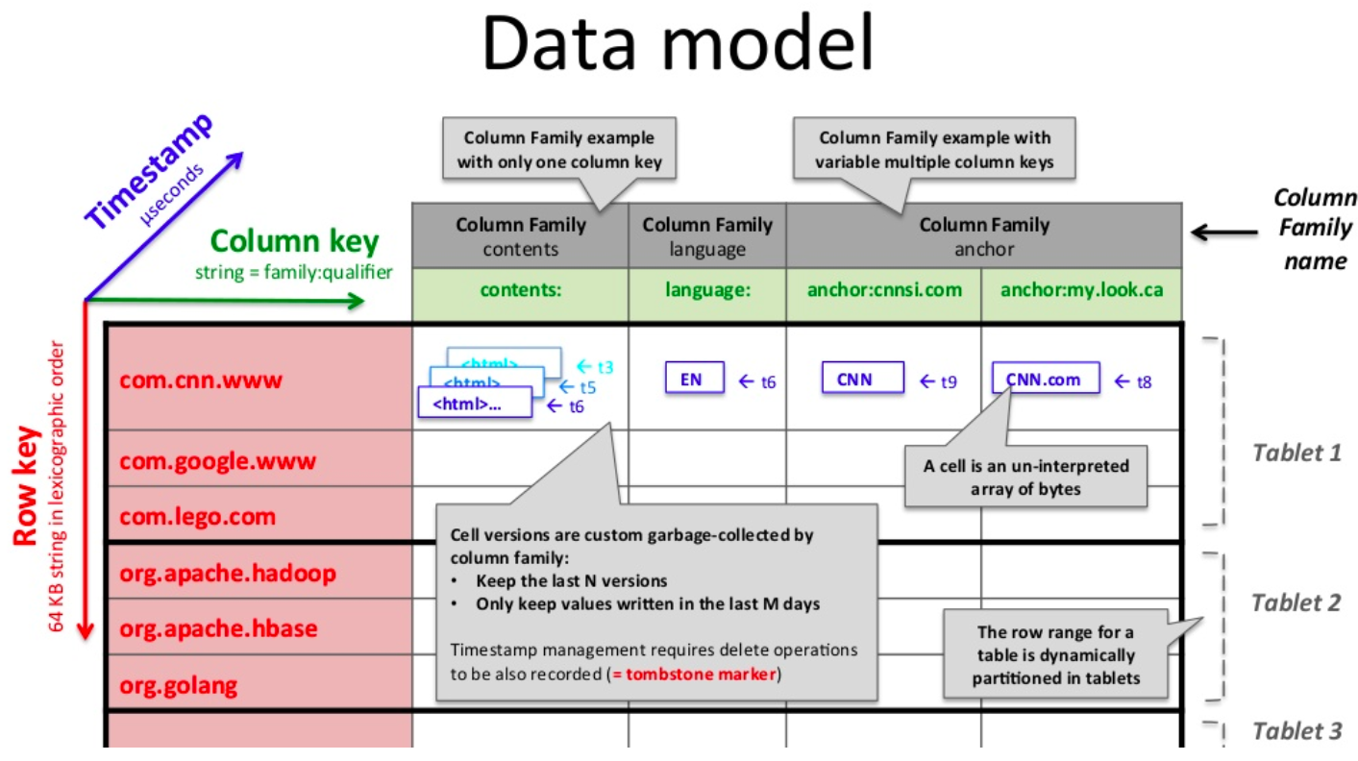
Another Example
from https://www.slideshare.net/romain_jacotin/undestand-google-bigtable-is-as-easy-as-playing-lego-bricks-lecture-by-romain-jacotin

Slide 26
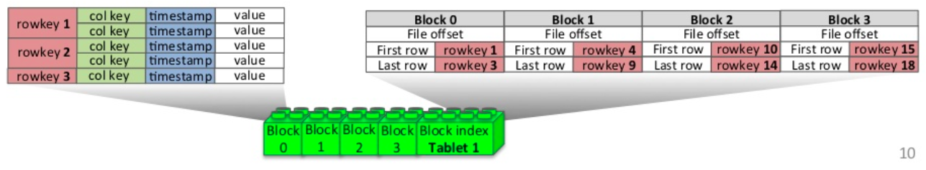
SSTable
Immutable, sorted file of key-value pairs
Chunks of Blocks plus an index
Index of block ranges, not values
Index loaded into memory when SSTable is opened
Lookup is a single disk seek
Client can map SSTable into mem
from https://www.slideshare.net/romain_jacotin/undestand-google-bigtable-is-as-easy-as-playing-lego-bricks-lecture-by-romain-jacotin

Slide 27
Putting Everything Together
SSTables can be shared
Tablets do not overlap, SSTables can overlap
Tablet
Tablet
aardvark
apple
apple_two_E
boat
SSTable
SSTable
SSTable
SSTable
(from www.cs.cmu.edu/~chensm/Big_Data_reading.../Gibbons_bigtable-updated.ppt)

Slide 28
API
Tables and column families: create, delete, update, control rights
Rows: atomic read and write, read-modify-write sequences
Values: delete, and lookup values in individual rows
Others
Iterate over subset of data in table
No transactions across rows, but support batching writes across rows

Slide 29
Architecture
Google-File-System (GFS) to store log and data files.
SSTable file format
Chubby as a lock service (another lecture)
Ensure at most one active master exists
Store bootstrap location of Bigtable data
Discover tablet servers
Store Bigtable schema information (column family info for each table)
Store access control lists

Slide 30
Implementation
Components:
Library linked with every client
Master server
Many tablet servers
Master responsible for assigning tablets to tablet servers
Tablet servers can be added or removed dynamically
Tablet server store typically 10-1000 tablets
Tablet server handle read and writes and splitting of tablets
Client data does not move through master

Slide 31
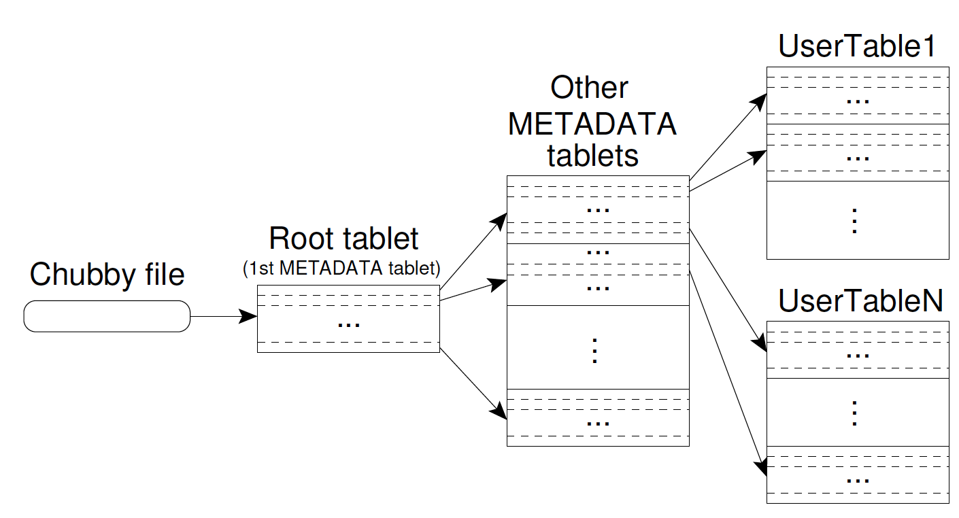
Tablet Location Hierarchy
Able to address 2³⁴ tablets

Slide 32
Tablet Assignment
Master keeps track of live tablet servers, current assignments, and unassigned tablets
Master assigns unassigned tablets to tablet servers
Tablet servers are linked to files in Chubby directory
Upon a master starting
Acquire master lock in Chubby
Scan live tablet servers
Get list of tablets from each tablet server, to find out assigned tablets
Learn set of existing tablets → adds unassigned tablets to list

Slide 33
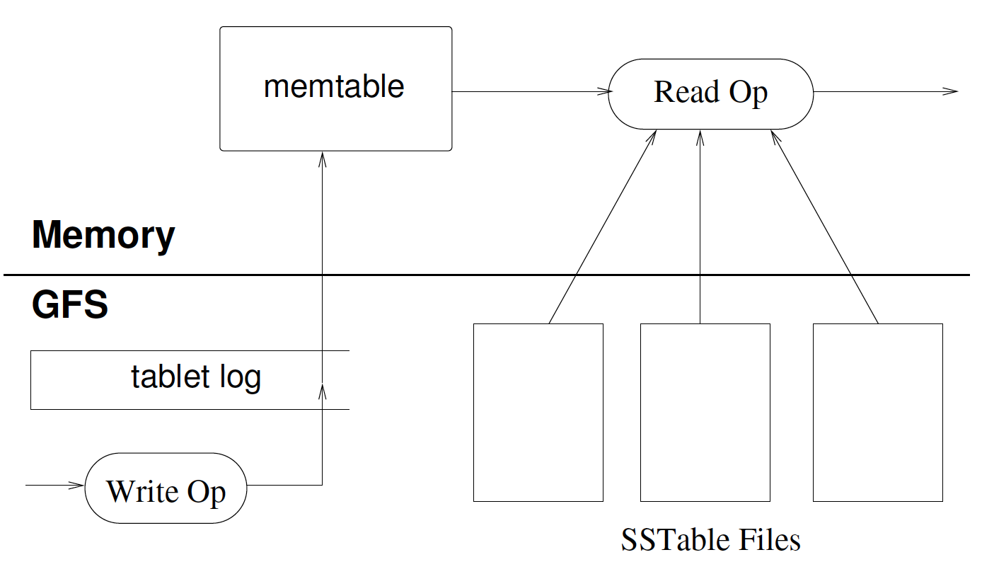
Tablet Representation
Tablet recovery:
METADATA: list of SSTables that comprise a tablet and set of redo points
Reconstructs the memtable by applying all of the updates that have committed since the redo points

Slide 34
BigTable vs. Relational DB
No data independence:
Clients dynamically control whether to serve data form memory or disk
Client control locality by key names
Uninterpreted values: clients can serialize, deserialize data
No multi-row transactions
No table-wide integrity constraints
API: C++, not SQL(no complex queries)
(from www.cs.cmu.edu/~chensm/Big_Data_reading.../Gibbons_bigtable-updated.ppt)

Slide 35
Lessons learned
Many types of failure possible, not only fail-stop:
Memory and network corruption, large clock skew, hung machines, extended and asymmetric network partitions, bugs in other systems, planned and unplanned hardware maintenance
Delay adding new features until it is clear they are needed
E.g., Initially planned for multi-row transaction APIs
Big systems need proper systems-level monitoring
Most important: value of simple designs
Related: use widely used features of systems you depend on as less widely features more likely to be buggy

Slide 36
Summary
Huge impact
GFS → HDFS
BigTable → HBase, HyperTable
Demonstrate the value of
Deeply understanding the workload, use case
Make hard tradeoffs to simplify system design
Simple systems much easier to scale and make them fault tolerant

