Slide 1
Microkernels: From Mach to seL4 (Lecture 18, cs262a)
Ali Godsi & Ion Stoica,
UC Berkeley
March 21, 2018
Notes:
3-D graph
Checklist
What we want to enable
What we have today
How we’ll get there

Slide 2
Papers
“Microkernel Operating System Architecure and Mach”, D. Black, D. Golub, D. Julin, R. Rashid, R. Draves, R. Dean, A. Forin, J. Barrera, H. Tokuda, G. Malan, and D. Bohman (https://amplab.github.io/cs262a-fall2016/notes/Mach.pdf)
“seL4: Formal Verification of an OS Kernel”, Gerwin Klein , Kevin Elphinstone, Gernot Heiser, June Andronick, David Cock, Philip Derrin, Dhammika Elkaduwe, Kai Engelhardt, Rafal Kolanski, Michael Norrish, Thomas Sewell, Harvey Tuch, Simon Winwood, (https://www.sigops.org/sosp/sosp09/papers/klein-sosp09.pdf)

Slide 3
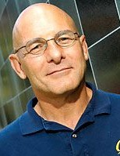
David Patterson – Turing Award winner (2017)
For RISC (Reduce Instruction Set Computer) project
SPARC processor from Sun (now Oracle)
ARM (Acorn Risc Machine)
Every processor today has a RISC architecture at its core
Lots of other impactful work: RAID, Recovery Oriented Computing, etc.

Slide 4
Key Observation (~1985)
Mondern OSes at that time (e.g., Unix, OS/2) primarily distinguished by the programming environment they provide and not by the way they manage resources
Opportunity:
Factor out the common part
Make it easier to build new OSes

Slide 5
Microkernels separates OS in two parts
Part of OS that control basic hardware resources (i.e.. microkernel)
Part of OS that determine unique characteristics of application environment (e.g., file system)

Slide 6
What problem do they try to solve?
Portability:
Environment mostly independent on the instruction set architecture
Extensibility & customization:
Can easily add new versions of environments
Enable environments to evolve faster (decouples them from microkernel)
Can simultaneously provide environments emulating interfaces
Sounds familiar?
Microkernel as a narrow waist (anchor point) of OSes
Provide hardware independence, similar to data independence in relational data models

Slide 7
What problem do they try to solve?
Easier to provide better functionality and performance for kernel:
Real-time: no need to maintain lock for extended periods of time; environments are preemptable
Multiprocessor support: simpler functionality → easier to parallelize
Multicomputer support: simpler functionality → easier to distribute
Security: simpler functionality → easier to secure
Flexibility (network accessibility):
System environment can run remotely

Slide 8
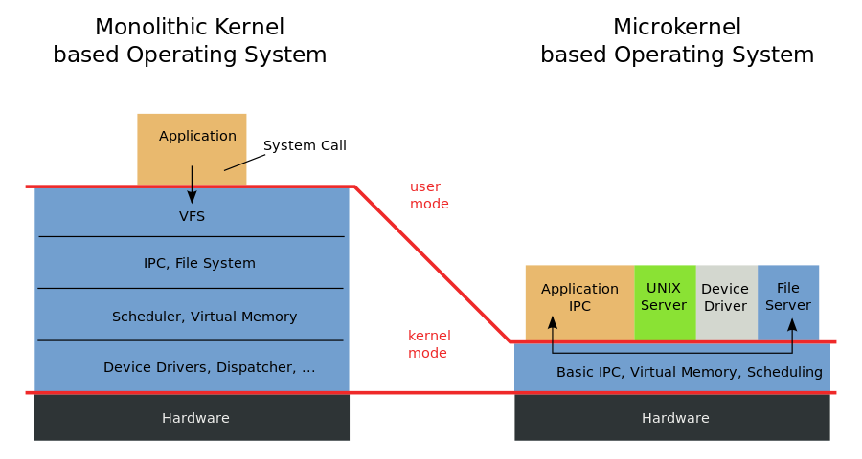
(https://en.wikipedia.org/wiki/Microkernel)

Slide 9
Mach
Goal: show that microkernels can be as efficient as monolithic operating systems:
“… achieving the levels of functionality and performance expected and required of commercial products”
Sounds familiar?
Similar goals as System R and Ingress: Show that a conceptually superior solution (i.e., relational model) admit efficient implementations that can match the performance of existing solutions (i.e., network and hierarchical models)

Slide 10
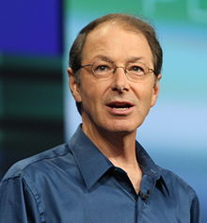
Mach
Developed at CMU
Led by Rick Rashid
Founded Microsoft Research
Initial release: 1985
Big impact (as we will see)
Rick Rashid

Slide 11
What does a microkernel (Mach) do?
Task and thread management:
Task (process) unit of allocation
Thread, unit of execution
Implements CPU scheduling: exposed to apps
Applications/environments can implement their own scheduling policies
Inter-process communication (IPC)
Between threads via ports
Secured by capabilities

Slide 12
What does a microkernel (Mach) do?
Memory object management:
Essentially virtual memory
Persistent store accessed via IPC
System call redirection:
Enable to trap system calls and transfer control to user mode
Essentially enable applications to modify/extend the behavior and functionality of system calls, e.g.,
Enable binary emulation of environments, tracing, debugging

Slide 13
What else does a microkernel (Mach) do?
Device support:
Implemented using IPC (devices are contacted via ports)
Support both synchronous and asynchronous devices
User multiprocessing:
Essentially a user level thread package, with wait()/signal() primitives
One or more user threads can map to same kernel thread
Multicomputer support:
Can map transparently tasks/resources on different nodes in a cluster

Slide 14
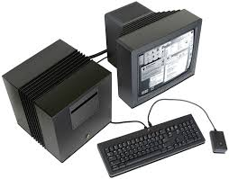
Mach 2.5
Contains BSD code compatibility code, e.g., one-to-one mapping between tasks and processes
Some commercial success:
NeXT
Steve Jobs’ company after he left Apple
Used by Tim Berners-Lee to develop WWW
Encore, OSF (Open Software Foundation), …

Slide 15
Mach 3
Eliminate BSD code
Rewrite IPC to improve performance
RPC on (then) contemporary workstations: 95 usec
Expose device interface
Provide more control to user applications via continuation:
Address of an user function to be called when thread is rescheduled plus some data: essentially a callback
Enable application to save restore state, so that the microkernel doesn’t need to do it, e.g., saving and restoring register state

Slide 16
OSes and Application Programs
Mach allows application to implement:
Paging
Control data cached by virtual memory
…
Redirection allows call traps to link directly to executable binaries without modifying he kernel!
Just need an emulation library

Slide 17
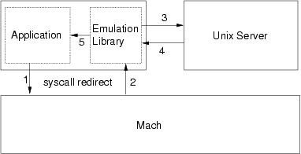
Emulation Libraries
Translator for system services and a cache for their results
Converts app calls to Mach calls
Invoke functionality of the environment (e.g., OS) and reply to app
Typically linked to app to avoid another context switching

Slide 18
OSes Environment Architectures
Fully implemented in the emulation library
Simple, single user systems (e.g., MS-DoS)
As a server (see previous slide)
Native OSes: use the code of the original systems
Used to implement both MacOS, and DOS
Emulation library also virtualizes the physical resources

Slide 19
Performance: Mach 2.5 vs 3.0
Virtually the same as Mach 2.5, and commercial Unix systems of that time
SunOS 4.1 and Ultrix 4.1
Why?
I/O dominated tasks (read, write, compile)
Microbenchmarks would have been nice, e.g.:
IPC
Cost of a page fault

Slide 20
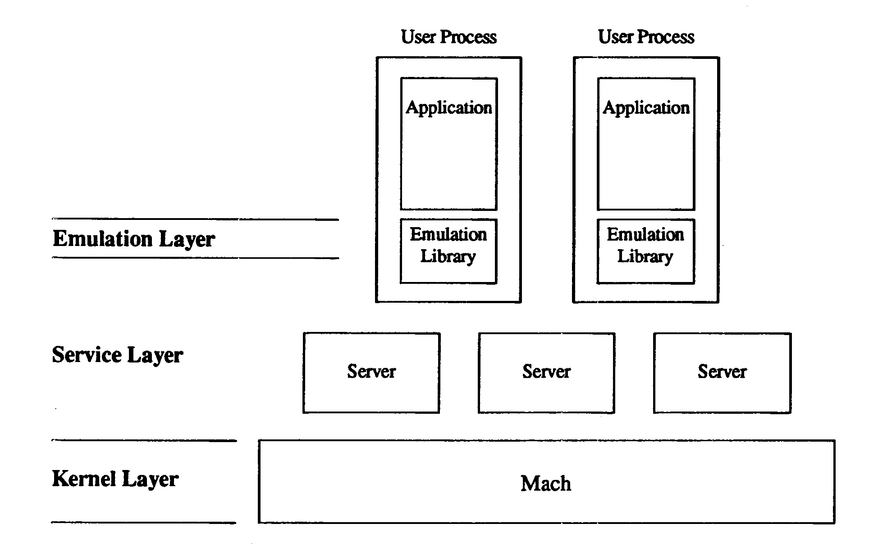
OSF/1 Unix Server
Even more modularity: different OS functionalities implemented as different servers, e.g.,
IPC, process management, file server, etc
Server proxies on client side for optimization

Slide 21
L3 → seL4

Slide 22
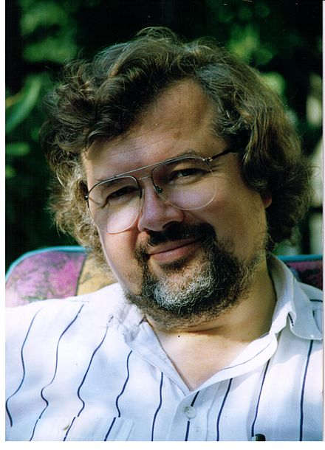
How it started? (1993)
Microkernels (e.g., Mach) still too slow
Mostly because IPCs
Tide was turning towards monolithic kernels
Jochen Liedtke (GMD – Society for Mathematics and Information technology) aimed to show that IPC can be supper-fast
Jochen Liedtke

Slide 23
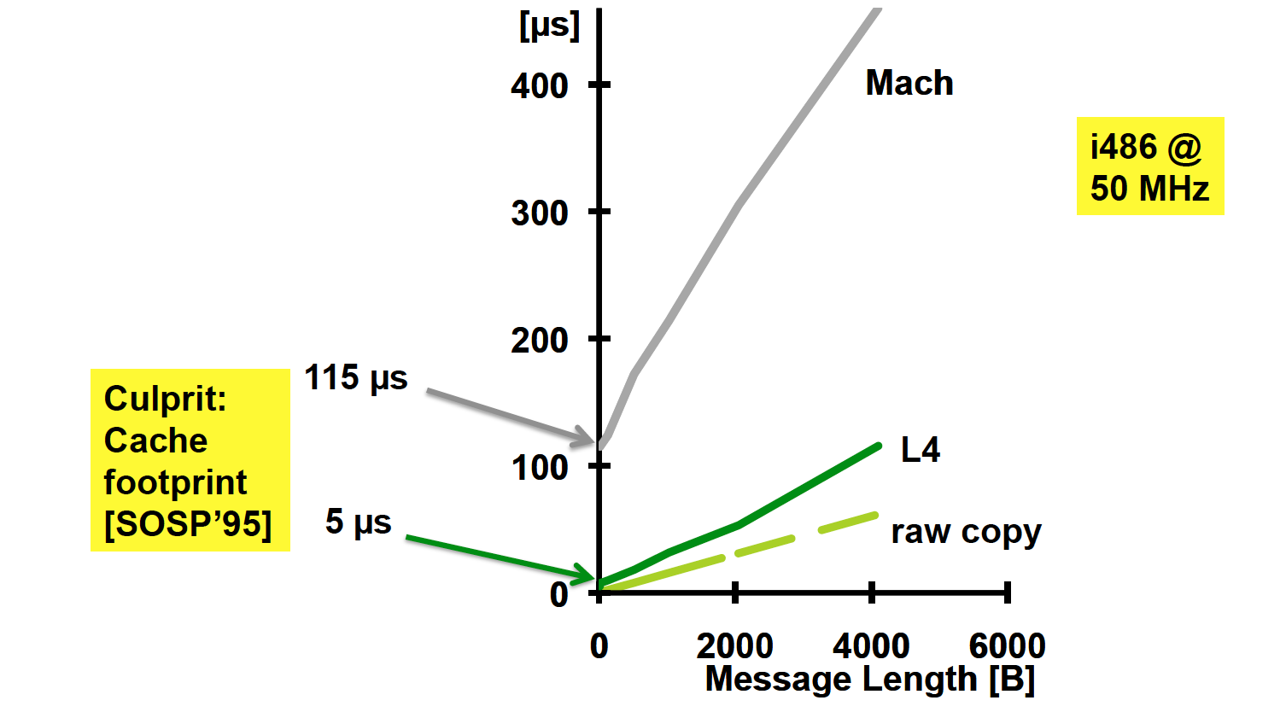

How fast?

Slide 24
How did he do it?
Synchronous IPC → Rendezvous model
Kernel executes in sender’s context
copies memory data directly to receiver (single-copy)
leaves message registers unchanged during context switch (zero copy)
Thread src
Thread dest
Running
Running
send(dest, msg)
Kernel copy
Wait
…
wait(src, msg)
Running
Running

Slide 25
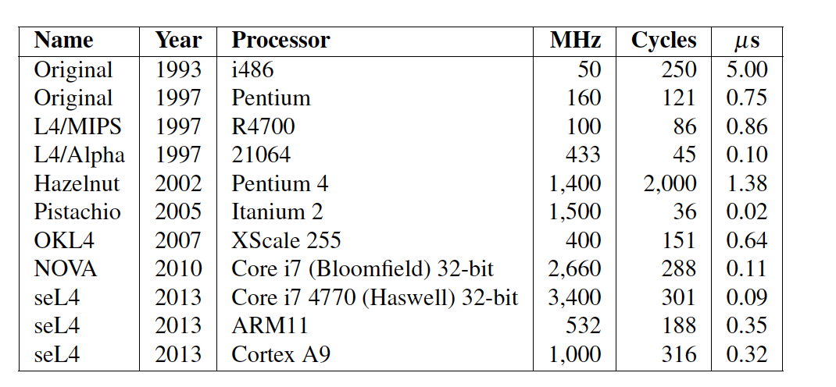
One-way IPC cost over years

Slide 26
Minimalist design
“A concept is tolerated inside the microkernel only if moving it outside the kernel, i.e. permitting competing implementations, would prevent the implementation of the system’s required functionality”
Sounds familiar?
“Don’t implement anything in the network that can be implemented correctly by the hosts”
-- radical interpretation of the e2e argument!

Slide 27
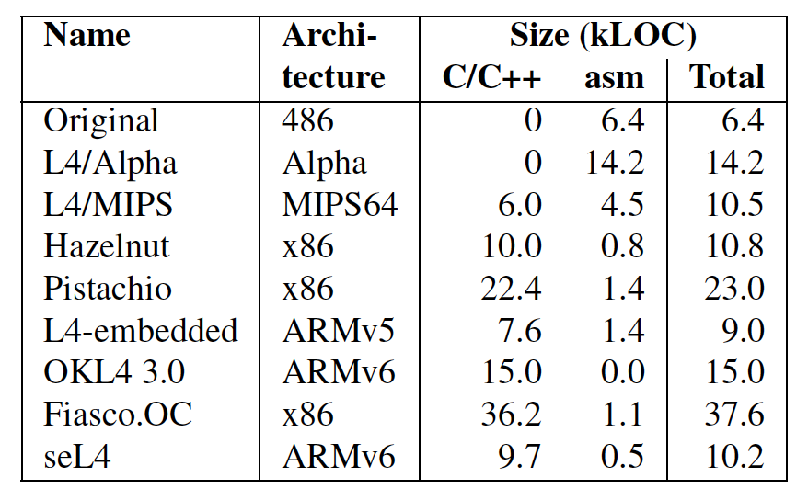
Source Lines of Code

Slide 28
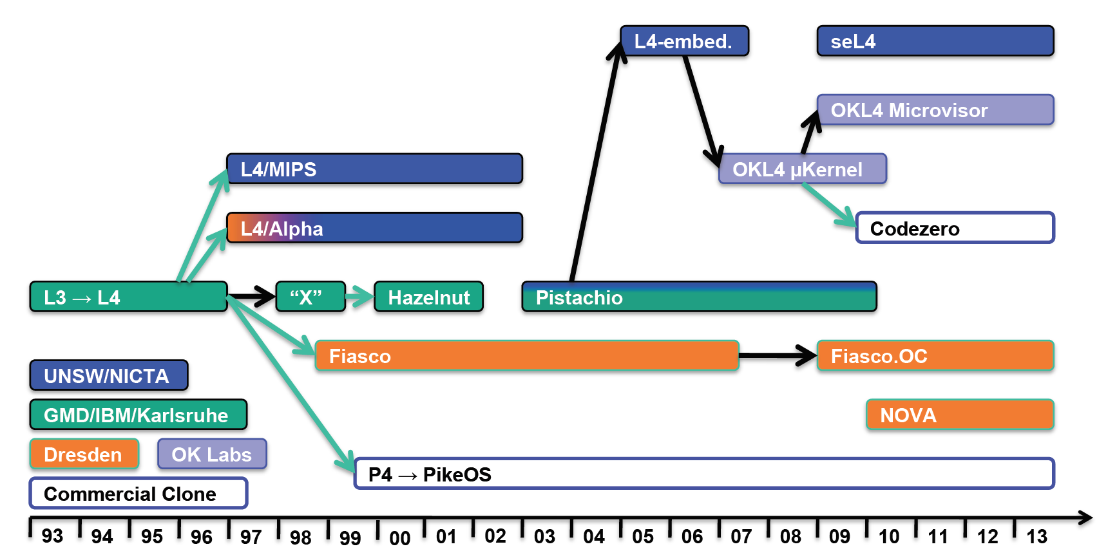
L4 family tree

Slide 29
L4 family tree
“The Secure Enclave runs an Apple-customized version of the L4 microkernel family”
- iOS Security, Apple Inc, 2015
(www.apple.com/business/docs/iOS_Security_Guide.pdf)

Slide 30
Secure L4 (seL4) – Design Goals
Create a formal model of a microkernel
Implement the microkernel
Prove that it always behaves according to the specification

Slide 31
Assumptions
Hardware works correctly
Compiler produces machine code that fits their formalization
Some unchecked assembly code is correct
Boot loader is correct

Slide 32
How to design kernel + spec?
Bottom-Up-Approach: Concentrate on low-level details to maximize performance
Problem: Produces complex design, hard to verify

Slide 33

Reminder
Not all equivalent programs are equally amenable to verification
void swap(ptr A, ptr B)
{
ptr C := A;
A := B;
B := C;
}
void swap(ptr A, ptr B)
{
A := A xor B;
B := A xor B;
A := A xor B;
}
vs.
Postcondition: $A_{post}=B_{pre}∧B_{post}=A_{pre}$

Slide 34
How to design kernel + spec?
Top-Down-Approach: Create formal model of kernel and generate code from it
Problem: High level of abstraction from hardware

Slide 35
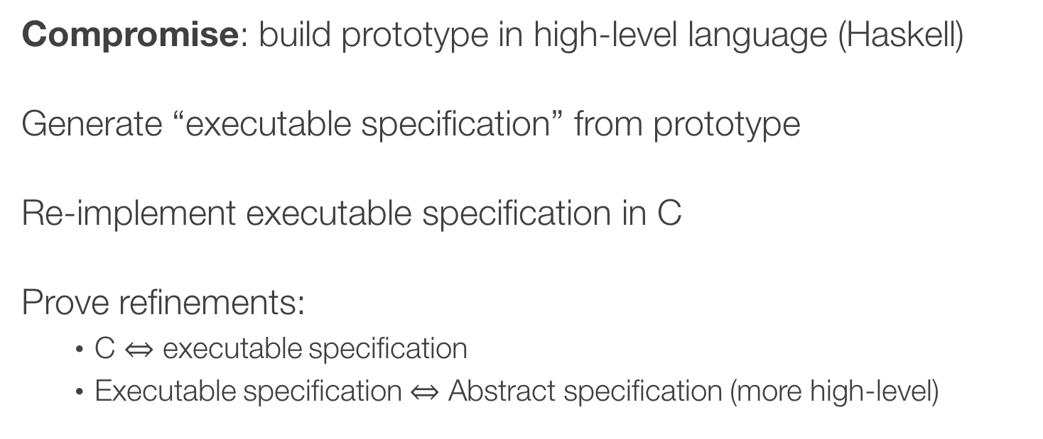
How to design kernel + spec?
Compromise: build prototype in high-level language (Haskell)
Generate “executable specification” from prototype
Re-implement executable specification in C
Prove refinements:
C $⇔$ executable specification
Executable specification $⇔$ Abstract specification (more high-level)

Slide 36
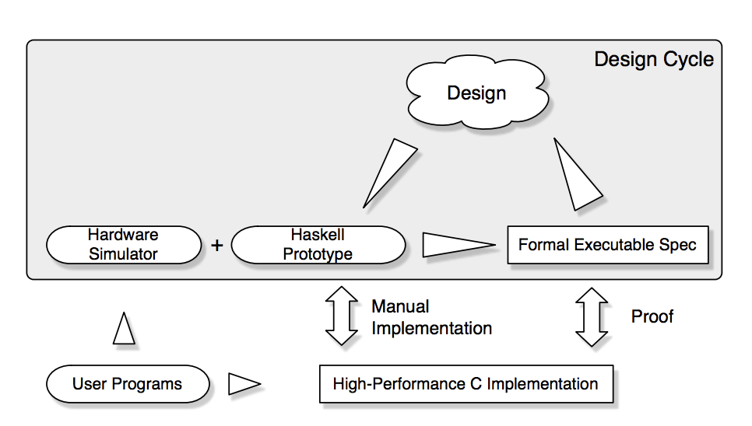
seL4 design process
Source: seL4, Klein et al.

Slide 37
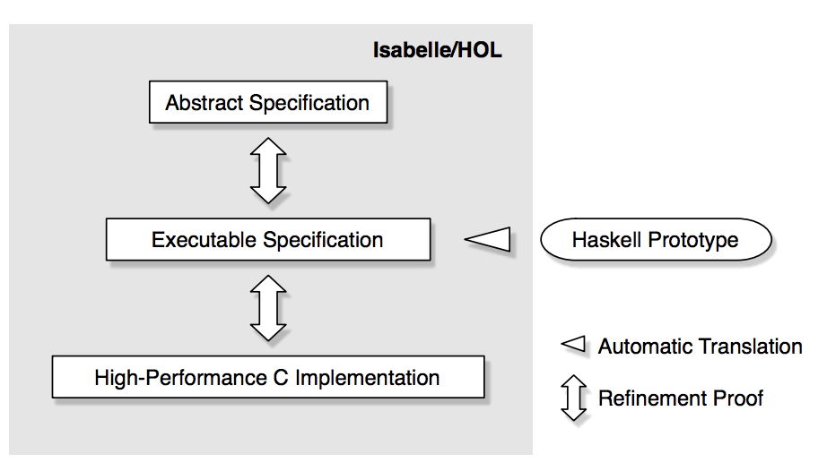
seL4 verification
Source: seL4, Klein et al.

Slide 38
Concurrency is a problem
Multiprocessors not included in the model
seL4 can only run on a single processor
Interrupts are still there
Yield points need to establish all system invariants

Slide 39
Cost of Verification
Source: seL4, Klein et al.

Slide 40
Cost of Verification
Source of Data: seL4, Klein et al.

Slide 41
Takeaway
Functional verification of microkernels is possible
Performance of verified kernels can be OK
However:
Verification is a huge effort
Still needs to assume compiler correctness (➔ huge trusted base)
Is proving functional correctness worth the effort?

Slide 42
What drove L4’s evolution?
Application domain: embedded devices (natural fit!)
Small footprint
Devices ran few applications, didn’t need all OS services (e.g., file system)
Embedded devices required:
Security and resilience → special attention to DoS attacks, formal verification
Real-time guarantees → non-preemptable kernel

Slide 43
Did microkernels take over the world?
Pretty much…
MacOS, based on NeXT, based on Mach
iOS has both bits of Mach and L4
Windows: hybrid (similar design goals to Mach)
With one notable exception, Linux!

Slide 44
So why didn’t take over entire world!
Hardware standardization:
Intel and ARM dominating
Less need for portability, one of main goals of Mach
Software standardization:
Windows, MacOS/iOS, Linux/Android
Less need to factor out common functionality
Maybe just a fluke?
Linux could have been very well adopted the microkernel approach
Philosophical debate between Linus and Andy Tanembaum
One of Linus main arguments: there is only i386 I need to write code for!
(http://www.oreilly.com/openbook/opensources/book/appa.html)

Slide 46
What drove L4’s evolution? (cont’d)
User experience, e.g.,
New features, e.g., async IPC
Remove features not useful: timeouts, clans & chiefs
Software evolution:
E.g., Linux raise and POSIX decline obviate the need for long IPCs
Hardware advances
Bigger caches, bigger TLBs, better context switching support → obviate the need for some optimizations (e.g., virtual TLBs. Thread IDs as destination IDs)
Multicores → push for some optimizations (async wait)

Slide 47
Long IPCs: Transferring large messages
What happens during page faults?
IPC page faults are nested exceptions
L4 executes with interrupts disabled for performance, no concurrency
Must invoke untrusted user mode page-fault handlers
Potential for DOSing other thread (i.e., page fault handler hangs)
Can use timeouts to avoid DOS attacks
Complex, goes against minimalist design

Slide 48
Why long IPCs?
POSIX-style APIs
Use message passing between apps and OS, e.g., write(fd, buf, nbytes)
Linux became de-facto standard
Communicate via shared memory
Supporting POSIX not as critical
Message passing can be emulated anyway via shared memory
Long IPC abandoned

Slide 49
IPC destinations
Initially use thread identifier (why?)
Wanted to avoid cache an TLB pollution
But
Poor information hiding (e.g., multi-threaded server has to expose the structure to the clients)
Large caches and TLBs reduced pollution
Thread IDs replaced by port-like endpoints

Slide 50
Timeouts
Synchronous IPC may lead to thread being blocked indefinitely
E.g., a thread which waits for another thread that hangs
Solution: timeouts
No reliable way to pick a timeout; application specific
Ended up just using two values: 0 and infinity
Client sends and receives with infinite timeouts
Servers requests with an infinite timeout but replies with a zero timeout
Timeouts abandoned

Slide 51
Asynchronous IPCs
Thread
Insufficient (Why?)
Disadvantages of synchronous IPCs
Have to block on IO operations
Forces apps to use multithreading
Poor choice for multicores (no need to block if IO executes on another core!)
Want async IPCs
Want something like select()/poll()/epoll() in Unix
Running
initiate_IO(…)
wait_IO(…)
…
receive
msg

Slide 52
Async notifications
Thread
Sending is non-blocking and asynchronous
Receiver, who can block or poll for message
seL4: Asynchronous Endpoints (AEP)
Single-word notification field
Send sets a bit in notification field
Bits in notification field are ORed → notification
wait(), effectively select() across notification fields
Running
poll(…)
wait()
…
receive
msg
Added async notifications to complement syn IPCs

Slide 53
Lazy scheduling
What is the problem?
Lot’s of queue manipulations: threads frequently switch between ready and wait queues due to the rendezvous IPC model
Lazy scheduling:
When a thread blocks on an IPC operation, leave it in ready queue
Dequeue all blocked threads at next scheduling event
Why does it work?
Move work from a high-frequency IPC operation to the less frequently scheduler calls

Slide 54
Benno scheduling
Lazy scheduling drawback
Bad when many threads → worst-case proportional with # of threads
Benno scheduling
Ready queue contains all runnable threads, except current running one
When a thread is unblocked by an IPC operation, run it without placing in ready queue (as it may block again very soon)
If running thread is preempted, place it in ready queue
Still need to maintain wait queues but typically they are in hit cache
Replace lazy scheduling by Benno scheduling

Slide 55
Summary
Original design decision | Maintained/Abandoned | Notes
Synchronous IPC | ✚ | Added async notifications
In-register msg transfer | ✖ | Replaced physical with virtual registers
Long IPC | ✖
IPC timeouts | ✖
Clans and chiefs | ✖
User level drivers | ✔
Process hierarchy | ✖
Recursive page mapping |  | Some retained it some didn’t
Kernel memory control | ✚ | Added user-level control

Slide 56
Summary (cont’d)
Original design decision | Maintained/Abandoned | Notes
Scheduling policies | ? | Unresolved: no policy agnostic solution
Multicores | ? | Unresolved: cannot be verified
Virtual TCP addressing | ✖
Lazy scheduling | ✖ | Replaced with Benno scheduling
Non-preemptable kernel | ✔ | Mostly maintained
Non-portability | ✖ | Mostly portable
Non-standard calling | ✖ | Replaced by C standard calling convention
Language | ✖ | Assembly/C++ mostly replaced by C

Slide 57
Discussions: L4 tenets
Minimalist design: strict interpretation of e2e argument
Only functionality that cannot be implemented completely in the app
No policies in the microkernel
Obsessive optimization of IPC
Unlike Mach, didn’t care about portability (at least initially)
So what got in besides IPC?
Scheduling, including scheduling policies
Some device drivers: timer, interrupt controller
Minimal memory management

Slide 58
What drove L4’s evolution?
Application domain: embedded devices (natural fit!)
Small footprint
Devices ran few applications, didn’t need all OS services (e.g., file system)
Embedded devices required:
Security and resilience → special attention to DoS attacks, formal verification
Real-time guarantees → non-preemptable kernel

Slide 59
What drove L4’s evolution? (cont’d)
User experience, e.g.,
New features, e.g., async IPC
Remove features not useful: timeouts, clans & chiefs
Software evolution:
E.g., Linux raise and POSIX decline obviate the need for long IPCs
Hardware advances
Bigger caches, bigger TLBs, better context switching support → obviate the need for some optimizations (e.g., virtual TLBs. Thread IDs as destination IDs)
Multicores → push for some optimizations (async wait)

Slide 60
Did microkernels take over the world?
Pretty much…
MacOS, based on NeXT, based on Mach
iOS has both bits of Mach and L4
Windows: hybrid (similar design goals to Mach)
With one notable exception, Linux!

Slide 61
So why didn’t take over entire world!
Hardware standardization:
Intel and ARM dominating
Less need for portability, one of main goals of Mach
Software standardization:
Windows, MacOS/iOS, Linux/Android
Less need to factor out common functionality
Maybe just a fluke?
Linux could have been very well adopted the microkernel approach
Philosophical debate between Linus and Andy Tanembaum
One of Linus main arguments: there is only i386 I need to write code for!
(http://www.oreilly.com/openbook/opensources/book/appa.html)

Slide 63
seL4 – Takeaway Goal
Functional verification of microkernels is possible
Performance of verified kernels can be OK
BUT:
Verification is a colossal effort
Still needs to assume compiler correctness (➔ huge trusted base)

Slide 64








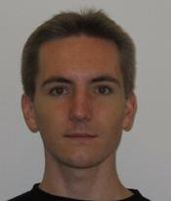

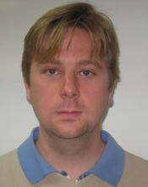
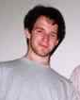

seL4 - Authors
Gerwin Klein
Kevin Elphinstone
Gernot Heiser
June Andronick
David Cock
Philip Derrin
Kai Engelhardt
Michael Norrish
Harvey Tuch
Dhammika Elkaduwe
Rafal Kolanski
Thomas Sewell
Simon Winwood

Slide 65
seL4 – Project Leaders
Gerwin Klein
TU Munich (PhD)
University of New South Wales
Does not put a CV on his webpage
Gernot Heiser
ETH Zurich (PhD, 1991)
University of New South Wales
Created Startup “Open Kernel Labs” to sell L4 technology
Collaborated with Jochen Liedtke (L4)
Kevin Elphinstone
University of New South Wales
Does not put a CV on his webpage
Collaborated with Jochen Liedtke (L4)

Slide 66
Secure L4 – Design Goal
Create a formal model of a microkernel
Implement the microkernel
Prove that it always behaves according to the specification

Slide 67
Assumptions
Hardware works correctly
Compiler produces machine code that fits their formalization
Some unchecked assembly code is correct
Boot loader is correct

Slide 68
How to design kernel + spec?
Bottom-Up-Approach:
Concentrate on low-level details to maximize performance
Problem:
Produces complex design, hard to verify

Slide 69

Reminder
Not all equivalent programs are equally amenable to verification
void swap(ptr A, ptr B)
{
ptr C := A;
A := B;
B := C;
}
void swap(ptr A, ptr B)
{
A := A xor B;
B := A xor B;
A := A xor B;
}
vs.
Postcondition: $A_{post}=B_{pre}∧B_{post}=A_{pre}$

Slide 70
How to design kernel + spec?
Top-Down-Approach:
Create formal model of kernel
Generate code from that
Problem:
High level of abstraction from hardware

Slide 71
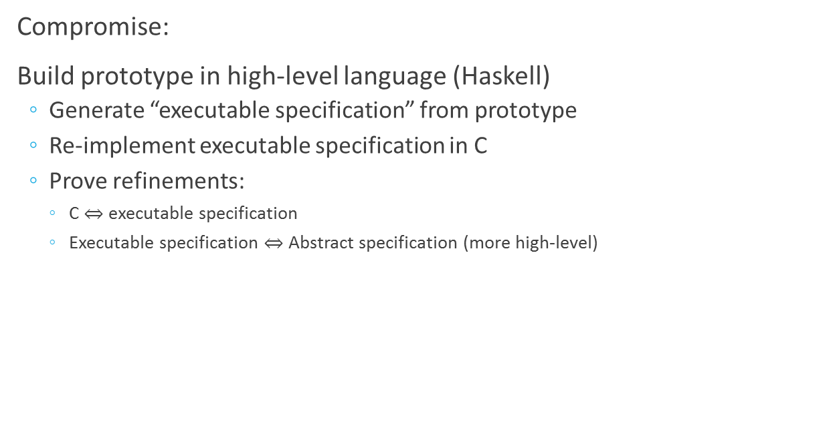
How to design kernel + spec?
Compromise:
Build prototype in high-level language (Haskell)
Generate “executable specification” from prototype
Re-implement executable specification in C
Prove refinements:
C $⇔$ executable specification
Executable specification $⇔$ Abstract specification (more high-level)

Slide 72
Concurrency is a problem
Multiprocessors not included in the model
seL4 can only run on a single processor
Interrupts are still there
Yield points need to establish all system invariants

Slide 73
Cost of Verification
Source: seL4, Klein et al.

Slide 74
Cost of Verification
Source of Data: seL4, Klein et al.

Slide 75
Takeaway
Functional verification of microkernels is possible
Performance of verified kernels can be OK
BUT:
Verification is a colossal effort
Still needs to assume compiler correctness (➔ huge trusted base)
Discussion
Is proving functional correctness worth the effort?

Slide 76
Singularity vs. seL4
Goal
Singularity | seL4
A verifiably safe system. Kernel should fail “safely” when an error occurs. | A verifiably correct system. There just should not be any errors.
Ease of Verification
Singularity | seL4
Most guarantees come for free Annotations and contracts can give more guarantees | Several person-years just for proving about 80 invariants.

Slide 77
Perspective
Lots of room between Singularity and seL4
I.e.: more parts of Singularity can be verified for functional correctness
Both are verified microkernels
Good Isolation → additional components can be verified independently

