Slide 1
Extensible OSes Exokernel and SPIN Lecture 19, cs262a
Ion Stoica & Ali Ghodsi
UC Berkeley
April 2, 2018
Notes:
3-D graph
Checklist
What we want to enable
What we have today
How we’ll get there

Slide 2
Today’s Papers
“Exokernel: An Operating System Architecture for
Application-Level Resource Management”, Dawson R. Engler, M. Frans Kaashoek, and James O’Toole Jr.
https://pdos.csail.mit.edu/6.828/2008/readings/engler95exokernel.pdf
“SPIN: An Extensible Microkernel for Application-specific Operating System Services”, Brian N. Bershad, Craig Chambers, Susan Eggers, Chris Maeda, Dylan McNamee, Przemysław Pardyak, Stefan Savage, and Emin Gün Sirer www.cs.cornell.edu/people/egs/papers/spin-tr94-03-03.pdf

Slide 3
Traditional OS services – Management and Protection
Provides a set of abstractions
Processes, Threads, Virtual Memory, Files, IPC
APIs, e.g.,: POSIX
Resource Allocation and Management
Protection and Security
Concurrent execution
Notes:
Why resource management?
- resource are shared for efficiency
- fairness
- Scheduling, VM

Slide 4
Abstractions
What is an abstraction?
Generalization. Often an API in CS. Hides implementation details.
What are the advantages of abstractions?
Simpler. Easy to understand and use. Just follow the contract. How we fight complexity.
Standardization. Many implementations all satisfy the abstraction. Loose coupling, e.g. Unix’ everything is a file, many implementations and all apps benefit from this standardization.
What are the disadvantages of abstractions?
Contract is a compromise. Least common denominator. Not perfect for each use case
Performance often suffers (if you only could tweak an implementation detail of a particular implementation)
Can create bloated software.

Slide 5
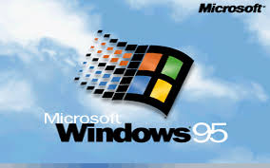
Context for These Papers (1990s)
Windows was dominating the market
Mac OS downward trend (few percents)
Unix market highly fragmented (few percents)
OS research limited impact
Vast majority of OSes proprietary
“Is OS research dead?”, popular panel topic at systems conferences of the era
An effort to reboot the OS research, in particular, and OS architecture, in general

Slide 6
Challenge: “Fixed” Interfaces
Both papers identify “fixed interfaces” provided by existing OSes as main challenge
Fixed interfaces provide protection but hurt performance and functionality
Exokernel:
“Fixed high-level abstractions hurt application performance because there is no single way to abstract physical resources or to implement an abstraction that is best for all applications.”
“Fixed high-level abstractions limit the functionality of applications, because they are the only available interface between applications and hardware resources”

Slide 7
Challenge: “Fixed” Interfaces
Both papers identify “fixed interfaces” provided by existing OSes as main challenge
Fixed interfaces provide protection but hurt performance and functionality
SPIN:
“Existing operating systems provide fixed interfaces and implementations to system services and resources. This makes them inappropriate for applications whose resource demands and usage patterns are poorly matched by the services provided.”

Slide 8
Problems in existing OSes
Extensibility
Abstractions overly general
Apps cannot dictate management
Implementations are fixed
Performance
Context switching expensive
Generalizations and hiding information affect performance
Protection and Management offered with loss in Extensibility and Performance
Notes:
Microkernels (replaceable trusted servers, fault isolation)
- Process, address space, IPC
- same abstraction to all processes (even with trusted servers)
- is there a need to cross the protection boundary often?
Virtual Machines (multiple VMs on the same host OS)
- virtualization of hardware expensive
- virtualization can be counter-productive (apps LRU pager Vs VMM pager)

Slide 9
Symptoms
Very few of innovations making into commercial OSes
E.g., scheduler activations, efficient IPC, new virtual memory policies, …
Applications struggling to get better performances
They knew better how to manage resources, and the OS was “standing” in the way

Slide 10
Examples Illustrating the need for App Control
Databases know better than the OS what pages they will access
Can prefetch pages, LRU hurts their performance, why?
Notes:
Shared virtual memory systems know whether to use disk or remote memory
Use a page fault to retrieve page from disk / another processor
…

Slide 11
Two Papers, Two Approaches
Exokernel:
Very minimalist kernel, most functionality implemented in user space
Assumed many apps have widely different requirements, maximal extensibility
SPIN:
Dynamically link extensions into the kernel
Rely on programming language features, e.g. static typechecking
Assumed device drivers need flexibility, so focused on how to enable them while staying protected

Slide 12
Exokernel
A nice illustration of the end-to-end argument:
``general-purpose implementations of abstractions force applications that do not need a given feature to pay substantial overhead costs.’’
In fact the paper is explicitly invoking it (sec 2.2)!
Corollary:
Kernel just safely exposes resources to apps
Apps implement everything else, e.g., interfaces/APIs, resource allocation pollcies

Slide 13
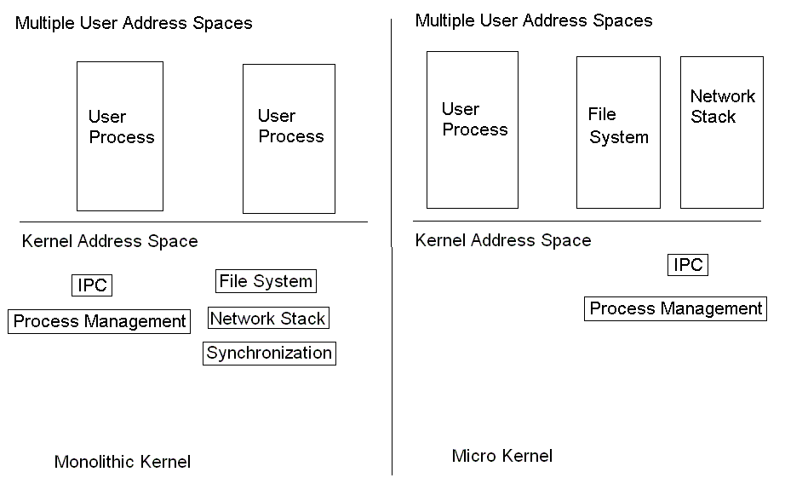
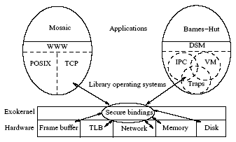
OS Component Layout
Exokernel
www.cs.cornell.edu/courses/CS6410/2011fa/lectures/08-extensible-kernels.pdf
(Hakim Weatherspoon, Cornell University)

Slide 14
Exokernel Main Ideas
Kernel: resource sharing, not policies
Library Operating System: responsible for the abstractions
IPC
VM
Scheduling
Networking

Slide 15
Lib OS and the Exokernel
Lib OS (untrusted) can implement traditional OS abstractions (compatibility)
Efficient (LibOS in user space)
Apps link with LibOS of their choice
Kernel allows LibOS to manage resources, protects LibOSes

Slide 16
Philosophy
“An exokernel should avoid resource management. It should only manage resources to the extent required by protection (i.e., management of allocation, revocation, and ownership).”
The motivation for this principle is our belief that distributed, application-specific, resource management is the best way to build efficient flexible systems.

Slide 17
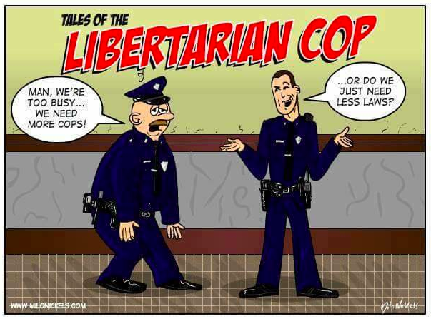

OS
ABSTRACTIONS
ABSTRACTIONS

Slide 18
Exokernel design
Securely expose hardware
Decouple authorization from use of resources
Authorization at bind time (i.e., granting access to resource)
Only access checks when using resource
E.g., LibOS loads TLB on TLB fault, and then uses it multiple times
Expose allocation
Allow LibOSes to request specific physical resources
Not implicit allocation; LibOS should participate in every allocation decision
Notes:
Securely expose hardware: hardware, software, download application code

Slide 19
Exokernel design
Expose names (CS trick #1⁻¹)
Remove one level of indirection and expose useful attributes
E.g., index in direct mapped caches identify physical pages conflicting
Additionally, expose bookkeeping data structures
E.g., freelist, disk arm position (?), TLB entries
Expose revocation
“Polite” and then forcibly abort
Notes:
Securely expose hardware: hardware, software, download application code

Slide 20
Example: Memory
Self-authenticated capability
Guard TLB loads and DMA
Secure binding: using self-authenticating capabilities
For each page Exokernel creates a random value, check
Exokernel records: {Page, Read/Write Rights, MAC(check, Rights)}
When accessing page, owner need to present capability
Page owner can change capabilities associated and deallocate it
Large Software TLB (why?)
TLB of that time small, LibOS can manage a much bigger TLB in software
Expensive checks during page fault can be reduced with a larger TLB

Slide 21
Example: Processor Sharing
Process time represented as linear vector of time slices
Round robin allocation of slices
Secure binding: allocate slices to LibOSes
Simple, powerful technique: donate time slice to a particular process
A LibOS can donate unused time slices to its process of choice
If process takes excessive time, it is killed (revocation)
Notes:
Quantum 15 ms

Slide 22
Example: Network
Downloadable filters
Application-specific Safe Handlers (ASHes)
Can reply directly to traffic, e.g., can implement new transport protocols; dramatically reduce
Secure biding happens at download time

Slide 23
SPIN

Slide 24
SPIN
Use of language features for extensions
Extensibility
Dynamic linking and binding of extensions
Safety
Interfaces; type safety; extensions verified by compiler
Performance
Extensions not interpreted; run in kernel space

Slide 25
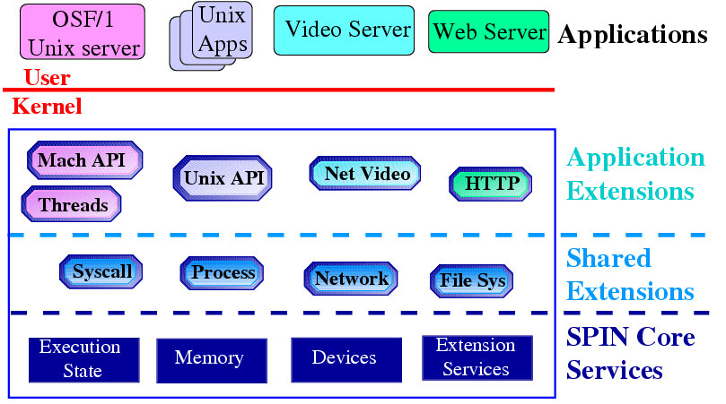
SPIN structure
From Stefan Savage’s SOSP 95 presentation
Notes:
Almost all ``system'' services are extensions
-- Network protocols
-- File systems
-- System call interface
SPIN only implements services which cannot be safely implemented as extensions
-- Processor execution state
-- Basic interface to MMU and physical memory
-- Device IO/DMA
-- Dynamic linker and Dispatcher

Slide 26
SPIN Main Ideas
Extend the kernel at runtime through statically-checked extensions
System and extensions written in Modula-3
Event/handler abstraction

Slide 27

Language: Modula 3
Designed by DEC and Olivetti (1980s)
Descendent from Mesa
Modern language (at that time)
Interfaces
Type safety
E.g., Array bounds checking, storage management, GC
Threads
Exceptions
“Died” together with DEC (acquired by Compaq in 1998)

Slide 28
SPIN design
Co-location
Extensions dynamically linked into same memory-space as kernel
Fast communication
Enforced modularity
Modula 3 extensions provide compile-time protection (memory and privileged instructions protected)

Slide 29
SPIN design
Local protection domains
Namespaces for extensions
Avoid context switch through a function-call that decides which interfaces (extensions) can be accessed
Dynamic call binding
Binds events to extensions
Handler pattern through function call

Slide 30
Events and Handler
Event: a message that announces a change in
the state of the system or a request for service
(Event) Handler: a procedure that receives the message
An extension installs a handler on an event by explicitly registering
the handler with the event through a central dispatcher
Essentially a callback mechanism

Slide 31
Example: Memory
The kernel controls allocation of physical and virtual addresses capabilities
Extensions:
Event: page fault
App provides handle for page faults

Slide 32
Example: Processor Sharing
Based on Modula-3 threads
Scheduler multiplexes processor among competing strands
A strand is similar to a thread in traditional operating but no kernel state
Use preemptive round-robin to schedule strands

Slide 33
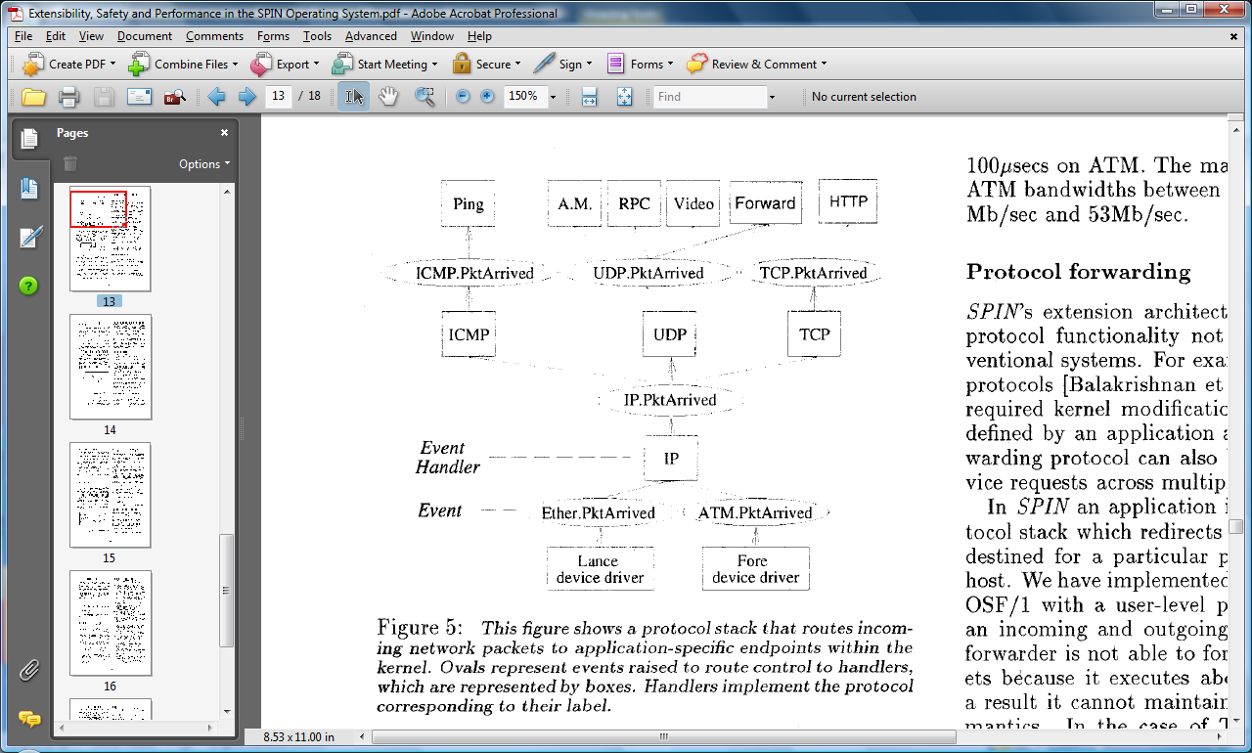
Example: Network Stack
www.cs.cornell.edu/courses/CS6410/2011fa/lectures/08-extensible-kernels.pdf
(Hakim Weatherspoon, Cornell University)

Slide 34
SPIN vs Exokernel
SPIN uses programming language facilities and communicates through procedure calls
Exokernel uses hardware specific calls to protect system calls

Slide 35
Zooming out
Performance vs Extensibility vs Protection
DOS provided no protection. Without protective checks, you get performance and apps could directly hack the core to get extensibility.
Monolithic kernels implemented performance and protection, but were hard to extend
Microkernels provided good protection and were extensible, but performance suffered
Exokernel and SPIN try to achieve all three!

Slide 36
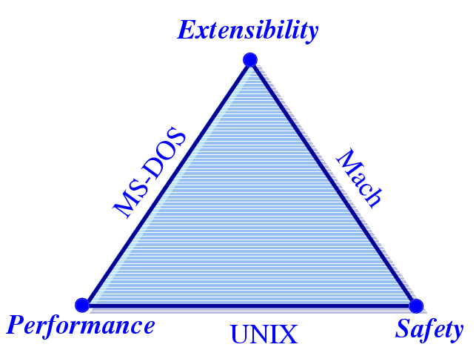
Challenges
Extensibility
Security
Performance
From Stefan Savage’s SOSP 95 presentation
Exokernel and SPIN attempt to have all 3 in one OS!
Notes:
Extensibility
Ability to use application specific knowledge
Security
Extensions should not compromise security. Applications should still be able to share resourses
Performance

Slide 37
Zooming out further
Much of computer system research is about tradeoffs
Efficiency vs Security
Efficiency vs Modularity (Extensibility)
Efficiency vs Fairness
Efficiency vs Correctness
Papers that show that you can have your cake and east it too get attention!

Slide 38
Microkernels vs Exokernels vs VMs vs Containers?
Exokernels provide secure bindings to hardware directly
What about microkernels?
Microkernels implement IPC and process management abstractions, they are fixed and cannot be changed
What about VMs?
VMs emulate full machine and also typically run another monolithic kernel inside of it (c.f. paravirtualization?)
What about containers?
Notes:
LXC, libcontainer, cgroups

Slide 39
Summary
Extensibility without loss of security or performance
Exokernels
Safely export machine resources
Decouple protection from management to get performance, no layers of indirection to slow things down
SPIN
Kernel extensions (imported) safely specialize OS services
Safety through Programming Language support

