Slide 1
MapReduce and Spark (and MPI) (Lecture 22, cs262a)
Ali Ghodsi and Ion Stoica,
UC Berkeley
April 11, 2018
Notes:
3-D graph
Checklist
What we want to enable
What we have today
How we’ll get there

Slide 2
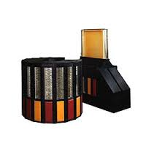
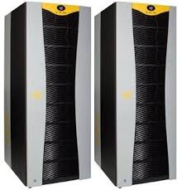
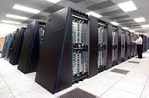
Context (1970s—1990s)
Supercomputers the pinnacle of computation
Solve important science problems, e.g.,
Airplane simulations
Weather prediction
…
Large national racing for most powerful computers
In quest for increasing power → large scale distributed/parallel computers (1000s of processors)
Question: how to program these supercomputers?

Slide 3
Shared memory vs. Message passing
Client
Client
Client
Client
send(msg)
recv(msg)
send(msg)
recv(msg)
Shared
Memory
MSG
MSG
MSG
IPC
Shared memory: all multiple processes to share data via memory
Applications must locate and and map shared memory regions to exchange data
Message passing: exchange data explicitly via IPC
Application developers define protocol and exchanging format, number of participants, and each exchange

Slide 4
Shared memory vs. Message passing
Easy to program; just like a single multi-threaded machines
Hard to write high perf. apps:
Cannot control which data is local or remote (remote mem. access much slower)
Hard to mask failures
Message passing: can write very high perf. apps
Hard to write apps:
Need to manually decompose the app, and move data
Need to manually handle failures

Slide 5
MPI
MPI - Message Passing Interface
Library standard defined by a committee of vendors, implementers, and parallel programmers
Used to create parallel programs based on message passing
Portable: one standard, many implementations
Available on almost all parallel machines in C and Fortran
De facto standard platform for the HPC community

Slide 6
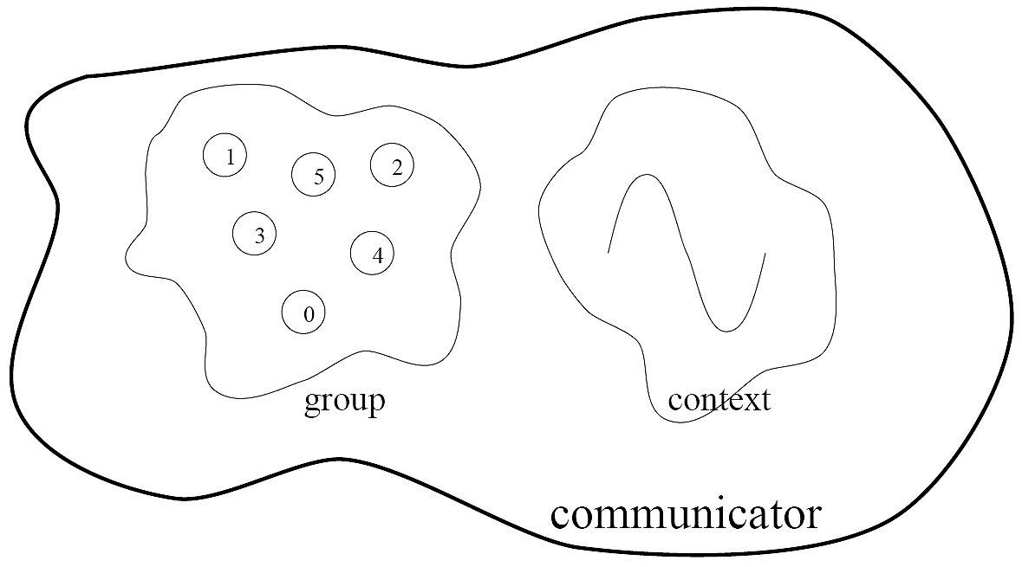
Groups, Communicators, Contexts
Group: a fixed ordered set of k processes, i.e., 0, 1, .., k-1
Communicator: specify scope of communication
Between processes in a group
Between two disjoint groups
Context: partition of comm. space
A message sent in one context cannot be received in another context
This image is captured from:
“Writing Message Passing Parallel Programs with MPI”, Course Notes, Edinburgh Parallel Computing Centre
The University of Edinburgh

Slide 7
Synchronous vs. Asynchronous Message Passing
A synchronous communication is not complete until the message has been received
An asynchronous communication completes before the message is received

Slide 8
Communication Modes
Synchronous: completes once ack is received by sender
Asynchronous: 3 modes
Standard send: completes once the message has been sent, which may or may not imply that the message has arrived at its destination
Buffered send: completes immediately, if receiver not ready, MPI buffers the message locally
Ready send: completes immediately, if the receiver is ready for the message it will get it, otherwise the message is dropped silently

Slide 9
Blocking vs. Non-Blocking
Blocking, means the program will not continue until the communication is completed
Synchronous communication
Barriers: wait for every process in the group to reach a point in execution
Non-Blocking, means the program will continue, without waiting for the communication to be completed

Slide 10
MPI library
Huge (125 functions)
Basic (6 functions)

Slide 11
MPI Basic
Many parallel programs can be written using just these six functions, only two of which are non-trivial;
MPI_INIT
MPI_FINALIZE
MPI_COMM_SIZE
MPI_COMM_RANK
MPI_SEND
MPI_RECV

Slide 12
Skeleton MPI Program (C)
#include <mpi.h>
main(int argc, char** argv)
{
MPI_Init(&argc, &argv);
/* main part of the program */
/* Use MPI function call depend on your data
* partitioning and the parallelization architecture
*/
MPI_Finalize();
}

Slide 13
A minimal MPI program (C)
#include “mpi.h”
#include <stdio.h>
int main(int argc, char *argv[])
{
MPI_Init(&argc, &argv);
printf(“Hello, world!\n”);
MPI_Finalize();
return 0;
}

Slide 14
A minimal MPI program (C)
#include “mpi.h” provides basic MPI definitions and types.
MPI_Init starts MPI
MPI_Finalize exits MPI
Notes:
Non-MPI routines are local; this “printf” run on each process
MPI functions return error codes or MPI_SUCCESS

Slide 15
Improved Hello (C)
#include <mpi.h>
#include <stdio.h>
int main(int argc, char *argv[])
{
int rank, size;
MPI_Init(&argc, &argv);
/* rank of this process in the communicator */
MPI_Comm_rank(MPI_COMM_WORLD, &rank);
/* get the size of the group associates to the communicator */
MPI_Comm_size(MPI_COMM_WORLD, &size);
printf("I am %d of %d\n", rank, size);
MPI_Finalize();
return 0;
}

Slide 16
Improved Hello (C)
/* Find out rank, size */
int world_rank, size;
MPI_Comm_rank(MPI_COMM_WORLD, &world_rank);
MPI_Comm_size(MPI_COMM_WORLD, &world_size);
int number;
if (world_rank == 0) {
number = -1;
MPI_Send(&number, 1, MPI_INT, 1, 0, MPI_COMM_WORLD);
} else if (world_rank == 1) {
MPI_Recv(&number, 1, MPI_INT, 0, 0, MPI_COMM_WORLD, MPI_STATUS_IGNORE);
printf("Process 1 received number %d from process 0\n", number);
}
Tag to identify message
Number of elements
Rank of destination
Default communicator
Rank of source
Status

Slide 17
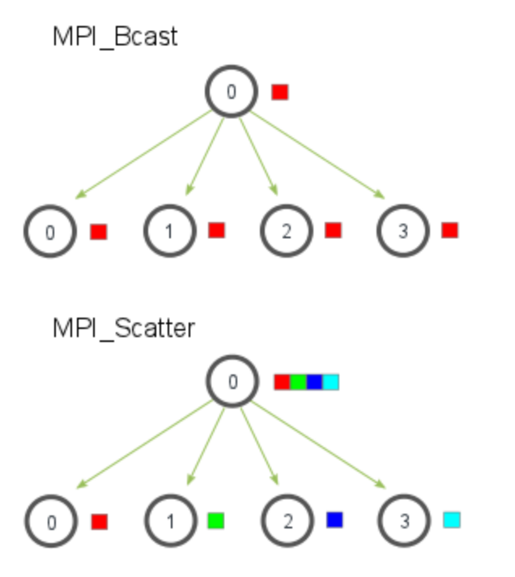
Many other functions…
MPI_Bcast: send same piece of data to all processes in the group
MPI_Scatter: send different pieces of an array to different processes (i.e., partition an array across processes)
From: http://mpitutorial.com/tutorials/mpi-scatter-gather-and-allgather/

Slide 18
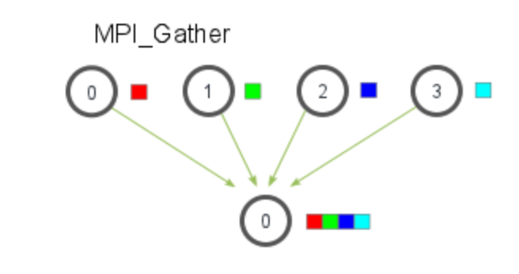
Many other functions…
MPI_Gather: take elements from many processes and gathers them to one single process
E.g., parallel sorting, searching
From: http://mpitutorial.com/tutorials/mpi-scatter-gather-and-allgather/

Slide 19
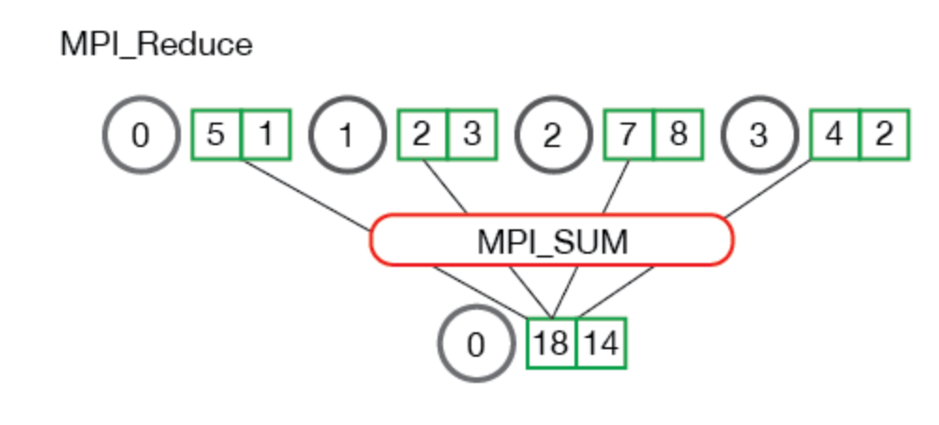
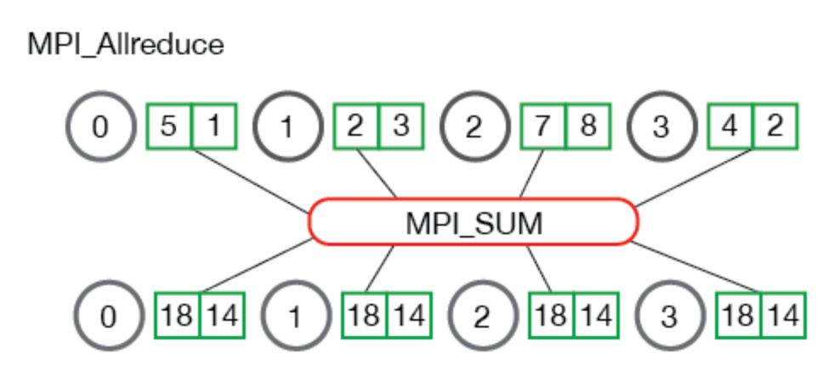
Many other functions…
MPI_Reduce: takes an array of input elements on each process and returns an array of output elements to the root process given a specified operation
MPI_Allreduce: Like MPI_Reduce but distribute results to all processes
From: http://mpitutorial.com/tutorials/mpi-scatter-gather-and-allgather/

Slide 20
MPI Discussion
Gives full control to programmer
Exposes number of processes
Communication is explicit, driven by the program
Assume
Long running processes
Homogeneous (same performance) processors
Little support for failures, no straggler mitigation
Summary: achieve high performance by hand-optimizing jobs but requires experts to do so, and little support for fault tolerance

Slide 21
Today’s Papers
MapReduce: Simplified Data Processing on Large Clusters, Jeffrey Dean and Sanjay Ghemawat, OSDI’04
http://static.googleusercontent.com/media/research.google.com/en//archive/mapreduce-osdi04.pdf
Spark: Cluster Computing with Working Sets,
Matei Zaharia, Mosharaf Chowdhury, Michael J. Franklin, Scott Shenker, Ion Stoica, NSDI’12
https://people.csail.mit.edu/matei/papers/2010/hotcloud_spark.pdf

Slide 22
Context (end of 1990s)
Internet and World Wide Web taking off
Search as a killer applications
Need to index and process huge amounts of data
Supercomputers very expensive; also designed for computation intensive workloads vs data intensive workloads
Data processing: highly parallel

Slide 23
Bulk Synchronous Processing (BSP) Model*
Data
Processors
Shuffle
Data
Processors
Shuffle
Data
…
…
Super-step
Super-step
Super-step
*Leslie G. Valiant, A bridging model for parallel computation, Communications of the ACM, Volume 33 Issue 8, Aug. 1990

Slide 24
MapReduce as a BSP System
Partitions
Maps
Shuffle
Partitions
Reduce
…
…
Super-step
(Map phase)
Super-step
(Reduce phase)

Slide 25
Example: Word Count

Slide 26
Context (2000s)
MapReduce and Hadoop de facto standard for big data processing → great for batch jobs
… but not effective for
Interactive computations
Iterative computations

Slide 27
Spark, as a BSP System
tasks
(processors)
tasks
(processors)
all tasks in same stage impl. same operations,
single-threaded, deterministic execution
RDD
Shuffle
RDD
Immutable dataset
…
…
Barrier implicit by data dependency
stage (super-step)
stage (super-step)

Slide 28
Spark, really a generalization of MapReduce
DAG computation model vs two stage computation model (Map and Reduce)
Tasks as threads vs. tasks as JVMs
Disk-based vs. memory-optimized
So for the rest of the lecture, we’ll talk mostly about Spark

Slide 29
More context (2009): Application Trends
Iterative computations, e.g., Machine Learning
More and more people aiming to get insights from data
Interactive computations, e.g., ad-hoc analytics
SQL engines like Hive and Pig drove this trend

Slide 30
More context (2009): Application Trends
Despite huge amounts of data, many working sets in big data clusters fit in memory

Slide 31
2009: Application Trends
Memory (GB) | Facebook (% jobs) | Microsoft (% jobs) | Yahoo! (% jobs)
8 | 69 | 38 | 66
16 | 74 | 51 | 81
32 | 96 | 82 | 97.5
64 | 97 | 98 | 99.5
128 | 98.8 | 99.4 | 99.8
192 | 99.5 | 100 | 100
256 | 99.6 | 100 | 100
*G Ananthanarayanan, A. Ghodsi, S. Shenker, I. Stoica, ”Disk-Locality in Datacenter Computing Considered Irrelevant”, HotOS 2011

Slide 32
2009: Application Trends
Memory (GB) | Facebook (% jobs) | Microsoft (% jobs) | Yahoo! (% jobs)
8 | 69 | 38 | 66
16 | 74 | 51 | 81
32 | 96 | 82 | 97.5
64 | 97 | 98 | 99.5
128 | 98.8 | 99.4 | 99.8
192 | 99.5 | 100 | 100
256 | 99.6 | 100 | 100
*G Ananthanarayanan, A. Ghodsi, S. Shenker, I. Stoica, ”Disk-Locality in Datacenter Computing Considered Irrelevant”, HotOS 2011

Slide 33
Operations on RDDs
Transformations f(RDD) => RDD
Lazy (not computed immediately)
E.g., “map”, “filter”, “groupBy”
Actions:
Triggers computation
E.g. “count”, “collect”, “saveAsTextFile”

Slide 34
Working With RDDs
textFile = sc.textFile(”SomeFile.txt”)
RDD
Notes:
Let me illustrate this with some bad powerpoint diagrams and animations
This diagram is LOGICAL,

Slide 35
Working With RDDs
textFile = sc.textFile(”SomeFile.txt”)
RDD
RDD
RDD
Transformations
RDD
linesWithSpark = textFile.filter(lambda line: "Spark” in line)
Notes:
Let me illustrate this with some bad powerpoint diagrams and animations
This diagram is LOGICAL,

Slide 36
Working With RDDs
textFile = sc.textFile(”SomeFile.txt”)
RDD
RDD
Action
RDD
Transformations
RDD
Value
linesWithSpark.count()
74
linesWithSpark.first()
# Apache Spark
linesWithSpark = textFile.filter(lambda line: "Spark” in line)
Notes:
Let me illustrate this with some bad powerpoint diagrams and animations
This diagram is LOGICAL,

Slide 37
Example: Log Mining
Load error messages from a log into memory, then interactively search for various patterns
Notes:
Add “variables” to the “functions” in functional programming

Slide 38

Example: Log Mining
Load error messages from a log into memory, then interactively search for various patterns
Worker
Driver
Worker
Worker
Notes:
Add “variables” to the “functions” in functional programming

Slide 39
Example: Log Mining
Load error messages from a log into memory, then interactively search for various patterns
lines = spark.textFile(“hdfs://...”)
Worker
Driver
Worker
Worker
Notes:
Add “variables” to the “functions” in functional programming

Slide 40
Example: Log Mining
Load error messages from a log into memory, then interactively search for various patterns
Base RDD
lines = spark.textFile(“hdfs://...”)
Worker
Driver
Worker
Worker
Notes:
Add “variables” to the “functions” in functional programming

Slide 41
Example: Log Mining
Load error messages from a log into memory, then interactively search for various patterns
lines = spark.textFile(“hdfs://...”)
errors = lines.filter(lambda s: s.startswith(“ERROR”))
Worker
Driver
Worker
Worker
Notes:
Add “variables” to the “functions” in functional programming

Slide 42
Example: Log Mining
Load error messages from a log into memory, then interactively search for various patterns
Transformed RDD
lines = spark.textFile(“hdfs://...”)
errors = lines.filter(lambda s: s.startswith(“ERROR”))
Worker
Driver
Worker
Worker
Notes:
Add “variables” to the “functions” in functional programming

Slide 43
Example: Log Mining
Load error messages from a log into memory, then interactively search for various patterns
lines = spark.textFile(“hdfs://...”)
errors = lines.filter(lambda s: s.startswith(“ERROR”))
messages = errors.map(lambda s: s.split(“\t”)[2])
messages.cache()
Worker
Driver
messages.filter(lambda s: “mysql” in s).count()
Worker
Worker
Notes:
Add “variables” to the “functions” in functional programming

Slide 44
Example: Log Mining
Load error messages from a log into memory, then interactively search for various patterns
lines = spark.textFile(“hdfs://...”)
errors = lines.filter(lambda s: s.startswith(“ERROR”))
messages = errors.map(lambda s: s.split(“\t”)[2])
messages.cache()
Worker
Driver
Action
messages.filter(lambda s: “mysql” in s).count()
Worker
Worker
Notes:
Add “variables” to the “functions” in functional programming

Slide 45
Example: Log Mining
Load error messages from a log into memory, then interactively search for various patterns
lines = spark.textFile(“hdfs://...”)
errors = lines.filter(lambda s: s.startswith(“ERROR”))
messages = errors.map(lambda s: s.split(“\t”)[2])
messages.cache()
Worker
Driver
Partition 1
messages.filter(lambda s: “mysql” in s).count()
Worker
Worker
Partition 2
Partition 3
Notes:
Add “variables” to the “functions” in functional programming

Slide 46
Example: Log Mining
Load error messages from a log into memory, then interactively search for various patterns
lines = spark.textFile(“hdfs://...”)
errors = lines.filter(lambda s: s.startswith(“ERROR”))
messages = errors.map(lambda s: s.split(“\t”)[2])
messages.cache()
Worker
tasks
Partition 1
Driver
tasks
messages.filter(lambda s: “mysql” in s).count()
tasks
Worker
Worker
Partition 2
Partition 3
Notes:
Add “variables” to the “functions” in functional programming

Slide 47
Example: Log Mining
Load error messages from a log into memory, then interactively search for various patterns
lines = spark.textFile(“hdfs://...”)
errors = lines.filter(lambda s: s.startswith(“ERROR”))
messages = errors.map(lambda s: s.split(“\t”)[2])
messages.cache()
Worker
Driver
Partition 1
Read
HDFS
Partition
messages.filter(lambda s: “mysql” in s).count()
Worker
Worker
Read HDFS
Partition
Partition 2
Read HDFS
Partition
Partition 3
Notes:
Add “variables” to the “functions” in functional programming

Slide 48
Example: Log Mining
Load error messages from a log into memory, then interactively search for various patterns
Cache 1
lines = spark.textFile(“hdfs://...”)
errors = lines.filter(lambda s: s.startswith(“ERROR”))
messages = errors.map(lambda s: s.split(“\t”)[2])
messages.cache()
Worker
Driver
Partition 1
Process & Cache
Data
messages.filter(lambda s: “mysql” in s).count()
Cache 2
Worker
Cache 3
Worker
Partition 2
Process & Cache
Data
Process & Cache
Data
Partition 3
Notes:
Add “variables” to the “functions” in functional programming

Slide 49
Example: Log Mining
Load error messages from a log into memory, then interactively search for various patterns
Cache 1
lines = spark.textFile(“hdfs://...”)
errors = lines.filter(lambda s: s.startswith(“ERROR”))
messages = errors.map(lambda s: s.split(“\t”)[2])
messages.cache()
Worker
results
Driver
Partition 1
results
messages.filter(lambda s: “mysql” in s).count()
Cache 2
results
Worker
Cache 3
Worker
Partition 2
Partition 3
Notes:
Add “variables” to the “functions” in functional programming

Slide 50
Example: Log Mining
Load error messages from a log into memory, then interactively search for various patterns
Cache 1
lines = spark.textFile(“hdfs://...”)
errors = lines.filter(lambda s: s.startswith(“ERROR”))
messages = errors.map(lambda s: s.split(“\t”)[2])
messages.cache()
Worker
Driver
Partition 1
messages.filter(lambda s: “mysql” in s).count()
Cache 2
messages.filter(lambda s: “php” in s).count()
Worker
Cache 3
Worker
Partition 2
Partition 3
Notes:
Add “variables” to the “functions” in functional programming

Slide 51
Example: Log Mining
Load error messages from a log into memory, then interactively search for various patterns
Cache 1
lines = spark.textFile(“hdfs://...”)
errors = lines.filter(lambda s: s.startswith(“ERROR”))
messages = errors.map(lambda s: s.split(“\t”)[2])
messages.cache()
Worker
tasks
Partition 1
Driver
tasks
messages.filter(lambda s: “mysql” in s).count()
Cache 2
tasks
Worker
messages.filter(lambda s: “php” in s).count()
Cache 3
Worker
Partition 2
Partition 3
Notes:
Add “variables” to the “functions” in functional programming

Slide 52
Example: Log Mining
Load error messages from a log into memory, then interactively search for various patterns
Cache 1
lines = spark.textFile(“hdfs://...”)
errors = lines.filter(lambda s: s.startswith(“ERROR”))
messages = errors.map(lambda s: s.split(“\t”)[2])
messages.cache()
Worker
Driver
Partition 1
Process from Cache
messages.filter(lambda s: “mysql” in s).count()
Cache 2
messages.filter(lambda s: “php” in s).count()
Worker
Cache 3
Worker
Partition 2
Process from Cache
Process from Cache
Partition 3
Notes:
Add “variables” to the “functions” in functional programming

Slide 53
Example: Log Mining
Load error messages from a log into memory, then interactively search for various patterns
Cache 1
lines = spark.textFile(“hdfs://...”)
errors = lines.filter(lambda s: s.startswith(“ERROR”))
messages = errors.map(lambda s: s.split(“\t”)[2])
messages.cache()
Worker
results
Driver
Partition 1
results
messages.filter(lambda s: “mysql” in s).count()
Cache 2
results
Worker
messages.filter(lambda s: “php” in s).count()
Cache 3
Worker
Partition 2
Partition 3
Notes:
Add “variables” to the “functions” in functional programming

Slide 54
Example: Log Mining
Load error messages from a log into memory, then interactively search for various patterns
Cache 1
lines = spark.textFile(“hdfs://...”)
errors = lines.filter(lambda s: s.startswith(“ERROR”))
messages = errors.map(lambda s: s.split(“\t”)[2])
messages.cache()
Worker
Driver
Partition 1
messages.filter(lambda s: “mysql” in s).count()
Cache 2
messages.filter(lambda s: “php” in s).count()
Worker
Cache your data ➔ Faster Results
Full-text search of Wikipedia
60GB on 20 EC2 machines
0.5 sec from mem vs. 20s for on-disk
Cache 3
Worker
Partition 2
Partition 3
Notes:
Add “variables” to the “functions” in functional programming

Slide 55
Language Support
Python
lines = sc.textFile(...) lines.filter(lambda s: “ERROR” in s).count()
Standalone Programs
Python, Scala, & Java
Interactive Shells
Python & Scala
Performance
Java & Scala are faster due to static typing
…but Python is often fine
Scala
val lines = sc.textFile(...) lines.filter(x => x.contains(“ERROR”)).count()
Java
JavaRDD<String> lines = sc.textFile(...); lines.filter(new Function<String, Boolean>() { Boolean call(String s) { return s.contains(“error”); } }).count();

Slide 56
Expressive API
map
reduce

Slide 57
Expressive API
map
filter
groupBy
sort
union
join
leftOuterJoin
rightOuterJoin
reduce
count
fold
reduceByKey
groupByKey
cogroup
cross
zip
sample
take
first
partitionBy
mapWith
pipe
save ...

Slide 58
Fault Recovery: Design Alternatives
Replication:
Slow: need to write data over network
Memory inefficient
Backup on persistent storage:
Persistent storage still (much) slower than memory
Still need to go over network to protect against machine failures
Spark choice:
Lineage: track seq. of operations to efficiently reconstruct lost RRD partitions
Enabled by determinist execution and data immutability

Slide 59
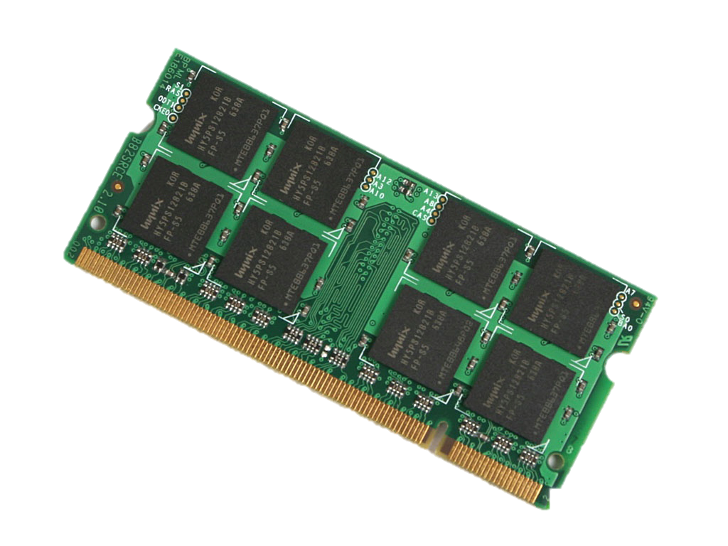

Fault Recovery Example
Two-partition RDD A={A₁, A₂} stored on disk
filter and cache → RDD B
join→ RDD C
aggregate → RDD D
A₁
filter
B₁
join
C₁
RDD A
agg.
D
A₂
filter
B₂
join
C₂

Slide 60
Fault Recovery Example
C₁ lost due to node failure before “aggregate” finishes
A₁
filter
B₁
join
C₁
RDD A
agg.
D
A₂
filter
B₂
join
C₂

Slide 61
Fault Recovery Example
C₁ lost due to node failure before reduce finishes
Reconstruct C₁, eventually, on different node
A₁
filter
B₁
join
C₁
agg.
agg.
D
RDD A
D
A₂
filter
B₂
join
C₂

Slide 62
Fault Recovery Results
Failure happens
Notes:
These are for K-means

Slide 63
Spark Streaming: Motivation
Process large data streams at second-scale latencies
Site statistics, intrusion detection, online ML
To build and scale these apps users want
Fault-tolerance: both for crashes and stragglers
Exactly one semantics
Integration: with offline analytical stack

Slide 64

Spark Streaming
Data streams are chopped into batches
A batch is an RDD holding a few 100s ms worth of data
Each batch is processed in Spark
receivers
data streams
batches

Slide 65

How does it work?
Data streams are chopped into batches
A batch is an RDD holding a few 100s ms worth of data
Each batch is processed in Spark
Results pushed out in batches
Streaming
receivers
data streams
batches
results

Slide 66
Streaming Word Count
val lines = context.socketTextStream(“localhost”, 9999)
val words = lines.flatMap(_.split(" "))
val wordCounts = words.map(x => (x, 1)).reduceByKey(_ + _)
wordCounts.print()
ssc.start()
create DStream
from data over socket
split lines into words
count the words
print some counts on screen
start processing the stream

Slide 67
Word Count
object NetworkWordCount {
def main(args: Array[String]) {
val sparkConf = new SparkConf().setAppName("NetworkWordCount")
val context = new StreamingContext(sparkConf, Seconds(1))
val lines = context.socketTextStream(“localhost”, 9999)
val words = lines.flatMap(_.split(" "))
val wordCounts = words.map(x => (x, 1)).reduceByKey(_ + _)
wordCounts.print()
ssc.start()
ssc.awaitTermination()
}
}

Slide 68
Word Count
public class WordCountTopology {
public static class SplitSentence extends ShellBolt implements IRichBolt {
public SplitSentence() {
super("python", "splitsentence.py");
}
@Override
public void declareOutputFields(OutputFieldsDeclarer declarer) {
declarer.declare(new Fields("word"));
}
@Override
public Map<String, Object> getComponentConfiguration() {
return null;
}
}
public static class WordCount extends BaseBasicBolt {
Map<String, Integer> counts = new HashMap<String, Integer>();
@Override
public void execute(Tuple tuple, BasicOutputCollector collector) {
String word = tuple.getString(0);
Integer count = counts.get(word);
if (count == null)
count = 0;
count++;
counts.put(word, count);
collector.emit(new Values(word, count));
}
@Override
public void declareOutputFields(OutputFieldsDeclarer declarer) {
declarer.declare(new Fields("word", "count"));
}
}
Spark Streaming
Storm
object NetworkWordCount {
def main(args: Array[String]) {
val sparkConf = new SparkConf().setAppName("NetworkWordCount")
val context = new StreamingContext(sparkConf, Seconds(1))
val lines = context.socketTextStream(“localhost”, 9999)
val words = lines.flatMap(_.split(" "))
val wordCounts = words.map(x => (x, 1)).reduceByKey(_ + _)
wordCounts.print()
ssc.start()
ssc.awaitTermination()
}
}
public static void main(String[] args) throws Exception {
TopologyBuilder builder = new TopologyBuilder();
builder.setSpout("spout", new RandomSentenceSpout(), 5);
builder.setBolt("split", new SplitSentence(), 8).shuffleGrouping("spout");
builder.setBolt("count", new WordCount(), 12).fieldsGrouping("split", new Fields("word"));
Config conf = new Config();
conf.setDebug(true);
if (args != null && args.length > 0) {
conf.setNumWorkers(3);
StormSubmitter.submitTopologyWithProgressBar(args[0], conf, builder.createTopology());
}
else {
conf.setMaxTaskParallelism(3);
LocalCluster cluster = new LocalCluster();
cluster.submitTopology("word-count", conf, builder.createTopology());
Thread.sleep(10000);
cluster.shutdown();
}
}
}

Slide 69
Spark 2.0
Dataframes/datasets instead of RDDs
Like tables in SQL
Far more efficient:
Can directly access any field (dramatically reduce I/O and serialization/deserialization)
Can use column oriented access
Dataframe APIs (e.g., Python, R, SQL) use same optimizer: Catalyst
New libraries or old libraries revamped to use dataframe APIs
Spark Streaming → Structured Streaming
GraphX

Slide 70




General
Unifies batch, interactive, streaming workloads
Easy to build sophisticated applications
Support iterative, graph-parallel algorithms
Powerful APIs in Scala, Python, Java, R
SparkSQL
Spark Streaming
MLlib
GraphX
SparkR
Spark Core

Slide 71
Summary
MapReduce and later Spark jump-started Big Data processing
Lesson learned
Simple design, simple computation model can go a long way
Scalability, fault-tolerance first, performance next
With Dataframes and SparkSQL now Spark implements DB like optimizations which significantly increase performance

Slide 72
Discussion
 | OpenMP/Cilk | MPI | MapReduce / Spark
Environment, Assumptions | Single node, multiple core, shared memory | Supercomputers Sophisticate programmers High performance Hard to scale hardware | Commodity clusters Java programmers Programmer productivity Easier, faster to scale up cluster
Computation Model | Fine-grained task parallelism | Message passing | Data flow / BSP
Strengths | Simplifies parallel programming on multi-cores | Can write very fast asynchronous code | Fault tolerance
Weaknesses | Still pretty complex, need to be careful about race conditions | Fault tolerance Easy to end up with non-deterministic code (if not using barriers) | Not as high performance as MPI

