Slide 1
MPI and comparison of models Lecture 23, cs262a
Ion Stoica & Ali Ghodsi
UC Berkeley
April 16, 2018
Notes:
3-D graph
Checklist
What we want to enable
What we have today
How we’ll get there

Slide 2
MPI
MPI - Message Passing Interface
Library standard defined by a committee of vendors, implementers, and parallel programmers
Used to create parallel programs based on message passing
Portable: one standard, many implementations
Available on almost all parallel machines in C and Fortran
De facto standard platform for the HPC community

Slide 3
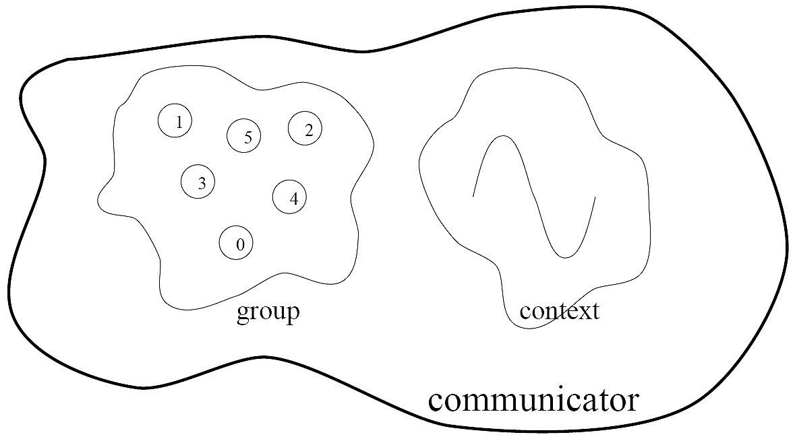
Groups, Communicators, Contexts
Group: a fixed ordered set of k processes, with ranks, i.e., 0, 1, …, k-1
Communicator: specify scope of communication
Between processes in a group (intra)
Between two disjoint groups (inter)
Context: partition of comm. space
A message sent in one context cannot be received in another context
This image is captured from:
“Writing Message Passing Parallel Programs with MPI”, Course Notes, Edinburgh Parallel Computing Centre
The University of Edinburgh

Slide 4
Synchronous vs. Asynchronous Message Passing
A synchronous communication is not complete until the message has been received
An asynchronous communication completes before the message is received

Slide 5
Communication Modes
Synchronous: completes once ack is received by sender
Asynchronous: 3 modes
Standard send: completes once the message has been sent, which may or may not imply that the message has arrived at its destination
Buffered send: completes immediately, if receiver not ready, MPI buffers the message locally
Ready send: completes immediately, if the receiver is ready for the message it will get it, otherwise the message is dropped silently

Slide 6
Blocking vs. Non-Blocking
Blocking, means the program will not continue until the communication is completed
Synchronous communication
Barriers: wait for every process in the group to reach a point in execution
Non-Blocking, means the program will continue, without waiting for the communication to be completed

Slide 7
MPI library
Huge (125 functions)
Basic (6 functions)

Slide 8
MPI Basic
Many parallel programs can be written using just these six functions, only two of which are non-trivial;
MPI_INIT
MPI_FINALIZE
MPI_COMM_SIZE
MPI_COMM_RANK
MPI_SEND
MPI_RECV

Slide 9
Skeleton MPI Program (C)
#include <mpi.h>
main(int argc, char** argv)
{
MPI_Init(&argc, &argv);
/* main part of the program */
/* Use MPI function call depend on your data
* partitioning and the parallelization architecture
*/
MPI_Finalize();
}

Slide 10
A minimal MPI program (C)
#include “mpi.h”
#include <stdio.h>
int main(int argc, char *argv[])
{
MPI_Init(&argc, &argv);
printf(“Hello, world!\n”);
MPI_Finalize();
return 0;
}

Slide 11
A minimal MPI program (C)
#include “mpi.h” provides basic MPI definitions and types.
MPI_Init starts MPI
MPI_Finalize exits MPI
Notes:
Non-MPI routines are local; this “printf” run on each process
MPI functions return error codes or MPI_SUCCESS

Slide 12
Improved Hello (C)
#include <mpi.h>
#include <stdio.h>
int main(int argc, char *argv[])
{
int rank, size;
MPI_Init(&argc, &argv);
/* rank of this process in the communicator */
MPI_Comm_rank(MPI_COMM_WORLD, &rank);
/* get the size of the group associates to the communicator */
MPI_Comm_size(MPI_COMM_WORLD, &size);
printf("I am %d of %d\n", rank, size);
MPI_Finalize();
return 0;
}

Slide 13
Improved Hello (C)
/* Find out rank, size */
int world_rank, size;
MPI_Comm_rank(MPI_COMM_WORLD, &world_rank);
MPI_Comm_size(MPI_COMM_WORLD, &world_size);
int number;
if (world_rank == 0) {
number = -1;
MPI_Send(&number, 1, MPI_INT, 1, 0, MPI_COMM_WORLD);
} else if (world_rank == 1) {
MPI_Recv(&number, 1, MPI_INT, 0, 0, MPI_COMM_WORLD, MPI_STATUS_IGNORE);
printf("Process 1 received number %d from process 0\n", number);
}
Tag to identify message
Number of elements
Rank of destination
Default communicator
Rank of source
Status

Slide 14
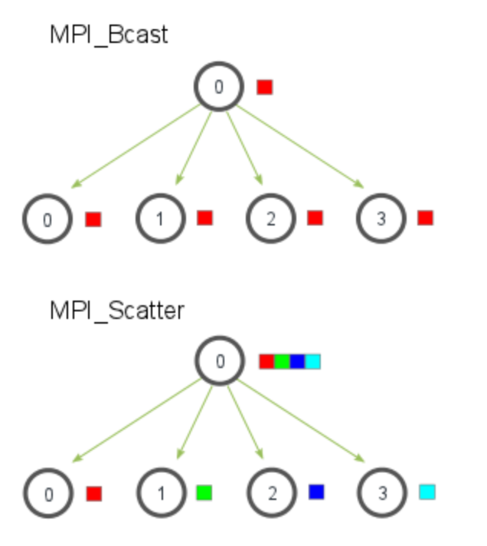
Many other functions…
MPI_Bcast: send same piece of data to all processes in the group
MPI_Scatter: send different pieces of an array to different processes (i.e., partition an array across processes)
From: http://mpitutorial.com/tutorials/mpi-scatter-gather-and-allgather/

Slide 15
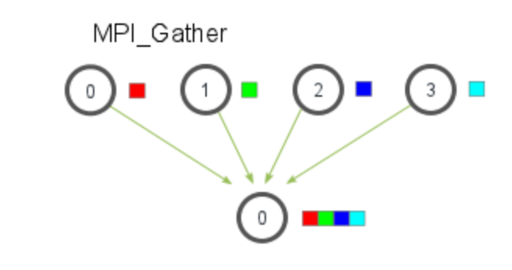
Many other functions…
MPI_Gather: take elements from many processes and gathers them to one single process
E.g., parallel sorting, searching
From: http://mpitutorial.com/tutorials/mpi-scatter-gather-and-allgather/

Slide 16
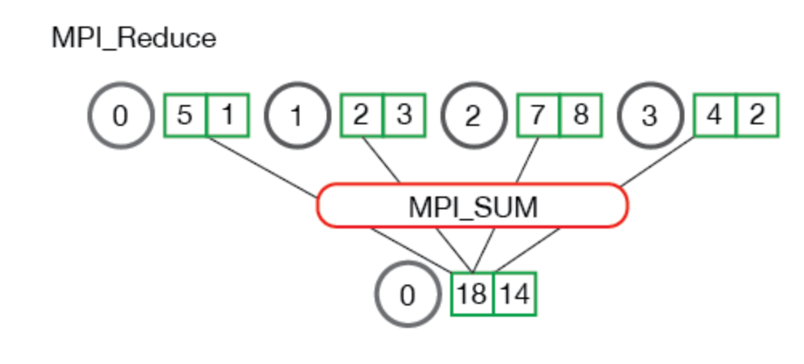
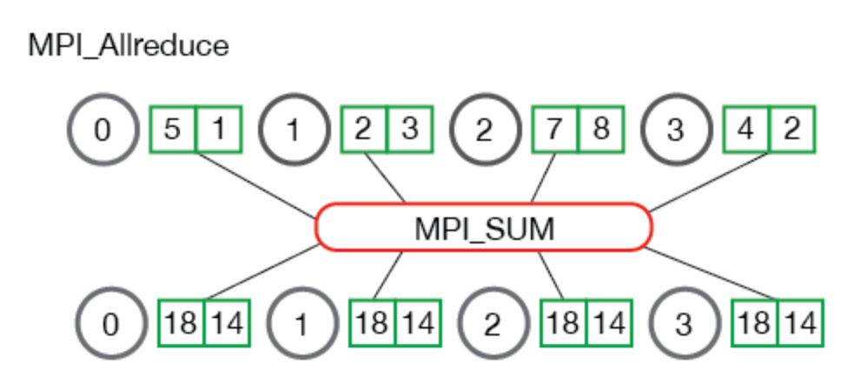
Many other functions…
MPI_Reduce: takes an array of input elements on each process and returns an array of output elements to the root process given a specified operation
MPI_Allreduce: Like MPI_Reduce but distribute results to all processes
From: http://mpitutorial.com/tutorials/mpi-scatter-gather-and-allgather/

Slide 17
MPI Discussion
Gives full control to programmer
Exposes number of processes
Communication is explicit, driven by the program
Assume
Long running processes
Homogeneous (same performance) processors
Little support for failures (checkpointing), no straggler mitigation
Summary: achieve high performance by hand-optimizing jobs but requires experts to do so, and little support for fault tolerance

Slide 18
Today’s Paper
A High-Performance, Portable Implementation of the MPI Message Passing Interface Standard, William Gropp, Ewing Lusk, Nathan Doss, Anthony Skjellum, Journal of Parallel Computing, Vol 22, Issue 6, Sep 1996 https://ucbrise.github.io/cs262a-spring2018/notes/MPI.pdf

Slide 19
MPI Chameleon
Many MPI implementations existed. MPICH’s goal was to create an implementation that was both
Portable (hence the name CHameleon)
Performant

Slide 20
Portability
MPICH is portable and leverages:
High performance switches
Supercomputers where different node communicate over switches (Paragon, SP2, CM-5)
Shared memory architectures
Implement efficient message passing on these machines (SGI Onyx)
Networks of workstations
Ethernet connected distributed systems communicating using TCP/IP

Slide 21
Performance
MPI standard already allowed to optimizations where usability wasn’t restricted.
MPICH comes with performance test suite (mpptest), it works both on MPICH but also on top of other MPI implementations!

Slide 22
Performance & Portability tradeoff
Why is there a tradeoff?
Custom implementation for each hardware (+performance)
Shared re-usable code across all hardware (+quick portability)
Keep in mind that this was the era of super computers
IBM SP2, Meiko CS-2, CM-5, NCube-2 (fast switching)
Cray T3D, SGI Onyx, Challenge, Power Challenge, IBM SMP (shared memory)
How do you use all the advanced hardware features ASAP?
This paper shows you how to have your cake and eat it too!

Slide 23
How to eat your cake and have it too?
Small narrow Abstract Device Interface (ADI)
Implemented on lots of different hardwares
Highly tuned and performant
Uses an even smaller (5 function) Channel Interface.
Implement all of MPI on top of ADI and the Channel interface
Porting to a new hardware requires porting ADI/Channel implementations.
All of the rest of the code is re-used (+portability)
Super fast message passing for various hardwares (+performance)

Slide 24
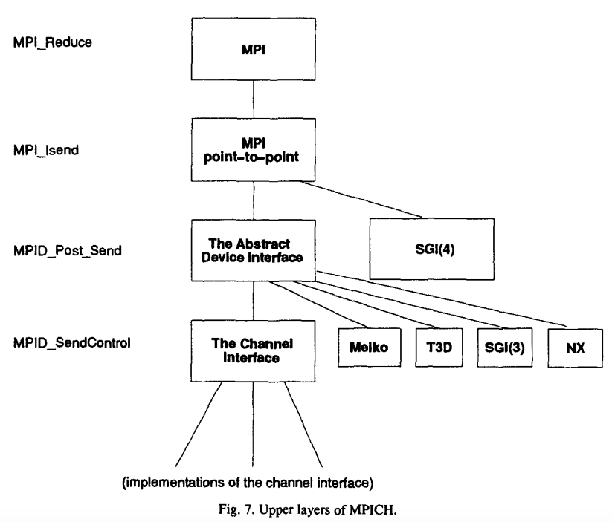
MPICH Architecture

Slide 25
ADI functions
Message abstraction
Moving messages from MPICH to actual hardware
Managing mailboxes (messages received/sent)
Providing information about the environment
If some hardware doesn’t support the above, then emulate it.

Slide 26
Channel Interface
Implements transferring data or envelope (e.g. communicator, length, tag) from one process to another
MPID_SendChannel to send a message
MPID_RecvFromChannel to receive a message
MPID_SendControl to send control (envelope) information
MPID_ControlMsgAvail checks if new ctrl msgs available
MPID_RecvAnyControl to receive any control message
Assuming that the hardware implements buffering. Tradeoff!

Slide 27
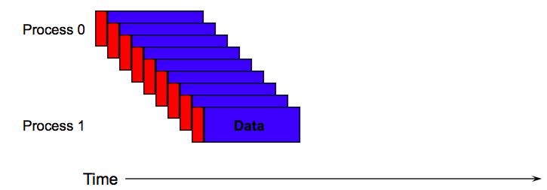
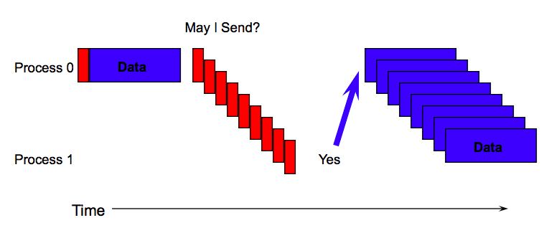
Eager vs Rendezvous
Eager mode immediately sends data to receiver
Deliver envelope and data immediately without checking with recv
Rendezvous
Deliver envelope, but check that receiver is ready to recv before sending data
Pros/Cons? Why needed?
Buffer overflow, asynchrony!
Speed vs robustness

Slide 28
How to use Channel Interface?
Shared memory
Complete channel implementation with malloc, locks, mutex:es
Specialized
Bypass shard memory portability, use hardware directly available in SGI and HPI shared memory systems
Scalable Coherent Interface (SCI)
Special implementation that uses the SCI standard

Slide 29
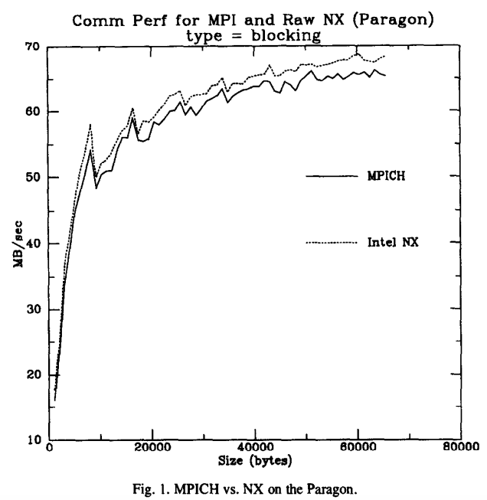
Competitive performance vs vendor specific solutions

Slide 30
Summary
Many super computer hardware implementations
Difficult to port MPI to all of them and use all specialized hardware
Portability vs Performance tradeoff
MPICH achieved both by carefully designing a kernel API (ADI)
Many ADI implementations that leverage hardware (performance)
All of MPICH build on ADI (portability)

Slide 31
Discussion
 | MPI | OpenMP | Ray | Spark / MapReduce
Environment, Assumptions | Supercomputers Sophisticated programmers High performance Hard to scale hardware | Single node, multiple core, shared memory | Commodity clusters Python programmers | Commodity clusters Java programmers Programmer productivity Easier, faster to scale up cluster
Computation Model | Message passing Lowest level | Shared memory Low level | Data flow / task parallel High level | Data flow / BSP Highest level
Strengths | Fastest asynchronous code | Simplifies parallel programming on multi-cores | Very high performance Very flexible | Very easy to use for parallel data processing (seq. control) Maximum fault tolerance
Weaknesses | Fault tolerance Easy to end up with non-deterministic code (if not using barriers), more code | Pretty complex, need to be careful about race conditions | Need to understand program structure for best performance; Inefficient fault-tolerance for actors | Harder to implement irregular computations (e.g., nested parallelism, ignore stragglers); Lower performance

