Slide 1
Making Information Flow Explicit in HiStar Lecture 25, cs262a
Ion Stoica & Ali Ghodsi
UC Berkeley
April 23, 2018
Notes:
3-D graph
Checklist
What we want to enable
What we have today
How we’ll get there

Slide 2
Today’s Paper
Making Information Flow Explicit in HiStar, Nickolai Zeldovich, Silas Boyd-Wickizer, Eddie Kohler, and David Mazières https://people.csail.mit.edu/nickolai/papers/zeldovich-histar.pdf

Slide 3
Motivation
Security vulnerabilities discovered in all kinds of apps
Buffer overflows, format string issues, SQL injection, JS injection, temp file races, integer overflows
Security implemented at many different levels
Web app implements its own logic, e.g. private Facebook posts
Web servers implement access to different directories (.htaccess)
OS implements its own ACLs, users, SU, …
Hardware implements security, page tables, etc
Bugs could exist anywhere, high level info can be leaked at any level!
Meltdown leaking secret webapp info to another tenant

Slide 4
Main idea
Small kernel (20k LoC) that controls information flow
Don’t care about bugs in programs, make sure kernel isn’t buggy
Control the information flow between potentially buggy programs
Seen this idea before?
Example
Antivirus needs to scan all your files.
It will see confidential information.
If the AV code is malicious, it can communicate that code out over the Internet
Kernel can simply now allow AV to send info anywhere

Slide 5
Military research in the 70s: Bell LaPadula
Bell Lapadula
Preserve confidentiality
Subjects reading/writing Objects
Subjects and Objects given a level, e.g. 1…4 (unclassified…top secret)
No read up
Subject at level i cannot read object at level j when i < j
e.g. anonymous user reading root’s files (could leak /etc/passwd)
No write down
Subject at level i cannot write object at level j when i > j
e.g. root writing to /user/anonymous (could leak secret info to anonymous)

Slide 6
Military research in the 70s: Biba
Biba
Preserve integrity / trustworthiness
Who would you trust when receiving information?
No write up
Subject at level i cannot write object at level j when i < j
Cannot authoritatively provide information to the upper levels
No read down
Subject at level i cannot read object at level j when i > j
Cannot trust information from lower levels

Slide 7
Military Operating Systems
Early OS:s implemented these ideas for file systems
Policies on how top secret or classified information could be handled
Reading and writing of files were protected
How is it different from today’s file systems and their security?
Application level concepts wouldn’t get these benefits
OS doesn’t know about the app data
HiStar exposes these security mechanisms to all apps
Information Flow as basic OS mechanisms exposed to apps!
Can implement Bell Lapadula and Biba in any app!

Slide 8
Information Flow Control (IFC)
How should we track information flow?
Associate a Label with the data
Label follows data when it moves around
Labels determine what you can do with the data
e.g. SSN cannot be sent to any other computer

Slide 9
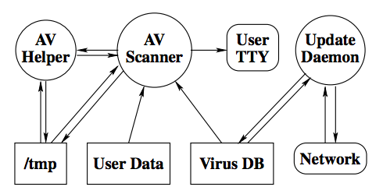
Example: Virus Scanner
AV Scanner/Helper
Read virus DB (signatures)
Read all files
Read/write tmp files
Write to screen scan status
Update daemon
Read/write data to Internet to fetch latest virus DB
Write to the virus DB to update it
Can we protect files from corruption and leakage to outside?

Slide 10
Problems today
Any process can get hacked
Ways in leaks could happen?
Send private data to Internet
Prevent AV scanner to communicate with the Internet!

Slide 11
Problems today
Any process can get hacked
Ways in leaks could happen?
Collude with Update DM
Update DM needs Inet
Prevent IPC too!

Slide 12
Problems today
Any process can get hacked
Ways in leaks could happen?
AV write data to tmp files
Update DM read tmp files

Slide 13
Problems today
OS today have protection
File systems with RBAC
Process protection
Memory protection
What’s the problem?
They ignore information flow
Process P can read a secret file it has access to and write it to a public file
P does so either maliciously or by getting hacked, e.g. buffer overflow
OS:s allow violating Bell Lapadula (no write down violated)

Slide 14
Information Flow to save us!
Information Flow Solution
Files & processes colored
Label private stuff RED
Label public stuff GREEN
Enforce the arrows in the chart

Slide 15
Kernels Objects
Six kernel objects
Segment (data itself), array of bytes
Thread
Address space
Device (network)
Gate (IPC)*
Container (“directory”), ever kernel object inside a container
All of Unix implemented on top of the 6 objects!

Slide 16
Information Flow: Labels & Categories
Every Kernel Object has a label
Label tells you the security property of the information inside an object
Since an object (e.g. Thread) might contain multiple types of information, labels contain multiple Categories (think of a category as a color)
HiStar will only allow kernel objects to interact (information to flow) if two kernel objects have “consistent” labels, i.e. implement Bell Lapadula/Biba
Segment
(Data Array)
Thread
Segment
(Data Array)

Slide 17
Antivirus example fixed with information flow
?
Great. But how do we get the AV result to the terminal screen?
Process creating a category (color) owns it: it can declassify it and bypass restrictions on that category.
Small 140 line wrapper script extracts the AV output and prints it

Slide 18
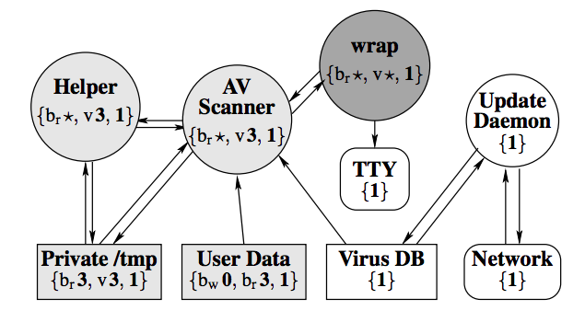
AV explained in full
Colors (categories) have levels, own, 0 lowest, 1 default, 4 highest
Bob marks all User Data as color {b_{w}0,b_{r}3,1}, i.e. color bob_{write}=0, bob_{read}=3, all other colors = 1
wrap creates and owns v (virus) category, and owns read category (can downgrade and bypass v and r restrictions)
wrap spawns virus scanner and helper with v level 3, /tmp with v level 3
AV/helper cannot communicate with network, update daemon, because they don’t have color v=3, it can write secrets to /tmp (but others cannot read it)
AV/helper cannot corrupt files, because they don’t have b_{w} permission
All communication through trusted 140 line wrap

Slide 19
Unix vs IFC
How is this different from Unix? We just have to be careful with permissions, right?
No, HiStar tracks information flow!
Any information flow out of AV gets tainted as special virus permission v3
If you don’t have v3, AV scanner cannot leak to you. No matter how buggy AV/Helper is, no matter how many buffer overflows or malicious code snippets it has!
In Unix, AV scanner might by mistake leak information to a public file, screen, or network

Slide 20
Conclusion
Current OSs have too many aspects that need to be secured
Sloppy code in many places lead to vulnerabilities
HiStar offers a minimalistic kernel that exposes information flow
Six objects in the kernel
Each object has a label (categories/colors)
Information flow controlled between objects
All of Unix implemented on top of these few abstractions
New applications can implement security using these abstractions

Slide 21
Zooming out
Radically different approach to OSs.
DAC vs MAC
Attacks the problem with a small microkernel
Everything else implemented on top of it
All future applications benefit from the security of HiStar
Great bold paper! Realistic implementation.
Why didn’t it have more impact?

