Slide 1
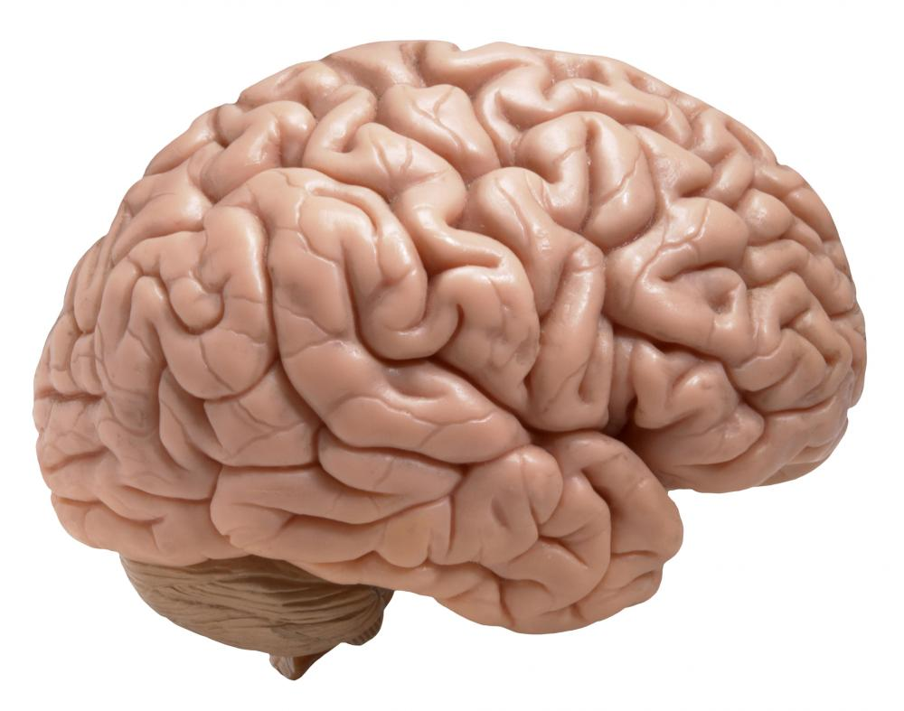
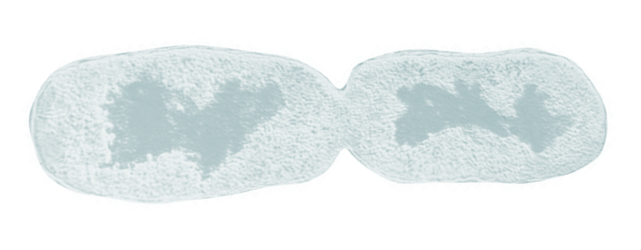

Sensory states
brain
External states
Internal states
Active states
bacillus
External states
Blanket states
Internal states

