Slide 1
Notes for presenters:
  These slides are provided courtesy of Tom Cortina (Carnegie Mellon University). Details about this activity can be found at http://csunplugged.org/finite-state-automata
  You can use the A/B buttons to navigate the map that’s in the Unplugged activity, which is useful if you need to do the activity indoors
  Suggest use is that you give out the blank map (in the book) to each student, and have them vote on taking A or B at each step, or simply nominate someone to choose.
  You can also have people nominated as islands, and as each island comes up, throw a ball (or toy boat) to that person.
  This file includes some images from the book and video. You can use these to discuss:
    Generating output (like “The old clown sang”)
    Parsing input (is “The old clown” valid? – No, because you don’t end up in the double-circle/treasure/accepting state)
    Interface evaluation – draw the A/B transitions for buttons on someone’s digital watch – a sample diagram is included. This indicates how complex the interface is for users
    General expression parsing – for example, get students to figure out the FSA that accepts an odd number of A’s. (which, by the way, is relevant to the parity activity, where you need to find rows and columns with an odd number of 1 bits).
  If you make changes to this file, please share them with the community. Contact tim.bell@canterbury.ac.nz with any improvements.

Slide 2
TREASURE HUNT
Computer programs often need to process a sequence of symbols such as words in a document or even the text of another program.
Computer scientists use a Finite State Automaton (FSA), a set of instructions to see if the sequence is acceptable or not.
This exercise uses the FSA idea using treasure maps!

Slide 3
TREASURE HUNT
Goal: Find Treasure Island
Start: from Pirates' Island
Friendly pirate ships sail along fixed routes between islands offering rides to travelers.
Each island has two departing ships, A and B.
Determine all possible sequences of ships that a traveler can take to arrive at Treasure Island.
Use your map to record all the ship routes.

Slide 4
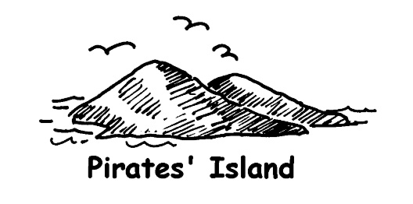
TREASURE HUNT
Pirate’s Island
A
B

Slide 5

TREASURE HUNT
Dead Man’s Island
A
B

Slide 6
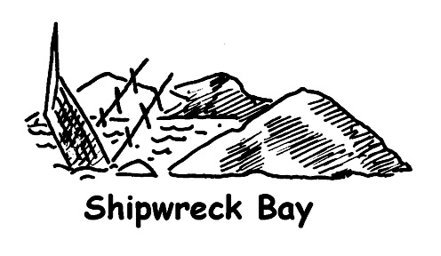
TREASURE HUNT
Shipwreck Bay
A
B

Slide 7

TREASURE HUNT
Mutineers’ Island
A
B

Slide 8

TREASURE HUNT:
Smugglers’ Cove
A
B

Slide 9

TREASURE HUNT:
Musket Hill
A
B

Slide 10

TREASURE HUNT:
Treasure Island
PLAY AGAIN

Slide 11
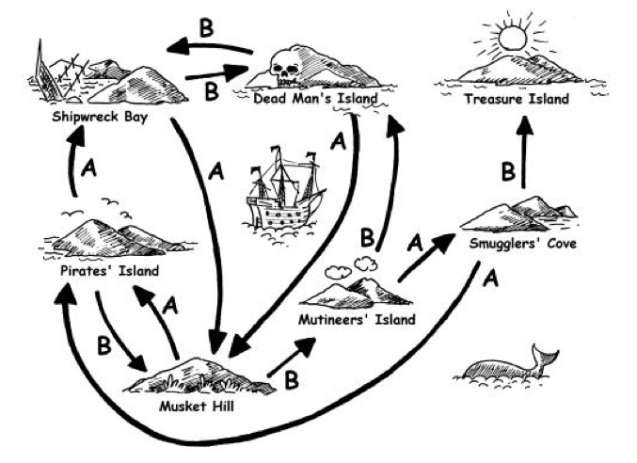
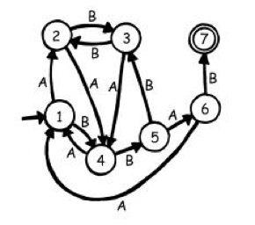
TREASURE HUNT
What is the
quickest
route?
Finite State Automaton

Slide 12
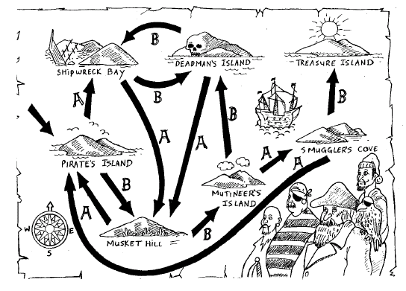
Finite state automaton

Slide 13
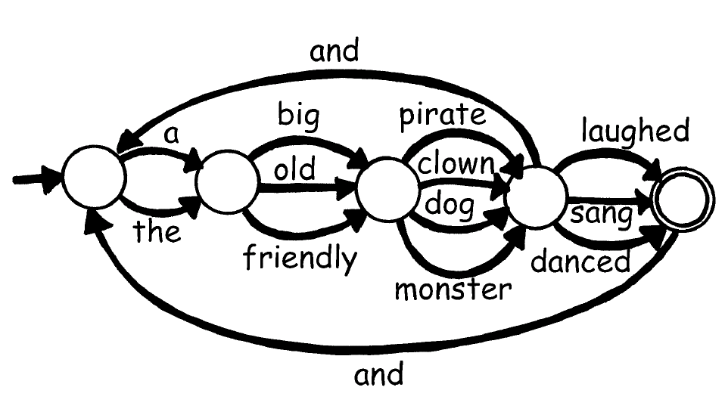
CT concepts – languages

Slide 14
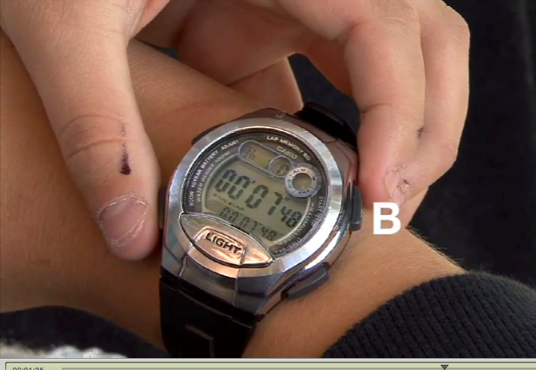
Interface design
A

Slide 15
Interface design
A

Slide 16
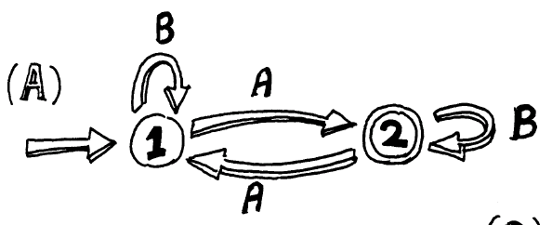
Simple languages

Slide 17
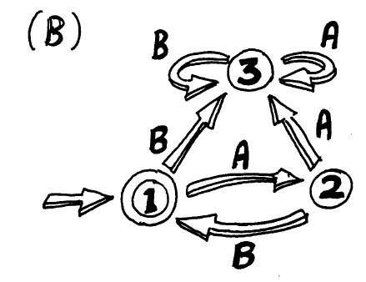

Slide 18
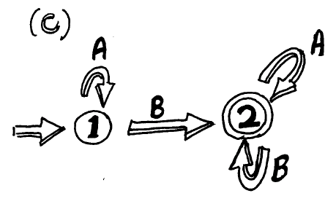

Slide 19
