Slide 1
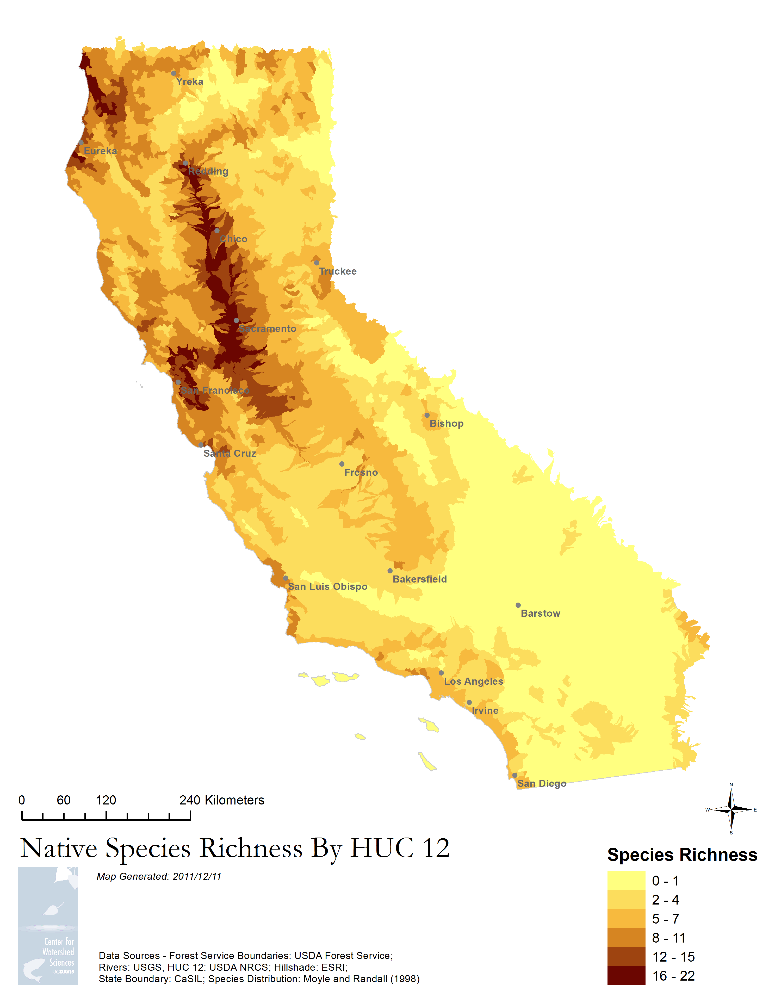
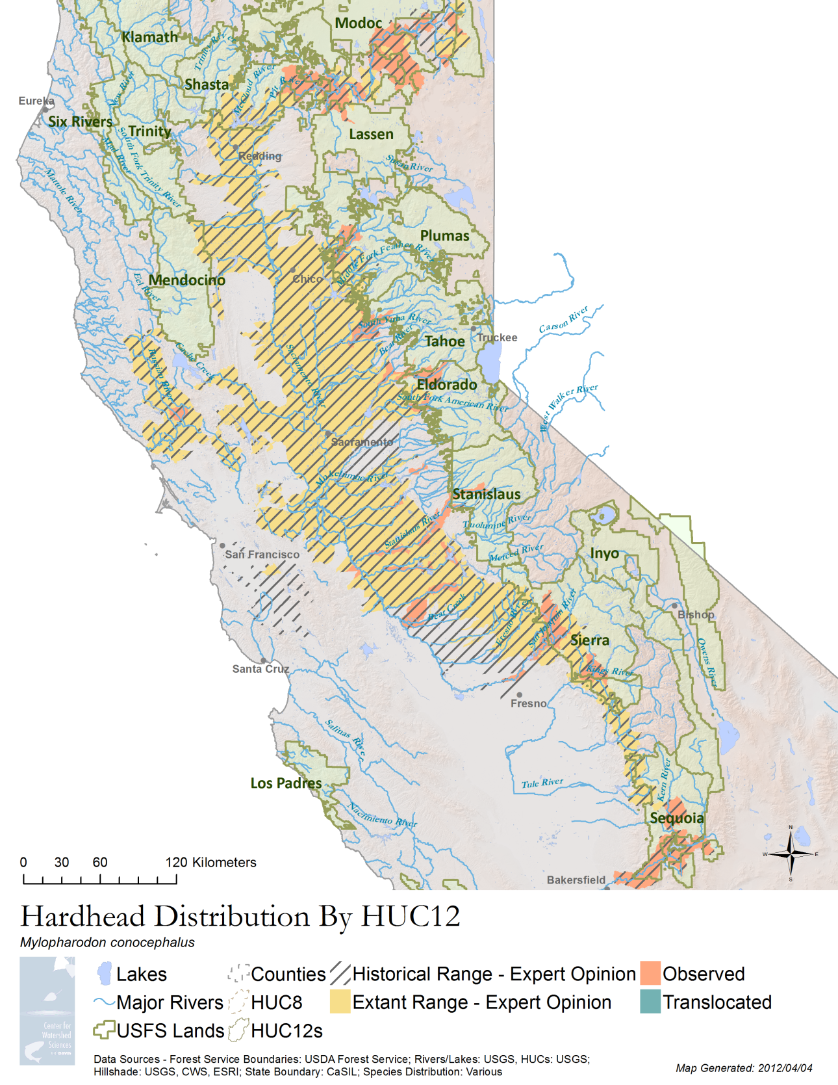
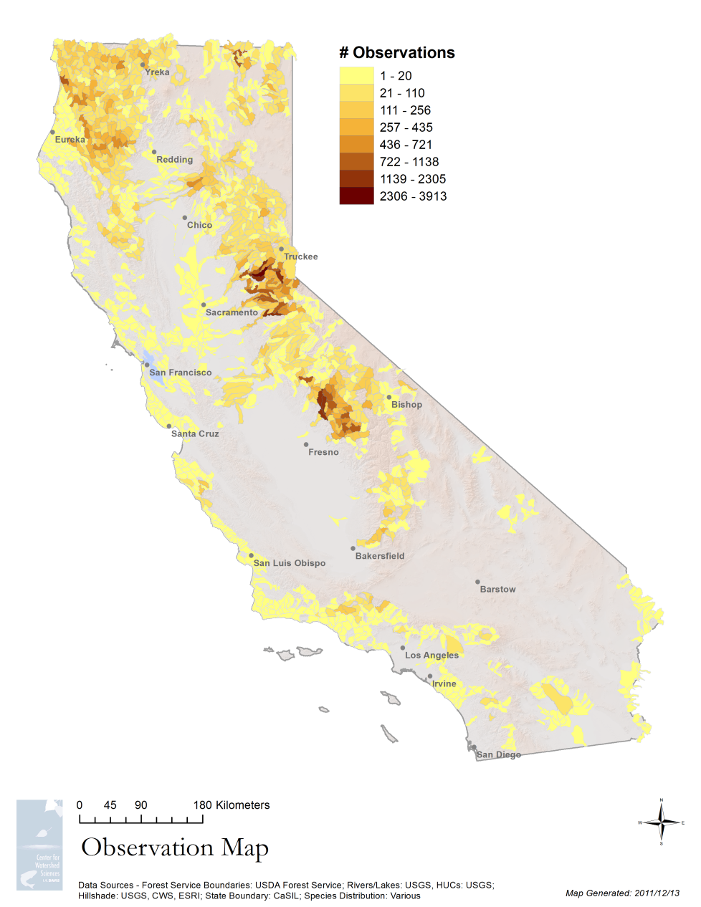
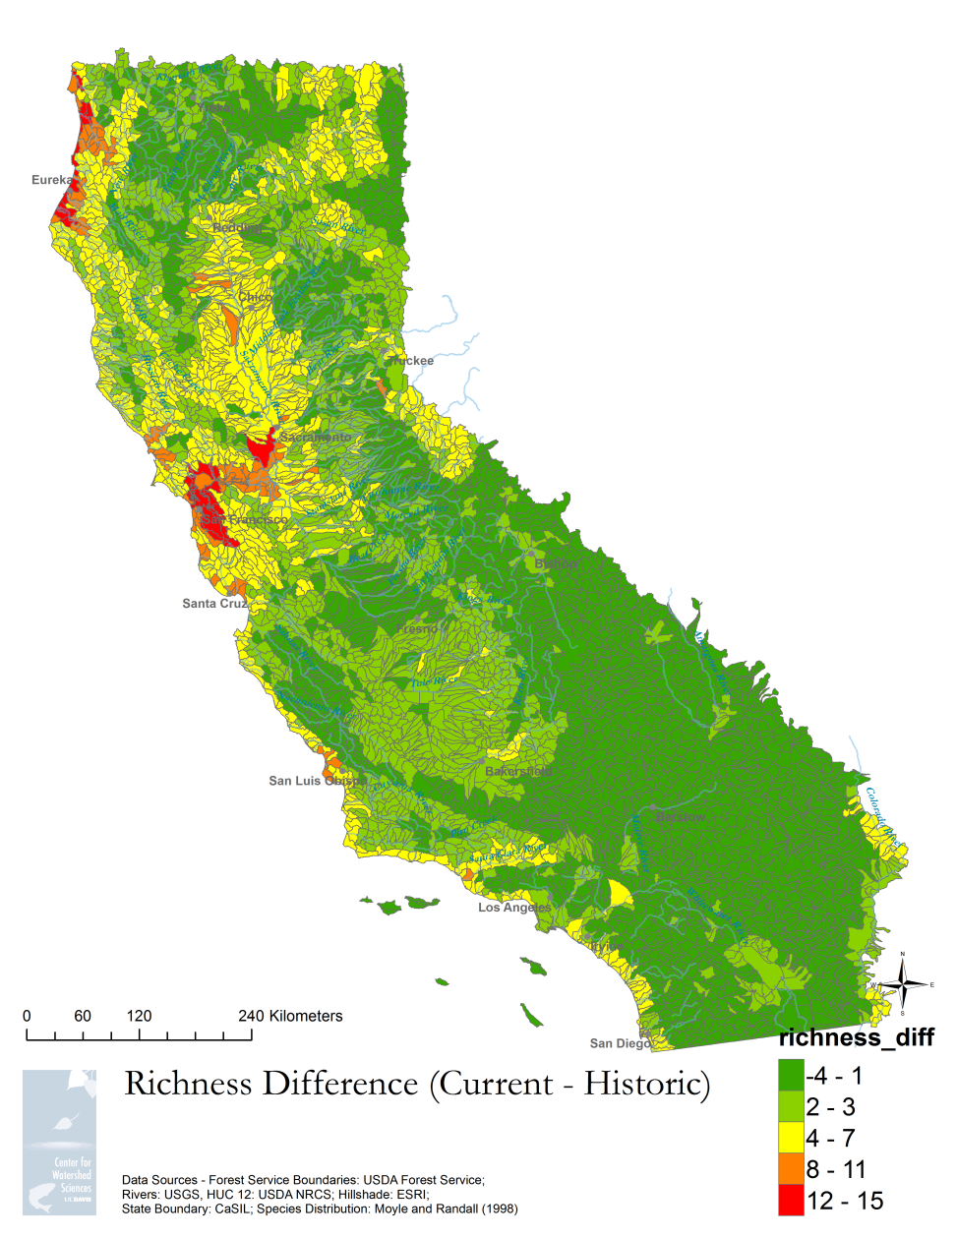
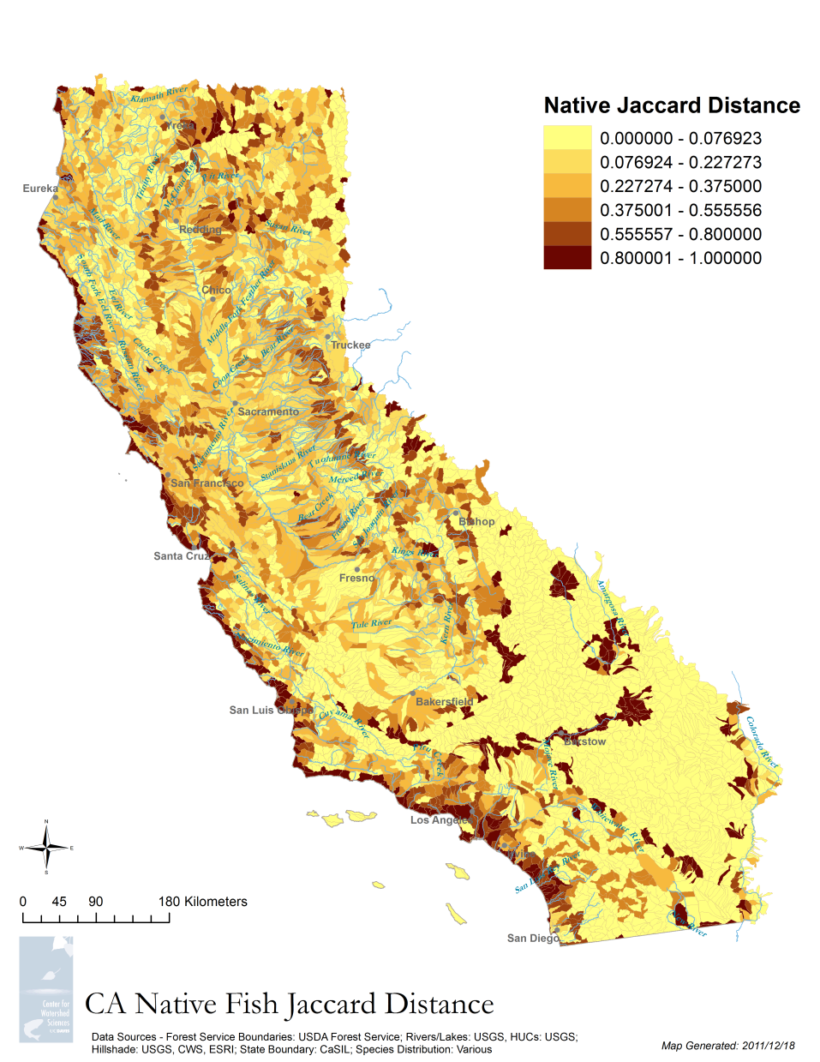
PISCES
5
1
PISCES is software written in Python that connects to ArcGIS and combines all the available data for fish species and lets us process it, combine it, store it, and view it, regardless of data storage format, design, or scale.
We have collected datasets from agencies and university staff on native fish species presence and combined them with expert knowledge to get the most comprehensive database of native fish species locations in California. By the time we are finished, PISCES will include complete range data for all 129 of California’s native freshwater fish taxa. We are now including amphibian data as well.
PISCES also includes a powerful mapping component (the maps at right were created with little staff intervention) that can combine, summarize and synthesize data while relating it to important human and environental factors. All maps can be easily regenerated as new data is incorporated.
The maps at the right (starting at top right, moving clockwise):
A simple species rangemap for PISCES. The generation of this map is fully automatic.
Native Fish Jaccard Distance (a measure of species beta diversity)
Alpha Richness Difference between pre-settlement and current times.
A map showing the spread of empirical data in the system (the rest is covered by expert information
Native species alpha richness – a raw count of the number of native fish taxa
4
3
2
Contact: Nick Santos (nrsantos@ucdavis.edu), or Josh Viers (jhviers@ucdavis.edu)

