Slide 1
Design of RF & Microwave Systems
EEC 134 A&B
Lecture 0: Course Mechanisms
Xiaoguang “Leo” Liu
Assistant Professor
School of Electrical and Computer Engineering
Tel: 530-289-6367
lxgliu@ucdavis.edu
http://ucdart.net

Slide 2
Course Objectives
To provide a senior design option for students interested in RF/microwave engineering
To provide a system design perspective
To get your hands dirty
To promote teamwork
To promote self-learning
To improve communication (oral & written) skills
To push your limit!

Slide 3
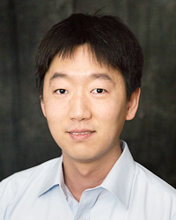
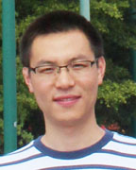
Basic Information
Instructor
Dr. Xiaoguang “Leo” Liu
Email: lxgliu@ucdavis.edu
Office hour: 10 AM – 12 PM Tuesday or by appointment in Kemper 3169
Teaching Assistants
Hao Wang
Email: haowang@ucdavis.edu
Office hours: 9:00 – 10:30 AM, Monday & Tuesday in Kemper 3089
Lecture
1:10 – 2 PM, Friday in Geidt 1007
Lab
Session 1: 2 – 5 PM, Friday
Session 2: 6 – 9 PM, Monday
Additional lecture time needed

Slide 4


Textbooks and References
There is no required textbook for this class
A highly recommended reference: Practical RF Circuit Design for Modern Wireless Systems
Volume I : Passive Circuits and Systems
Volume 2: Active Circuits and Systems

Slide 5







Textbooks and References
Additional texts that may be useful:
D.M. Pozar, “Microwave and Rf Design of Wireless Systems,” Wiley, 2000
D.M. Pozar, “Microwave Engineering,” Wiley, 2011
W.F. Egan, “Practical RF System,” Wiley, 2003
ADI Engineers, “Linear Circuit Design Handbook,” Newnes, 2008
C. Saytre, “Complete Wireless Design,” McGraw-Hill, 2008
P. Vizmuller, “RF Design Guide Systems, Circuits and Equations,” Artech House, 1995
J. Carr and G. Hippisley, “Practical Antenna Handbook,” McGraw-Hill, 2011

Slide 6
Course Organization
Quarter 1:
Lectures on RF/microwave system engineering
Guided labs to assemble, test and analyze a simple radar system
We’ll follow a bottom-up approach, i.e. learning about the individual components before eventually assembling the system.
Deliverables:
Lab reports
PCB design files and test reports
Quarter 2:
Radar performance competition
Compete in range and accuracy of distance speed measurements
Certain size/weight/power and construction constraints apply
(Optional) Radar system design for small UAVs
Deliverables:
Weekly progress report and presentation
Final report (1 per group)
Application Note / Tutorial (1 per individual)
Notes:
Add pictures in the future.

Slide 7
Teaming
Teaming has already started before the quarter through Piazza
We’ll allocate sometime for teaming up in this lecture
Each team should consist of 3 – 4 members
We recommend that you include team members of different background to complement each other
We need one student from each team to take up the responsibility of ordering supplies for your team
By the end of the first lecture, you will need to submit to the TA
Team name; will default to “Team #” if none submitted
Name of the purchaser

Slide 8
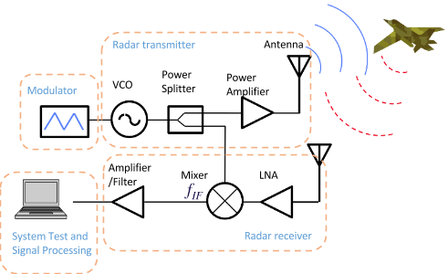
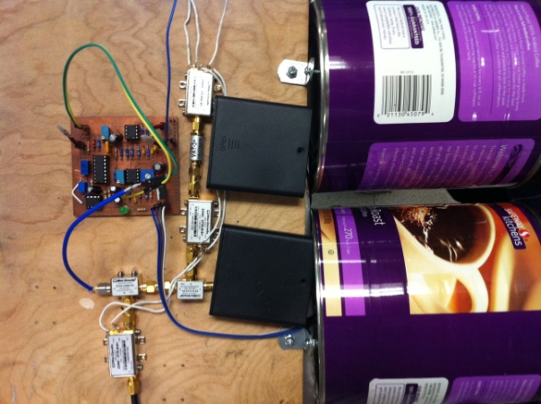
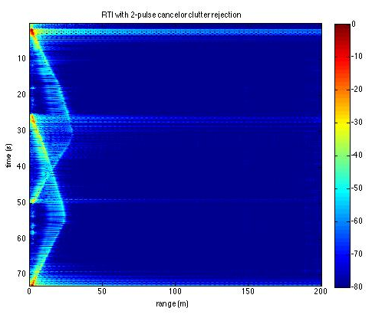
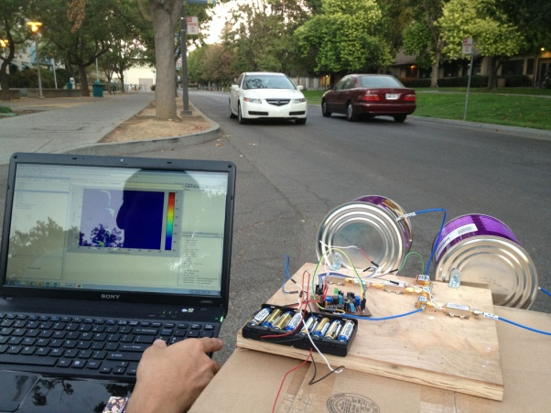
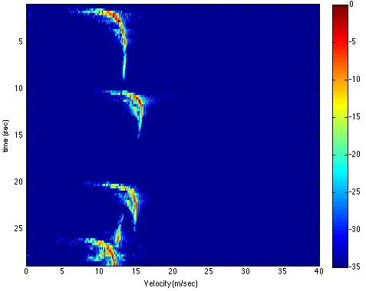
Quarter 1 – Assembly of a simple Radar
Baseband
RF
Antennas made from coffee cans
Doppler Testing
Range vs. Time
Speed vs. Time

Slide 9
Quarter 1 – Facilities and Supplies
We will be using Kemper 2112 for this class.
2112 is big enough to hold both sessions
2112 is usually locked outside of the class time, but each group can have a key to 2112 so that you can work off-hours
Each group will get a toolbox
In the first lab, you need to sign a form acknowledging that your group received the toolbox with all its contents
The toolbox and the components must be returned to the TA by the end of the Winter quarter before grades can be assigned
Your group must be responsible for replacing broken or lost items

Slide 10
Quarter 1 Lab Schedule
Week | Lectures | Labs
1 | Course mechanism | Elements of Electronic Systems
2 | Introduction
3 | RF amplifiers and basic concepts
4 |  | RF amplifier characterization
5 | Oscillators and Synthesizers | Oscillators characterization
6 | Frequency mixer and modulation | Mixers characterization
7 | Passive devices | Antenna
8 | Antennas and Propagation | Radar system assembly and characterization
9 | RF System Architectures
A more detailed schedule is available at the following link; make sure you read it carefully: TBD

Slide 11
Labs
Be warned!
Labs are heavy and time consuming.
Do the pre-lab problems, read the lab manually carefully, and plan well before you walk into the lab.
Team work is important! Everyone needs to work hard!
You may still end up needing both Friday and Monday sessions!
Lab reports are due on Fridays so plan your time well. If you rely on Monday sessions only, you will have one weekend less to finish your report!

Slide 12
Printed Circuit Board (PCB)
Learning PCB design is a critical focus of this class
We will have three “free” PCB design runs in Quarter 1.
1st run: Oct. 23rd
2nd run: Oct. 30th
3rd run: Nov. 6th
Hard deadlines; don’t even ask!
The cost of the above three runs is covered by the course fees
If you miss the deadline, you can still have the PCB made at your own cost
Similar runs will be arranged for Quarter 2
Notice that the first PCB is due only about a month from the start of the class so start early!

Slide 13
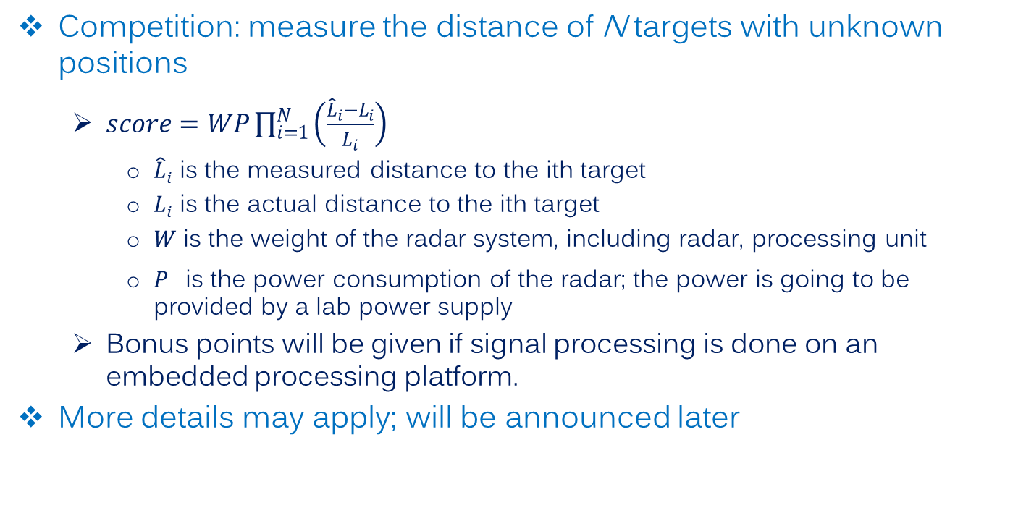
Quarter 2 – Option 1: Performance Competition
Competition: measure the distance of N targets with unknown positions
$score=WP\prod_{i=1}^{N}{\left(\frac{{\hat{L}}_{i}−L_{i}}{L_{i}}\right)}$
${\hat{L}}_{i}$ is the measured distance to the ith target
$L_{i}$ is the actual distance to the ith target
$W$ is the weight of the radar system, including radar, processing unit
$P^{}$is the power consumption of the radar; the power is going to be provided by a lab power supply
Bonus points will be given if signal processing is done on an embedded processing platform.
More details may apply; will be announced later

Slide 14
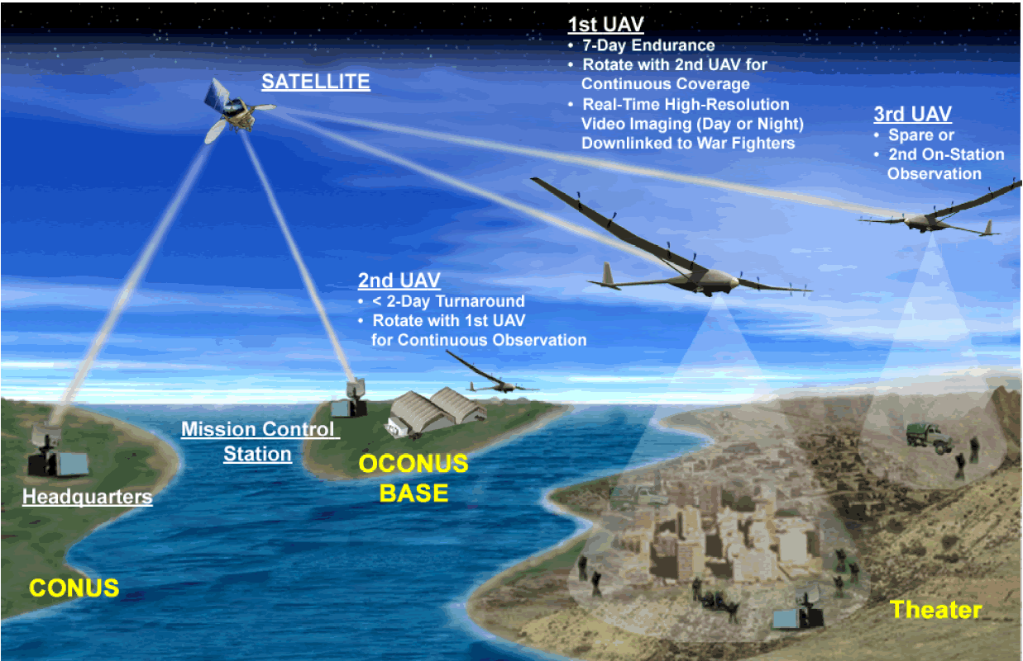
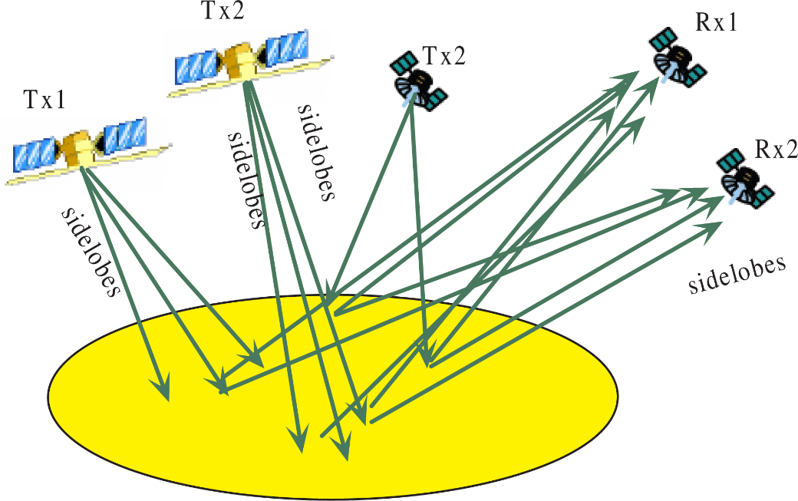
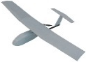
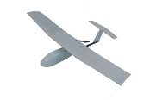
Quarter 2 – Option 2: Radar for UAV
Small unmanned aerial vehicles offer unique opportunities for high resolution remote sensing
Small low-power radar are needed as remote sensors, as well as situation awareness sensors, for UAV platforms.
Detailed specification will be announced in the middle of the quarter.

Slide 15
Grading
Quarter 1 (36 pts)
Lab reports (6x 4pts)
PCB design reports (3x 2pts)
PCB test reports (3x 2pts)
Quarter 2 (40 pts)
Competition (15 pts)
Final report (15 pts)
Application Note / Tutorial (15 pts)
Peer review (15 pts)
Participation (9 pts)
Based on Piazza participation, weekly report and presentation (quarter 2)
Graded by the instructor and TA
Purely subjective
Bonus points
A substantial portion of your grade!
Work hard and contribute to your team!

Slide 16
Grading – Bonus Points
Errors for Bonus!
Help us find errors (typos, grammar mistakes, technical mistakes, etc) in the course materials (lecture notes, lab manuals, guidelines, etc)
The first to find and report an error on Piazza gets 0.1 point for each error

Slide 17

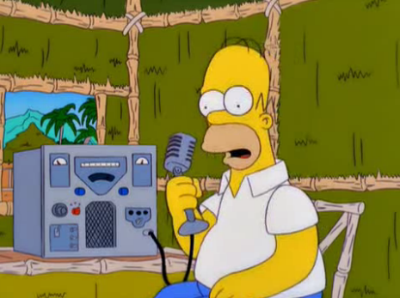
Grading – Bonus Points
Getting your HAM radio license
Technician class (2 pts)
Transmission above 30 MHz
General class (2 pts)
Access to the HF band
Extra (3 pts)
Transmission on all bands
Log on to www.arrl.org for information on licensing and exams
The following links provides additional materials for preparing for the exams
http://www.hamradioschool.com/
We may arrange training sessions or even exams

Slide 18


Grading – Bonus Points
Participating in the Picnic Day (10 pts) and/or the Maker Faire (10 pts)
Showcase your project
Some visual/audio effects are needed to attract the audience
Consent from the instructor
If you are interested in pursuing this, you should start talking with the instructor early

Slide 19





Seeking Help
The EEC 134 Piazza forum:
https://piazza.com/ucdavis/fall2014/eec134a/home
Reference materials provided by the class
The almighty Internet !
Google!
Wikipedia
Forums
http://www.edaboard.com/
http://www.eevblog.com/forum/
http://electronics.stackexchange.com/
https://forum.sparkfun.com/
https://forums.adafruit.com/
The UCD library

