Slide 1
Design of RF & Microwave Systems
EEC 134 A&B
Lecture 0: Course Mechanisms
Xiaoguang “Leo” Liu
Assistant Professor
School of Electrical and Computer Engineering
Tel: 530-289-6367
lxgliu@ucdavis.edu
http://ucdart.net

Slide 2
Course Objectives
To provide a senior design option for students interested in RF/microwave engineering
To provide a system design perspective
To get your hands dirty
To promote teamwork
To promote self-learning
To improve communication (oral & written) skills
To push your limit!

Slide 3
Basic Information
Lecture
10 – 11 AM, Tuesday in TBD
Lab
Session 1: 2 – 5 PM, Friday
Session 2: 6 – 9 PM, Monday
Instructor
Dr. Xiaoguang “Leo” Liu
Email: lxgliu@ucdavis.edu
Office hour: 10 AM – 12 PM Monday or by appointment
Teaching Assistants
Hao Wang
Email: haowang@ucdavis.edu
Office hours: TBD

Slide 4
Course Organization
Quarter 1:
Lectures on RF/microwave system engineering
Guided labs to assemble, test and analyze a simple radar system
We’ll follow a bottom-up approach, i.e. learning about the individual components before eventually assembling the system.
Deliverables:
Lab reports
PCB design files and test reports
Quarter 2:
Radar performance competition
Compete in range and accuracy of distance speed measurements
Certain size/weight/power and construction constraints apply
Deliverables:
Weekly progress report and presentation
Final report (1 per group)
Application Note / Tutorial (1 per individual)
Notes:
Add pictures in the future.

Slide 5
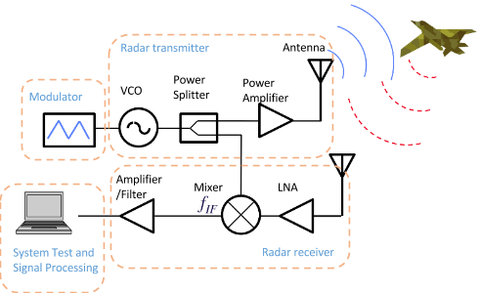
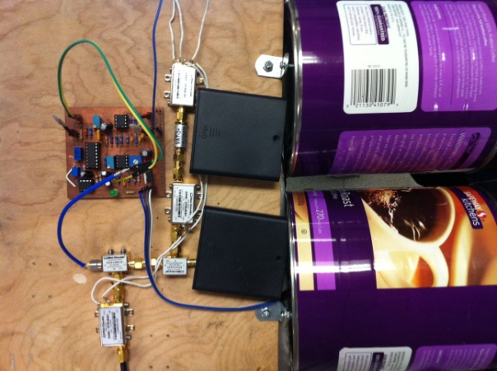
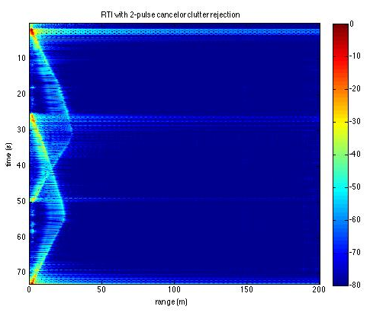
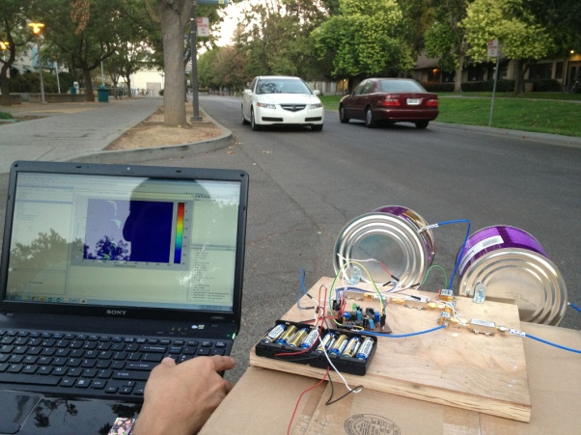
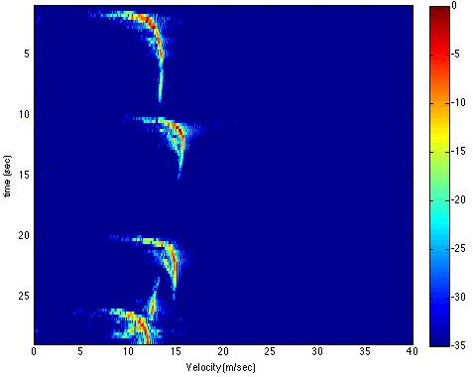
Quarter 1 – Assembly of an FMCW System
Baseband
RF
Antennas made from coffee cans
Doppler Testing
Range vs. Time
Speed vs. Time

Slide 6
Quarter 1 Lab Schedule
Week | Lectures | Labs
1 | Course mechanism | Elements of Electronic Systems
2 | Introduction
3 | RF amplifiers and basic concepts
4 |  | RF amplifier characterization
5 | Oscillators and Synthesizers | Oscillators characterization
6 | Frequency mixer and modulation | Mixers characterization
7 | Passive devices | Antenna
8 | Antennas and Propagation | Radar system assembly and characterization
9 | RF System Architectures

Slide 7
Labs
Be warned!
Labs are heavy and time consuming.
Do the pre-lab problems, read the lab manually carefully, and plan well before you walk into the lab.
Team work is important! Everyone needs to work hard!
You may still end up needing both Friday and Monday sessions!
Lab reports are due on Fridays so plan your time well. If you rely on Monday sessions only, you will have one weekend less to finish your report!

Slide 8
Teaming
Teaming starts before the quarter through Piazza
We’ll allocate sometime for teaming up in the first lecture
Each team should consist of 3-4 team members
We recommend that you include team members of different background to complement each other
By the end of the first lecture, you will need to submit to the TA
Team name; will default to “Team #” if none submitted
Name of the purchaser

Slide 9
Grading
Quarter 1 (30 pts)
Lab reports (30 pts)
Quarter 2 (45 pts)
Competition (15 pts)
Final report (15 pts)
Application Note / Tutorial (15 pts)
Peer review (15 pts)
Participation (10 pts)
Based on Piazza participation, weekly report and presentation (quarter 2)
Graded by the instructor
Purely subjective
Bonus points

Slide 10
Grading – Bonus Points
Errors for Bonus
Help us find errors (typos, grammar mistakes, technical mistakes, etc) in the course materials (lecture notes, lab manuals, guidelines, etc)
The first to find and report an error on Piazza gets 0.1 point for each error

Slide 11

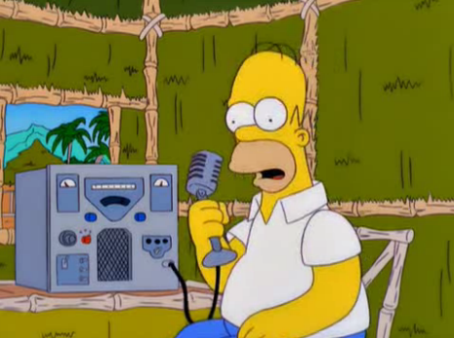
Grading – Bonus Points
Getting your HAM radio license
Technician class (2 pts)
Transmission above 30 MHz
General class (2 pts)
Access to the HF band
Extra (3 pts)
Transmission on all bands
Log on to www.arrl.org for information on licensing and exams
The following links provides additional materials for preparing for the exams
http://www.hamradioschool.com/
We may arrange training sessions or even exams

Slide 12


Grading – Bonus Points
Participating in the Picnic Day (10 pts) and/or the Maker Faire (10 pts)
Showcase your project
Some visual/audio effects are needed to attract the audience
Consent from the instructor
If you are interested in pursuing this, you should start talking with the instructor early

Slide 13





Seeking Help
The EEC 134 Piazza forum:
https://piazza.com/ucdavis/fall2014/eec134a/home
Reference materials provided by the class
The almighty Internet !
Google!
Wikipedia
Forums
http://www.edaboard.com/
http://www.eevblog.com/forum/
http://electronics.stackexchange.com/
https://forum.sparkfun.com/
https://forums.adafruit.com/
The UCD library

