Slide 1
Design of RF & Microwave Systems
EEC 134 A&B
Lecture 6: Building Blocks of RF Systems
– (De)Modulation and (De)Modulators
Xiaoguang “Leo” Liu
Associate Professor
School of Electrical and Computer Engineering
Tel: 530-289-6367
lxgliu@ucdavis.edu
http://dart.ece.ucdavis.edu

Slide 2
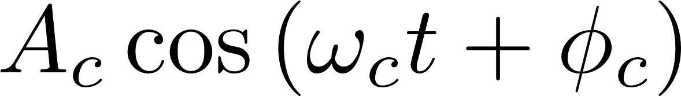
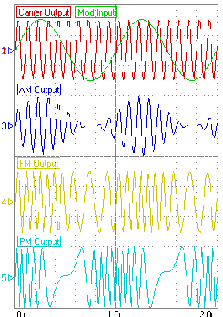
Modulation
Encode low frequency information onto a high frequency carrier
Both analog and digital
Need to consider signal quality (analog) or error rate (digital) in the presence of noise, efficient utilization of frequency bandwidth, efficient utilization of power
There are two independent variables in a cosine (or sine) carrier
Amplitude
Phase (Frequency is the derivative of phase!)
Amplitude
Frequency
Phase
Analog Modulations
http://www.studyvilla.com/modultn.aspx

Slide 3
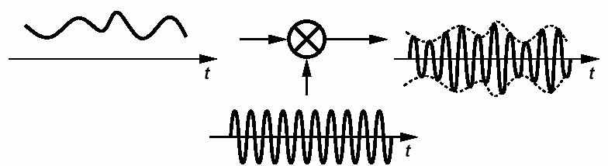
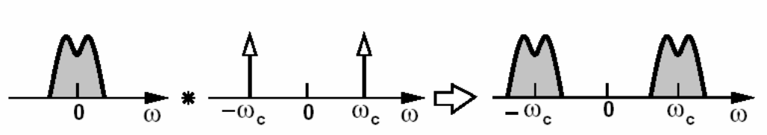
Amplitude Modulation
Simple to realize: need one mixer
Signal quality depends on amplitude noise and circuit linearity (because amplitude carries the information)
B. Razavi, UCAL EE215C Lecture notes
Notes:
Change to own graph

Slide 4
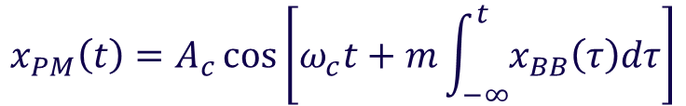

Phase and Frequency Modulation
Mostly insensitive to non-linearity; can use a non-linear power amplifier (therefore system efficiency is higher)
Some phase and frequency modulation does incur amplitude variation
Typically occupies more bandwidth
Since frequency is the derivative of phase, frequency modulation can be considered a special case of phase modulation. It is for this reason that frequency and phase modulation are sometimes called angle modulation altogether
$$x_{PM}\left(t\right)=A_{c}\cos\left[ω_{c}t+mx_{BB}\left(t\right)\right]$$
$$x_{PM}\left(t\right)=A_{c}\cos\left[ω_{c}t+m\int_{−∞}^{t}{x_{BB}\left(τ\right)dτ}\right]$$
B. Razavi, UCAL EE215C Lecture notes
Notes:
Change to own graph

Slide 5
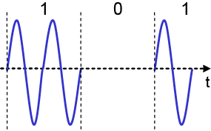
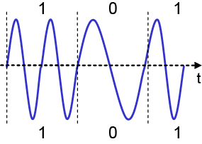
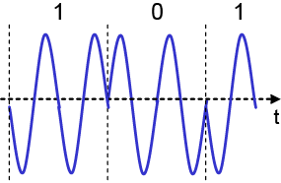
Digital Modulation
Modulation of digital signals is also known as Shift Keying
Amplitude Shift Keying (ASK)
Frequency Shift Keying (FSK)
Phase Shift Keying (PSK)
More advanced modulation schemes: QPSK, DQPSK, MFSK, MSK/GMSK, QAM, CPM, etc
ASK
FSK
PSK
Read more: http://en.wikipedia.org/wiki/Digital_modulation#Digital_modulation_methods

Slide 6
Quadrature Amplitude Modulation
Combines both amplitude and phase (angle) modulation
More efficient use of spectrum
Transmits a complex signal -- a very general representation of modulation
A carrier signal has two components that can carry information: amplitude and phase
Therefore a sinusoidal signal is really “two-dimensional”. It can be represented in either 1) amplitude and phase, 2) real and imaginary parts
Q
A_{m}
ϕ_{m}
In-phase
Quadrature
I

Slide 7
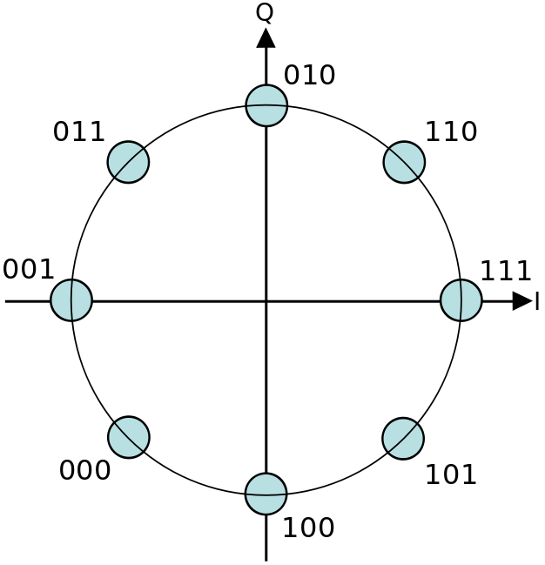
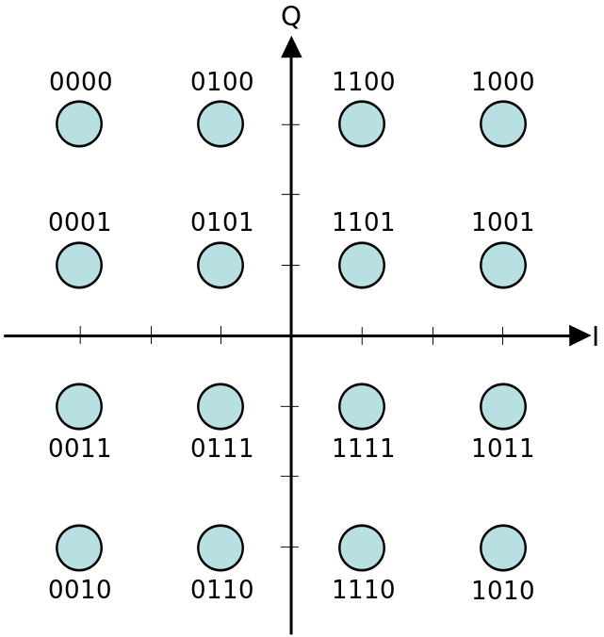
Constellation Diagram
Representation of the modulated signal on a complex plane according to its amplitude and phase modulation (or in-phase and quadrature modulation)
8-PSK
16-QAM

Slide 8
Quadrature Modulation
I(t)
Base-band
Signal
I/Q
Generator
Σ
Q(t)

Slide 9
Quadrature Modulation
I(t)
Base-band
Signal
I/Q
Generator
Σ
-90°
Q(t)

Slide 10
How do We Generate the Quadrature Signals?
Quadrature hybrid!!
I(t)
Base-band
Signal
I/Q
Generator
90° Hybrid
Σ
Q(t)

Slide 11
Quadrature Demodulation

Slide 12
Quadrature Demodulation
I(t)
-90°
Q(t)
I(t)
Base-band
Signal
I/Q
Generator
Σ
Q(t)

Slide 13



Quadrature Demodulation in a Doppler Radar Receiver
Simple mixer
Since $\cos\left(−α\right)=\cos{α}$, positive and negative speed can not be differentiated, i.e. you can only measure the speed but can’t tell if the object is moving towards you or away from you
$$\cos{({1±\frac{v_{d}}{c})ω}_{c}t}$$
$$\cos\left({±\frac{v_{d}}{c}ω}_{c}t\right)$$

Slide 14





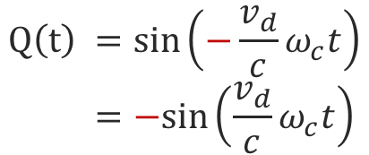
Quadrature Demodulation in a Doppler Radar Receiver
Quadrature demodulator
The quadrature output is different for positive and negative Doppler frequency shift
$$I\left(t\right)=cos{\frac{v_{d}}{c}ω_{c}t}$$
$$\cos{({1+\frac{v_{d}}{c})ω}_{c}t}$$
-90°
$$Q\left(t\right){=\sin{\frac{v_{d}}{c}ω_{c}t}}$$
$$I\left(t\right)=cos\left(−\frac{v_{d}}{c}ω_{c}t\right) \\ =\cos\left(\frac{v_{d}}{c}ω_{c}t\right)$$
$$\cos{({1−\frac{v_{d}}{c})ω}_{c}t}$$
-90°
$$Q\left(t\right){=\sin\left(−\frac{v_{d}}{c}ω_{c}t\right)} \\ =−sin\left(\frac{v_{d}}{c}ω_{c}t\right)$$

Slide 15
IQ Demodulation Imperfections
In a practical demodulation circuit, it may be difficult to have a precisely aligned receiver LO frequency and phase
What if
LO has a slightly different frequency?
LO has a slightly different phase?
The quadrature LOs are not exactly in quadrature?
The quadrature LOs have slightly different amplitude?

Slide 16
IQ Demodulation Imperfections
Example: slight demodulator LO frequency offset
Received in-phase signal has a component from the quadrature signal
Leads to error in the demodulation if the frequency offset is large enough
Similarly, other imperfections can lead to signal demodulation errors

Slide 17
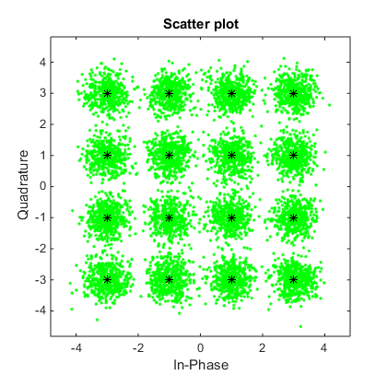
Signal Distortion viewed on the Constellation Diagram

Slide 18
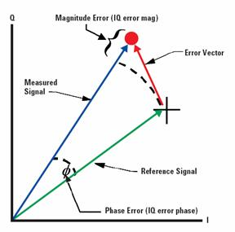

Error Vector Magnitude (EVM)
In digital transmission, several factors can cause perturbation to the signal
Noise in the propagation channel
Noise and non-linearity in the transmit and receive circuits
Imperfect modulation and demodulation circuit
Phase noise of the LO signals in Tx and Rx
LO phase and amplitude mismatch
Error vector magnitude (EVM) is used to quantify the amount of distortion to the modulated signal
Defined based on the constellation diagram
is the I component of the j-th symbol received, is the Q component of the j-th symbol received, is the ideal I component of the j-th symbol received, is the ideal Q component of the j-th symbol received.
http://www.ni.com/white-paper/3652/en/
http://www.hometoys.com/emagazine.php?url=/htinews/feb05/articles/chipcon/zigbee.htm

Slide 19
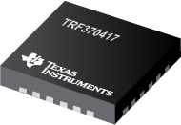
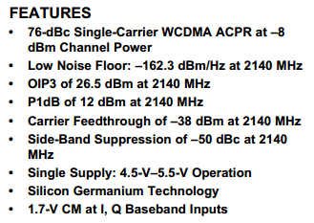
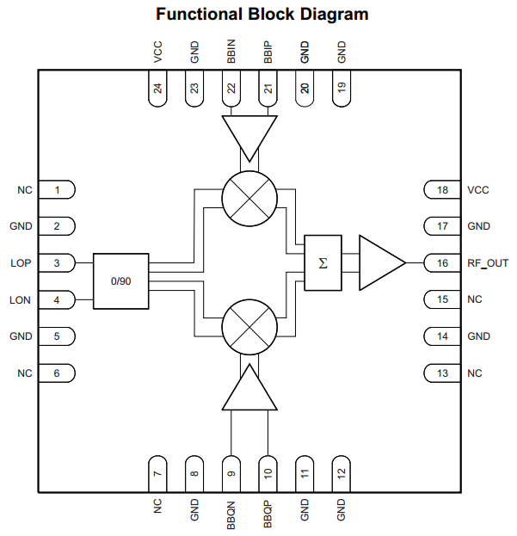
IQ (Quadrature) Modulator Example
Texas Instruments TRF370417 50 MHz – 6 GHz Quadrature Modulator IC

Slide 20
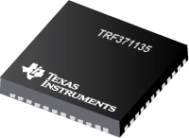
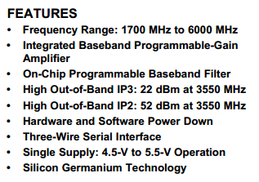
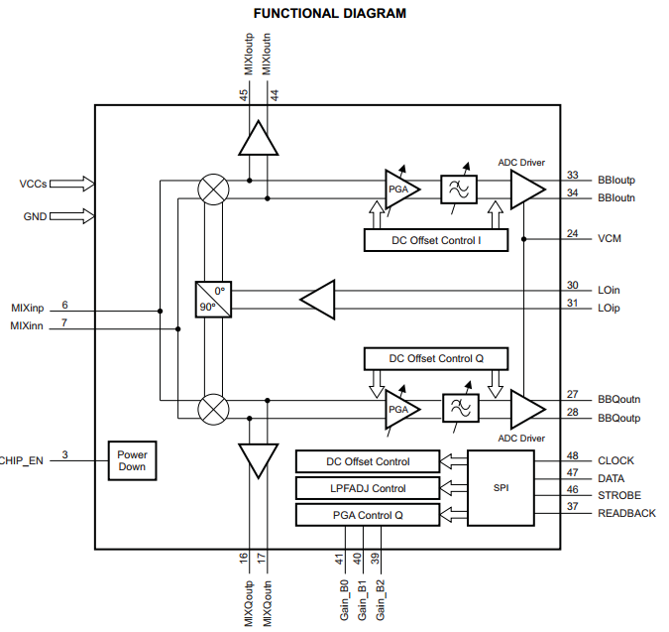
IQ (Quadrature) Modulator Example
Texas Instruments TRF371135 1.7– 6 GHz Quadrature Demodulator IC (direct down-conversion receiver)
Baseband
In-phase
LO
RF in
Quadrature
Generator
Baseband
Quadrature

Slide 21
Single Side Band Modulation and Image Reject Mixers
The concept of quadrature modulation also finds application in two other areas
Single side band modulation
Image reject mixers

Slide 22
Single Side Band Modulation
Consider a simple AM modulator with a mixer
There are two sidebands with identical information: not very efficient use of spectrum
Ideally you just want to transmit one sideband because it has all the information
You can filter the other sideband but sometimes this would require a very sharp (and therefore lossy) filter
B. Razavi, UCAL EE215C Lecture notes

Slide 23

Single Side Band Modulation
Base-band Signal
$$cos⁡ω_{m}t$$
Σ
-90°
90°
$$\cos{ω_{m}t}⋅\cos{ω_{c}t}−\sin{ω_{m}t}⋅\sin{ω_{c}t}=\cos\left(ω_{m}+ω_{c}\right)t$$

Slide 24

Single Side Band Modulation
If we take 90° phase shift of the LO, i.e. use $\sin{ω_{c}t}$ instead of $−sin{ω_{c}t}$, we can get the difference frequency
Base-band Signal
$$cos⁡ω_{m}t$$
Σ
90°
90°
$$\cos{ω_{m}t}⋅\cos{ω_{c}t}+\sin{ω_{m}t}⋅\sin{ω_{c}t}=\cos\left(ω_{m}−ω_{c}\right)t$$

Slide 25











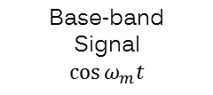


Single Side Band Modulation
Visualization in the frequency domain
Multiplication in time domain is convolution in frequency domain
Base-band Signal
$$cos⁡ω_{m}t$$
Σ
90°
90°
$$\cos{ω_{m}t}=\frac{1}{2}e^{jω_{m}t}+\frac{1}{2}e^{−jω_{m}t}$$
$$\cos{ω_{c}t}=\frac{1}{2}e^{jω_{c}t}+\frac{1}{2}e^{−jω_{c}t}$$
$$\frac{1}{2}$$
$$\frac{1}{2}$$
$$\frac{1}{2}$$
$$\frac{1}{2}$$
$$ω_{m}$$
$$ω_{m}$$
$$ω_{c}$$
$$ω_{c}$$
$$\sin{ω_{m}t}=\frac{1}{2j}e^{jω_{m}t}−\frac{1}{2j}e^{−jω_{m}t}$$
$$\sin{ω_{c}t}=\frac{1}{2j}e^{jω_{c}t}−\frac{1}{2j}e^{−jω_{c}t}$$
+
X
X
$$\frac{1}{2j}$$
$$\frac{1}{2j}$$
$$ω_{m}$$
$$ω_{m}$$
$$ω_{c}$$
$$ω_{c}$$
$$−\frac{1}{2j}$$
$$−\frac{1}{2j}$$

Slide 26
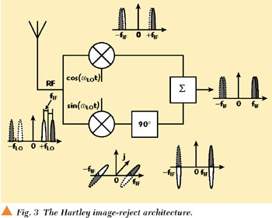
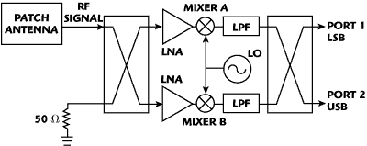




Image Reject Mixer
$$f_{LO}$$
The quadrature signals can also help to eliminate the image problem
The Hartley image reject mixer
Introduced in 1928
Quadrature LO
90° phase shift of one of the IF signals
$$f_{RF}$$
$$f_{image}$$
$$f_{IF}$$
An alternative Hartley image reject mixer, allowing both the signal and image to be captured
http://www.microwavejournal.com/articles/3226-on-the-direct-conversion-receiver-a-tutorial

Slide 27
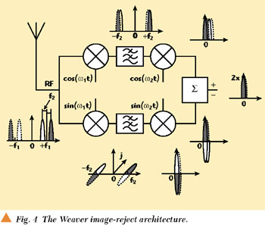
Image Reject Mixer
The Weaver image reject mixer
Using two quadrature LOs
Does not need a separate 90° phase shifter
http://www.microwavejournal.com/articles/3226-on-the-direct-conversion-receiver-a-tutorial

Slide 28
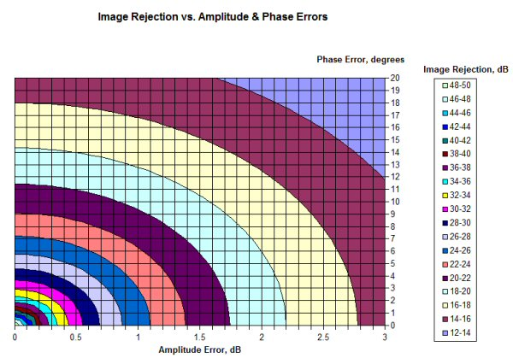
Image Reject Mixer
The performance of both the Hartley and the Weaver image reject mixers rely on the accuracy of the phase quadrature and amplitude balance
http://www.microwaves101.com/encyclopedias/image-rejection-mixers

Slide 29
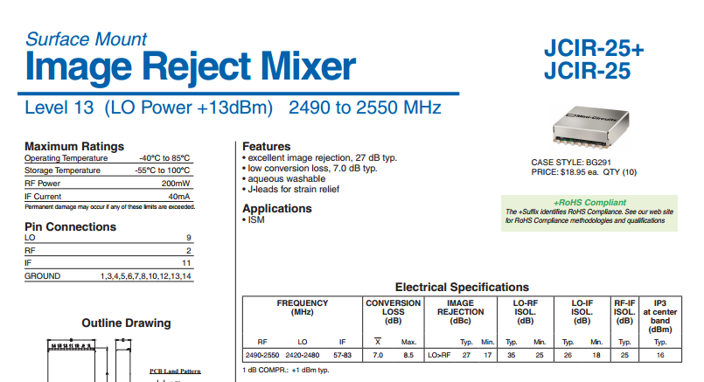
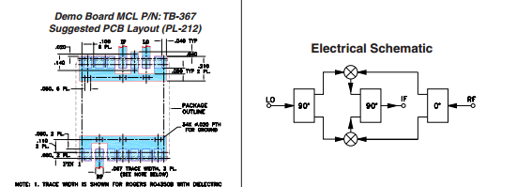
Image Reject Mixer Example
Mini-Circuits JCIR-25+
The quadrature output of the 90° hybrid is terminated to 50 Ω

