Slide 1
Design of RF & Microwave Systems
EEC 134 A&B
Lecture 2: Basics Concepts
Xiaoguang “Leo” Liu
Assistant Professor
School of Electrical and Computer Engineering
Tel: 530-289-6367
lxgliu@ucdavis.edu
http://ucdart.net

Slide 2
Outline
Review of transmission lines
Refer to the “Lec2-ReviewTransmissionLines.pptx”, which contains excerpts from 130A course materials
The Radio Spectrum
Units in RF engineering
Scattering parameters

Slide 3
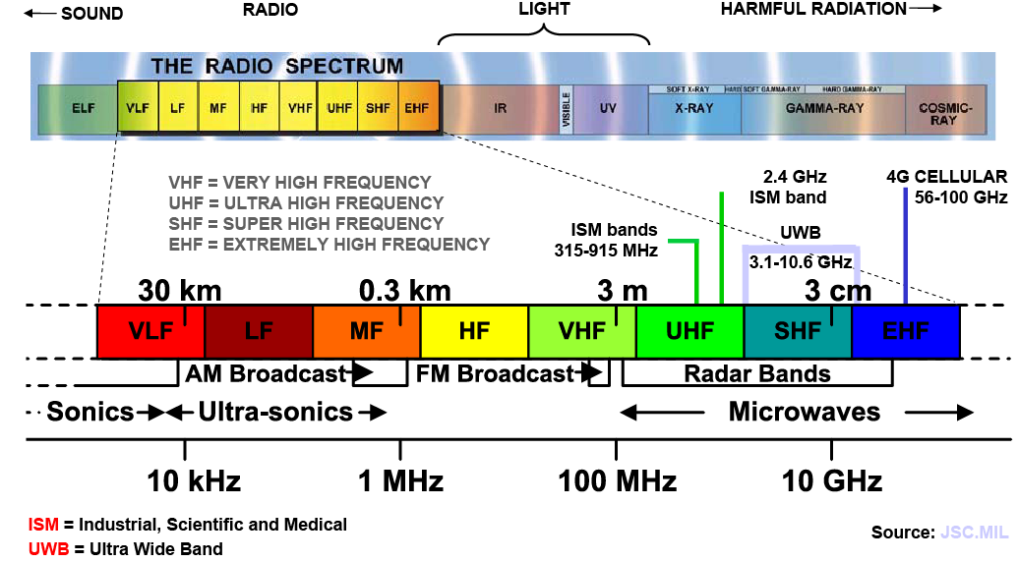
The Radio Spectrum

Slide 4
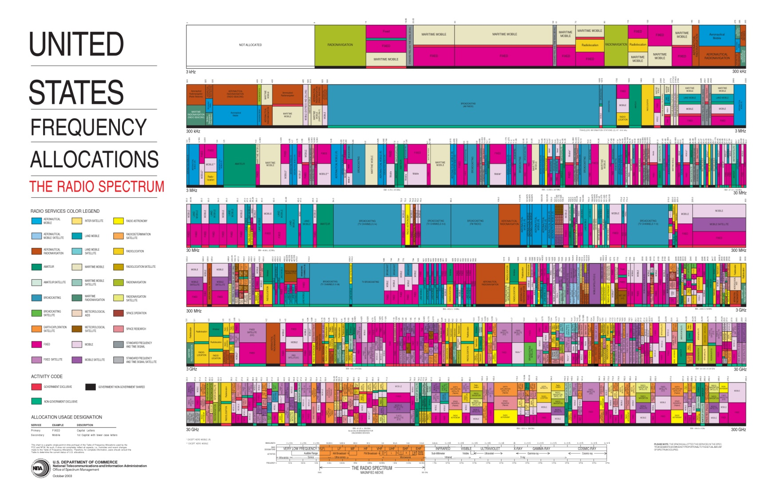
Frequency Spectrum Allocation
Radio spectrum is considered a scarce natural resource and is heavily regulated
Note that regulation only applies to transmitting
Image from Federal Communications Commission (FCC)
Notes:
Add introduction to ITU and FCC

Slide 5
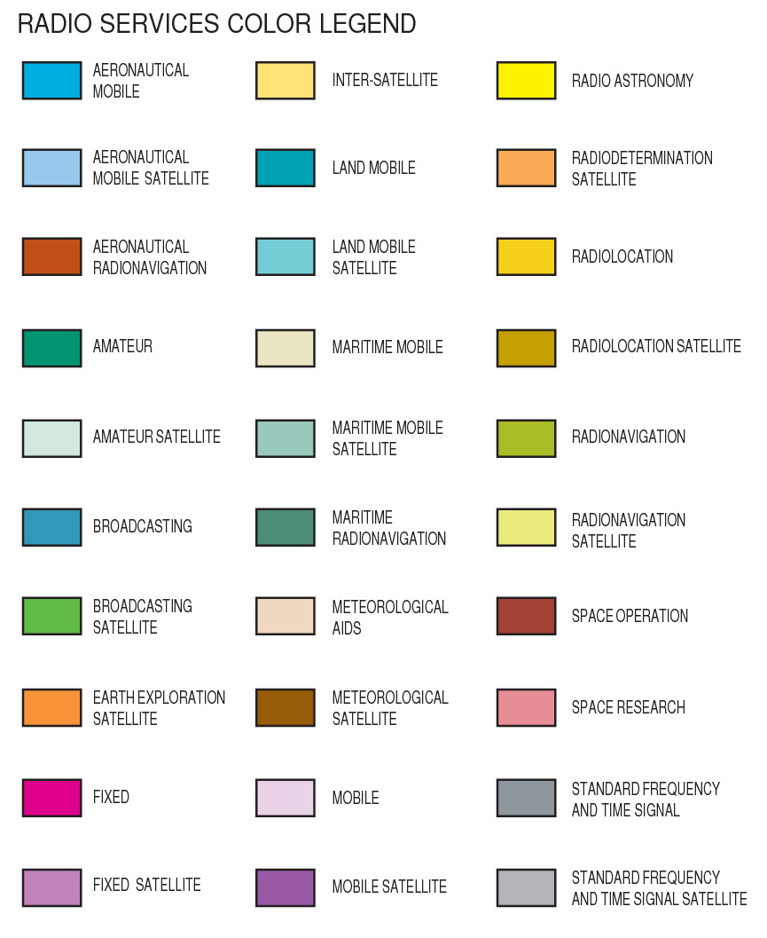
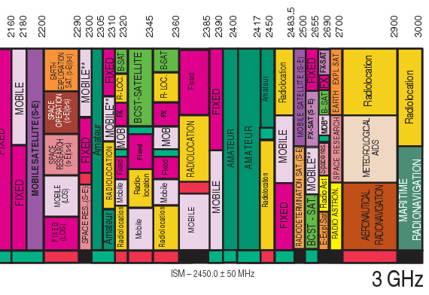
Frequency Spectrum Allocation
Image from Federal Communications Commission (FCC)

Slide 6
Frequency Spectrum Allocation
Radio Spectrum is expensive
“Since July 1994, the FCC has conducted 87 spectrum auctions, which raised over $60 billion for the U.S. Treasury” -- Wikipedia
“The President has set the goal of freeing up 500 MHz of spectrum …within a decade. Critical to realizing this goal are “voluntary incentive auctions” and more efficient use of government spectrum, estimated to raise $27.8 billion over the next decade.”
-- The White House, 2011
http://www.whitehouse.gov/the-press-office/2011/02/10/president-obama-details-plan-win-future-through-expanded-wireless-access

Slide 7
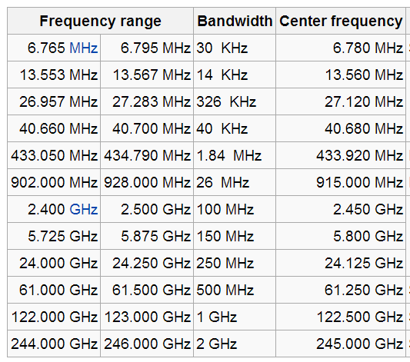
Frequency Spectrum Allocation
Unlicensed ISM Bands
ISM = Industrial, Scientific and Medical
Your product still needs to pass FCC certification

Slide 8
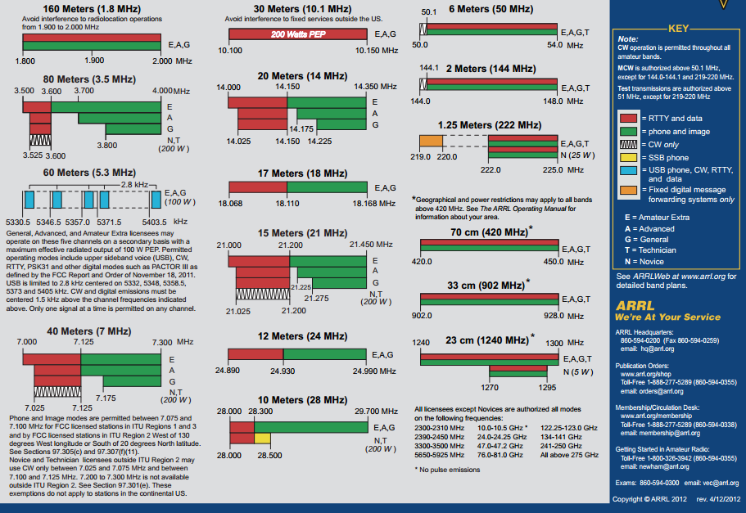
Frequency Spectrum Allocation
Amateur Radio Bands

Slide 9


Units in RF Systems
decibel (dB)
Ratio between two quantities (usually power or intensity, i.e. square of field)
Numerically equals to 10 times the logarithm to base 10
Neper
Natural log based
You mostly see this unit when specifying attenuation

Slide 10
Units in RF Systems – A Simple Example
Amplifier
P_{in}
P_{out}
Gain
Only holds when the input and output impedance are equal!

Slide 11
Units in RF Systems
Quick calculations:
2 × ≈ +3 dB
0.5 × ≈ -3 dB
4 × ≈ 6 dB
0.25 × ≈ - 6 dB
10 × ≈ 10 dB
100 × ≈ 20 dB
Why do we want to use dB?
Log scale converts multiplication to addition/subtraction
Note:
10log2 =3.010,
not exactly 3 dB

Slide 12
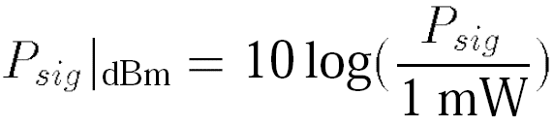
Units in RF Systems
dBm
Power relative to 1mW in dB scale
Examples:
10 mW = 10 dBm
0 dBm = 1 mW
30 dBm = ?
Don’t confuse dBm with dB
dBm is a unit; it represents power
dB is a pure number; it represents a ratio

Slide 13
Example
How much is the input power in W?
How much is the output power in W?
Assume the output is connected to a 50 Ω load, what is the RMS voltage on the load?
Amplifier Gain 17 dB
Input 3 dBm

Slide 14
Typical Power Levels
dBm level | Power | Notes
80 dBm | 100 kW | Typical transmission power of FM radio station with 50-kilometre (31 mi) range
50 dBm | 100 W | Typical thermal radiation emitted by a human body
33 dBm | 2 W | Maximum output from a mobile phone (Power class 1 mobiles)
30 dBm | 1 W | Typical RF leakage from a microwave
27 dBm | 500 mW | Typical cellular phone transmission powerMaximum output from a mobile phone (Power class 2 mobiles)
3 dBm | 2.0 mW | More precisely (to 8 decimal places) 1.9952623 mW
0 dBm | 1.0 mW = 1,000 µW | Bluetooth standard (Class 3) radio, 1 m range
−80 dBm | 10 pW | Typical range (−70 to −90 dBm) of wireless received signal power over a WiFi network (802.11 variants)
−127.5 dBm | 0.178 fW = 178 aW | Typical received signal power from a GPS satellite
From Wikipedia

Slide 15
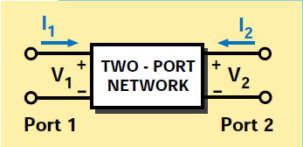
Scattering Parameters
RF/microwave circuits
Voltage/current may not be easily defined
Open/short hard to make
Power is easier to work with
No position dependence
2-Port networks
Power is either “transmitted”, “reflected”, or “dissipated”
Work with a standard system impedance: “matched” or “mis-matched”
Agilent Application Note 95-1, “S-Parameter Techniques”

Slide 16
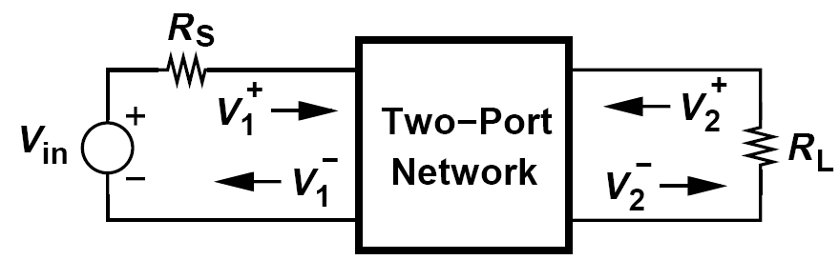
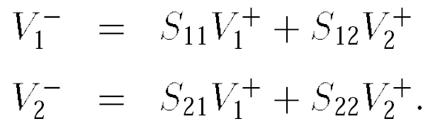
Scattering Parameters
S-Parameter: Use power quantities instead of voltage or current
The difference between the incident power (the power that would be delivered to a matched load) and the reflected power represents the power delivered to the circuit.
B. Razavi, “RF Microelectronics”, 2nd Ed. 2011

Slide 17
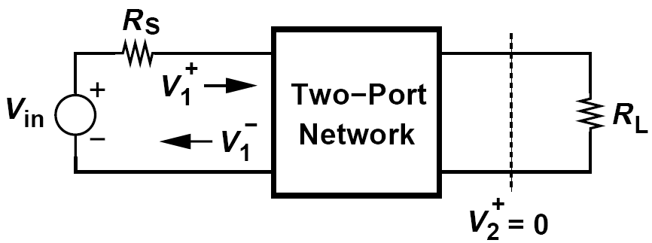
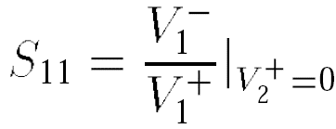
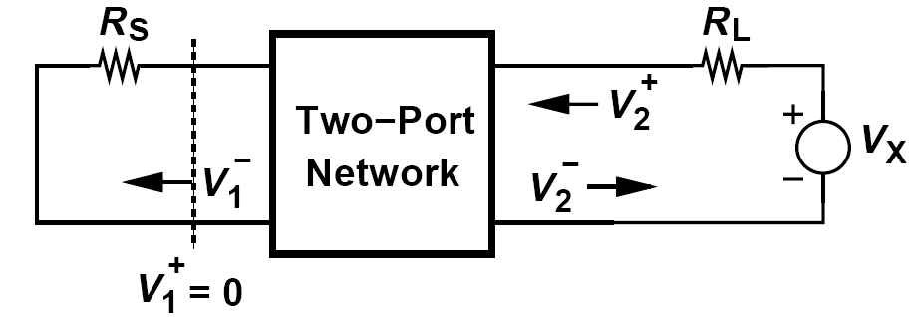
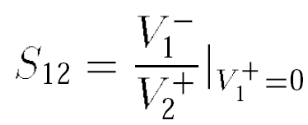
S-Parameters
S₁₁ is the ratio of the reflected and incident waves at the input port when the reflection from R_{L} is zero.
Represents the effectiveness of the input matching
S₁₂ is the ratio of the reflected wave at the input port to the incident wave into the output port when the input is matched
Characterizes the reverse isolation
B. Razavi, “RF Microelectronics”, 2nd Ed. 2011

Slide 18
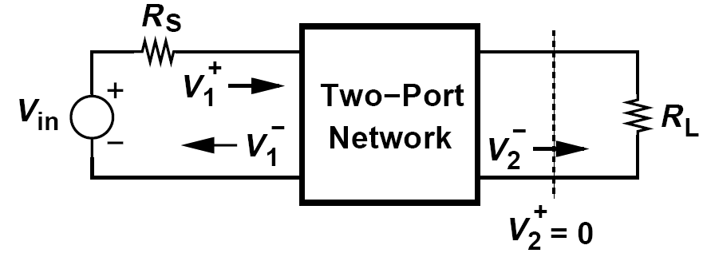
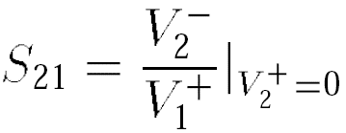
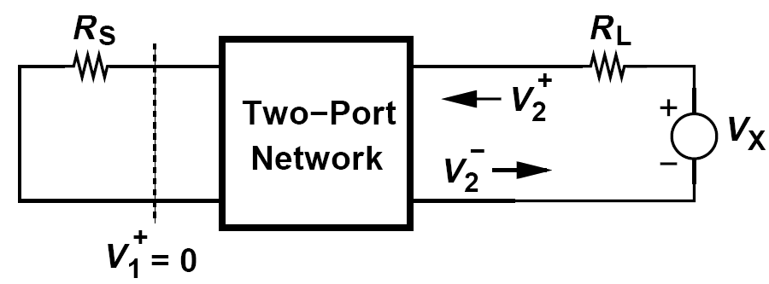
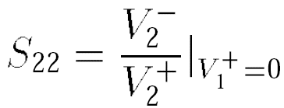
S-Parameters
S₂₁ is the ratio of the wave incident on the load to that going to the input when the reflection from R_{L} is zero
Represents the gain (or loss) of the circuit
S₂₂ is the ratio of reflected and incident waves at the output when the reflection from R_{s} is zero
Represents the effectiveness of the output matching
B. Razavi, “RF Microelectronics”, 2nd Ed. 2011

Slide 19
S-Parameters
S-parameters generally have frequency-dependent complex values
We often express S-parameters in dB
B. Razavi, “RF Microelectronics”, 2nd Ed. 2011

Slide 20
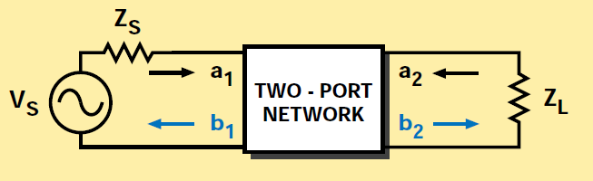
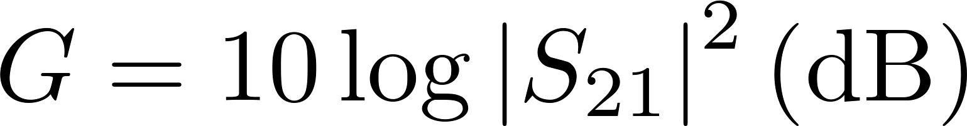
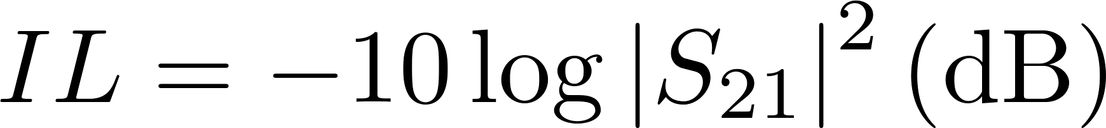

A Few Definitions
Gain
Insertion loss
Return loss
Both insertion loss and return loss should be positive
Agilent Application Note 95-1, “S-Parameter Techniques”

Slide 21
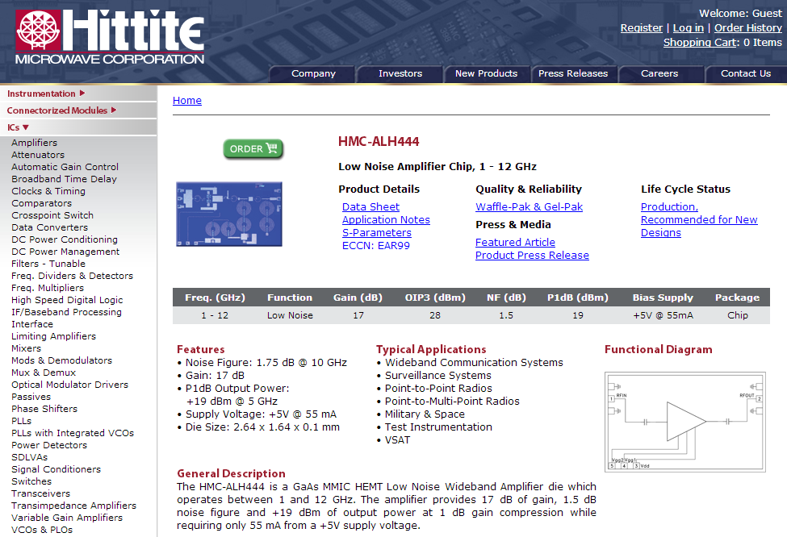
Example –HMC-ALH444 Low Noise Amplifier
http://www.hittite.com/products/view.html/view/HMC-ALH444

Slide 22
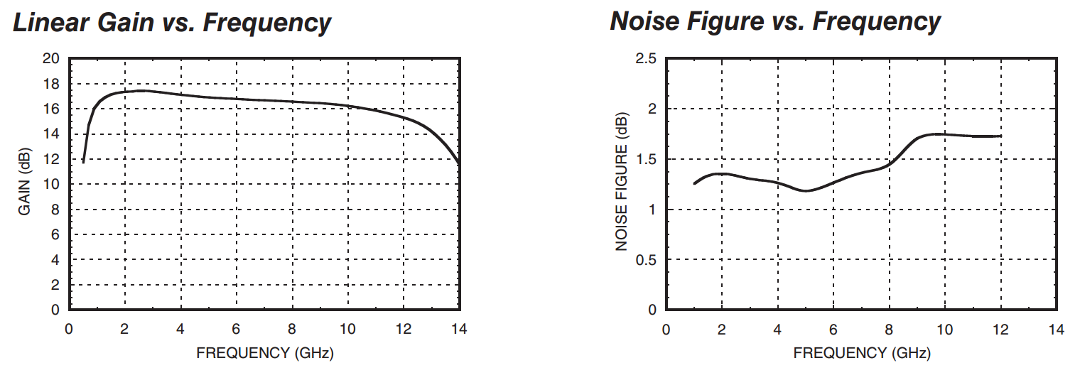
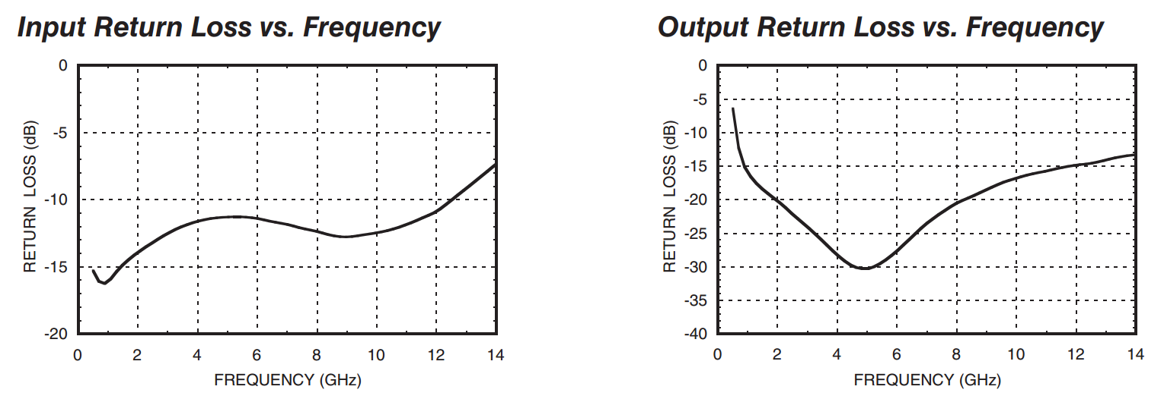
Example

Slide 23
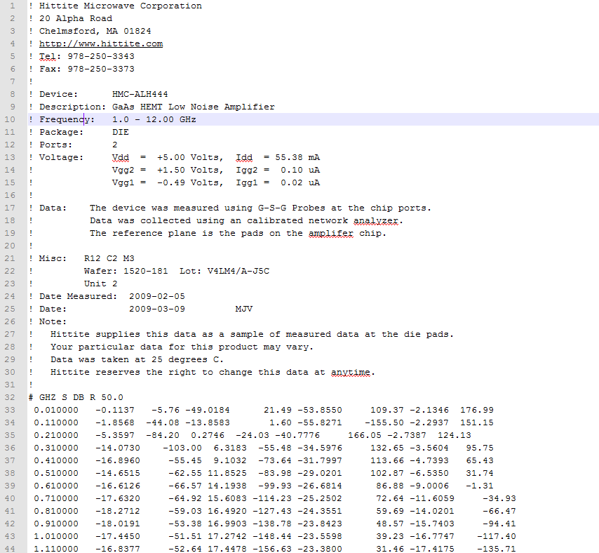
Example
Vendor information;
Measurement Setup.
File Header

Slide 24
SnP File format
Standard file format for storing and transferring S-parameters
ASCII text
Supports multi-port S-parameters, .snp
Can be imported into EDA software for simulation of the device
SnP (Touchstone) File Format, Agilent Documentation,
http://na.tm.agilent.com/plts/help/WebHelp/FilePrint/SnP_File_Format.htm

